Slide 1
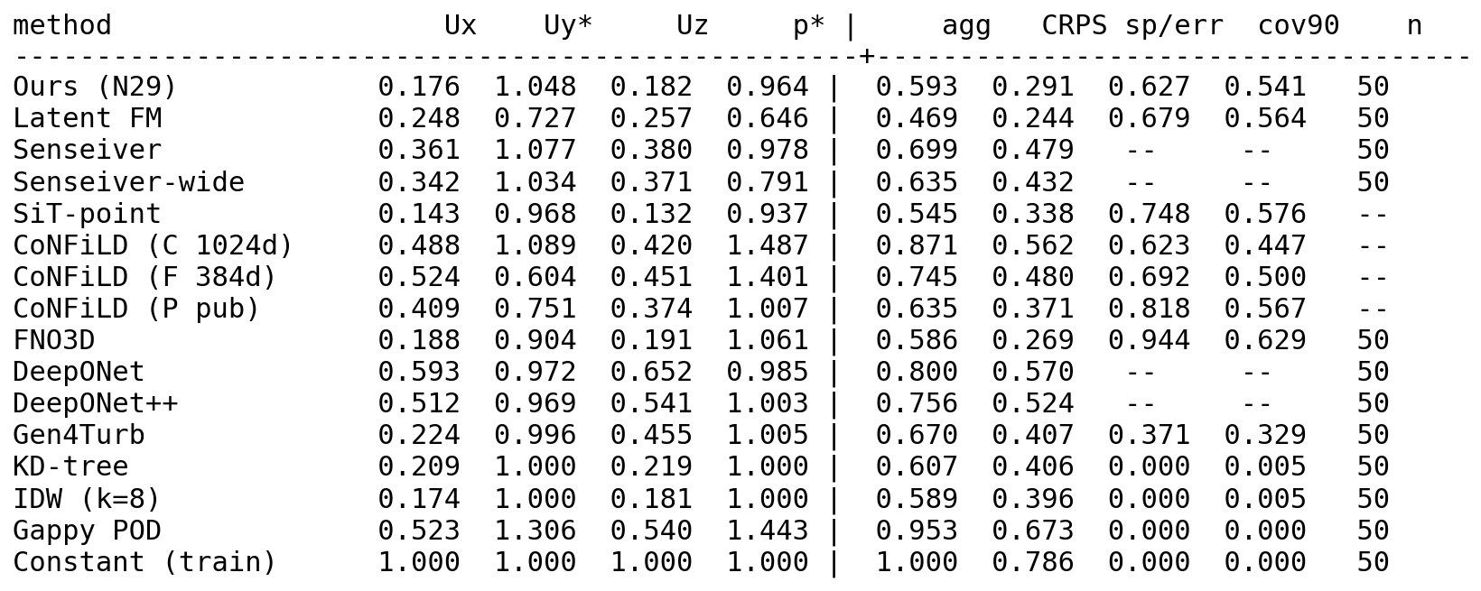
Baseline campaign complete & audited
10 baselines trained + evaluated on one identical JHU protocol (canonical sensor draw, cross-cube, n=50)
Fidelity audit vs upstream: 5 of 6 external baselines had misconfigurations — all fixed
Fair capacity matching: ~6.5M params (±10%) across learned methods
LOCUS weekly update — 2026-08-30

Slide 2
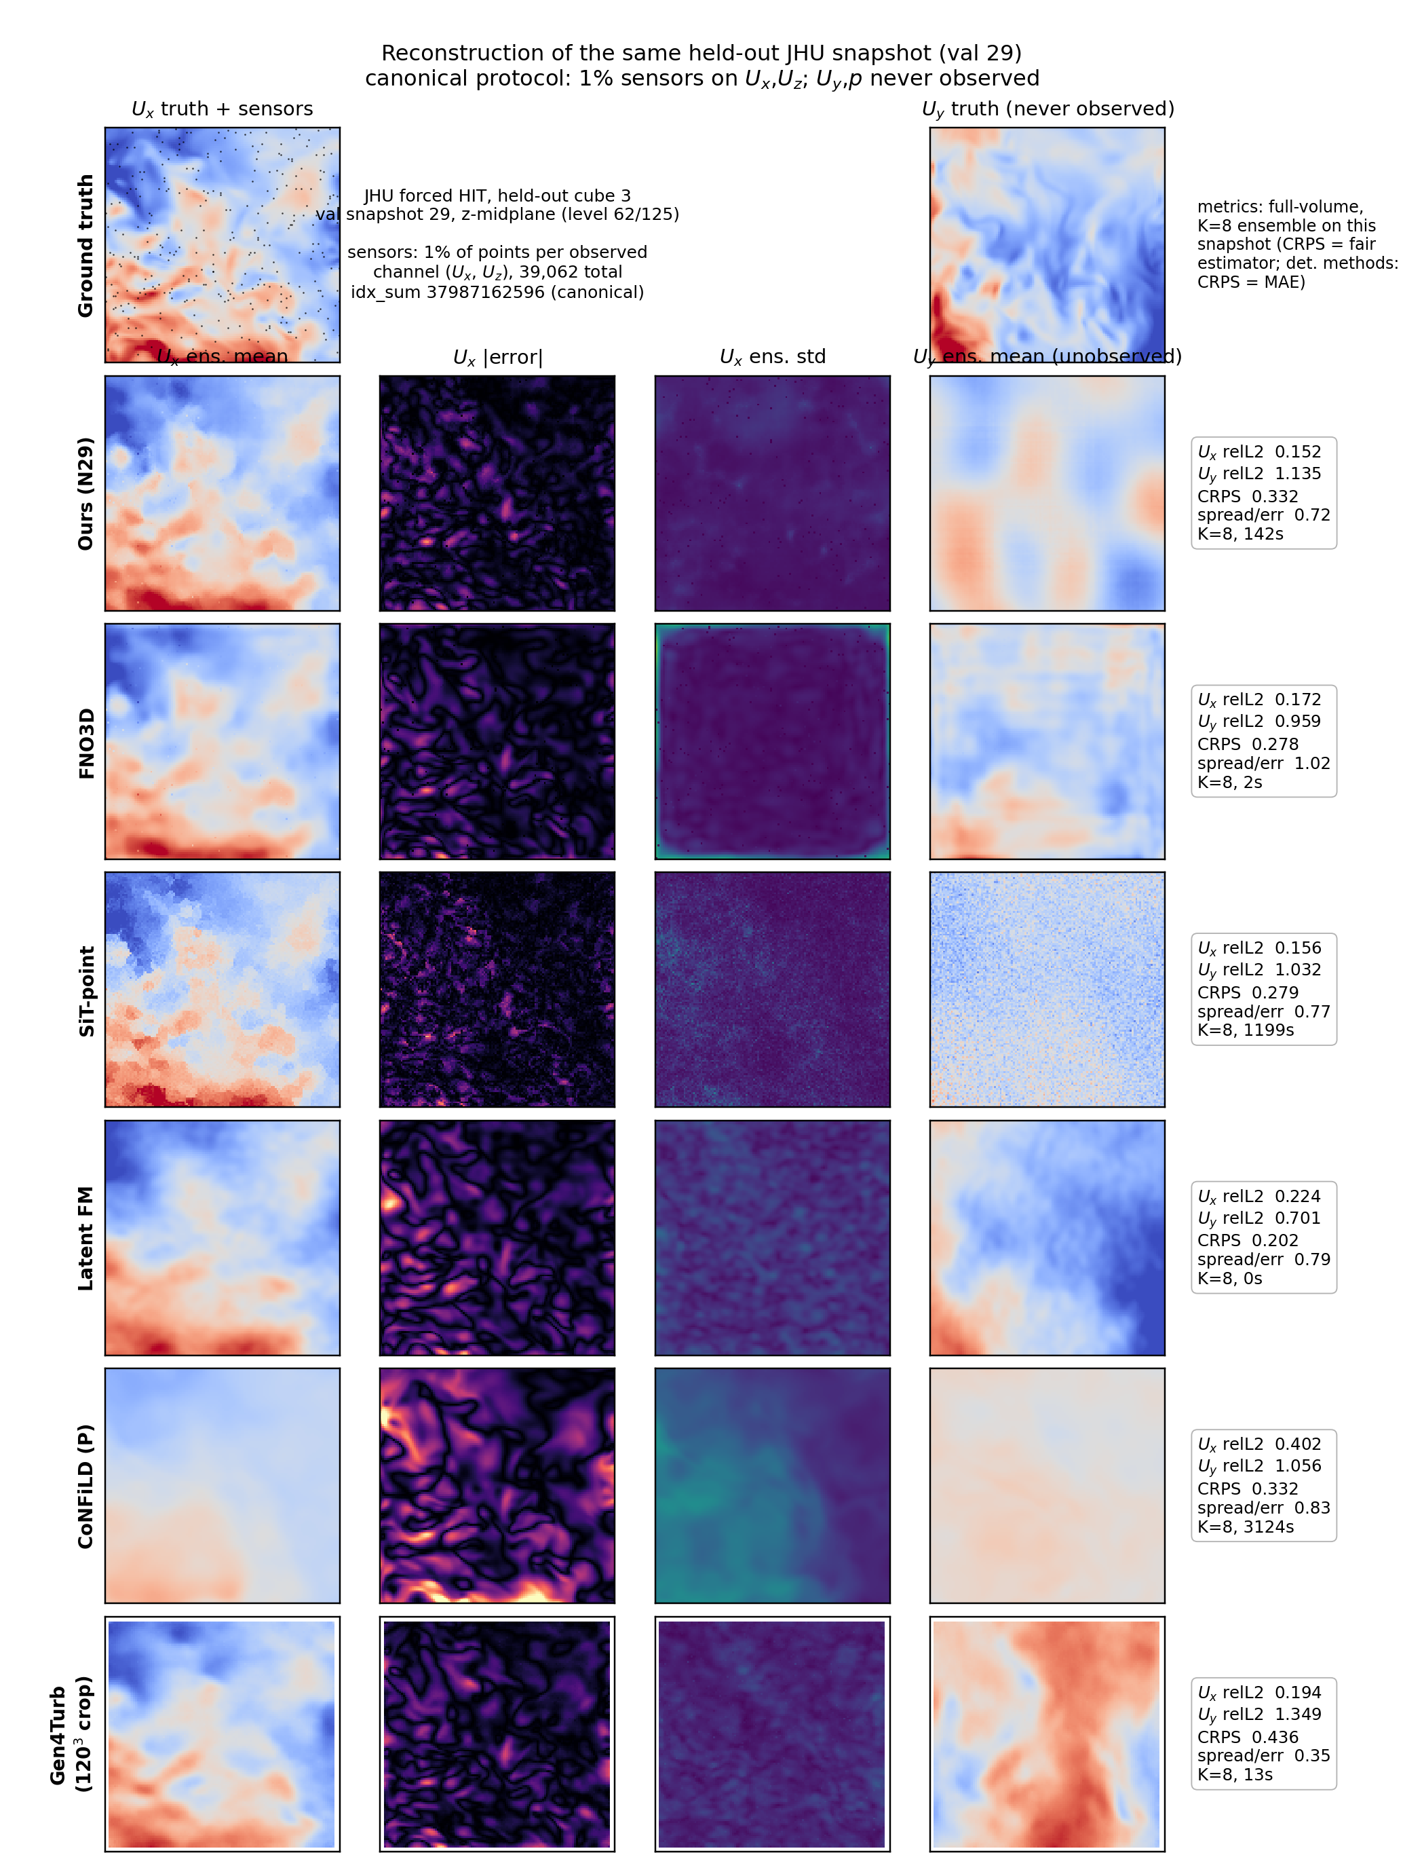
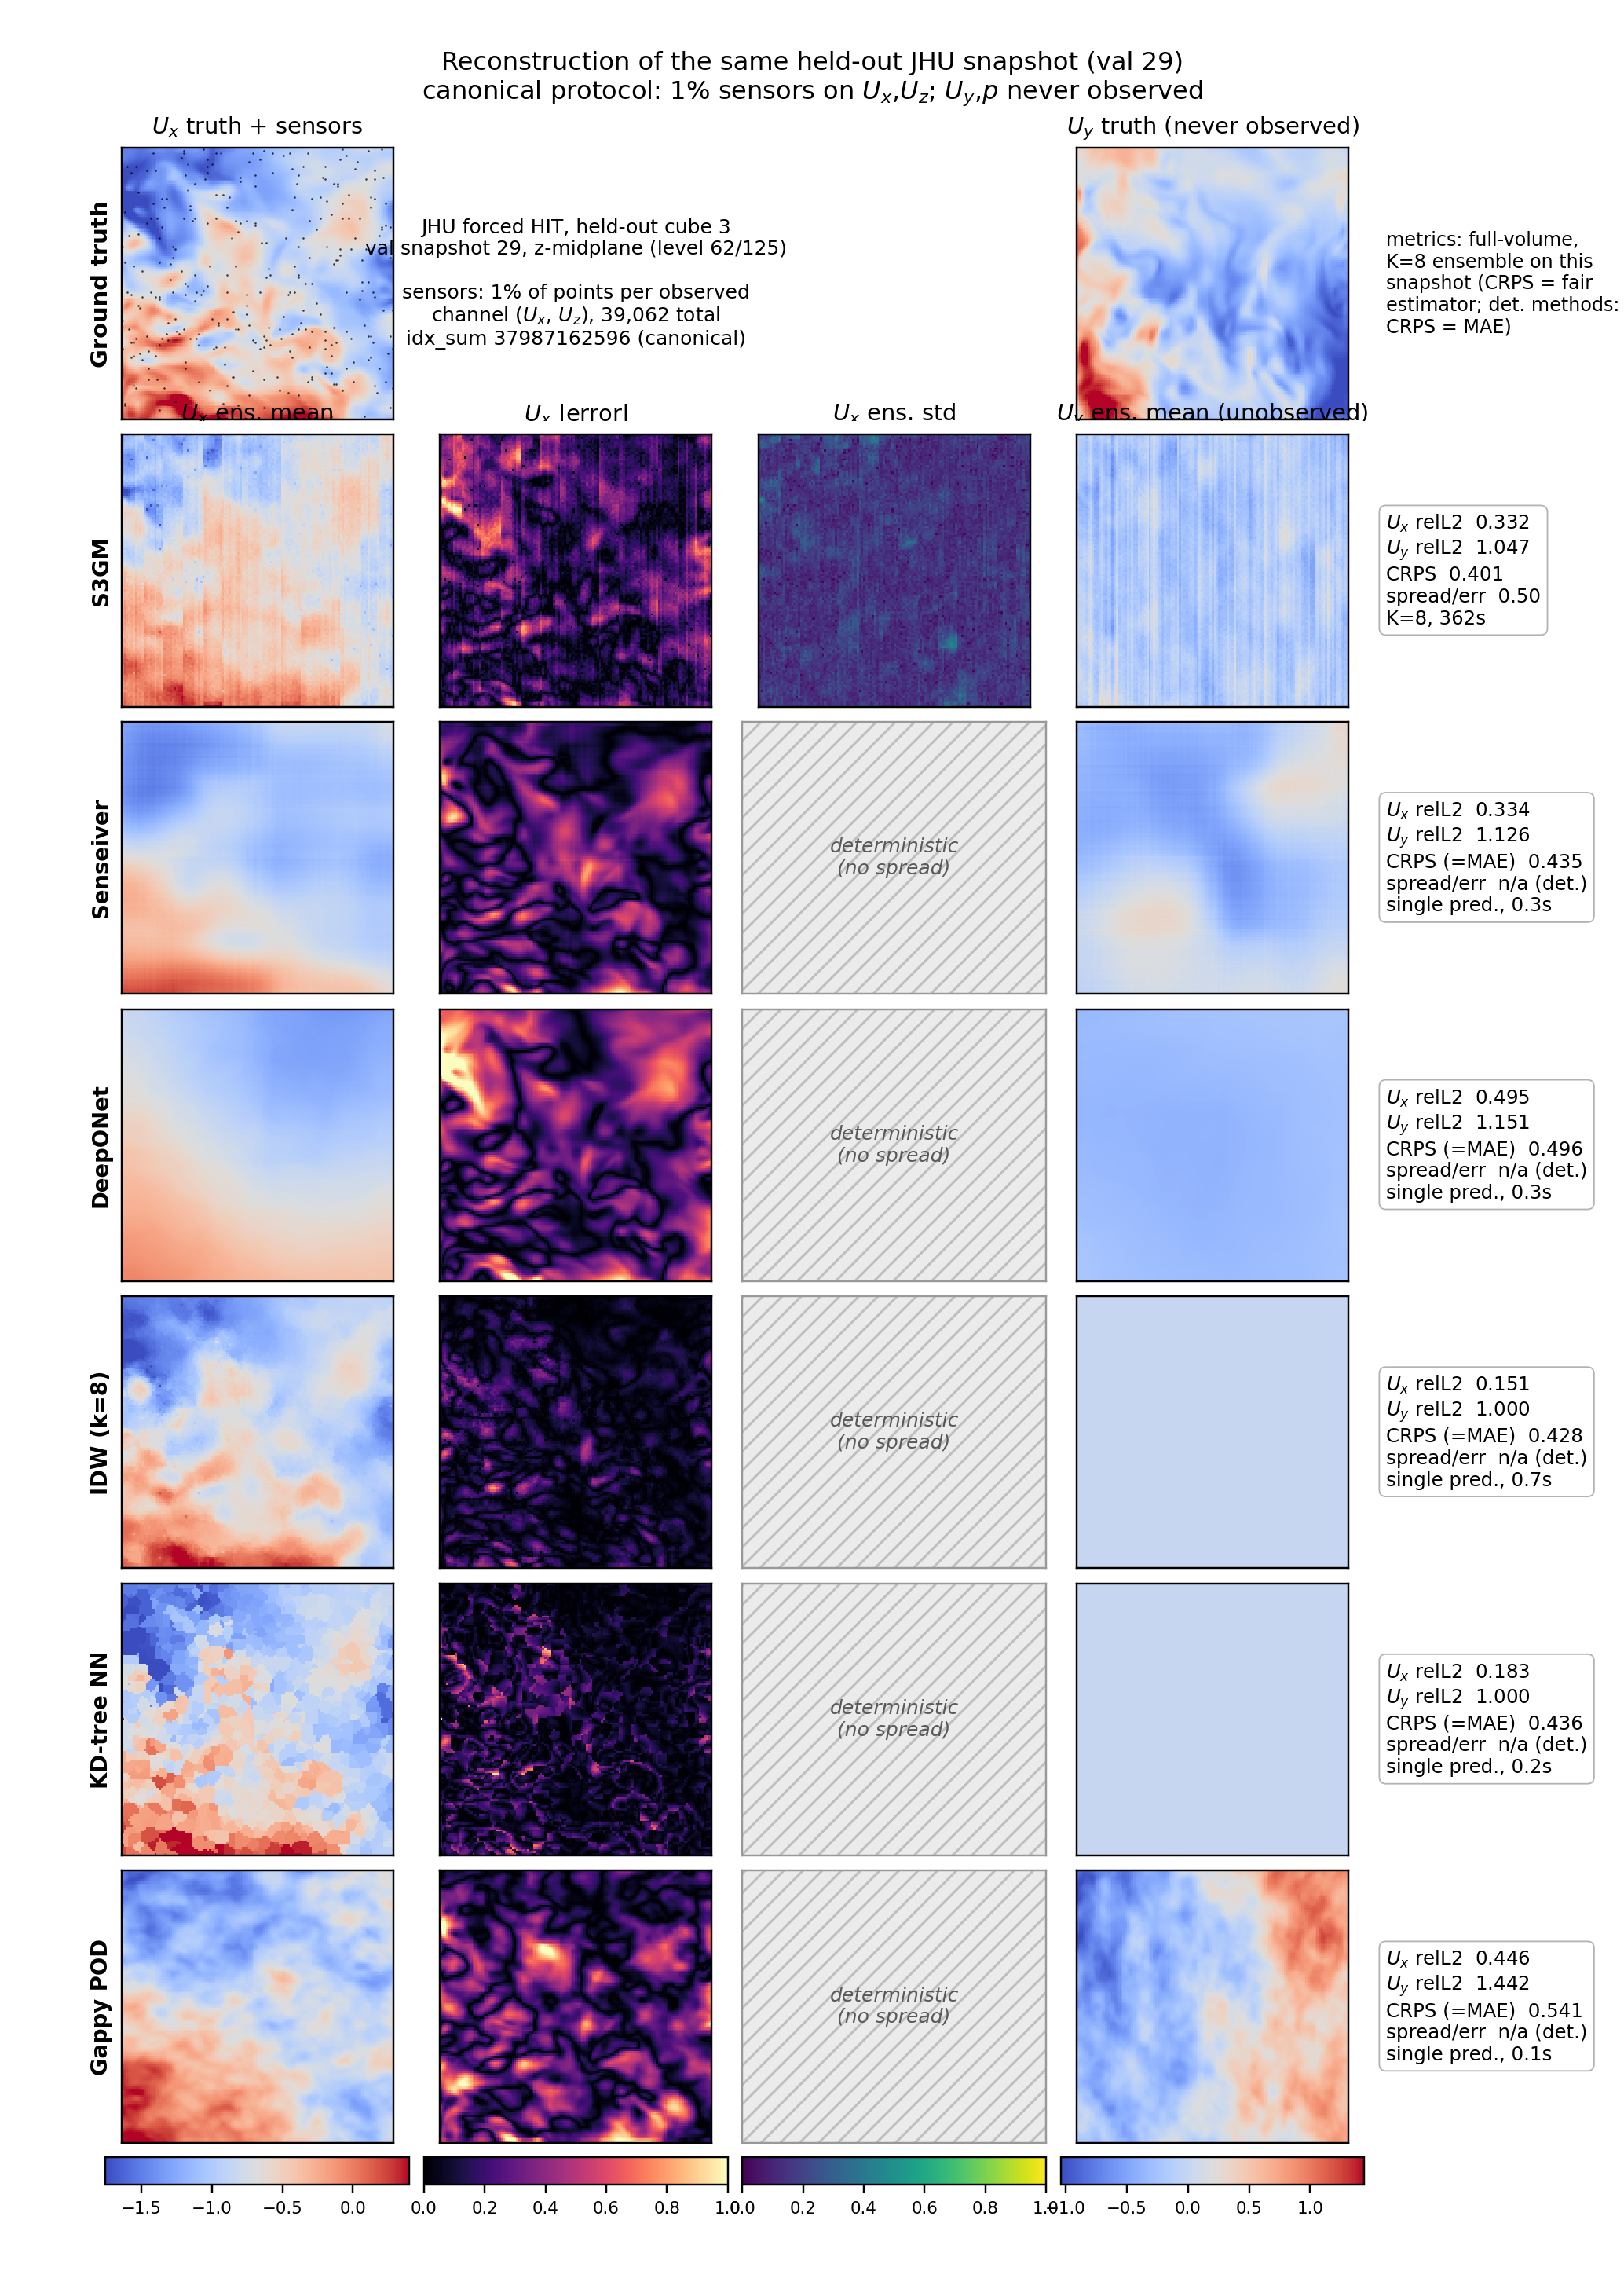
Every method, same snapshot
All 13 methods reconstruct held-out JHU snapshot 29 from 1% sensors on Ux, Uz — Uy and p never observed.
LOCUS weekly update — 2026-08-30

Slide 3
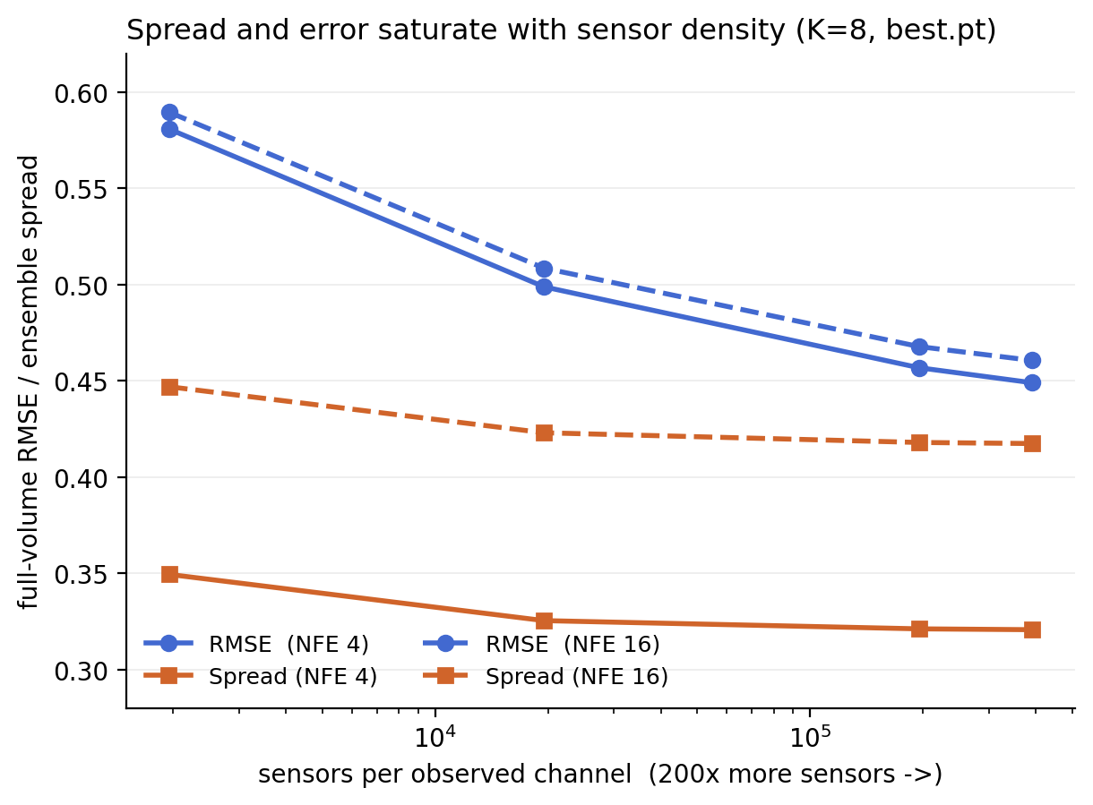
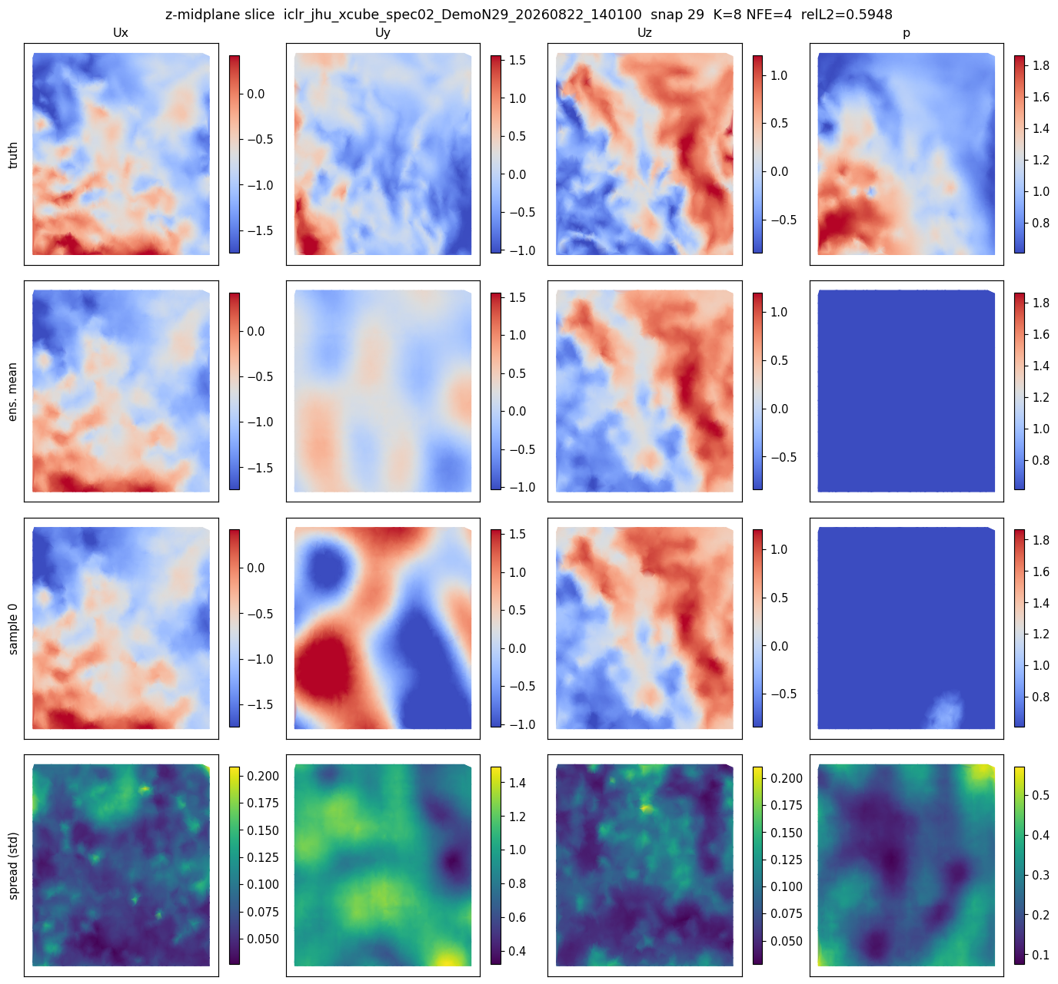
Uncertainty characterized
Ensemble spread is a density-invariant function of distance-to-sensor, with a hard ~0.09 floor
No (density, NFE) operating point is calibrated — NFE 4→16 adds spread (+0.10), barely moves error
Floor reproduces across independent retrains; checkpoint noise negligible (σ ≤ 0.0005)
LOCUS weekly update — 2026-08-30

Slide 4
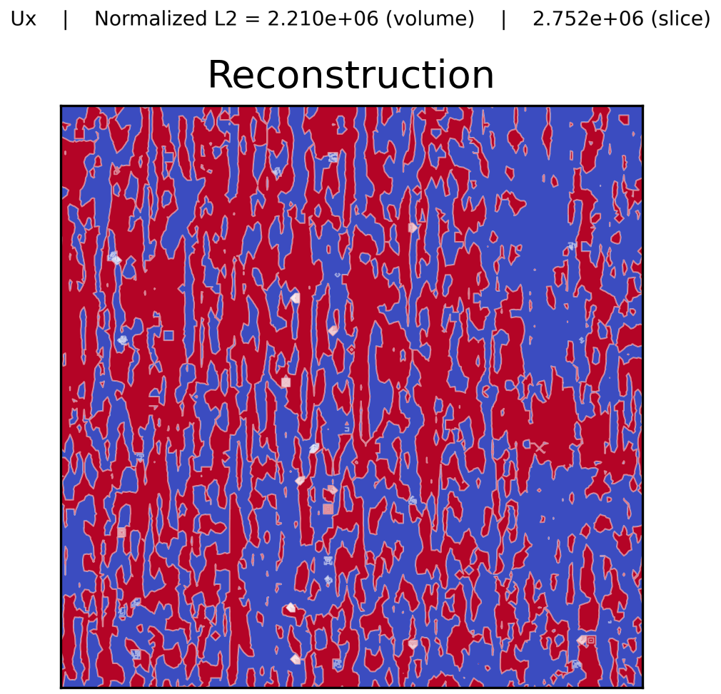
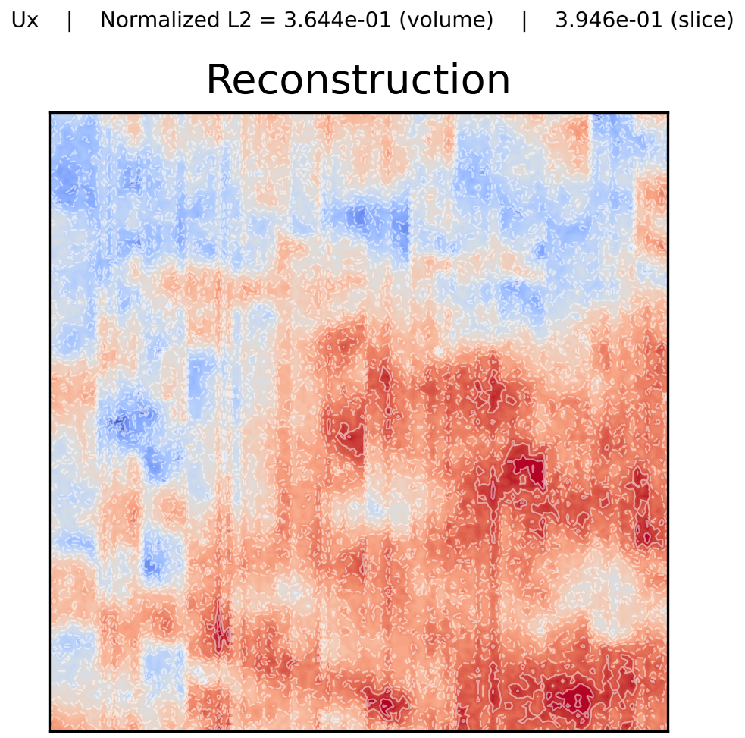
Improving the strugglers (in flight)
DeepONet++ structured branch: Ux 0.59 → 0.51, now conditioning-responsive
Senseiver capacity 64 → 128 tokens: agg 0.68 → 0.63
S3GM sampler diagnosed: unnormalized guidance (α=5) exploded to ~1e7; normalized ζ-guidance stable — figures regenerated
Before: unnormalized α=5 guidance
After: normalized ζ-guidance
LOCUS weekly update — 2026-08-30

