Slide 1
Workout Tracker
Nick Lang Rod Hammond
http://rodhammond.info:8080/WorkoutDWP
http://nicklang.io:8080/WorkoutDWP
September 23, 2016
A Fend Brotherhood Application

Slide 2
Application Features
Persistent Storage of user data using MySQL
Unlimited Workout Sessions
Customizable exercise data
Administration features to tailor:
Default workout plan
Available exercise selection
User data update/management
Scalable dataset
Responsive UI
Full stack
Spring mvc
jpa
Mysql
Html/css

Slide 3
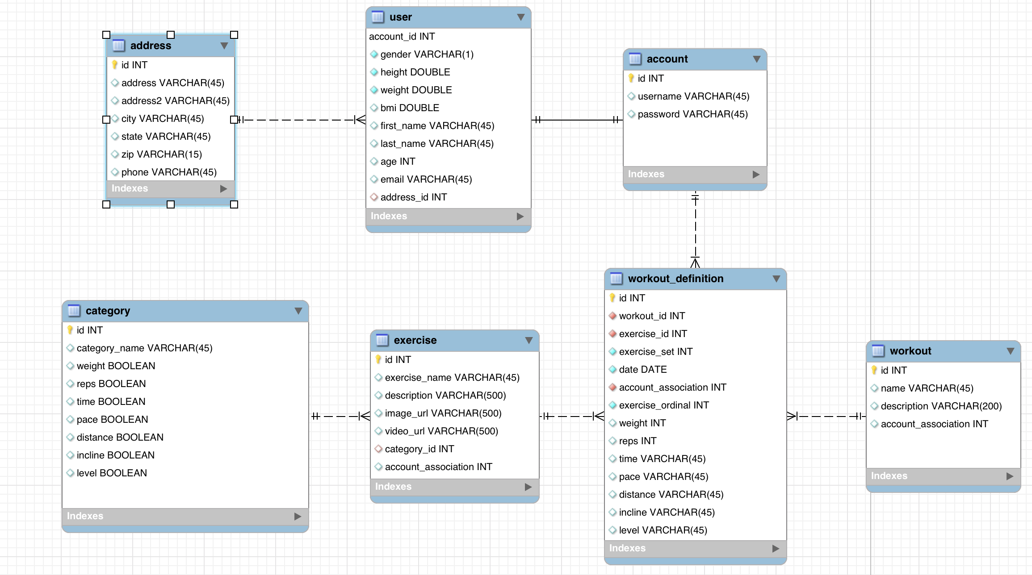
Database model

Slide 4
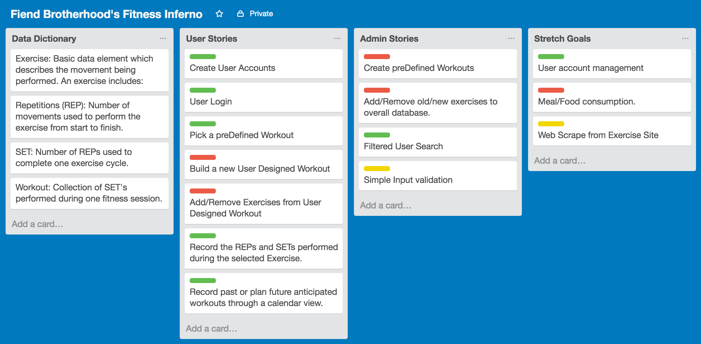
Project Board

Slide 5
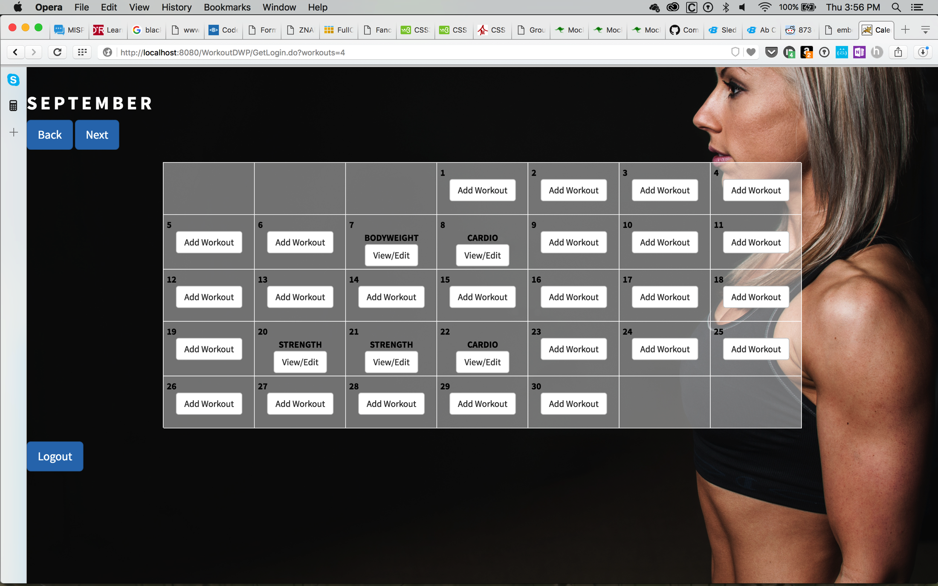
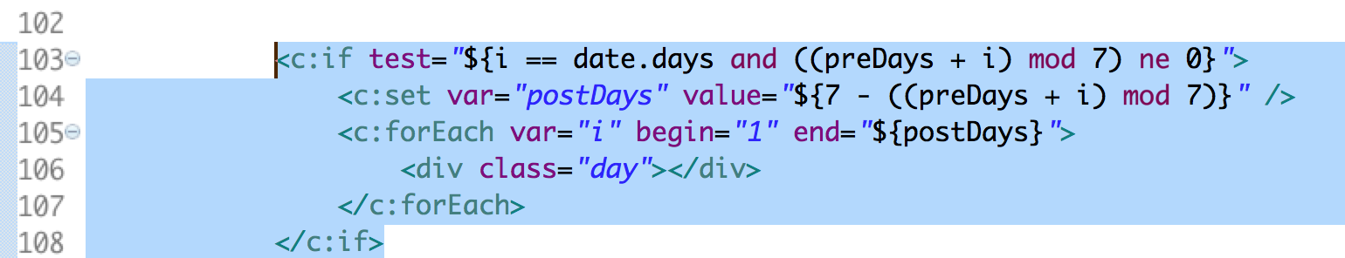
Code features
User Calendar
Created java object
Dynamic construction
Nested jsp logic

Slide 6
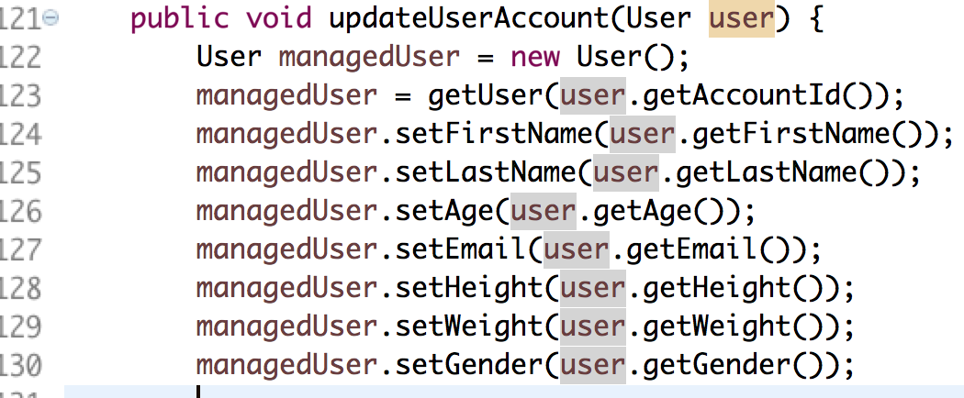
Code features
Memory vs mysql data objects
Tracking object data changes
Selecting the correct object to persist
Correct notation to target associated data

Slide 7
Workout Tracker 2.0
Workouts:
List workouts
Create customizable workout plans
Exercise:
Add new exercises
Partnering relationship with local fitness orgs
Using fitness API’s to pull new information
Nutrition:
Meal planning
Calorie tracking

Slide 8
Learning points
Agree on design and simplify database early
Assigning user stories helped prevent Git conflicts
Better time management to help reach project goals

