Slide 1

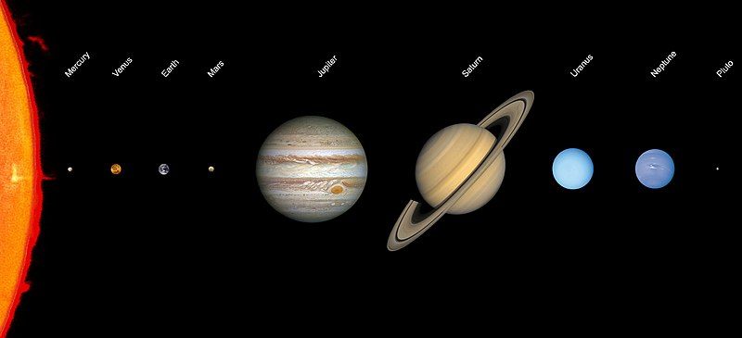
pluto
Is there an Impostor among us?

Slide 2
Table of Contents
01
02
03
04
05
Opening
About Pluto
Why Pluto?
General information about Pluto.
Argument
Counter Argument
Why Pluto should not be classified as a planet.
Why Pluto should maintain planet status.
Closing
Final thoughts.

Slide 3
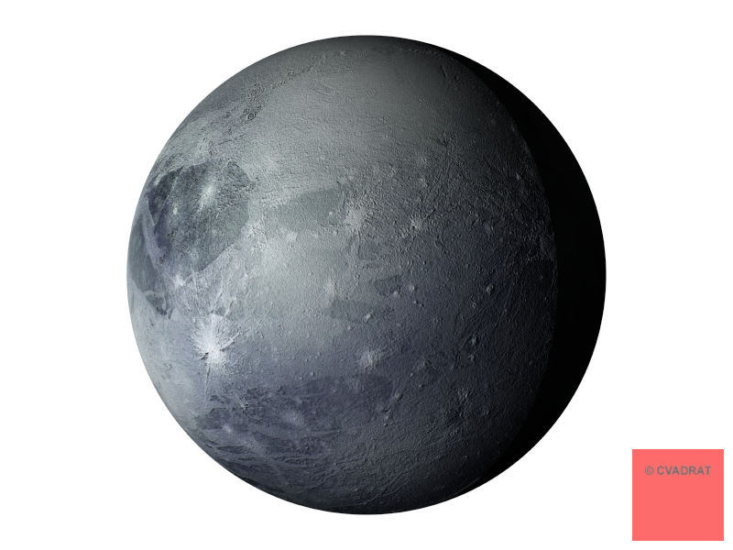
01
why Pluto?
Why I chose Pluto and it’s reclassification as my topic

Slide 4
— dr. alan stern
“Just because Pluto orbits with many other dwarf planets doesn't change what it is, just as whether an object is a mountain or not doesn't depend on whether it's in a group or in isolation.”

Slide 5
02
About Pluto
Some information and context to help us to understand Pluto better

Slide 6
Information about pluto
First discovered in 1930
Is in barycentric orbit with Charon, it’s largest moon
Has five satellites
Pluto’s Astrogeology
Pluto’s neighborhood

Slide 7
Pluto’s timeline
Percival Lowell begins search for “Planet X”
Pluto is classified as a dwarf planet by the IAU
1906
2006
~ 4.5 B years ago…
1930
2015
Pluto is formed
Clyde Tombaugh “discovers” Pluto and it is deemed a planet
New Horizons becomes the first spacecraft to visit Pluto
Hamilton, Calvin J. (2006). "Dwarf Planet Pluto". Views of the Solar System.

Slide 8
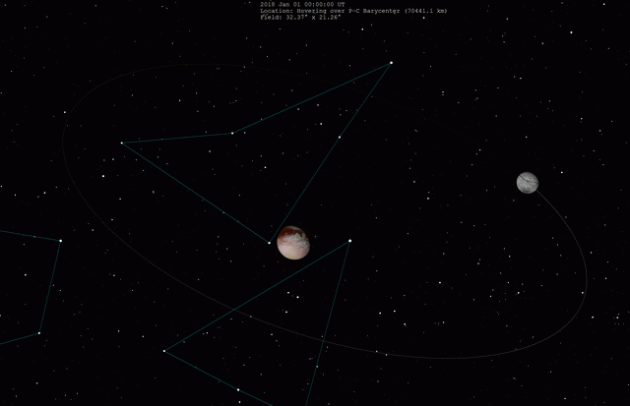
Whoa!
Pluto and its largest moon Charon comprise our solar system’s only binary system.
Pluto and Charon. Retrieved December 9, 2021, from https://upload.wikimedia.org/wikipedia/commons/2/2f/Pluto-Charon_system-new.gif

Slide 9
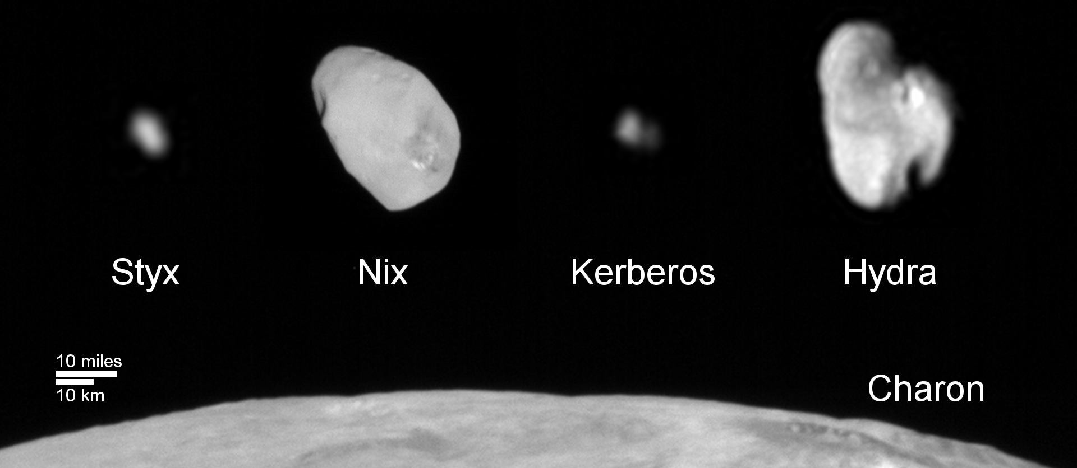
Charon and the moons of pluto
Pluto and Moons Family Portrait. Retrieved December 9, 2021, from https://www.nasa.gov/sites/default/files/thumbnails/image/nh-pluto_moons_family_portrait.png

Slide 10
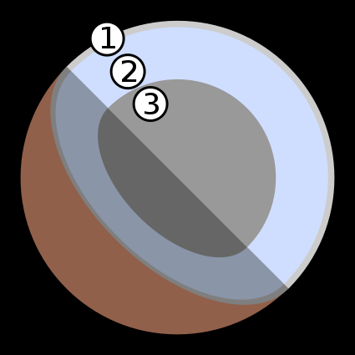
Astrogeology of pluto
Surface (1)
Mostly made up of volatile ices
Has several mountains that could be ice volcanoes
Interior
Evidence suggests that Pluto’s mantle (2) is comprised of liquid water and/or organics
May be rocky (3)
Pluto Interior. Retrieved December 9, 2021,from https://commons.wikimedia.org/wiki/File:Pluto-cutaway.svg
The Geology of Pluto and Charon through the Eyes of New Horizons. Science. Moore, McKinnon, Spencer, et al. https://www.science.org/doi/10.1126/science.aad7055.

Slide 11
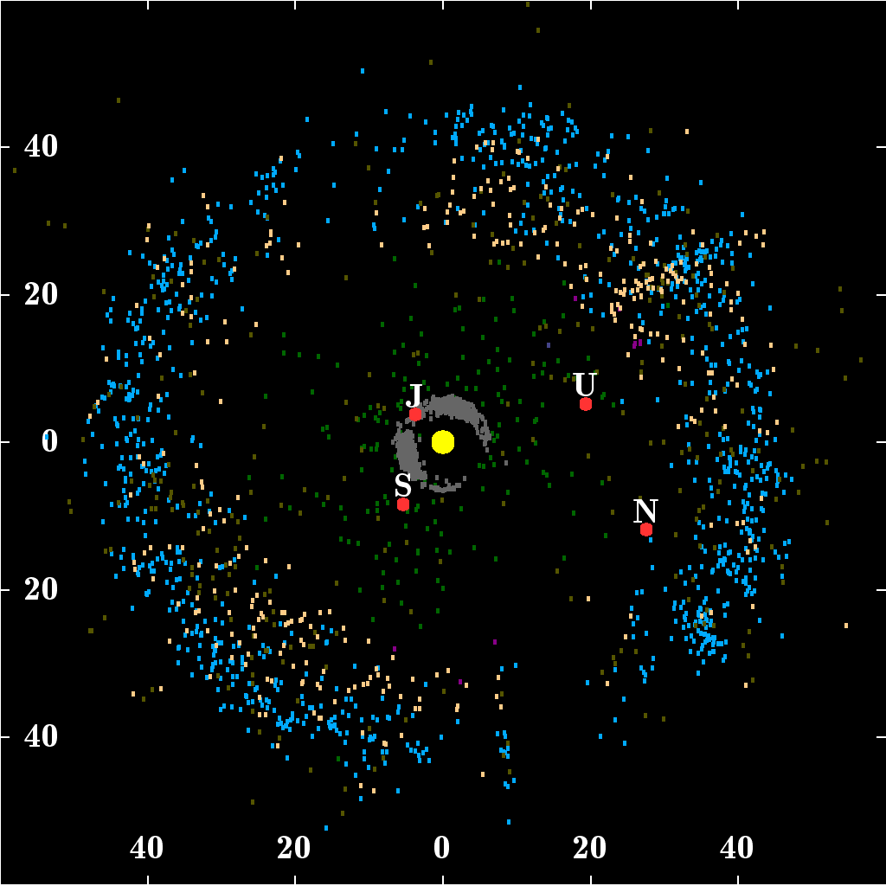
Pluto and it’s neighborhood - the kuiper belt
Ranges from 30 AU to 50 AU from our sun
Comprised of asteroids, comets, centaurs, and trans-Neptunian objects
Estimates put total mass of objects in Pluto’s neighborhood at 1.636×10²³ kg
The mass of Pluto is about 1.31×10²² kg
Known objects in the Kuiper belt beyond the orbit of Neptune.Retrieved December 9, 2021, from https://upload.wikimedia.org/wikipedia/commons/thumb/5/5b/Kuiper_belt_plot_objects_of_outer_solar_system.png/800px-Kuiper_belt_plot_objects_of_outer_solar_system.png

Slide 12
03
Pluto’s Reclassification

Slide 13
Everyone must follow these rules!
According to the IAU, a planet is a celestial body that:
is in orbit around the sun
has sufficient mass for its self-gravity to overcome rigid body forces so that it assumes a hydrostatic equilibrium
has cleared the neighbourhood around its orbit
"The IAU draft definition of "planet" and "plutons"" (Press release). International Astronomical Union. 2006-08-1

Slide 14
Clearing the neighborhood: definitions
A “planet” is an end product of secondary accretion from a disk around a primary body
An “end product” of disk accretion is a body containing more than 100 times the mass of all other bodies that share its orbital zone
Two bodies share an “orbital zone” if their orbits cross a common radial distance from the primary, and their periods are non-resonant and differ by less than an order of magnitude
The Geology of Pluto and Charon through the Eyes of New Horizons. Science. Moore, McKinnon, Spencer, et al. https://www.science.org/doi/10.1126/science.aad7055.

Slide 15


Clearing the neighborhood: the planetary discriminant
Steven Soter proposed this measure in his 2006 paper published by The Astronomical Journal
If , the candidate is considered a planet
The Planetary Discriminant was one of the criteria used to classify Pluto as a dwarf planet by the IAU in 2006
Soter, Steven (2006-08-16). "What Is a Planet?". The Astronomical Journal. 132 (6): 2513–2519.

Slide 16
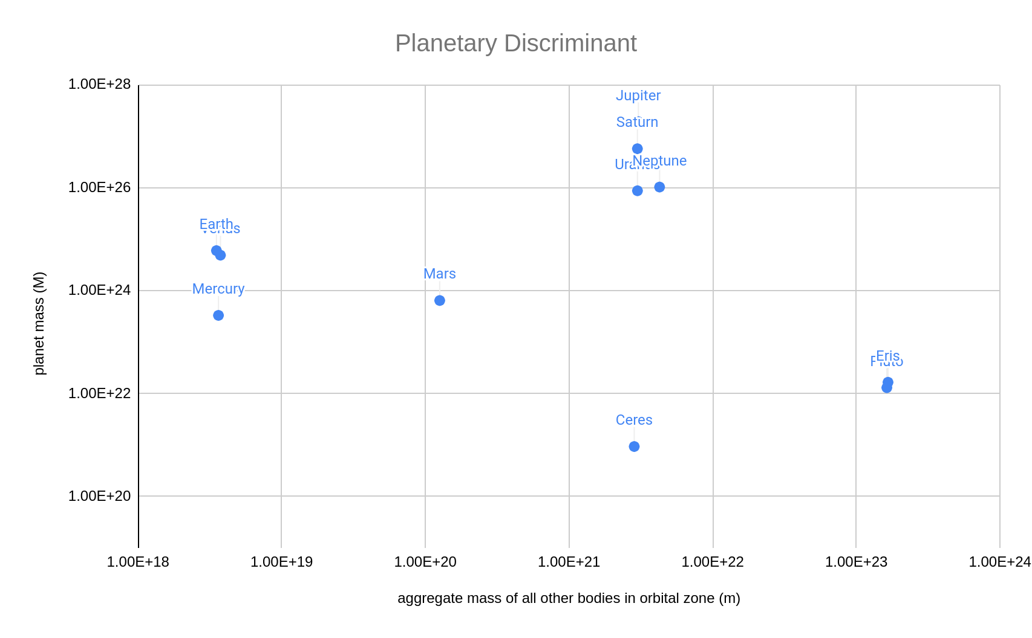

Clearing the neighborhood: the planetary discriminant
Soter, Steven (2006-08-16). "What Is a Planet?". The Astronomical Journal. 132 (6): 2513–2519.

Slide 17
Related information
“Plutoids” are bodies that meet planet criteria #1 and #2 only
The new definition of planet only applies to mature systems
If Pluto is considered a planet, this complicates cases like Eris, Ceres, and other KBOs
Soter, Steven (2006-08-16). "What Is a Planet?". The Astronomical Journal. 132 (6): 2513–2519.

Slide 18
pluto was Ejected

Slide 19
04
Argument for pluto
(and against the IAU classification system)

Slide 20
overview
Objective: Reclassify Pluto and overhaul the IAU planet definition
Soter’s planetary discriminant is too restrictive
Earth does not fit “planet” criteria
The idea of having “too many planets” is flawed
The IAU’s classifications are based on only one system
IAU’s static taxonomy is ill-suited for planetary astronomy
Pluto’s cultural significance matters

Slide 21
Remember the planetary discriminant?
One of the main criteria when considering the ability for a candidate planet to clear its orbit
If , the candidate is considered a planet
Soter, Steven (2006-08-16). "What Is a Planet?". The Astronomical Journal. 132 (6): 2513–2519.

Slide 22

what if Earth was subject to the same aggregate mass in its orbital zone?
“If for any body orbiting a primary star or substar, then that body is by definition a planet.”(Sotor, 2006)
Soter, Steven (2006-08-16). "What Is a Planet?". The Astronomical Journal. 132 (6): 2513–2519.

Slide 23
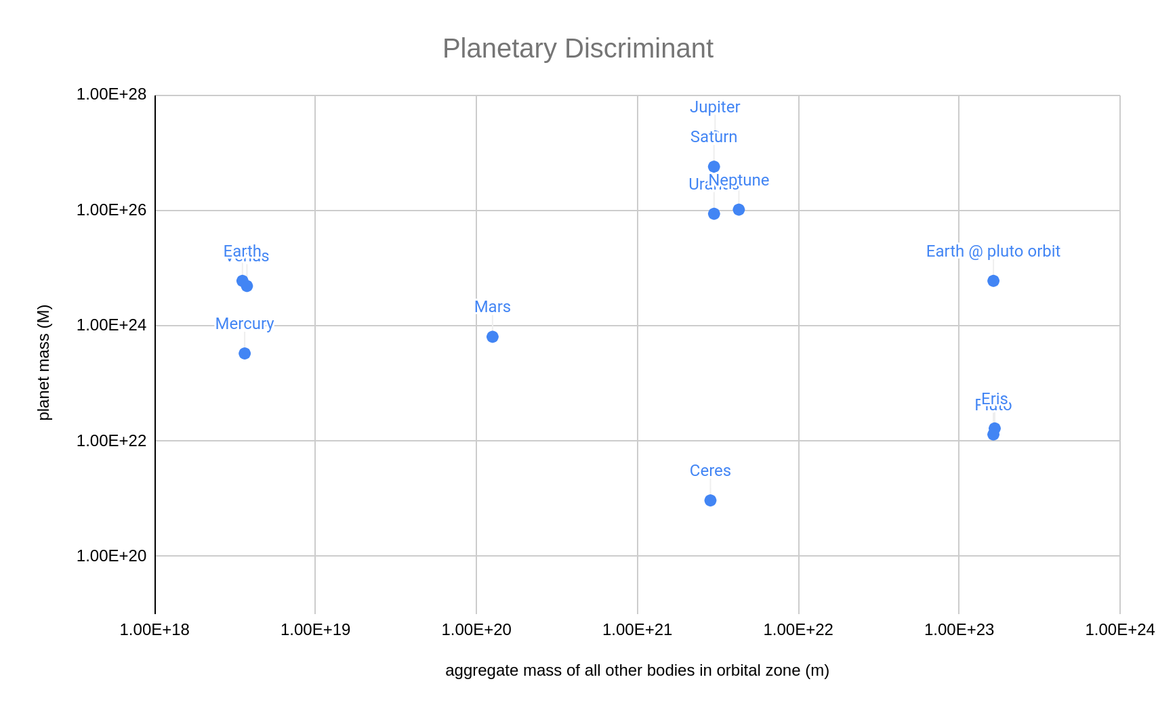
Clearing the neighborhood: the planetary discriminant
Soter, Steven (2006-08-16). "What Is a Planet?". The Astronomical Journal. 132 (6): 2513–2519.

Slide 24
Too many planets?
“If Pluto is included as a planet, we have no physical basis for excluding Eris, dozens of other large spherical KBOs, and Ceres. The term “planet” would then lose any taxonomic utility.”(Sotor, 2006)
“If a non-stellar object is massive enough to be round and orbits a star, it ought to be a planet. The key here is that once an object gets that big, important geophysical processes begin.”(Sykes, 2008)

Slide 25
The IAU’s taxonomy of non-satellite bodies
A "planet" is a celestial body that (a) is in orbit around the Sun, (b) has sufficient mass for its self-gravity to overcome rigid body forces so that it assumes a hydrostatic equilibrium (nearly round) shape, and (c) has cleared the neighbourhood around its orbit.
A "dwarf planet" is a celestial body that (a) is in orbit around the Sun, (b) has sufficient mass for its self-gravity to overcome rigid body forces so that it assumes a hydrostatic equilibrium (nearly round) shape, (c) has not cleared the neighbourhood around its orbit.
All other objects, except satellites, orbiting the Sun shall be referred to collectively as "Small Solar System Bodies".
The Final IAU Resolution on the definition of "planet" ready for voting, IAU 2006. Retrieved from https://www.iau.org/news/pressreleases/detail/iau0602/ December 9, 2021

Slide 26
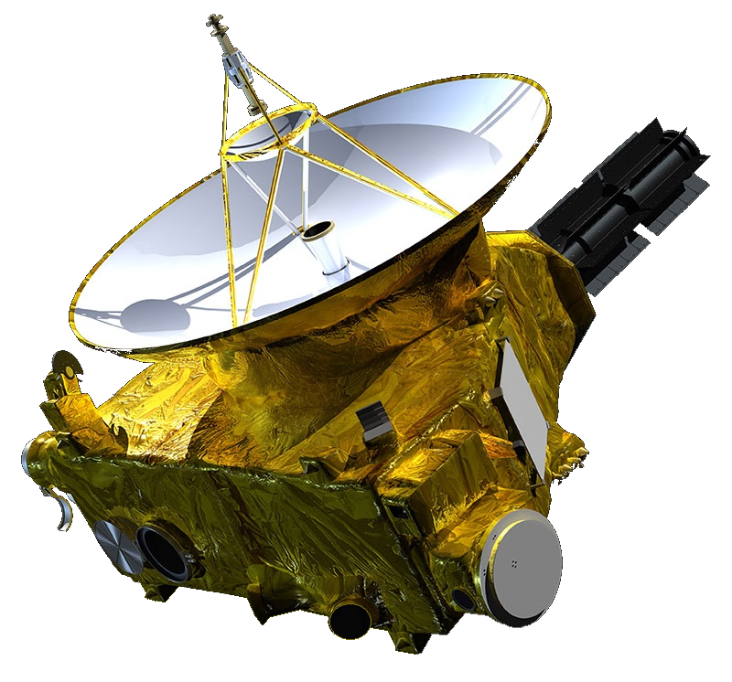
Criticism of The IAU’s taxonomy
Thanks to New Horizons, we are discovering new and unique objects more frequently; this requires a more dynamic classification system
Does not allow for easy comparison to exoplanets, since the taxonomy is based on our solar system only
Lumps asteroids, TNOs, comets, and anything else into one category
"PEPSSI Instrument Tastes Pluto's Atmosphere" from the Applied Physics Laboratory New Horizons website.Image retrieved December 9, 2021.
The Final IAU Resolution on the definition of "planet" ready for voting, IAU 2006. Retrieved from https://www.iau.org/news/pressreleases/detail/iau0602/ December 9, 2021

Slide 27
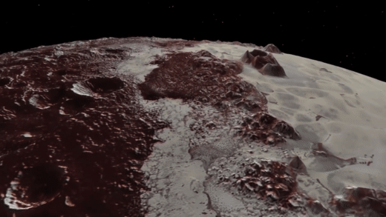
Pluto’s cultural significance matters!
Objective: Inspire continued exploration of our solar system
IAU’s static planet list has potential to stifle exploration
States have passed legislation regarding Pluto’s status
Pluto is a scientific AND cultural object
“Plutoed” was the 2006 ADS word of the year
Surface of Pluto, as seen by New Horizons. Retrieved December 9, 2021, from https://www.youtube.com/watch?v=g1fPhhTT2Oo
Social Studies of Science Vol. 40, No. 2 (April 2010), pp. 187-214 (28 pages)

Slide 28
05
Final Thoughts

Slide 29
References
Hamilton, Calvin J. (2006). "Dwarf Planet Pluto". Views of the Solar System.
Messeri, Lisa. (2010). Social Studies of Science Vol. 40, No. 2 (April 2010), pp. 187-214
Moore, J., McKinnon, W., Spencer, J., et al. (2016). The Geology of Pluto and Charon through the Eyes of New Horizons. Science. Retrieved December 9, 2021, from https://www.science.org/doi/10.1126/science.aad7055.
Pluto and Charon. Retrieved December 9, 2021, from https://upload.wikimedia.org/wikipedia/commons/2/2f/Pluto-Charon_system-new.gif
Pluto and Moons Family Portrait. Retrieved December 9, 2021, from https://www.nasa.gov/sites/default/files/thumbnails/image/nh-pluto_moons_family_portrait.png.
Pluto Interior. Retrieved December 9, 2021, from https://commons.wikimedia.org/wiki/File:Pluto-cutaway.svg.
Scientists Debate Planet Definition and Agree to Disagree. Planetary Science Institute. (2008). Retrieved December 9, 2021 from https://www.psi.edu/news/press-releases/2008/scientists-debate-planet-definition-and-agree-disagree.
Soter, Steven. (2006). "What Is a Planet?". The Astronomical Journal. 132 (6): 2513–2519.
Standish, M. (1992). Planet X – No dynamical evidence in the optical observations. Astronomical Journal. 105 (5): 200–2006.
Stern, Alan. (2006). Unabashedly Onward to the Ninth Planet. Retrieved December 9, 2021 from https://www.spacedaily.com/reports/Unabashedly_Onward_to_the_Ninth_Planet_999.html.
The Final IAU Resolution on the definition of "planet" ready for voting, IAU 2006. Retrieved December 9, 2021, from https://www.iau.org/news/pressreleases/detail/iau0602/.
Viswanathi, G., Narang, M., Manoj, P., et al. (2020). A Statistical Search for Star–Planet Interaction in the Ultraviolet Using GALEX. The Astronomical Journal, 159:194 (11pp), 2020 May.

Slide 30


