Slide 1
UCB Data Analytics Bootcamp Spring 2020 Clinical trials analysis
Nick Nasse, Parker Prowell, Raymond Garskovas, Varun Kaushik

Slide 2
Analysis X: Analysis of Studies’ Target Demographics (Age, Gender) & Overall Enrollment Count
Age hypothesis: The target age of the studies will skew towards the elderly individuals because they are the age group most impacted by COVID-19.
Gender hypothesis: The target gender of the studies will be for both men and women because both genders are at high risk of contracting COVID-19; however, it could slighty skew towards studies targeting men because they’re at a higher risk of dying due to COVID-19*.
Enrollment hypothesis: The majority of studies will have an enrollment count of less than 1000 participants due COVID-19 being a new, novel virus and the fast acting nature of the virus making it hard for patients to participate in lengthy trials.
Notes:
https://nwhn.org/does-covid-19-affect-women-differently-than-men-heres-what-we-know/
https://www.npr.org/sections/goatsandsoda/2020/04/10/831883664/the-new-coronavirus-appears-to-take-a-greater-toll-on-men-than-on-women
https://www.bbc.com/future/article/20200409-why-covid-19-is-different-for-men-and-women

Slide 3
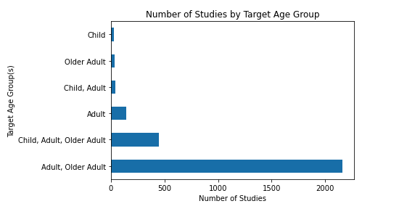
Studies’ Target Age Groups
Age Conclusion: While correct in hypothesizing that the “Older Adults” would be heavily represented (2,640 studies) it turns out that the “Adults” age group was the most represented (2,828 studies)
Notes:
Adults – 2,828
Older Adults – 2,640
Children -- 514

Slide 4
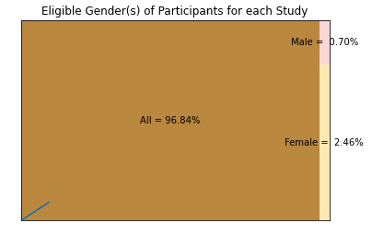
Studies’ Target Genders
Gender Conclusion: The hypothesis that most studies would be looking for both men and women was correct; however, of those studies that looked for a single sex, female specific studies were more prevalent.

Slide 5
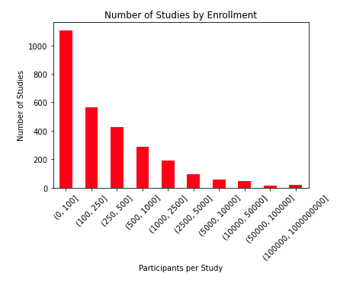
Studies’ Enrollment Count
Enrollment hypothesis: The hypothesis that the majority of studies would have an enrollment count of less than 1000 participants was correct, with studies fitting this criteria making ~85% of the total studies.

