Slide 1
UCB Data Analytics Bootcamp Spring 2020 Clinical trials analysis
Nick Nasse, Parker Prowell, Raymond Garskovas, Varun Kaushik

Slide 2


Analysis X: COVID-19 trials keyword frequency analysis
Initial hypothesis: Frequency distribution between keywords among clinical trials related to COVID-19 would be similar amongst most keywords, but greater for respiratory related terms.
This was my initial hypothesis because:
COVID-19 is a novel virus. This should mean a specific set of keywords dominating the frequency would be less likely.
COVID-19 is known to be especially aggressive towards the respiratory system.

Slide 3
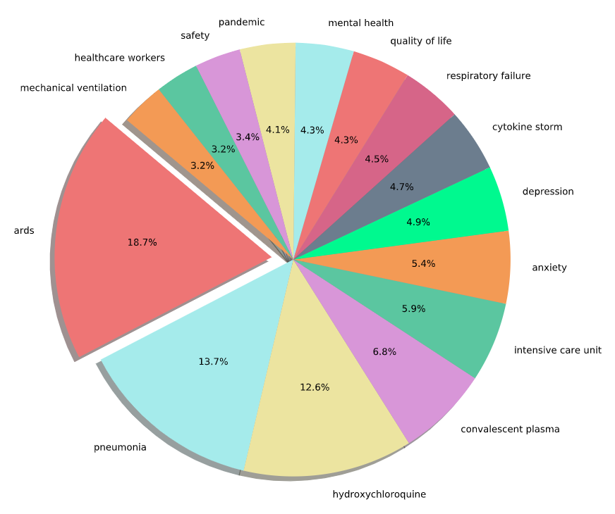
Frequency Distribution Amongst Top 15 Keywords

Slide 4
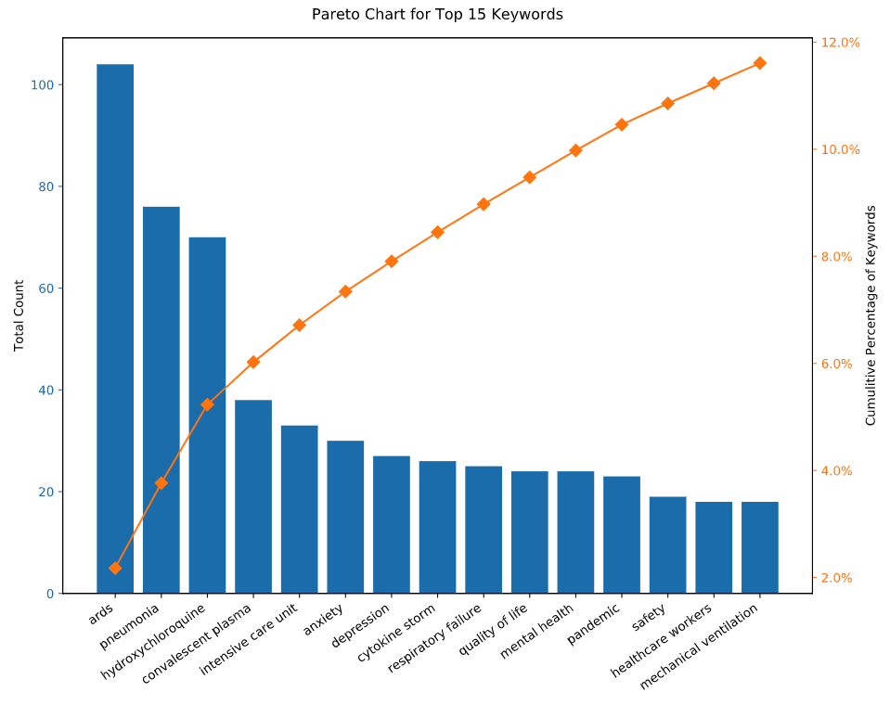
Frequency Distribution Amongst Top 15 Keywords

Slide 5
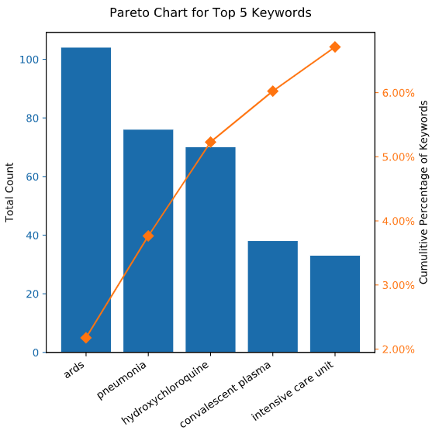
Top 5 Keywords
ARDS:
Acute respiratory distress syndrome
Pneumonia:
Infection that inflames the air sacs in one or both lungs
Hydroxychloroquine: Immunosuppressive drug and Anti-parasite. Used to treat and prevent malaria.
Convalescent Plasma:
Plasma that is collected from people who have recovered from a disease, whose blood is presumed to have antibodies for that disease.
Intensive Care Unit: health care facility that provides intensive treatment medicine.

Slide 6
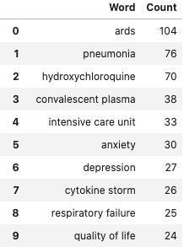
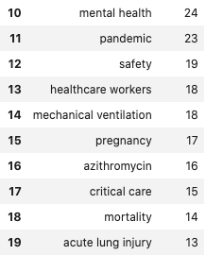
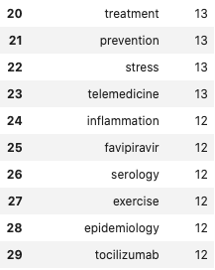
Keywords Analysis
Conclusion: Frequency Analysis among COVID-19 clinical trial keywords has proven our hypothesis incorrect. While frequencies were relatively similar, the data has proven to be greatly skewed towards trials related to ARDS, Pneumonia, and Hydroxychloroquine. Despite a large amount of keywords corresponding to respiratory related illnesses or symptoms, the data was diversely distributed categorically.

