Slide 1
VISUALIZING 2013 NYC FLIGHT DELAYS
Group 7
Karyn Cook
Ziyin Lui
Nicholas Occhipinti
https://nocchipi.shinyapps.io/design_contest_dashboard

Slide 2
RESEARCH QUESTION
What factors can determine the cause of flight delays that occurred in 2013 NYC airports?
NYC airports flight delay information throughout the year
Destination airports locations and distance
Plane information such as the year of the plane, manufacturer and seats
Compare different airlines performance
Weather conditions
Notes:
AREAS OF INVESTIGATION

Slide 3
POTENTIAL USER
FLIGHT OPERATIONS
AIRLINE
AIRPORT
GOVERNMENT ENTITIES
Notes:
Discuss the hypothetical users of this data.

Slide 4
PROCESS
DPLYR
Joining flight data with other datasets (planes, airports, airlines) to see if they factor into causing delays
Filtering out delayed flights
Grouping by different variables and performing counts
HTML Widgets
Flexdashboard for the Layout
Leaflet for the destination map
Plotly for the interactive plots
Application
Shiny to host dashboards and create user interface

Slide 5
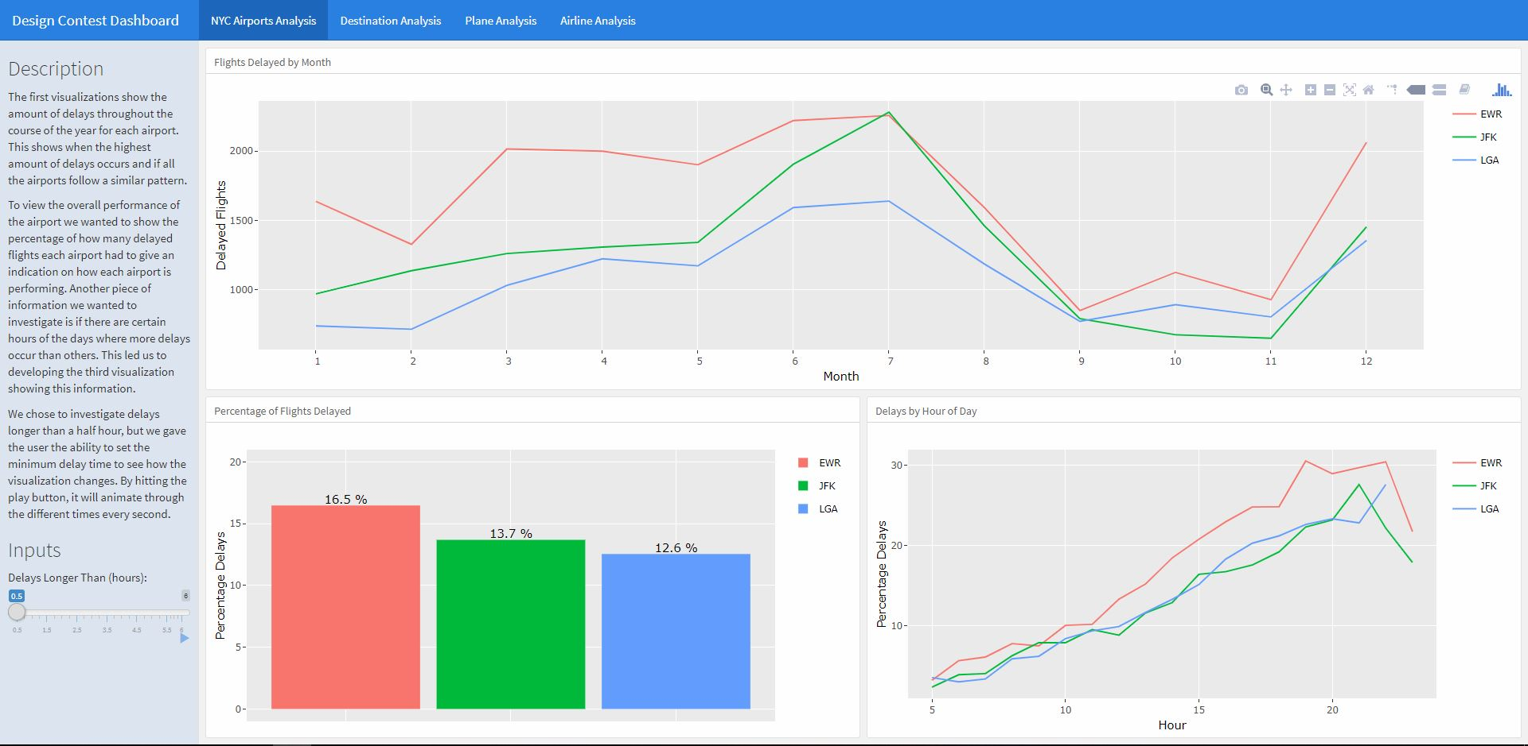
NYC AIRPORTS ANALYSIS
Peaks of delays during summer and the end of year
All three airports had low delays in Autumn.
Percentage of delays in 2013 ranged from about 13% to almost 17% based on delays of over 30 minutes or longer
As the day progresses delays get worse until then end of the night
Notes:
analyzed departure delays

Slide 6
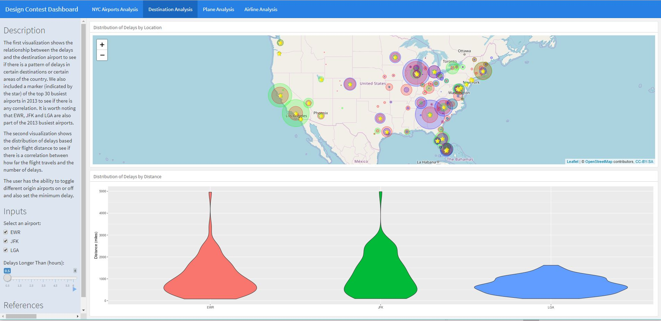
DESTINATION ANALYSIS
Analysis on flights within the US
A large number of delays occur in destination airports that rank as the top US busiest airports in 2013
EWR (13), JFK (6) & LGA (20) also ranked as the top busiest US airports in 2013
The shorter the distance the more delays

Slide 7
DESTINATION ANALYSIS
EWR
JFK
LGA
FAA Code | Delays
ORD | 1180
ATL | 952
SFO | 939
BOS | 891
LAX | 827
CLT | 804
MCO | 730
FLL | 710
DTW | 650
IAH | 625
FAA Code | Delays
LAX | 1567
SFO | 1323
BOS | 928
MCO | 920
FLL | 797
SJU | 762
BUF | 628
RDU | 611
ORD | 572
DCA | 571
FAA Code | Delays
ATL | 1712
ORD | 1423
CLT | 1031
FLL | 773
MIA | 737
BNA | 684
DEN | 681
MCO | 645
DTW | 640
DCA | 622
2013 Top 30 Busiest Airport in the US
Notes:
departure delays. With more time, we would look at flights that left NYC facilities on time but arrived late at destinations. (User=airport operations)

Slide 8
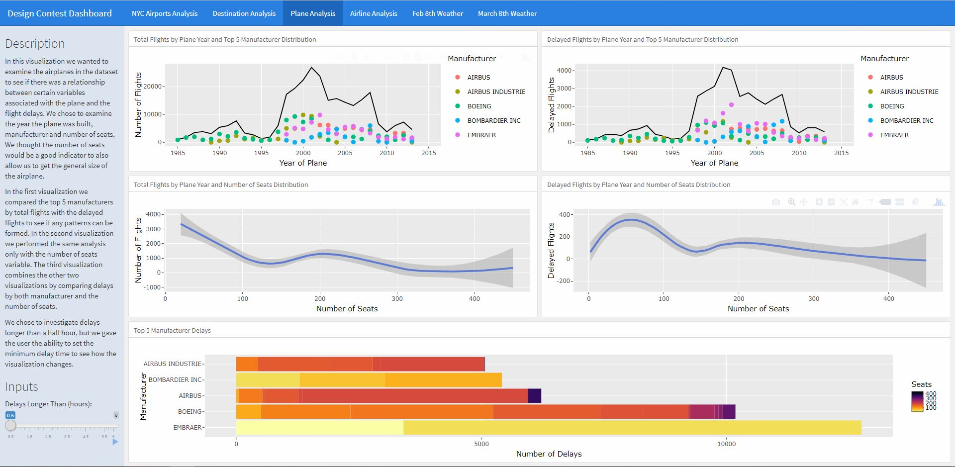
PLANE ANALYSIS
Out of the top 5 manufacturers Embraer had the most manufacturer delays and all occurred in planes with less than 100 seats
Most planes that were flown out of the NYC airports were built in 2001 and 2002 - Embraer had the most delays of planes built in that time
Notes:
Embraer < 100 = regional jets. Often used for flights to smaller regional airports. May be correlations to data in slide 5 noting shorter distance = increased likelihood of delays.

Slide 9
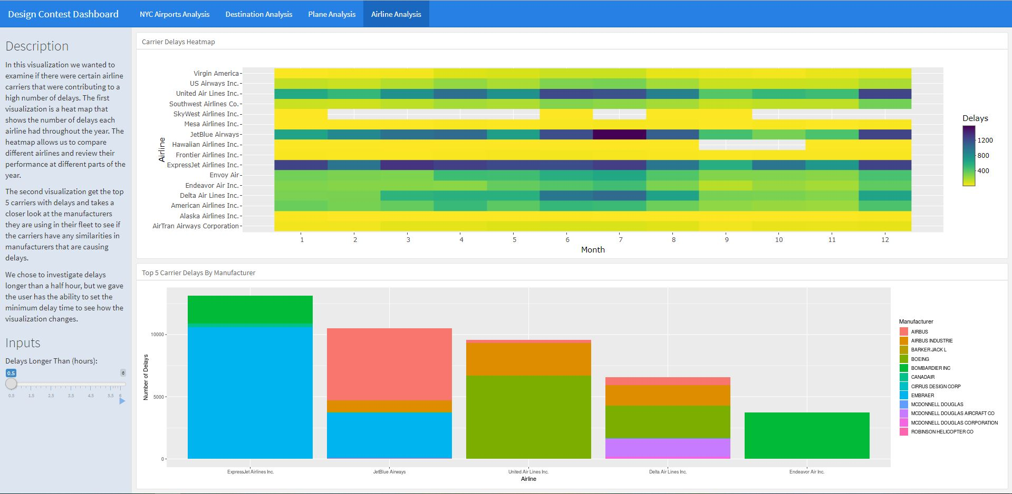
AIRLINE ANALYSIS
ExpressJet, JetBlue, United, Delta and Endeavor have the most delays
Out of these airlines they are mostly using planes from manufacturers with the most delays (Embraer, Boeing, Airbus)

Slide 10
WEATHER ANALYSIS
Assumptions
lengthy delays (>60 min) and cancellations would be associated with poor weather conditions
weather conditions would be similar at all 3 airports.
packages
dplyr, ggplot, lubridate
Process
Examined hourly weather readings for visibility, barometric pressure, and wind speed.
identified days with the most cancellations and delays > 60 min.

Slide 11
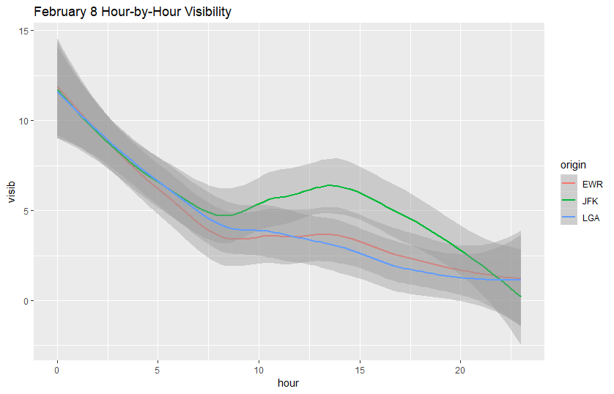
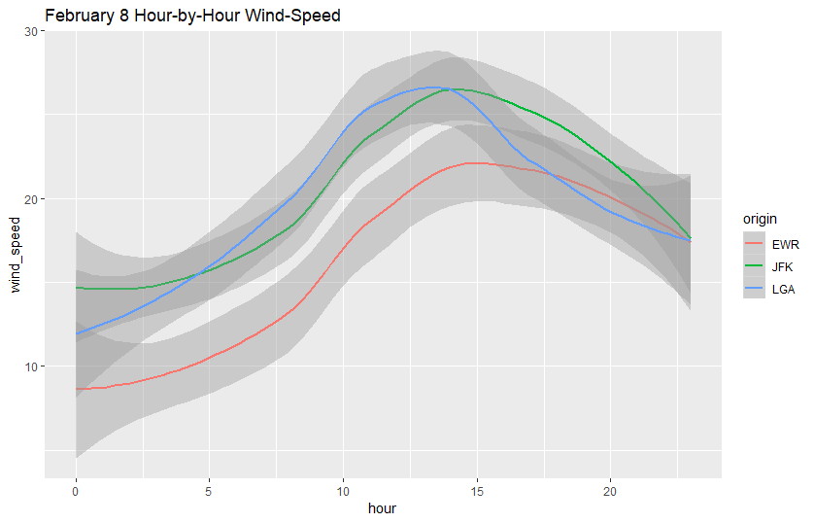
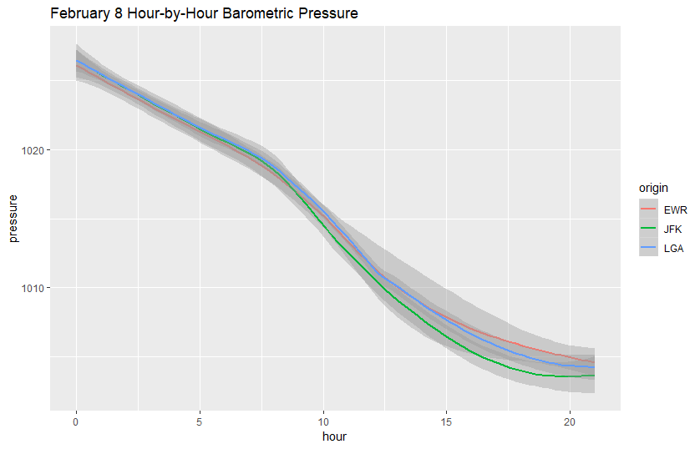
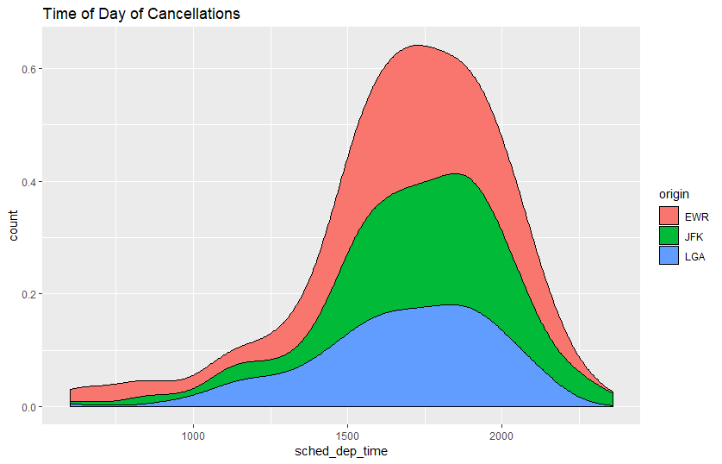
FEBRUARY 8 - GREATEST NUMBER OF CANCELLATIONS

Slide 12
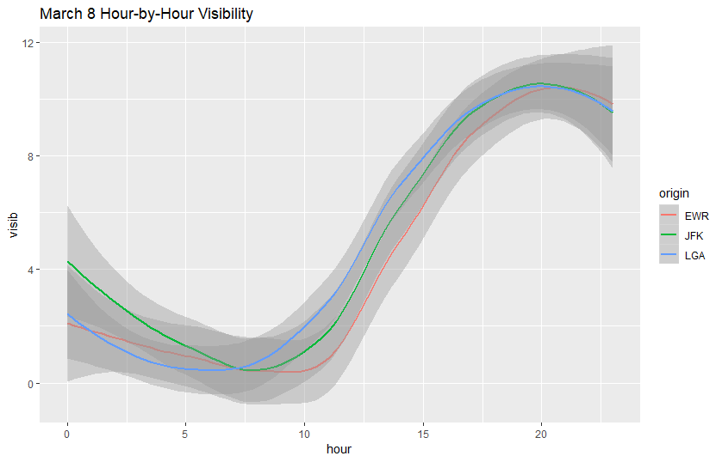
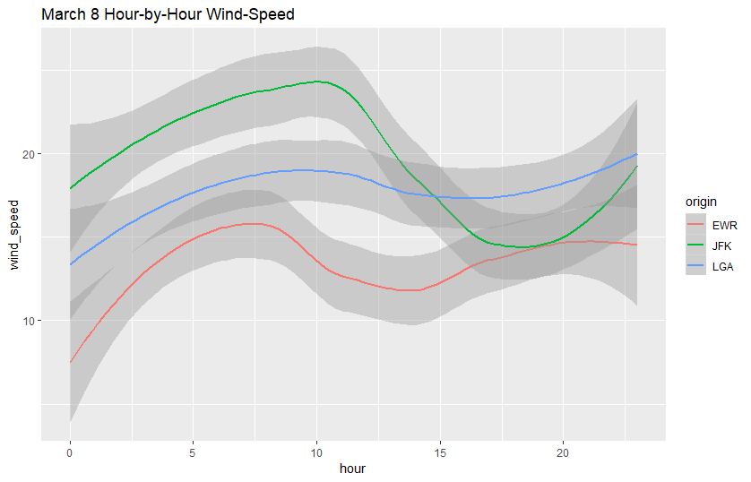
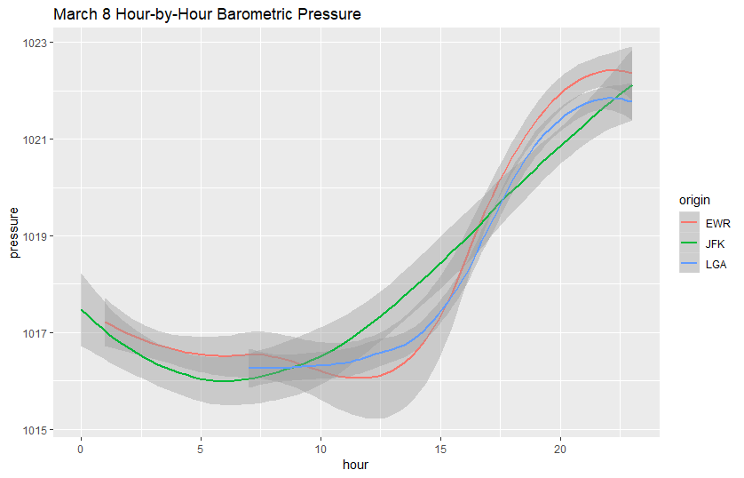
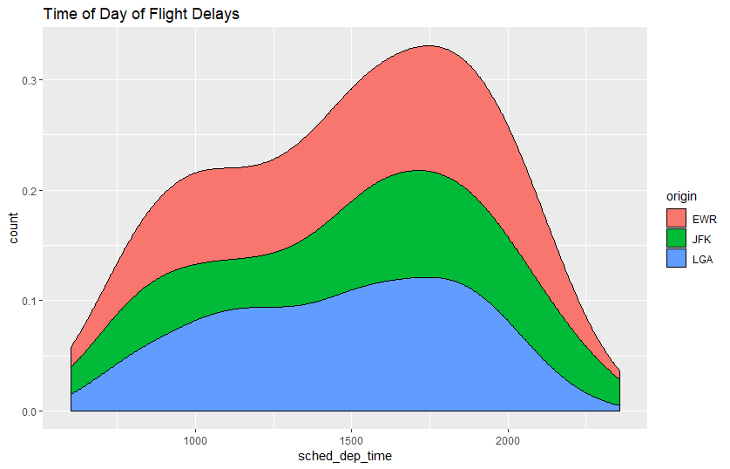
MARCH 8 - GREATEST NUMBER OF DELAYS > 60 MIN

Slide 13
DATA ISSUES
LAT/LON DATA WAS USED FOR PLOTTING DESTINATION, BUT EXCLUDED MOST INTERNATIONAL DESTINATIONS.
MISSING WEATHER OBSERVATIONS.

Slide 14
SUMMARY
Best chance to avoid delays was in Autumn and early in the morning (5am)
If you are traveling a relatively short distance you are more likely to face delays
The busiest destination airports plays a factor in delays
Plane attributes for delays follow similar patterns as the total flights
Most delays occur in planes with less than 100 seats

Slide 15
WHAT IF WE HAD MORE TIME
Compare NYC airport data for other years
Examine the weather data in more detail
Explore other busy airports
Explore non-overlapping departure delays vs arrival delays
Research different events that occurred in NYC at that would effect air travel
Weather, Emergency, Special Events
Look into flights outside of the US for destination analysis

