Slide 1
3-Bit ADC
Nick Snyder

Slide 2
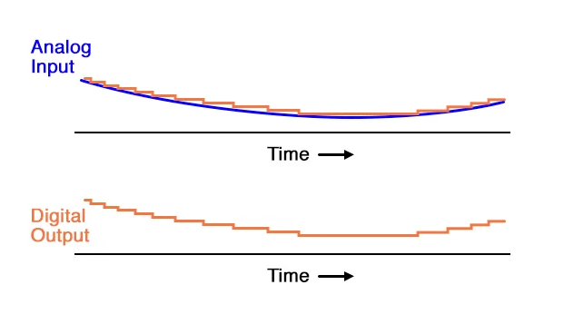
Introduction
An ADC converts a continuous-time and continuous-amplitude analog signal to a discrete-time and discrete-amplitude digital signal
What is an Analog-to-Digital Converter?
Different Kinds?
Direct-conversion (Flash)
Successive Approximation
Ramp-Compare
Integrating
Delta-Encoded
Pipelined
Delta-Sigma
Time-Interleaved
Intermediate FM Stage
Time-Stretch

Slide 3
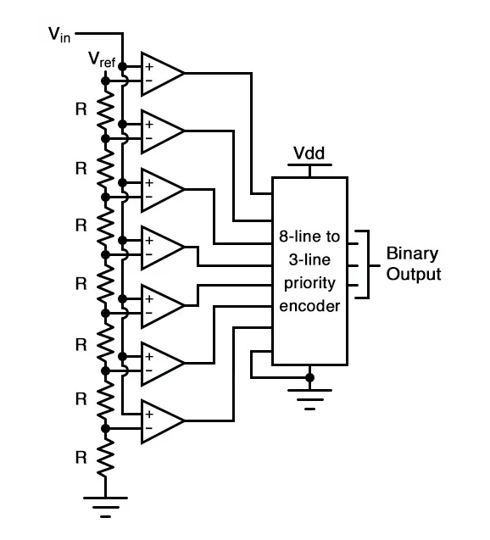
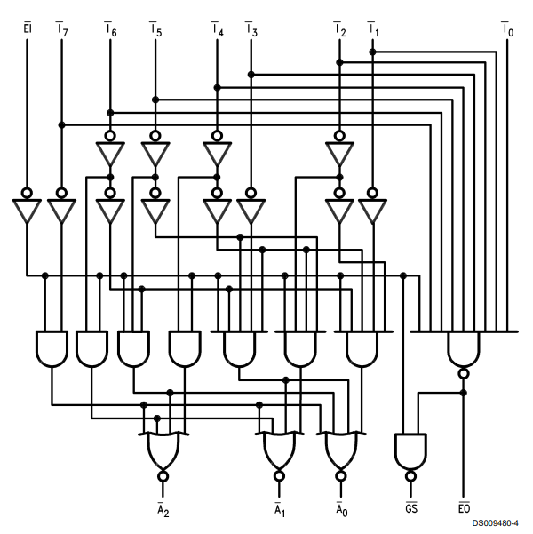
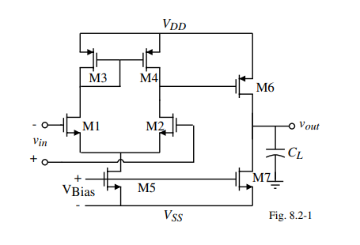
Challenges
Finding circuits
Flash ADC
Priority Encoder
Comparator

Slide 4
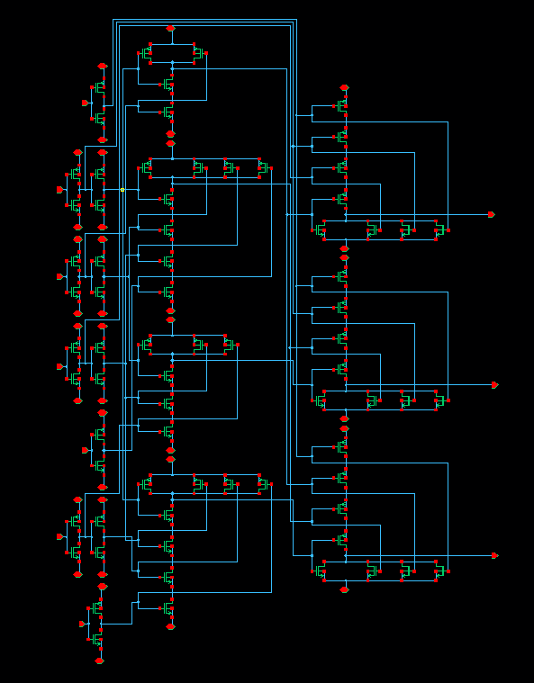
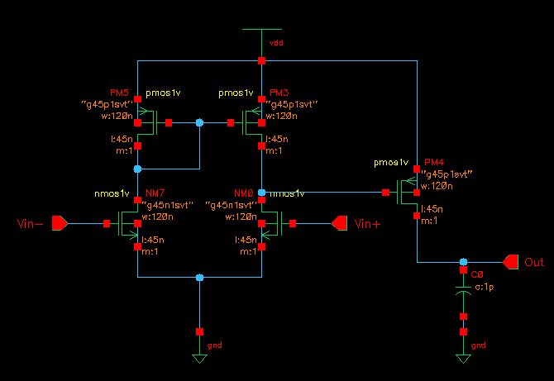
Methods

Slide 5
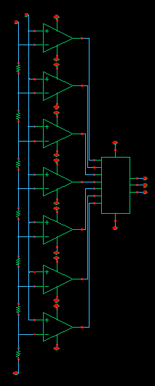
Results
Yet to test DRC, LVS, QRC

Slide 6
Future Directions
Fix small errors in the schematic
Need to start the written report

Slide 7
Conclusions
I learned how analog to digital conversions are made at a very low level
I learned how complicated other kinds ADC can be (detla-sigma)
More practice using Cadence

