Slide 1
Virtualization Management
and the
Open Source World
Samuel Barton
Maine Cyber Security Cluster
Department of Computer Science

Slide 2
Open source?
Definition: A piece of software whose source code has been released to the public by its developer.
The paradigm: massively collaborative decentralized development of software by a community
Notable examples:
- Firefox web browser
- VLC media player
- Linux

Slide 3
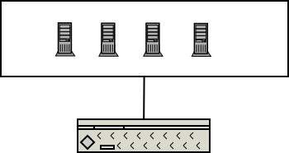
Virtualization Technology
Has grown tremendously in last decade
Enables
massive systems without the hardware and energy costs
Multiple operating systems on one physical machine.
Simulation of physical infrastructure

Slide 4
Simulating Infrastructure
We can simulate the infrastructure of a town or city
Hundreds or thousands of virtual machines
dozens or hundreds of virtual networks
This has many applications in research and education

Slide 5
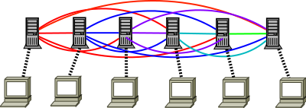
The Problem - Complexity
Managing large numbers of virtual machines across individual servers is untenable
Error prone and not scalable
Insufficiently allocates resources

Slide 6
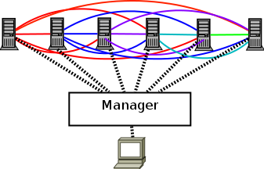
The Solution - Management
Virtual machine managers provide
Resource allocation
Provide a single point of management
Reduction of human error

Slide 7
oVirt
Open source project developed by Red Hat
Fully featured virtual machine manager
Highly coupled to Red Hat Linux distribution

Slide 8
Our story
Ubuntu-based system isolated from the internet
Attempted port of oVirt to Ubuntu
Realized that it was untenable within our timeframe
Converted some of our system to CentOS
oVirt now runs our virtual infrastructure

Slide 9
Virtualization is a powerful technology with many interesting applications
Open source is a paradigm of software development based on community collaboration
Research takes perseverance, insight, and humility

