Slide 1
Panda3d presentation
Nick Ratti and Kevin Panasiuk

Slide 2
What is Panda3D
Panda3D is an open-source 3D engine designed for the development of real-time 3D rendering applications.
It supports the creation of interactive 3D applications, including games, simulations, and visualizations.
Originally developed by Disney and maintained by the Carnegie Mellon Entertainment Technology Center.

Slide 3
Key Features of Panda3D
Real-Time Rendering:
Supports advanced graphical effects like shadows, reflections, and post-processing shaders
Scene Graph Management:
Simplifies organizing and managing objects in a 3D scene
Extensive Asset Support:
Compatible with multiple 3D file formats (e.g., .obj, .fbx, .egg).
Cross-Platform Compatibility:
Runs on Windows, macOS, and Linux.

Slide 4
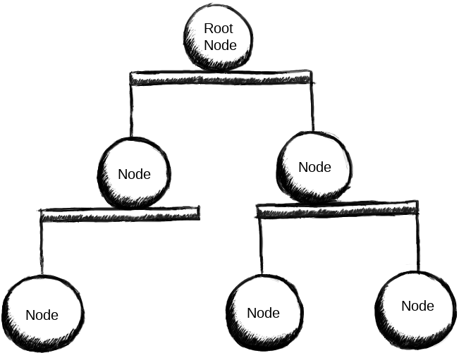
Understanding something something
Panda3D stores its objects in a “scene graph”. Essentially, this is a hierarchy of objects–called “nodes”.
More info and stuff here

Slide 5
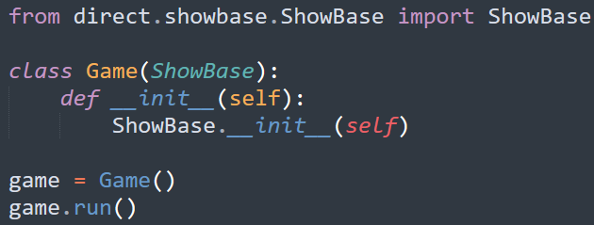
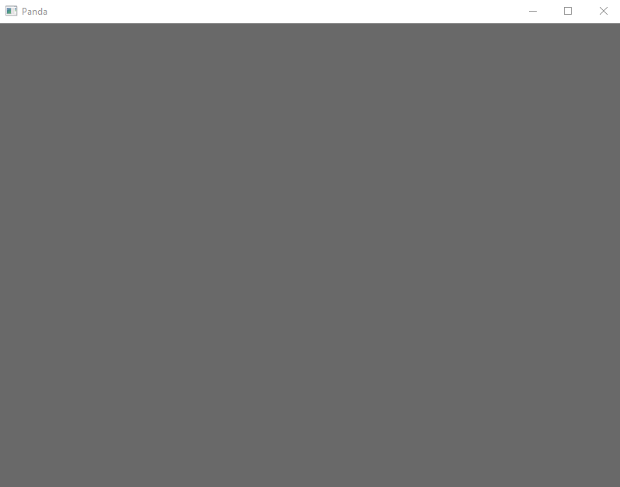
Making Window

Slide 6
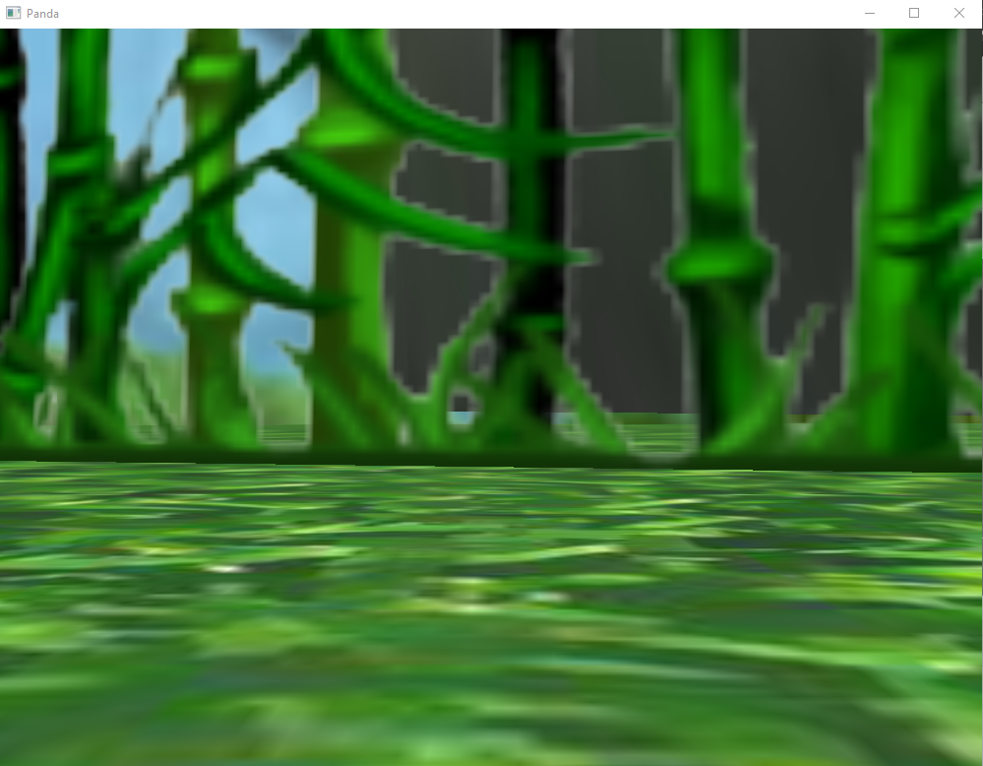
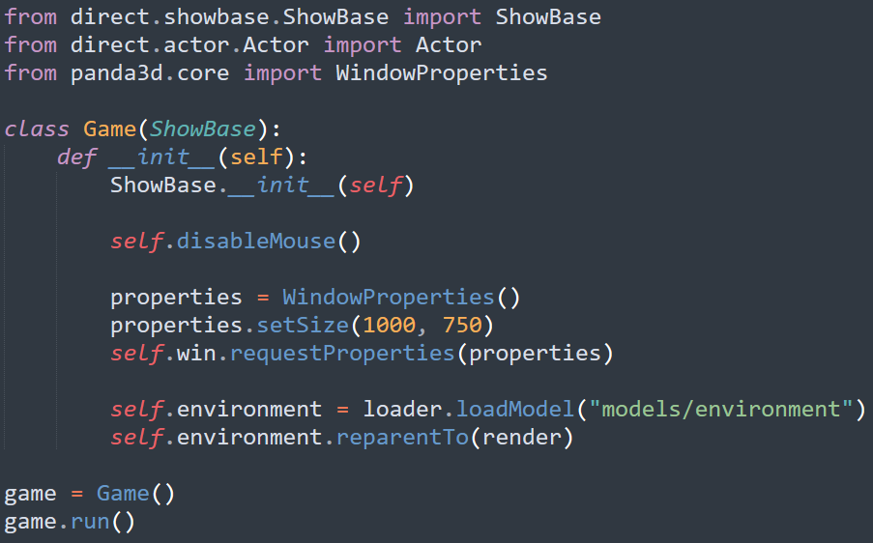
Loading Model

Slide 7
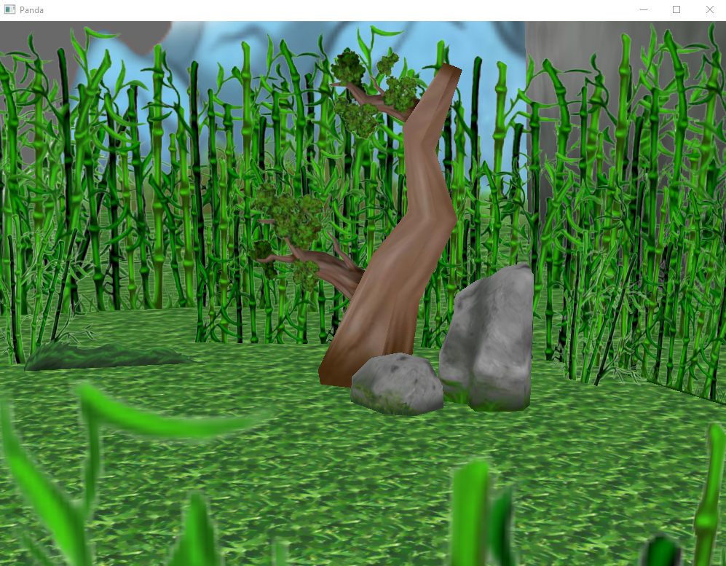
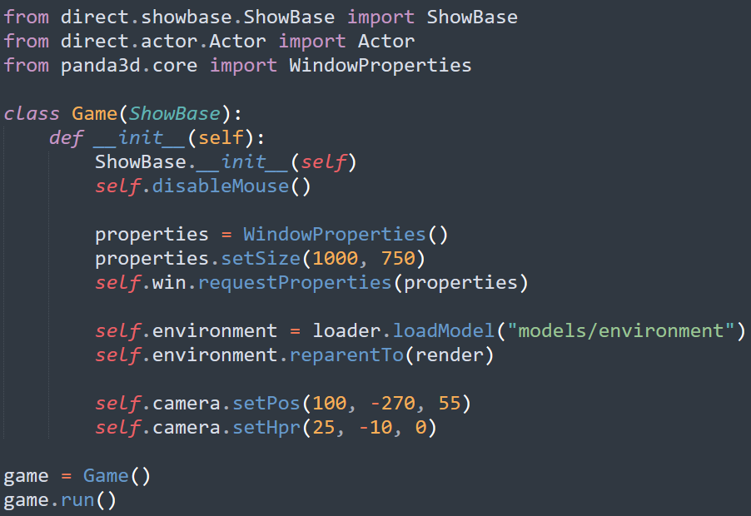
Moving the Camera

Slide 8
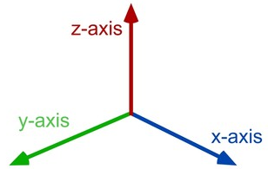
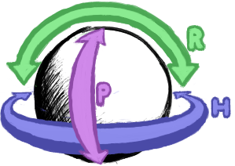
Coordinate System and Orientation
3D space is defined by three axes:
X: Horizontal (left/right)
Y: Depth (forward/backward)
Z: Vertical (up/down)
Heading, Pitch, and Roll (HPR):
Heading: Rotation around the Z-axis (yaw, turning left/right)
Pitch: Rotation around the X-axis (tilting forward/backward)
Roll: Rotation around the Y-axis (tilting sideways)

