Slide 1
Software Lab IV
Expense Tracker App
An E- Legder book
An app to manage ledger of small business and within a community of people.

Slide 2
Requirements
Android Studio
Java
Firebase for Database & OTP
UI/UX
Android Permissions
XML

Slide 3
Features
Secure Login
Invoice as PDF
Payment Reminder
Feedback
E - Ledger
Call support

Slide 4

BT18CSE102
BT18CSE103
BT18CSE101
1.Add details of user to database.
2.Signup for users.
1.Event reminder.
2.Sidebar option.
3.Transfer details to calendar.
1.Getting users details.
2.Feedback
3.Customer complaints.
BT18CSE125
BT18CSE148
BT18CSE150
1.Payment management.
2.Firebase database for transaction , Customer , seller.
3.Final integration
1.Login using OTP.
2.UI/UX
3.Calling
4.PDF generation.
5.Final integration.
1.Login using ID-password.
2.Maintaining Firebase.

Slide 5


DEVELOPMENT TIMELINE
Goals achieved different Weeks
01
Mission
Create an app to manage expense for small business owners who cannot afford highly priced accounting software.
02
Learning Period
Learning App development from different resources.

Slide 6



03
Learning period
Learning app development from different resources.
04
UI/UX and Features
Designing UI/UX
Creating Feedback Activity.
Payment Notifier.
05
Firebase & features
Implementing firebase for users details and login using email id and password.

Slide 7



06
Ledger book
Using firebase to store user (owner) transaction details like transactions made , pending transaction, expense, income.
07
Other Features
Sidebar options.
Editing customer complaints feature.
Pdf generation.
08
Tailoring feature
Login with OTP.
Though we created multiple features but we didn’t applied them all in final integration.

Slide 8


9
ALL DONE
We had combined all the work done by members for making this app work.
Milestone achieved
Link for app:
https://github.com/nick09k/Xpense

Slide 9
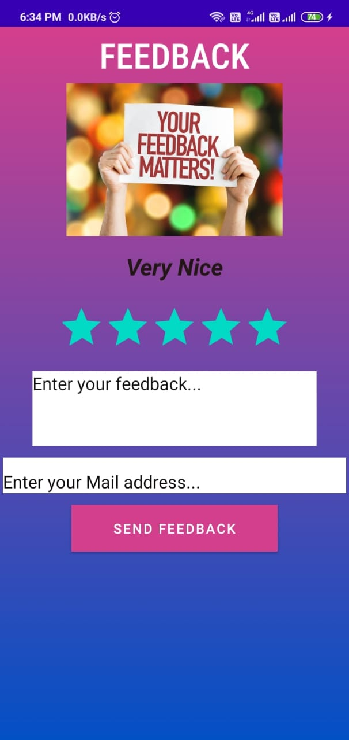
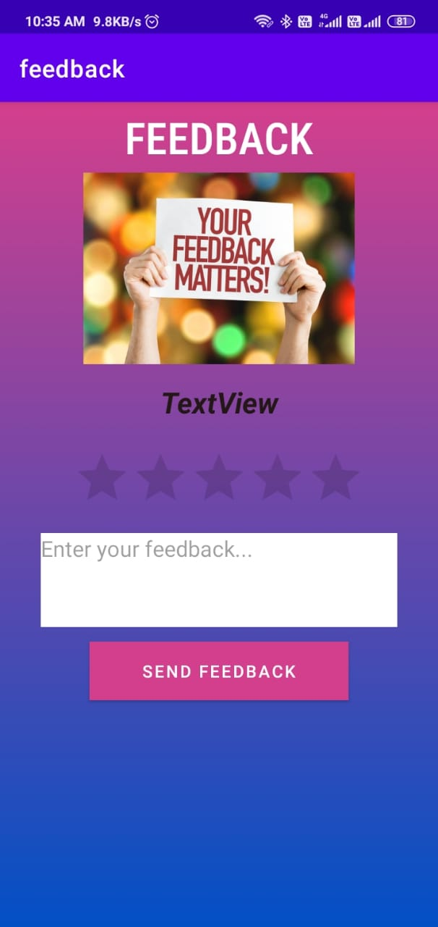
Screenshots for different stages:

Slide 10
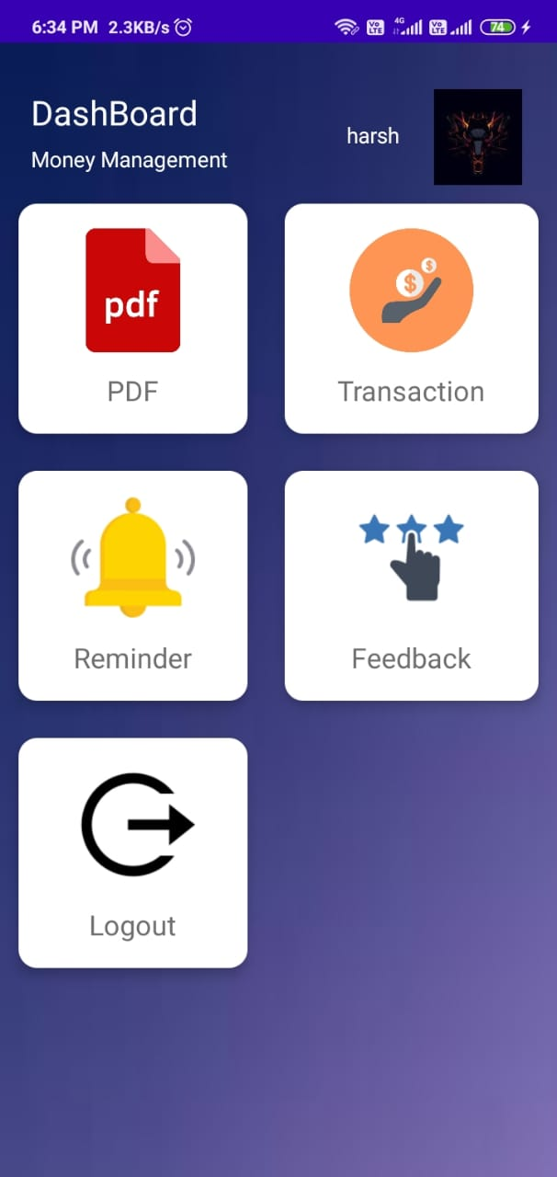
Dashboard

Slide 11
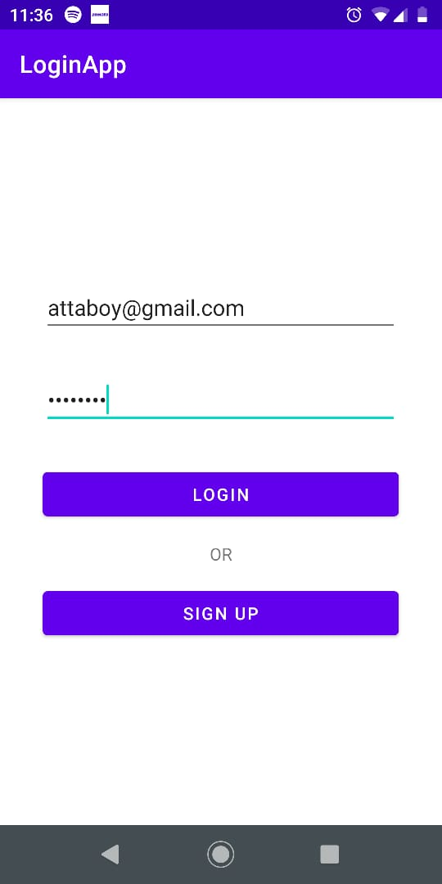
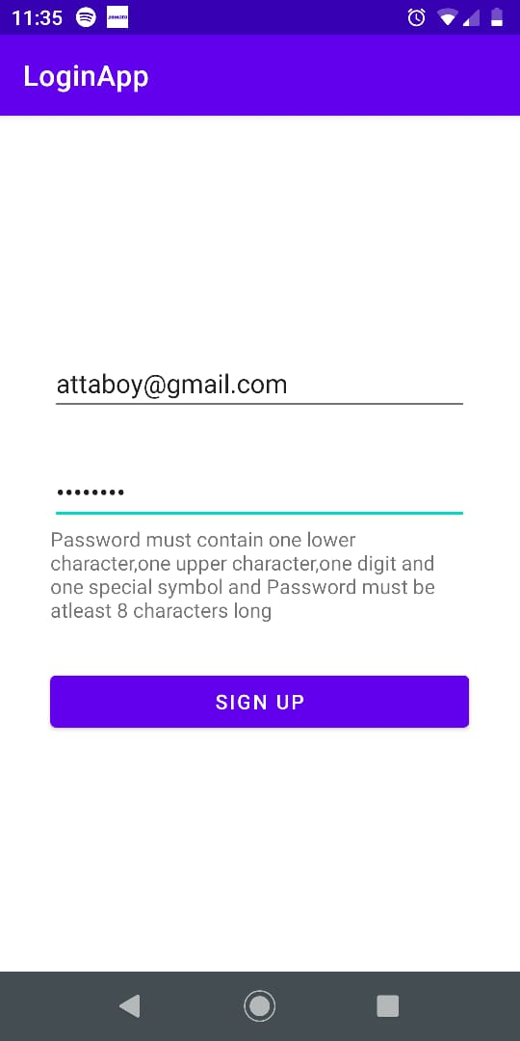
Login and sigin up activity

Slide 12
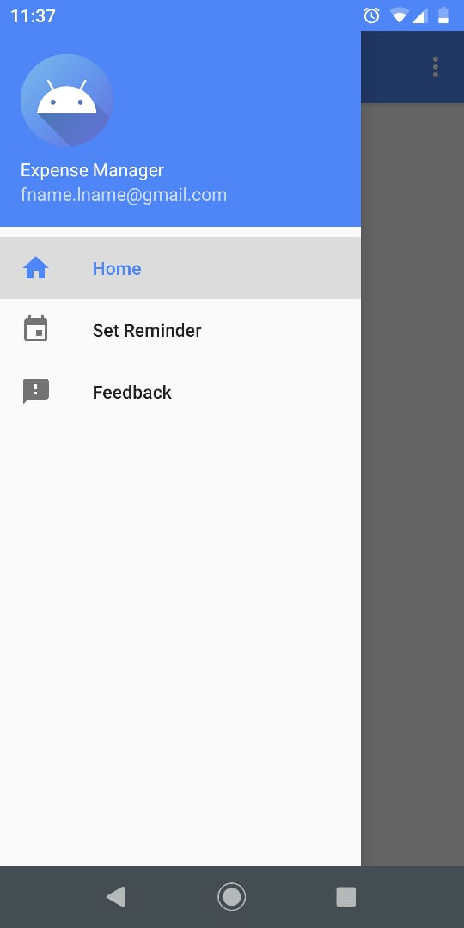
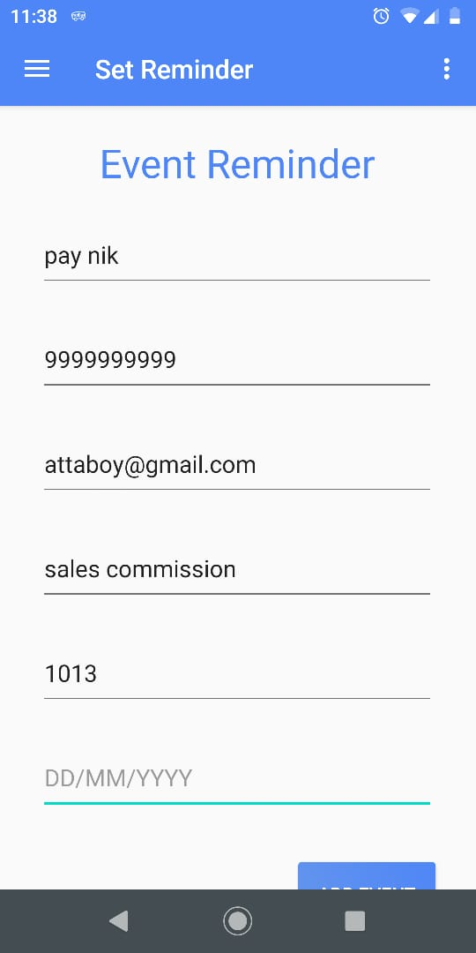
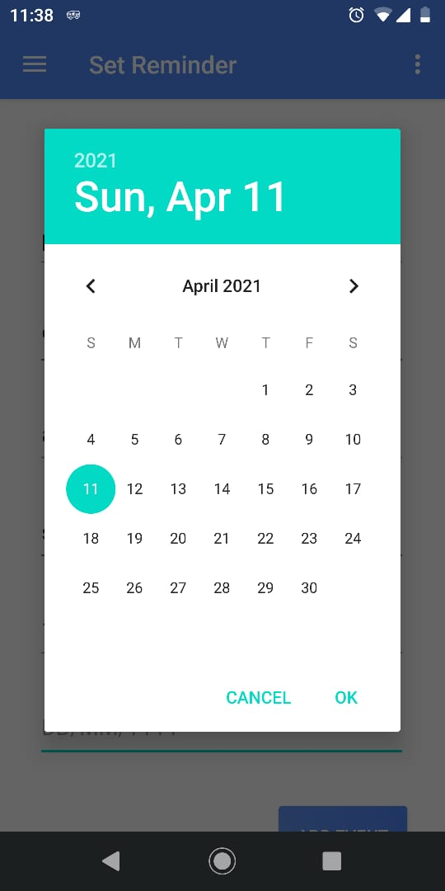
Event reminder and side bar

Slide 13
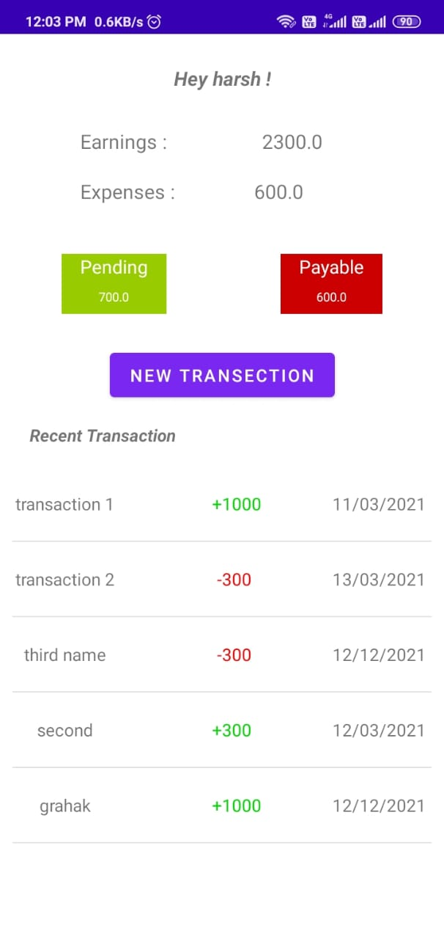
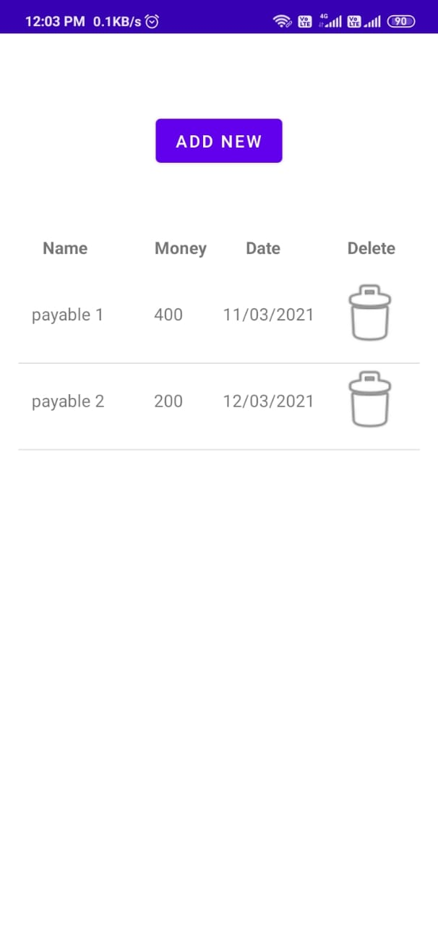
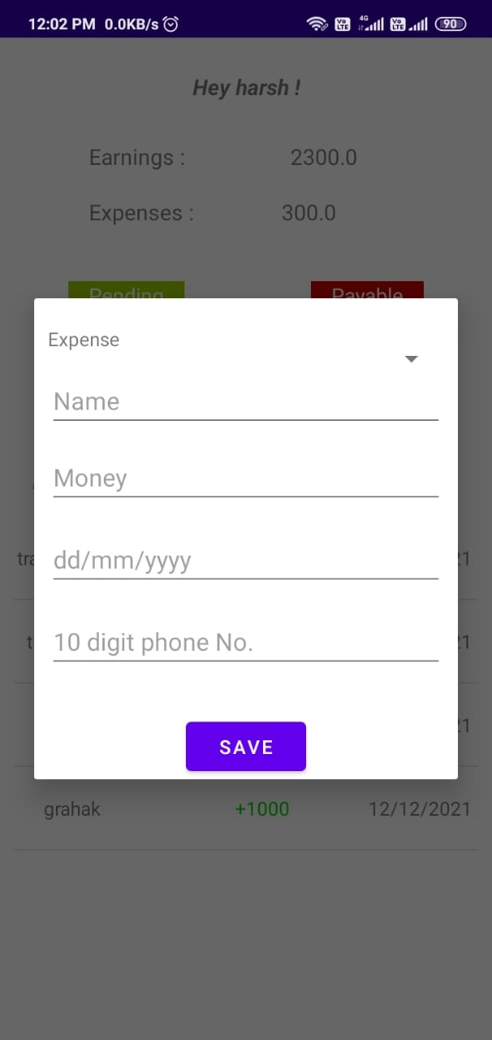
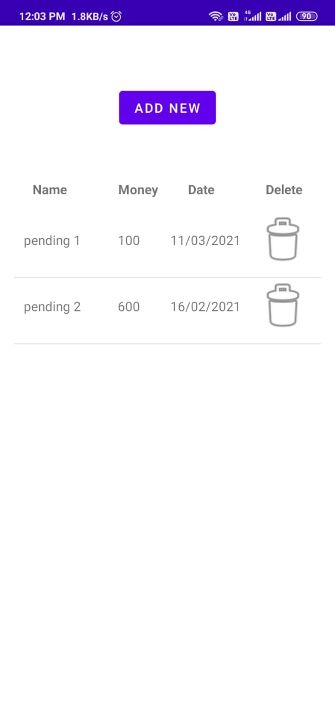
Transaction

Slide 14
Note:
We had tried different features for apps but have not included some feature as our target was for small business man and shop owners and small community of people.
Many features require a specific version of sdk and others which might not work on different devices.

