Slide 1
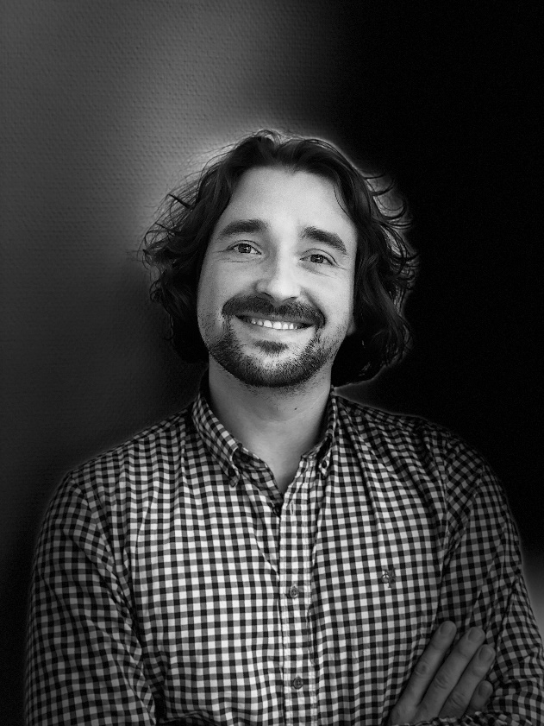
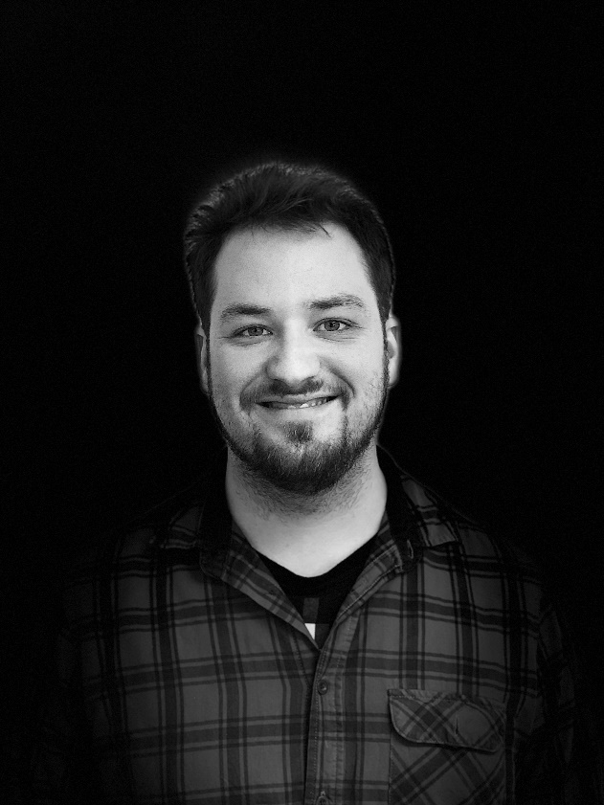
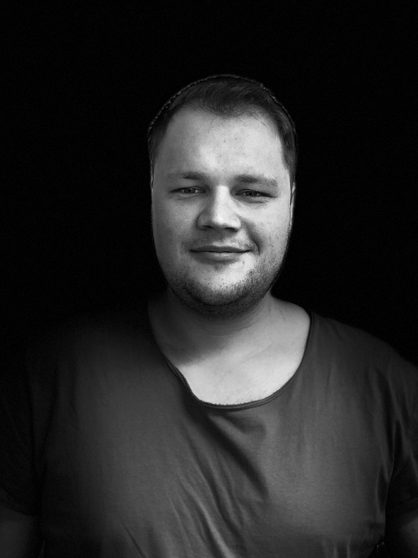
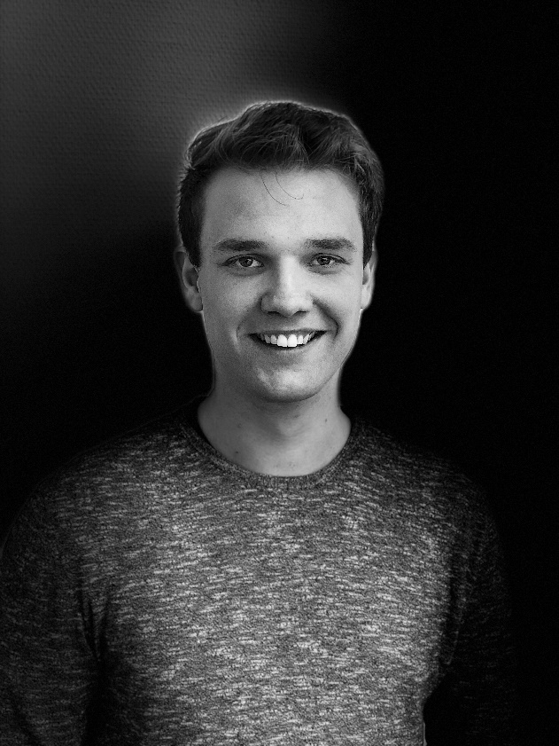
Team
The Creators of WANDERLUST
Product and Strategy
Architecture
Product and Strategy
Mock-ups
Nicolas Urbach
Dennis
Mayer
Lukas Oldach
Alexander Kopp
“I don’t plan, I use WANDERLUST.”
“New route, new challenge.”
“WANDERLUST is my weekends favorite.”
“My favorite feature: follow the tips and enjoy the breaks.”

