Slide 1
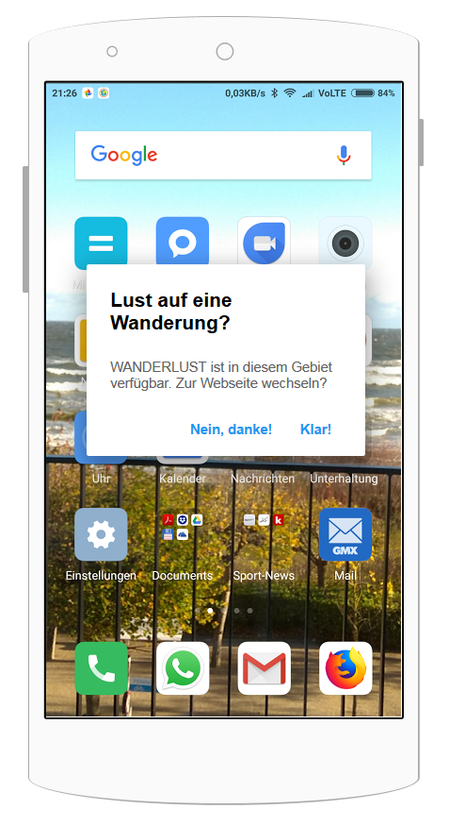



IoT Architecture of WANDERLUST
2
3
Beacon DB
1
5
4
Content DB
Beacon
Smartphone / Browser
Server

Slide 2
IoT Architecture of WANDERLUST
 | Beacon | Smartphone / Browser | Server | Beacon DB | Content DB
Technology | Bluetooth Low Energy | iOS or Android | Application Server e.g. Apache Tomcat | Database Server e.g. MongoDB | Database Server e.g. MySQL
Protocolls | Eddystone | REST Services | REST Services | REST Services | REST Services
Usage | Pushing an unique Eddystome-UID to identify each beacon and a Eddystone URL to a Smartphone nearby based on Bluetooth Low Energy (BLE) technology. | The smartphone / browser is used to trace beacons in an area. It can send and receive data to the server via REST services and can display these data. It is also used by the user for controls of the user interface. | The server is used to receive and send data from and to the smartphone browser. It also check the Beacon DB and the Content DB and push the information back to the Smartphone / Browser. | The Beacon DB manages the Beacons. Here you can change the pushed URLs of each beacon. Thus, the URL of individual beacons can be changed at a later date without much effort using the unique Eddystone-UID. | Within the Content DB all content, that is be pushed from the server to the smartphone, is stored and managed. It can be managed by the users themselves via a content management system.

Slide 3
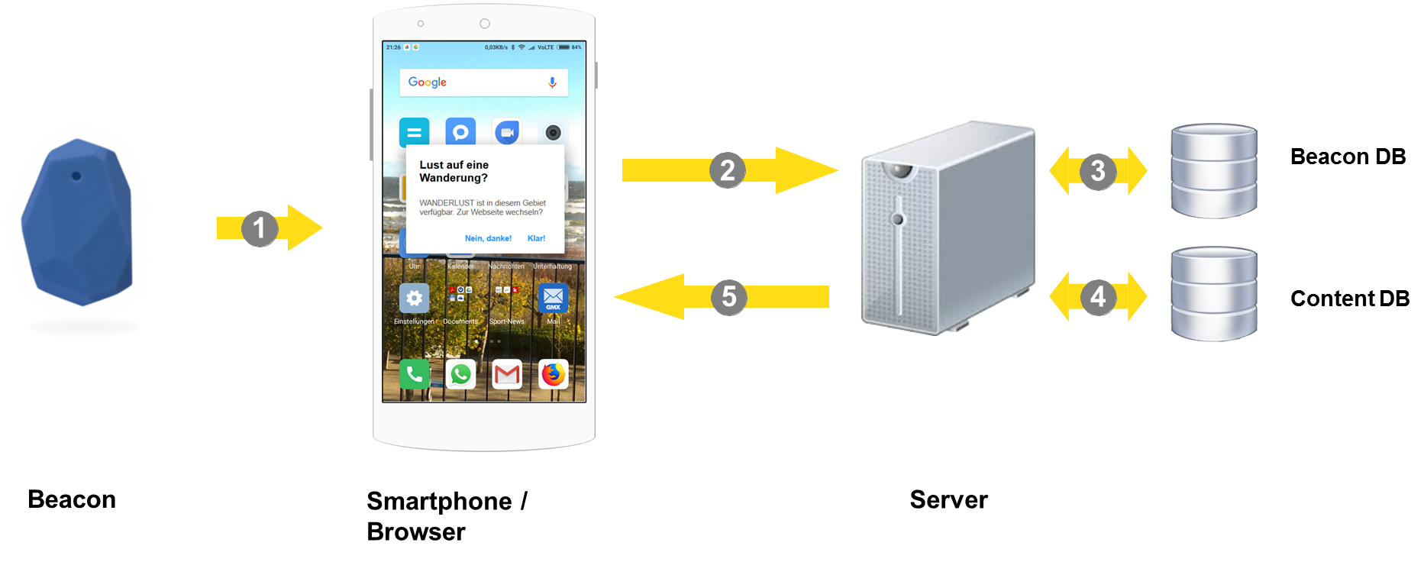
Closer look @ WANDERLUST Architecture
Exemplary procedure
A Beacon sends its unique Eddystone UID and an Eddystone URL via Bluetooth Low Energy. A compatible smartphone receives the UID and the URL and gives the user a push message on the display that a function of a beacon is available.
If the user wants to use the function of the beacon, the smartphone addresses a server by a RESTful API and pass UID to the server.
The server passes the UID to the Beacon DB and gets back a content URL which can be used to connect to the content DB.
The server requests the content of the Content DB identified by the unique URL and returns the content in a readable format e.g. JSON to the server.
The server pushes the content of the Content DB to the smartphone and back to the user.

