Slide 1
10-605 / 10-405
Machine Learning from Large Datasets

Slide 2
Recap: the course so far
Tool: Scalable computation on clusters
MapReduce, Spark and iteration, Spark workflows
Tool: Learning as optimization
gradient descent (batch, parallel, stochastic), ..
for linear regression, logistic regression, k-means clustering
“Craft” of ML
Tool: feature extraction / augmentation/ kernels
Tool: regularization and sparsity, hyperparameter tuning
Tool: the hash trick, efficient SGD, distributed ML
Tool: Randomized algorithms
Bloom filter, Count-Min sketch, locality sensitive hashing (LSH)
Today:
A new (complicated) Count-Min sketch application
Automatic differentiation

Slide 3
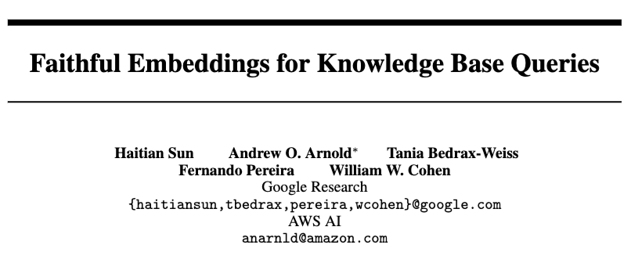
Another application of count-min sketches
NeurIPS 2020

Slide 4
NQL: a Neural Query Language
c = NeuralQueryContext() --- set up a context object
… --- declare relations, load data, etc
henry8 = c.one(‘Henry_VIII of house of Tudor’, ‘person_t’)
henry8.wife() → {‘Catherine of Aragorn’:1.0, ‘Anne of house of
Bolyn’:1.0, etc }
(henry8.son() | henry8.daughter()).son() → grandsons of Henry VIII
henry8.follow(r1).follow(r2) → follow the relation path r1.r2
Sets of size k are encoded as “k-hot vectors”
NQL expression evals to weighted set of entities
r1, r2 are weighted sets of relations (entities of special type)
r1 = {‘son’:1.0, ‘daughter’:1.0} r2={‘son’:1.0}

Slide 5
NQL: a Neural Query Language
NQL expressions ⬄ compositionally defined neural networks
(henry8.son() | henry8.daughter()).son()
.son()
henry8
union
.son()
.daughter()
y_{output =} x_{input1} + x_{input2}
y_{output =} x_{input} M_{daughter}

Slide 6
NQL: a Neural Query Language
NQL expressions ⬄ compositionally defined neural networks
(henry8.son() | henry8.daughter()).son()
.son()
henry8
union
.son()
.daughter()
output = f2(input2, input2)
output = f1(input, relation)

Slide 7
Motivation: Neural QLs for QA over a KB (KBQA)
Neural
Question: “are any Google interns attending KBC2020?”
KBQA can be a semantic parse of a question, then ….
google.follow(internAt⁻ ¹) ∩ akbc2020.follow(registeredFor)
….access to a symbolic QL that queries the KB to get the final answer.
Symbolic
KB
Answers
Training data is pairs:
(question, KBquery)

Slide 8
Motivation: Neural QLs for QA over a KB (KBQA)
Neural
Question: “are any Google interns attending VLDB2020?”
google.follow(internAt⁻ ¹) & vldb2020.follow(registeredFor)
KB
Answers

Slide 9
Motivation: Neural QLs for QA over a KB (KBQA)
Neural
Question: “are any Google interns attending VLDB2020?”
google.follow(internAt⁻ ¹) & vldb2020.follow(registeredFor)
KB
Predicted answers
Target answers
Loss

Slide 10
Motivation: Neural QLs for QA over a KB (KBQA)
Neural
Define a template for the structured query.
Define neural functions to fill each slot in the template
Minimize loss by gradient descent through the neural QL to the analysis of the question to the k-hot target answer vector
q = “are any Google interns attending VLDB2020?”
x1 = f1(q); x2 = f2(q); r1 = f3(q); r2 = f4(q)
a = x1.follow(r1) & x2.follow(r2)
KB
Predicted answers
Target answers
Loss

Slide 11
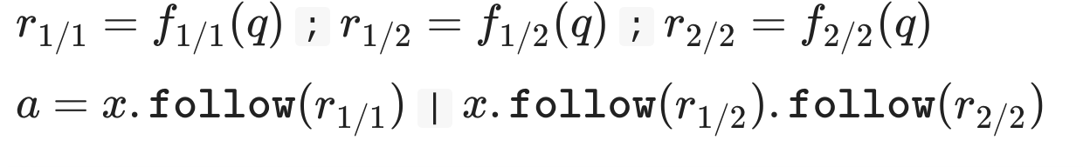
KBQA with NQL for WebQuestionsSP
KB: subset of FreeBase with 43.7m triples, 12.9m entities, 697 relations
Data: 4737 natural language questions with entity-set answers
Every question q is associated with a set of seed entities x
All questions are 1- or 2- hops through the KB
Model:
Loss: softmax(a)’s cross-entropy with target answer set
Relation functions f: simple neural models

Slide 12
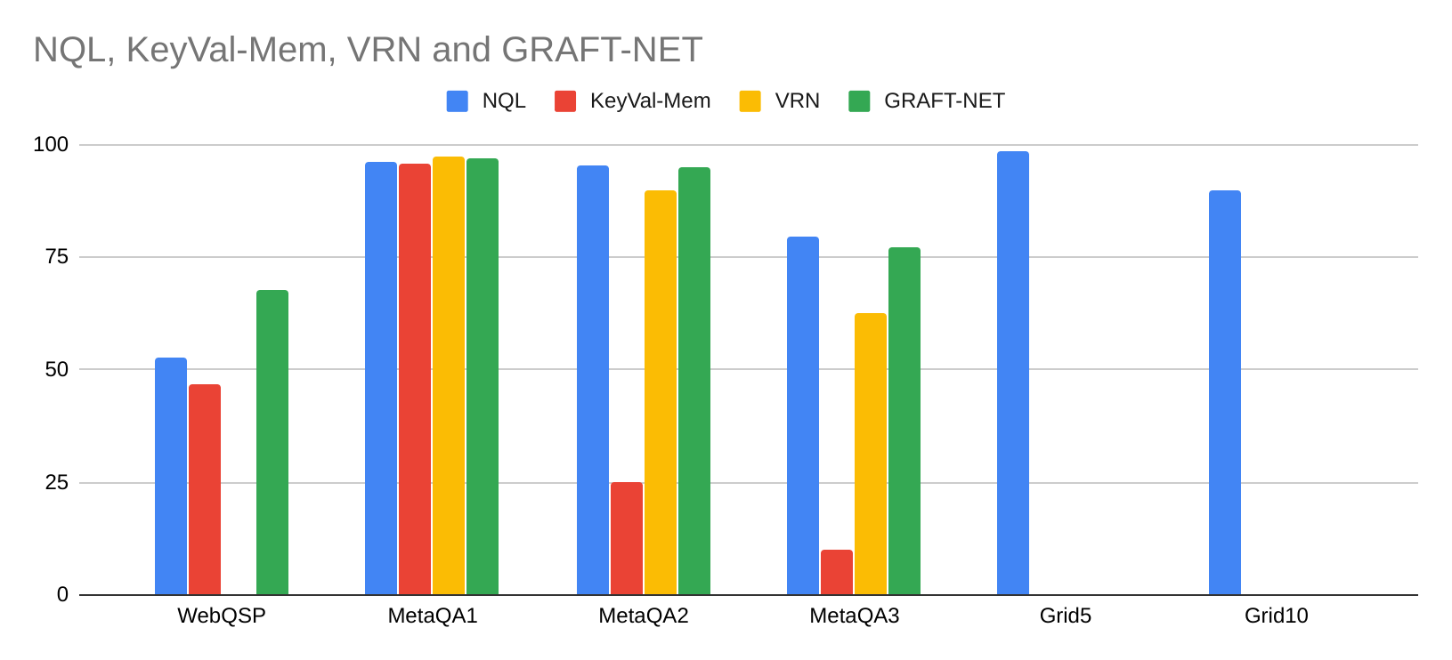
NQL: WebQuestionsSP and other KBQA tasks
~ 700 relations, noisy text
1, 2, and 3-hop questions, 10 relations, O(10k) facts
Synthetic 1..5-hop and 1..10- hop questions
Notes:
12 min

Slide 13
NQL: WebQuestionsSP and other KBQA tasks
~ 700 relations, noisy text
1, 2, and 3-hop questions, 10 relations, O(10k) facts
Synthetic 1..5-hop and 1..10- hop questions
Notes:
12 min

Slide 14
Other concurrent work….

Slide 15
Recap: Recovering latent factors in a matrix
m terms
doc term matrix
~
x1 | y1
x2 | y2
.. | ..
… | …
xn | yn
a1 | a2 | .. | … | am
b1 | b2 | … | … | bm
v11 | …
… | …
 | vij
n documents
 |  |  | …
 |  |  |  | vnm
V[i,j] = TFIDF score of term j in doc i
Notes:
relationship between terms and words
extrapolation to similarity

Slide 16



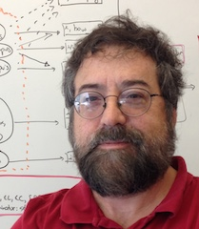
Recovering latent structure in a relationship from a KB
m people
coauthorship matrix
~
x1 | y1
x2 | y2
.. | ..
… | …
xn | yn
a1 | a2 | .. | … | am
b1 | b2 | … | … | bm
v11 | …
… | …
 | vij
coauthor(wc, hsun)
coauthor(wc,tom
...
n people
 |  |  | …
 |  |  |  | vnm
V[i,j] = (1 if coauthor(i,j) else 0)

Slide 17
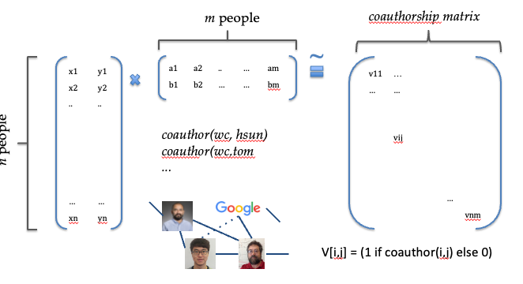
Knowledge Base completion
~= matrix completion for relations in a KB
worksAt(wc, google)
coauthor(wc, hsun)
...
worksAt(hsun, google)
KBC via KBE is a neural function
f(v_{hsun}, v_{worksAt}, v_{google}) = 0.85
Plausible
Triples
True
Triples
generalization
Notes:
Be quick!

Slide 18
Knowledge Base completion
~= matrix completion for relations in a KB
worksAt(wc, google)
coauthor(wc, hsun)
...
worksAt(hsun, google)
KBC via KBE is a neural function
f(v_{hsun}, v_{worksAt}, v_{google}) = 0.85
Plausible
Triples
True
Triples
generalization
Notes:
Be quick!

Slide 19
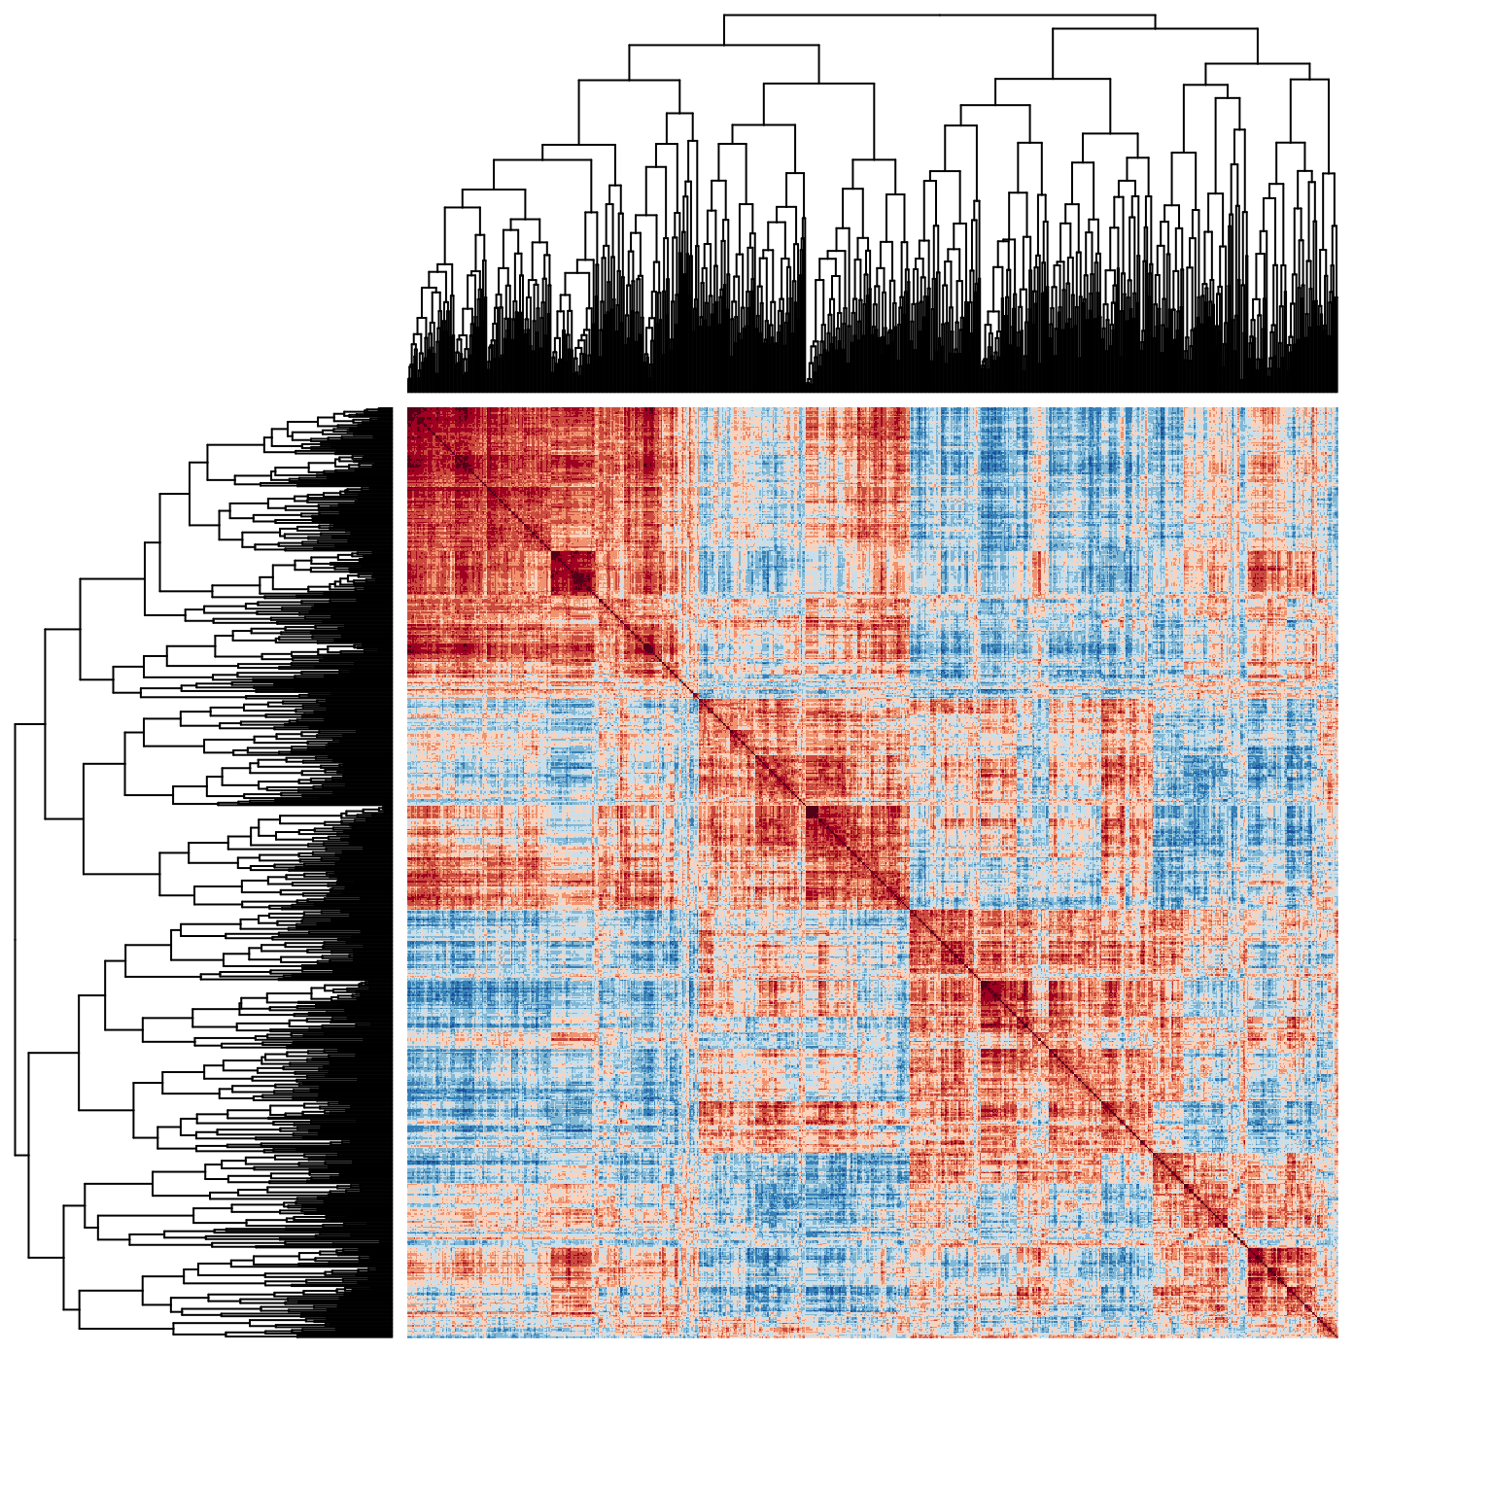
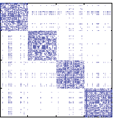
KB completion
~= matrix completion for relations in a KB
co-authorship in 4 fields
more realistic relationships
Notes:
Be quick!

Slide 20
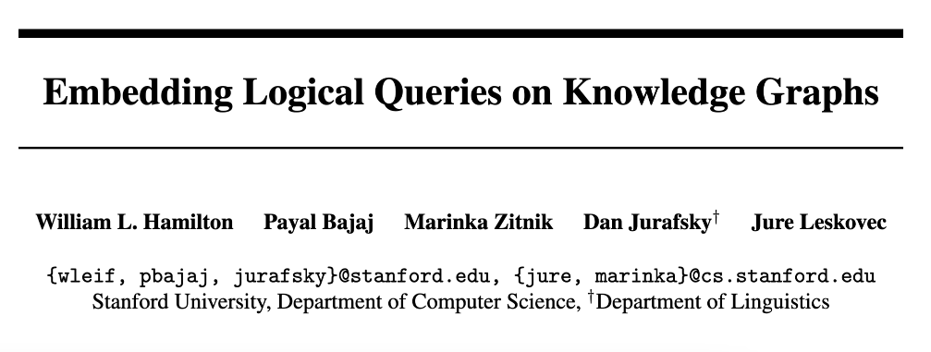
KB queries on an incomplete KB
NeurIPS 2018
Notes:
Be quick!

Slide 21
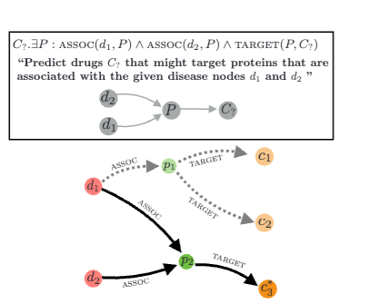
KB queries on an incomplete KB
Notes:
Be quick!

Slide 22
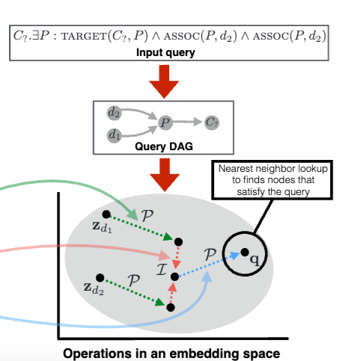
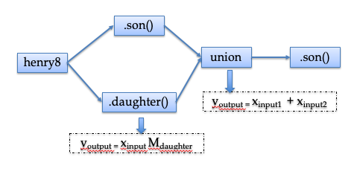
KB queries on an incomplete KB
NQL
GQE
Query2Box, …
Notes:
Be quick!

Slide 23
KB completion vs inference
Entailed
Triples
worksAt(hsun, google)
logical inference
worksAt(wc, google)
reportsTo(hs, wc)
...
reportsTo(x,y) & worksAt(y,z) ⇒ worksAt(x,z)
True
Triples

Slide 24
Neural QLs compared to KBC
Can you do both?
GQE
Entailed
Triples
Entailed
Triples
Query2Box
NQL focuses on getting the same answers as logical KR systems -- using differentiable methods.
logical inference
Plausible
Triples
True
Triples
GQE, Query2Box focus on generalization from true to plausible triple.
generalization

Slide 25
Neural QLs compared to KB embeddings
NQL uses a sparse localist representation: r_{1/1} makes ~700 independent predictions as to what relations to include. So learning r_{1/1} = f_{1/1}(q) is difficult.
x₁
x₄
x₂
q
x₁ x₂ x₃ x₄
x₃
Embeddings require fewer predictions
NQL
SOTA

Slide 26
Neural QLs compared to KB embeddings
x₁
x₄
x₂
q
x₃
Embeddings require fewer predictions and generalize well
… but don’t memorize the details of a relationship

Slide 27
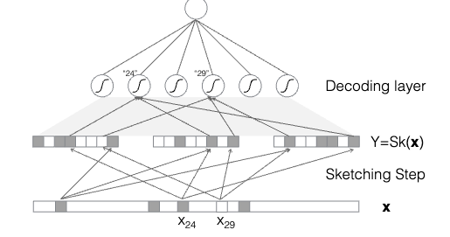
CM Sketches Are Also Neural Networks
( approx. “min”)

Slide 28
EmQL: centroid-sketch sets
The centroid defines a “fine-grained type” for elements of X
Set X is encoded by pair (a_{X}, b_{X})
a_{X} is centroid of the elements in embedding space - assume m elements of set
b_{X} is a count-min sketch of X
CM sketch is accessed with differentiable operations, doesn’t need a sparse matrix, and can be small… if you don’t query it too often
To decode X from (a_{X}, b_{X}):
Get top-k entities i₁,...,i_{k} using a_{X} as a query
If |X| <= n, let k=10*n
Score entity i_{j} as CM(i_{j}, b_{X})
We only query the sketch 10n times so we don’t need a very large sketch
Notes:
Add some more CM sktech info - soft Bloom filter

Slide 29
EmQL: centroid-sketch sets
Set X is encoded by pair (a_{X}, b_{X})
a_{X} is centroid of the elements in embedding space
b_{X} is a count-min sketch for k-hot vector v_{X}
To predict X=(a_{X}, b_{X}):
Let the neural model produce a_{X} (a point in embedding space)
E.g., a_{X} = f(q)
Let the sketch be vacuous: CM(i, b_{X}) =1
Now you predict an embedded representation, not an entity id

Slide 30
EmQL: centroid-sketch sets
Count-min sketches are awesome! Because if
b_{X} is a count-min sketch for k-hot vector v_{X}
b_{y} is a count-min sketch for k-hot vector v_{y}
Then
b_{X} + b_{y} is a sketch for union vector v_{X} + v_{y}
b_{X} * b_{y} is a sketch for intersection v_{X} * v_{y}

Slide 31
EmQL: centroid-sketch sets
Recall:
b_{X} is a count-min sketch for k-hot vector v_{X}
b_{y} is a count-min sketch for k-hot vector v_{y}
Then
b_{X} + b_{y} is a sketch for union vector v_{X} + v_{y}
b_{X} * b_{y} is a sketch for intersection v_{X} * v_{y}
To compute union of X = (a_{X}, b_{X}) and Y = (a_{Y}, b_{Y})
Average the centroids
Union the sketches b_{X} + b_{y}
Similar for intersection
This works well for combining sets of similar “fine-grained types” …. and really who care about other cases?

Slide 32
EmQL: centroid-sketch sets and triples of embeddings as relations
Implementing X.follow(R) in EmQL
Build a KB of embedded triples: r(x,y) is encoded as [e_{r} ; e_{x} ; e_{y}]
Find the top-k triples in the KB from the query [a_{R} ; a_{X} ; 0]
This is can be fast (more later!)
These should have the right relation and subject
Rescore those triples using the sketches b_{X} and b_{R}
These definitely have the right relation and subject
Extract the objects from those triples and convert to centroid-sketch format
This is fast (one top-k query) and faithful
Prior approaches used geometric operations on sets
Notes:
todo: to add a diagram

Slide 33
x₁ | y₁
... | ...
x₃ | y₃
x₄ | y₄
... | ...
y₄
y’₁
x₁
y₂
x₁
y’₂
y’₄
x₂
y₃
x₂
x₄
y’₃
x₄
y₁
x₃
x₃
Notes:
todo: to add a diagram

Slide 34
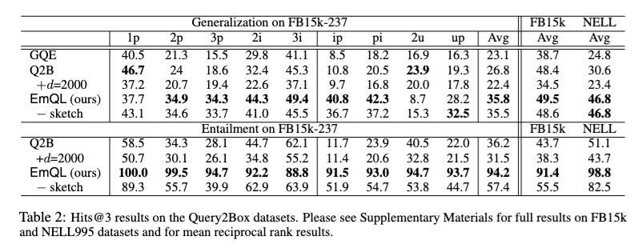
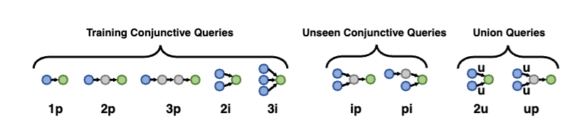
EmQL Results
Notes:
20min

Slide 35
EmQL Results
Notes:
20min

Slide 36
Motivation: Neural QLs for QA over a KB (KBQA)
Neural
Define a template for the structured query.
Define neural functions to fill each slot in the template
Minimize loss by gradient descent through the neural QL to the analysis of the question to the k-hot target answer vector
q = “are any Google interns attending VLDB2020?”
x1 = f1(q); x2 = f2(q); r1 = f3(q); r2 = f4(q)
a = x1.follow(r1) & x2.follow(r2)
KB
Predicted answers
Target answers
Loss

Slide 37
Neural QLs compared to KB embeddings
x₁
x₄
x₂
q
x₃
Embeddings require fewer predictions and generalize well
… but don’t memorize the details of a relationship

Slide 38
Motivation: Neural QLs for QA over a KB (KBQA)
Neural
Define a template for the structured query.
Define neural functions to fill each slot in the template
Minimize loss by gradient descent through the neural QL to the analysis of the question to the k-hot target answer vector
q = “are any Google interns attending VLDB2020?”
x1 = f1(q); x2 = f2(q); r1 = f3(q); r2 = f4(q)
a = x1.follow(r1) & x2.follow(r2)
KB
Predicted answers
Target answers
Loss
unfaithful execution of a query looks like noise to the KBQA learner

Slide 39
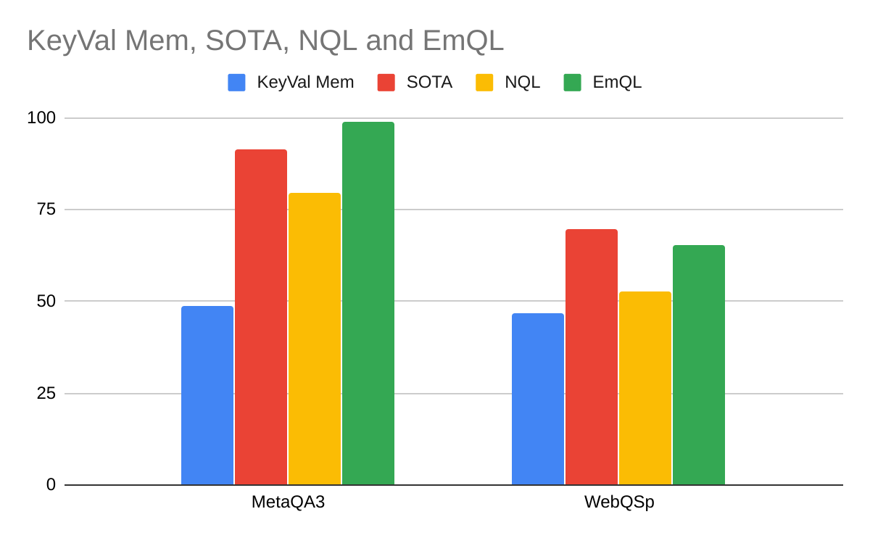
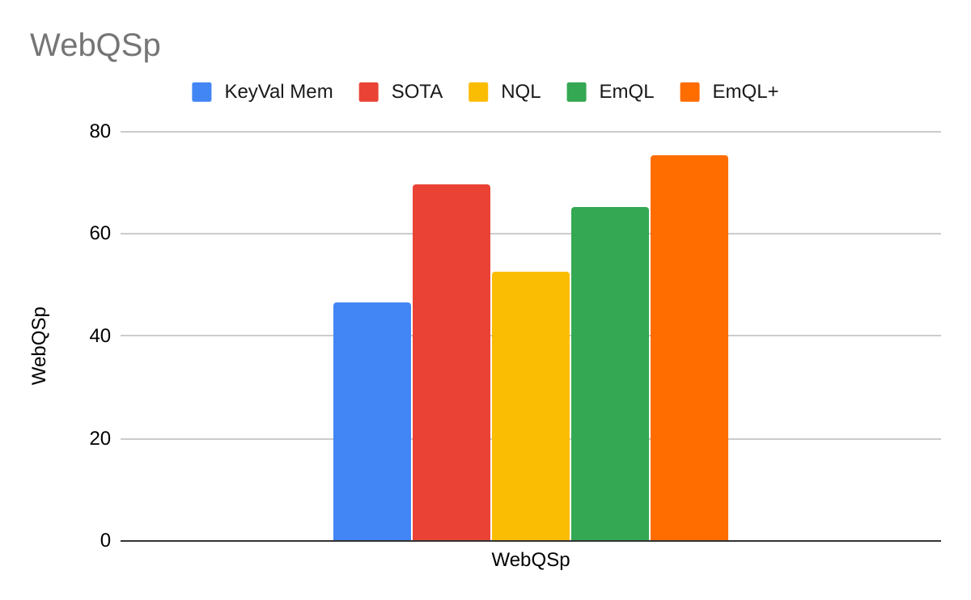
EmQL for KBQA
Add one rare template to NQL model

Slide 40
Automatic Differentiation and Deep Learning

Slide 41
Motivation

Slide 42
NQL/EmQL/GQE all lead to complex networks
NQL expressions ⬄ compositionally defined neural networks
(henry8.son() | henry8.daughter()).son()
.son()
henry8
union
.son()
.daughter()
output = f2(input2, input2)
output = f1(input, relation)

Slide 43
NLP analysis chained with NQL/EmQL/GQE is a really complex network
being able to put together different modules like this is super useful…
Neural
Question: “are any Google interns attending VLDB2020?”
But we don’t want to manually to the math to optimize this!
google.follow(internAt⁻ ¹) & vldb2020.follow(registeredFor)
KB
Answers

Slide 44
Recap: Spark Transformations vs Actions
For large data it’s important to have an explicit representation of the “code” you want to run
For optimization
For distribution to workers
For recovery from errors
…
Spark’s transformations are like “code”
This happens over and over in different contexts
Tensorflow and PyTorch have “computation graphs”
Databases have query languages and query optimizers
…
Language-like packages in Python are not different
We will use the same trick to make gradient computation complex, arbitrary functions easy
Notes:
change

Slide 45
Automatic differentiation systems
The main idea: for a function f
Build a “computation” graph for each f
Nodes in the graph are real numbers
floats, vectors of floats, matrices, tensors, ….
Automatically derive derivatives from the graph
Autodiff is part of many ML platforms, along with
Gradient-based optimizers (e.g., Adam, …)
GPU-based accelerators
Libraries of ML models and model components
…

Slide 46
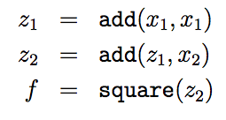

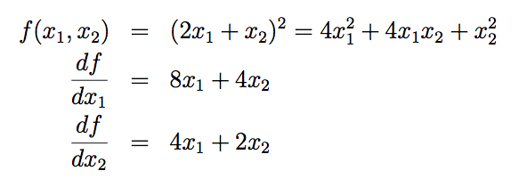
Autodiff
Wengert list
Flattened version of computation graph

Slide 47
Autodiff
Flattened version of computation graph
x1
add
add
square
f
x2
Autodiff on Wengert lists (“tape” of operations) is straightforward
but also somehow confusing?
Notes:
todo: flip

Slide 48
Autodiff: Simple or Confusing?

Slide 49
Autodiff
We don’t want a symbolic form for the derivative – we want an algorithm to compute it at a given point
We do want to collect all the partial gradients
…at least the ones for parameters

Slide 50
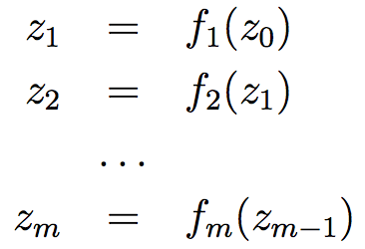
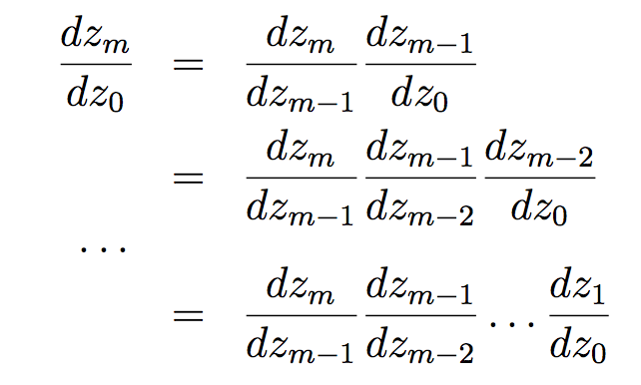
Simple case: a chain of functions
High school: symbolic differentiation, compute a symbolic form of the deriv of f
Now: automatic differentiation, find an algorithm to compute f’(a) at any point a

Slide 51
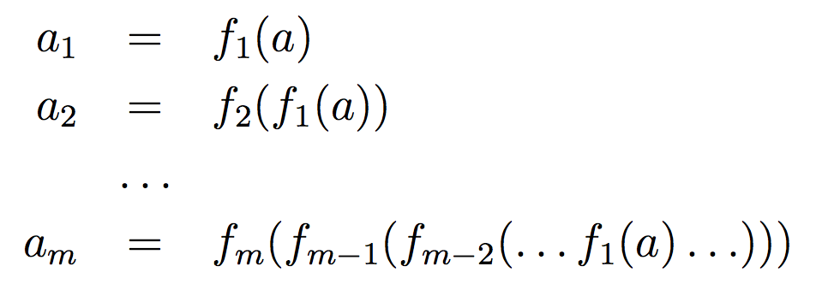


Differentiating a Wengert list: a simple case
Now: automatic differentiation, find an algorithm to compute f’(a) at any point a
a_{i} is the i-th output
on input a
Notation:
→

Slide 52


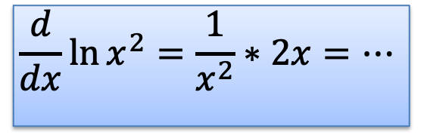
Differentiating a Wengert list: a simple case
What did Liebnitz mean with this?
for all a
$$\frac{d}{dx}\ln{x^{2}}=\frac{1}{x^{2}}∗2x=…$$
$$h_{m,0}\left(a\right)={f^{′}}_{m}\left(a_{m−1}\right)h_{m−1,0}(a)$$
$$h_{m,0}\left(a\right)=h_{m,m−1}\left(a_{m−1}\right)h_{m−1,0}(a)$$
m-1,0
Notation:
→
a_{i} is the i-th ouput
on input a

Slide 53
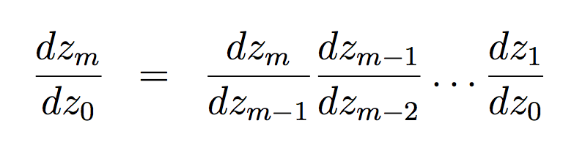
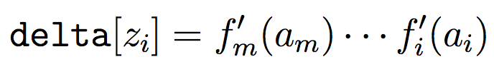
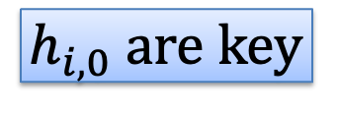
Differentiating a Wengert list: a simple case
for all a
reverse-mode compute order
need to track:
$$h_{i,0} \text{are} \text{key}$$

Slide 54
Autodiff: Breaking It Down

Slide 55
Autodiff
We can compute the value of f at a given point, like (x1,x2)=(2,3)
Want an algorithm to compute partial derivatives at given points
Flattened version of computation graph
x1=2
add=4
g1(2,3)=28
add=7
square=49
f=49
x2=3
Annotate/traverse the compute graph so we compute g1(x1,x2), g2(x1,x2)
g1(x1,x2) =
g2(2,3)=14
g2(x1,x2) =
Notes:
todo: flip

Slide 56


Wengert lists: forward (eval)
Possible Python data structure:
Plus the definitions:

Slide 57

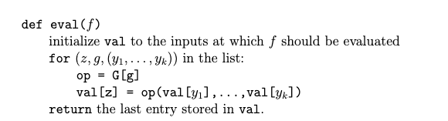
Wengert lists: forward (eval)
Plus the definitions:
and input values:

Slide 58


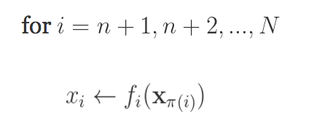

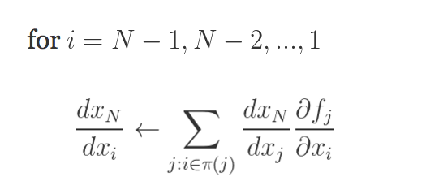

Wengert lists: backward (gradients)
https://justindomke.wordpress.com/
Wengert list
e.g.
Step 0: a function of n variables, coded as a series of assignments
Step 1: evaluate each variable
Step 2: back propagate by going thru the list in reverse order, starting with…
…and using the chain rule
Step 1: forward
inputs:
return
Step 2: backward
evaluated at (x1,…,xn)
Computed in previous step

Slide 59
Wengert lists: backward (gradients)
Plus the definitions:
and input values:

Slide 60
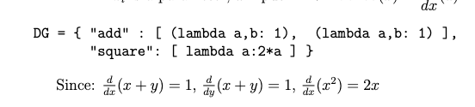


Wengert lists: backward (gradients)
Need the partial derivatives of each function wrt. each input:
Now “backpropagate errors (loss)” to each variable. We want:

Slide 61
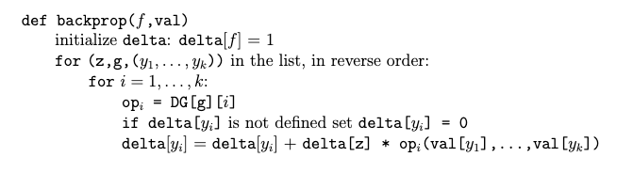
Wengert lists: backward (gradients)

Slide 62
Demo

Slide 63
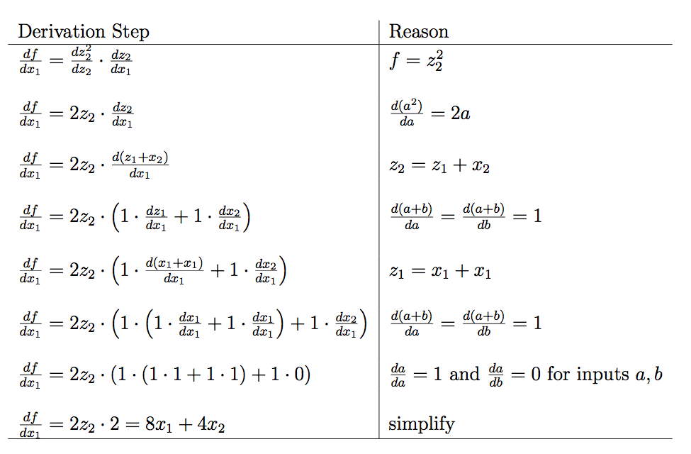
chain rule +
derivative of “square(.)”
need to know derivative of every function wrt every parameter
chain rule +
…

Slide 64
(for us, not autodiff)

Slide 65
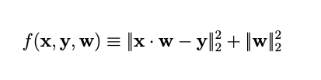
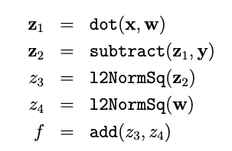
Ridge Regression as a Wengert list
Autodiff with linear algebra operations is much more useful
Also a little more confusing…
df/dw is a vector <df/dw₁, … df/dw_{n}>

Slide 66
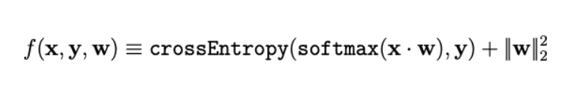
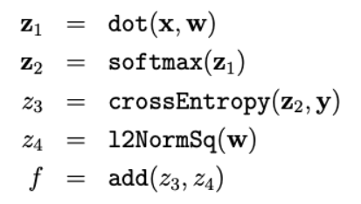
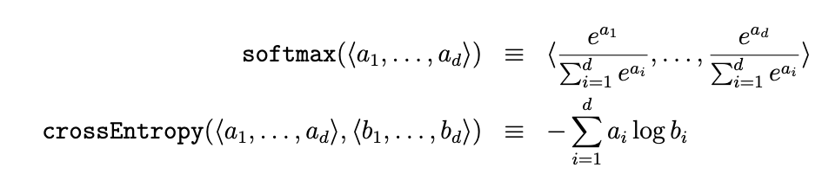
Logistic Regression as a Wengert list
Like logistic
where:
Notes:
TODO: s/W/w/. and add one for linear regression
talk about optimizations – softmax numerical optimization, crossent-softmax optimization

Slide 67
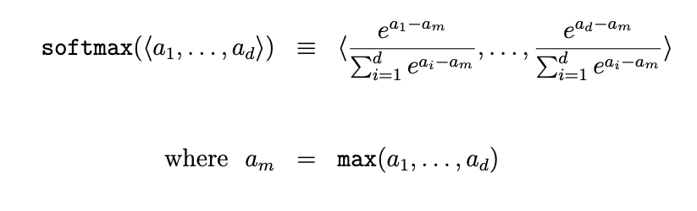
Logistic Regression as a Wengert list
loss = crossEntropy(softmax(z), y) is widely used
but it’s important to use this version
Notes:
TODO: s/W/w/. and add one for linear regression
talk about optimizations – softmax numerical optimization, crossent-softmax optimization

Slide 68
Logistic Regression as a Wengert list
loss = crossEntropy(softmax(z), y) is widely used
Also if p is the output of the softmax, there is a simple form of d loss / d z
d loss / d z = p - y
Notes:
TODO: s/W/w/. and add one for linear regression
talk about optimizations – softmax numerical optimization, crossent-softmax optimization

Slide 69
Logistic Regression as a Wengert list
How can you take advantage of this?
(1) write a special crossEntropyOfSoftmax(z, y) function in your library of functions.
torch.nn.CrossEntropyLoss
(2) optimize the “generated code”
Most systems do a lot of both
Notes:
TODO: s/W/w/. and add one for linear regression
talk about optimizations – softmax numerical optimization, crossent-softmax optimization

Slide 70
Notes on Wengert lists
Most ML frameworks sort-of conceal the computation graph
Torch, PyTorch, TensorFlow2 let you build a graph on-the-fly as you evaluate expressions
It’s still there and still important to understand

Slide 71
Notes on Wengert lists
You can do reverse-mode backprop without them
Accumulate gradients on-the-fly by traversing the computation graph
They are helpful conceptually (I think)
Sometimes a Wengert list is called a “tape”

Slide 72
Optional walkthrus of autodiff for NN

Slide 73
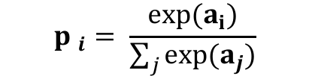
Example: 2-layer neural network
X
W1
Z1A
B1
Z1B
A1
W2
Z2A
B2
Z2B
A2
mul
add*
tanh
mul
add*
tanh
X is N*D, W1 is D*H, B1 is 1*H, W2 is H*K, …
Inputs: X,W1,B1,W2,B2
Z1a = mul(X,W1) // matrix mult
Z1b = add*(Z1a,B1) // add bias vec
A1 = tanh(Z1b) //element-wise
Z2a = mul(A1,W2)
Z2b = add*(Z2a,B2)
A2 = tanh(Z2b) // element-wise
P = softMax(A2) // vec to vec
C = crossEnt_{Y}(P) // cost function
Z1a is N*H
Z1b is N*H
$${p }_{i}= \frac{exp⁡(a_{i})}{\sum_{j}{exp⁡(a_{j})}}$$
A1 is N*H
Z2a is N*K
Z2b is N*K
A2 is N*K
P is N*K
C is a scalar
Target Y; N examples; K outs; D feats, H hidden

Slide 74
Example: 2-layer neural network
X
W1
Z1A
B1
Z1B
A1
W2
Z2A
B2
Z2B
A2
P
C
mul
crossEnt
add*
tanh
mul
add*
tanh
softmax
Y
X is N*D, W1 is D*H, B1 is 1*H, W2 is H*K, …
Inputs: X,W1,B1,W2,B2
Z1a = mul(X,W1) // matrix mult
Z1b = add*(Z1a,B1) // add bias vec
A1 = tanh(Z1b) //element-wise
Z2a = mul(A1,W2)
Z2b = add*(Z2a,B2)
A2 = tanh(Z2b) // element-wise
P = softMax(A2) // vec to vec
C = crossEnt_{Y}(P) // cost function
Z1a is N*H
Z1b is N*H
$${p }_{i}= \frac{exp⁡(a_{i})}{\sum_{j}{exp⁡(a_{j})}}$$
A1 is N*H
Z2a is N*K
Z2b is N*K
A2 is N*K
P is N*K
C is a scalar
Target Y; N examples; K outs; D feats, H hidden

Slide 75
Example: 2-layer neural network
Step 1: forward
Step 1: backprop
inputs:
return
dC/dC = 1
dC/dP = dC/dC * dCrossEnt_{Y}/dP
dC/dA2 = dC/dP * dsoftmax/dA2
dC/Z2b = dC/dA2 * dtanh/dZ2b
dC/dZ2a = dC/dZ2b * dadd*/dZ2a
dC/dB2 = dC/dZ2b * dadd*/dB2
dC/dA1 = …
Inputs: X,W1,B1,W2,B2
Z1a = mul(X,W1) // matrix mult
Z1b = add*(Z1a,B1) // add bias vec
A1 = tanh(Z1b) //element-wise
Z2a = mul(A1,W2)
Z2b = add*(Z2a,B2)
A2 = tanh(Z2b) // element-wise
P = softMax(A2) // vec to vec
C = crossEnt_{Y}(P) // cost function
Target Y; N rows; K outs; D feats, H hidden

Slide 76
Example: 2-layer neural network
X
W1
Z1A
B1
Z1B
A1
W2
Z2A
B2
Z2B
A2
P
C
mul
crossEnt
add*
tanh
mul
add*
tanh
softmax
Y
dC/dC = 1
dC/dP = dC/dC * dCrossEnt_{Y}/dP
dC/dA2 = dC/dP * dsoftmax/dA2
dC/Z2b = dC/dA2 * dtanh/dZ2b
dC/dZ2a = dC/dZ2b * dadd*/dZ2a
dC/dB2 = dC/dZ2b * dadd*/dB2
dC/dA1 = …
Inputs: X,W1,B1,W2,B2
Z1a = mul(X,W1) // matrix mult
Z1b = add*(Z1a,B1) // add bias vec
A1 = tanh(Z1b) //element-wise
Z2a = mul(A1,W2)
Z2b = add*(Z2a,B2)
A2 = tanh(Z2b) // element-wise
P = softMax(A2) // vec to vec
C = crossEnt_{Y}(P) // cost function
N*K
N*K
Target Y; N rows; K outs; D feats, H hidden

Slide 77
Example: 2-layer neural network
X
W1
mul
dC/dC = 1
dC/dP = dC/dC * dCrossEnt_{Y}/dP
dC/dA2 = dC/dP * dsoftmax/dA2
dC/dZ2b = dC/dA2 * dtanh/dZ2b
dC/dZ2a = dC/dZ2b * dadd*/dZ2a
dC/dB2 = dC/dZ2b * dadd*/dB2
dC/dA1 = dC/dZ2a *dmul/dA1
dC/dW2 = dC/dZ2a *dmul/dW2
dC/dZ1b = dC/dA1 * dtanh/dZ1b
dC/dZ1a = dC/dZ1b * dadd*/dZ1a
dC/dB1 = dC/dZ1b * dadd*/dB1
dC/dX = dC/dZ1a * dmul*/dZ1a
dC/dW1 = dC/dZ1a * dmul*/dW1
Z1a
B1
add
Z1b
tanh
W2
A1
mul
Z2a
B2
add
Z2b
tanh
A2
softmax
P
crossent_{Y}
C

Slide 78
Example: 2-layer neural network
with “tied parameters”
X
W1
mul
dC/dC = 1
dC/dP = dC/dC * dCrossEnt_{Y}/dP
dC/dA2 = dC/dP * dsoftmax/dA2
dC/dZ2b = dC/dA2 * dtanh/dZ2b
dC/dZ2a = dC/dZ2b * dadd*/dZ2a
dC/dB2 = dC/dZ2b * dadd*/dB
dC/dA1 = dC/dZ2a *dmul/dA1
dC/dW2 = dC/dZ2a *dmul/dW2
dC/dZ1b = dC/dA1 * dtanh/dZ1b
dC/dZ1a = dC/dZ1b * dadd*/dZ1a
dC/dB1 = dC/dZ1b * dadd*/dB
dC/dX = dC/dZ1a * dmul*/dZ1a
dC/dW1 = dC/dZ1a * dmul*/dW1
Z1a
B
add
Z1b
tanh
W2
A1
mul
Z2a
B
add
Z2b
tanh
A2
softmax
P
crossent_{Y}
C

