Slide 1
10-605 / 10-405
Machine Learning from Large Datasets

Slide 2
Tokenization for Transformers

Slide 3
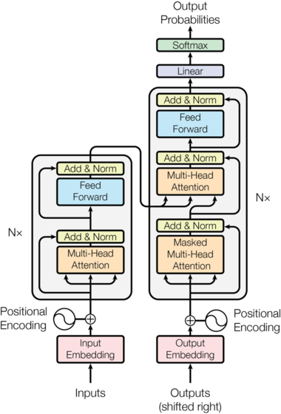
The token vocabulary that is used is important
For NLP, current approaches use techniques like Byte Pair Encoding, wordpieces, or sentence pieces---which are all quite similar
BPE tokenizers (and the rest) are trained on a corpus

Slide 4
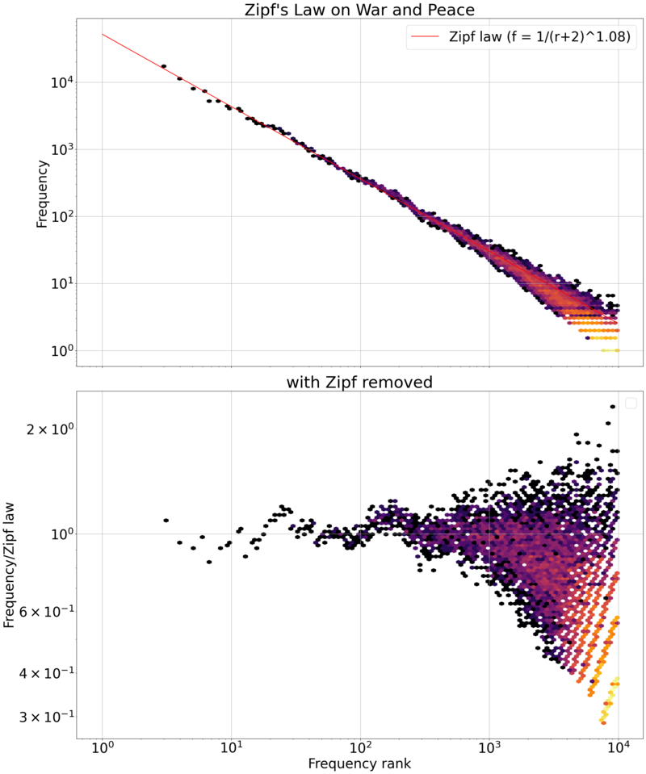
Tokenization for NLP Transformers

Slide 5
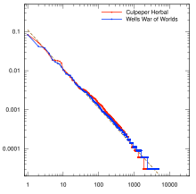

Tokenization for NLP
1990’s NLP: English tokenization was spaces and a few special rules
Eg “don’t” → “do” + “n’t”
This never worked well for other languages
This also leads to many many tokens for English
In practice you always need an UNK token for words not seen in training

Slide 6
Tokenization for NLP
1990’s NLP: English tokenization was spaces and a few special rules
Eg “don’t” → “do” + “n’t”
This never worked well for other languages
This also leads to many many tokens for English
In practice you always need an UNK token for words not seen in training
UNK token might mean many different things
a new emerging entity/phrase (e.g. LSTM, FAFO, Groq, …)
a missspelling
a big number
…
TFIDF suggests rare entity names are important.

Slide 7
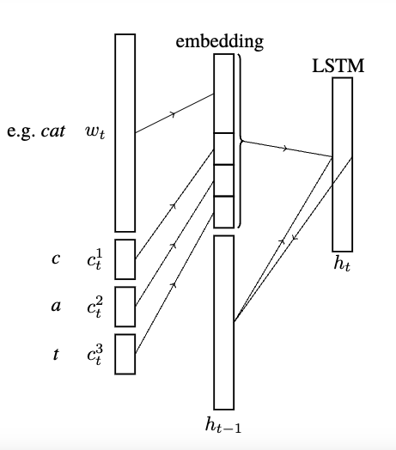
Tokenization for NLP
Mid-2000’s: character-level LSTM models and hybrid token-level/character-level models
But Transformers get very large with longer sequences.
Also: revival of old 1990’s approaches to compressing text by finding frequent subwords
Notes:
Character-Word LSTM Language Models
Lyan Verwimp, Joris Pelemans, Hugo Van hamme, Patrick Wambacq

Slide 8
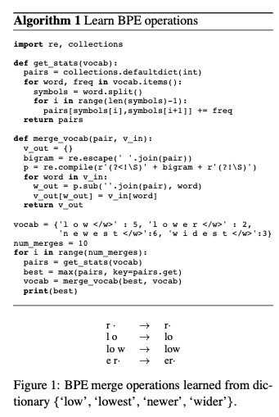
Tokenization in BERT / GPT2
Idea: reduce the number of tokens by finding meaningful subwords
Simplest version of this is Byte Pair Encoding (BPE)
BERT used a variant called wordpieces
Notes:
https://arxiv.org/pdf/1508.07909

Slide 9
Tokenization in BERT / GPT2: BPE
Step 1: Find all tokens in the corpus and save their frequency.
Step 2: Break all the tokens into characters (the initial vocabulary)
Step 3: Repeat for i = 1, … max_merges:
Find the ordered pair that occurs most frequently
Add that pair to the vocabulary
Replace that pair with the new word everywhere
u,g occurs 20x
“ug” is a new subword
Notes:
https://arxiv.org/pdf/1508.07909
https://huggingface.co/docs/transformers/tokenizer_summary

Slide 10
Tokenization in BERT / GPT2: BPE
Step 3: Repeat for i = 1, … max_merges:
Find the ordered pair that occurs most frequently
Add that pair to the vocabulary
Replace that pair with the new word everywhere
u,n occurs 16x
“un” is a new subword
Notes:
https://arxiv.org/pdf/1508.07909
https://huggingface.co/docs/transformers/tokenizer_summary

Slide 11
Tokenization in BERT / GPT2
BPE is simple and very efficient when you apply it reduce the number of tokens
use a trie to store the weighted corpus and update all the counts incrementally
<s>
15
h
17
p
b
4
15
u
17
u
u
4
15
g
5
g
n
n
5
s
<e>
<e>
<e>
<e>
10
5
12
4
<e>
5
Notes:
https://arxiv.org/pdf/1508.07909

Slide 12
Tokenization in BERT / GPT2
BPE is simple and very efficient when you apply it reduce the number of tokens
use a trie to store the weighted corpus and update all the counts incrementally
The trie of tokens is much smaller than the full corpus
<s>
15
h
17
p
b
4
15
12
u
u
4
15
ug
5
ug
n
n
5
s
<e>
<e>
<e>
<e>
10
5
12
4
<e>
5
Notes:
https://arxiv.org/pdf/1508.07909

Slide 13

Tokenization in Later Transformers
BPE is simple and very efficient when you apply it reduce the number of tokens
use a trie to store the weighted corpus and update all the counts incrementally
The trie of tokens is much smaller than the full corpus
Wordpieces was used in BERT: much like BPE but tries to maximize the probability of the corpus
under a naïve Bayes-like model of probability
main difference: instead of scoring pairs by frequency score of pointwise mutual information
Notes:
https://arxiv.org/pdf/1508.07909

Slide 14
Tokenization in Later Transformers
Wordpieces and BPE are constrained by the initial tokenization.
Could be a problem, e.g., if you tokenized Python code naively.
SentencePieces starts with “sentences” instead of words.
Common approach now is to use BPE on a large corpus with minimal pre-splitting: eg using all bytes as the initial vocabulary
Wordpieces was used in BERT: much like BPE but tries to maximize the probability of the corpus
under a naïve Bayes-like model of probability
main difference: instead of scoring pairs by frequency score of pointwise mutual information
Other approaches start with lots of proposed tokens and subtokens and repeatedly prune away subtokens
Notes:
Ref for sentencepieces?

Slide 15
Tokenization in Later Transformers
Step 1: Find all tokens in the corpus and save their frequency.
Step 2: Break all the tokens into characters (the initial vocabulary)
Step 3: Repeat for i = 1, … max_merges:
Find the ordered pair that occurs most frequently
Add that pair to the vocabulary
Replace that pair with the new word everywhere
u,g occurs 20x
“ug” is a new subword
Notes:
https://arxiv.org/pdf/1508.07909
https://huggingface.co/docs/transformers/tokenizer_summary

Slide 16
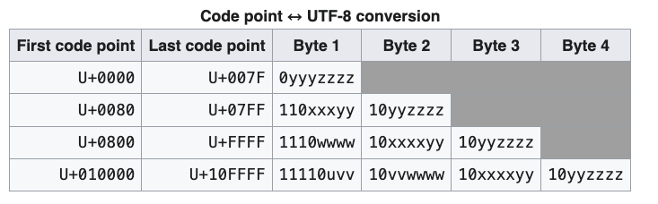
Tokenization in Later Transformers
Step 1: Find all tokens in the corpus and save their frequency.
Step 2: Break all the tokens into characters (the initial vocabulary)
All the bytes from UTF-8
ascii
Latin alphabets, Greek, Hebrew, …,
mostly CJK
emojis …
Notes:
https://arxiv.org/pdf/1508.07909
https://huggingface.co/docs/transformers/tokenizer_summary

Slide 17
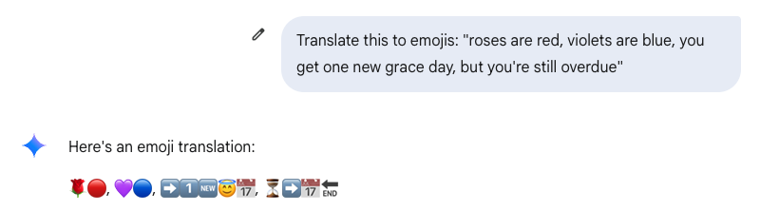
Impacts of BPE for Transformers
Math is hard
some common integers are tokens, some are not
Spelling is hard
“How many r’s in the word strawberry?”
“How many times does the letter e appear in the word catsup?
Emoticons are hard

Slide 18
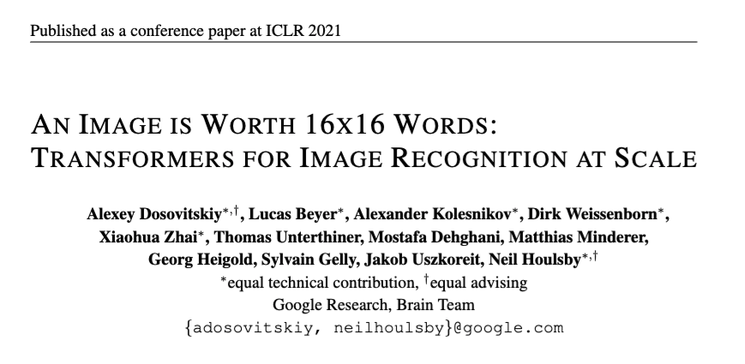
Tokenization for Vision Transformers
Notes:
https://arxiv.org/pdf/2010.11929/1000

Slide 19
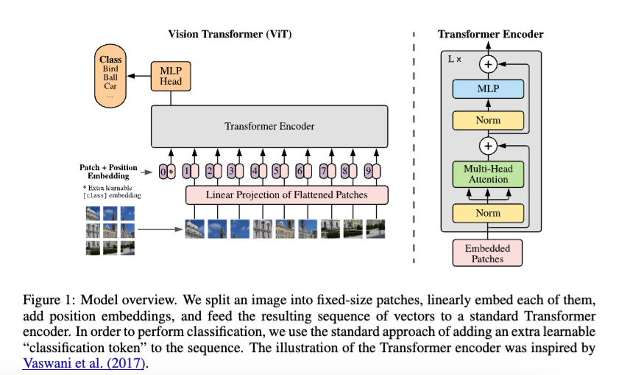
Tokenization for Vision Transformers

Slide 20
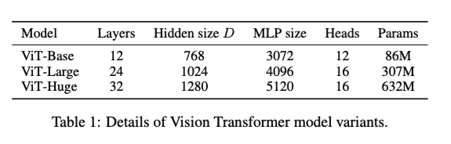
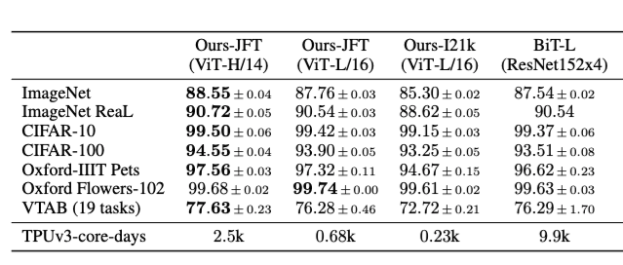
Tokenization for Vision Transformers
JFT = 300M images @ Google
Also trained on JFT

Slide 21
Vision Transformers – Pros and Cons
ViTs have a weaker bias than CNNs and usually need more data to train
They don’t “know” that local-area features matter
Transformers are not the SoTA way of generating images
Although they often do quite well!
ViTs are excellent for multimodal vision/language models

Slide 22
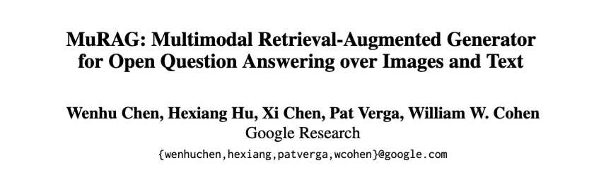
Multi-Model Transformer: Example
2022

Slide 23
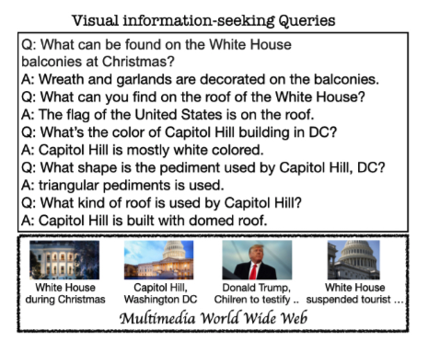
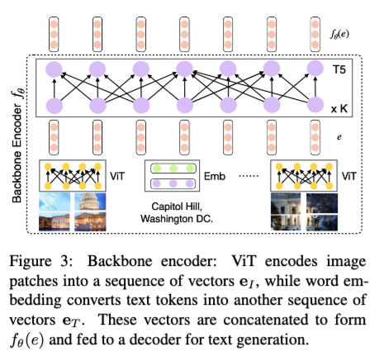
Multi-Model Transformer: Example

Slide 24
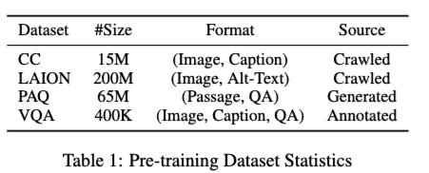
Vision Transformers – Pros and Cons
0. ViT and T5
1.
2. FT

Slide 25
Key-Value Caching for Transformers

Slide 26

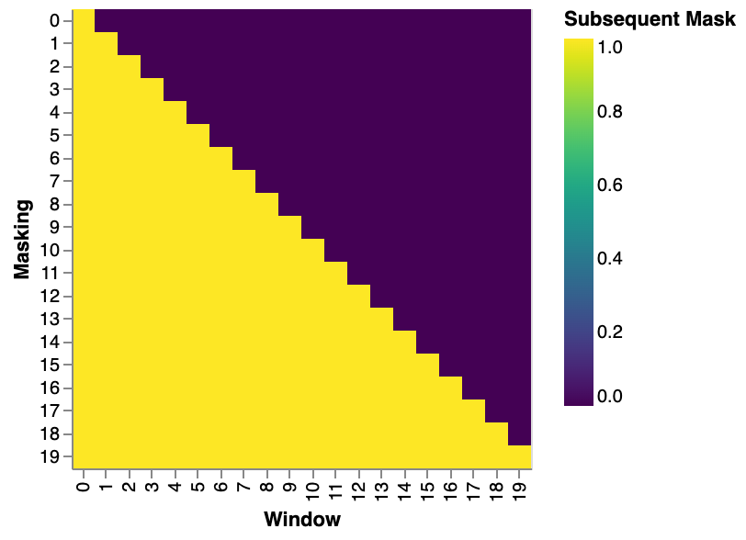
Recap: masked self-attention
In masked self-attention, the query for token at position i can only attend to thr keys for tokens at positions 0,1,…,i
This is done with a mask
Masked self-attention is used in the decoder
Prediction for token at i is not affected by “future” tokens at i+1,i+2, …
aka ”causal LM” or “causal masking”

Slide 27
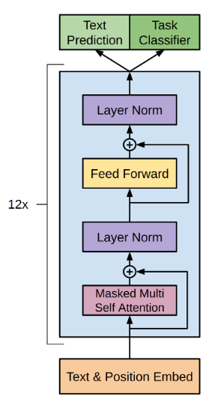
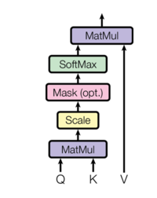
GPT
Recap: masked self-attention is always used in decoder-only Transformers

Slide 28
GPT
Recap: generation is auto-regressive
https://medium.com/@joaolages/kv-caching-explained-276520203249
Notes:
https://medium.com/@joaolages/kv-caching-explained-276520203249

Slide 29

Observation
Step 1 | Step 2 | Step 3 | Step 4

Slide 30
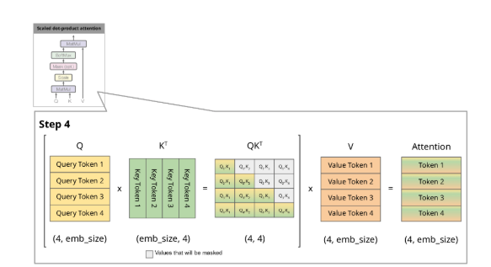
Observation
In MSA (Masked Self Attention) the QK^{T} matmul is the only place where information from one token’s representation is moved to another token
if x_{i} is token representation
q_{i} = x_{i} W_{Q.} ; k_{i} = x_{i} W_{K.} ; v_{i} = x_{i} W_{V.}

Slide 31
Observation
input | input | Step 3 | Step 4
Third output depends only on the first two tokens

Slide 32
Observation
input | input | Step 3 | Step 4
Third output depends only on the first two tokens

Slide 33
Key-Value Caching
input | input | input | Step 4
Stuff in green boxes has not changed since step 3
The keys and values can be cached and re-used in forward pass
Third output depends only on the first two tokens
Fourth output output depends only on the first three tokens

Slide 34
GPT
Important point: the FFN and LayerNorms are applied independently to each token position, so there MSA is the only place where information moves from one token position to another.

