Slide 1
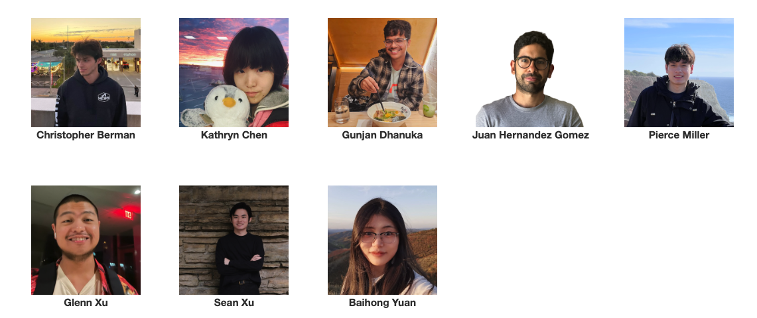
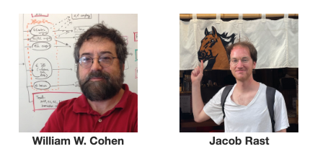
10-605/10-405 Machine Learning from Large Datasets

Slide 2
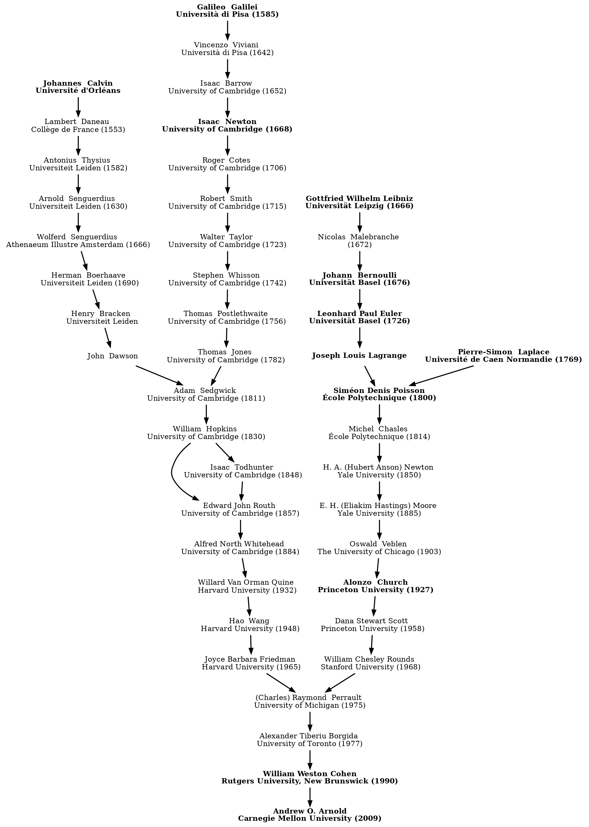
https://www.ml.cmu.edu/academics/ta.html
by Thursday 4/10

Slide 3
Comment on Key-Value Caching
Key-value caching speeds up a Transformer
avoids recomputation
Key-value cache management changes what a Transformer does
you don’t recover from “cache miss”
evicted tokens are not attended to
that’s why it’s like pruning

Slide 4
Retrieval Augmented LLMs

Slide 5
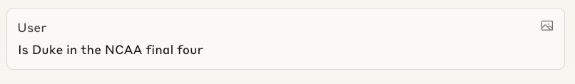
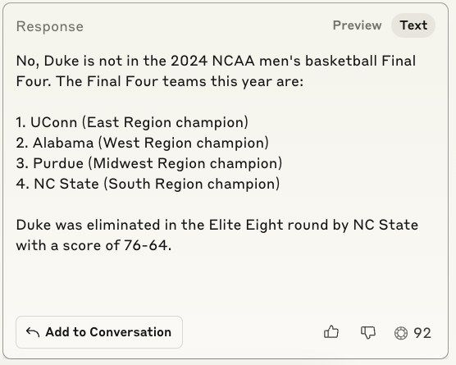
as of March 30th, 2025
Anthropic Claude 3.7
Notes:
date March 2025

Slide 6
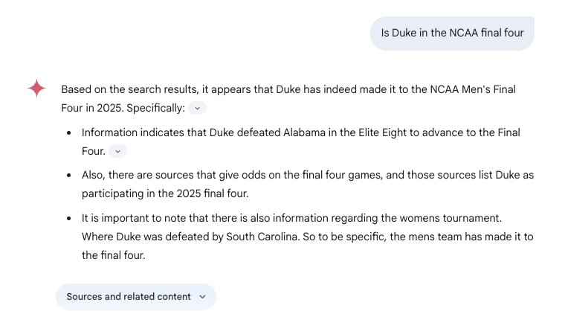

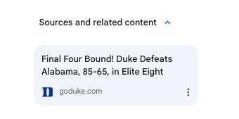
Gemini Advanced 2.0 Flash

Slide 7
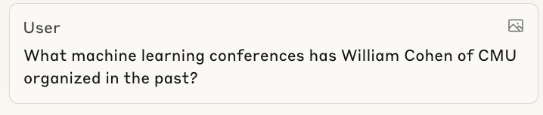
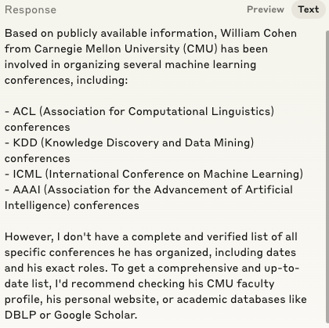
Mostly wrong
Anthropic Claude 3.7

Slide 8
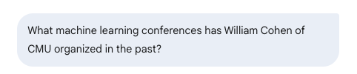
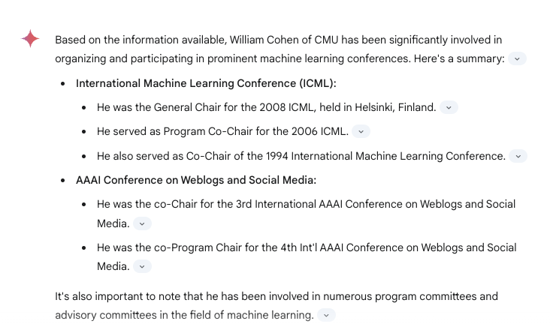
Gemini Advanced 2.0 Flash

Slide 9
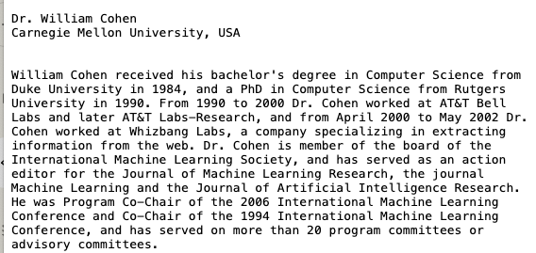
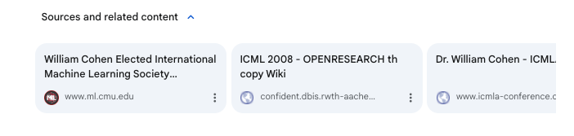
Irrelevant from 2017
copy of ICML 2008 info
from 2007
https://www.cs.cmu.edu/~wcohen/ has all this information
Gemini Advanced 2.0 Flash

Slide 10
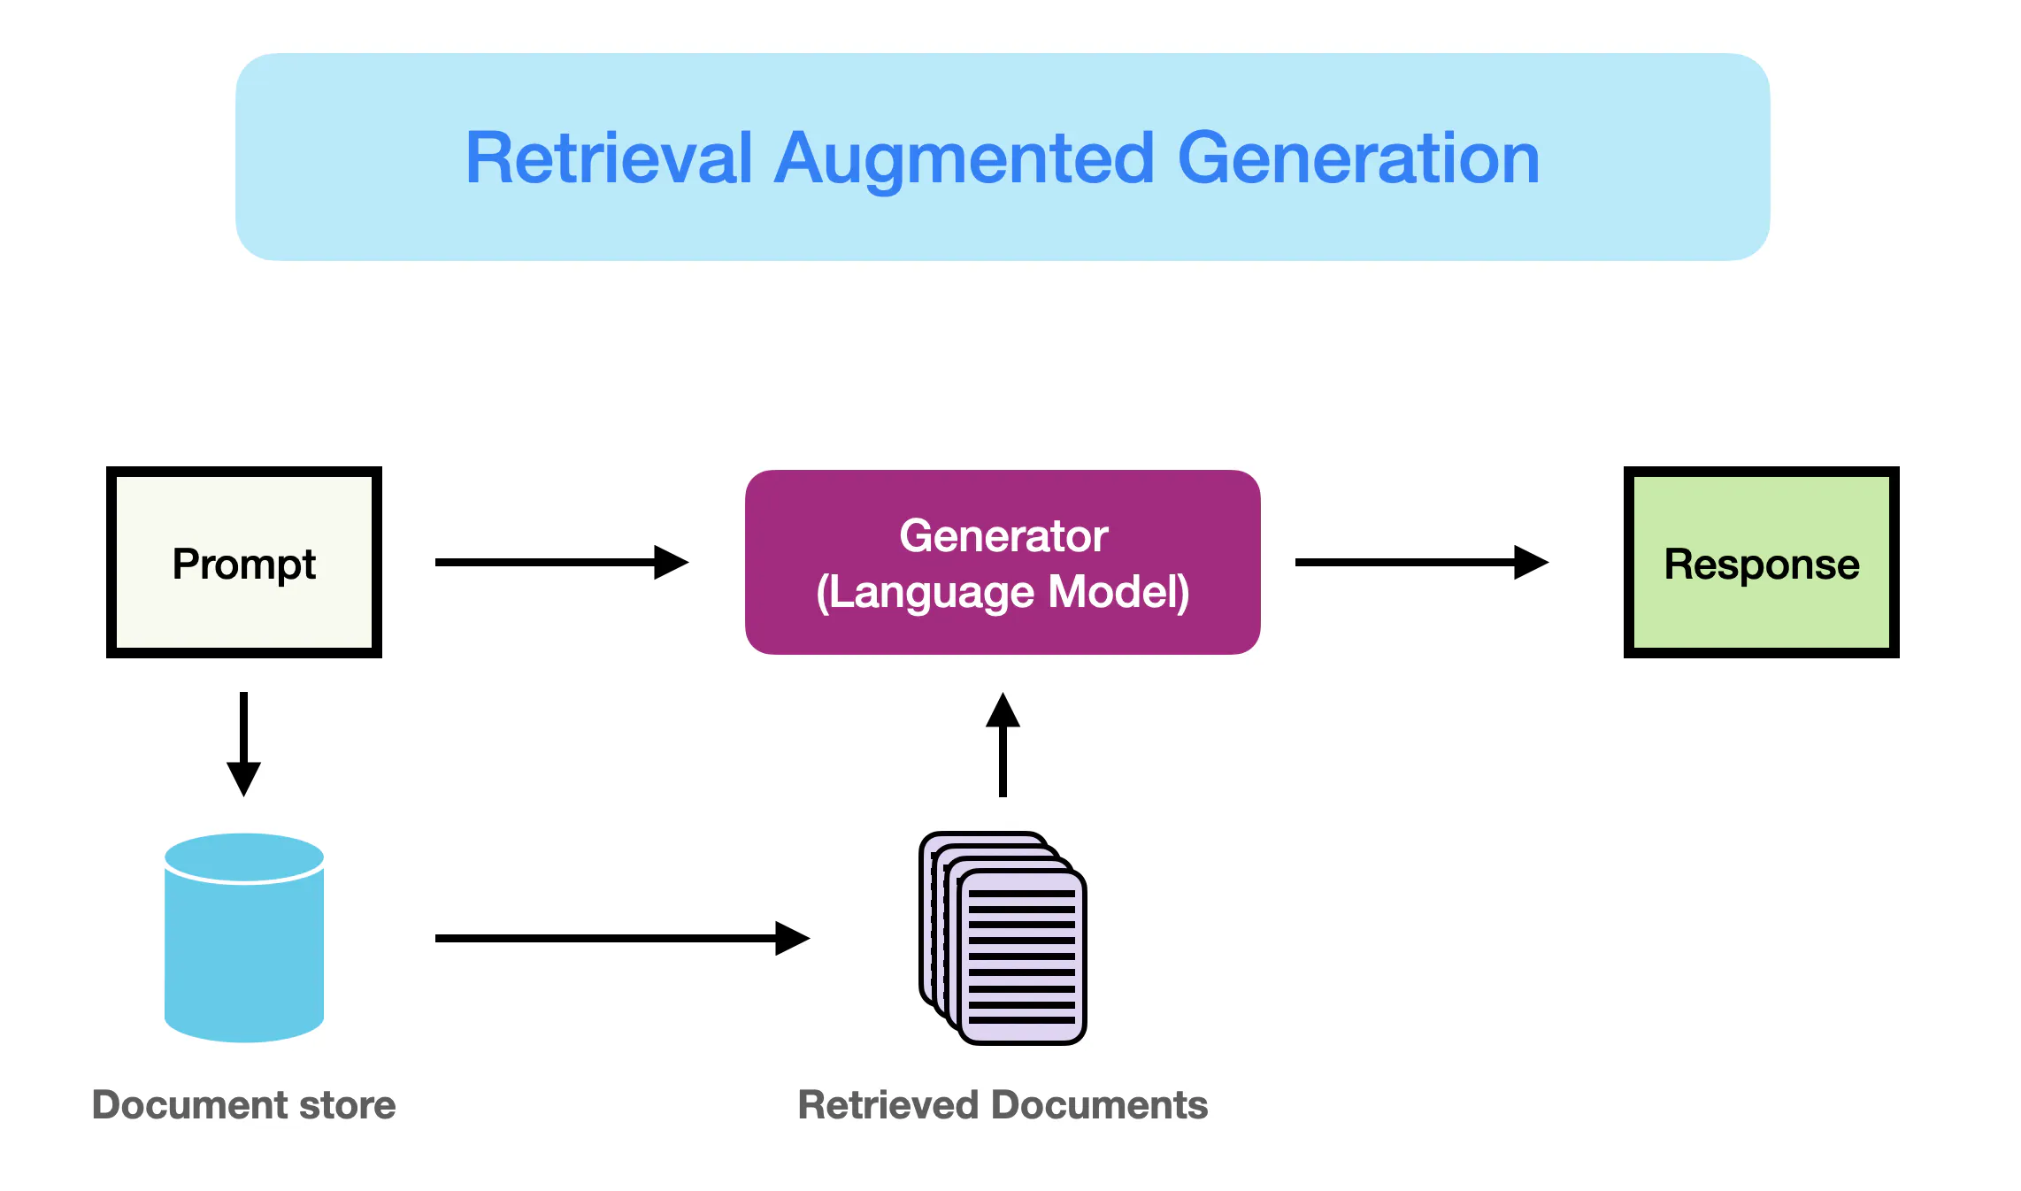

Slide 11
Questions
How to retrieve? Can we learn to retrieve better?
How to generate? Are there generation problems specific to RAG?
Do we learn to retrieve jointly with learning to generate, or separately?
What if information needed is spread across many documents?
Is the source of information reliable?
What if documents contradict each other?

Slide 12
Contrastive Learning: Overview and ExamPLE

Slide 13
Recap: LSH: key ideas
Goal:
map feature vector x to bit vector bx
ensure that bx preserves “similarity”
Basic idea: use random projections of x
Repeat many times:
Pick a random hyperplane r by picking random weights for each feature (say from a Gaussian)
Compute the inner product of r with x
Record if x is “close to” r (r.x>=0)
the next bit in bx
Theory says that is x’ and x have small cosine distance then bx and bx’ will have small Hamming distance
cosine similarity

Slide 14
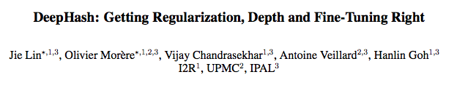
Alternative: learn a similarity metric
One example paper…
ICML 2017
Notes:
https://dl.acm.org/doi/abs/10.1145/3078971.3078983

Slide 15
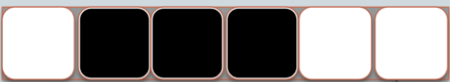
DeepHash
Image
Compact Bit Vector
64-1000 bits long

Slide 16
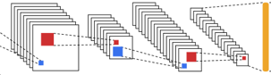
DeepHash
Image
Compact Bit Vector
64-1000 bits long
LSH, or …
4k floats

Slide 17
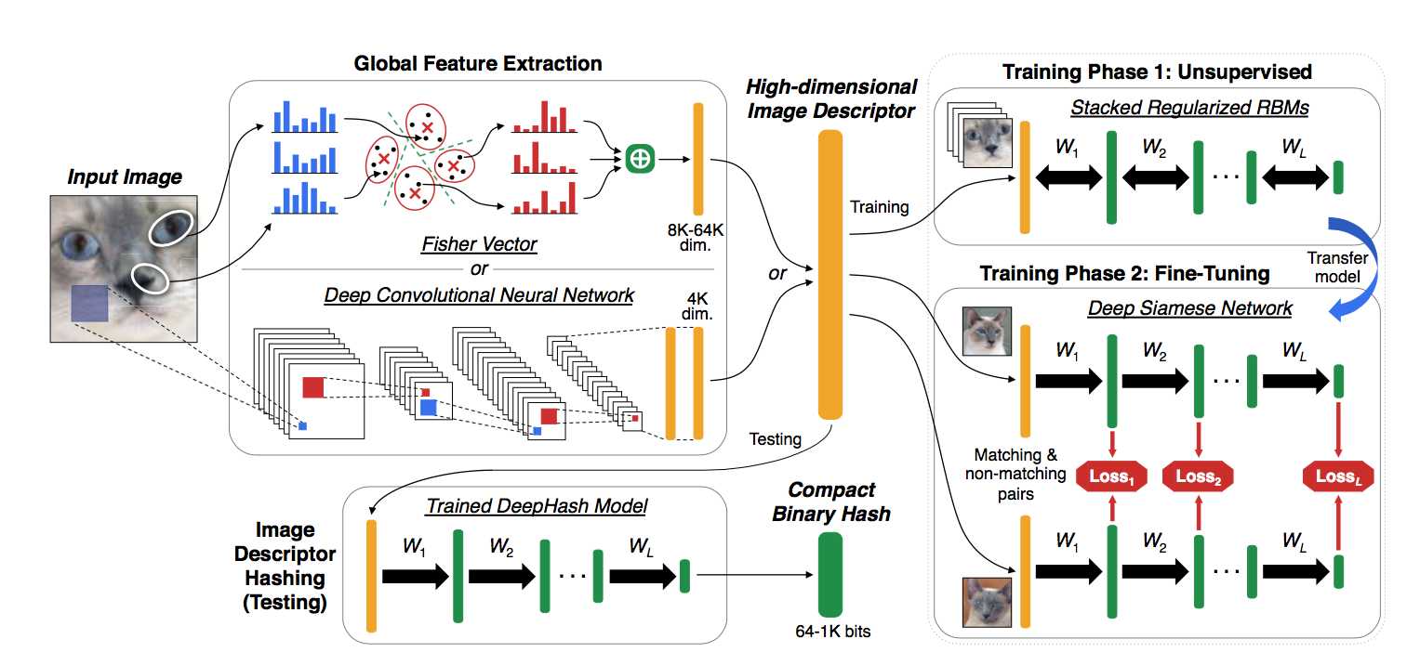
Pipeline for DeepHash

Slide 18
Training on matching vs non-matching pairs
Contrastive learning
Learned deep RBM
Loss pushes the representation for “matching” pairs together and representation for “non-matching” pairs apart

Slide 19
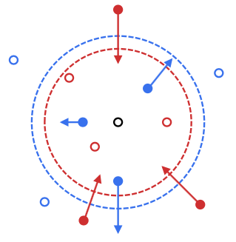
Training on matching vs non-matching pairs
Notes:
orange

Slide 20
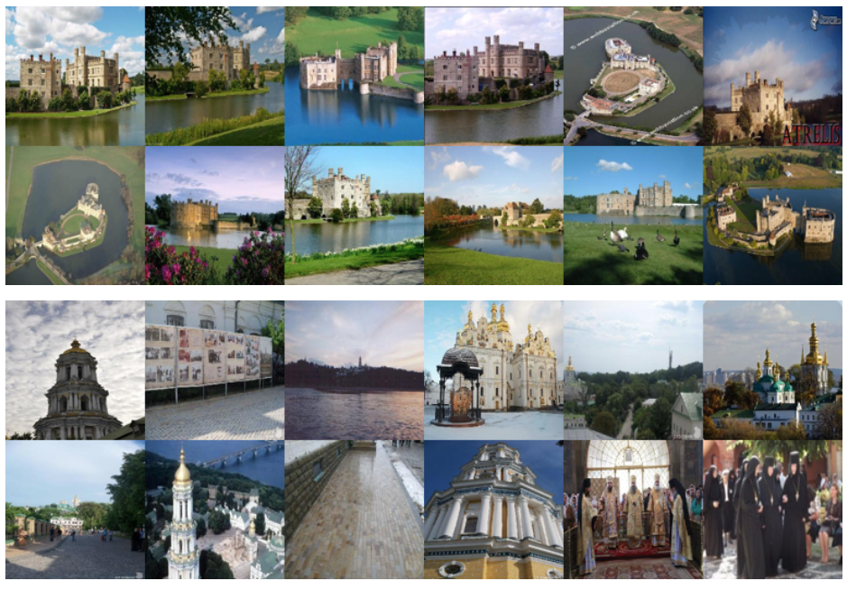
Training on matching vs non-matching pairs
matching pairs were photos of the same “landmark”

Slide 21
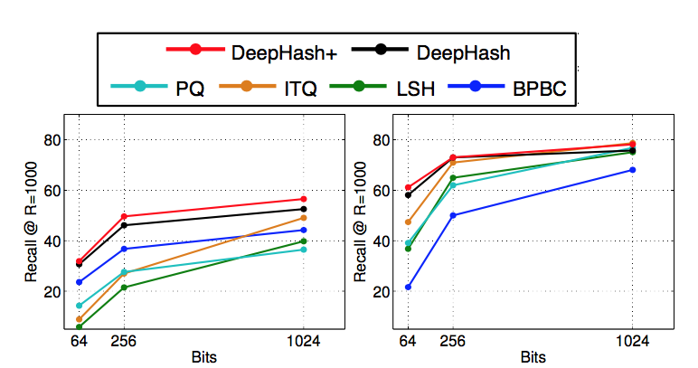
feature-vector encoding of image
CNN encoding of image
Task: retrieve images of the same landmark using the bitstrings

Slide 22
Contrastive Learning: The General Idea
Notes:
https://proceedings.mlr.press/v119/chen20j/chen20j.pdf

Slide 23
Learning for retrieval
Learn a mapping g(x) from objects x (images, documents, …) to vectors g(x)
Generally the same encoder g is used for objects and queries about those objects
Encode a big collection C of objects (images, documents, …) as a big set of vectors V
To retrieve objects in C relevant to q find the vectors in V closest to g(q)
Usually closest means dot product similarity
Usually you use tricks like hierarchical k-means, LSH, … to do the retrieval quickly

Slide 24
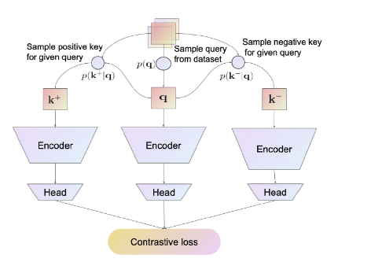
Contrastive learning
Contrastive loss fine-tunes the large encoder (and the projection head)
Usually a fairly large model
"Projection head” to compress large representation
Usually not a bit vector
Loss usually needs positive and negative retrievals for q

Slide 25

Contrastive learning
Loss
z _{i} and z _{i’} match
NT-Xent: normalized temperature-scale cross-entropy
the z _{j}’s don’t match z _{i}

Slide 26
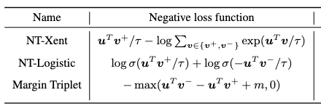
Contrastive learning
Other common contrastive losses
z _{i} and z _{i’} match
NT-Xent: normalized temperature-scale cross-entropy
the z _{j}’s don’t match z _{i}
the z _{j}’s are negative examples of similarity

Slide 27
Contrastive learning
How do you select positive pairs?
If you know the downstream retrieval task you can finetune on real pairs
For pre-training image representations, you often create a pair by using a real image and and “augmented” version of it

Slide 28
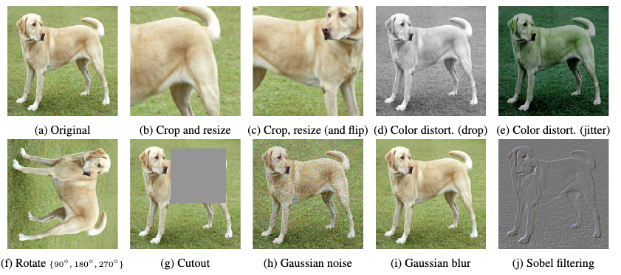
Contrastive learning
How do you select positive pairs?
If you know the downstream retrieval task you can finetune on real pairs
For pre-training image representations, you often create a pair by using a real image and and “augmented” version of it

Slide 29
Contrastive learning
How do you select negative pairs?
This depends on the application
We’ll talk some about question-answering using LLMs and retrieved documents
How do you fine-tune?
This also depends …

Slide 30
Retrieval FOR QUESTION-ANSWERING
Notes:
https://proceedings.mlr.press/v119/chen20j/chen20j.pdf

Slide 31
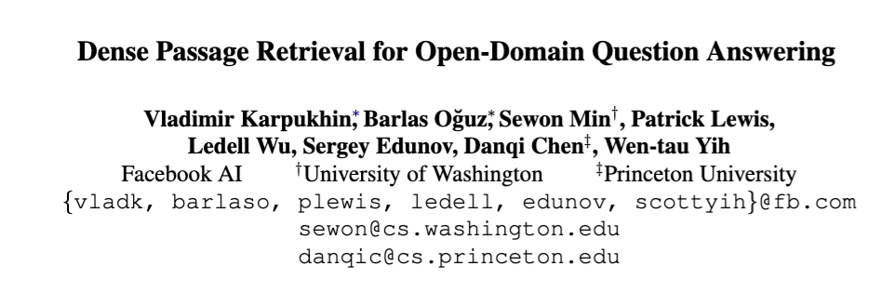
2020
Notes:
https://arxiv.org/pdf/2004.04906v2/1000

Slide 32
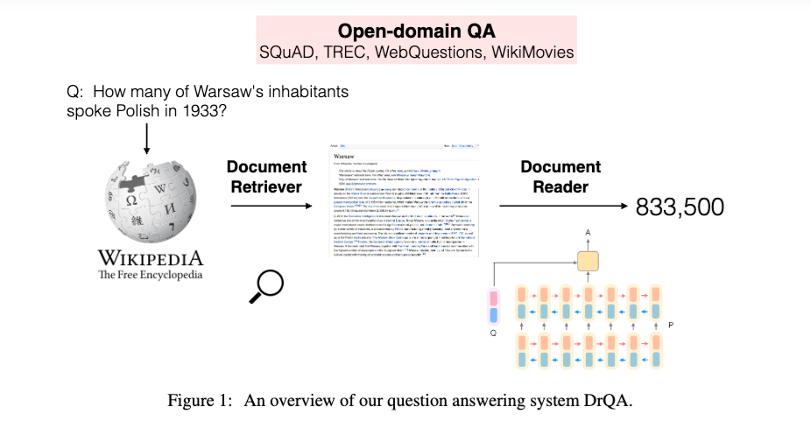
Prior State of the Art
Retrieve with TFIDF or BM25 using question as search query
SOTA in 2020 was based on BERT and extracted a span from the document
A modern “reader” would append the top few retrievals to the question and use that as a prompt for an LLM
Notes:
https://arxiv.org/pdf/1704.00051

Slide 33
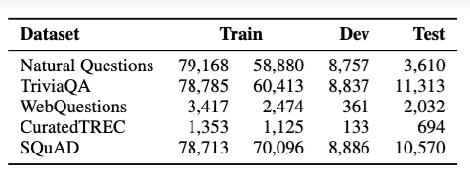
The Dense Passage Retriever (DPR)
Split Wikipedia into “passages”
21M passages, each 100 tokens long
Passages also include the page title
Encoder is Bert
“Projection head” is the [CLS] token
Process several QA datasets to get triples:
(question, gold passage id, gold answer span)
Filtered questions after heuristics to find gold passages
Notes:
squad and NQ, have extracted span, but passage need not align with NQ/Squad doc/paragraph
for others, just have question/anwer, using highest-ranked passage that contains the answer as gold passage

Slide 34
The Dense Passage Retriever (DPR)
Process several QA datasets to get triples:
(question, gold passage id, gold answer span)
Triples give positive question/passage examples (q_{i}, p_{i}) encoded in d=768 dimensions by pre-trained BERT
Q is mini-batch of B questions, P is B passages, S = QP^{T} is (B x B) matrix of similarity scores
score is positive for q_{i}, p_{j} iff i=j
“in-batch negatives” trick
also add as additional negatives
random passages (doesn’t help)
1-2 passages with high TFIDF score to q which do not contain the answer span (“hard negatives”)
Separate encoders for queries and documents
more recent models usually don’t do this
Each batch has B * (B-1) pairs
You need large B for the trick to work:
B=128

Slide 35
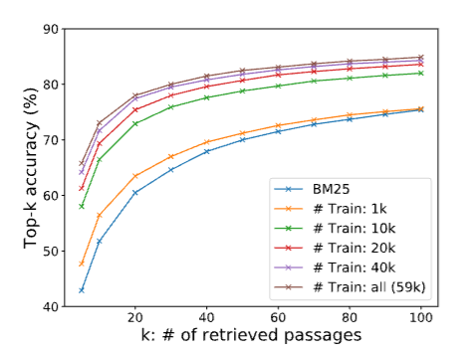
The Dense Passage Retriever (DPR)
NQ top-k retrieval accuracy: fraction of questions for which retrieval set contains a span which answers the question.

Slide 36
Discussion of DPR AND SOME USEFUL TRICKS FOR CONTRASTIVE LEARNING

Slide 37
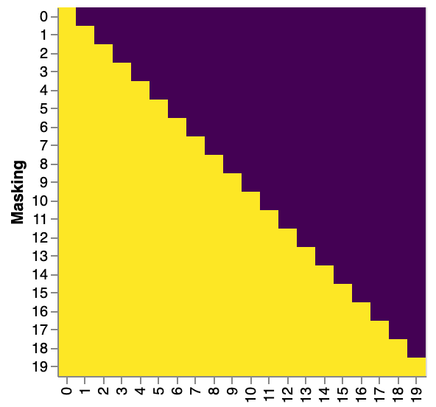
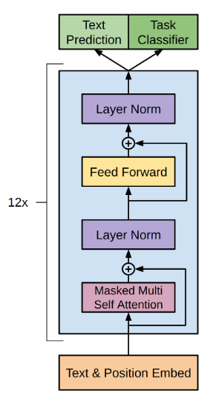
Discussion of DPR
Encoder used in DPR:
BERT with [CLS] token
The obvious choice in 2020
Still a very good choice
Decoder only models: intuitively
Token representations don’t “know” about tokens appearing after them (causal attention)
Decoder only

Slide 38
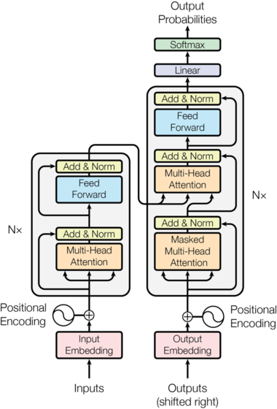
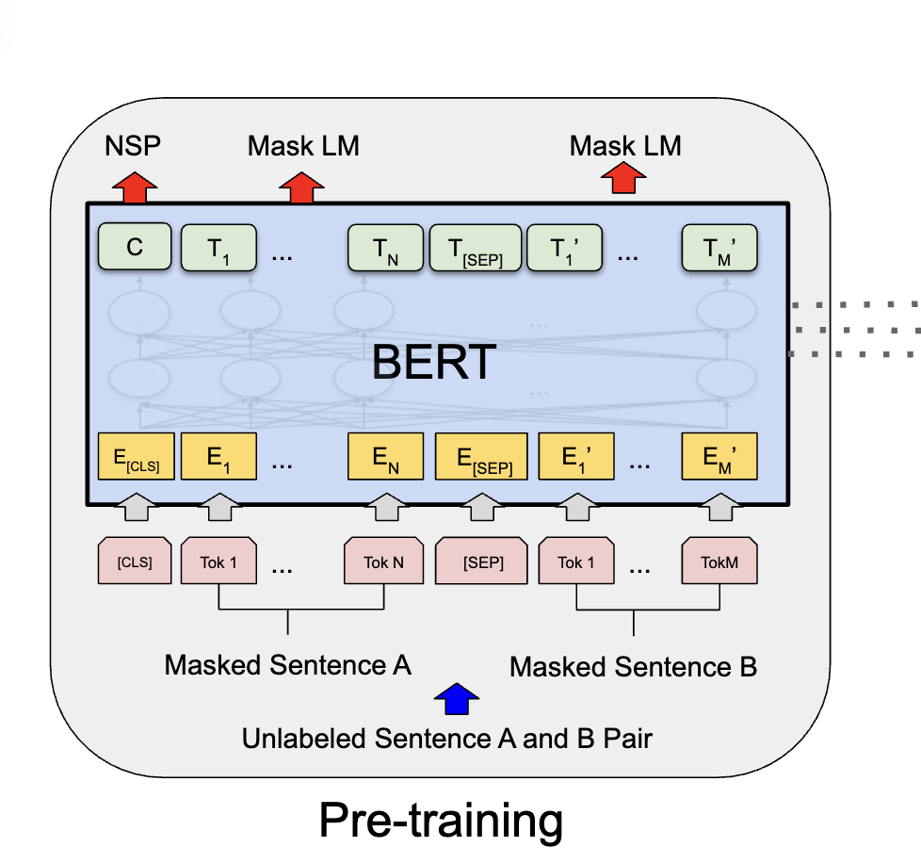
Discussion of DPR
Encoder used in DPR:
BERT with [CLS] token
The obvious choice in 2020
Still a very good choice
Encoder-only and encoder-decoder models have a “bottleneck”
Decoder only
Encoder only
Encoder-decoder

Slide 39
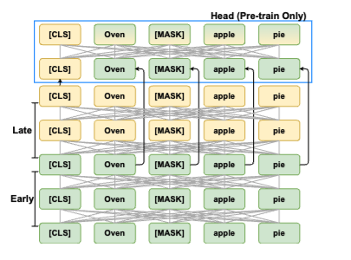
Discussion of DPR
Encoder used in DPR:
BERT with [CLS] token
The obvious choice in 2020
Still a very good choice
Encoder-only and encoder-decoder models have a “bottleneck”
Later work on encoders for retrieval tends to improve bottlenecking behavior
E.g., “Condenser” architecture (Gao and Callan, 2021) tries to make the [CLS] embedding work even harder
Notes:
https://arxiv.org/pdf/2104.08253

Slide 40
Discussion of DPR
DPR performs less well on queries about rare entities
TFIDF weights rare words heavily
DPR is trained on questions about (mostly) common entities

Slide 41
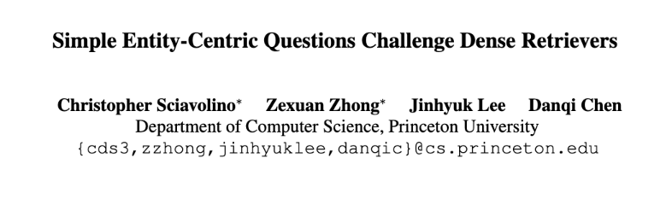
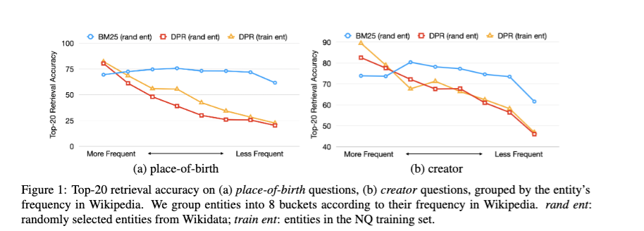
2022
Notes:
https://arxiv.org/pdf/2109.08535

Slide 42
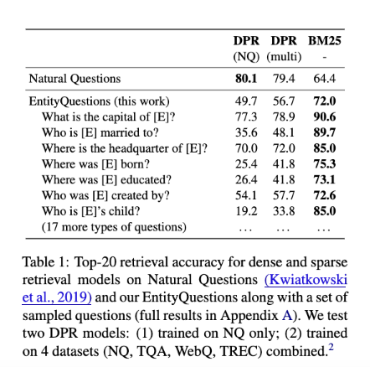
Notes:
https://arxiv.org/pdf/2109.08535

Slide 43
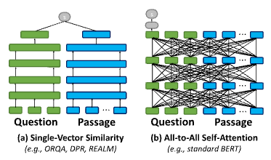
Discussion of DPR
Contrastively learned encoders are limited
They don’t know what the question is when they encode a document
So they can’t represent the relation between the document and the questions
One solution
Retrieve documents with a fast contrastive model
Rerank them with a more powerful model

Slide 44
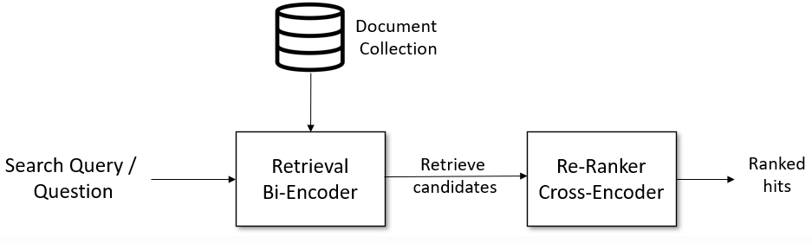
Cross-Encoders
relevance of i-th candidate to query
query
i-th candidate
c₁, c2, … c_{N}

Slide 45
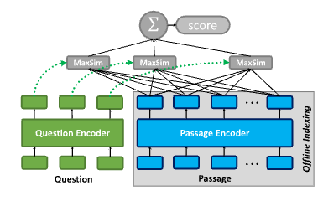
Discussion of DPR
Contrastively learned encoders are limited
A second solution
Store and index every token representation in the document and query
Score document-query similarity by the maximum similarity of any token pair
This approach is used in the COLBERT retrieval system
Notes:
https://direct.mit.edu/tacl/article/doi/10.1162/tacl_a_00405/107205/Relevance-guided-Supervision-for-OpenQA-with
https://dl.acm.org/doi/abs/10.1145/3397271.3401075

Slide 46
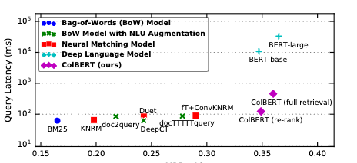
Discussion of DPR
A second solution
Store and index every token representation in the document and query
Score document-query similarity by the maximum similarity of any token pair
This approach is used in the COLBERT retrieval system
Intermediate in cost and effectiveness (between contrastive and reranking)
Notes:
https://direct.mit.edu/tacl/article/doi/10.1162/tacl_a_00405/107205/Relevance-guided-Supervision-for-OpenQA-with
https://dl.acm.org/doi/abs/10.1145/3397271.3401075

Slide 47
Contrastive Learning: Some Useful TRICKS

Slide 48
The Triplet Loss
Often useful!
uT v – = similarity of negative v to u
uT v ⁺ = similarity of positive v to u
our goal is uT v ⁺ > uT v –
even stronger pos>neg by a ”margin” m: uT v ⁺ > uT v – + m
suffer a loss if (uT v – + m) - uT v ⁺ > 0

Slide 49
In-batch negatives
Practically important!
Q is mini-batch of B questions, P is B passages, S = QP^{T} is (B x B) matrix of similarity scores
score is positive for q_{i}, p_{j} iff i=j
“in-batch negatives” trick
Each batch has B questions and B passages
B training examples
each with one positive and B-1 negative examples
With in-batch negatives, large batches are important
which means smaller encoders

Slide 50
Hard negatives trick
Practically important!
Q is mini-batch of B questions, P is B passages, S = QP^{T} is (B x B) matrix of similarity scores
score is positive for q_{i}, p_{i} iff i=j
“in-batch negatives” trick
DPR also added as additional negatives
1-2 passages with highest TFIDF score to q which do not contain the answer span
“hard negatives” trick
Each batch has B questions and 2B passages
B training examples
each with one positive and 2B-1 negative examples

Slide 51
Hard negatives trick
Hard negatives without TFIDF?
Use an earlier version of the model being trained as a source of hard negatives?
E.g., use the current model, or previous checkpoint
Complication: finding the K passages that are most similar to q with the old model involves
Re-encoding all the passages with previous model
Indexing them for quick retrieval
… can we avoid this?

Slide 52
The Mega-batching Trick
Assume we have
A dataloader that streams through mini-batches
An SGD trainer than learns from the mini-batchers
Idea: modify data stream
Collect M adjacent mini-batches into a mega-batch
Add to each mini-batch the hardest negative example in the mega-batch
Unless it’s already there
This is a simpler approach to hard-negative finding
Weiting and Gimpel, 2018: https://arxiv.org/pdf/1711.05732
Notes:
https://arxiv.org/pdf/1711.05732

Slide 53
Mega-batching and Dynamic Dictionaries
Assume we have
A dataloader that streams through mini-batches
An SGD trainer than learns from the mini-batchers
Idea: modify data stream
Keep a queue of the M most recently-seen examples
Add to each mini-batch the hardest negative example in the queue
Advantage:
Queue size is independent of batch size
Notes:
https://openaccess.thecvf.com/content_CVPR_2020/papers/He_Momentum_Contrast_for_Unsupervised_Visual_Representation_Learning_CVPR_2020_paper.pdf

Slide 54
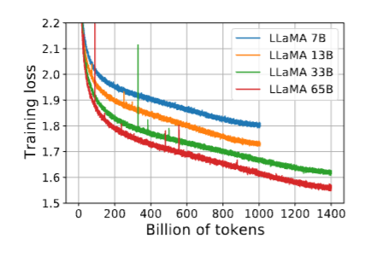
Momentum Encoders
Hard negatives without TFIDF?
Use an earlier version of the model being trained as a source of hard negatives?
E.g., use the previous checkpoint
Another complication: the most recent checkpoint might be an unstable one

Slide 55
Momentum Encoders
If recent checkpoints are unstable
Consider an ensemble of several recent checkpoints
e.g., vote with them
Averaging the weights of similar models is a good approximation to an ensemble
E.g., using the most recent two models:
$θ_{∗}$ = ${α θ}_{t−1}+(1−$ $α$) $θ_{t}$
Similar to a momentum term in optimization

Slide 56
Contriever: Unsupervised Dense Retrieval
Notes:
https://proceedings.mlr.press/v119/chen20j/chen20j.pdf

Slide 57
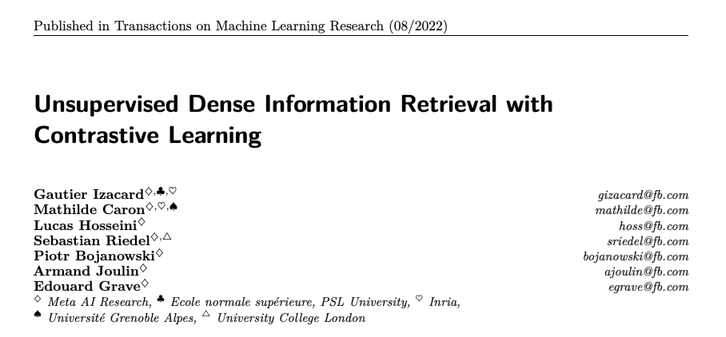
Notes:
o

Slide 58
Contriever
Goal: a pre-trained document retriever that
works well out-of-the-box
no supervision!
can be improved by fine-tuning on small datasets
Main question:
how to build an unsupervised dense retrieval model?

Slide 59
Recap: Contrastive learning
How do you select positive pairs?
If you know the downstream retrieval task you can finetune on real pairs
For pre-training image representations, you often create a pair by using a real image and and “augmented” version of it

Slide 60
Contriever
Goal: a pre-trained document retriever that
works well out-of-the-box
no supervision!
can be improved by fine-tuning on small datasets
Main question:
how to build an unsupervised dense retrieval model?
Solution:
build positive pairs from a single document
then train with contrastive loss

Slide 61
Contriever vs DPR
Same NT-Xent contrastive loss
One BERT encoder instead of two
Data augmentation tricks explored
Inverse cloze task
Independent cropping
Random word deletion, replacement, or masking
Negatives were from
in-batch negatives
momentum contrast (MoCo)

Slide 62
Inverse Cloze Task
Background: a cloze question is formed by hiding an important word in a sentence
Document retrievers learned with contrastive learning usually encode text as a ____ vector.
Inverse close: given a paragraph p create a pair (a, b) where
a is a sentence from p
b is p with sentence a removed (with probability 0.9)
b is p (with probability 0.1)
p
..Zebras have four gaits: walk, trot, canter and gallop. They are generally slower than horses, but their great stamina helps them outrun predators. When chased, a zebra will zigzag from side to side...
a
b
They are generally slower than horses, but their great stamina helps them outrun predators.
..Zebras have four gaits: walk, trot, canter and gallop. When chased, a zebra will zigzag from side to side...
Notes:
https://arxiv.org/pdf/1906.00300 – Lee et al, ORQA

Slide 63
Independent cropping
Given a paragraph p create a pair (a, b) where
a and b are both independently chosen subsequences of the text
length of a and b are either fixed or sampled
Note a and b will be similar size, not sentence vs paragraph
p
..Zebras have four gaits: walk, trot, canter and gallop. They are generally slower than horses, but their great stamina helps them outrun predators. When chased, a zebra will zigzag from side to side...
a
b
four gaits: walk, trot, canter and gallop. They are generally
great stamina helps them outrun predators. When chased
Notes:
https://arxiv.org/pdf/1906.00300 – Lee et al, ORQA

Slide 64
MoCo dynamic dictionary + momentum
Don’t backprop through the “keys”, only the qery encoder.
Notes:
https://arxiv.org/pdf/1906.00300 – Lee et al, ORQA

Slide 65

MoCo
Don’t backprop through the “keys”, only the qery encoder.
Encoder params:
𝜃_{q} for the keys: being trained
𝜃_{k} for the keys: “stale” version of 𝜃_{q}
vector for k-
MoCo update 𝜃_{k} with:
vector for k+
Notes:
https://openaccess.thecvf.com/content_CVPR_2020/papers/He_Momentum_Contrast_for_Unsupervised_Visual_Representation_Learning_CVPR_2020_paper.pdf

Slide 66
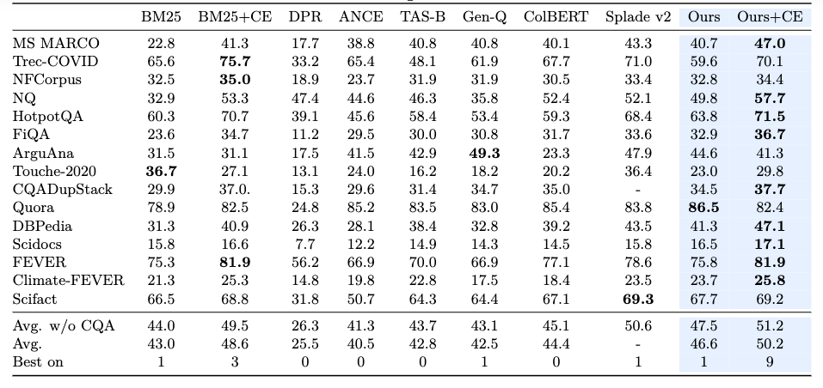
Contriever
Best configuration
Random cropping
Tokens deleted from a, b with probability 0.1
MoCo

Slide 67
Retrieval WITH Modern LLMS

Slide 68
Recap: Discussion of DPR
Encoder used in DPR:
BERT with [CLS] token
The obvious choice in 2020
Still a very good choice
Decoder only models: intuitively
Token representations don’t “know” about tokens appearing after them (causal attention)
Token representations from late in the document aren’t used much
Decoder only

Slide 69
Better retrieval
Retrieval models
Are trained contrastively
In-batch negatives means models need to be compact
Must produce “small” embeddings
Or the index becomes too large
Large decoder-only LLMs are powerful
But hard to use for retrieval
There is no natural “bottleneck”
Most retrievers are based on encoder-only or encoder-decoder models
Can we use decoder-only LLMs for retrieval?
One idea: augment a query with an LLM

Slide 70
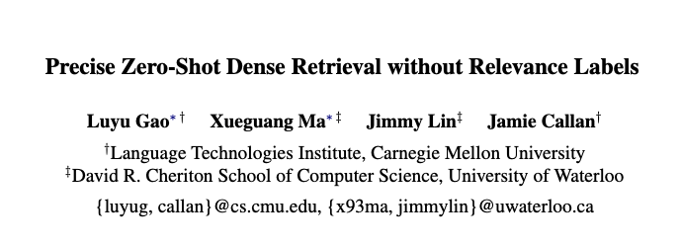
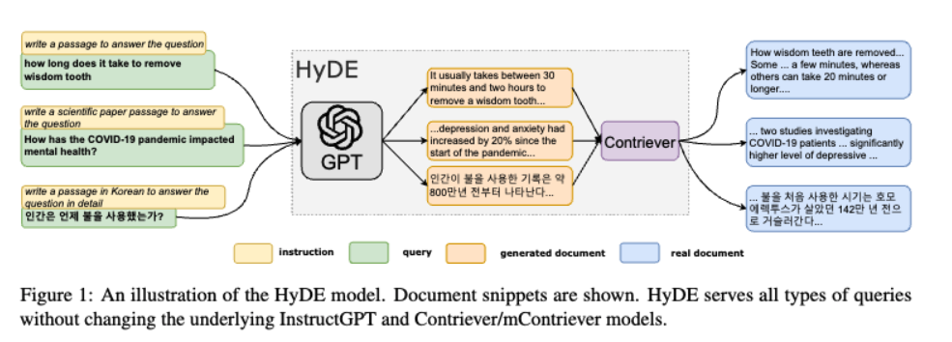
2023
Notes:
https://aclanthology.org/2023.acl-long.99.pdf

Slide 71
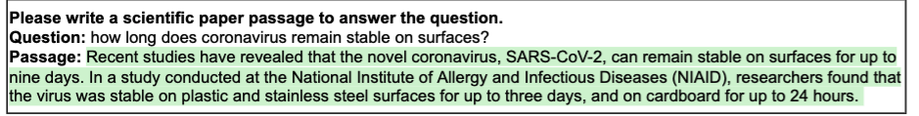
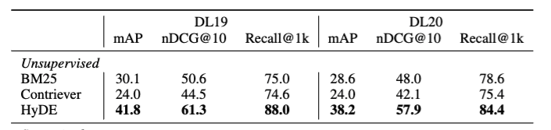
Hypothetical Document Embedding (HyDE)
Details
prompt model (InstructGPT) to convert question q to a query document d
sample N documents d₁, …, d_{N}, by generation with temperature T
query vector for Contriever is average of embeddings for q and d₁, …, d_{N}
Notes:
see also MSR query2doc
https://arxiv.org/pdf/2304.14233 and LameR gets similar results concatenating generated documents to the query and using a sparse retriever

Slide 72
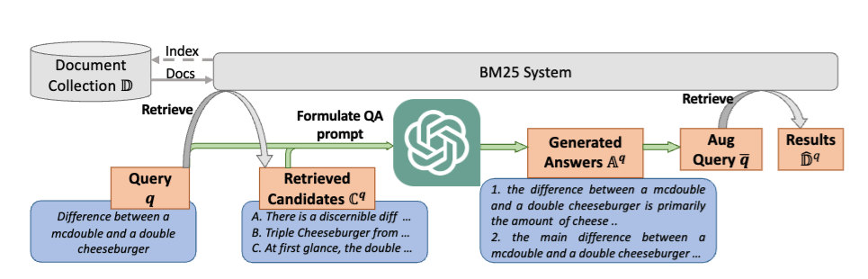
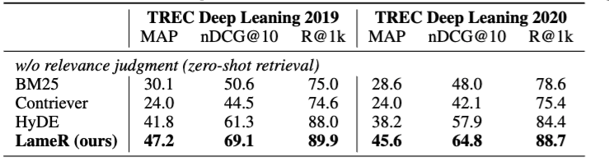
Language Model as Retriever (LameR)
https://arxiv.org/pdf/2304.14233 2023 Shen et al
Notes:
see also MSR query2doc
https://arxiv.org/pdf/2304.14233 and LameR gets similar results concatenating generated documents to the query and using a sparse retriever

Slide 73
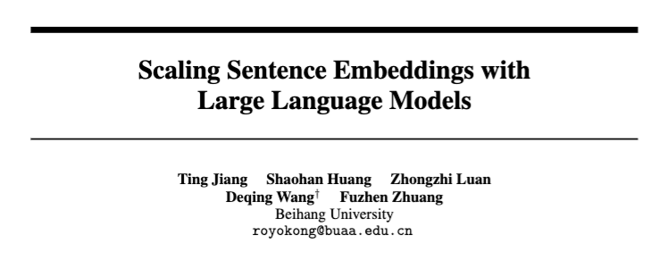

Decoder-only models as encoders?
2023
PromptEOL
2025
Echo embeddings
Notes:
https://openreview.net/pdf?id=Ahlrf2HGJR
and https://arxiv.org/pdf/2307.16645

Slide 74

PromptEOL: Key ideas
To summarize a sentence x
Prompt the model with
Take the last hidden state of Transformer as representation
Then
Use 300 sentence/word pairs as ICL demonstrations
Train the representations contrastively with
This sentence: “x” means in one word:

Slide 75

Echo embeddings: key ideas
To summarize a sentence x
Prompt the model with
Mean-pool the tokens for x as the representation
Rewrite the sentence: x; rewritten sentence: x

