Slide 1
10-605 / 10-405
Machine Learning from Large Datasets

Slide 2
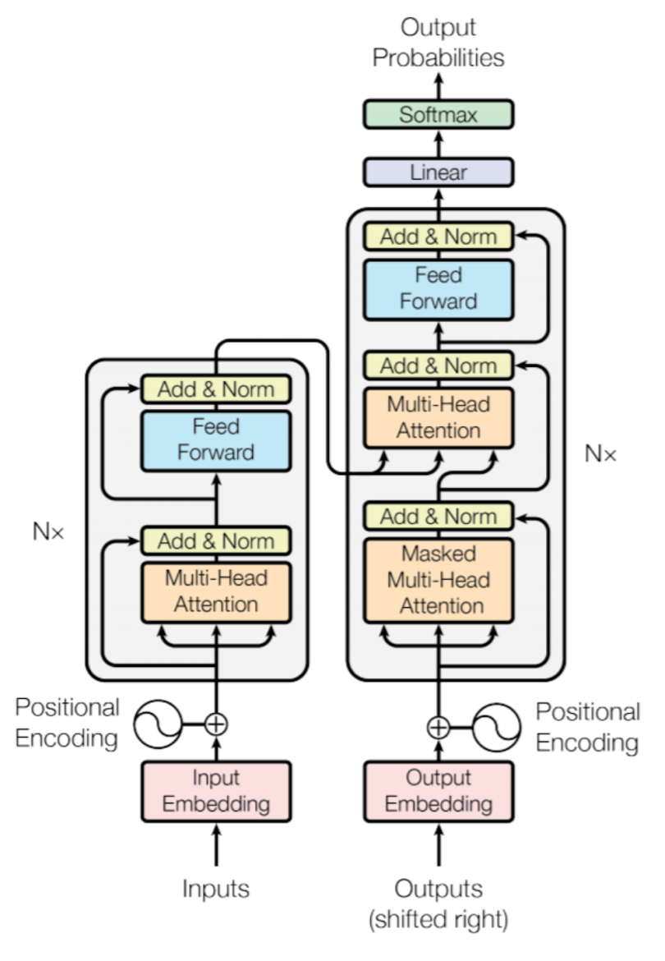
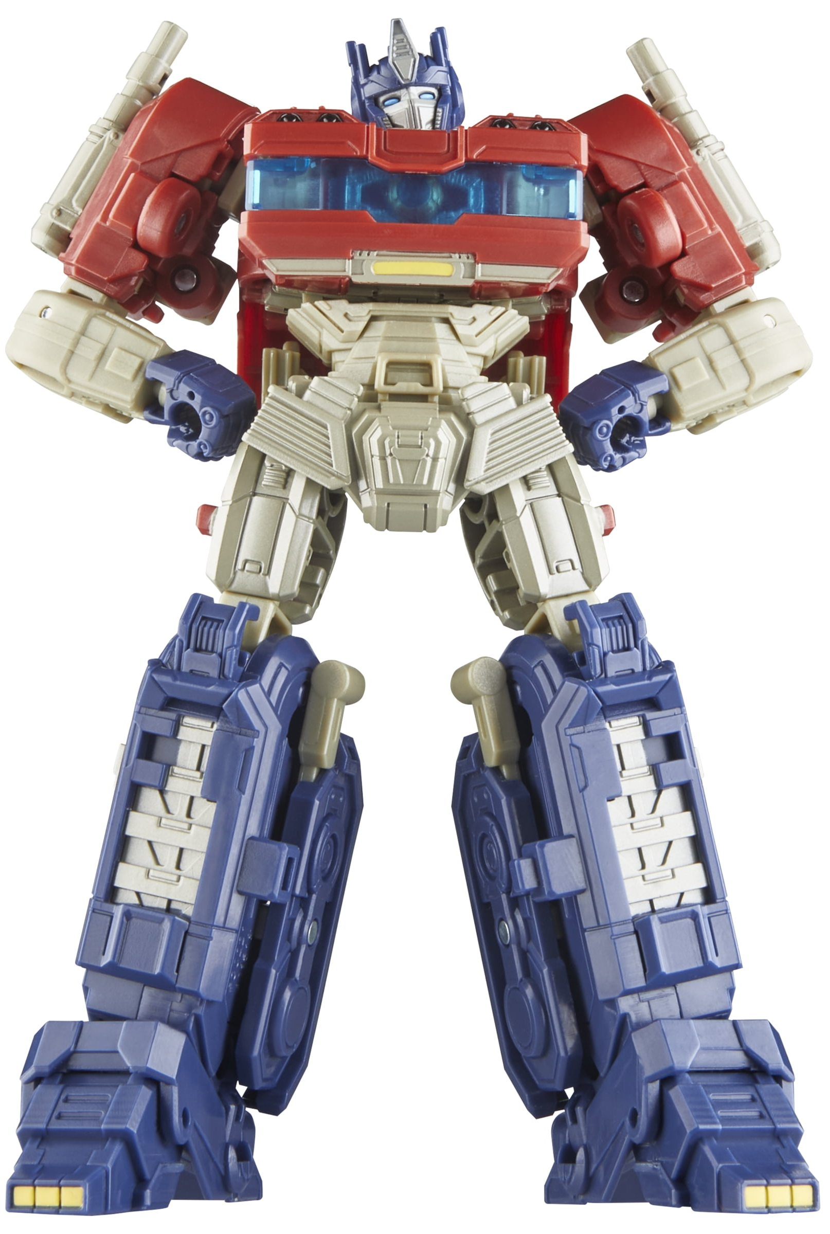

The Evolution of Transformers

Slide 3
Goals of next lectures
Describe modern LLM architectures in detail
“What” is relatively easy
“Why” is a harder
There is both a science and an “art” to designing deep networks
A lot of borrowing/adapting ideas that work elsewhere
More evolution than design?

Slide 4
Early History of Artificial Neural Networks (ANNs)
1940s-60’s:
McCulloch & Pitts; Hebb: modeling real neurons
Rosenblatt, Widrow-Hoff: : perceptrons
1969: Minskey & Papert, Perceptrons book showed formal limitations of one-layer linear network
mid-1980’s – mid-1990’s:
backprop and multi-layer networks
Sejnowski’s NETTalk, Backprop-based text-to-speech
Rumelhart and McClelland PDP book set
Neural Info Processing Systems (NIPS) conference starts
Deep networks were always interesting in theory, not so much in practice
Why?

Slide 5
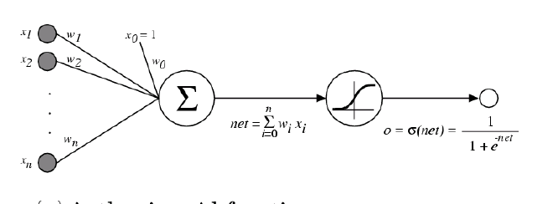
Multilayer ANNs
Simplest case: classifier defined by a multilayer network of logistic classifiers (units)
Each unit takes some inputs and produces one output using a logistic classifier
Output of one unit can be the input of another
Input layer
Hidden layer
Output layer
1
w^{0,1}
w^{0,2}
w^{1,1}
v¹=S(w^{T}X)
w¹
w^{2,1}
x¹
z¹=S(w^{T}V)
w^{1,2}
w²
x²
w^{2,2}
v²=S(w^{T}X)

Slide 6
Learning a Deep (Multilayer) ANN
Define a loss (simplest case: squared error, like linear regression)
But over a network of “units” – including some sort of logistic-like function
Minimize loss with gradient descent
You can do this over complex networks if you can take the gradient of each unit: every computation is differentiable
1
w^{0,1}
w^{0,2}
w^{1,1}
v¹=S(w^{T}X)
w¹
w^{2,1}
x¹
z¹=S(w^{T}V)
w^{1,2}
w²
x²
w^{2,2}
v²=S(w^{T}X)

Slide 7
Pro: Deep ANNs are expressive
One logistic unit can implement and AND or an OR of a subset of inputs
e.g., (x₃ AND x₅ AND … AND x₁₉)
Every boolean function can be expressed as an OR of ANDs
e.g., (x₃ AND x₅ ) OR (x₇ AND x₁₉) OR …
So one hidden layer can express any Boolean function
But it might need lots and lots of hidden units – e.g. parity functions are O(2^{N})

Slide 8
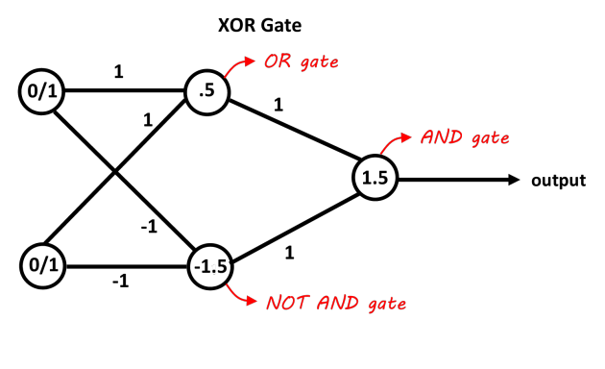
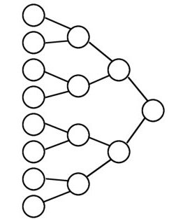
Pro: Deeper ANNs are more expressive
A two-layer network needs O(2^{N}) units to express some functions (like parity)
A 2*logN layer network can express the parity of N inputs (even/odd number of 1’s)
With O(logN) units in a binary tree
Deep network + parameter tying ~= subroutines
x1
x2
x3
x4
x5
x6
x7
x8

Slide 9
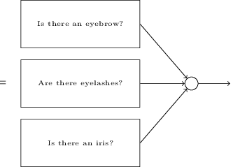
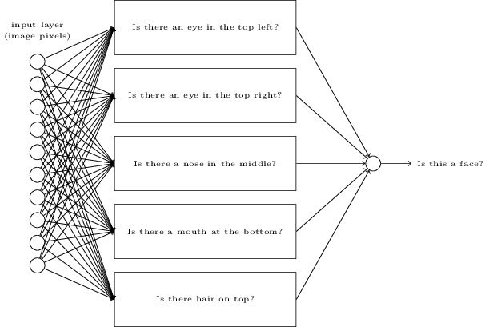
Hypothetical code for face recognition
http://neuralnetworksanddeeplearning.com/chap1.html
….
….

Slide 10
Early History of Artificial Neural Networks (ANNs)
1940s-60’s:
McCulloch & Pitts; Hebb: modeling real neurons
Rosenblatt, Widrow-Hoff: : perceptrons
1969: Minskey & Papert, Perceptrons book showed formal limitations of one-layer linear network
mid-1980’s – mid-1990’s:
backprop and multi-layer networks
Sejnowski’s NETTalk text-to-speech (1 hidden layer)
2-3 layer nets worked well but were slow to train
Rumelhart and McClelland PDP book set
Neural Info Processing Systems (NIPS) conference starts
Deep networks were always interesting in theory, not so much in practice
deeper nets worked .. sometimes … but only with expert design and training

Slide 11
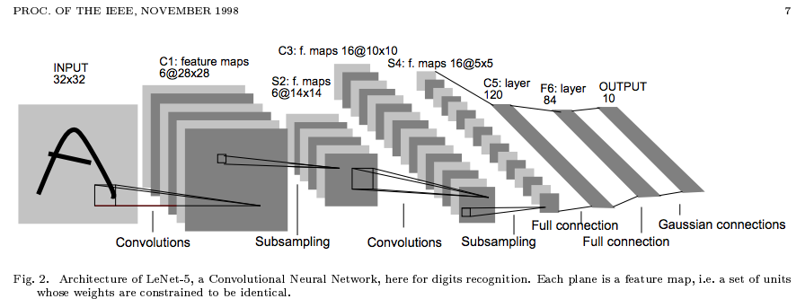
Neural Networks in the 90’s
ANNs were mostly 2-layer networks or else very carefully constructed “deep” networks (eg CNNs)
Some good results but training was slow and finicky
Nov 1998 – Yann LeCunn, Bottou, Bengio, Haffner

Slide 12

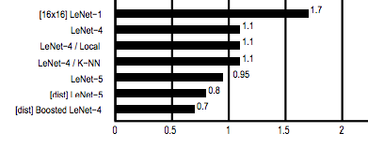
Neural Networks in the 90’s
ANNs were mostly 2-layer networks or else very carefully constructed “deep” networks (eg CNNs)
Some good results but training was slow and finicky
SVM: 98.9-99.2% accurate
CNNs: 98.3-99.3% accurate

Slide 13
Why are DEEP Networks Hard to Train?

Slide 14
How to Train Deep Networks?
X
W1
Z1A
B1
Z1B
A1
W2
Z2A
B2
Z2B
A2
mul
add*
tanh
mul
add*
tanh
Inputs: X,W1,B1,W2,B2
Z1a = mul(X,W1) // matrix mult
Z1b = add*(Z1a,B1) // add bias vec
A1 = tanh(Z1b) //element-wise
Z2a = mul(A1,W2)
Z2b = add*(Z2a,B2)
A2 = tanh(Z2b) // element-wise
P = softMax(A2) // vec to vec
C = crossEnt_{Y}(P) // cost function
Target Y; N examples; K outs; D feats, H hidden
Notes:
We always knew how but it didn’t work

Slide 15

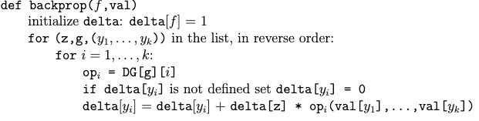
Recap: weight updates for multilayer ANN
What happens as the layers get further and further from the output layer? E.g., what’s gradient for the bias term with several layers between it and output?

Slide 16
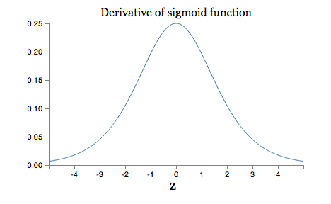
Recap: weight updates for multilayer ANN
What happens as the layers get further and further from the output layer? E.g., what’s gradient for the bias term with several layers between it and output?
Max at 1/4
If weights are usually < 1 then we are multiplying by many numbers < 1 so the gradients get very small.
The vanishing gradient problem

Slide 17
Recap: weight updates for multilayer ANN
What happens as the layers get further and further from the output layer? E.g., what’s gradient for the bias term with several layers between it and output?
Max at 1/4
If weights are usually > 1 then we are multiplying by many numbers > 1 so the gradients get very large.
The exploding gradient problem

Slide 18
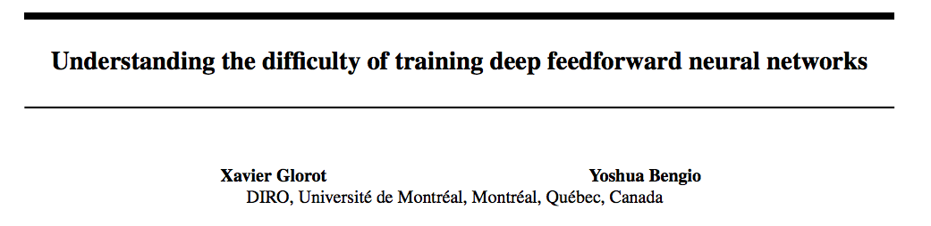
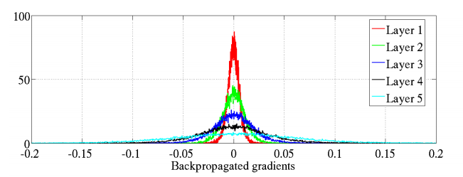
AI Stats 2010
output
input
Histogram of gradients in a 5-layer network for an artificial image recognition task

Slide 19
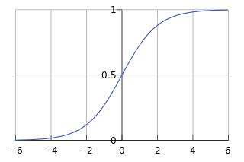
Another problem: It’s easy for sigmoid units to saturate
Learning rate approaches zero and unit is “stuck”

Slide 20
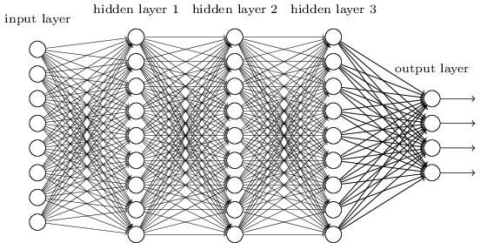
It’s easy for sigmoid units to saturate
For a big network there are lots of weighted inputs to each neuron. If any of them are too large then the neuron will saturate. So neurons get stuck with a few large inputs OR many small ones.

Slide 21
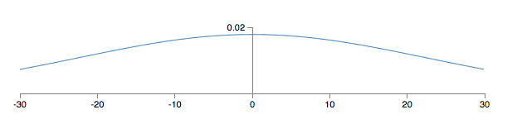
It’s easy for sigmoid units to saturate
If there are 500 non-zero inputs initialized with a Gaussian ~N(0,1) then the SD is

Slide 22
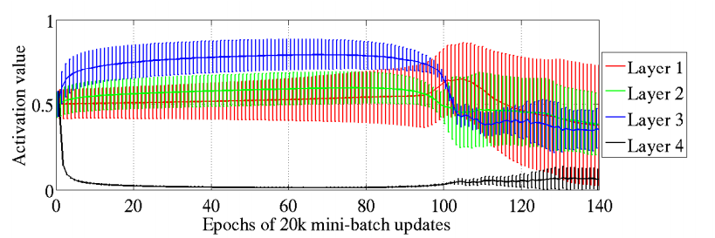

It’s easy for sigmoid units to saturate
Furthest-from-output hidden layer still stuck after 100 epochs
Saturation visualization from Glorot & Bengio 2010 -- using a smart(ish) initialization scheme

Slide 23
Recall: Neural Networks in the 90’s
ANNs were mostly 2-layer networks or else very carefully constructed deep networks (CNNs)
Some good results but training was slow and finicky
Nov 1998 – Yann LeCunn, Bottou, Bengio, Haffner

Slide 24
Early History of Artificial Neural Networks (ANNs)
mid-1980’s – mid-1990’s:
backprop and multi-layer networks
Sejnowski’s NETTalk text-to-speech (1 hidden layer)
2-3 layer nets worked ok but were slow to train
Rumelhart and McClelland PDP book set
Neural Info Processing Systems (NIPS) conference starts
Deep networks were always interesting in theory, not so much in practice
deeper nets worked .. sometimes … but only with expert design and training
The first practical application was convolutional ANNs for vision tasks

Slide 25
Convolutional Neural Networks
Notes:
first success for deep NNs

Slide 26
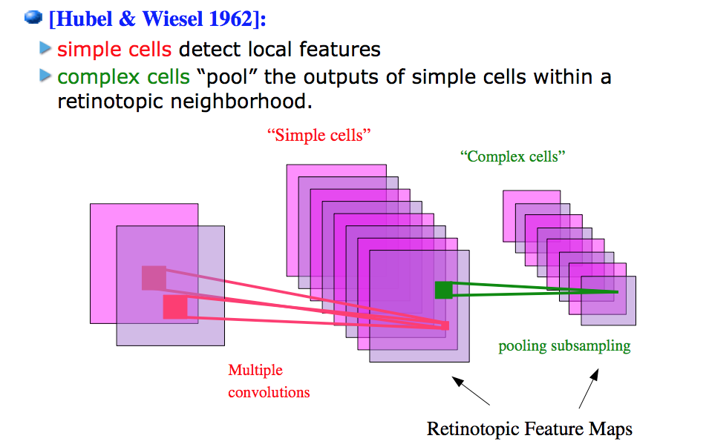
Model of vision in animals

Slide 27
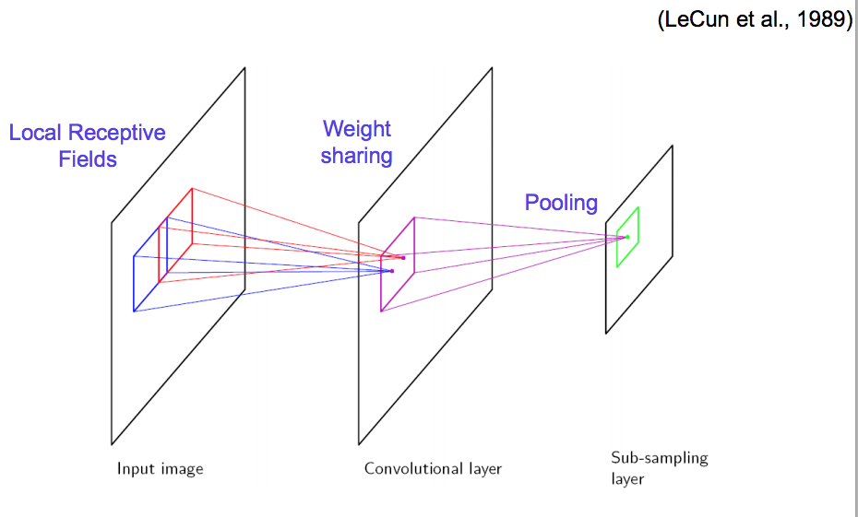
Vision with CNNs

Slide 28
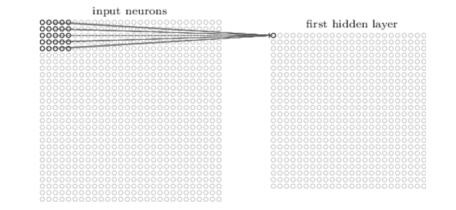
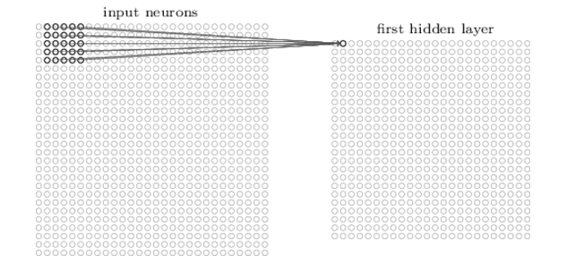
How do we convolve an image with an ANN?
Note that the parameters in the matrix defining the convolution are tied across all places that it is used

Slide 29
What’s a convolution?
Basic idea:
Pick a 3-3 matrix F of weights
Slide this over an image and compute the inner product similarity of F and the corresponding field of the image, and replace the pixel in the center of the field with the output of the inner product operation
Key point:
Different convolutions extract different types of low-level “features” from an image
All that we need to vary to generate these different features is the weights of F

Slide 30
Convolution DEMO
https://deeplizard.com/resource/pavq7noze2

Slide 31
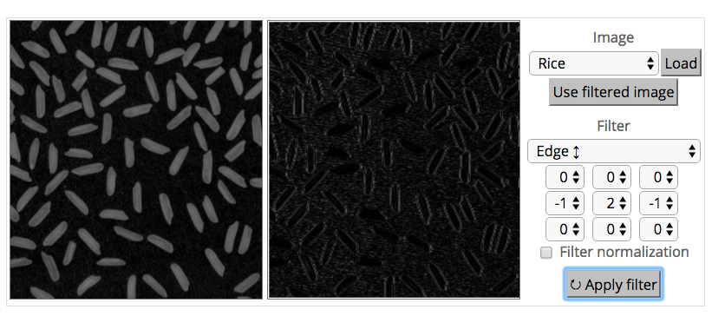
What’s a convolution?

Slide 32
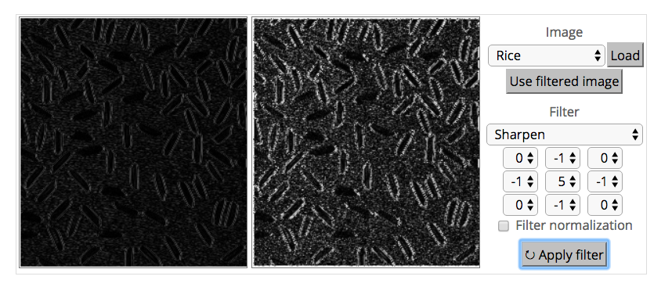
What’s a convolution?

Slide 33
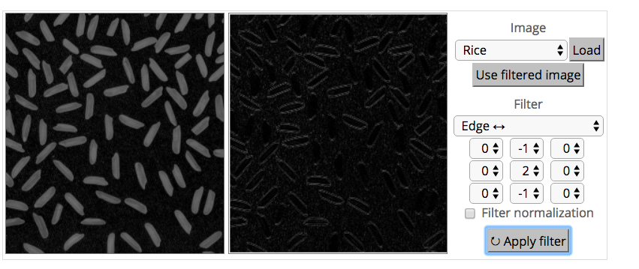
What’s a convolution?

Slide 34
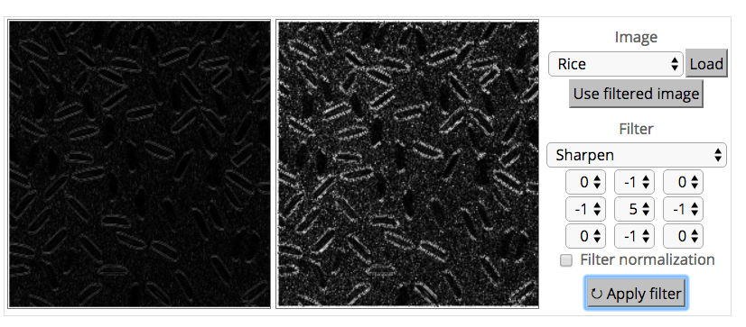
What’s a convolution?

Slide 35
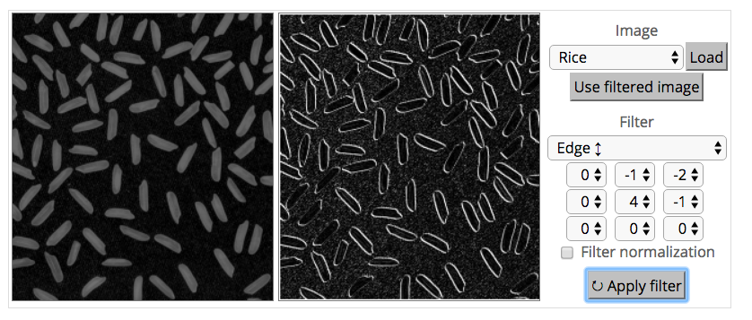
What’s a convolution?

Slide 36
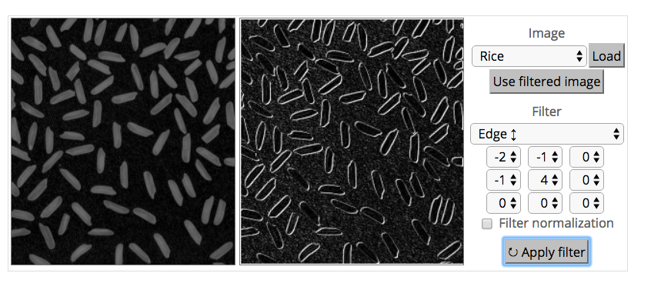
What’s a convolution?
http://matlabtricks.com/post-5/3x3-convolution-kernels-with-online-demo

Slide 37

How do we convolve an image with an ANN?
Note that the parameters in the matrix defining the convolution are tied across all places that it is used
weight matrix W
Notes:
formula has a nice gradient

Slide 38
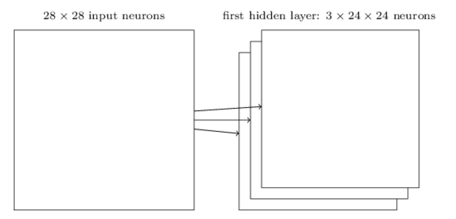
How do we do many convolutions of an image with an ANN?
W3
W2
weight matrix W1

Slide 39
Convolutions and more….
Usually alternate convolutions with down-sampling or max-pooling
So properties of larger subimages can be detected
Also these are non-linear operations
At some point the feature maps become indicators of some semantic property, not a recognizable transformation of the image
Then you switch to fully-connected layers (e.g. logistic units)

Slide 40
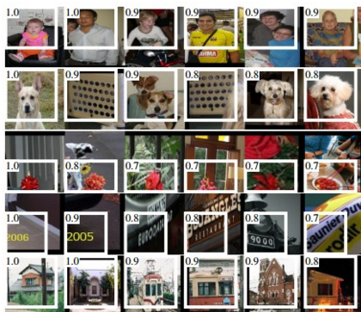
Convolutions and more….
5 layers up
The subfield in a large dataset that gives the strongest output for a neuron

Slide 41
Why are CNNs easier to train?
Sharing: When we autodiff then delta[W] is incremented many many times … so vanishing gradient is less of a problem
Note that the parameters in the matrix defining the convolution are tied across all places that it is used
weight matrix W

Slide 42
Why are CNNs easier to train?
Many layers are linear … so saturation is less of a problem
CNNs were great for vision but not widely used beyond vision

Slide 43
CNNs history
History
“Neocognitron” was a learned CNN from 1979
John Denker , Larry Jackal, Isabell Guyon(Bell Labs) trained a CNN in 1989 on USPS digit recognition (preprocessed data)
LeNet-1 was used in 1990 by Yann LeCun
About 10k parameters
LeNet-5 was state-of-the-art on NIST/MNIST (digit recognition, 60k examples) in mid- 1990’s
About 60k parameters
But other systems were competitive
More complex vision problems generally relied on feature engineering, kernels, …
Mid-2000’s GPUs began being used for ML
Early 2010’s GPU-based CNNs were trained in days not weeks
ImageNet (22k classes, 14M images) released 2009
AlexNet (60M parameters) in 2012 achieved SoTA results

Slide 44
Further History of ANNs
mid-1980’s – mid-1990’s:
Sejnowski’s NETTalk text-to-speech (1 hidden layer)
Rumelhart and McClelland PDP book set
Neural Info Processing Systems (NIPS) conference starts
Convolutional ANNs for vision tasks
2000-2015 saw a lot of progress
Mid-2000’s GPUs began being used for ML
Theano, 2007 – first widely-used autodiff + GPU ML platform
Larger datasets (e.g., ImageNet)
Many incremental improvements in architecture

Slide 45
The Art of ANNs
Incremental ANN improvements in early 2000’s

Slide 46
How to Design a Deep NN
Art not science
Useful new architectures are usually incremental changes to existing ones
Useful new optimizers are usually incremental changes to existing ones
The ML community has been jointly evolving
neural architectures (like Transformer)
loss functions (like cross-entropy)
optimizers (like SGD, Adam)
hardware (like GPUs/TPUs)

Slide 47
Some key differences in 2nd wave of ANNs
Use of softmax and entropic loss instead of squared loss.
Use of alternate non-linearities
reLU and hyperbolic tangent
Better understanding of weight initialization
Residual connections (aka skip connections)
“Highway networks”

Slide 48
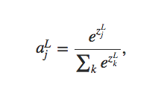
Softmax output layer
Softmax
Δw_{ij =} (y_{i}-z_{i})y _{j}
Network outputs a probability distribution!
Cross-entropy loss after a softmax layer gives a very simple, numerically stable gradient: Y - P

Slide 49
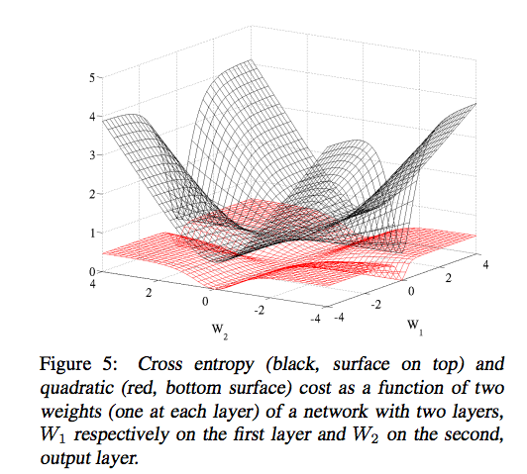
Cross-entropy loss

Slide 50
Some key differences
Use of softmax and entropic loss instead of squared loss.
Use of alternate non-linearities
reLU and hyperbolic tangent
Better understanding of weight initialization
Residual connections (aka skip connections)

Slide 51
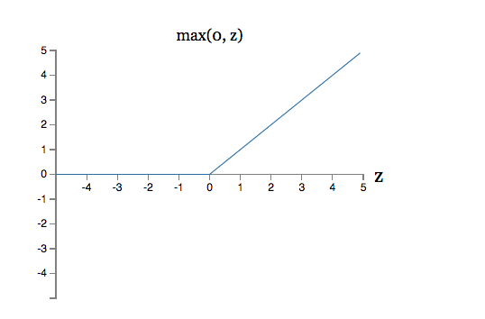

Alternative non-linearities
A new change: modifying the nonlinearity
reLU often used in vision tasks
Alternate 2: rectified linear unit
Linear with a cutoff at zero
(Implement: clip the gradient when you pass zero)

Slide 52
Some key differences
Use of softmax and entropic loss instead of squared loss.
Use of alternate non-linearities
reLU and hyperbolic tangent
Better understanding of weight initialization
Residual connections (aka skip connections)

Slide 53
It’s easy for sigmoid units to saturate
For a big network there are lots of weighted inputs to each neuron. If any of them are too large then the neuron will saturate. So neurons get stuck with a few large inputs OR many small ones.

Slide 54
It’s easy for sigmoid units to saturate
If there are 500 non-zero inputs initialized with a Gaussian ~N(0,1) then the SD is
Common heuristics for initializing weights:

Slide 55
It’s easy for sigmoid units to saturate
Saturation visualization from Glorot & Bengio 2010 using

Slide 56
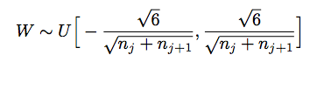
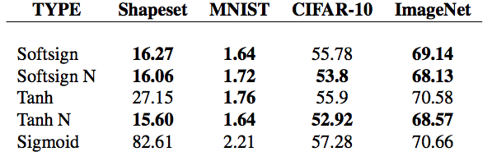
Initializing to avoid saturation
In Glorot and Bengio they suggest weights if level j (with n_{j} inputs) from
First breakthrough deep learning results were based on clever pre-training initialization schemes, where deep networks were seeded with weights learned from unsupervised strategies
This is not always the solution – but good initialization is very important for deep nets!

Slide 57
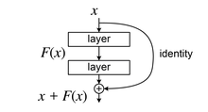
Some key differences
Use of softmax and entropic loss instead of squared loss.
Use of alternate non-linearities
reLU and hyperbolic tangent
Better understanding of weight initialization
Residual connections (aka skip connections)

Slide 58
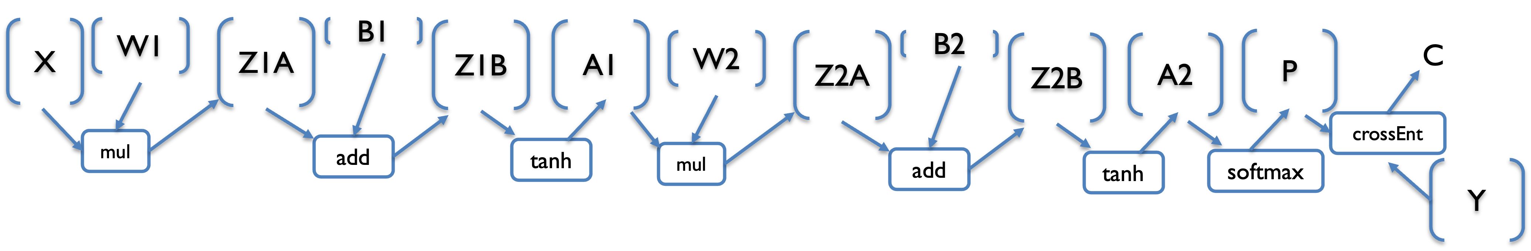
CNNs with Residual Connections
Inputs: X,W1,B1,W2,B2
Z1a = mul(X,W1) // matrix mult
Z1b = add(Z1a,B1) // add bias vec
A1 = tanh(Z1b) //element-wise
Z2a = mul(A1,W2)
Z2b = add(Z2a,B2)
A2 = tanh(Z2b) // element-wise
P = softMax(A2) // vec to vec
C = crossEnt_{Y}(P) // cost function
Inputs: X,W1,B1,W2,B2
Z1a = mul(X,W1) // matrix mult
Z1b = add(Z1a,B1) // add bias vec
A1 = tanh(Z1b) //element-wise
Z2a = mul(A1,W2)
Z2b = add(Z2a,B2)
A2 = tanh(Z2b) + A1 // element-wise
P = softMax(A2) // vec to vec
C = crossEnt_{Y}(P) // cost function

Slide 59
CNNs with Residual Connections
Inputs: X,W1,B1,W2,B2
Z1a = mul(X,W1) // matrix mult
Z1b = add(Z1a,B1) // add bias vec
A1 = tanh(Z1b) //element-wise
Z2a = mul(A1,W2)
Z2b = add(Z2a,B2)
A2 = tanh(Z2b) // element-wise
P = softMax(A2) // vec to vec
C = crossEnt_{Y}(P) // cost function
Inputs: X,W1,B1,W2,B2
Z1a = mul(X,W1) // matrix mult
Z1b = add(Z1a,B1) // add bias vec
A1 = tanh(Z1b) //element-wise
Z2a = mul(A1,W2)
Z2b = add(Z2a,B2)
Z3 = tanh(Z2b)
A2 = add(Z3, A1)
P = softMax(A2) // vec to vec
C = crossEnt_{Y}(P) // cost function

Slide 60

CNNs with Residual Connections
Inputs: X,W1,B1,W2,B2
Z1a = mul(X,W1) // matrix mult
Z1b = add(Z1a,B1) // add bias vec
A1 = tanh(Z1b) //element-wise
Z2a = mul(A1,W2)
Z2b = add(Z2a,B2)
Z3 = tanh(Z2b)
A2 = add(Z3, A1)
P = softMax(A2) // vec to vec
C = crossEnt_{Y}(P) // cost function
for z=A2,
delta[Z3] += delta[A2]*1
delta[A1] += delta[A2]*1

Slide 61
CNNs with Residual Connections
If gradient through Z3, Z2a, Z2b vanishes then A1 still gets a signal…pushing the first layer to minimize loss ➔ fit the data directly
Inputs: X,W1,B1,W2,B2
Z1a = mul(X,W1) // matrix mult
Z1b = add(Z1a,B1) // add bias vec
A1 = tanh(Z1b) //element-wise
Z2a = mul(A1,W2)
Z2b = add(Z2a,B2)
Z3 = tanh(Z2b)
A2 = add(Z3, A1)
P = softMax(A2) // vec to vec
C = crossEnt_{Y}(P) // cost function
If layer 1 can’t fit the data then layer 2 will be able to correct layer 1’s approximate fit
for z=A2,
delta[Z3] += delta[A2]*1
delta[A1] += delta[A2]*1

Slide 62
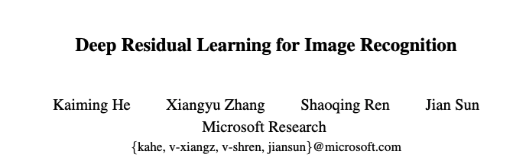
CNNs with Residual Connections
2015

Slide 63
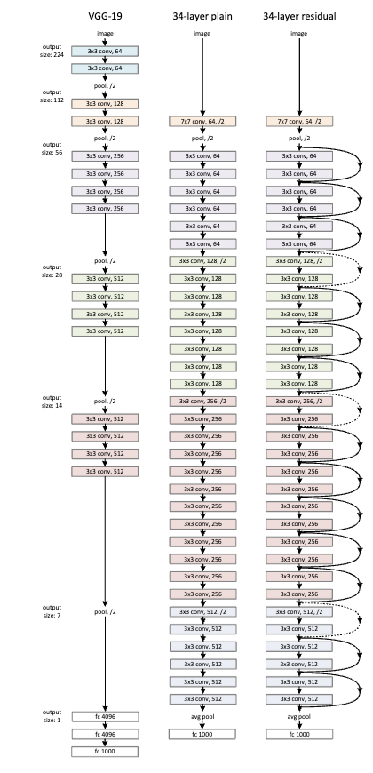
CNNs with Residual Connections

Slide 64
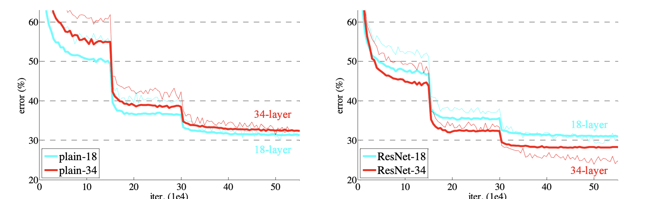
CNNs with Residual Connections

Slide 65
Further History of ANNs
mid-1980’s – mid-1990’s:
Sejnowski’s NETTalk text-to-speech (1 hidden layer)
Rumelhart and McClelland PDP book set
Neural Info Processing Systems (NIPS) conference starts
Convolutional ANNs for vision tasks
2000-2015 saw a lot of progress
Mid-2000’s GPUs began being used for ML
autodiff + GPU ML platforms
Larger datasets (e.g., ImageNet)
Many incremental improvements in architecture
Pre-trained word-embeddings (word2vec, GloVE)

Slide 66
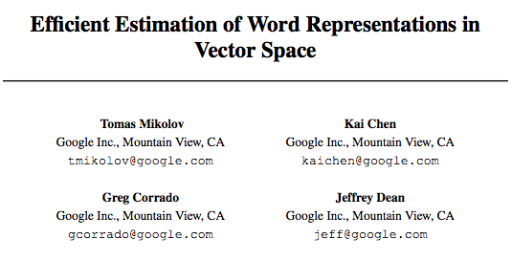
Word2Vec and Word embeddings
Some models that were very influential were large (trained on millions of words) but not deep….
2013

Slide 67
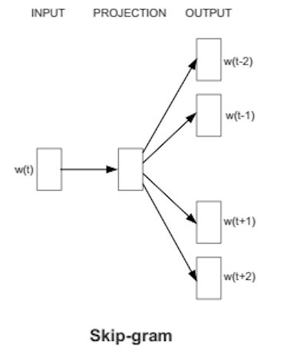
Basic idea behind skip-gram embeddings
construct hidden layer that “encodes” that word
So that the hidden layer will predict likely nearby words w(t-K), …, w(t+K)
from an input word w(t) in a document
final step of this prediction is a softmax over lots of outputs

Slide 68
Basic idea behind skip-gram embeddings
Training data:
positive examples are pairs of words w(t), w(t+j) that co-occur
You want to train over a very large corpus (100M words+) and hundreds+ dimensions
Training data:
negative examples are samples of pairs of words w(t), w(t+j) that don’t co-occur

Slide 69
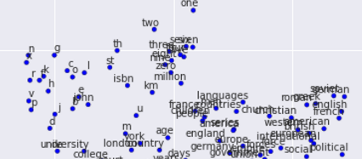
Results from word2vec
https://projector.tensorflow.org/

Slide 70
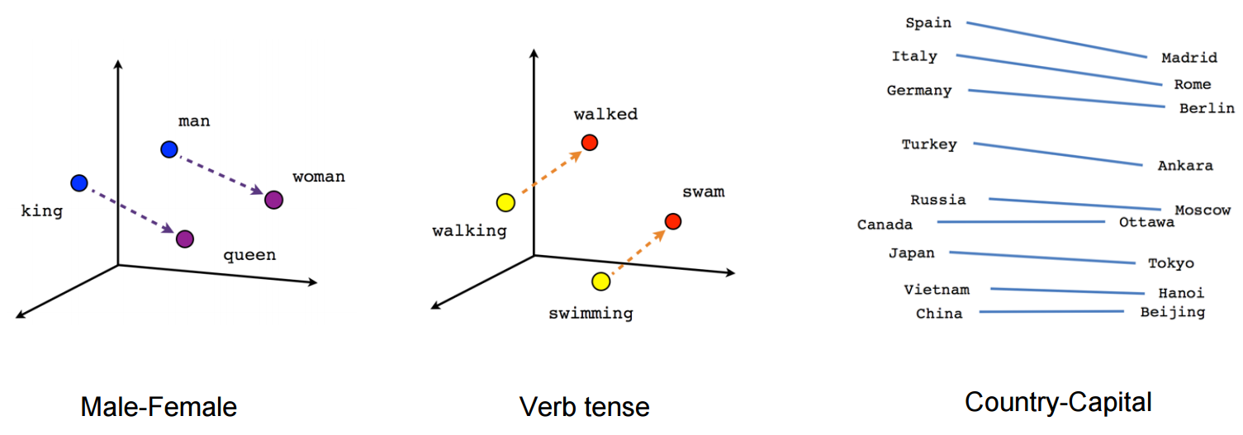
Results from word2vec
A number of properties of word2vec were surprising and mysterious! until they were explained by Omer Levy and Yoav Goldberg a couple of years later

Slide 71
Further History of ANNs
mid-1980’s – mid-1990’s:
Sejnowski’s NETTalk text-to-speech (1 hidden layer)
Rumelhart and McClelland PDP book set
Neural Info Processing Systems (NIPS) conference starts
Convolutional ANNs for vision tasks
2000-2015 saw a lot of progress
Mid-2000’s GPUs began being used for ML
autodiff + GPU ML platforms
Larger datasets (e.g., ImageNet)
Many incremental improvements in architecture
Pre-trained word-embeddings (word2vec, GloVE)
LSTMs and other encoder-decoder seq2seq learners

Slide 72
The ART OF Recurrent Neural Networks – Part 1

Slide 73
Motivation: what about sequence prediction?
What can I do when input size and output size vary?

Slide 74
Motivation: what about sequence prediction?
h
A
x

Slide 75
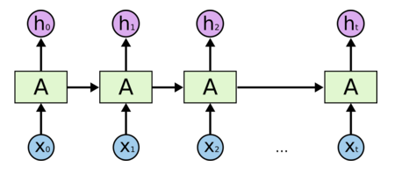
Architecture for an RNN (recurrent neural network)
Some information is passed from one subunit to the next
Sequence of outputs
Sequence of inputs
Start of sequence marker
End of sequence marker
http://colah.github.io/posts/2015-08-Understanding-LSTMs/

Slide 76
Architecture for an 1980’s RNN
…
Problem with this: it’s very hard to train using the usual multi-layer networks

Slide 77
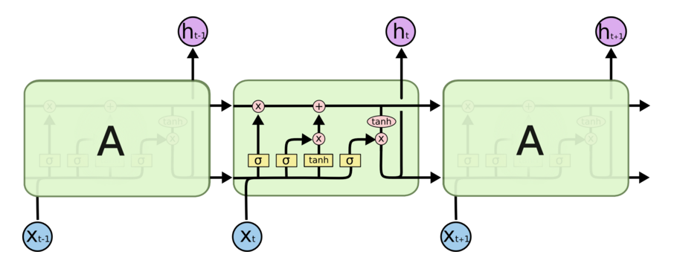
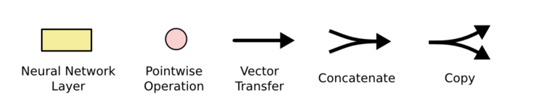
The architecture for an LSTM
“Bits of memory”
(vector)
Decide what to forget
Decide what to insert
Longterm-shortterm memory model
Combine with transformed x_{t}
No sigmoids/ReLU’s on the main “highway”
σ: output in [0,1]
tanh: output in [-1,+1]
http://colah.github.io/posts/2015-08-Understanding-LSTMs/
Notes:
Info is transferred down the chain, not just propagated
Decide when to insert imformation from input into the “backbone”

Slide 78
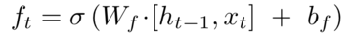
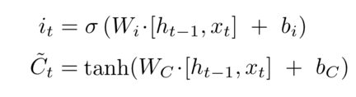
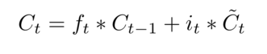
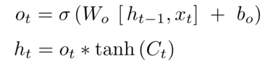
Implementing an LSTM
For t = 1,…,T:
(1)
(2)
(3)
http://colah.github.io/posts/2015-08-Understanding-LSTMs/
Notes:
Info is transferred down the chain, not just propagated
Decide when to insert imformation from input into the “backbone”

Slide 79

LSTMs can be used for other sequence tasks
image captioning
sequence classification
named entity recognition
translation
seq2seq
http://karpathy.github.io/2015/05/21/rnn-effectiveness/

Slide 80
LSTMs can be used for other sequence tasks
image captioning
sequence classification
named entity recognition
translation
Decoder
Encoder
seq2seq
http://karpathy.github.io/2015/05/21/rnn-effectiveness/

Slide 81

Character-level language model
Test time:
pick a seed character sequence
generate the next character
then the next
then the next …
http://karpathy.github.io/2015/05/21/rnn-effectiveness/

Slide 82

Character-level language model
http://karpathy.github.io/2015/05/21/rnn-effectiveness/

Slide 83

Character-level language model
http://karpathy.github.io/2015/05/21/rnn-effectiveness/

Slide 84

Character-level language model
Yoav Goldberg:
order-10 unsmoothed character n-grams
http://karpathy.github.io/2015/05/21/rnn-effectiveness/

Slide 85

Character-level language model
http://karpathy.github.io/2015/05/21/rnn-effectiveness/

Slide 86

Character-level language model
LaTeX “almost compiles”
http://karpathy.github.io/2015/05/21/rnn-effectiveness/

Slide 87

Character-level language model
http://karpathy.github.io/2015/05/21/rnn-effectiveness/

Slide 88
Further History of ANNs
mid-1980’s – mid-1990’s:
Sejnowski’s NETTalk text-to-speech (1 hidden layer)
Rumelhart and McClelland PDP book set
Neural Info Processing Systems (NIPS) conference starts
Convolutional ANNs for vision tasks
2000-2015 saw a lot of progress
Mid-2000’s GPUs began being used for ML
autodiff + GPU ML platforms
Larger datasets (e.g., ImageNet)
Many incremental improvements in architecture
Pre-trained word-embeddings (word2vec, GloVE)
LSTMs and other encoder-decoder seq2seq learners
Attention as an architectural primitive

Slide 89
The ART OF Recurrent Neural Networks – Part 2

Slide 90
ANN Tricks for NLP
Common tricks in using LSTMs
represent words with embeddings (one per token)
represent words in context with RNN hidden state
represent a sentence with the last hidden state
or pool all hidden states with MAX or SUM
biLSTM: run an LSTM in both directions
represent with first + last hidden state
feed representations into a deeper network….
Often using attention

Slide 91


Attention: History
2007

Slide 92


Attention: History
2010

Slide 93


Example: question answering
2016
Common trick: train network to make representations similar/dissimilar, not to classify
Goal: take a question/fact pair and test if the question is answered by the fact

Slide 94

Example: question answering
Adding attention:
classify the hidden states h₁, … h_{m} of the answer according to relevance to the question
classifier is based on question representation o_{q} and hidden state h_{i}
score of h_{i} is softmax of similarities of question o_{q} to answer-token encoding h_{i}
score ~= ”probability that answer token is useful”
when you pool answer tokens reps, weight by the classifier’s score

Slide 95


Example: question answering

Slide 96

Example: question answering (biDAF)
Seo et al, ICLR 2017

Slide 97
Recall: Encoder-Decoder Models for Sequences
image captioning
sequence classification
named entity recognition
translation
Decoder
Encoder
seq2seq
http://karpathy.github.io/2015/05/21/rnn-effectiveness/

Slide 98


Example: Machine Translation
2016
Statistical MT models would:
Guess “alignment” between words in the source and target text
Use the guessed alignment to learn to translate words or phrases

Slide 99
Example: Machine Translation
2016
This model
encodes the source text
decodes to produce the target text while
using a soft alignment between the word to be generated and the encodings of the source words
alignment is based on attention

