Slide 1
10-605 / 10-405
Machine Learning from Large Datasets

Slide 2
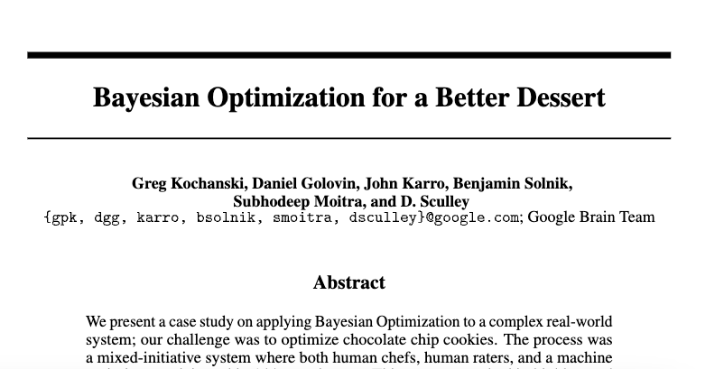
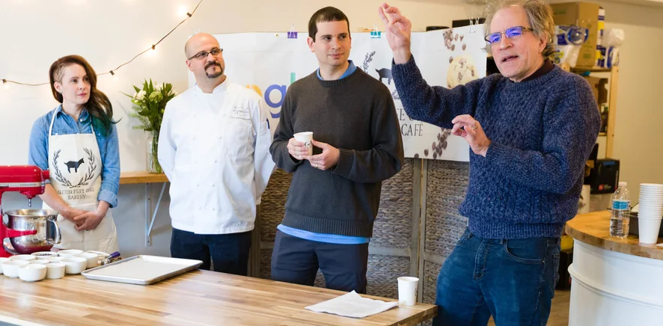
Guest Speaker Monday! Greg Kochanski, Google DeepMind
https://blog.google/technology/research/makings-smart-cookie/

Slide 3
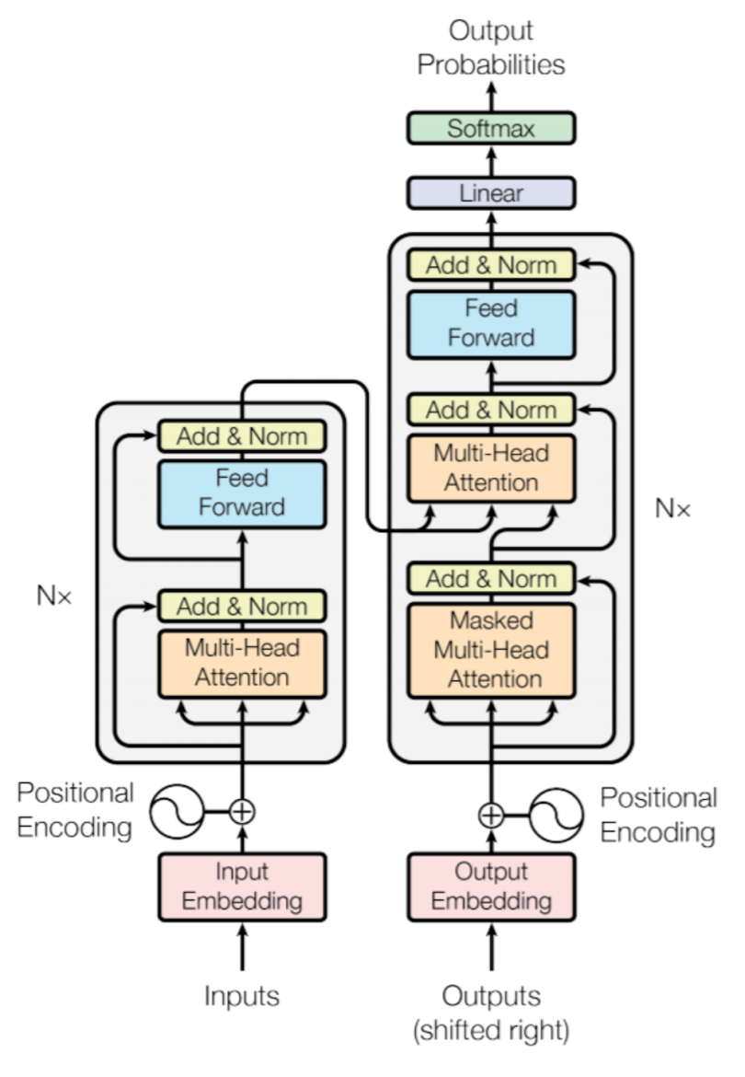
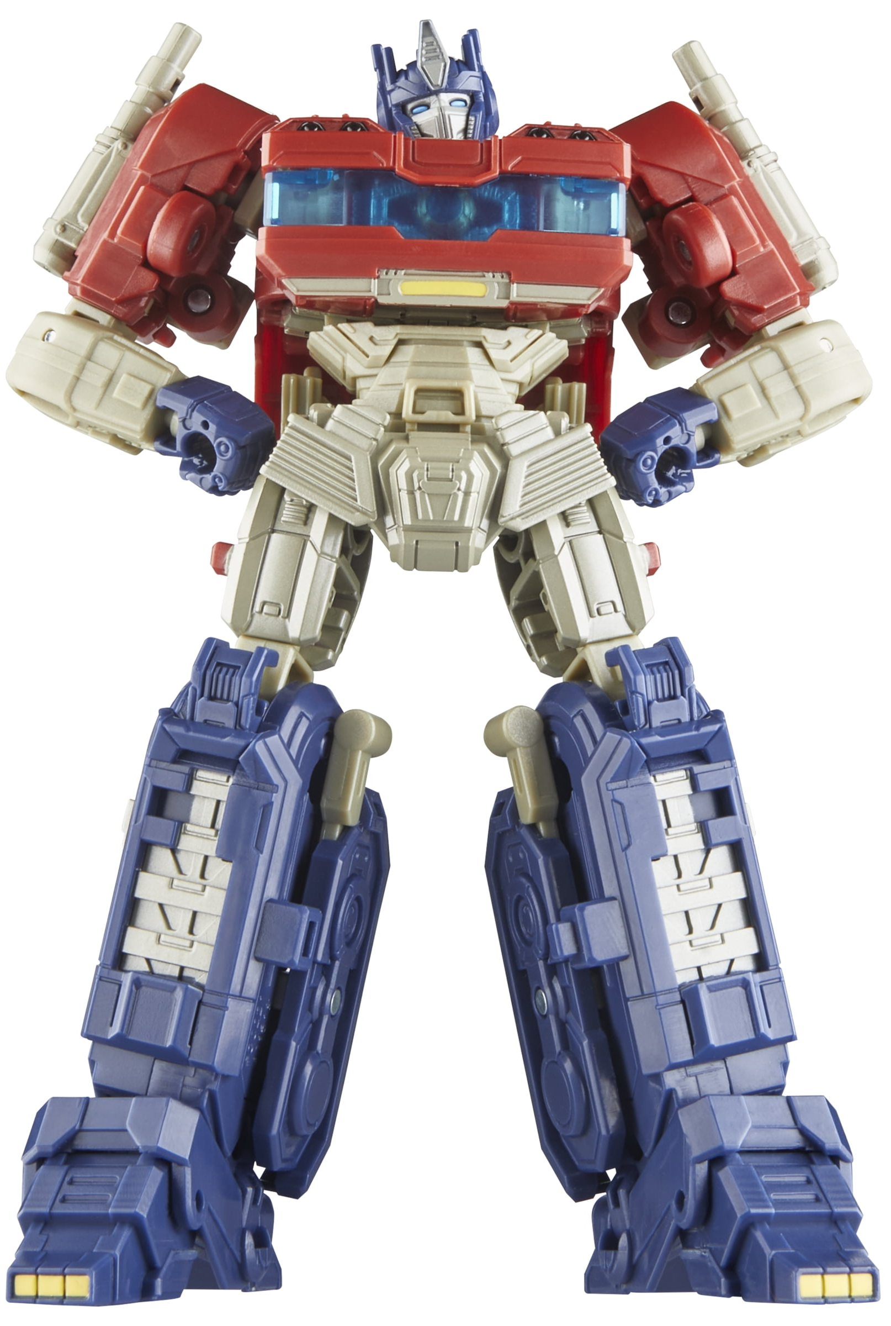
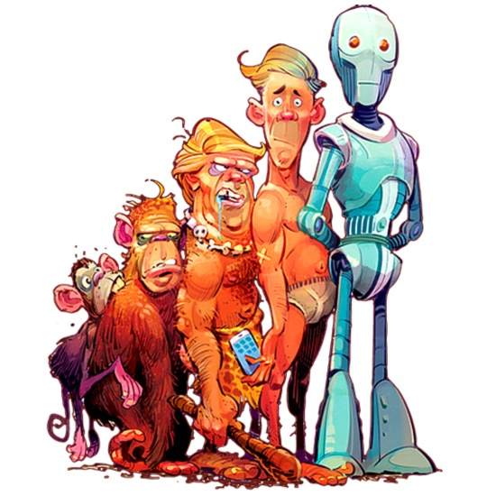
The Evolution of Transformers: Summary

Slide 4
Topics
Why are deep MLPs interesting?
They are more expressive
Why are they hard to learn?
Vanishing gradients: gradients can get exponentially smaller with depth
Activation values need to stay in a narrow range or else sigmoid units get “stuck”

Slide 5
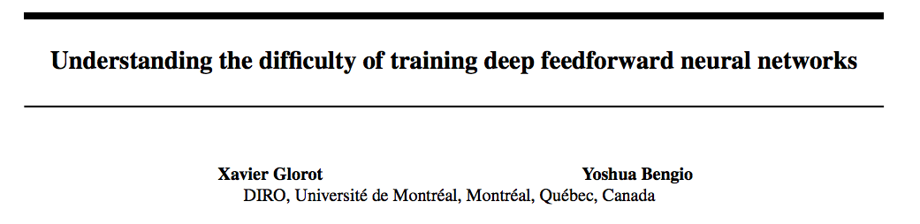
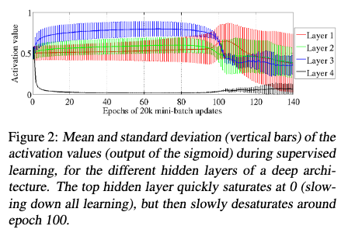
AI Stats 2010
input
output

Slide 6
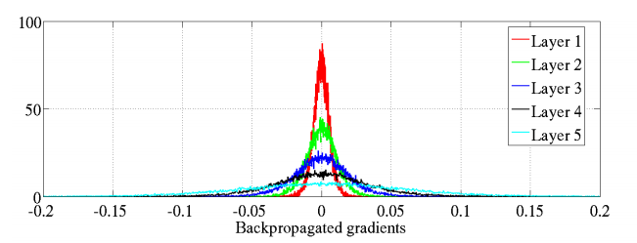
AI Stats 2010
input
output
Histogram of gradients in a 5-layer network for an artificial image recognition task

Slide 7
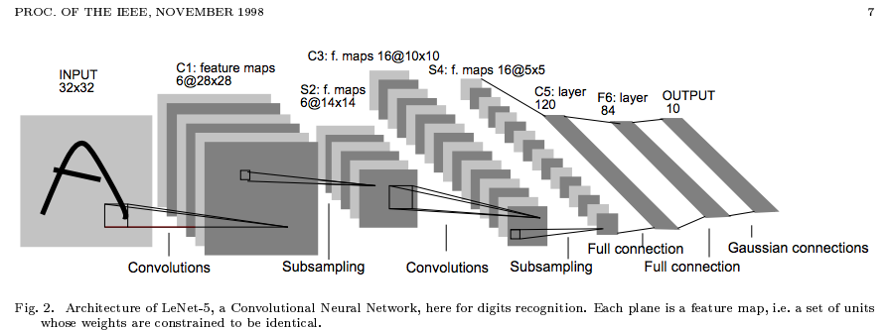
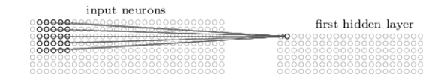
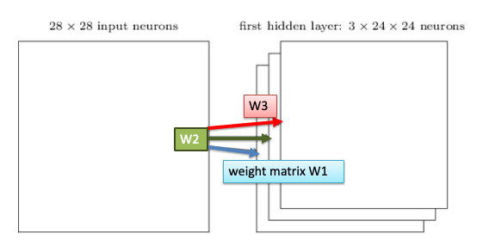
Topics
What tricks make learning easier/better ?
CNNs
CNNs using multiple parallel convolutions can are more expressive

Slide 8
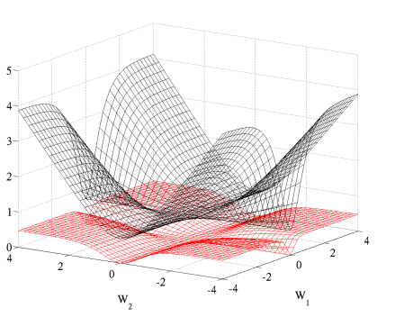
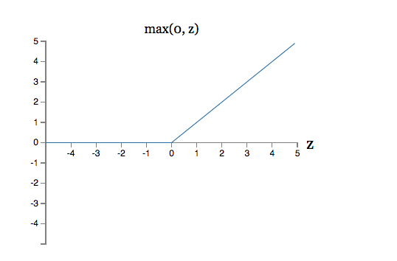
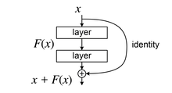
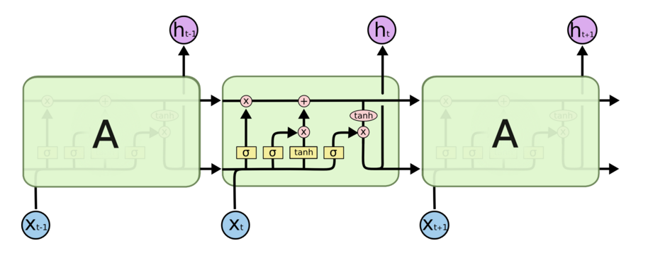
Topics
What tricks make learning easier/better ?
softmax loss
reLU and variants instead of sigmoids
better heuristics for weight initialization
residual/skip connections
“highway” networks like LSTMs
limited number of “deep” paths which pass through a limited number of kinds of nodes

Slide 9
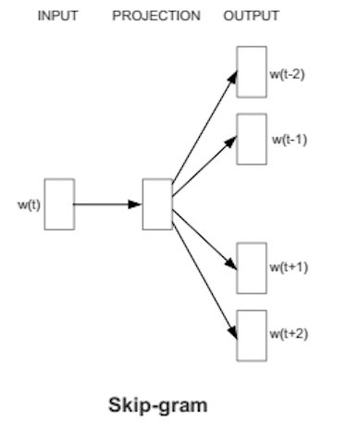
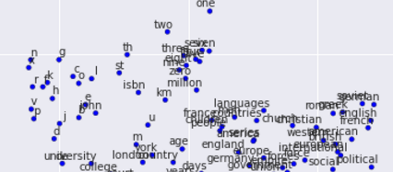
Topics
How can we learn language?
LSTMs, GRUs, etc
word embeddings
using attention to
“classify” parts a₁, …, a_{N} of a network (e.g. embeddings of words, or words-in-context) as relevant to some second representation B
import the parts A_{i} considered relevant into B

Slide 10
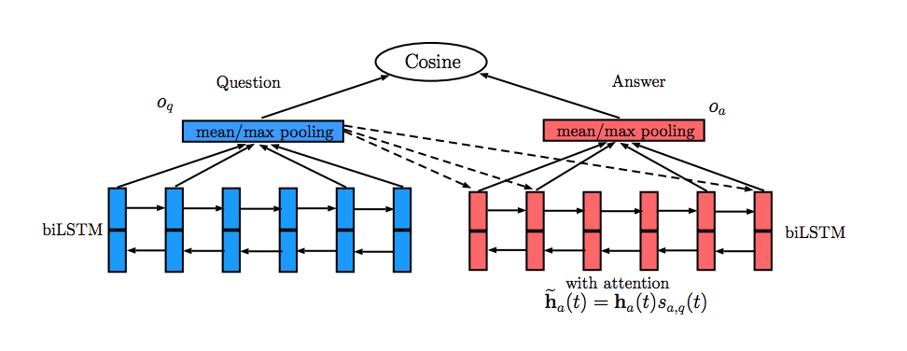
Recap: Attention for “question answering”
Adding attention:
classify the hidden states h₁, … h_{m} of the answer according to relevance to the question
classifier is based on question representation o_{q} and hidden state h_{i}
score of h_{i} is softmax of similarities of question o_{q} to answer-token encoding h_{i}
score ~= ”probability that answer token is useful”
when you pool answer tokens reps, weight by the classifier’s score

Slide 11
Topics
How can we learn language?
LSTMs, GRUs, etc
word embeddings
using attention
representing
words with embeddings
words in context with RNN hidden states
sequences with last RNN hidden state
training representations end-to-end on a task
but often starting with pre-trained representations of words

Slide 12
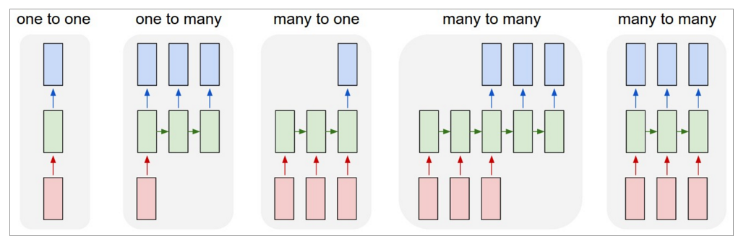
Topics
Utility of sequence-to-sequence learning
and encoder-decoder models
image captioning
sequence classification
named entity recognition
translation
Decoder
Encoder
seq2seq

Slide 13
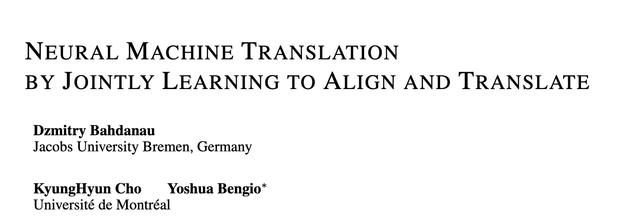
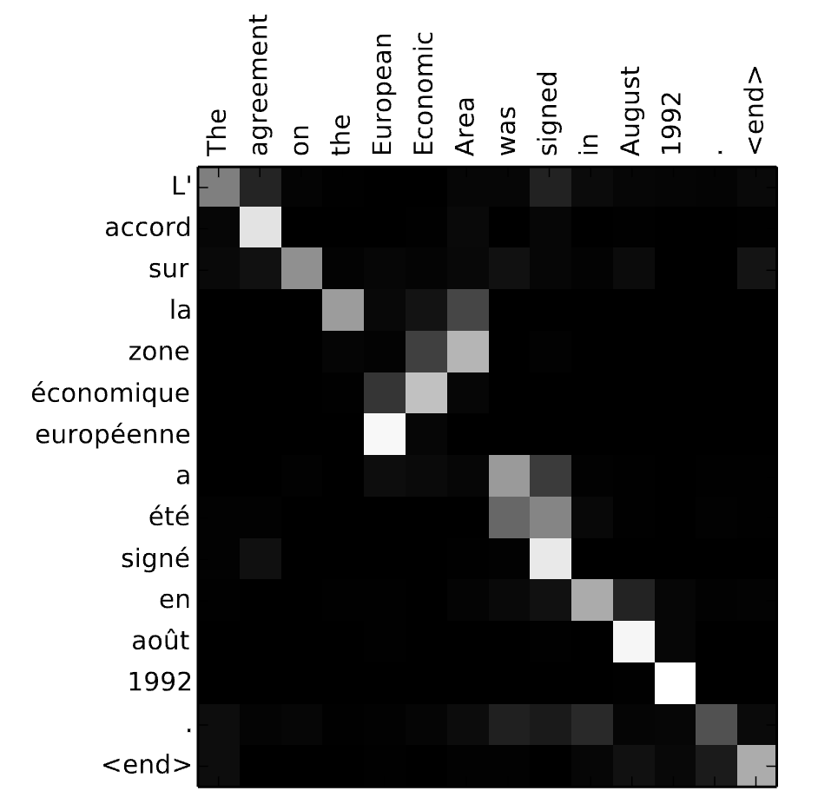
Example: Machine Translation
2016
This model
encodes the source text
decodes to produce the target text while
using a soft alignment between the word to be generated and the encodings of the source words
alignment is based on attention

Slide 14
Transformers

Slide 15
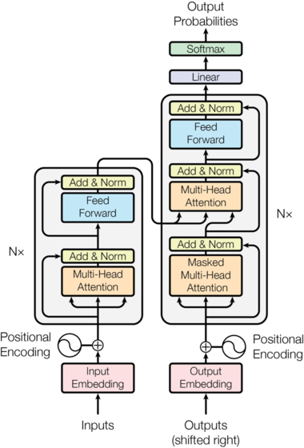
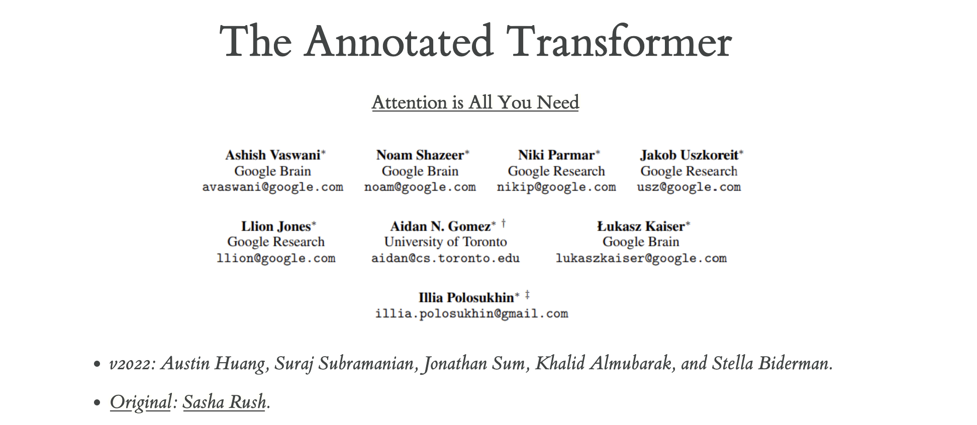
Original paper 2017
Will talk also about connections to other Transformer models
https://e2eml.school/transformers.html
https://github.com/rasbt/LLMs-from-scratch

Slide 16
Inputs and Outputs

Slide 17
output: sequence of tokens (int ids)
Simplify: assume we output one output token at a time
input: sequence of tokens (int ids)
Notes:
Where is the bottleneck in the 2007 transformer?
is my interpretation of outputs correct here? or is an approximation based on masking?

Slide 18
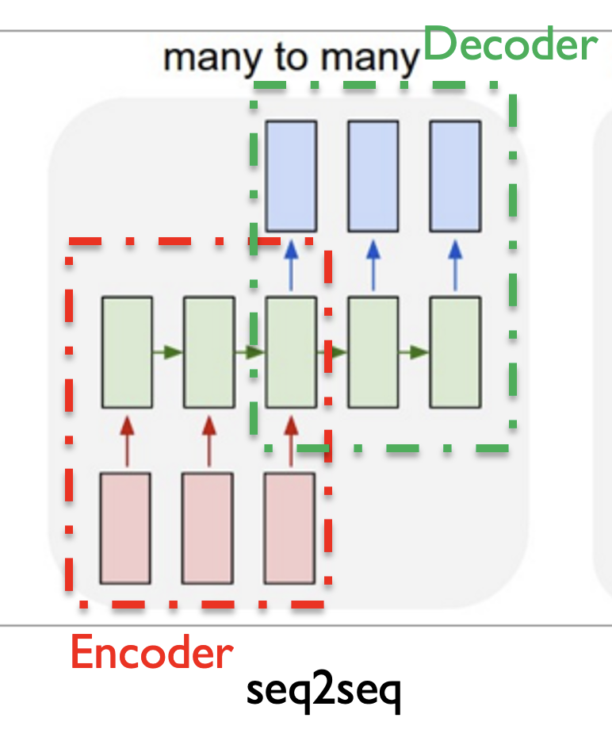
output n, n+1, …
BERT-like models have no decoder (encoder only)
Transformers are Encoder-Decoder Models
GPT models have no “bottleneck” (decoder-only)
… but decoder can also “attend” to encoder states
“outputs” 1 ... n-1
Notes:
Where is the bottleneck in the 207 transformer?
is my interpretation of outputs correct here? or is an approximation based on masking?

Slide 19
End by mapping predicted token embedding to most (dot-product) similar legal embedding in the same table
To get probability distribution on a predicted token take a softmax of the dot-product similarities
token embeddings are learned parameters
Start by mapping tokens to embeddings from an embedding table, like in word2vec
in 2017 paper embeddings were 512 floats/token

Slide 20
768 tokens
attention | is | all | … | …
-1.67 | 9.86 | 1.56 | … | …
-12.31 | 4.43 | … | … | …
… | … | … | … | …
0.145 | -7.2 | … | … | …
512 floats/tokens
Start by mapping tokens to embeddings from an embedding table, like in word2vec

Slide 21
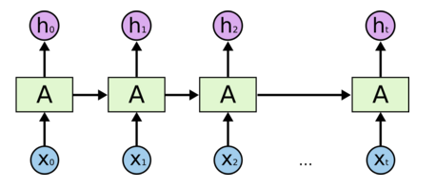
The main block of the Transformer is repeated a fixed numbers of times, independent of how long the input is.
in 2017 paper 6 layers of encoder
12 in BERT, 24 in BERT-large
126 layers in Llama-3 405B
Recap: an LSTM is as deep as its input is long, and reads data sequentially
Transformers don’t - they use feature engineering to encode token sequence

Slide 22
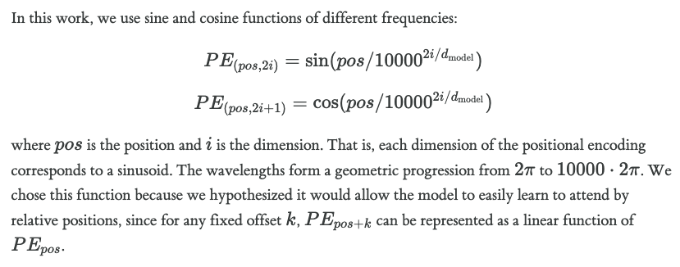
The PE features for a token’s position are just added to the embedding for that token

Slide 23
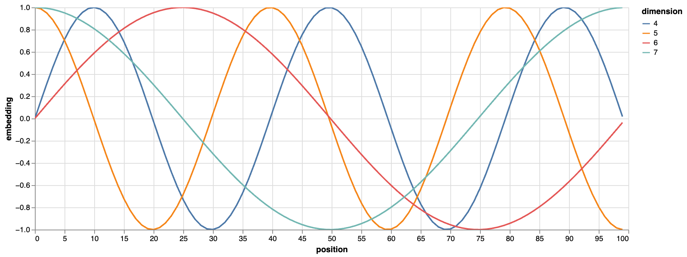
pos | d4 | d5 | d6 | d7
pos 0 | 0 | 1 | 0 | 1
pos 1 | 0.01 | 0.99 | 0.01 | 0.98
… | … | … | … | …
pos 5 | 0.73 | 0.72 | 0.31 | 0.97
… | … | … | … | ..
pos 20 | 0.01 | -1.0 | 0.97 | 0.29
vectors for nearby positions are similar

Slide 24
768 tokens
attention | is | … | MT
-0.67 | 0.86 |  | …
-1.31 | 1.43 | … | …
… | … | … | …
0.145 | -.72 | … | …
pos 0 | pos 1 | … | pos 20
0 | 1 |  | …
1 | 0.99 | … | …
… | … | … | …
0 | 0.98 | … | …

Slide 25
Attention

Slide 26

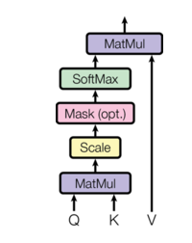
for a single attention “head”:
Q = L_{j} W^{Q} # usually smaller
K = L_{j} W^{K} # usually smaller
V = L_{j} W^{V}
L_{j} is layer input (initially embedding + PE)

Slide 27
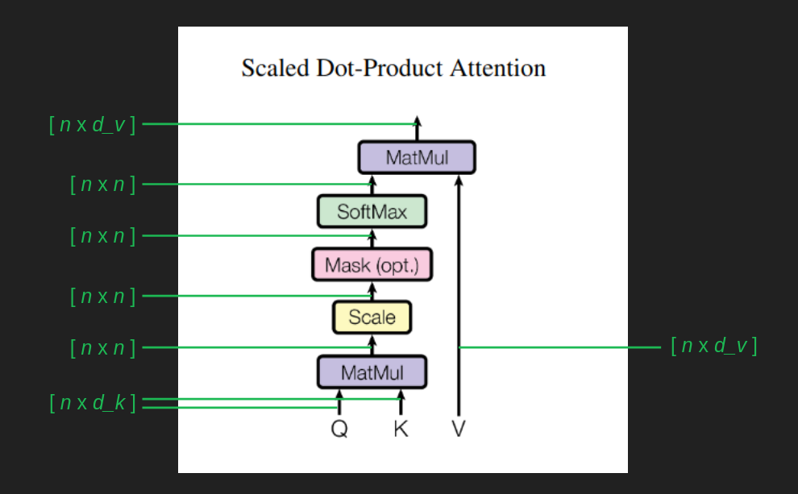
for each token i,
sum(value[j] * P(key[j] | query[i]) )
~ Pr(key|query) for each key, query … if each query is attending to a single key
dot-product similarity of each key to each query
for a single attention “head”:
Q = L_{j} W^{Q} # usually smaller
K = L_{j} W^{K} # usually smaller
V = L_{j} W^{V}
L_{j} is layer input (initially embedding + PE)

Slide 28
for a single attention “head”:
Q = L_{j-1} W^{Q}
K = L_{j-1} W^{K}
V = L_{j-1} W^{V}
L_{j-1} is previous layer output (or embedding + PE)

Slide 29
Multi-head attention is the same idea as used with CNNs – use multiple copies of the same trick in parallel with different trainable parameters and then later compress them back to one representation

Slide 30
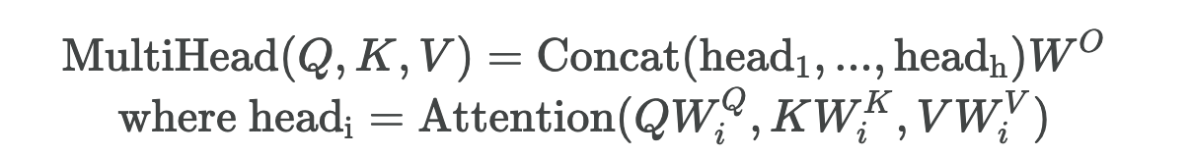
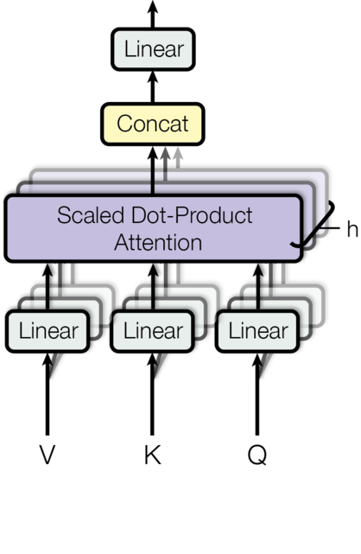

Slide 31
Other Layers in the Transformer Block

Slide 32
Add is a skip connection (aka residual connection)
Layer normalization normalizes the outputs of a layer so that mean is zero and variance is 1
…and also adds gain and bias vectors (gain is multiplicative, bias is additive)
It helps with vanishing gradients

Slide 33
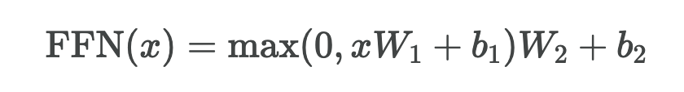
The same feed-forward MLP is applied to every token encoding
Different FFN parameters are used in different layers

Slide 34
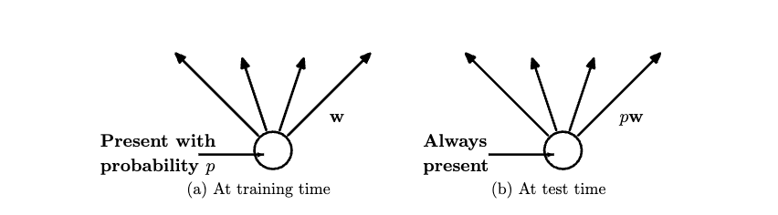
There is also a dropout layer after the FFN (another “trick” from 2014)

Slide 35
That’s the whole story for the encoder side!

Slide 36
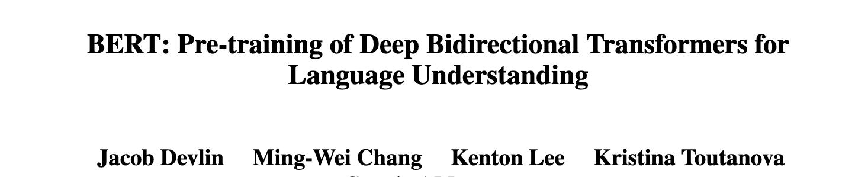
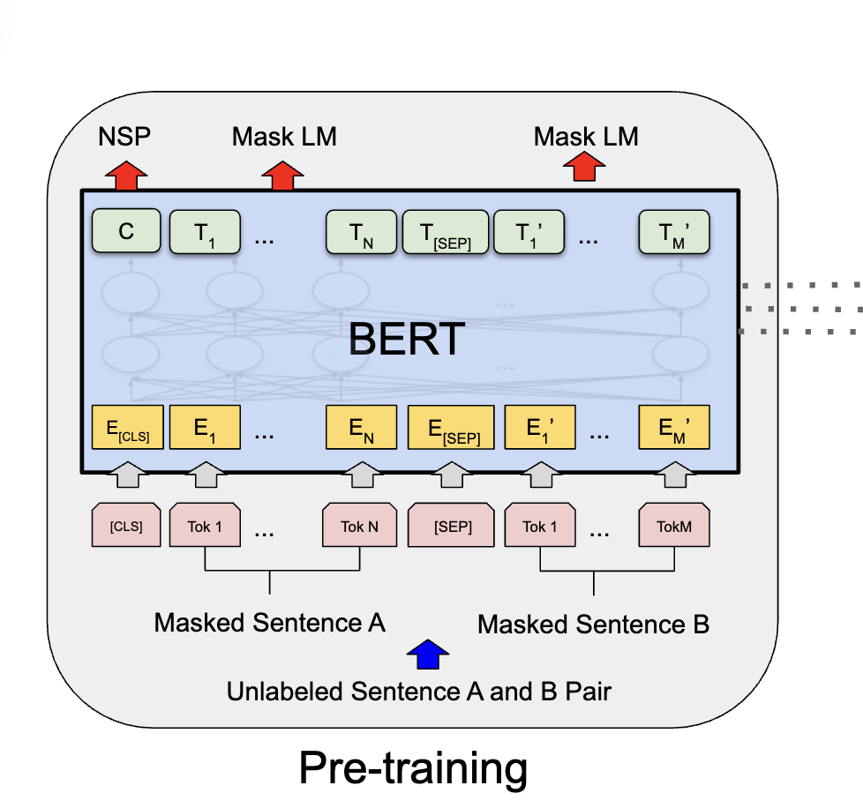
BERT: An Encoder-Only Transformer
2019
=

Slide 37
BERT: An Encoder-Only Transformer
Recall: produce a predicted token embedding to most (dot-product) similar legal embedding in the same table
What does the encoder do?
To get probability distribution on a predicted token take a softmax of the dot-product similarities
2019
The model tries to predict the masked tokens in the output layer.
15% of the input token embeddings are selected randomly and replaced with zero vectors….by a component-wise multiply with a “mask” vector of 0’s and 1’s.

Slide 38
BERT: An Encoder-Only Transformer
2019
If there are 512 tokens in each input passage then there are about 75 prediction tasks for model to learn from that passage
The model tries to predict the masked tokens in the output layer.
15% of the input token embeddings are selected randomly and replaced with zero vectors

Slide 39
BERT: An Encoder-Only Transformer
2019
The model also predicts if sentence B is the “next sentence” after sentence A in the original document.
Prediction was done based on the output embedding of a special [CLS] token that was prepended to the input text.

Slide 40
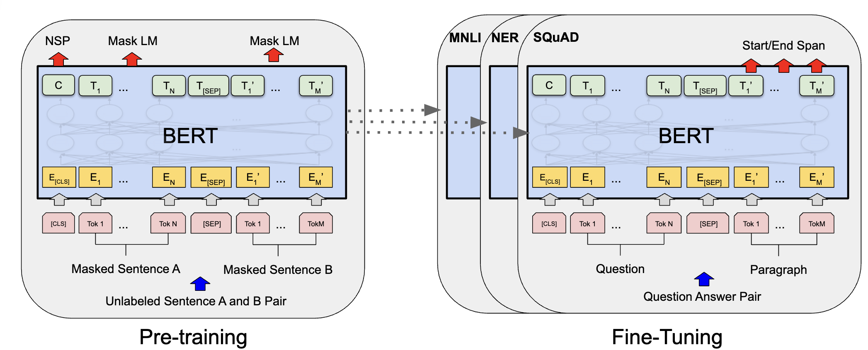
BERT: An Encoder-Only Transformer
2019
Then the model could be naturally fine-tuned for sentence-pair classification tasks (as well as other NLP tasks).

Slide 41
Back to: Encoder-Decoder Transformers

Slide 42
Encoder-decoder cross-attention is also used in each layer if the decoder
Masked self-attention is used in the decoder

Slide 43
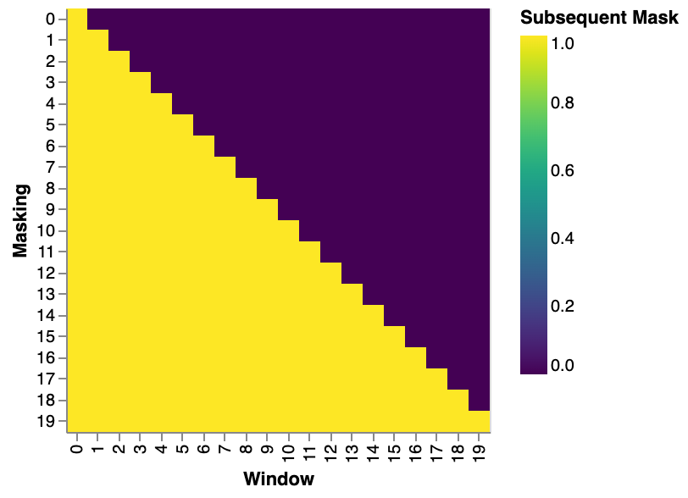
In masked self-attention, the query for token at position i can only attend to thr keys for tokens at positions 0,1,…,i
This is done with another mask
Masked self-attention is used in the decoder
Prediction for token at i is not affected by “future” tokens at i+1,i+2, …
aka ”causal LM” or “causal masking”

Slide 44
In decoder cross-attention the keys are always the highest (closest to output) layer of the encoder.
Very similar to the attention used in early attentive variants of LSTM
Encoder-decoder cross-attention is also used in each layer if the decoder
The highest layer of the encoder is a bottleneck – the decoder doesn’t see anything else computer by the encoder
All the parameters for the encoder and decoder are separate – nothing is shared but the word embeddings

Slide 45
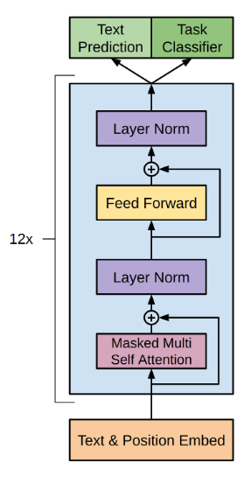
Decoder-Only Transformers
GPT-1

Slide 46
Decoder-Only Transformers
GPT-1
GPT-1 was a decoder-only Transformer pre-trained for next word prediction on books and then fine-tuned for various NLP tasks
GPT-2 was bigger, trained on more text, and could do some tasks zero-shot (e.g., summarize a document by prompting it with the document + “tld;dr: “ and then taking the first 100 words as a summary.
GPT-3 was still bigger and was tested on in-context learning tasks
Decoder-only models are believed to do better on in-context learning tasks

Slide 47
Comments: Fine-Tuning Transformers

Slide 48
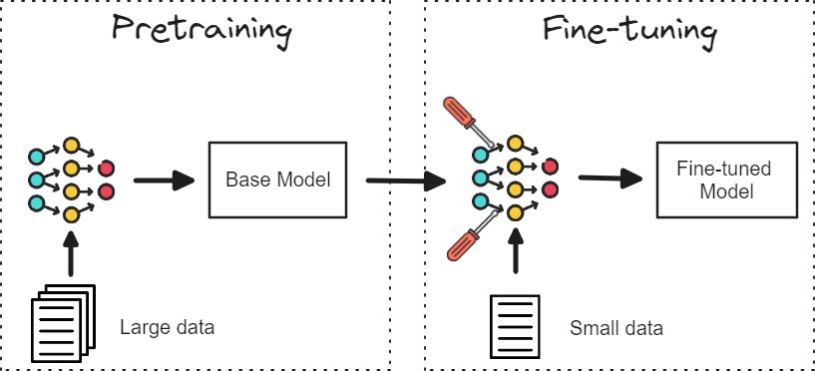
How do we ‘finetune’ models?
Start with a model trained on a lot of data
Using the pretrained model as a starting point, update the weights by fitting the model to a small amount of finetuning data (e.g., running a small number of steps of gradient descent)
Credit: Prasad Mahamulkar

Slide 49
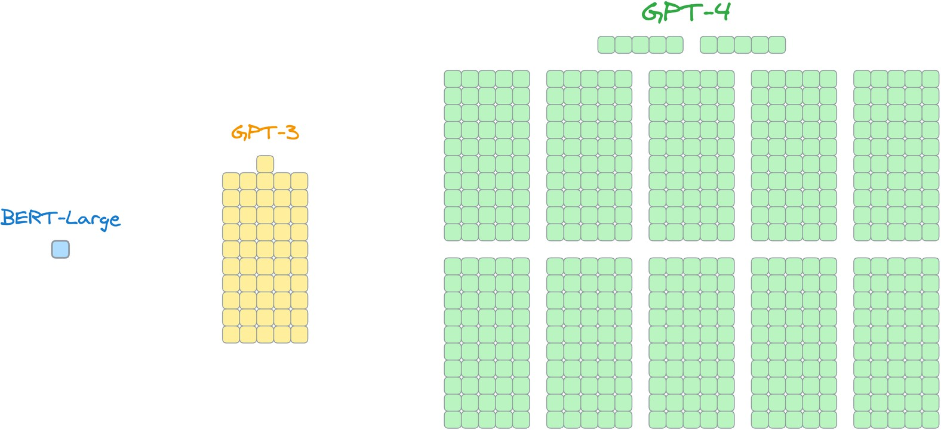
Potential issue: models are getting large!
340M parameters
175B parameters
???
https://www.dailydoseofds.com/implementing-lora-from-scratch-for-fine-tuning-llms/

Slide 50
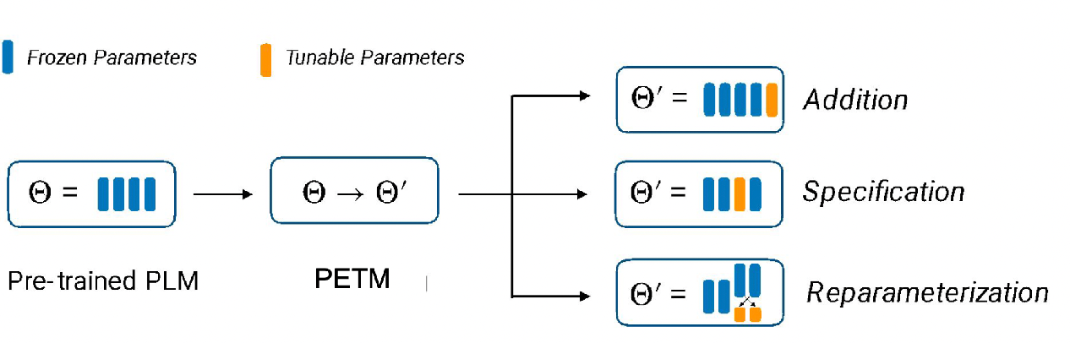
Types of PEFT methods
specification: pick a small subset of the parameters and tune those
addition: introduce additional trainable parameters, and just train those
reparameterization: re-parameterize the network into something more efficient to train
https://www.andrew.cmu.edu/course/11-667/lectures/W4L2_PETM.pptx.pdf

Slide 51
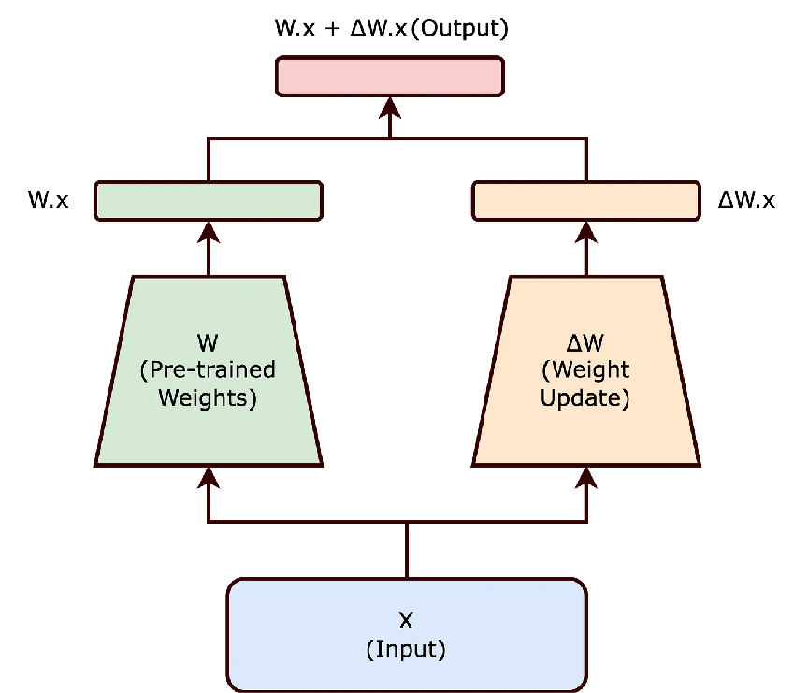
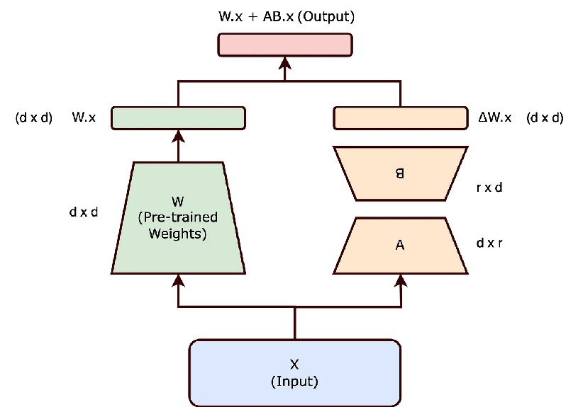
LoRA (low rank adaptation) finetuning
Key idea: don’t learn a full d x d matrix of weights, instead learn a low-rank approximation to this matrix!
full finetuning
LoRA
finetuning

Slide 52
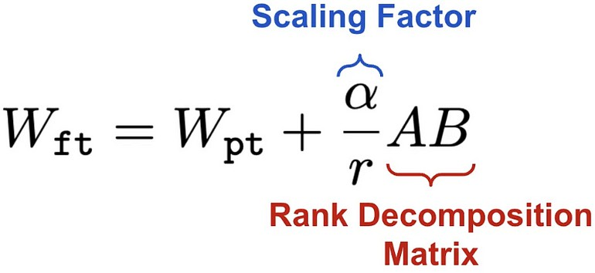
LoRA (low rank adaptation) finetuning
LoRa scaling: default value of alpha/r is 1. However, can be tuned to trade-off emphasis on pretrained weights vs. updated weights

Slide 53
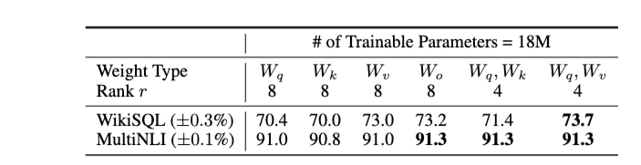
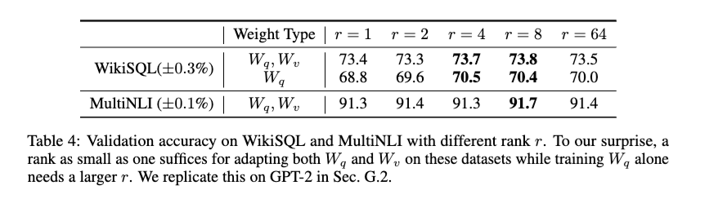
LoRA finetuning
Notes:
https://arxiv.org/pdf/2106.09685v1/1000 paper

Slide 54
recap: k-means as MF
indicators for r clusters
cluster means
original data set
~
M
0 | 1
1 | 0
.. | ..
… | …
xn | yn
a1 | a2 | .. | … | am
b1 | b2 | … | … | bm
v11 | …
… | …
 | vij
n examples
Z
X
 |  |  | …
 |  |  |  | vnm

Slide 55
MF to adjust weights
soft indicators for r clusters
cluster specific weight adjustment
original data set
~
B
0.1 | 0.9
0.8 | 0.1
.. | ..
… | …
xn | yn
a1 | a2 | .. | … | am
b1 | b2 | … | … | bm
v11 | …
… | …
 | vij
n examples
A
ΔW
 |  |  | …
 |  |  |  | vnm

Slide 56
rank-1 MF to adjust weights
adjustment scaling factor
weight adjustment
original data set
~
B
0.1
0.8
..
…
xn
a₁ | a₂ | .. | … | a_{m}
v₁₁ | …
… | v₁₂ | … | … | v_{m2}
n examples
A
ΔW
 | … |  | …
… | v_{n2} | … | … | v_{mn}

Slide 57
Tokenization for Transformers

Slide 58
The token vocabulary that is used is important
For NLP, current approaches use techniques like Byte Pair Encoding, wordpieces, or sentence pieces---which are all quite similar
BPE tokenizers (and the rest) are trained on a corpus

Slide 59
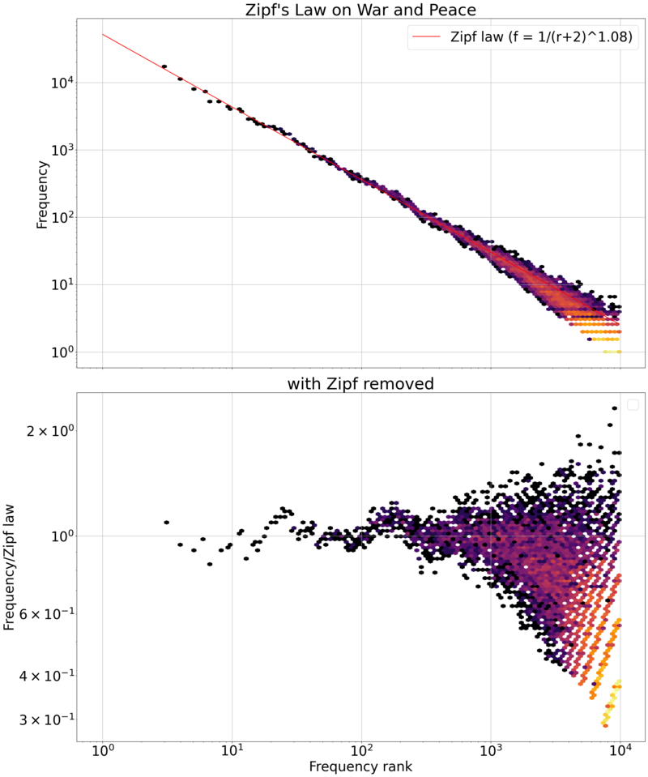
Tokenization for NLP Transformers

Slide 60
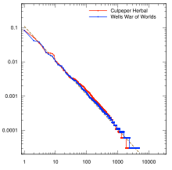

Tokenization for NLP
1990’s NLP: English tokenization was spaces and a few special rules
Eg “don’t” → “do” + “n’t”
This never worked well for other languages
This also leads to many many tokens for English
In practice you always need an UNK token for words not seen in training

Slide 61
Tokenization for NLP
1990’s NLP: English tokenization was spaces and a few special rules
Eg “don’t” → “do” + “n’t”
This never worked well for other languages
This also leads to many many tokens for English
In practice you always need an UNK token for words not seen in training
UNK token might mean many different things
a new emerging entity/phrase (e.g. LSTM, FAFO, Groq, …)
a missspelling
a big number
…
TFIDF suggests rare entity names are important.

Slide 62
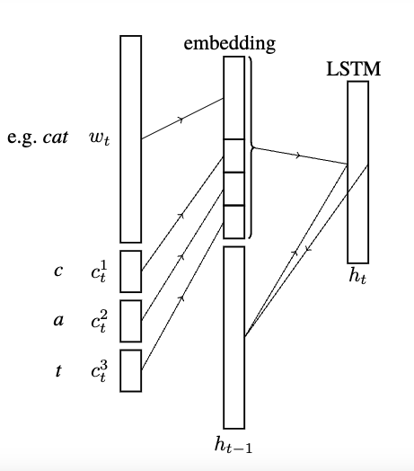
Tokenization for NLP
Mid-2000’s: character-level LSTM models and hybrid token-level/character-level models
But Transformers get very large with longer sequences.
Also: revival of old 1990’s approaches to compressing text by finding frequent subwords
Notes:
Character-Word LSTM Language Models
Lyan Verwimp, Joris Pelemans, Hugo Van hamme, Patrick Wambacq

Slide 63
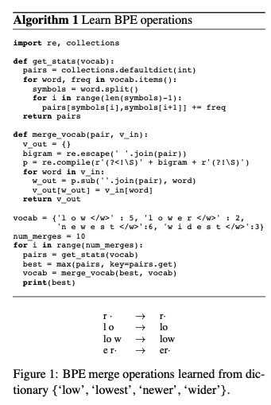
Tokenization in BERT / GPT2
Idea: reduce the number of tokens by finding meaningful subwords
Simplest version of this is Byte Pair Encoding (BPE)
BERT used a variant called wordpieces
Notes:
https://arxiv.org/pdf/1508.07909

Slide 64
Tokenization in BERT / GPT2: BPE
Step 1: Find all tokens in the corpus and save their frequency.
Step 2: Break all the tokens into characters (the initial vocabulary)
Step 3: Repeat for i = 1, … max_merges:
Find the ordered pair that occurs most frequently
Add that pair to the vocabulary
Replace that pair with the new word everywhere
u,g occurs 20x
“ug” is a new subword
Notes:
https://arxiv.org/pdf/1508.07909
https://huggingface.co/docs/transformers/tokenizer_summary

Slide 65
Tokenization in BERT / GPT2: BPE
Step 3: Repeat for i = 1, … max_merges:
Find the ordered pair that occurs most frequently
Add that pair to the vocabulary
Replace that pair with the new word everywhere
u,n occurs 16x
“un” is a new subword
Notes:
https://arxiv.org/pdf/1508.07909
https://huggingface.co/docs/transformers/tokenizer_summary

Slide 66
Tokenization in BERT / GPT2
BPE is simple and very efficient when you apply it reduce the number of tokens
use a trie to store the weighted corpus and update all the counts incrementally
<s>
15
h
17
p
b
4
15
u
17
u
u
4
15
g
5
g
n
n
5
s
<e>
<e>
<e>
<e>
10
5
12
4
<e>
5
Notes:
https://arxiv.org/pdf/1508.07909

Slide 67
Tokenization in BERT / GPT2
BPE is simple and very efficient when you apply it reduce the number of tokens
use a trie to store the weighted corpus and update all the counts incrementally
The trie of tokens is much smaller than the full corpus
<s>
15
h
17
p
b
4
15
12
u
u
4
15
ug
5
ug
n
n
5
s
<e>
<e>
<e>
<e>
10
5
12
4
<e>
5
Notes:
https://arxiv.org/pdf/1508.07909

Slide 68

Tokenization in Later Transformers
BPE is simple and very efficient when you apply it reduce the number of tokens
use a trie to store the weighted corpus and update all the counts incrementally
The trie of tokens is much smaller than the full corpus
Wordpieces was used in BERT: much like BPE but tries to maximize the probability of the corpus
under a naïve Bayes-like model of probability
main difference: instead of scoring pairs by frequency score of pointwise mutual information
Notes:
https://arxiv.org/pdf/1508.07909

Slide 69
Tokenization in Later Transformers
Wordpieces and BPE are constrained by the initial tokenization.
Could be a problem, e.g., if you tokenized Python code naively.
SentencePieces starts with “sentences” instead of words.
Common approach now is to use BPE on a large corpus with minimal pre-splitting.
Wordpieces was used in BERT: much like BPE but tries to maximize the probability of the corpus
under a naïve Bayes-like model of probability
main difference: instead of scoring pairs by frequency score of pointwise mutual information
Other approaches start with lots of proposed tokens and subtokens and repeatedly prune away subtokens
Notes:
Ref for sentencepieces?

Slide 70
Tokenization in Later Transformers
Step 1: Find all tokens in the corpus and save their frequency.
Step 2: Break all the tokens into characters (the initial vocabulary)
Step 3: Repeat for i = 1, … max_merges:
Find the ordered pair that occurs most frequently
Add that pair to the vocabulary
Replace that pair with the new word everywhere
u,g occurs 20x
“ug” is a new subword
Notes:
https://arxiv.org/pdf/1508.07909
https://huggingface.co/docs/transformers/tokenizer_summary

Slide 71

Tokenization in Later Transformers
Step 1: Find all tokens in the corpus and save their frequency.
Step 2: Break all the tokens into characters (the initial vocabulary)
All the bytes from UTF-8
ascii
Latin alphabets, Greek, Hebrew, …,
mostly CJK
emojis …
Notes:
https://arxiv.org/pdf/1508.07909
https://huggingface.co/docs/transformers/tokenizer_summary

Slide 72

Tokenization for Vision Transformers
Notes:
https://arxiv.org/pdf/2010.11929/1000

Slide 73

Tokenization for Vision Transformers

Slide 74


Tokenization for Vision Transformers
JFT = 300M images @ Google
Also trained on JFT

Slide 75
Vision Transformers – Pros and Cons
ViTs have a weaker bias than CNNs and usually need more data to train
They don’t “know” that local-area features matter
Transformers are not the SoTA way of generating images
Although they often do quite well!
ViTs are excellent for multimodal vision/language models

Slide 76

Multi-Model Transformer: Example
2022

Slide 77


Multi-Model Transformer: Example

Slide 78

Vision Transformers – Pros and Cons
0. ViT and T5
1.
2. FT

Slide 79
Transformers: Some Comments

Slide 80
Attention is all you need – and all you get
Decoder
Encoder
Notes:
Where is the bottleneck in the 2007 transformer?
is my interpretation of outputs correct here? or is an approximation based on masking?

Slide 81
depth: 12 “layers”
Attention is all you need – and all you get
really O(12)
every self-attention layer is O(n²)
O(|input| + |output|) = O(n)
Decoder
layer-to-layer is sequential, individual layers can be done in parallel
Encoder
Notes:
Where is the bottleneck in the 2007 transformer?
is my interpretation of outputs correct here? or is an approximation based on masking?

Slide 82

Comments
The O(depth * n²) means
Transformers are highly parallel – ideally O(depth)
Most of the computation in BERT is matmul
Transformers are huge
vocab = 26 letters + 2 special
https://medium.com/@amniskin/another-annotated-transformer-1c7be3f99e23

Slide 83
Comments
The O(depth * n²) means
Transformers are highly parallel – ideally O(depth)
Most of the computation in BERT is matmul
Transformers are huge
Well-suited to being pre-trained and fine-tuned

Slide 84

Comments
Transformers are highly parallel
Transformers are huge
Transformers haven’t changed much since 2017
RMS Norm vs LayerNorm
ReLU variants
Positional encoding (PE) – more late – for longer contexts
Grouped query attention
combined with MoE which is another old ANN idea

Slide 85

Comments
Grouped query attention: don’t require that every attention head have its own keys, values, and queries – instead re-use keys and values in “groups”

Slide 86
Comments
Transformers haven’t changed much since 2017
as an architecture
There are some important algorithmic changes
FlashAttention: better algorithm than vanilla matrix multiplication
KeyValue caches: reduce re-computation and help allow longer contexts

