Slide 1
10-605 / 10-405
Machine Learning from Large Datasets

Slide 2
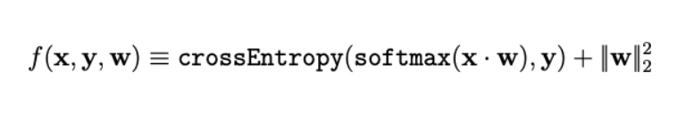
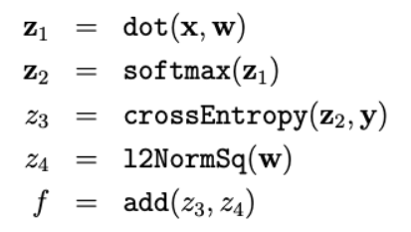
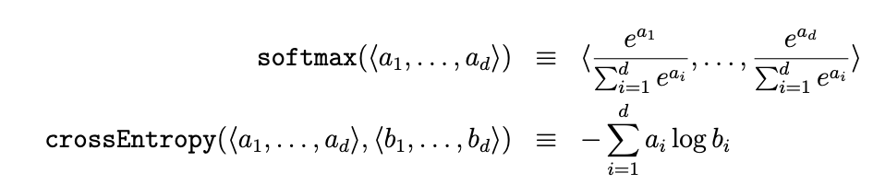
Recap: Autodiff for Logistic Regression
Like logistic
where:
Notes:
TODO: s/W/w/. and add one for linear regression
talk about optimizations – softmax numerical optimization, crossent-softmax optimization

Slide 3
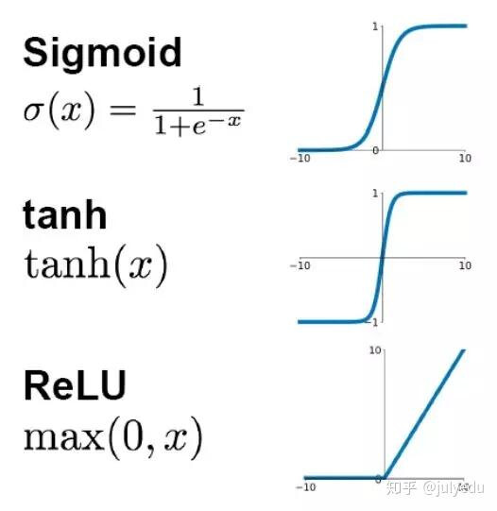
Extension: Deeper Logistic Regression
h1 = softmax(dot(x, w1))
h2 = softmax(dot(h1, w1))
…
h5 = softmax(dot(h4, w5))
r = l2NormSq(w1) + …. + l2NormSq(w2)
loss = crossEntropy(h5, y) + λ r
h1 = reLU(dot(x, w1) + b1)
h2 = reLU(dot(h1, w1) + b2)
…
h5 = reLU(dot(h4, w5) + b3)
r = l2NormSq(w1) + …. + l2NormSq(w2)
loss = crossEntropy(h5, y) + λ r
Notes:
TODO: s/W/w/. and add one for linear regression
talk about optimizations – softmax numerical optimization, crossent-softmax optimization

Slide 4
Autodiff for Multilayer Linear Perceptrons (MLPs)
X
W1
Z1A
B1
Z1B
A1
W2
Z2A
B2
Z2B
A2
mul
add*
tanh
mul
add*
tanh
A2
P
C
Inputs: X Params: W1,B1,W2,B2
Z1a = mul(X,W1) // matrix mult
Z1b = add*(Z1a,B1) // add bias vec
A1 = tanh(Z1b) //element-wise
Z2a = mul(A1,W2)
Z2b = add*(Z2a,B2)
A2 = tanh(Z2b) // element-wise
P = softMax(A2) // vec to vec
C = crossEnt_{Y}(P) // cost function
…
crossEnt
softmax
Y

Slide 5
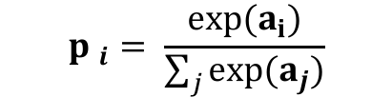
Autodiff for Multilayer Linear Perceptrons (MLPs)
X
W1
Z1A
B1
Z1B
A1
W2
Z2A
B2
Z2B
A2
P
C
mul
crossEnt
add*
tanh
mul
add*
tanh
softmax
Y
X is N*D, W1 is D*H, B1 is 1*H, W2 is H*K, …
Inputs: X,W1,B1,W2,B2
Z1a = mul(X,W1) // matrix mult
Z1b = add*(Z1a,B1) // add bias vec
A1 = tanh(Z1b) //element-wise
Z2a = mul(A1,W2)
Z2b = add*(Z2a,B2)
A2 = tanh(Z2b) // element-wise
P = softMax(A2) // vec to vec
C = crossEnt_{Y}(P) // cost function
Z1a is N*H
Z1b is N*H
$${p }_{i}= \frac{exp⁡(a_{i})}{\sum_{j}{exp⁡(a_{j})}}$$
A1 is N*H
Z2a is N*K
Z2b is N*K
A2 is N*K
P is N*K
C is a scalar
Target Y; N examples; K outs; D feats, H hidden

Slide 6
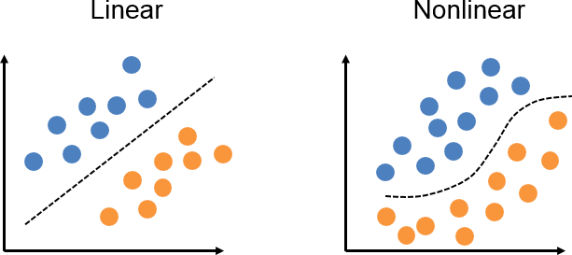
Not all data is linear …
REC ALL
Deeper models can learn non-linear hypotheses….

Slide 7
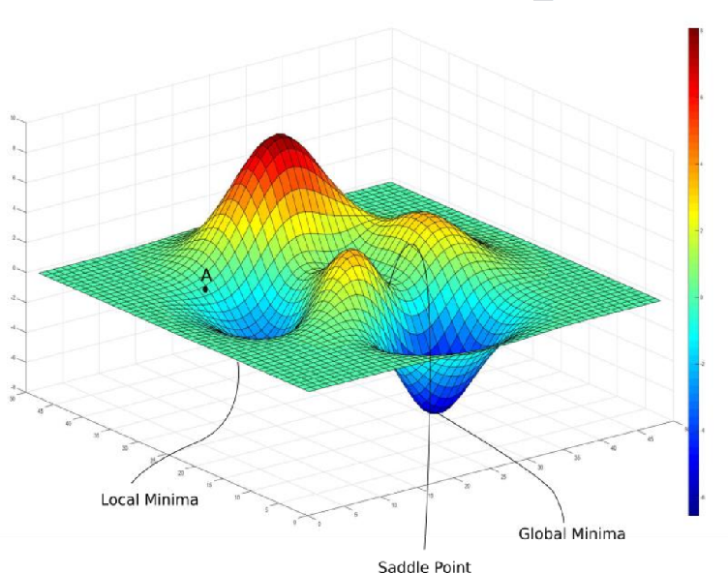
Non-convexity
CH AL L E NGE
Types of stationary points:
Global minimum: actual minimizer, i.e., f(x̂) ≤ f(x) ∀ x ∈ ℝ^{k}
Local minimum: f(x̂) ≤ f(x) ∀ x ∈ ℝ^{k} :
Local maximum: f(x̂) ≥ f(x) ∀ x ∈ ℝ^{k} :
∥x − x̂∥ ≤ ϵ
∥x − x̂∥ ≤ ϵ
Saddle point: a stationary point that is not a local minimum or maximum

Slide 8
Non-convexity
CH AL L E NGE
Types of stationary points:
Global minimum: finding these is hard (both in theory [NP-hard] and in practice)
Local minimum: can often still provide reasonable solutions
Saddle point: want to avoid these

Slide 9
Non-convexity
CH AL L E NGE
What makes non-convex optimization difficult?
Potentially many local minima
Saddle points
Very flat regions
Widely varying curvature

Slide 10
Outline
Scaling up Mb-SGD: Communication schemes
AllReduce for GPU clusters
Challenges with mini-batched optimization
Fine-tuning
More on Modern optimizers

Slide 11
Methods for distributed optimization
REC ALL
less local computation, more communication
more local computation, less communication
stochastic gradient descent
gradient descent
divide-and-conquer / one-shot averaging
mini-batch SGD
local-updating methods

Slide 12
Mini-batch SGD
REC ALL
n
where f(w) := ∑ f_{j}(w)
Objective we want to solve:
min f(w)
w
j=1
Gradient Descent Update:
w_{i+1} = w_{i} − α_{i} ∇f(w_{i})
Stochastic Gradient Descent (SGD) Update:
w_{i+1} = w_{i} − α_{i} ∇f_{j}(w_{i})
with j sampled at random
Mini-batch SGD Update:
w = w − α ∇f (w )
i+1 i i ℬ i
i
with mini-batch Bi ⊆{1,… n} sampled at random

Slide 13
How to parallelize mini-batch SGD?
QU ES TION
Parallelization scheme can vary based on:
parallelization technique (what to parallelize?)
synchronization model (when do we send updates?)
communication strategy (where do we send them?)
compression (what updates do we send?)
*Note: While we motivate these approaches with mini-batch SGD, they are applicable to the other first-order optimization methods (AdaGrad, RMSProp, Adam, etc.)

Slide 14
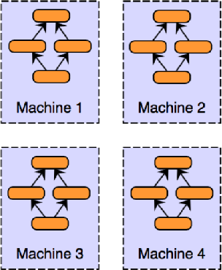
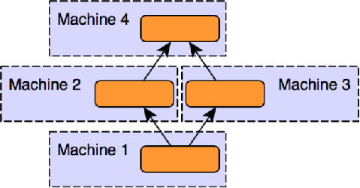
Data parallel vs. model parallel
Data parallel
Replicate the model on each machine
Each machine accesses a portion of the dataset
Most common approach: typically preferable in terms of implementation, fault tolerance, and parallelizability
Hybrid schemes
Model parallel
Replicate the data on each machine
Each machine accesses a portion of the model
An attractive approach for massive models
Subcategories:
Intra-layer parallel
Tensor parallel
Inter-layer parallel
Pipeline parallel

Slide 15
Data parallel vs. model parallel
Data parallel
Replicate the model on each machine
Each machine accesses a portion of the dataset
Most common approach: typically preferable in terms of implementation, fault tolerance, and parallelizability
Model parallel
Replicate the data on each machine
Each machine accesses a portion of the model
An attractive approach for massive models

Slide 16
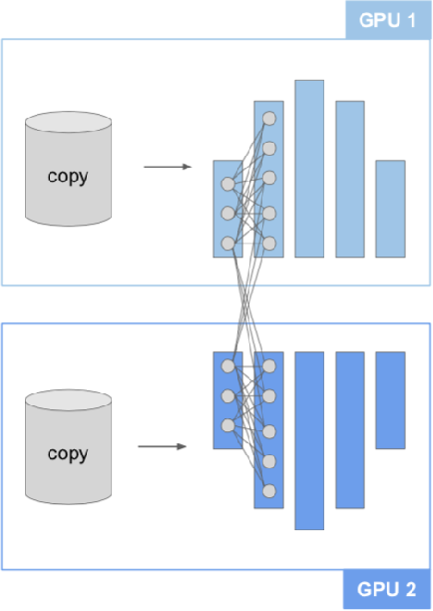
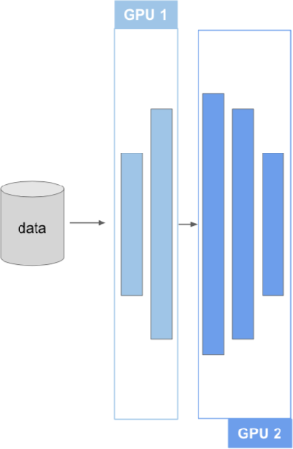
Model parallel
intra-layer parallelism: units within one layer are partitioned
inter-layer parallelism: entire layers are partitioned

Slide 17

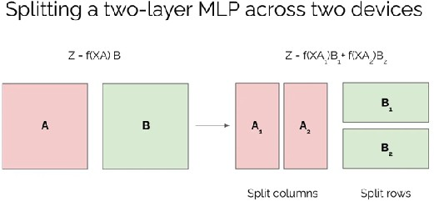
Tensor parallelism is a kind of intra-layer parallelism
Tensor parallelism (intra-layer model parallelism): splits tensor operations (e.g., matrix matmul) across nodes

Slide 18
Model parallel
intra-layer parallelism: units within one layer are partitioned
inter-layer parallelism: entire layers are partitioned

Slide 19
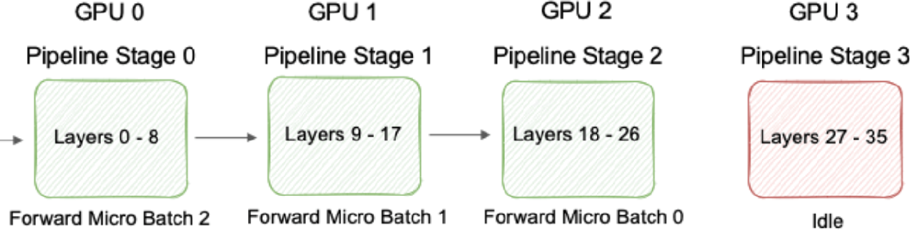
Pipeline parallelism schedules inter-layer parallelism
Pipeline parallelism (inter-layer parallelism)
interleave pipeline parallel training to avoid idle states
https://docs.nvidia.com/nemo-framework/user-guide/latest/nemotoolkit/features/parallelisms.html

Slide 20
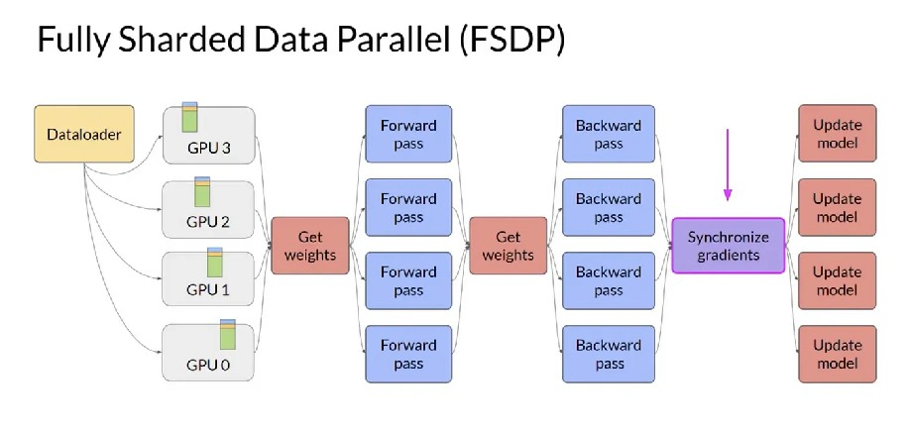
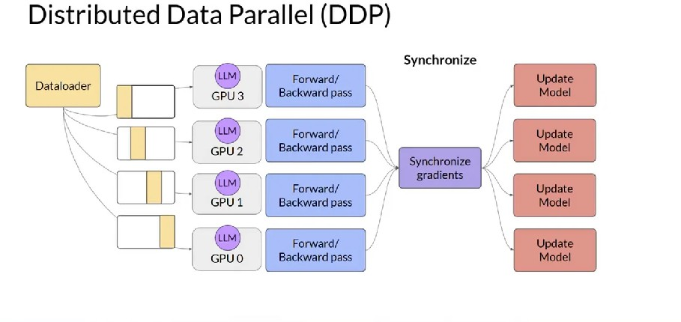
Example of combined/hybrid parallelism: FSDP
Fully sharded data parallelism: data parallelism, but also shard the model parameters / optimization states / gradients to handle memory issues

Slide 21
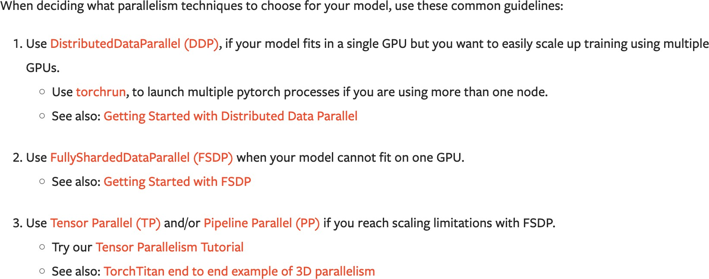
Which strategy to use? (In Pytorch)
https://pytorch.org/tutorials/beginner/dist_overview.html

Slide 22
How to parallelize mini-batch SGD?
QU ES TION
Parallelization scheme can vary based on:
parallelization technique (what to parallelize?)
synchronization model (when do we send updates?)
communication strategy (where do we send them?)
compression (what updates do we send?)
*Note: While we motivate these approaches with mini-batch SGD, they are applicable to the other first-order optimization methods (AdaGrad, RMSProp, Adam, etc.)

Slide 23
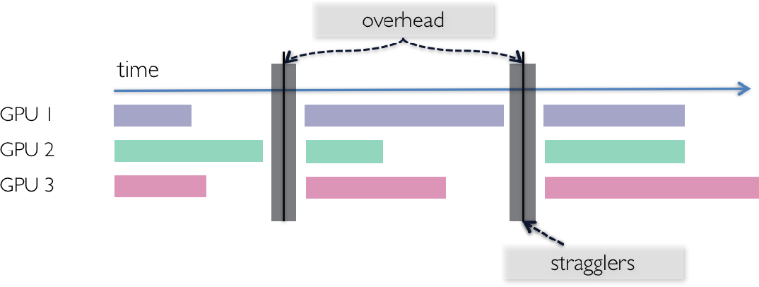
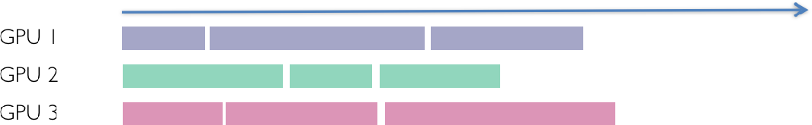
Synchronous vs. asynchronous
synchronous
guaranteed to be correct
but: can be slow due to stragglers, overhead
asynchronous
fast—no waiting!
but: there may be errors
Image: Dimitris Papailiopoulos

Slide 24
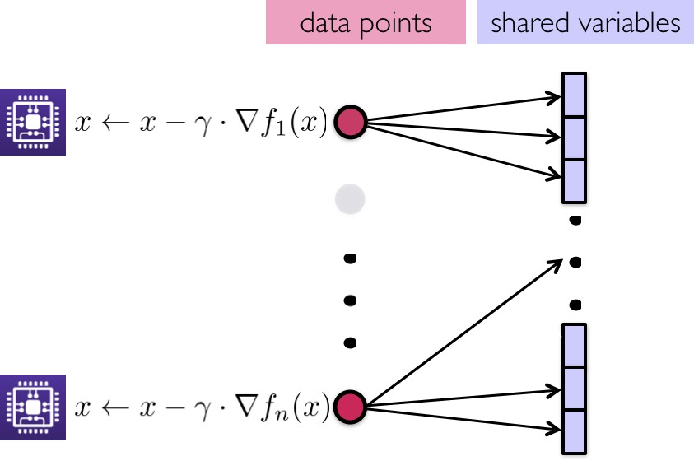
Asynchronous ML
Recommended when:
sparse updates that don’t overlap
workers have low-bandwidth connections between them
Not usually case with high-end GPU clusters
if no conflicts (e.g., when the shared parameter, x, is very sparse), asynchrony is great!
recall: HogWild!
Image: Dimitris Papailiopoulos

Slide 25
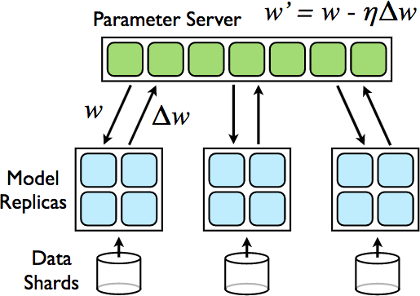
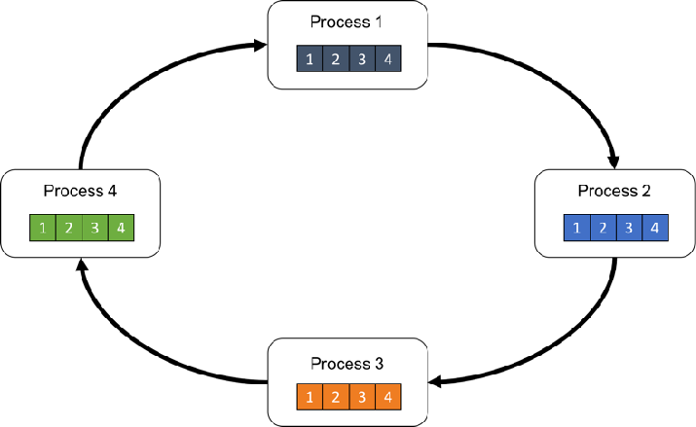
Communication strategies
centralized: parameter server
decentralized: ring all-reduce

Slide 26
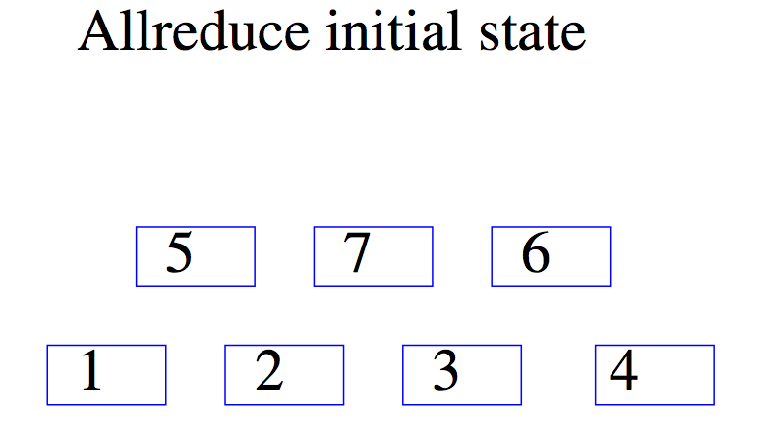
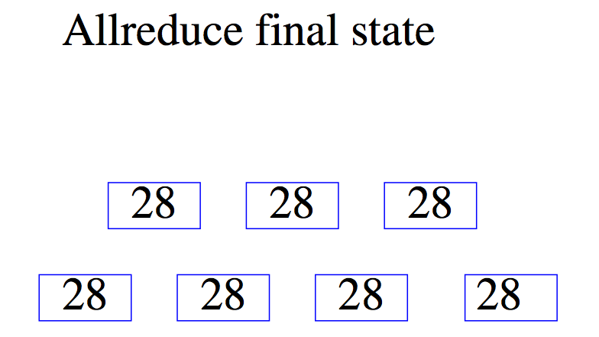
Recap: Tree AllReduce
Common pattern in ML:
Reduce (e.g., aggregate gradients) information from many workers
Distribute aggregation to all workers

Slide 27
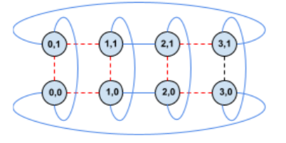
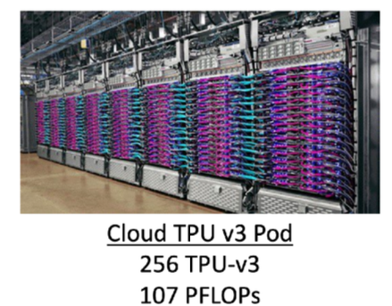
Tree vs Ring AllReduce
High-even clusters (e.g. TPU Pods) have high-bandwidth connections between some (not all pairs) of accelerators
Common topology: a ring / mesh / torus in 2D or 3D.
Common pattern in ML:
Reduce (e.g., aggregate gradients) information from many workers
Distribute aggregation to all workers

Slide 28
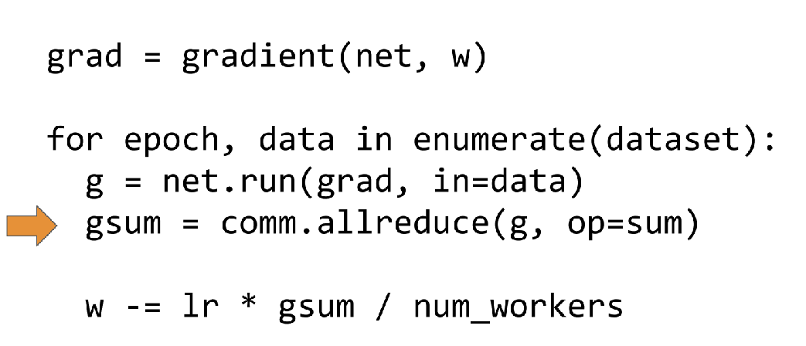
Ring all-reduce is used like tree all-reducer
All-reduce: compute some reduction (usually a sum) of data on multiple machines p1, p2, . . . , pm and materialize the result on all those machines
Baidu, Horovod (Uber), 2017

Slide 29
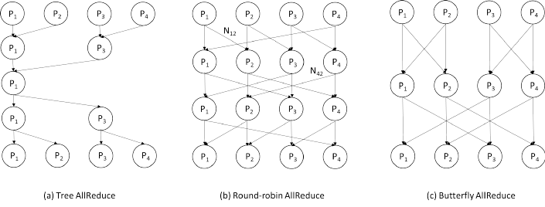
Many Possisble AllReduce Communication Patterns

Slide 30
Ring all-reduce has different goals
Use the bandwidth as effectively as possible:
Don’t minimize number of messages
Send smaller messages in parallel
Use the high-bandwidth connections
Baidu, Horovod (Uber), 2017

Slide 31
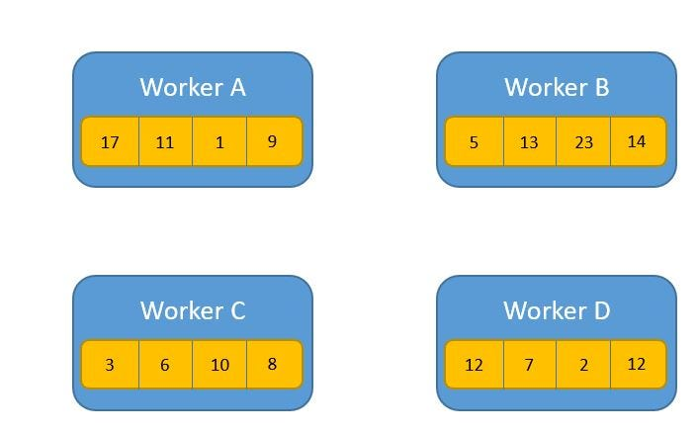
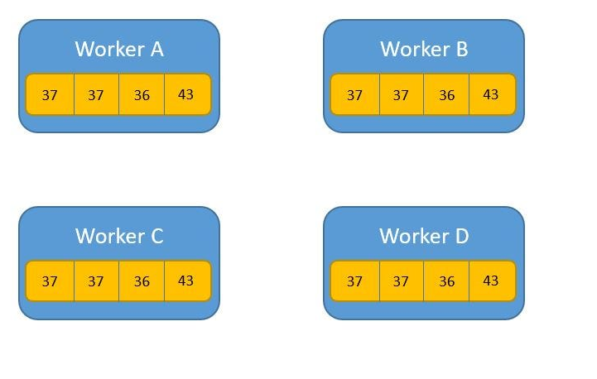
Ring AllReduce
https://towardsdatascience.com/visual-intuition-on-ring-allreduce-for-distributed-deep-learning-d1f34b4911da

Slide 32
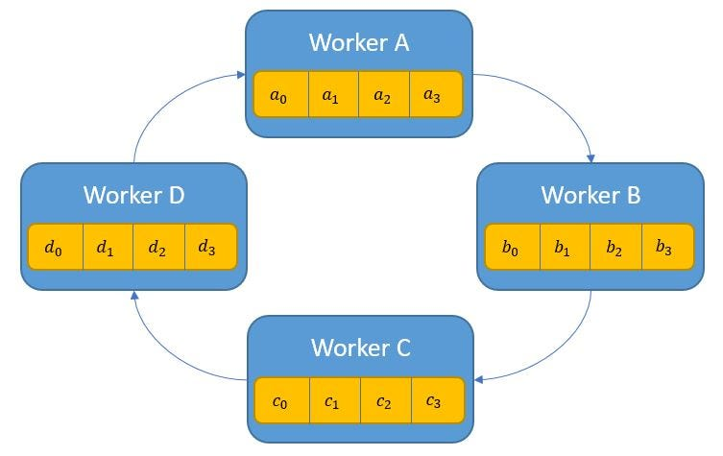
Ring AllReduce

Slide 33
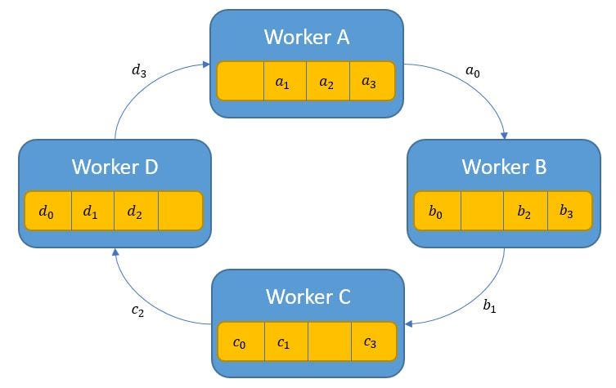
Ring AllReduce
Everyone sends small messages to the next worker in the ring
Everyone picks a different subset of the parameters to send

Slide 34
Ring AllReduce
Workers reduce their local content with the incoming messages
a₃ + d₃
c₂ + d₂
a₀ + b₀
c₁ + b₁

Slide 35
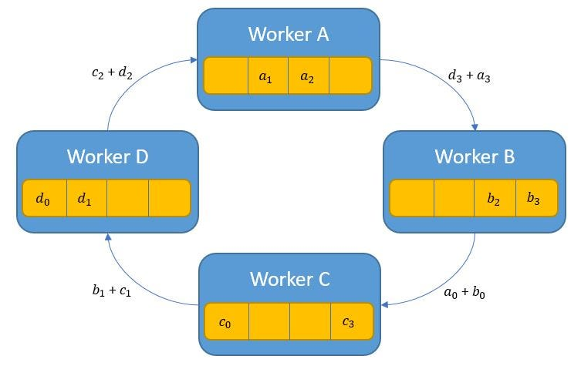
Ring AllReduce
Everyone sends another slice to the next worker in the ring
…sending the most reduced slice they can
a₃ + d₃
c₂ + d₂
a₀ + b₀
c₁ + b₁

Slide 36
Ring AllReduce
Everyone sends another slice to the next worker in the ring
…sending the most reduced slice they can
c₂ + d₂
c₁ + b₁
a₃ + d₃
a₀ + b₀
Iterate until all slices are full reduced (all data has gone the way around the ring)

Slide 37
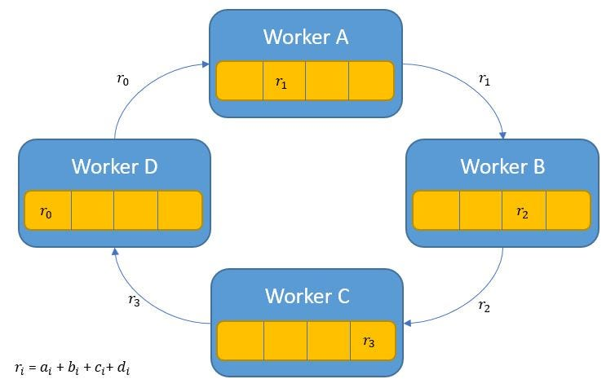
Ring AllReduce
Then continue passing the fully-reduced data until everybody has seen it

Slide 38
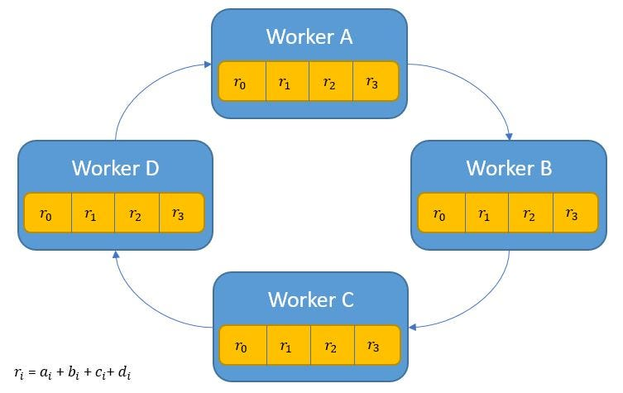
Ring AllReduce
Q: how many rounds of communication?
Q: how much is communicated per round per node?
2 (m-1)
k / m
m = ring cycle
k = size of param vector

Slide 39
Communication strategies
D ATA PA R A L L E L D L :
centralized: parameter server
decentralized: ring all-reduce

Slide 40
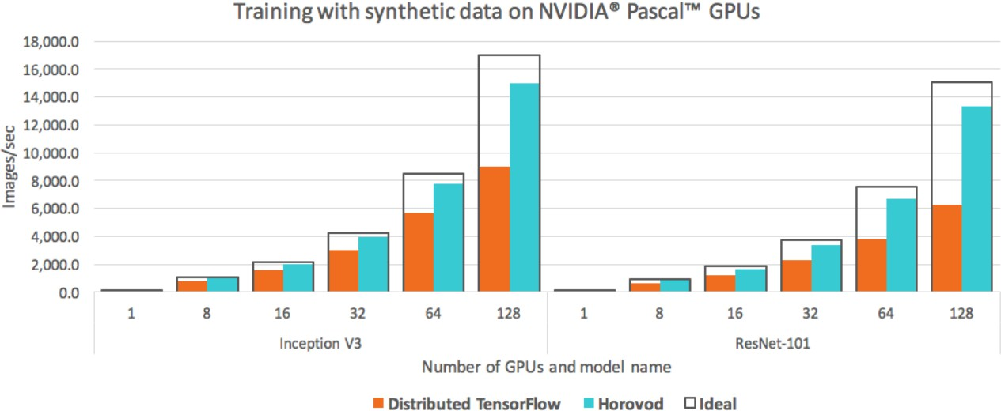
Ring all-reduce vs parameter server!
distributed tensorflow default (parameter server) vs. horovod (ring all-reduce)
https://eng.uber.com/horovod/

Slide 41
Outline
Scaling up Mb-SGD: Communication schemes
AllReduce for GPU clusters
Challenges with mini-batched optimization
Fine-tuning
More on Modern optimizers

Slide 42
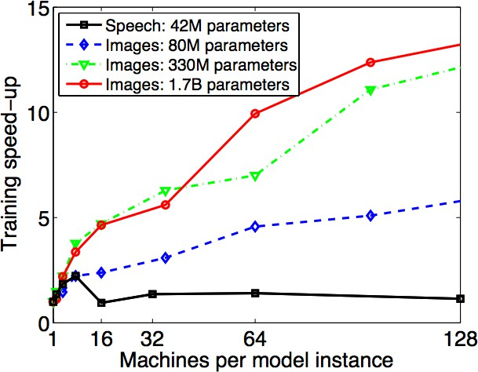
One major issue with mini-batch SGD
ideally, speedups should scale linearly (i.e., you increase the # of machines by X, and you can converge X times faster)
some issues preventing speedups:
communication between machines
diminishing returns with larger batches
Dean et al., 2012

Slide 43
One major issue with mini-batch SGD
Systems perspective: large batches are good
more computation, less communication Statistical perspective: large batches are bad
why??
Two problems with large batches:
diminishing returns (after a certain point, additional data on computing a single gradient doesn’t help much)
poor generalization (for non-convex optimization)

Slide 44
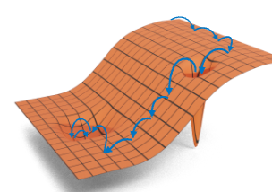
Recap: Stochastic gradient descent
For non-convex problems SGD/GD find a local minimum. SGD tends to find “flat”, not “sharp” local minima.
Variants of SGD are almost always used in deep learning.
sample a “minibatch” of examples B<<N
approximate the gradient using them
“on average” this is the right direction
take a step in that direction
repeat….
Notes:
training loss bounces around

Slide 45
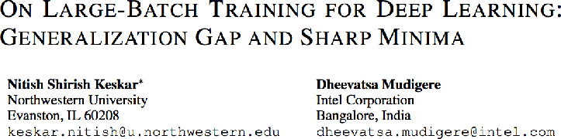
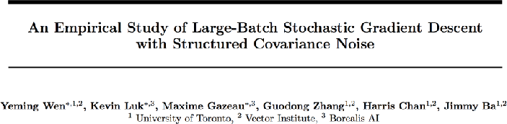
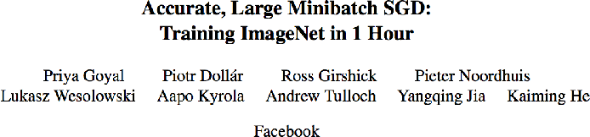
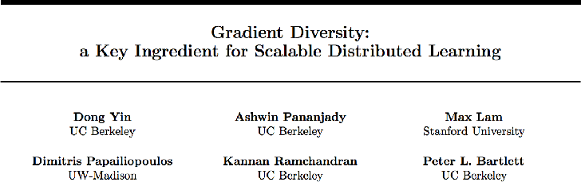
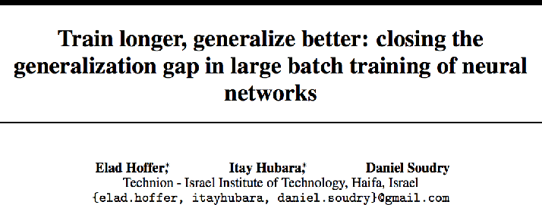
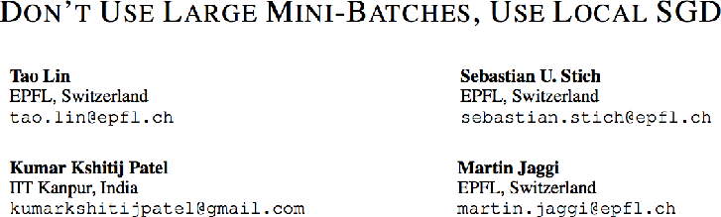
LO T S O F [ O N - G O I N G ] W O R K I N T H I S A R E A …
One major issue with mini-batch SGD

Slide 46
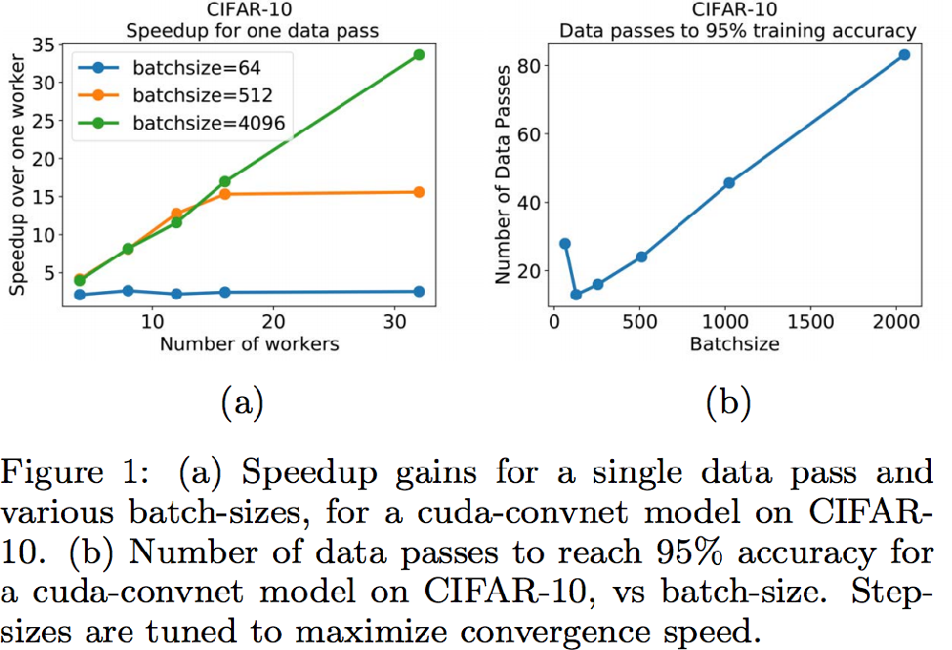
Diminishing returns
larger batches = better potential for
BUT when you also consider training accuracy, speedups
scaling
may saturate
Yin et al., AISTATS 2018

Slide 47
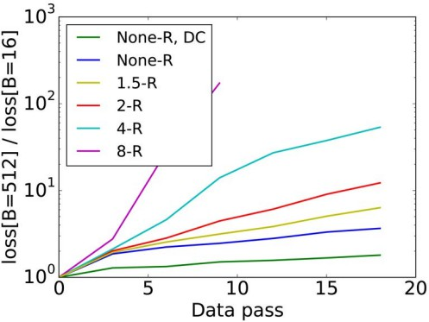
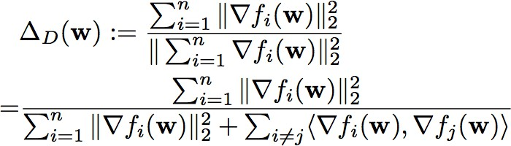
Diminishing returns
a potential explanation: gradient diversity, i.e.,
the degree to which gradients differ from one another
large batches perform worse when they lack diversity, e.g., when data is replicated by some factor (R)
Yin et al., AISTATS 2018

Slide 48
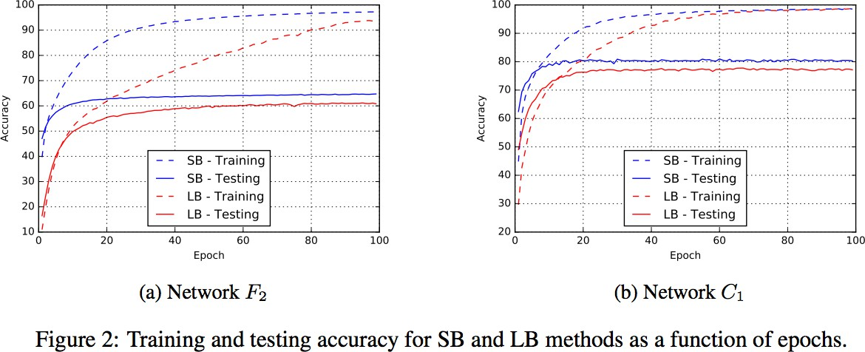
Poor generalization
EVEN WORSE
generalization gap: large batch methods converge to lower test accuracy
Keskar, et al, ICLR 2017

Slide 49
Outline
Scaling up Mb-SGD: Communication schemes
AllReduce for GPU clusters
Challenges with mini-batched optimization
Fine-tuning
More on Modern optimizers

Slide 50
Training in the Foundation Model Era: Fine-Tuning

Slide 51
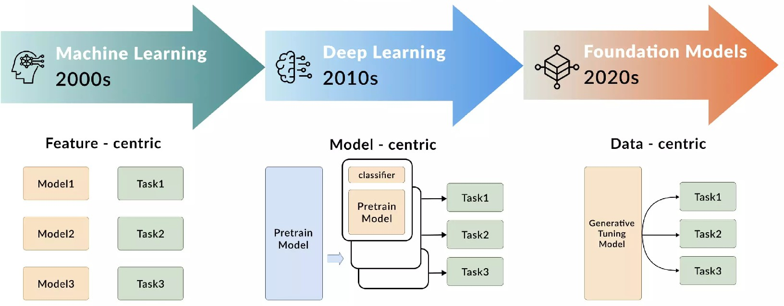
How are foundation models changing deep learning?
https://dataforest.ai/blog/ai-foundation-models-for-big-business-innovation

Slide 52

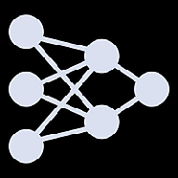

Classical ML
training
data
model

Slide 53




ML in the foundation model era
lots of data!
pretraining
alignment
flnetuning
pretrained
aligned
finetuned

Slide 54
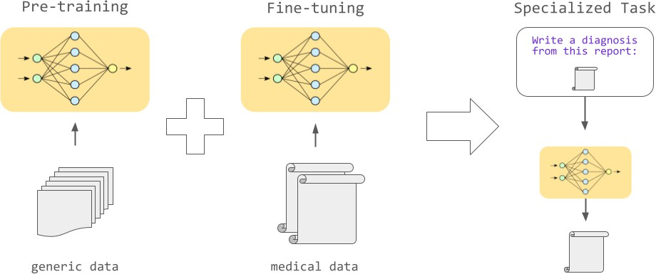
How do we ‘finetune’ models?
Start with a model trained on a lot of data
Using the pretrained model as a starting point, update the weights by fitting the model to a small amount of finetuning data (e.g., running a small number of steps of gradient descent)
Credit: AssemblyAI

Slide 55

How do we ‘finetune’ models?
Start with a model trained on a lot of data
Using the pretrained model as a starting point, update the weights by fitting the model to a small amount of finetuning data (e.g., running a small number of steps of gradient descent)
Credit: Prasad Mahamulkar

Slide 56





Gradient descent for model training
REC ALL
Start at a random point, w0
Repeat
Determine a descent direction Choose a step size
Update model using gradient calculated from training data
Until stopping criterion is satisfied
f(w)
_{w}* … w₂
w1 w0
Update Rule:
w_{i+1} = w_{i} — a_{i}∇f(w_{i})

Slide 57
Gradient descent for model finetuning
with a pretrained model, wpre
Start at a random point, w0
Repeat
Determine a descent direction Choose a step size
f(w)
Update model using gradient
calculated from training finetuning data Until stopping criterion is satisfied
_{w}* … w₂
w1 w0
w
Update Rule:
w_{i+1} = w_{i} — a_{i}∇f(w_{i})

Slide 58

Fine-tuning example: BERT (2019)

Slide 59


Slide 60



Slide 61




Slide 62
Training in the Foundation Model Era: Efficient Fine-Tuning

Slide 63

Potential issue: pre-trained models are getting large!
340M parameters
175B parameters
???
https://www.dailydoseofds.com/implementing-lora-from-scratch-for-fine-tuning-llms/

Slide 64

How do we ‘finetune’ large models?
When finetuning, we expect the change in weights (orange) to be small
However, updating all of these weights can be expensive!
How can we reduce the number of weights we need to update?
… enter parameter-efficient finetuning

Slide 65
Types of PEFT methods
specification: pick a small subset of the parameters and tune those
addition: introduce additional trainable parameters, and just train those
reparameterization: re-parameterize the network into something more efficient to train
https://www.andrew.cmu.edu/course/11-667/lectures/W4L2_PETM.pptx.pdf

Slide 66

Linear probing
aka Foundation models as features
Just update a portion of the weights, e.g., just the last layer (linear probing)
Credit: Ke et al, 2024, https://arxiv.org/pdf/2402.18905v1

Slide 67
Recap (again): Recovering latent factors in a matrix
K * m
~
x1 | y1
x2 | y2
.. | ..
… | …
xn | yn
a1 | a2 | .. | … | am
b1 | b2 | … | … | bm
v11 | …
… | …
 | vij
n * K
 |  |  | …
 |  |  |  | vnm

Slide 68

Adapters
Adapters are new modules are added between layers of a pre-trained network. Original model weights are fixed — just the adapter modules are tuned

Slide 69

LoRA (low rank adaptation) finetuning
Key idea: don’t learn a full d x d matrix of weights, instead learn a low-rank approximation to this matrix!
full finetuning
LoRA
finetuning

Slide 70

LoRA (low rank adaptation) finetuning
LoRa scaling: default value of alpha/r is 1. However, can be tuned to trade-off emphasis on pretrained weights vs. updated weights

Slide 71

QLoRA: Quantized LoRA
Key idea: quantize pretrained weights so they are very small / memory efficient Hope is that LoRA finetuning can help to offset issues with lower precision
https://github.com/bitsandbytes-foundation/bitsandbytes

Slide 72
Outline
Scaling up Mb-SGD: Communication schemes
AllReduce for GPU clusters
Challenges with mini-batched optimization
Fine-tuning
More on Modern optimizers

Slide 73
Non-convexity
RECALL
What makes non-convex optimization difficult?
Potentially many local minima
Saddle points
Very flat regions
Widely varying curvature

Slide 74
Techniques for large-scale optimization
REC ALL
Reduce computation:
•
•
•
Parallelize/distribute computation Use stochastic methods
Use first-order methods (i.e., no 2nd-order or higher gradients)
Reduce communication:
•
•
Keep large objects local Reduce iterations

Slide 75
Reducing iterations
We are interested in optimization techniques that reduce the total number of iterations until convergence
However, these techniques often come at a price: more computation
Will discuss two popular techniques for DL that aim to reduce iterations with little additional computation:
Adaptive learning rate methods
Momentum-based methods

Slide 76


Gradient descent
REC ALL
2D Example:
•
•
Function values are in black/white and black represents higher values
Arrows are gradients
"Gradient2" by Sarang. Licensed under CC BY-SA 2.5 via Wikimedia Commons http://commons.wikimedia.org/wiki/File:Gradient2.svg#/media/File:Gradient2.svg
We can move anywhere in R^{d}
Negative gradient is direction of
steepest descent!
Step Size
Update Rule: w_{t+1} = w_{t} − α ∇f(w_{t})
Negative Slope

Slide 77

Motivation: Newton’s method
issue: gradient may be the same despite varying curvature
Newton’s method uses second order information to estimate the curvature of the function being minimized (i.e., the loss)

Slide 78


Motivation: Newton’s method
issue: gradient may be the same despite varying curvature
Newton’s method uses second order information to estimate the curvature of the function being minimized (i.e., the loss)

Slide 79
Motivation: Newton’s method
issue: gradient may be the same despite varying curvature
Newton step makes more progress
Newton’s method uses second order information to estimate the curvature of the function being minimized (i.e., the ERM objective)

Slide 80




Motivation: Newton’s method
REC ALL
w_{t+1} = w_{t} − α ∇f(w_{t})
Gradient descent
can we do better? idea: use second order information (i.e., the Hessian)
−1
w_{t+1} = w_{t} − α ₍ ∇²f(w_{t})₎ ∇f(w_{t})
Newton’s method
can significantly reduce number of iterations needed for convergence however, comes at a cost: need to invert k×k matrix → O(k³)
often too expensive for neural networks (k can be in the millions)

Slide 81


Motivation: Newton’s method
But – for functions with n inputs the “second derivative” is too large.
Hessian matrix:

Slide 82

Motivation: Newton’s method
Hessian is worse than the Jaccobian (from autodiff)

Slide 83

AdaGrad
A CHEAPER APPRO A CH
AdaGrad:
^{w}t+1
= w − αG
−1
∇f(w )
t
t
t
₍G_{t)ii} = ∑
t
∇f(w )
2
, 0
where
j i
else
j=1
A cheap approximation of the Hessian: only estimate the diagonal elements
Enforces a separate step size / learning rate for every coordinate of the weight vector
Decreases the step size for coordinates with high gradient magnitudes
Why does this make sense when the model is large?
There may be high variability across the coordinates
Potential issue: step size can become very small in some directions
Duchi et al, 2011

Slide 84

RMSProp
AN A LT ERN ATI VE T O AD A GRAD
RMSProp:
w = w − αG
−1
∇f(w )
t+1 t t
t
₍G_{t)ii} = (g_{t})_{i} , 0
where
else
₍g_{t)} = β(g_{t−1})_{i} + (1 − β)( ∇f(w_{t})_{i})²
i
Take a moving average of the coordinates of the gradient, instead of a sum
Puts more of an emphasis on the current gradients than the gradient history
Can be more effective for DNNs
Also see: AdaDelta
Hinton [Coursera], 2012

Slide 85


Momentum
AN O T HER APPRO A CH
Polyak momentum
w_{t+1} = w_{t} − α ∇f(w_{t}) + β(w_{t} − w_{t−1})
Another cheap way to potentially improve gradient descent: use momentum
Intuition: if current gradient step is in same direction as previous step, then move a little further in that direction; if not, move less far
Also known as the heavy ball method
Polyak ‘64

Slide 86


Nesterov accelerated gradient
evaluate gradient at ‘look-ahead’ point
Nesterov momentum
w_{t+1} = w_{t} − α ∇f(w_{t} + β(w_{t} − w_{t−1})) + β(w_{t} − w_{t−1})
A “look-ahead” variant of momentum
Provably faster convergence than GD for any convex function
Nesterov ’83

Slide 87

Adam
ON E L A S T M E THOD: C OM B IN E EV ER Y THIN G!
Adam:
w = w − αG
−1
v
RMSProp update
t+1 t t t
₍G_{t)ii} =
(g_{t})_{i} , 0
where
else
₍g_{t)} = β (g
) + (1 − β )( ∇f(w ) )²
Momentum
i
1 t−1 i 1 t i
v_{t} = β₂v_{t−1} + (1 − β₂) ∇f(w_{t})
Combines momentum and RMSprop
Default choice in most DL frameworks
However, does not converge (even for convex problems) without modifications
[Reddi, Kale, Kumar, ICLR ’19 best paper]

Slide 88

Early stopping
ON E L A S T TRIC K …
Recall: what we actually care about is generalization performance (i.e., how will the trained model perform on new, unseen data?)
Many techniques to regularize DNNs and prevent overfitting
Early stopping is a simple (and cheap!) way to improve generalization and prevent overfitting
Idea: stop training when validation accuracy starts to reduce

