Slide 1
10-605 / 10-405
Machine Learning from Large Datasets

Slide 2
Outline
Finish up Transformer details
Tokenization for VLMs
Key-value caching for Decoders
More on this later!
Even more on hyperparameter tuning
bandits and early stopping (for upcoming HW)
Methods for making big models smaller
distillation
pruning (for mini-project)
quantization

Slide 3
Tokenization for Transformers

Slide 4
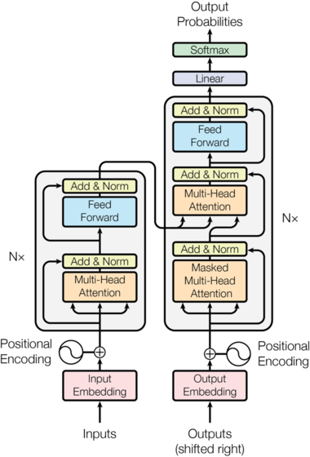
The token vocabulary that is used is important
For NLP, current approaches use techniques like Byte Pair Encoding, wordpieces, or sentence pieces---which are all quite similar

Slide 5
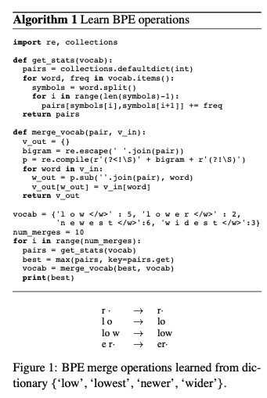

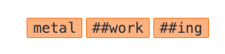
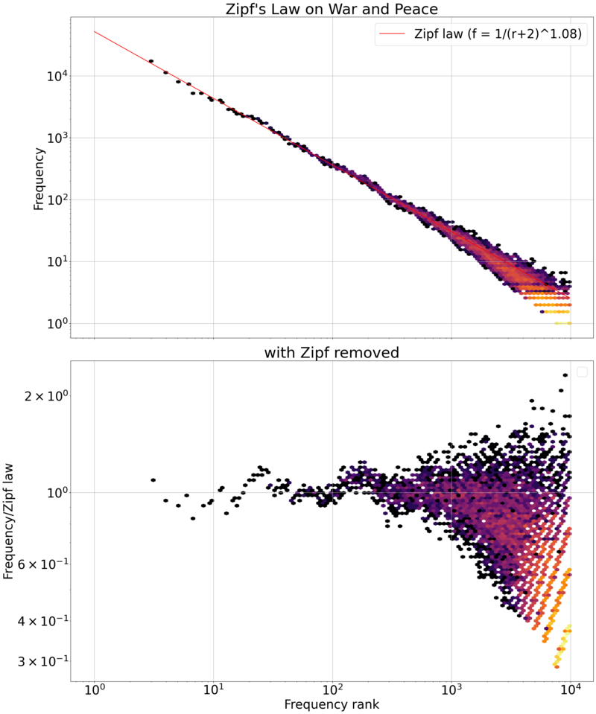
Tokenization in BERT / GPT2
Idea: reduce the number of tokens by finding meaningful subwords
Simplest version of this is Byte Pair Encoding (BPE)
Wordpieces is BERT’s variant
Notes:
https://arxiv.org/pdf/1508.07909

Slide 6
Tokenization in Later Transformers
Wordpieces and BPE are constrained by the initial tokenization.
Could be a problem, e.g., if you tokenized Python code naively.
SentencePieces starts with “sentences” instead of words.
Common approach now is to use BPE on a large corpus in UTF-8 with minimal pre-splitting.
Wordpieces was used in BERT: much like BPE but tries to maximize the probability of the corpus
under a naïve Bayes-like model of probability
main difference: instead of scoring pairs by frequency score of pointwise mutual information
Transformers are used for other modalities of input as well: images, audio, …
Notes:
Ref for sentencepieces?

Slide 7
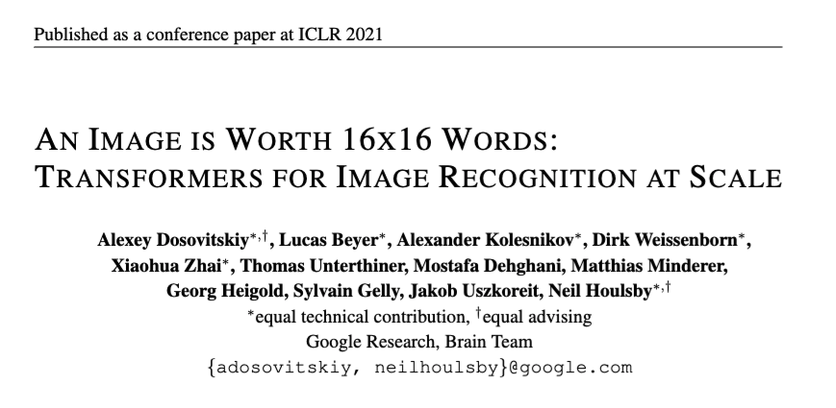
Tokenization for Vision Transformers
Transformers are used for other modalities of input as well: images, audio, …
Notes:
https://arxiv.org/pdf/2010.11929/1000

Slide 8
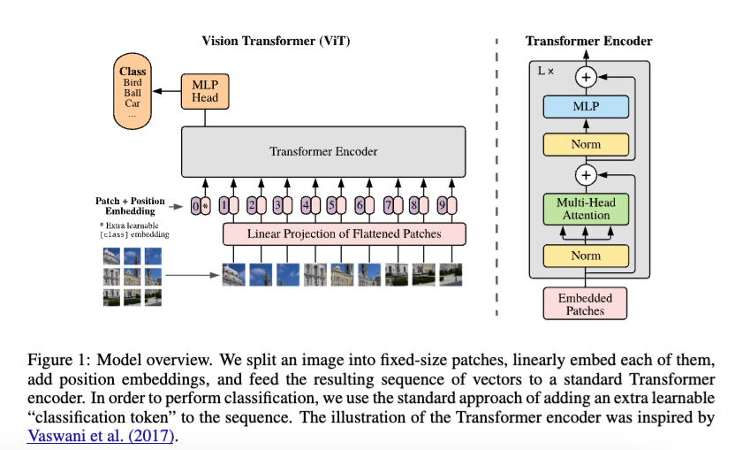
Tokenization for Vision Transformers
2D positional encoding is not better than 1D positional encoding

Slide 9
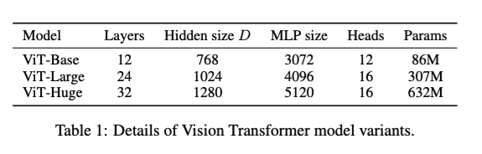
Tokenization for Vision Transformers

Slide 10
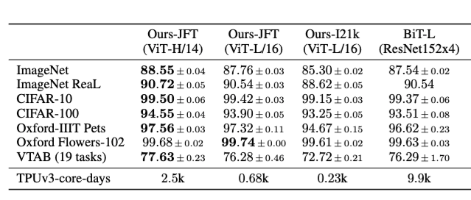
Tokenization for Vision Transformers
21k classes and 14M images
JFT = 300M images @ Google
Also trained on JFT

Slide 11
Tokenization for Vision Transformers
TPUv3 – 2 cores
16Gb/core
1024 TPUs per pod
L/16 trains on 14M images with 8 cores in 30days
JFT = 300M images @ Google
Also trained on JFT

Slide 12
Vision Transformers – Pros and Cons
ViTs have a weaker bias than CNNs and usually need more data to train
They don’t “know” that local-area features matter
“For example, ViT-B/32 is slightly faster than ResNet50; it performs much worse on the 9M subset, but better on 90M+ subsets.”
Transformers are not the SoTA way of generating images
Although they often do quite well!
ViTs are excellent for multimodal vision/language models

Slide 13
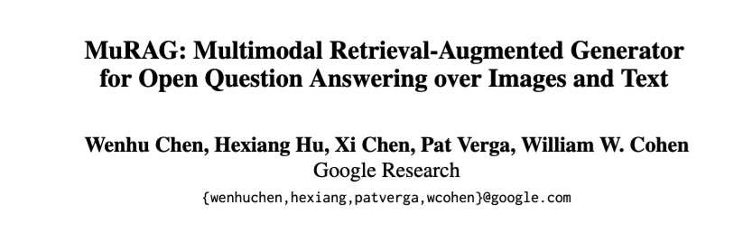
Multi-Model Transformer: Example
2022

Slide 14
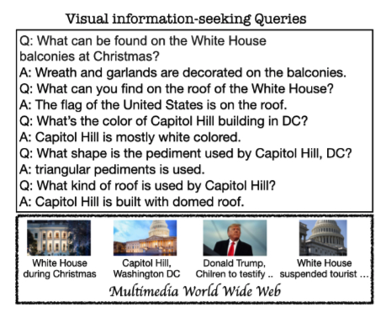
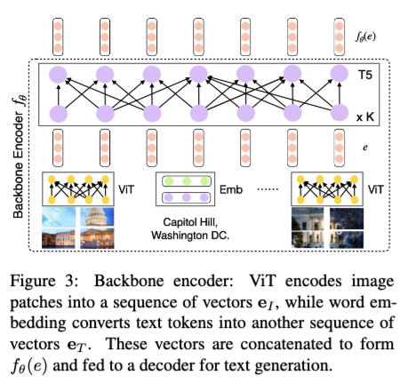
Multi-Model Transformer: Example

Slide 15
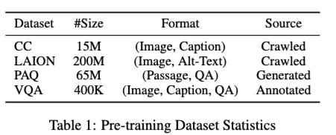
Multi-Model Transformer: Example
0. ViT and T5
1.
2. FT

Slide 16
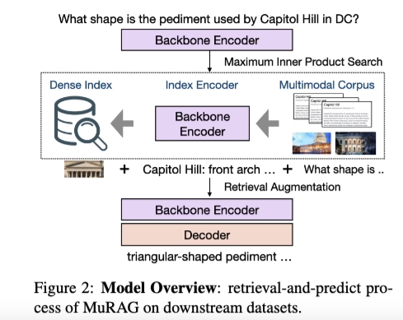
Multi-Model Transformer: Example
0. ViT and T5
1.
One encoder is used for two purposes – retrieval and generation

Slide 17
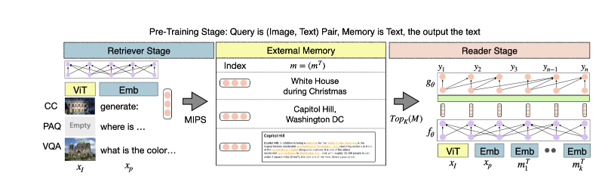
Multi-Model Transformer: Example
“Contrastive loss”: CLS embeddings of “positive pairs” are dot-product closer than CLS embeddings of “negative pairs”
“Generative loss”: generated tokens are high-probability
Image-caption pairs: ignore memory, train for image + prompt “generate caption:” → caption
Visual QA: memory is captions, train for image + prompt=question → answer
PAQ (question, passage, answer): memory is passages, train for question→answer

Slide 18
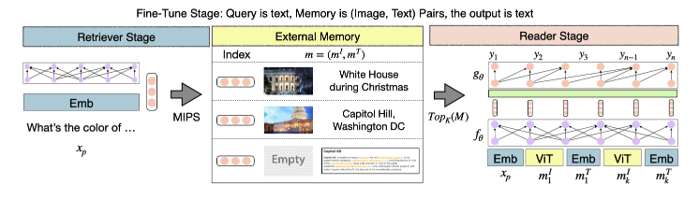
Multi-Model Transformer: Example
Retrieve from memory using encodings
Generate

Slide 19
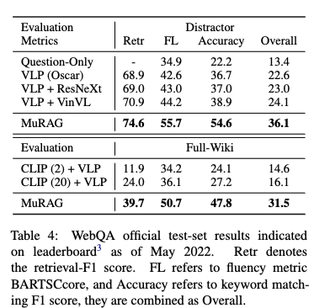
Vision Transformers – Pros and Cons
No retrieval
Retrieval at test time

Slide 20
Outline
Finish up Transformer details
Tokenization for Vision Transformers
Key-value caching for Decoders
More on this later!
Even more on hyperparameter tuning
bandits and early stopping (for upcoming HW)
Methods for making big models smaller
distillation
pruning (for mini-project)
quantization

Slide 21
Key-Value Caching for Transformers

Slide 22

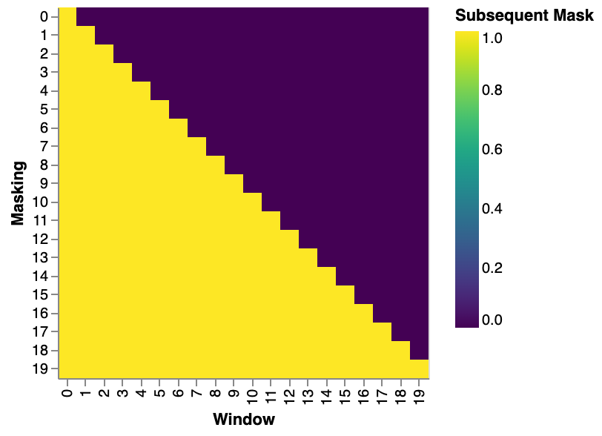
Recap: masked self-attention
In masked self-attention, the query for token at position i can only attend to thr keys for tokens at positions 0,1,…,i
This is done with a mask
Masked self-attention is used in the decoder
Prediction for token at i is not affected by “future” tokens at i+1,i+2, …
aka ”causal LM” or “causal masking”

Slide 23
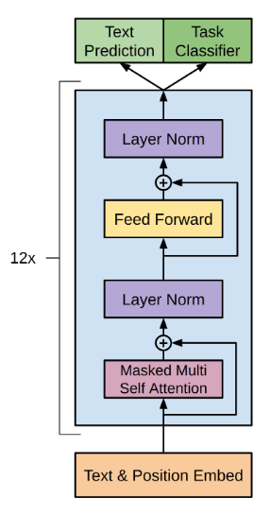
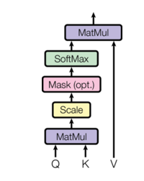
GPT
Recap: masked self-attention is always used in decoder-only Transformers

Slide 24
GPT
Recap: generation is auto-regressive
https://medium.com/@joaolages/kv-caching-explained-276520203249
Notes:
https://medium.com/@joaolages/kv-caching-explained-276520203249

Slide 25

Observation
Step 1 | Step 2 | Step 3 | Step 4

Slide 26
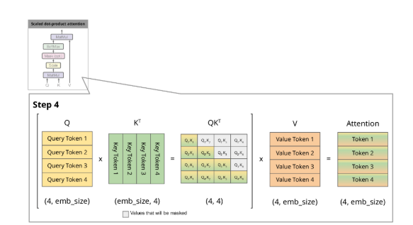
Observation
In Transformers the QK^{T} matmul is the only place where information from one token’s representation is moved to another token
if x_{i} is token representation
q_{i} = x_{i} W_{Q.} ; k_{i} = x_{i} W_{K.} ; v_{i} = x_{i} W_{V.}

Slide 27
Observation
input | input | Step 3 | Step 4
Third output depends only on the first two tokens

Slide 28
Observation
input | input | Step 3 | Step 4
Third output depends only on the first two tokens

Slide 29
Key-Value Caching
input | input | input | Step 4
Stuff in green boxes has not changed since step 3
The keys and values can be cached and re-used in forward pass
Third output depends only on the first two tokens
Fourth output output depends only on the first three tokens

Slide 30
GPT
Important point: the FFN and LayerNorms are applied independently to each token position, so there MSA is the only place where information moves from one token position to another.

Slide 31
Outline
Finish up Transformer details
Tokenization for Vision Transformers
Key-value caching for Decoders
More on this later!
Even more on hyperparameter tuning
bandits and early stopping (for upcoming HW)
Methods for making big models smaller
distillation
pruning (for mini-project)
quantization

Slide 32
HyperParameter Selection

Slide 33
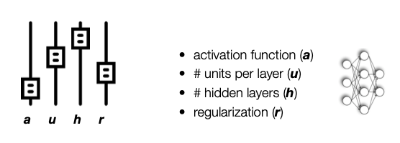
Hyperparameter Selection
Given
a set of hyperparameters
which leads to a space of possible configurations
Find:
the configuration c that gives the best possible result f(c) for some task
eg: minimize validation loss after training with c

Slide 34
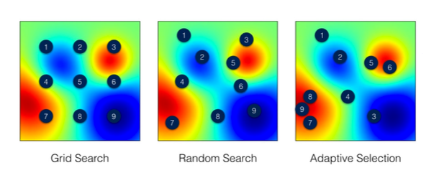
Hyperparameter Selection

Slide 35
Hyperparameter Selection
Adaptive selection loop:
Build a model of f from past experiments
“Surrogate”
Pick the next experiment to do based on the model
Repeat…
What if experiments have differing costs?

Slide 36
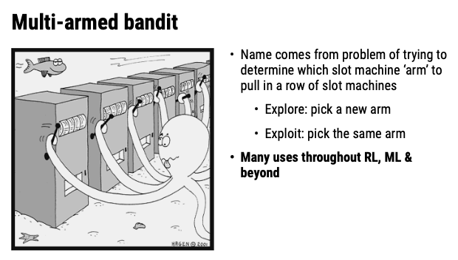
Theory: Bandit Problems in ML
Goal: (1) discover which arm has the lowest loss, so you can exploit this information (2) discover the best arm quickly so you can start winning!

Slide 37
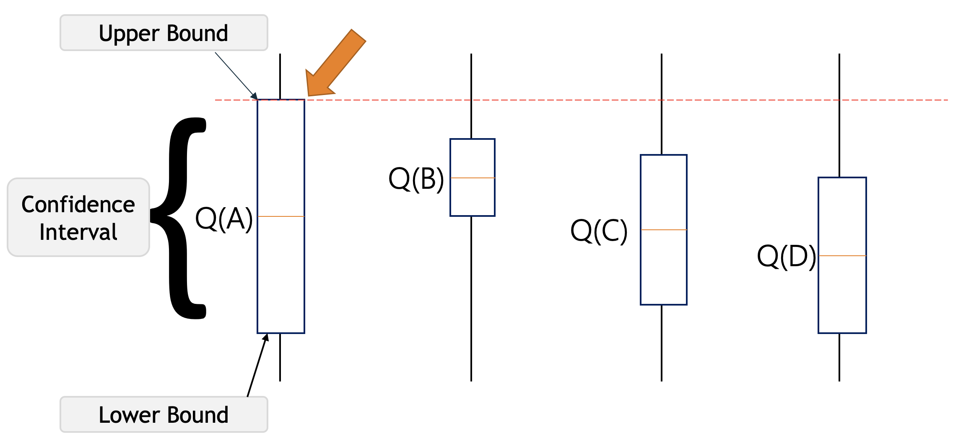
Theory: Bandit Problems in ML
Some common sampling strategies
𝜺-greedy: Pick a random arm with probability 𝜺 and the best arm with probability 1- 𝜺
Upper confidence bound (UCB): Compute confidence intervals on the expected loss of each arm, and pick the arm with best UCB

Slide 38
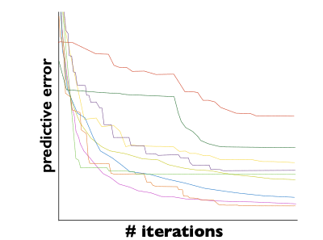
Hyperparameter Selection: Early Stopping
What if experiments have differing costs?
Example: #iterations of training is a hyperparameter
We can save computation if we cut off unpromising experiments early

Slide 39
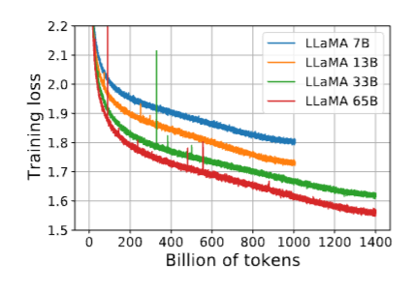
Hyperparameter Selection: Early Stopping
What can we prove about this?
What do we need to assume?
In practice there are often big jumps in discrete eval metrics like error rate, win ratios, …
In general we don’t know where a learning curve will end up…
The losses you train and test on are often fairly smooth … and sometimes there are models for them

Slide 40
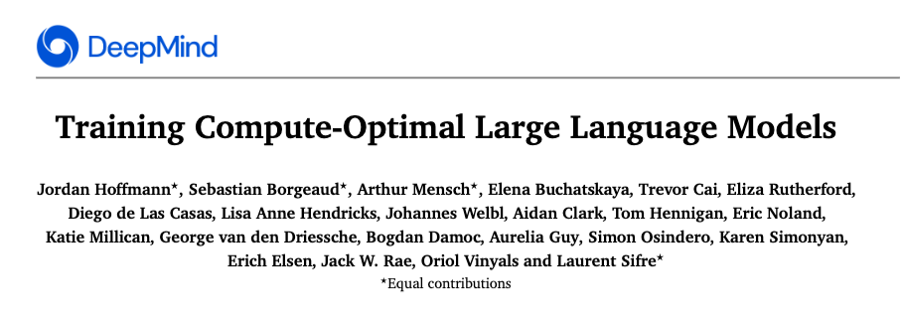
Recap: Chinchilla Scaling Laws
First 10-605 lecture!
2022

Slide 41
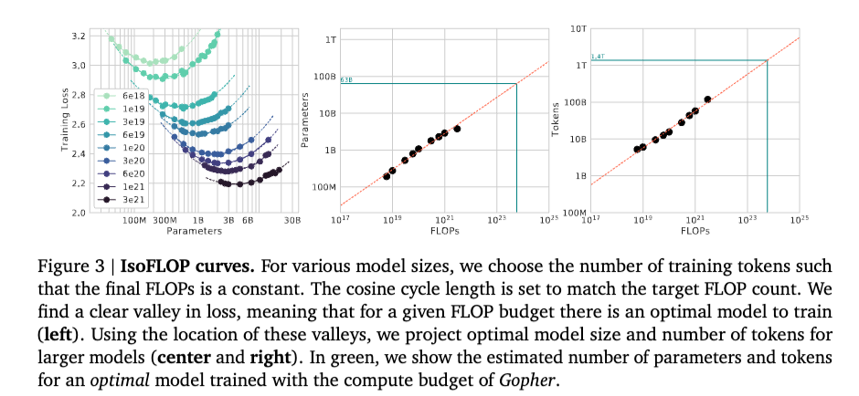
Chinchilla Scaling Laws
1.4T
63B
Idea: fit a simple model to the data that relates compute, parameters, and loss, and use that to optimize loss given a total compute budget.
Constraint = Budget = $$
Notes:
10**21 is a billion trillion FLOPS

Slide 42
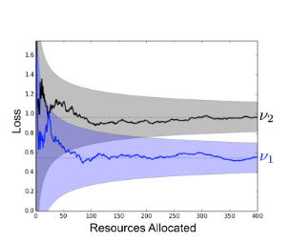
Hyperparameter Selection: Early Stopping
What can we prove about this?
What do we need to assume?
If we know where we are converging to then we can be confident when two curves separate

Slide 43
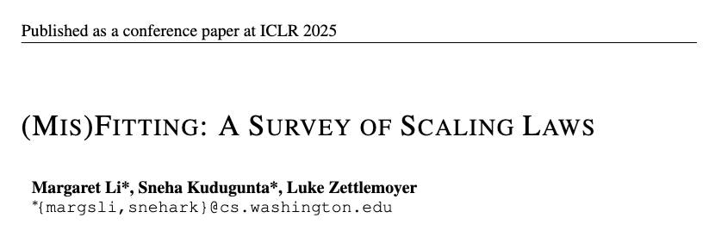
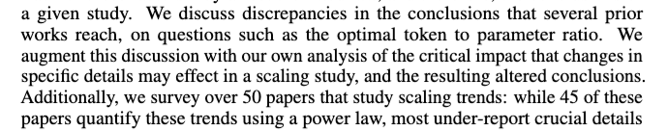
Caveat About Scaling Laws

Slide 44
Hyperparameter Selection: Early Stopping
What can we prove about this?
What do we need to assume?
If we can’t do everything what is most likely to be helpful?

Slide 45
Early Stopping Heuristics Without Parametric Scaling Curves?

Slide 46
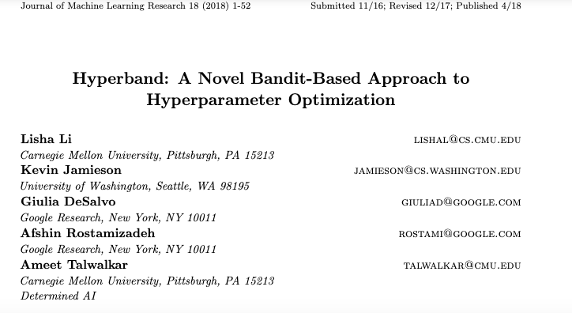

Slide 47





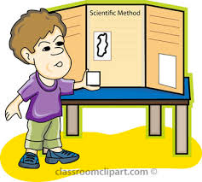
slide credit: Kevin Jamieson
Choosing the winner of a Science Fair
Project 1
Project 2
Judges
. . .
Project n-1
Project n

Slide 48
slide credit: Kevin Jamieson
Choosing the winner of a Science Fair
Uniform Judge Allocation
Project 1
judges
per
project
3, 3, …
. . .
1
2
3
4
5
6
7
n
Project 2
average
score
5, 4, …
Judges
1
2
3
4
5
6
7
. . .
n
. . .
Project n-1
5, 4, …
2, 1, …
Project n

Slide 49
slide credit: Kevin Jamieson
Choosing the winner of a Science Fair
Uniform Judge Allocation
Project 1
judges
per
project
3.3
. . .
1
2
3
4
5
6
7
n
Project 2
average
score
4.5
. . .
Judges
2
3
4
6
1
5
7
n
. . .
Project n-1
4.5
Project n
2.1
Notes:
Laplace defined science as a predicting tool.

Slide 50
slide credit: Kevin Jamieson
Choosing the winner of a Science Fair
Uniform Judge Allocation
Project 1
judges
per
project
+
3.3
.3
-
. . .
1
2
3
4
5
6
7
n
Project 2
average
score
[ ]
[ ]
+
. . .
4.5
.3
[ ]
[ ]
-
Judges
X
X
X
X
2
3
4
6
1
5
7
n
. . .
Statistically indistinguishable!
Project n-1
+
4.5
.3
-
Project n
+
.3
2.1
-
Notes:
Laplace defined science as a predicting tool.

Slide 51
slide credit: Kevin Jamieson
Choosing the winner of a Science Fair
Uniform Judge Allocation
Project 1
judges
per
project
. . .
1
2
3
4
5
6
7
n
Project 2
average
score
[ ]
[ ]
[ ]
[ ]
. . .
Judges
X
X
X
X
2
3
4
6
1
5
7
n
. . .
Adaptive Judge Allocation
Project n-1
Project n
Notes:
Laplace defined science as a predicting tool.

Slide 52
slide credit: Kevin Jamieson
Choosing the winner of a Science Fair
Uniform Judge Allocation
Project 1
judges
per
project
2, 4
. . .
1
2
3
4
5
6
7
n
Project 2
average
score
[ ]
[ ]
5, 4
[ ]
[ ]
. . .
Judges
X
X
X
X
2
3
4
6
1
5
7
n
. . .
Adaptive Judge Allocation
Proceed in rounds: Round 1
Project n-1
5, 4
judges
per
project
. . .
1
2
3
4
5
6
7
n
2, 1
average
score
Project n
1
2
3
4
5
6
7
. . .
n
Notes:
Laplace defined science as a predicting tool.

Slide 53
slide credit: Kevin Jamieson
Choosing the winner of a Science Fair
Uniform Judge Allocation
Project 1
judges
per
project
3.1
. . .
1
2
3
4
5
6
7
n
Project 2
average
score
[ ]
[ ]
4.8
[ ]
[ ]
. . .
Judges
X
X
X
X
2
3
4
6
1
5
7
n
. . .
Adaptive Judge Allocation
Proceed in rounds: Round 1
Project n-1
judges
per
project
4.7
. . .
1
2
3
4
5
6
7
n
average
score
. . .
Project n
2.2
2
3
4
6
1
5
7
n
Notes:
Laplace defined science as a predicting tool.

Slide 54
slide credit: Kevin Jamieson
Choosing the winner of a Science Fair
Uniform Judge Allocation
Project 1
judges
per
project
+
3.1
.5
-
. . .
1
2
3
4
5
6
7
n
Project 2
average
score
[ ]
[ ]
+
. . .
4.8
.5
[ ]
[ ]
-
Judges
X
X
X
X
2
3
4
6
1
5
7
n
. . .
Adaptive Judge Allocation
Proceed in rounds: Round 1
Project n-1
judges
per
project
+
. . .
4.7
.5
-
1
2
3
4
5
6
7
n
average
score
[ ]
[ ]
Project n
[ ]
[ ]
. . .
[ ]
[ ]
[ ]
+
.5
[ ]
2.2
-
2
3
4
6
1
5
7
n
Notes:
Laplace defined science as a predicting tool.

Slide 55
slide credit: Kevin Jamieson
Choosing the winner of a Science Fair
Uniform Judge Allocation
Project 1
judges
per
project
+
3.1
.5
-
. . .
1
2
3
4
5
6
7
n
Project 2
average
score
[ ]
[ ]
+
. . .
4.8
.5
[ ]
[ ]
-
Judges
X
X
X
X
2
3
4
6
1
5
7
n
. . .
Adaptive Judge Allocation
Proceed in rounds: Round 1
Project n-1
judges
per
project
+
. . .
4.7
.5
-
1
2
3
4
5
6
7
n
average
score
[ ]
[ ]
Project n
[ ]
[ ]
. . .
[ ]
[ ]
[ ]
+
.5
[ ]
2.2
-
2
3
4
6
1
5
7
n
Notes:
Laplace defined science as a predicting tool.

Slide 56
slide credit: Kevin Jamieson
Choosing the winner of a Science Fair
Uniform Judge Allocation
Project 1
judges
per
project
+
3.1
.5
-
. . .
1
2
3
4
5
6
7
n
Project 2
average
score
[ ]
[ ]
+
. . .
4.8
.5
[ ]
[ ]
-
Judges
X
X
X
X
2
3
4
6
1
5
7
n
. . .
Adaptive Judge Allocation
Proceed in rounds: Round 1
Project n-1
judges
per
project
+
. . .
4.7
.5
-
1
2
3
4
5
6
7
n
average
score
[ ]
[ ]
Project n
[ ]
[ ]
. . .
[ ]
[ ]
[ ]
+
.5
[ ]
2.2
-
2
3
4
6
1
5
7
n
Notes:
Laplace defined science as a predicting tool.

Slide 57
slide credit: Kevin Jamieson
Choosing the winner of a Science Fair
Uniform Judge Allocation
Project 1
judges
per
project
+
3.1
.5
-
. . .
1
2
3
4
5
6
7
n
Project 2
average
score
[ ]
[ ]
+
. . .
4.8
.5
[ ]
[ ]
-
Judges
X
X
X
X
2
3
4
6
1
5
7
n
. . .
Adaptive Judge Allocation
Proceed in rounds: Round 1
Project n-1
judges
per
project
+
. . .
4.7
.5
-
1
2
3
4
5
6
7
n
average
score
[ ]
[ ]
Project n
[ ]
[ ]
. . .
[ ]
+
.5
2.2
-
X
X
X
2
3
4
6
1
5
7
n
Notes:
Laplace defined science as a predicting tool.

Slide 58
slide credit: Kevin Jamieson
Choosing the winner of a Science Fair
Uniform Judge Allocation
Project 1
judges
per
project
3.1
+
.5
-
. . .
1
2
3
4
5
6
7
n
Project 2
average
score
[ ]
[ ]
4.8
+
.5
[ ]
[ ]
. . .
1.
-
4.7
+
.3
2.
-
Judges
X
X
X
X
2
3
4
6
1
5
7
n
. . .
Adaptive Judge Allocation
Proceed in rounds: Round 2
Project n-1
judges
per
project
4.7
+
.5
. . .
1.
-
4.8
+
.3
2.
-
1
2
3
4
5
6
7
n
average
score
[ ]
[ ]
Project n
[ ]
[ ]
. . .
[ ]
2.2
+
.5
-
X
X
X
2
3
4
6
1
5
7
n
Notes:
Laplace defined science as a predicting tool.

Slide 59
slide credit: Kevin Jamieson
Choosing the winner of a Science Fair
Uniform Judge Allocation
Project 1
judges
per
project
3.1
+
.5
-
. . .
1
2
3
4
5
6
7
n
Project 2
average
score
[ ]
[ ]
4.8
+
.5
[ ]
[ ]
. . .
1.
-
4.7
+
.3
2.
-
Judges
X
X
X
X
2
3
4
6
1
5
7
n
. . .
Adaptive Judge Allocation
Proceed in rounds: Round 2
Project n-1
judges
per
project
4.7
+
.5
. . .
1.
-
4.8
+
.3
2.
-
1
2
3
4
5
6
7
n
average
score
[ ]
[ ]
Project n
[ ]
[ ]
. . .
[ ]
2.2
+
.5
-
X
X
X
2
3
4
6
1
5
7
n
Notes:
Laplace defined science as a predicting tool.

Slide 60
slide credit: Kevin Jamieson
Choosing the winner of a Science Fair
Uniform Judge Allocation
Project 1
judges
per
project
3.1
+
.5
-
. . .
1
2
3
4
5
6
7
n
Project 2
average
score
[ ]
[ ]
4.8
+
.5
[ ]
[ ]
. . .
1.
-
4.7
+
.3
2.
-
Judges
X
X
X
X
2
3
4
6
1
5
7
n
. . .
Adaptive Judge Allocation
Proceed in rounds: Round 2
Project n-1
judges
per
project
4.7
+
.5
. . .
1.
-
4.8
+
.3
2.
-
1
2
3
4
5
6
7
n
average
score
[ ]
[ ]
Project n
. . .
2.2
+
.5
-
X
X
X
X
X
X
2
3
4
6
1
5
7
n
Notes:
Laplace defined science as a predicting tool.

Slide 61
slide credit: Kevin Jamieson
Choosing the winner of a Science Fair
Uniform Judge Allocation
Project 1
judges
per
project
3.1
+
.5
-
. . .
1
2
3
4
5
6
7
n
Project 2
average
score
[ ]
[ ]
4.8
+
.5
[ ]
[ ]
. . .
1.
-
4.7
+
.3
2.
-
Judges
X
X
X
X
2
3
4
6
4.9
+
.1
1
5
7
n
3.
-
. . .
Adaptive Judge Allocation
Proceed in rounds: Round 3
Project n-1
judges
per
project
4.7
+
.5
. . .
1.
-
4.8
+
.3
2.
-
4.7
+
.1
1
2
3
4
5
6
7
n
3.
-
average
score
[]
[]
Project n
. . .
2.2
+
.5
-
X
X
X
X
X
X
2
3
4
6
1
5
7
n
Notes:
Laplace defined science as a predicting tool.

Slide 62
slide credit: Kevin Jamieson
Choosing the winner of a Science Fair
Uniform Judge Allocation
Project 1
judges
per
project
3.1
+
.5
-
. . .
1
2
3
4
5
6
7
n
Project 2
average
score
[ ]
[ ]
4.8
+
.5
[ ]
[ ]
. . .
1.
-
4.7
+
.3
2.
-
Judges
X
X
X
X
2
3
4
6
4.9
+
.1
1
5
7
n
3.
-
. . .
Adaptive Judge Allocation
Proceed in rounds: Round 3
Project n-1
judges
per
project
4.7
+
.5
. . .
1.
-
4.8
+
.3
2.
-
4.7
+
.1
1
2
3
4
5
6
7
n
3.
-
average
score
[]
[]
Project n
. . .
2.2
+
.5
-
X
X
X
X
X
X
2
3
4
6
1
5
7
n
Notes:
Laplace defined science as a predicting tool.

Slide 63
slide credit: Kevin Jamieson
Choosing the winner of a Science Fair
Uniform Judge Allocation
Project 1
judges
per
project
3.1
+
.5
-
. . .
1
2
3
4
5
6
7
n
Project 2
average
score
[ ]
[ ]
4.8
+
.5
[ ]
[ ]
. . .
1.
-
4.7
+
.3
2.
-
Judges
X
X
X
X
2
3
4
6
4.9
+
.1
1
5
7
n
3.
-
. . .
Adaptive Judge Allocation
Proceed in rounds: Round 3
Project n-1
judges
per
project
4.7
+
.5
. . .
1.
-
4.8
+
.3
2.
-
4.7
+
.1
1
2
3
4
5
6
7
n
3.
-
average
score
[]
Project n
. . .
2.2
+
.5
-
X
X
X
X
X
X
X
2
3
4
6
1
5
7
n
Notes:
Laplace defined science as a predicting tool.

Slide 64

slide credit: Kevin Jamieson
Choosing the winner of a Science Fair
Uniform Judge Allocation
Project 1
judges
per
project
3.1
+
.5
-
. . .
1
2
3
4
5
6
7
n
Project 2
average
score
[ ]
[ ]
4.8
+
.5
[ ]
[ ]
. . .
1.
-
4.7
+
.3
2.
-
Judges
X
X
X
X
2
3
4
6
+
1
5
7
n
3.
4.9
-
.1
Same number of total judgments
. . .
Adaptive Judge Allocation
Proceed in rounds: Round 3
Project n-1
judges
per
project
4.7
+
.5
. . .
1.
-
4.8
+
.3
2.
-
4.7
+
.1
1
2
3
4
5
6
7
n
3.
-
average
score
[]
Project n
. . .
2.2
+
.5
-
X
X
X
X
X
X
X
2
3
4
6
1
5
7
n
Notes:
Laplace defined science as a predicting tool.

Slide 65
Why Halving?
x
x | x
x | x | x | x
x | x | x | x | x | x | x | x
1
2
4
8

Slide 66
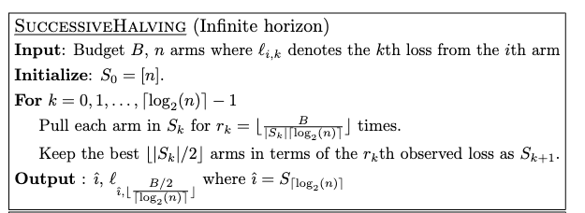
Successive Halving Method
If the number of configurations n is large, we may get very noisy results early on and miss the best
If n is too small then we will waste resources on bad arms.
https://jmlr.org/papers/volume18/16-558/16-558.pdf

Slide 67
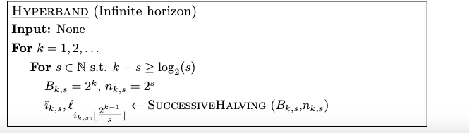
Hyperband
Hyperband runs several rounds of SuccessiveHalving with very different sizes n

Slide 68
Outline
Finish up Transformer details
Tokenization for Vision Transformers
Key-value caching for Decoders
More on this later!
Even more on hyperparameter tuning
bandits and early stopping (for upcoming HW)
Methods for making big models smaller
distillation
pruning (for mini-project)
quantization

Slide 69
MAKING BIG Transformers SMALLER

Slide 70
Compressing Large Models
Very large models are powerful but
High $$$ cost
High electricity/carbon output
High latency
Important questions:
Can we make a large model smaller/cheaper
without reducing overall performance (too much)?
without reducing performance on a particular task of interest (too much)?

Slide 71
Main techniques for compressing models
Distillation
Train a smaller “student model” to give the same outputs as a larger “teacher model”
Usually on a particular task
Model pruning
Remove parts of a large model and re-train
Quantization
Replace floating-point operations in parts of the model with lower-precision versions

Slide 72
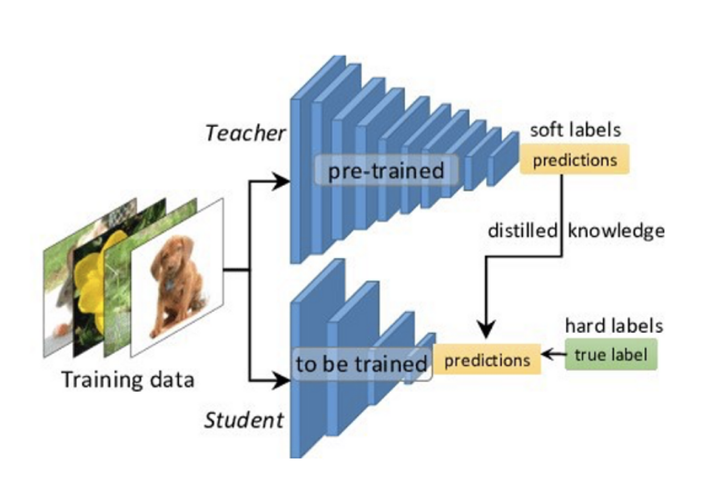
Distillation
Typically we distill a model on lots and lots of data only labeled by the teacher (transfer set)
The simple case: teacher predictions are “hard” labels (e.g., training a generative LLM).
Notes:
https://arxiv.org/pdf/1503.02531

Slide 73
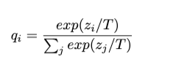
Distillation
Less simple case: loss is squared errors of the logits of the student model vs the logits of the teacher model (Caruana et al, 2006 – “model compression”).
The simple case: teacher predictions are “hard” labels (e.g., training a generative LLM).
Alternative: add “temperature” T to the softmax layer:
…and loss is cross-entropy with the “high temperature” version of the softmax.
If logits are zero-mean and temperature is high this approximates model compression.
Notes:
https://arxiv.org/pdf/1503.02531 – hinton
https://dl.acm.org/doi/pdf/10.1145/1150402.1150464?casa_token=ZxtFG3fO6mEAAAAA:IdLIREL8pvqky67MmXOnwomiq0HI8LnFL2LltZIZZG1OsjRENg6fQh1aqpbiPbRKg8k4LqXHcRLC - caruana

Slide 74
Distillation: advantages over compression
Easy to add cross-entropy loss to a set of gold labels.
Moderate temperatures seem to require less transfer data for same accuracy.
Notes:
https://arxiv.org/pdf/1503.02531 – hinton
https://dl.acm.org/doi/pdf/10.1145/1150402.1150464?casa_token=ZxtFG3fO6mEAAAAA:IdLIREL8pvqky67MmXOnwomiq0HI8LnFL2LltZIZZG1OsjRENg6fQh1aqpbiPbRKg8k4LqXHcRLC - caruana

Slide 75
Main techniques for compressing models
Distillation
Train a smaller “student model” to give the same outputs as a larger “teacher model”
Usually on a particular task
Model pruning – more later!
Remove parts of a large model and re-train
Quantization
Replace floating-point operations in parts of the model with lower-precision versions

Slide 76
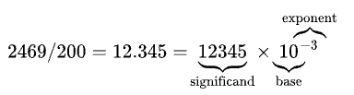
Quantization: Background
Scientific notation:
±

Slide 77
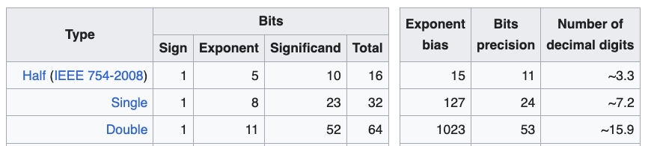
Quantization: Background
Scientific notation:
±
Subtract bias from stored exponent to get true exponent, so float range of exponents is [-126, 127]
IEEE standards for hardware:

Slide 78
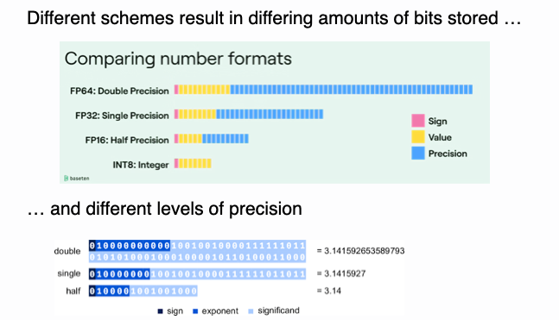
Quantization: Background

Slide 79
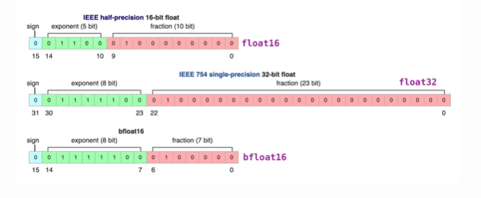
Quantization: Background
PyTorch, TensorFlow, many accelerators, … support bfloat16 as well
Some chips support fp8 but training with it is tricky (see DeepSeek)
…but training with 16 bit floats often works
Traditionally: train with float32…then it’s easy to truncate to bfloat16 for inference.

Slide 80
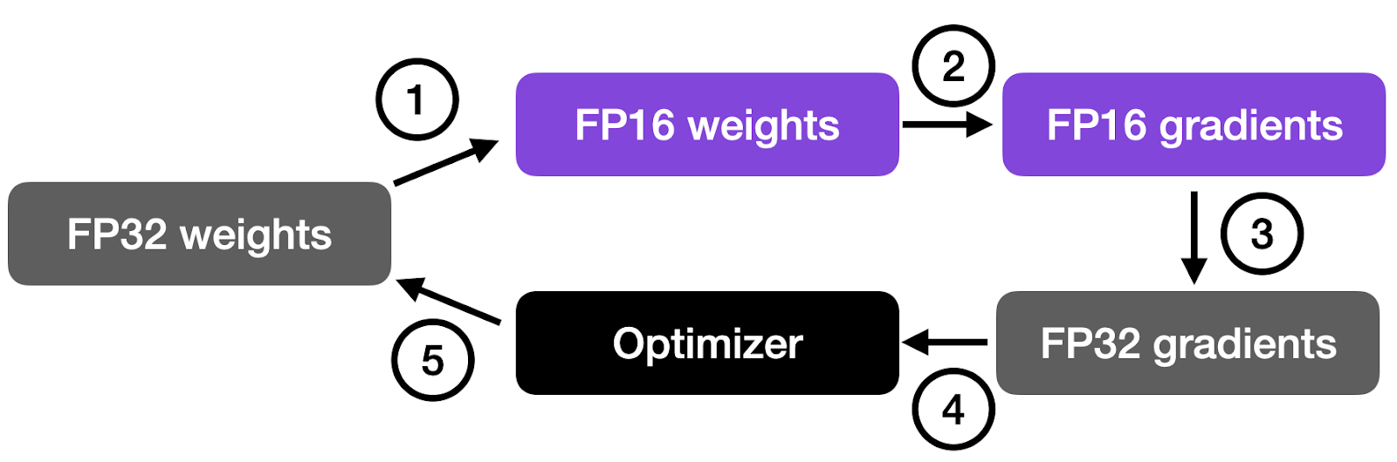
Quantization: Background
Working with even fp32 requires some care
E.g., accelerators support “fused multiply add” (FMA)
FMA(x,y,z)=round(x*y + z) != round(round(x*y) + z)
Dot product computation is chain of FMAs
FP16 usually is part of mixed precision training
Matmul precision can also be adjusted
Notes:
https://sebastianraschka.com/blog/2023/llm-mixed-precision-copy.html

Slide 81
Quantization: Beyond 16 bits
Going from fp32 → int8 or int4 requires some tricks:
Note: everything needs to be h/w and library aware!
Quantize different parts of the model differently
quantize(x; S, Z) = round(x/S + Z)
S is “scale”
Z is “zero point”
S, Z are set for this model slice to get the needed range [⍺,β]
do as much as you can in quantized space instead of quantizing and de-quantizing frequently (the FMA trick)
complete matmul, conv2D-BatchNorm-ReLU
Sometimes: quantize dynamically
set S, Z after you see the activation values
Don’t quantize everything
eg bias layers aren’t usually quantized
Notes:
https://leimao.github.io/article/Neural-Networks-Quantization/

Slide 82
Quantization: Beyond 16 bits
Going from fp32 → int8 or int4 requires some tricks:
Quantize different parts of the model differently
quantize(x; S, Z) = round(x/S + Z)
S is “scale”
Z is “zero point”
S, Z are set for this model slice to get the needed range [⍺,β]
do as much as you can in quantized space instead of quantizing and de-quantizing frequently (the FMA trick)
complete matmul, conv2D-BatchNorm-ReLU
Sometimes: quantize dynamically
set S, Z after you see the activation values
Don’t quantize everything
eg bias layers aren’t usually quantized
Notes:
https://leimao.github.io/article/Neural-Networks-Quantization/

Slide 83
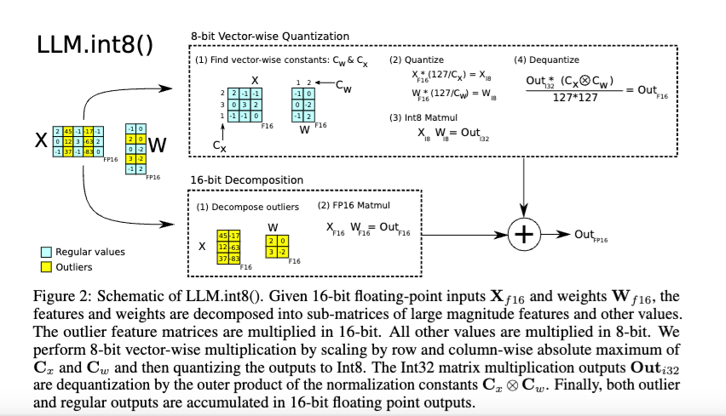
Quantization: Beyond 16 bits
Going from fp32 → int8 or int4 requires some tricks:
Mixed-precision quantization – keep large “outlier” features
Notes:
https://proceedings.neurips.cc/paper_files/paper/2022/file/c3ba4962c05c49636d4c6206a97e9c8a-Paper-Conference.pdf

Slide 84
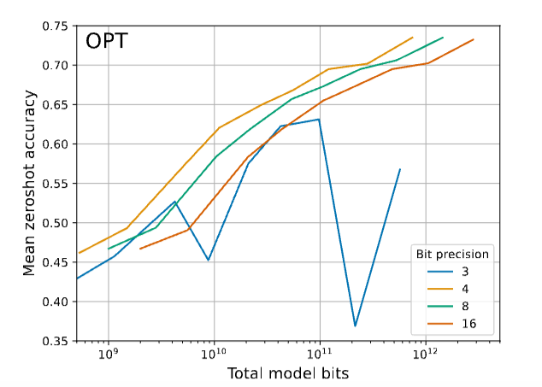
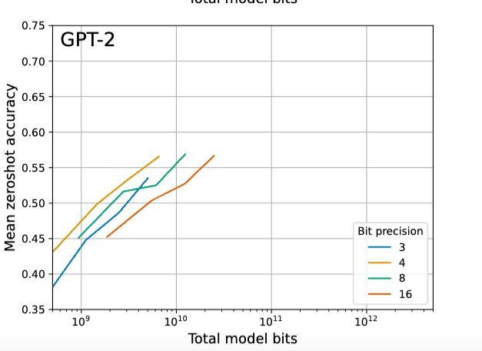
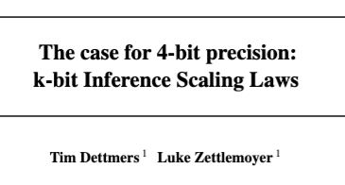
Quantization: Performance Tradeoffs
2023
Notes:
https://openreview.net/forum?id=i8tGb1ab1j

Slide 85
Quantization: At Training time
You can also adjust training
add “quantization layers” at training
approximate actual quantization operations at training time
because the real operations aren’t differentiable
or replace pure gradient descent with something different, like coordinate descent or EM or …
introduce the same sort of “noise” that quantization introduces
learned network will be more robust to quantization “noise”
Notes:
https://openreview.net/forum?id=i8tGb1ab1j

Slide 86
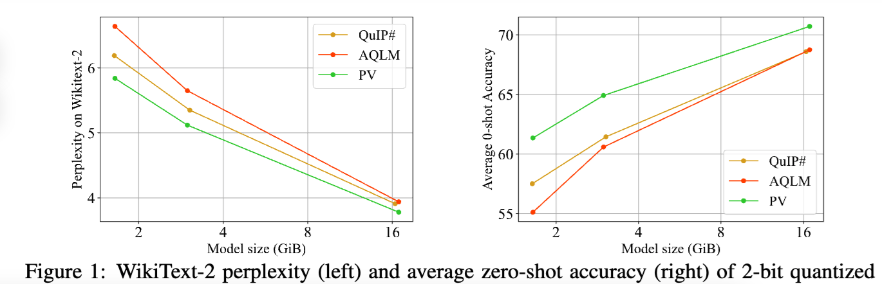
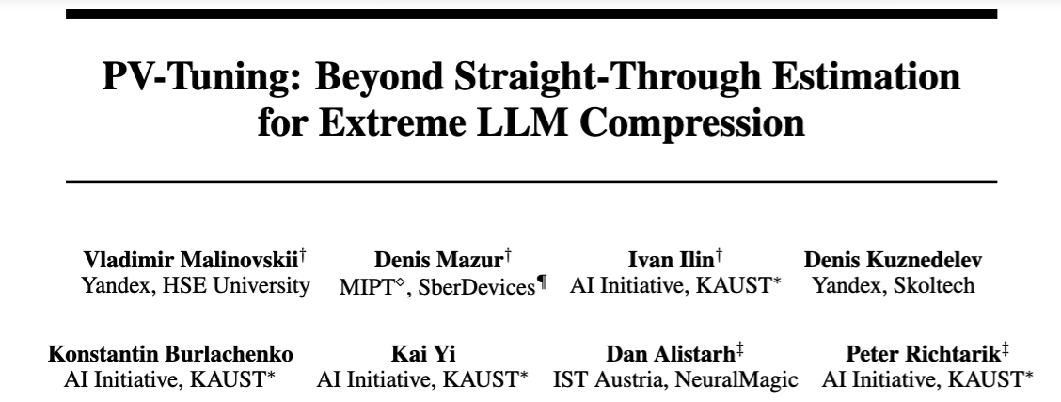
Quantization: Performance Tradeoffs
2024
Notes:
https://openreview.net/forum?id=i8tGb1ab1j

