Slide 1
10-605 / 10-405
Machine Learning from Large Datasets

Slide 2
Where were we again?
Compressing models
Distillation
Quantization
Pruning
Unstructured
Semi-Structured (e.g. 2:4 Pruning)
Structured
Key-value caching
Motivation and importance
Origin story
Long-context Transformers
Techniques
Heavy hitters – H2O
Attention sinks – StreamingLLM
Predictive caching – SnapKV
…

Slide 3
Plan for today
Recap of KV Caching
H2O, StreamingLLM
More predictive techniques for KV Caching
SnapKV
FastGen
Wrapup & discussion of KV caching
Wrapup and discussion of whole model compression segment

Slide 4
But first a word from our sponsors

Slide 5
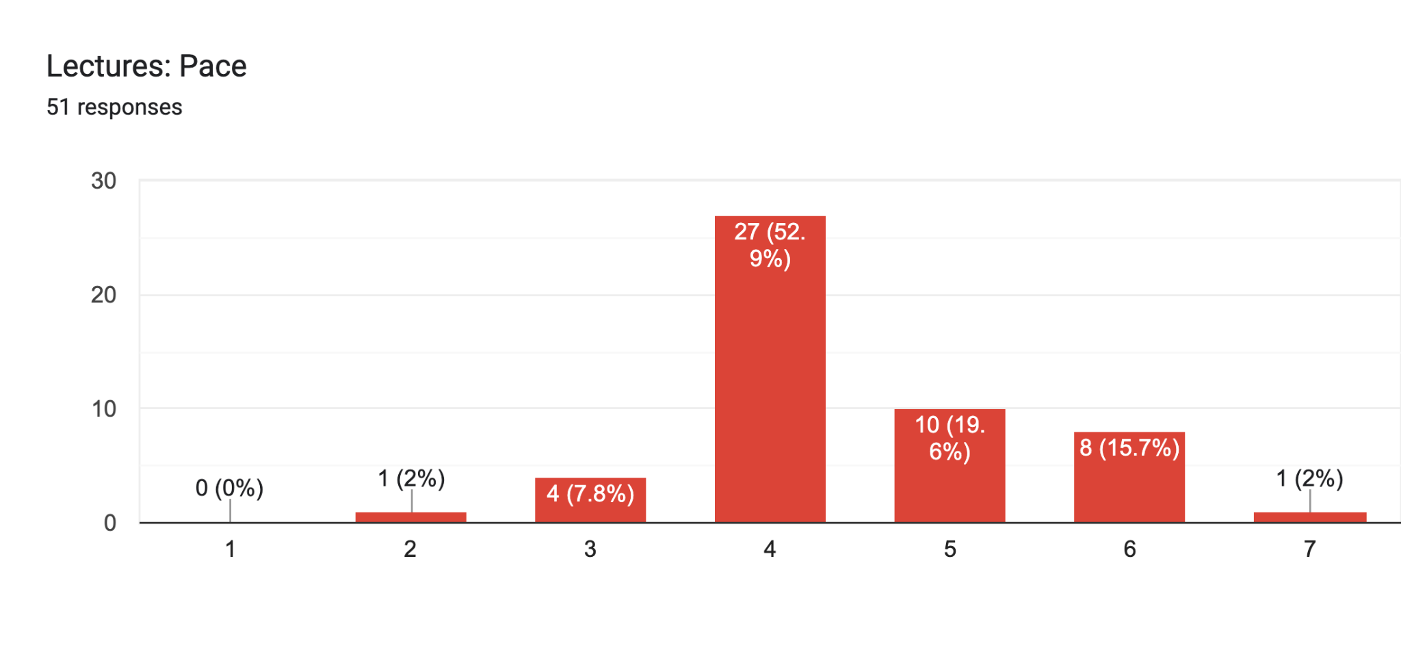
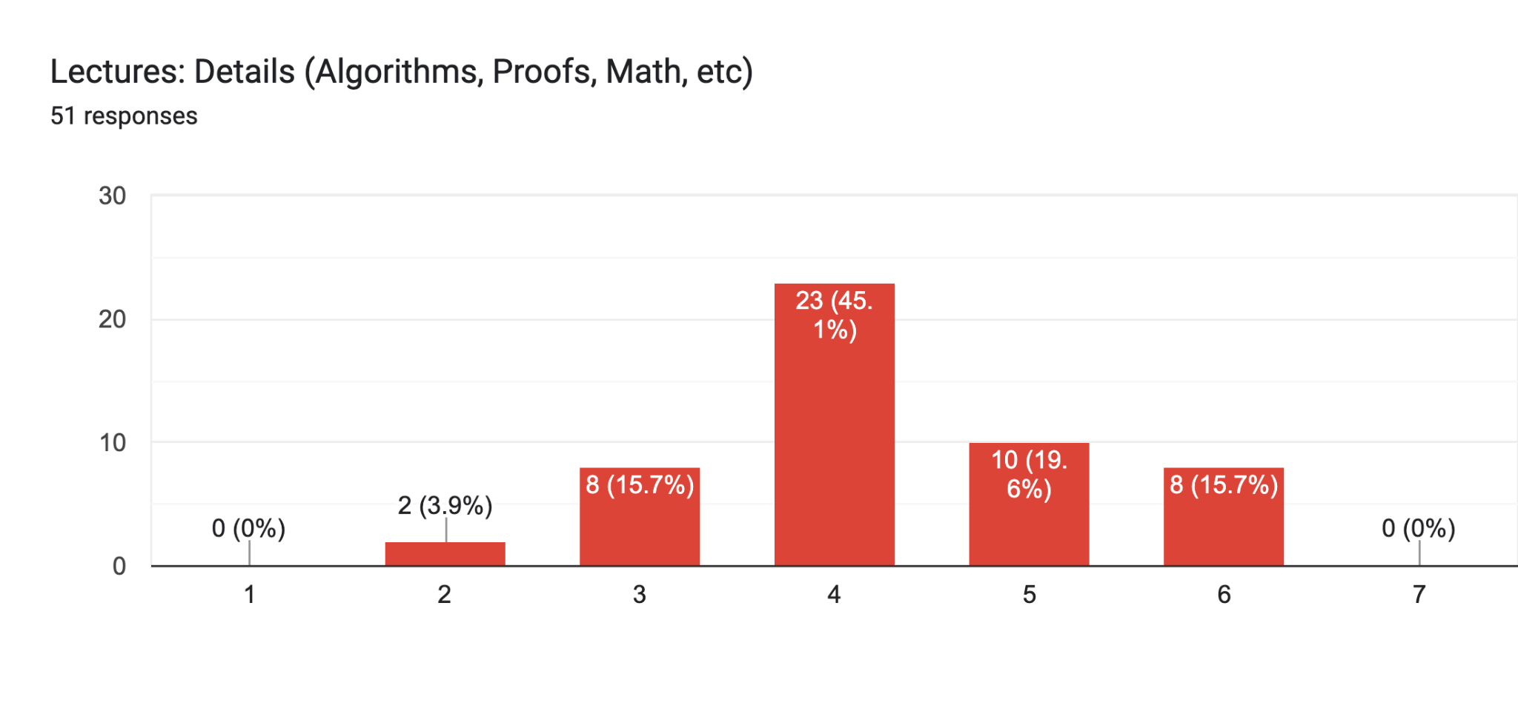
Lecture feedback
On the whole, the class feels that lecture pace, amount of detail, number of examples, and number of coding demos is about right.
Too slow
Too fast
Too few
Too many

Slide 6
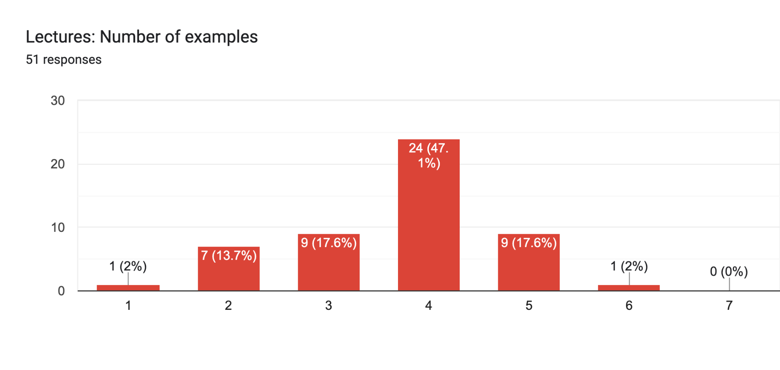
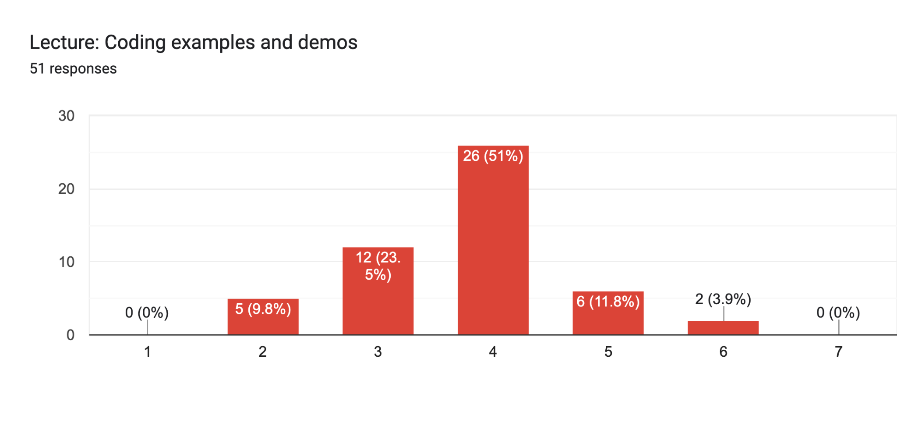
Lecture feedback
On the whole, the class feels that lecture pace, amount of detail, number of examples, and number of coding demos is about right.
Too slow
Too fast
Too few
Too many

Slide 7
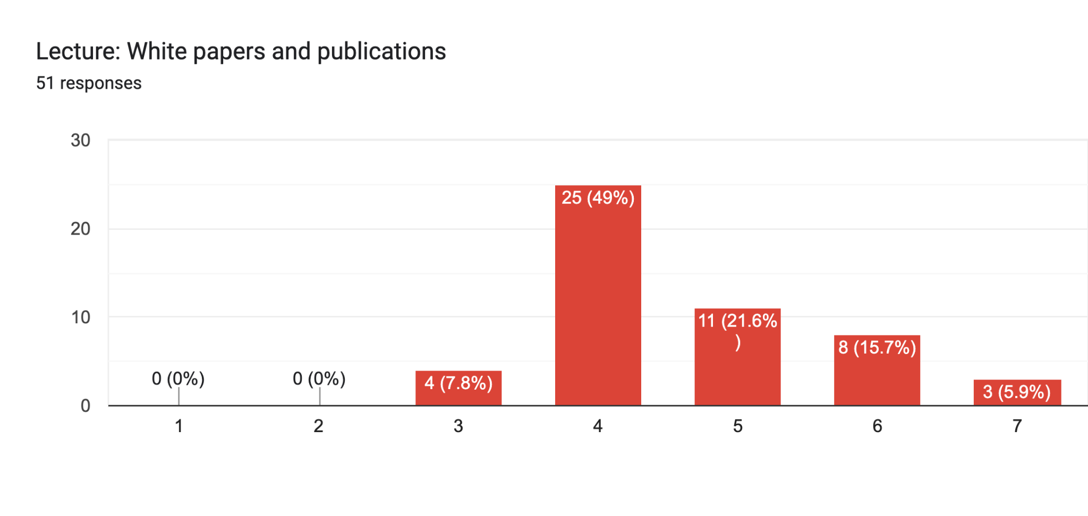
Lecture feedback
On the whole, the class feels that lecture pace, amount of detail, number of examples, and number of coding demos is about right.
Students would like to see fewer papers.
Too few
Too many

Slide 8
Post-lecture quiz feedback
We forgot to collect this in the survey
Notes:
Snap poll

Slide 9
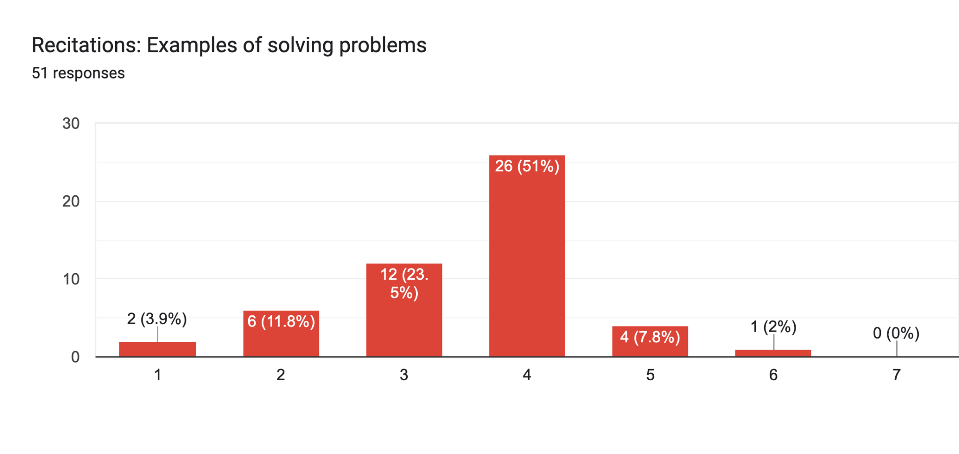
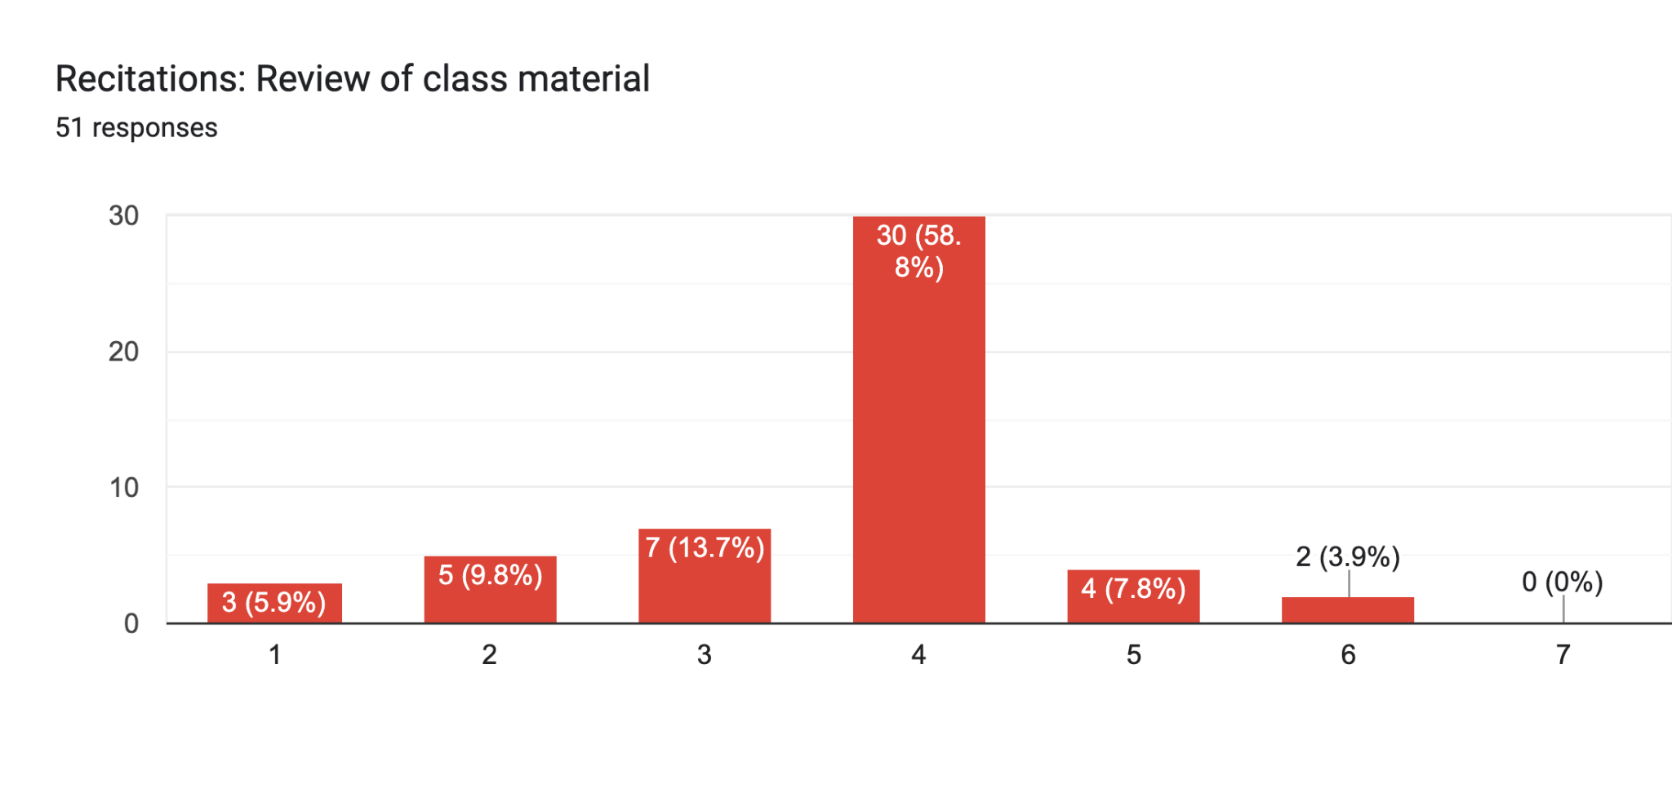
Recitation feedback
There is demand for more examples and review of class material in recitation.
Too little
Too much
Too little
Too much

Slide 10
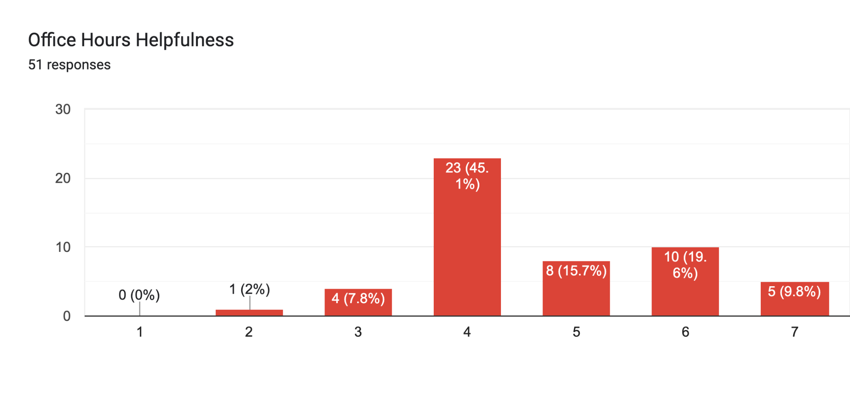
OH Feedback
Many of you feel that office hours could be more helpful. Please let us know what we could be doing better here!
Not helpful
Very helpful
Notes:
Snap poll

Slide 11
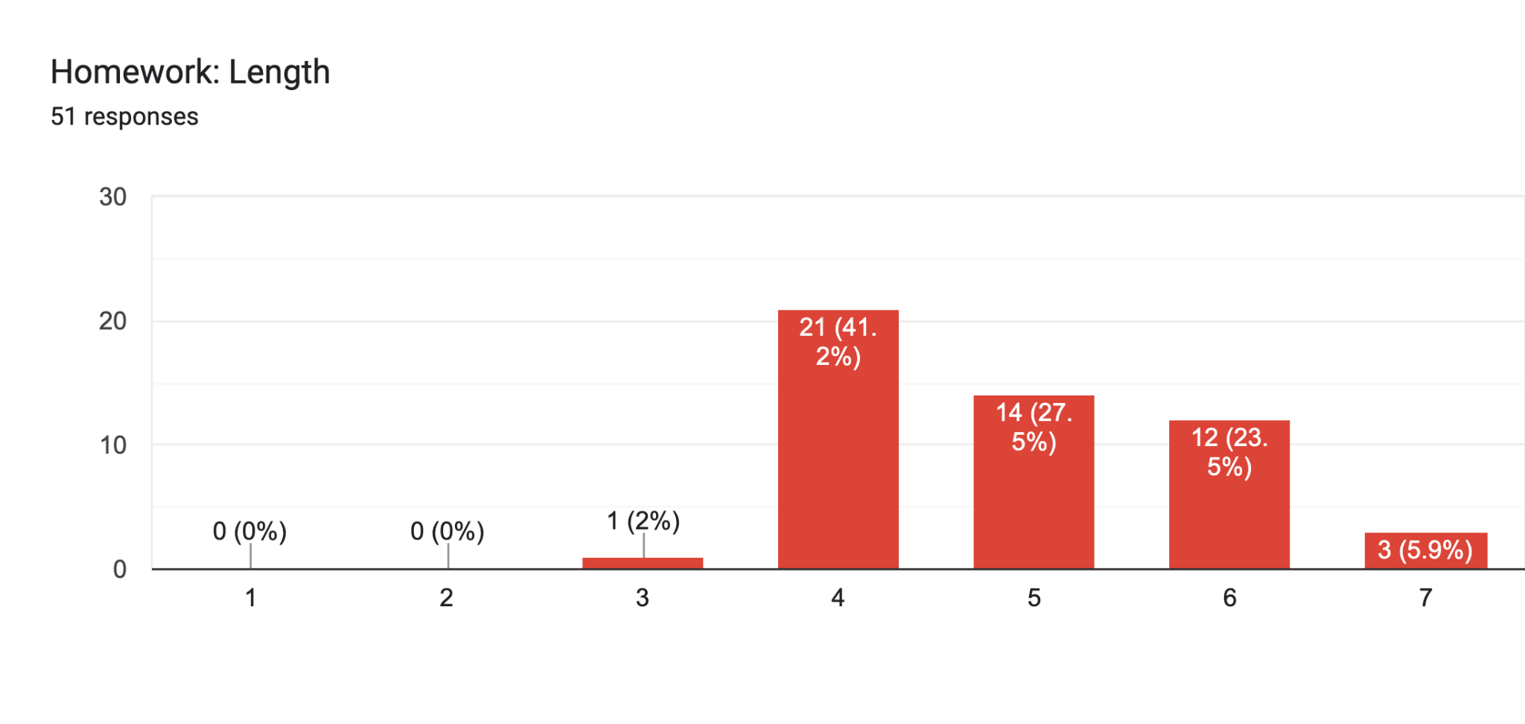
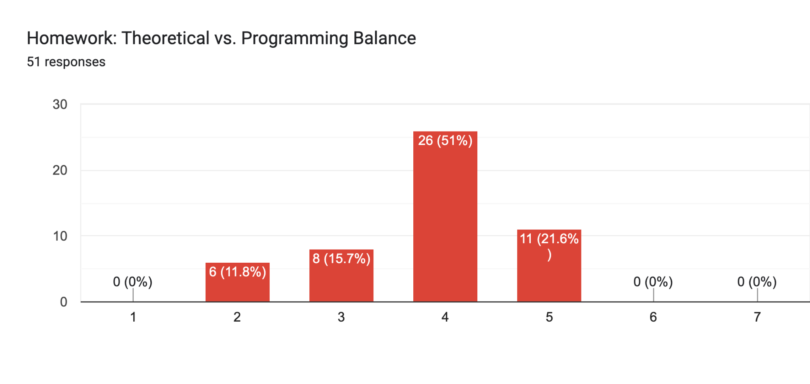
Homework feedback
The homework is currently too long
However, the balance of theory to programming is just about right
Too little
Too much
Too little
Too much

Slide 12
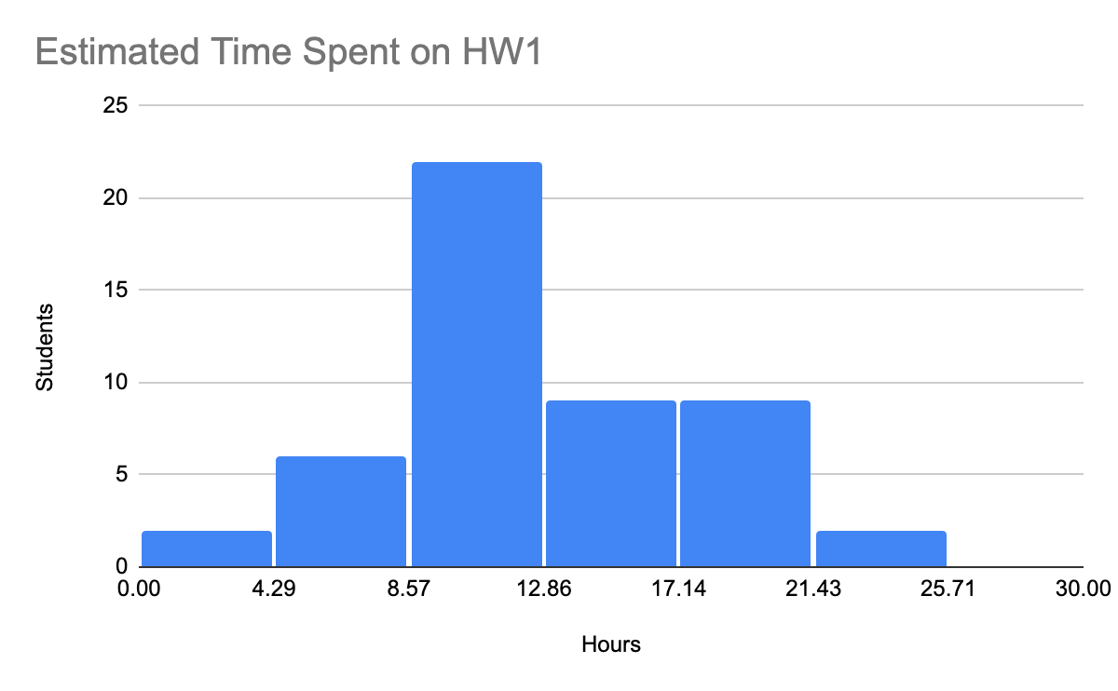
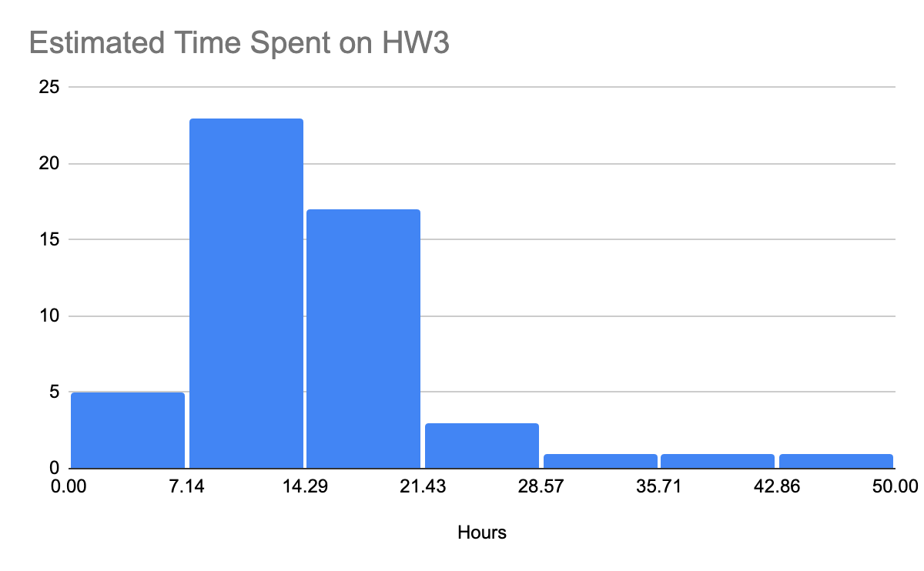
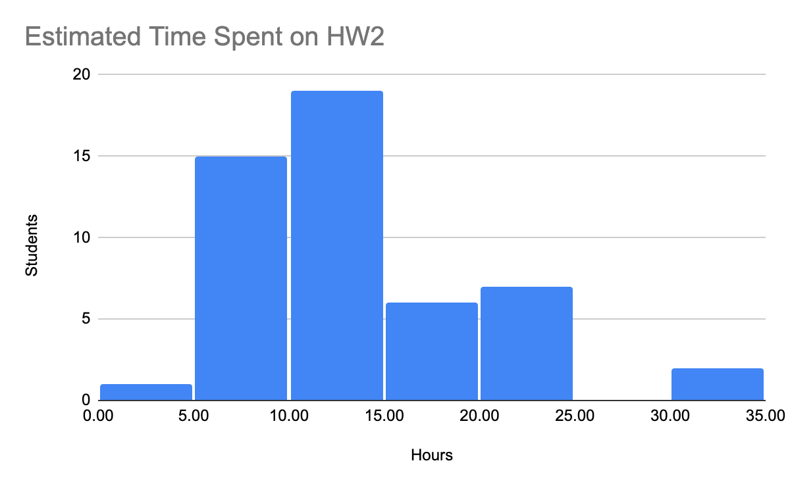
Homework Length
Homework 3 was a bit too long. We will trim this down in future iterations.

Slide 13
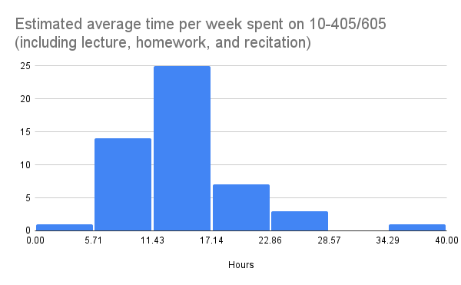
Course Workload
Students spend on average 14h per week on 10-405/605

Slide 14
Plan for today
Recap of KV Caching
H2O, StreamingLLM
More predictive techniques for KV Caching
SnapKV
FastGen
Discussion of KV caching
Recap and overview of model compression

Slide 15
Key-Value Cache Management: Recap
Attention is all you need….
…but you don’t need all the attention
Attention that’s quadratic in sequence length doesn’t scale to long sequences
So we need to approximate somehow…
What attention do we really need?
What can we ignore?
In decoder-only Transformers manipulating the KV cache is the main way of restricting attention

Slide 16
Key-Value Cache Management: Recap
In key-value caching we restrict attention after training by evicting from the cache
This is a crucial method for long inputs
or outputs, e.g. reasoning models (O1,…)
Big question: what is the eviction policy?
We know recent tokens are attended to
from long-context Transformers like ETC, BigBird, Reformer, …
so First In First Out (FIFO) is a good start

Slide 17
Outline
Compressing models
Distillation
Quantization
Pruning
Unstructured
Semi-Structured (e.g. 2:4 Pruning)
Structured
Key-value caching
Motivation and importance
Origin story
Long-context Transformers
Techniques
Heavy hitters – H2O
Attention sinks – StreamingLLM
Predictive caching – SnapKV
…

Slide 18
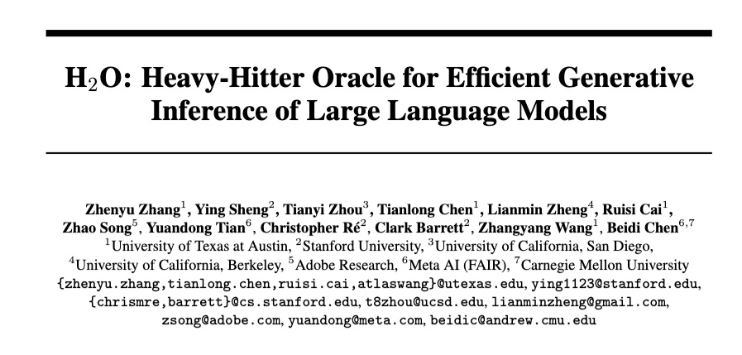
Finding “Heavy Hitters” in KV Caches
2023
Notes:
https://proceedings.neurips.cc/paper_files/paper/2023/hash/6ceefa7b15572587b78ecfcebb2827f8-Abstract-Conference.html

Slide 19
Finding “Heavy Hitters” in KV Caches
Proposed method
Fix the cache size to K
Generate tokens i=1, …, …
Track score (cumulative attention) of each token in the cache
“local H2 statistic” – cumulative attention up to position i
When the cache is full, overwrite the token with lowest local H2 score
(Attention to recent-past tokens keeps tokens from being evicted too quickly – W?)
Called an “eviction policy”
Local H2 statistic is close to full oracle H2 statistic that looks at future tokens

Slide 20
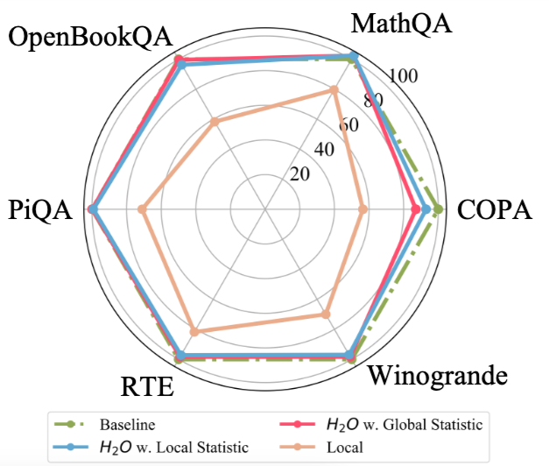
Finding “Heavy Hitters” in KV Caches

Slide 21
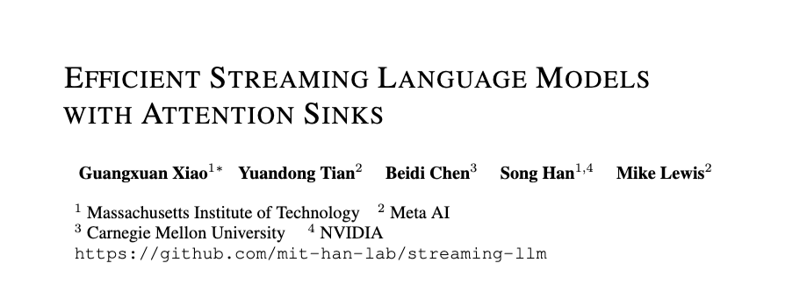
Other ways of predicting attention
2024
Notes:
https://arxiv.org/pdf/2309.17453

Slide 22
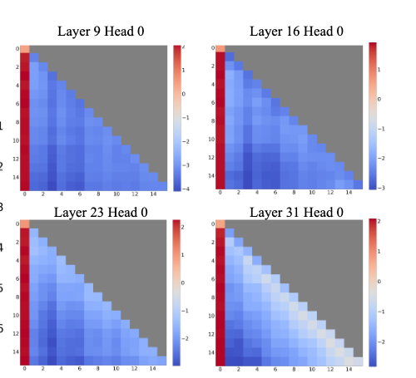
Other ways of predicting attention
Why are initial positions getting so much attention?

Slide 23
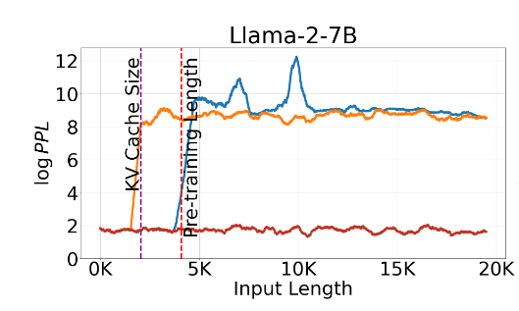
StreamingLLM
Proposed method
Fix the cache size to K
Generate tokens i=1, …, …
Keep the first 4 tokens and the most recent K-4
red: stream LLM
orange: sliding window attention
blue: dense attention

Slide 24
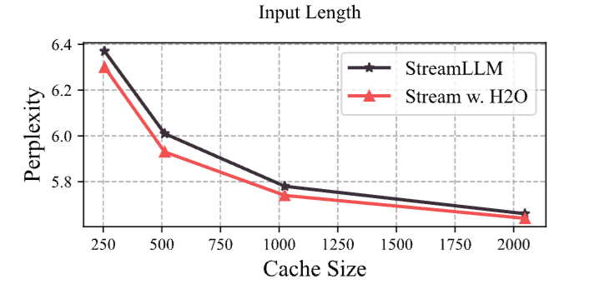
StreamingLLM and H2O
Proposed method
Fix the cache size to K
Generate tokens i=1, …, …
Keep the first 4 tokens and the most recent K-4
Notes:
STOPPED HERE

Slide 25
Backup: KV caching and model compression
Compressing models
Distillation
Quantization
Pruning
Unstructured
Semi-Structured (e.g. 2:4 Pruning)
Structured
Key-value caching
Motivation and importance
Origin story
Long-context Transformers
Techniques
Heavy hitters – H2O
Attention sinks – StreamingLLM
Predictive caching – SnapKV, FastGen

Slide 26
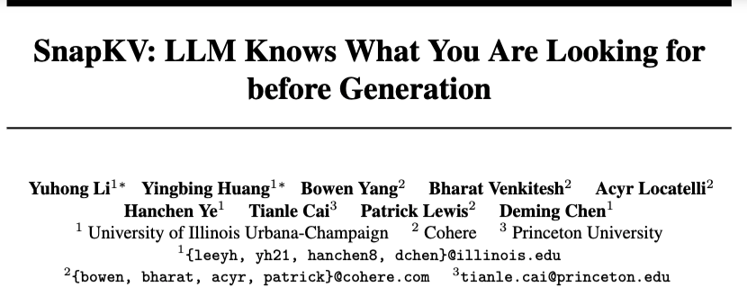
Predictive KV Caching: SnapKV
2024

Slide 27
Predictive KV Caching: SnapKV
Data: UltraChat
1.4M sequences, selected dialog turns with prompt > 3k tokens, and response > 512 tokens
New observation
The attention pattern for prompt tokens is consistent throughout decoding
The attention pattern for prompt tokens is predictable from LLM behavior before decoding starts

Slide 28
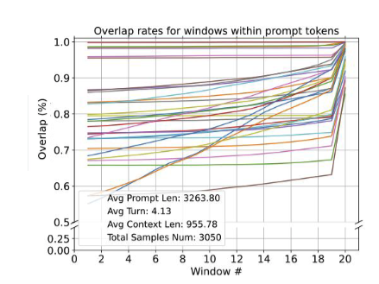
Predictive KV Caching: SnapKV
Example: Attn overlap between decoding and 128-tokens windows from the prompt
Each line is a layer
There is high overlap with the last window in the prompt
Notes:
What is the set with “high attn weights which determines overlap

Slide 29
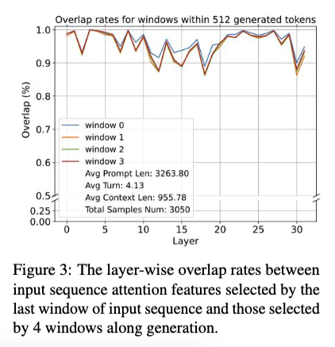
Predictive KV Caching: SnapKV
Example: Attn overlap between four 128-token windows in decoded response and last 128-token window in prompt

Slide 30
SnapKV: Details
Observation window: the n-th window in the prompt
Prefix: first n-1 windows in the prompt
SumAttn[head h, prefix position j]: attention weights
for head h to position j
summed over all positions in observation window
(W_{obs} in paper)
p: compression ratio, (e.g., 0.9)
Caching strategy: evict the KV cache entries for the bottom p*|Prefix| positions (for each head)
Refinement: also keep positions near a top (1-p) position (i.e., max-pool SumAttn locally)

Slide 31
SnapKV: Experiment
“Needle-in-a-haystack” problem:
a long document with a sentence inserted randomly in the middle (e.g., recommend a coffeehouse in Pittsburgh in the middle of the Lord of the Rings)
a question answerable by the inserted sentence

Slide 32
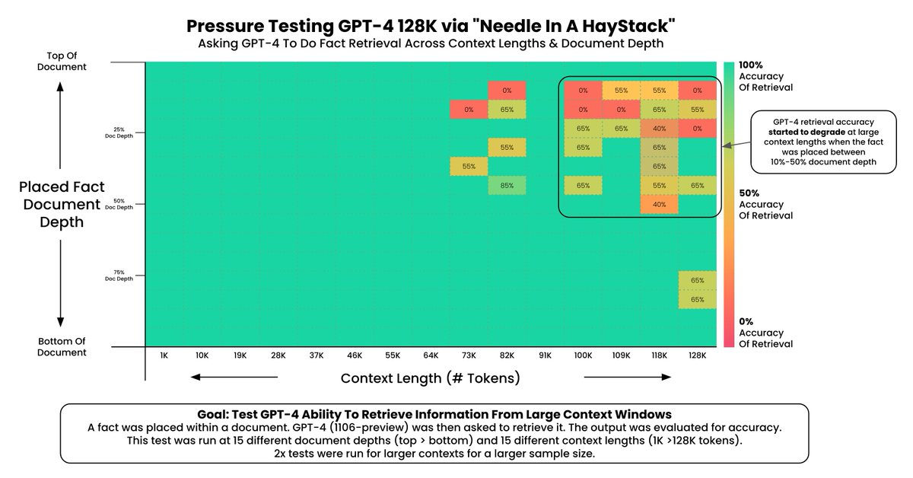
Needle in a Haystack: Background
Source: https://arize.com/blog-course/the-needle-in-a-haystack-test-evaluating-the-performance-of-llm-rag-systems/
Notes:
https://arize.com/blog-course/the-needle-in-a-haystack-test-evaluating-the-performance-of-llm-rag-systems/

Slide 33
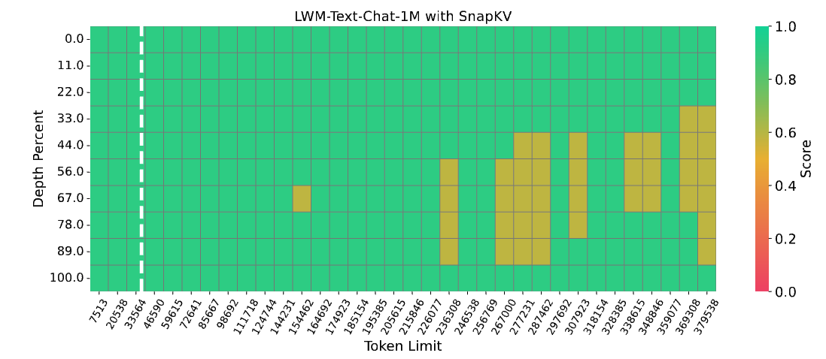
Needle in a Haystack: SnapKV results
Notes:
https://arize.com/blog-course/the-needle-in-a-haystack-test-evaluating-the-performance-of-llm-rag-systems/

Slide 34
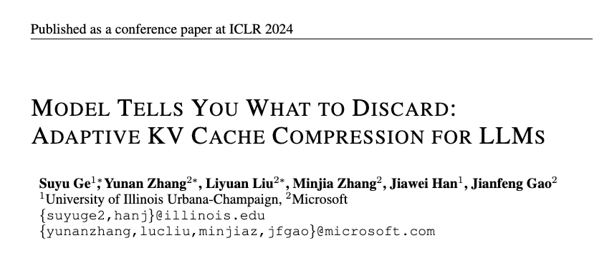
Predictive KV Caching: FastGen
2024

Slide 35
Predictive KV Caching: FastGen
Conjecture: a separator representation summarizes a segment
Caching policies explored in past work
Locality (C_{local})
hyperparam: r_{local} = (#local tokens)/(cache size)
Heavy Hitter (C_{frequent})
hyperparam: r_{frequent} = (#HH tokens)/(cache size)
Special tokens (C_{special})
Examples: start-of-sequence <s>, …
hyperparam: none
Punctuation (C_{punct})
Examples: period (.), colon (:), question mark (?), …
hyperparam: none
No eviction (C_{full})
Hybrid strategies: e.g., C_{special} + C_{local}
union of the two caches
Prior analysis of BERT showed it often attends to separators
Also SepLLM showed separators + initial tokens are useful for KV-caching
Notes:
https://arxiv.org/abs/2412.12094

Slide 36
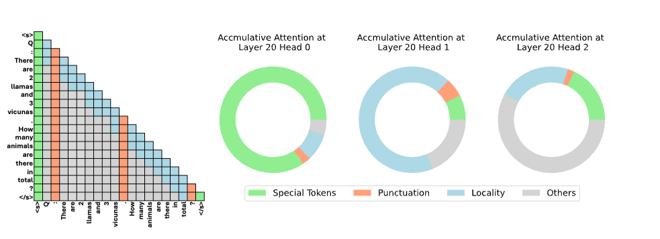
Predictive KV Caching: FastGen
Which works best? It depends….
Different heads at level 20

Slide 37
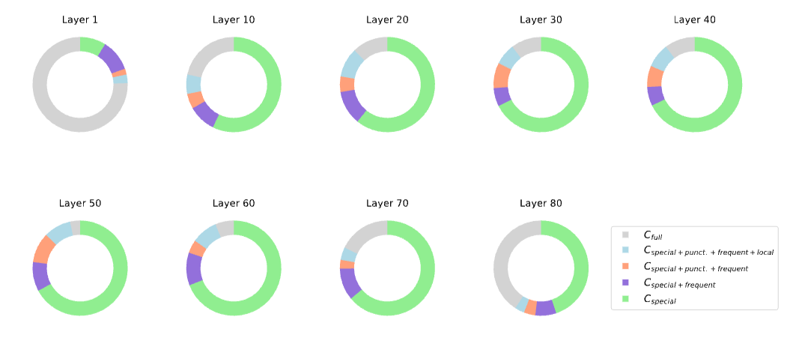
Predictive KV Caching: FastGen
Which works best? It depends….
Same head different layers

Slide 38
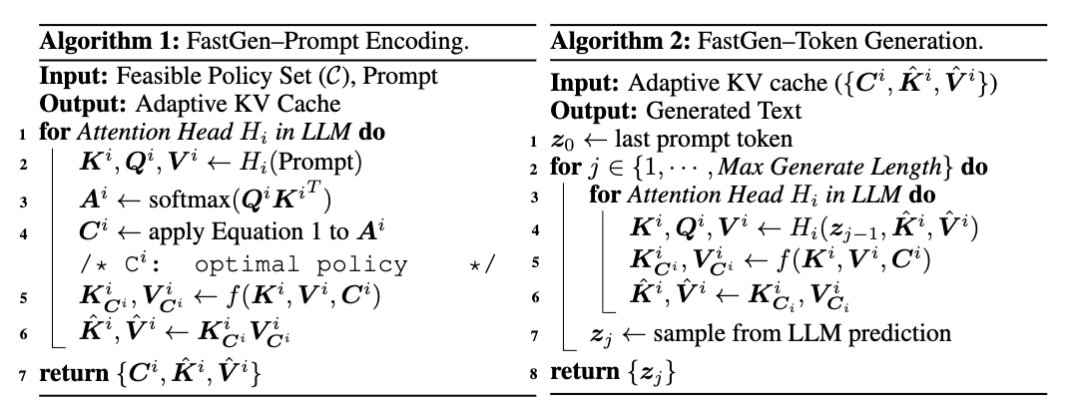
Predictive KV Caching: FastGen
Which caching strategy to use?
Pick a policy for each head/layer based on the prefilling
Use that policy to initialize KV cache, and in decoding

Slide 39
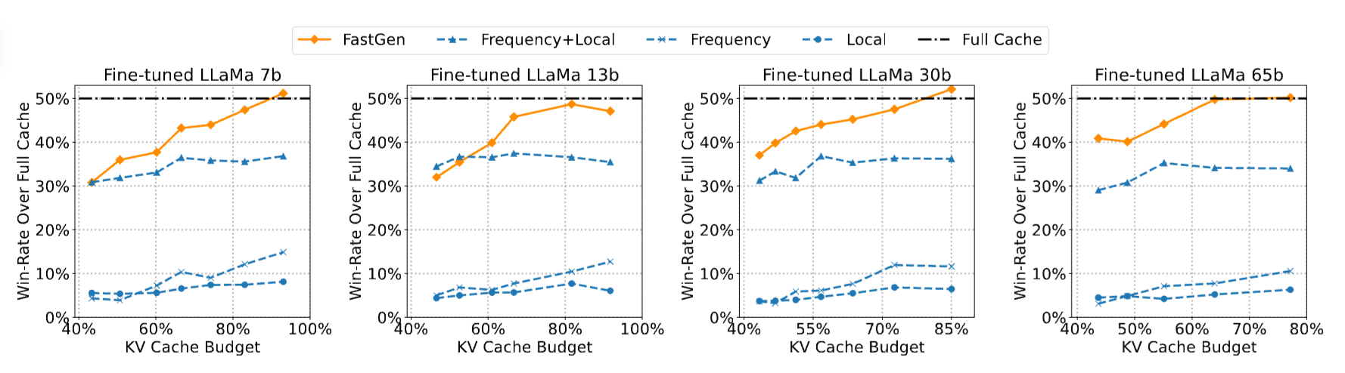
Predictive KV Caching: FastGen Results

Slide 40
Backup: KV caching and model compression
Compressing models
Distillation
Quantization
Pruning
Unstructured
Semi-Structured (e.g. 2:4 Pruning)
Structured
Key-value caching
Motivation and importance
Origin story
Long-context Transformers
Techniques - discussion
Heavy hitters – H2O
Attention sinks – StreamingLLM
Predictive caching – SnapKV, FastGen

Slide 41
Discussion
Main cost of Transformers: attention
Key optimization: restricting attention
Restricted attention in decoder-only models: key-value cache manipulation
Key-value cache management is an active research area

Slide 42
Discussion
Heavy Hitter Oracle (H2O):
Observations:
power-law of cumulative attn
running total of cumulative attn is good approximation
Strategy: evict lowest cumulative attn KV pairs (during decoding)
Streaming LLM:
Observation: first few tokens are “attention sinks”
Strategy: don’t evict the first few tokens (during decoding)
Experiment: H2O is a little better with StreamingLLM
SnapKV:
Observation: last window of prompt predicts attention during decoding
Strategy: compress the KV pairs from the prompt based on last-window attention before decoding
FastGen:
Observation: no uniform caching strategy is optimal
Strategy: pick a strategy for each head/layer (based on prompt)

Slide 43
Model compression: Recap and Overview

Slide 44
How should we think about these?
Quantization
Pruning
Key-Value Cache Management
…which is also pruning
Heuristic: find a survey paper!
Notes:
What’s in common? these are all basically learning tasks

Slide 45
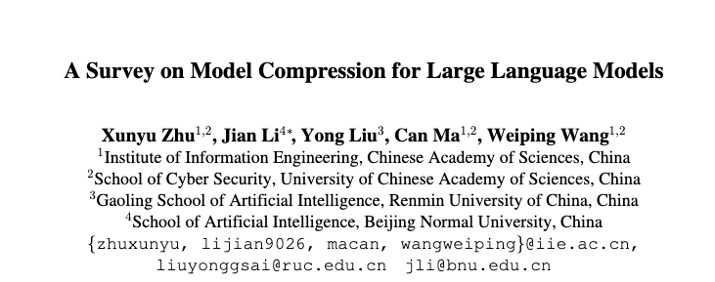
How should we think about these?
TACL 2024
Notes:
https://direct.mit.edu/tacl/article/doi/10.1162/tacl_a_00704/125482

Slide 46
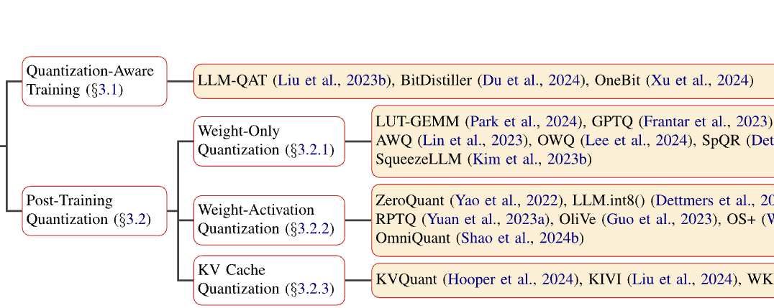
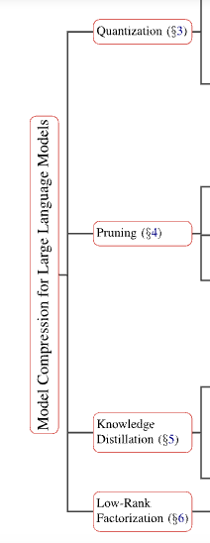

Slide 47
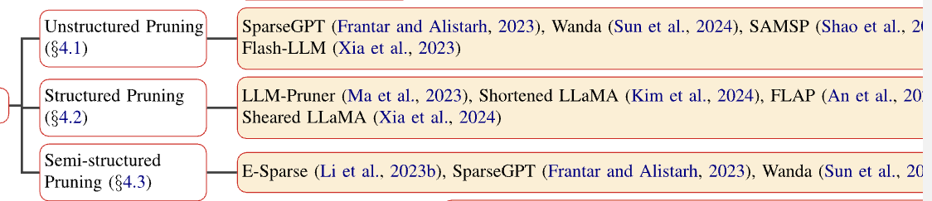
To reduce the cost about the weight update process required by SparseGPT, Wanda (Sun et al., 2024) achieves model sparsity by pruning weights with the smallest magnitudes multiplied by the norm of the corresponding input activations, without the need for retraining or weight updates.
Notes:
often not much detail for anything in particular – it’s a road map for one particular way of navigating

Slide 48
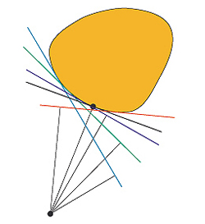
Recap: making a large model smaller
Distillation
briefly discussed
Quantization
Pruning
Key-Value Cache Management
…which is also pruning
Quantization, Pruning, and KV Cache Management are really learning problems … with constraints on the model learned
Optimization with discrete constraints is harder—so in practice people approximate
Heuristic: learn a model without constraints then try and “project it” into the constrained area
Notes:
What’s in common? these are all basically learning tasks

Slide 49
Recap: making a large model smaller
Quantization
Pruning
Key-Value Cache Management
Old-school ML in practice:
examine the data
select/engineer features
pick a simple learning/optimization method that worked for that task
sometimes invent a new optimization method
sometimes invent a new representation for models
Notes:
What’s in common? these are all basically learning tasks

Slide 50
Recap: making a large model smaller
Manual rules for satisfying constraints
better rules based on data analysis
better metrics
Greedy search
More complex search
Adaptive methods
…
Distillation
briefly discussed
Quantization
Pruning
Key-Value Cache Management
…which is also pruning
Quantization, Pruning, and KV Cache Management are really learning problems … with constraints on the model learned
Optimization with discrete constraints is harder—you need to find the best way to satisfy the discrete constraints and the best parameters
Research papers often are searching the discrete part of the space
Notes:
What’s in common? these are all basically learning tasks

Slide 51
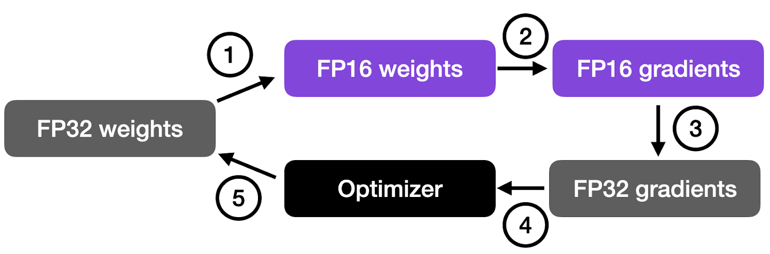
Quantization: Background
Recap
Optimize parameter values via gradient descent (as usual) subject to constraint:
parameters are stored in bfloat16
Working with even fp32 requires some care
E.g., accelerators support “fused multiply add” (FMA)
FMA(x,y,z)=round(x*y + z) != round(round(x*y) + z)
Dot product computation is chain of FMAs
FP16 usually is part of mixed precision training
optimizer accumulates gradients and scales by LR
Matmul precision can also be adjusted
Notes:
https://sebastianraschka.com/blog/2023/llm-mixed-precision-copy.html

Slide 52
Quantization: Beyond 16 bits
Recap
Optimize weights by training LLM
Optimize quantization next (don’t retrain)
Going from fp32 → int8 or int4 requires some tricks:
Quantize different parts of the model differently
quantize(x; S, Z) = round(x/S + Z)
S is “scale”
Z is “zero point”
S, Z are set for this model slice to get the needed range [⍺,β]
do as much as you can in quantized space instead of quantizing and de-quantizing frequently (the FMA trick)
complete matmul, conv2D-BatchNorm-ReLU
Quantize dynamically
set S, Z after you see the activation values
Don’t quantize everything
eg bias layers aren’t usually quantized
Optimize parameter values via gradient descent (as usual) subject to constraint:
groups of parameters are stored in int8/int4
multiple S,Z optimized independently by group
groups to be quantized: by manual rules
subset to be quantized is chosen with manually fixed rules (int8: based on activation values)
Notes:
https://leimao.github.io/article/Neural-Networks-Quantization/
Note: these tricks need to be h/w and library aware!

Slide 53
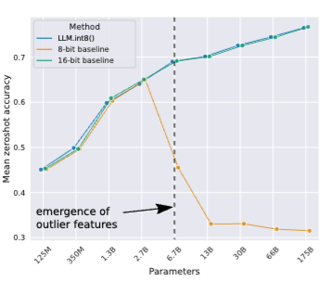
Quantization: Beyond 16 bits
Recap
Feature: any single dimension of a token representation
Outlier feature: magnitude >= 6 in 25% of the layers and 6% of “sequence dimensions”
sequence dimension: token positions
Observation: outliers are
probabilistic in smaller models (in some layers and not others)
systematic in larger models (most layers)
Hypothesis: outlier features are why int8 stops working!
Notes:
https://proceedings.neurips.cc/paper_files/paper/2022/file/c3ba4962c05c49636d4c6206a97e9c8a-Paper-Conference.pdf

Slide 54
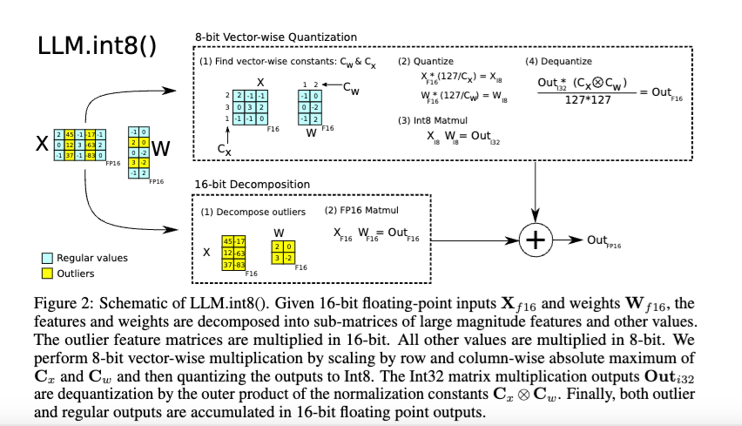
Quantization: Beyond 16 bits
Recap
Going from fp32 → int8 or int4 requires some tricks:
Mixed-precision quantization – keep large “outlier” features (which are consistently in fixed locations)
Optimize parameter values via gradient descent (as usual) subject to constraint:
groups of parameters are stored in int8/int4
multiple S,Z optimized independently by group
groups to be quantized: by manual rules
subset to be quantized is chosen with manually fixed rules (based on activation values)
Notes:
https://proceedings.neurips.cc/paper_files/paper/2022/file/c3ba4962c05c49636d4c6206a97e9c8a-Paper-Conference.pdf

Slide 55
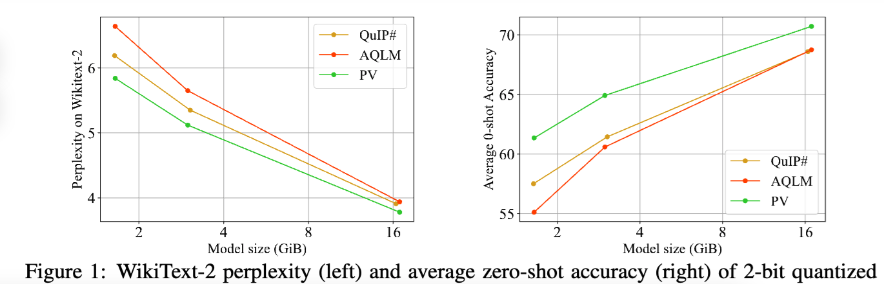
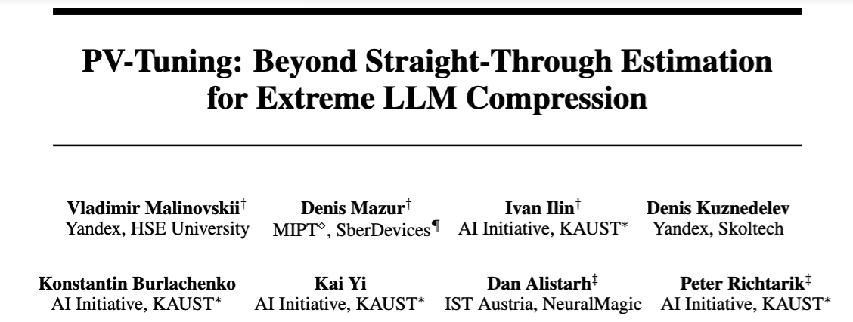
Quantization: Performance Tradeoffs
Recap
2024
Notes:
https://openreview.net/forum?id=i8tGb1ab1j

Slide 56
Quantization: Beyond 4 bits
Recap
Quantization-aware training
(de)quantization operations are not differentiable
partial solutions
approximate the ops
use “straight through estimation” (STE) of gradients
extreme quantization requires methods quantize vectors by combining vectors from a “codebook”
similar to product quantization
e.g. ”additive quantization”
learning should ideally jointly optimize the continuous parts (codebook values) and discrete parts (assignment of values to code)
this can’t be done with gradient descent only
Optimize weights by training LLM
Optimize quantization next
The retrain to jointly optimize weights and quantization strategy
Notes:
https://openreview.net/forum?id=i8tGb1ab1j

Slide 57
Recap: making a large model smaller
Distillation
briefly discussed
Quantization
Pruning
Key-Value Cache Management
…which is also pruning
jointly optimize codebook/codes and where to quant while doing gradient updates on weights
“16 bits except for bias”
“32 bits everywhere”
int8() except for outliers, defined as ….
simple quant rules
complex rules, learning
Notes:
What’s in common? these are all basically learning tasks

Slide 58
Recap: making a large model smaller
Distillation
briefly discussed
Quantization
Pruning
Key-Value Cache Management
…which is also pruning
Notes:
What’s in common? these are all basically learning tasks

Slide 59
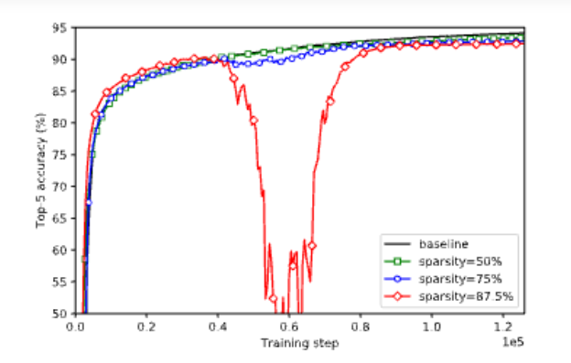
Unstructured pruning
Recap
Observations (on CNNs):
pruning only occasionally causes major degradation in performance
performance recovers quickly with re-training
performance only slightly degrades even with lots of sparsity
Optimize parameter while minimizing NNZ weights by alternating
reducing NNZ weights (greedily)
optimizing NZ weights (gradient)
For each layer to prune:
Repeat i=1,…,t:
Sort weights by |w_{j}|
Zero* out weights to reach sparsity s_{i}
*by adjusting a binary mask
Re-train for n steps (also adjusting learning rate)

Slide 60

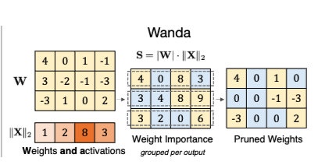
Unstructured pruning: Wanda
Recap
Design decisions:
Which subset to prune?
How much to re-train, and on what data?
Do you iterate or not?
When do you stop?
Optimize parameter while minimizing NNZ weights by alternating
reducing NNZ weights (greedily, with weights times activations)
optimizing NZ weights (gradient)

Slide 61
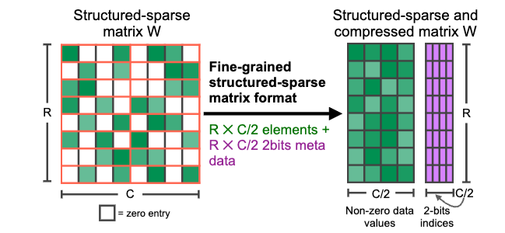
What sparse operations are supported?
Recap
Nvidia supports 2:4 sparse matrices
General version is “N:M”
In each contiguous block of 4 weights at least 2 are zero.
Notes:
https://arxiv.org/abs/2104.08378

Slide 62
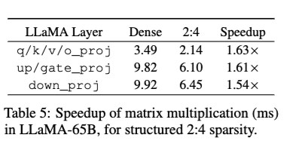
What sparse operations are supported?
Recap
Nvidia supports 2:4 sparse matrices
General version is “N:M”
In each contiguous block of 4 weights at least 2 are zero.
Speeds for WANDA using semi-structured N:M pruning
Optimize parameter while minimizing NNZ weights by alternating
reducing NNZ weights (greedily, with weights times activations, in a comparison group)
optimizing NZ weights (gradient)
Notes:
https://arxiv.org/abs/2104.08378

Slide 63
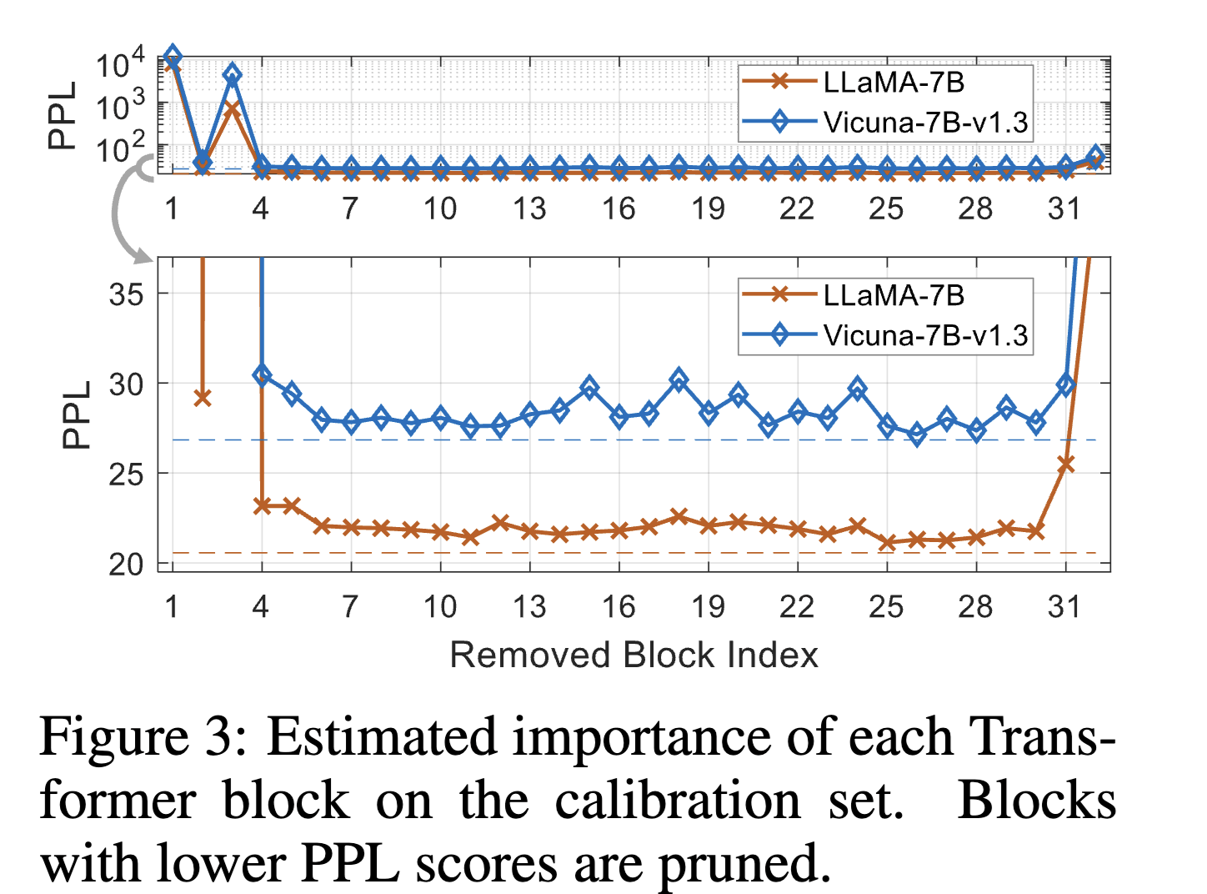
Structured Pruning: Shortened Llama
Recap
Approach
For each layer, compute increase in PPL on a calibration set if removed
Also use a gradient*weight metric, Taylor+
Prune layers one-shot to get target size
Retrain with LoRA
Optimize parameter while reducing # layers:
reducing layers (greedily)
optimizing remaining layers (LoRA)

Slide 64
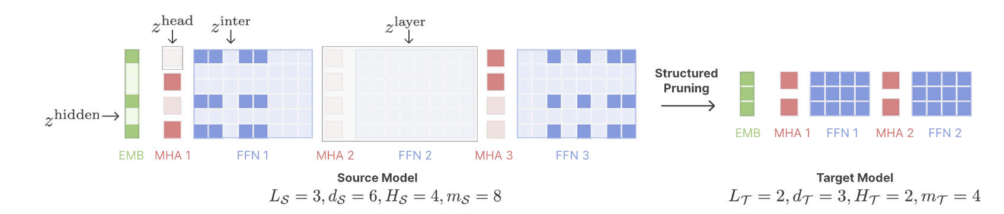
Structured Pruning: Sheared Llama
Recap
Some key ideas:
Prune to a particular target architecture
Optimize a loss that includes PPL on a validation set + loss indicating how masks are mismatched to target architecture
Use Lagrange multipliers and soft approximation of the mask in training (slow!)

Slide 65
Structured Pruning: Sheared Llama
Recap
Some key ideas:
Prune to a particular target architecture
Pruning and retraining are done in the same optimization pass
Retrain to a ”reference loss” predicted by scaling laws.
In pruning/retraining, focus on high-loss slices of the data.
Use gradients with Lagrange multipliers to jointly optimize perplexity and distance to a valid mask

Slide 66
Recap: making a large model smaller
Distillation
briefly discussed
Quantization
Pruning
Key-Value Cache Management
…which is also pruning
Important note:
complicated ≠ good!
Sheared Llama: jointly optimize weights and continuous approximation to mask.
shortened Llama: greedy layer pruning + LoRA
Wanda: greedy weight pruning
Magnitude: greedy weight pruning alternating with gradients
simple optimization
complex optimization
Notes:
What’s in common? these are all basically learning tasks

Slide 67
Recap: making a large model smaller
Distillation
briefly discussed
Quantization
Pruning
Key-Value Cache Management
…which is also pruning
… pruning parts of the key-value cache
Notes:
What’s in common? these are all basically learning tasks

Slide 68
H2O: “Heavy Hitters” in KV Caches
Recap
Proposed method
Fix the cache size to K
Generate tokens i=1, …, …
Track score (cumulative attention) of each token in the cache
“local H2 statistic” – cumulative attention up to position i
When the cache is full, overwrite the token with lowest local H2 score
(Attention to recent-past tokens keeps tokens from being evicted too quickly)
The“eviction policy”
Local H2 statistic is close to full oracle H2 statistic that looks at future tokens
Greedy pruning (eviction) based on running estimate of cumulative attention

Slide 69
StreamingLLM
Recap
Eviction is FIFO with an exception for first few tokens
Proposed method
Fix the cache size to K
Generate tokens i=1, …, …
Keep the first 4 tokens and the most recent K-4
red: stream LLM
orange: sliding window attention
blue: dense attention

Slide 70
StreamingLLM and H2O
Recap
Eviction is H2O rule with an exception for first few tokens
Proposed method
Fix the cache size to K
Generate tokens i=1, …, …
Keep the first 4 tokens and the most recent K-4
Notes:
STOPPED HERE

Slide 71
SnapKV: Details
Recap
Eviction for a prompt is based on a score learned from the observation window for that prompt
Observation window: the n-th window in the prompt
Prefix: first n-1 windows in the prompt
SumAttn[head h, prefix position j]: attention weights
for head h to position j
summed over all positions in observation window
(W_{obs} in paper)
p: compression ratio, (e.g., 0.9)
Caching strategy: evict the KV cache entries for the bottom p*|Prefix| positions (for each head)
Refinement: also keep positions near a top (1-p) position (i.e., max-pool SumAttn locally)

Slide 72
Predictive KV Caching: FastGen
Recap
2024

Slide 73
Predictive KV Caching: FastGen
Recap
Caching policies explored in past work
Locality (C_{local})
hyperparam: r_{local} = (#local tokens)/(cache size)
Heavy Hitter (C_{frequent})
hyperparam: r_{frequent} = (#HH tokens)/(cache size)
Special tokens (C_{special})
Examples: start-of-sequence <s>, …
hyperparam: none
Punctuation (C_{punct})
Examples: period (.), colon (:), question mark (?), …
hyperparam: none
No eviction (C_{full})
Hybrid strategies: e.g., C_{special} + C_{local}
union of the two caches
Notes:
https://arxiv.org/abs/2412.12094

Slide 74
Predictive KV Caching: FastGen
Recap
Eviction strategy for a prompt is learned based on the strategy’s effectiveness in prefilling
Which caching strategy to use?
Pick a policy for each head/layer based on the prefilling
Use that policy to initialize KV cache, and in decoding
…and head identity and layer is also a feature (i.e., each can have a different strategy)

Slide 75
Recap: making a large model smaller
Distillation
briefly discussed
Quantization
Pruning
Key-Value Cache Management
FastGen: Pick strategy per head and layer based on prefilling.
Score by recency (FIFO)
H2O: score by running accumulated attention
+ start token
SnapKV: Adaptively pick specific weights based on observation window in prefilling
+ separator
simple optimization
complex optimization
Notes:
What’s in common? these are all basically learning tasks

Slide 76
Recap: making a large model smaller
Quantization
Pruning
Key-Value Cache Management
Old-school ML in practice:
examine the data
select/engineer features
pick a simple learning/optimization method that worked for that task
sometimes invent a new method
Notes:
What’s in common? these are all basically learning tasks

Slide 77
What’s next?
Quantization
Pruning
Key-Value Cache Management
Simple combinations:
it works to sequential prune then quantize
it works to quantize a KV cache
Jointly learning to optimize together?
prune, quantize, and restrict attention so that KV cache is more effective?
Notes:
What’s in common? these are all basically learning tasks

