Slide 1
10-605 / 10-405 Learning as Optimization - 1
Machine Learning from Large Datasets

Slide 2
Recap: the course so far
Why bigdata is important in ML
History of bigdata in ML
Scalable computation on clusters
MapReduce
Spark and iteration
Sample Spark workflows
Next up: more on scaling up learning algorithms
But first background on learning…

Slide 3
Learning As Optimization: Motivation

Slide 4
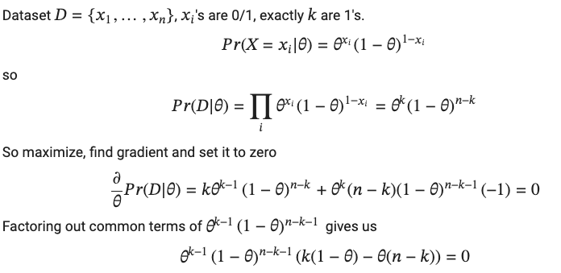
Learning as optimization: warmup
Goal: Learn the parameter θ of a binomial

Slide 5
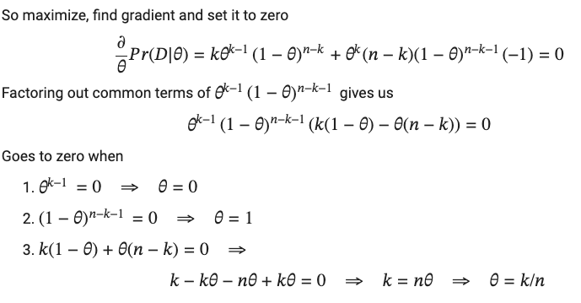
Learning as optimization: warmup
Goal: Learn the parameter θ of a binomial

Slide 6
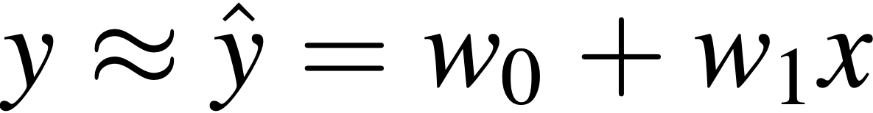
Learning as optimization: linear regression
Goal: find the line of best fit
x coordinate: features
y coordinate: labels
y
x
Intercept / Offset
Slope

Slide 7
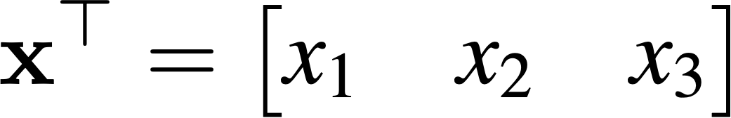
Linear regression
Example: Predicting house price from size, location (distance from GHC), age
For each observation we have a feature vector, x, and label, y
Assume a linear mapping between features and label:
Notes:
explain why I represent x with a transpose

Slide 8
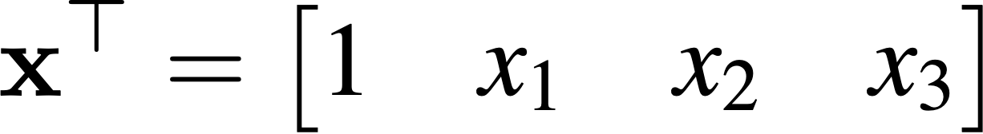
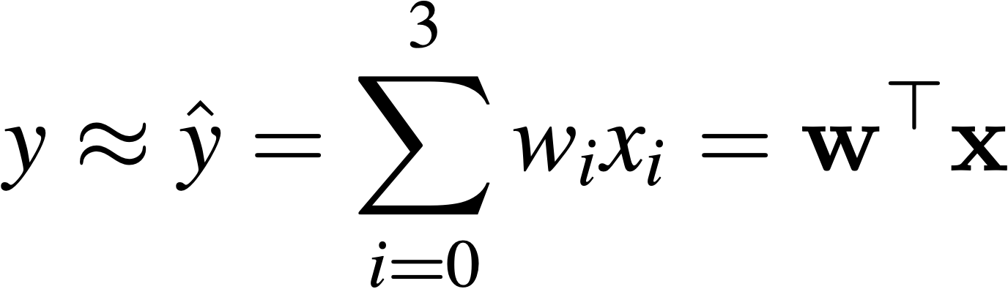
Linear regression
Example: Predicting house price from size, location, age
If we augment the feature vector to incorporate the intercept term w₀:
We can then rewrite this linear mapping as a dot product:

Slide 9
Why a linear mapping?
Simple
Often works well in practice
Linearity isn’t a big deal since you can add new features easily (more later)
Notes:
explain why I represent x with a transpose

Slide 10
Learning as optimization: linear regression
To learn our binomial’s parameters we assumed wanted to optimize Pr(D).
What do we optimize here?
What do we want our learned function to do?
y
x
We need to define what we want to optimize.
Usually we minimize instead of maximize so we define a loss function, which describes “how wrong” predictions are.

Slide 11

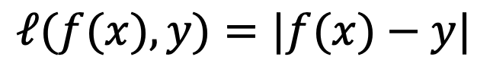
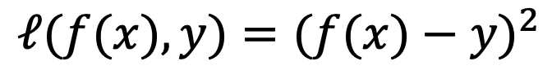
Absolute Loss
$$ℓ(f(x),y)=|f(x)−y|$$
Square Loss
$$ℓ(f(x),y)=(f(x)−y)^{2}$$
x | y | f(x) | Square Loss | Absolute Loss
 | $300,000 | $300,000 | 0 | 0
 | $300,000 | $300,500 | 250,000 | 500
 | $300,000 | $400,000 | 1E+10 | 100,000
Square loss turns out to be very useful in practice:
optimization problem is very nice
“least squares” linear regression

Slide 12
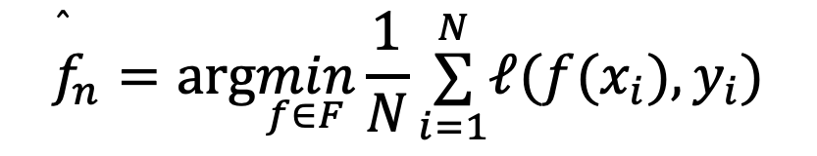
General idea: Empirical risk minimization
$${\overset{̂}{f}}_{n}=arg\min_{f∈F}\frac{1}{N}\overset{N}{\underset{i=1}{∑}}ℓ(f(x_{i}),y_{i})$$
A popular approach in supervised ML
Given a loss 𝓁 and data (x1, y1), … (xn, yn), we estimate a predictor f by minimizing the loss on the data (empirical risk)
We typically restrict this predictor to lie in some class, F
Could reflect our prior knowledge about the task
Or may be for computational convenience
Can apply to many function classes F and many loss functions

Slide 13
General idea: Empirical risk minimization
$${\overset{̂}{f}}_{n}=arg\min_{f∈F}\frac{1}{N}\overset{N}{\underset{i=1}{∑}}ℓ(f(x_{i}),y_{i})$$
Example: find parameter theta of a Bernoulli
Loss = -log Pr(D)
Can apply to many function classes F and many loss functions

Slide 14
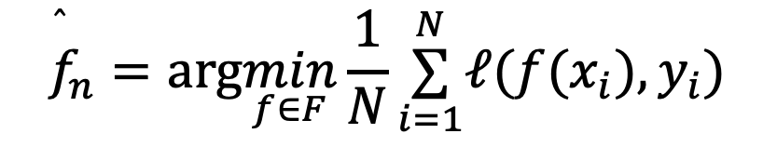
Learning as optimization: linear least squares regression as empirical risk minimization
$${\overset{̂}{f}}_{n}=arg\min_{f∈F}\frac{1}{N}\overset{N}{\underset{i=1}{∑}}ℓ(f(x_{i}),y_{i})$$
y
X is the examples: a matrix with N rows (each an example) and D columns (each a feature)
w is length-D weight vectcor
y is a length-N vector of target values
L(w; X, y) is the overall square loss on the N examples
x

Slide 15

Learning as optimization: linear least squares regression as empirical risk minimization
X is the examples: a matrix with N rows (each an example) and D columns (each a feature)
w is length-D weight vectcor
y is a length-N vector of target values
L(w; X, y) is the overall loss on the N examples
Optimization task: find w to minimize L :

Slide 16
Learning as optimization: linear least squares regression as empirical risk minimization
If you assume the data y=Xw + n where n is Gaussian noise then
least-squares ⬄ maximum likelihood
Optimization task: find w to minimize L :

Slide 17
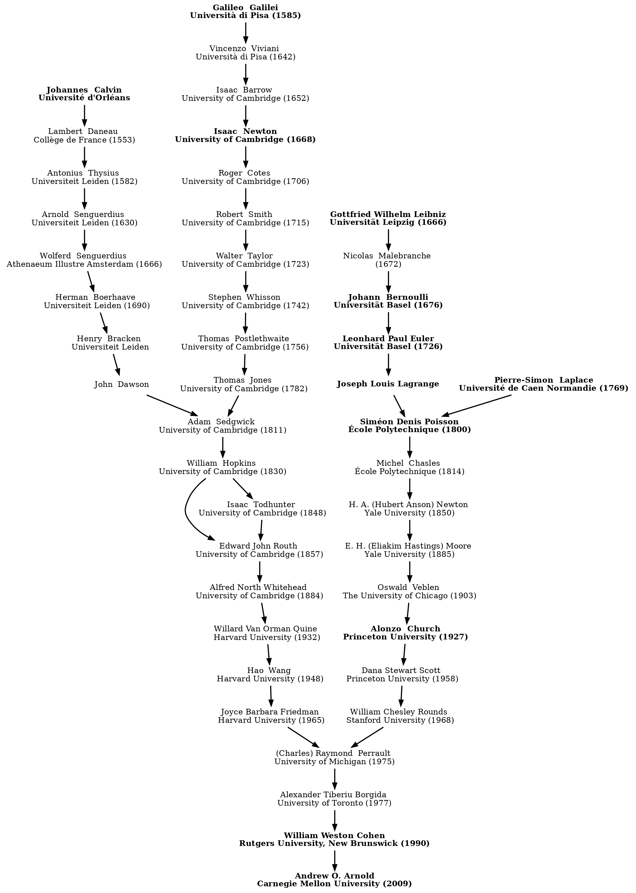

Slide 18
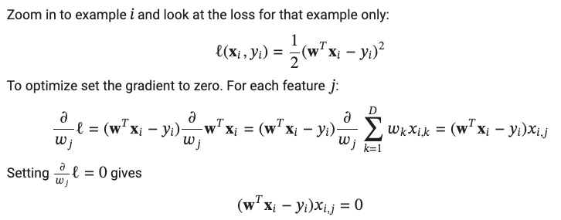
Learning as optimization: linear least squares regression as empirical risk minimization

Slide 19
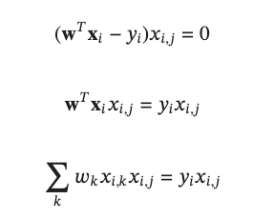
Learning as optimization: linear least squares regression as empirical risk minimization

Slide 20
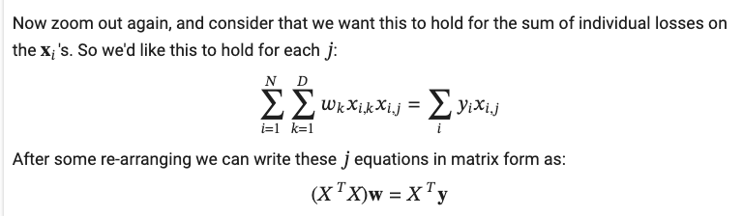
Learning as optimization: linear least squares regression as empirical risk minimization
Minimum is where:

Slide 21

Learning as optimization: linear least squares regression as empirical risk minimization
What else can we do?
Task: find w to minimize L:
So: solve this system of D equations:
Expensive for large N, D

Slide 22
GRADIENT DESCENT for Linear Regression

Slide 23
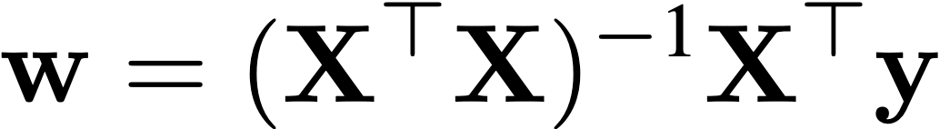
Learning as optimization: linear least squares
To minimize
Compute
Cost: O(ND² + D³) operations - Impractical for large D!
More scalable method: gradient descent
Each iteration is O(DN)
Often converges quickly
Can also exploit sparse features and can parallelize
Generalizes to many other empirical risk minimization settings

Slide 24

Gradient descent
f(w)
Start at a random point
Determine a descent direction
Choose a step size
Update
w*
w
w1
w0

Slide 25
Gradient descent
f(w)
Start at a random point
Repeat
Determine a descent direction
Choose a step size
Update
Until stopping criterion is satisfied
w*
w
w2
w1
w0

Slide 26
Gradient descent
f(w)
Start at a random point
Repeat
Determine a descent direction
Choose a step size
Update
Until stopping criterion is satisfied
w*
w
…
w2
w1
w0

Slide 27
Where will we converge?
f(w)
Convex
g(w)
Non-convex
…
…
…
w*
w
w′
w*
w
Any local minimum is a global minimum
Multiple local minima may exist
Many linear models (linear regression, logistic regression, ridge regression, …) are convex
Notes:
http://www.cs.berkeley.edu/~russell/classes/cs194/f11/lectures/CS194%20Fall%202011%20Lecture%2006.pdf
http://www.cs.berkeley.edu/~russell/classes/cs194/f11/lectures/CS194%20Fall%202011%20Lecture%2005.pdf

Slide 28
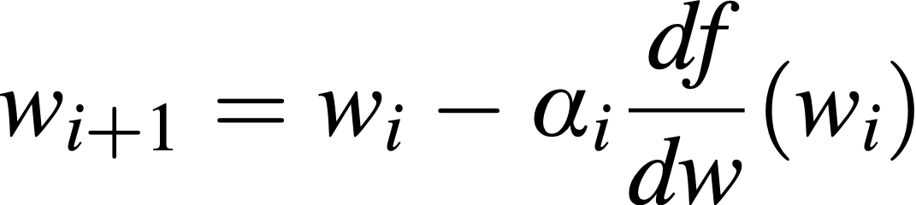
Choosing a descent direction (1D)
f(w)
positive ⇒ go left!
f(w)
negative ⇒ go right!
zero ⇒ done!
w*
w
w*
w
w0
w0
Step Size
We can only move in two directions
Negative slope is direction of descent!
Update Rule:
Negative Slope

Slide 29
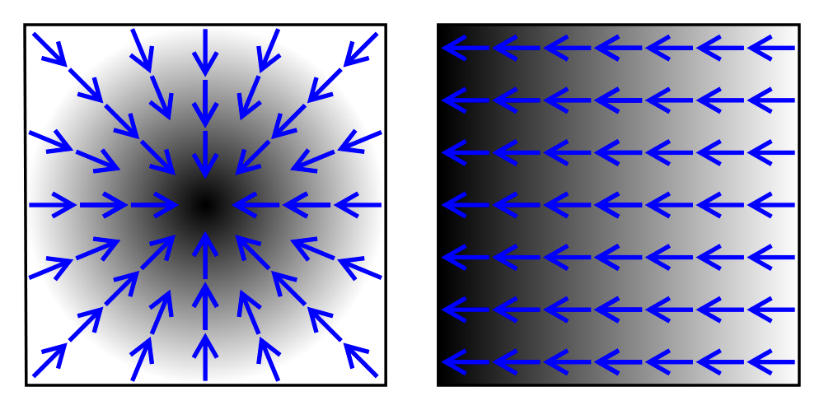
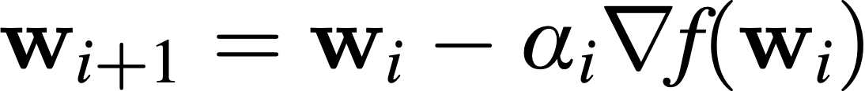

Choosing a descent direction
2D Example:
Function values are in black/white and black represents higher values
Arrows are gradients
"Gradient2" by Sarang. Licensed under CC BY-SA 2.5 via Wikimedia Commons
http://commons.wikimedia.org/wiki/File:Gradient2.svg#/media/File:Gradient2.svg
Step Size
We can move anywhere in
Negative gradient is direction of steepest descent!
$$ℝ^{k}$$
Update Rule:
Notes:
the directional derivative along a given vector v at a given point x intuitively represents the instantaneous rate of change of the function, moving through x with a velocity specified by v. It generalizes the notion of a partial derivative, in which the rate of change is taken along one of the coordinate curves, all other coordinates being constant.
http://math.stackexchange.com/questions/223252/why-is-gradient-the-direction-of-steepest-ascent
https://www.khanacademy.org/math/multivariable-calculus/partial_derivatives_topic/gradient/v/gradient-1

Slide 30
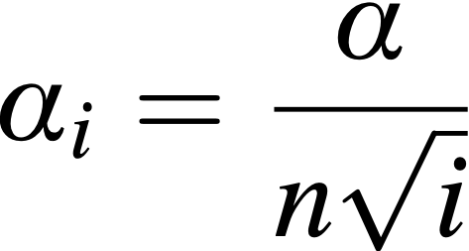
Choosing a step size
f(w)
f(w)
f(w)
w*
w
w*
w
w*
w
Too small: converge very slowly
Too big: overshoot, can diverge
Reduce size over time
Theoretical convergence results for various step sizes
A common step size is
Constant
Iteration #
# Training Points

Slide 31
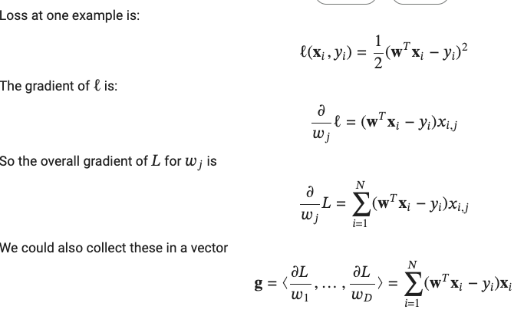
Least squares with gradient descent

Slide 32
Least squares linear with gradient descent
What else can we do?
Initialize w₀
For t=1, … until converged:
Compute gradient g
Update: w_{t} = w_{t-1} - ⍺ g

Slide 33
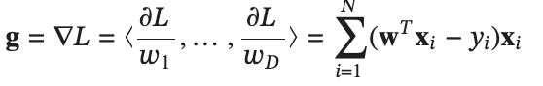
Least squares linear with parallel gradient descent
Initialize w₀
For i=1, … until converged:
Compute gradient g
Update: w_{i} = w_{i-1} - ⍺ g
Computation of g can be done in parallel!

Slide 34
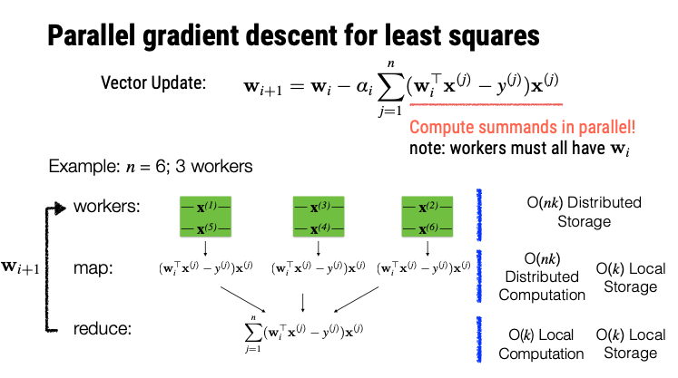
O(ND) distributed storage
O(ND) distributed computation | O(D) local storage
O(D) local computation | O(D) local storage
Update: w_{i} = w_{i-1} - ⍺ g

Slide 35
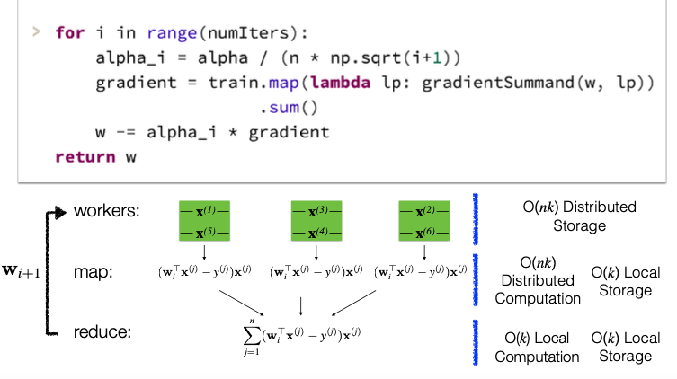
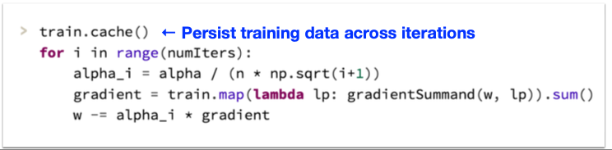
O(ND) distributed storage
O(ND) distributed computation | O(D) local storage
O(D) local computation | O(D) local storage

Slide 36
Least squares linear with parallel gradient descent
There are many, many approaches to doing gradient descent in parallel
We’ll talk more about them later …
Often they combine gradient (batch gradient) and stochastic gradient

Slide 37
Variants of GRADIENT DESCENT

Slide 38
Least squares linear with parallel gradient descent
Initialize w₀
For i=1, … until converged:
Compute gradient g
Update: w_{i} = w_{i-1} - ⍺ g

Slide 39
Stochastic gradient descent (SGD)
Big-data problem: the gradient depends on all the data. Can we approximate it with less memory?
Solution:
sample a small subset of examples B<<N
approximate the gradient using them
“on average” this is the right direction
take a step in that direction
repeat….

Slide 40
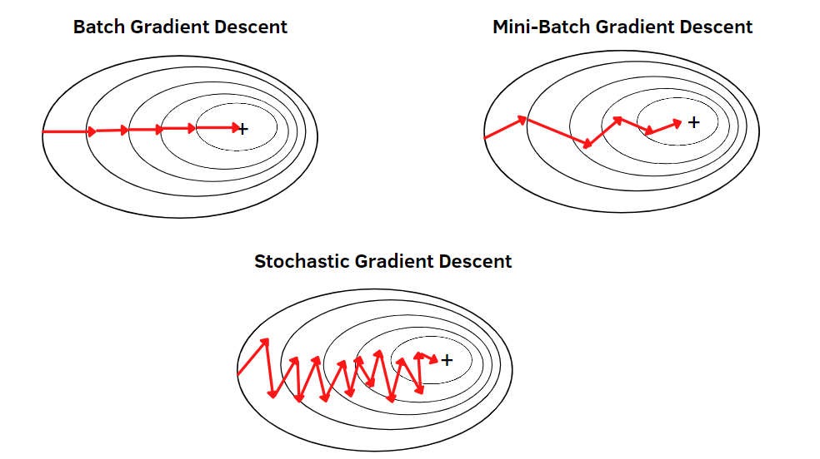
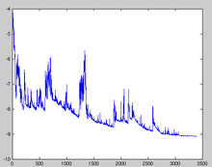
Stochastic gradient descent
sample a “minibatch” of examples B<<N
approximate the gradient using them
“on average” this is the right direction
take a step in that direction
repeat….
Notes:
training loss bounces around

Slide 41
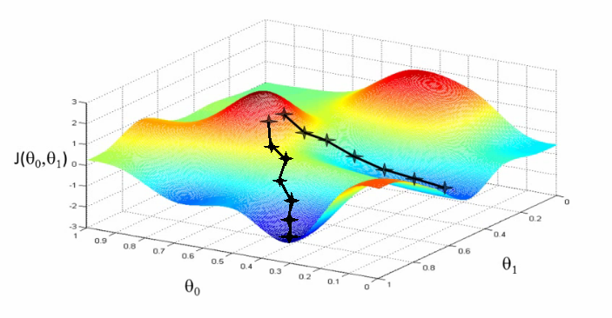
Stochastic gradient descent
For non-convex problems SGD/GD find a local minimum. SGD tends to find ”flat”, not “sharp” minima.
sample a “minibatch” of examples B<<N
approximate the gradient using them
“on average” this is the right direction
take a step in that direction
repeat….
Notes:
training loss bounces around

Slide 42
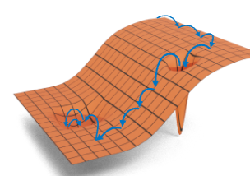
Stochastic gradient descent
For non-convex problems SGD/GD find a local minimum. SGD tends to find “flat”, not “sharp” local minima.
Variants of SGD are almost always used in deep learning.
sample a “minibatch” of examples B<<N
approximate the gradient using them
“on average” this is the right direction
take a step in that direction
repeat….
SGD is very memory-efficient!
Notes:
training loss bounces around

Slide 43
Recap: gradient descent for least squares
Initialize w₀
For i=1, … until converged:
Compute gradient g
Update: w_{i} = w_{i-1} - ⍺ g
Notes:
training loss bounces around

Slide 44
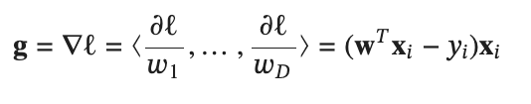
SGD for least squares
Initialize w₀
For t=1, … until converged:
For each example x_{i}
Compute gradient
Update: w_{new} = w_{prev} - ⍺ g
Notes:
training loss bounces around

Slide 45
SGD for linear regression ~ streaming
Streaming:
pass through the data once
hold model + one example in memory
update model for each example
Stochastic gradient:
pass through the data multiple times
stream through a disk file repeatedly
hold model and B examples in memory
update model via gradient step
B = one example is a popular choice
its simple ☺
sometimes its cheaper to evaluate 100 examples at once than one example 100 times ☹

Slide 46
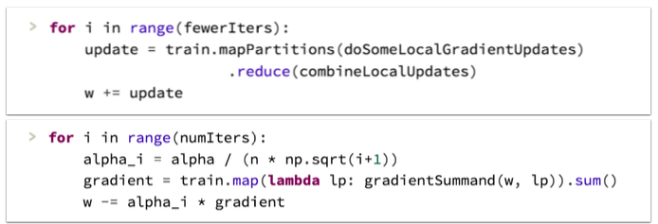
Parallel SGD?
Initialize w₀
For t=1, … until converged:
For each example x_{i}
Compute gradient
Update: w_{new} = w_{prev} - ⍺ g
Option 1: Make minibatch B larger and parallelize computation of B
E.g., vectorize the gradient computation and use a GPU
Option 2: Run multiple SGD processes in parallel, and synchronize them occasionally
More on this later
Better suited to cluster-level parallelism
Harder to analyze and few formal guarantees

Slide 47
On beyond SGD
Momentum: combine update with weighted average of previous ones
AdaGrad, RMSProp: Adjust learning rate for each parameter
Adam: combines RMSProp/AdaGrad ideas and momentum
AdaFactor: more memory-efficient version of Adam
Using carefully-tuned optimizers is important especially for non-convex DL problems
For non-convex problems SGD/GD find a local minimum. SGD tends to find “flat”, not “sharp” local minima.
Variants of SGD are almost always used in deep learning.

Slide 48
Logistic Regression with Stochastic Gradient Descent

Slide 49
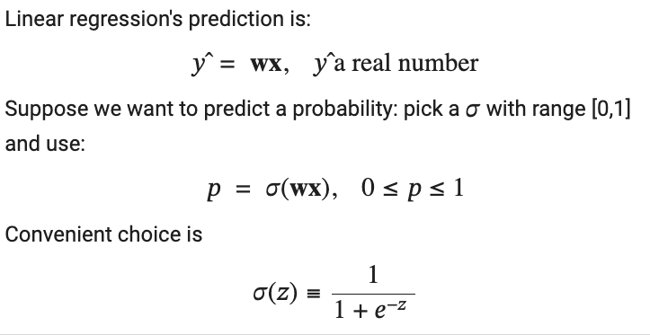
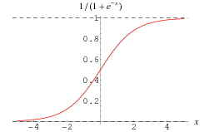
Logistic regression
The “logistic function”

Slide 50


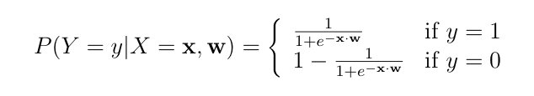
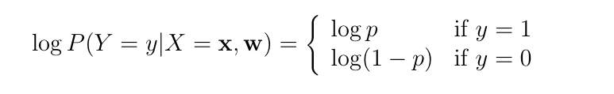
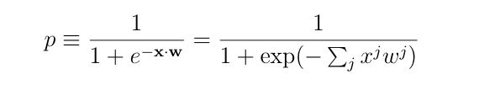
Learning as optimization for logistic regression
Goal: Learn the parameter w of the classifier
Probability of a single example P(y|x,w) would be
Or with logs (maximum likelihood)::
Notation: x^{j} is j-th feature

Slide 51
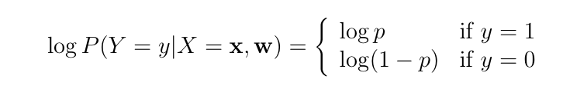
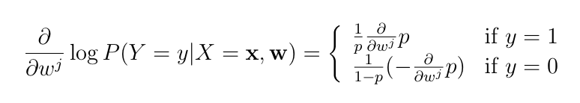


Slide 52
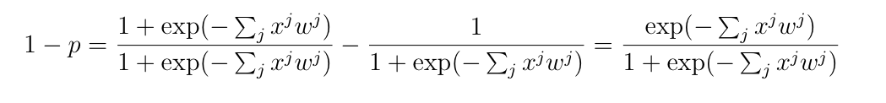
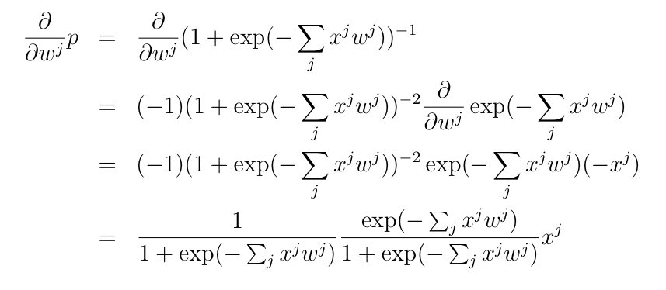

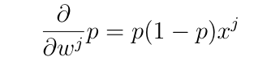
p

Slide 53
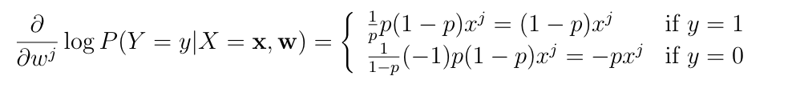
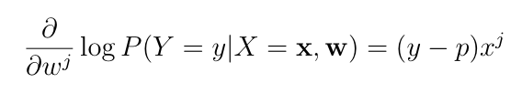


Recall linear regression SGD update:

Slide 54
Recall linear regression SGD update:
William’s comments:
Logistic regression
loss is a special-case of cross-entropy
very closely related to softmax
this is very widely used in DL
Kind of crazy they are so similar!
Linear regression
Logistic regression/softmax

Slide 55
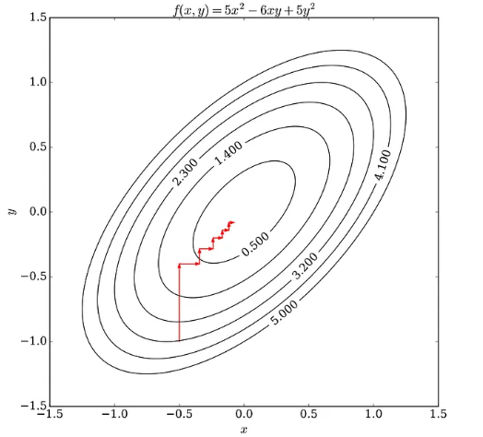
Expectation-Maximization
EM is a kind of coordinate ascent:
Split variables w to optimize into two sets: x,y
Fix one set (x) and optimize the other (y)
Then fix y and optimize x
Then repeat…

Slide 56
Expectation-Maximization
In EM there is typically
instances X
a “soft assignment” of each x_{i} to a “cluster”, z_{i}
z_{i,j} = Pr(x_{i} in cluster j)
parameters w
Then do coordinate descent on w, Z to maximize
–log Pr(X| w, Z)

Slide 57
An example from Ron Bekkerman k-means in Map-Reduce

Slide 58
Example: k-means clustering
An EM-like algorithm:
Initialize k cluster centroids
E-step: associate each data instance with the closest centroid
Find expected values of cluster assignments given the data and centroids
M-step: recalculate centroids as an average of the associated data instances
Find new centroids that maximize that expectation

Slide 59
k-means Clustering
centroids

Slide 60
Parallelizing k-means

Slide 61
Parallelizing k-means

Slide 62
Parallelizing k-means

Slide 63
k-means on MapReduce
Mappers read data portions and centroids
Mappers assign data instances to clusters
Mappers compute new local centroids and local cluster sizes
Reducers aggregate local centroids (weighted by local cluster sizes) into new global centroids
Reducers write the new centroids

Slide 64
k-means in Apache Pig: input data
Assume we need to cluster documents
Stored in a 3-column table D:
Initial centroids are k randomly chosen docs
Stored in table C in the same format as above
Document | Word | Count
doc1 | Carnegie | 2
doc1 | Mellon | 2

Slide 65
k-means in Apache Pig: E-step
D_C = JOIN C BY w, D BY w;
PROD = FOREACH D_C GENERATE d, c, i_{d} * i_{c} AS i_{d}i_{c} ;
PROD_{g} = GROUP PROD BY (d, c);
DOT_PROD = FOREACH PROD_{g} GENERATE d, c, SUM(i_{d}i_{c}) AS dXc;
SQR = FOREACH C GENERATE c, i_{c} * i_{c} AS i_{c}²;
SQR_{g} = GROUP SQR BY c;
LEN_C = FOREACH SQR_{g} GENERATE c, SQRT(SUM(i_{c}²)) AS len_{c};
DOT_LEN = JOIN LEN_C BY c, DOT_PROD BY c;
SIM = FOREACH DOT_LEN GENERATE d, c, dXc / len_{c};
SIM_{g} = GROUP SIM BY d;
CLUSTERS = FOREACH SIM_{g} GENERATE TOP(1, 2, SIM);

Slide 66
k-means in Apache Pig: M-step
D_C_W = JOIN CLUSTERS BY d, D BY d;
D_C_W_{g} = GROUP D_C_W BY (c, w);
SUMS = FOREACH D_C_W_{g} GENERATE c, w, SUM(i_{d}) AS sum;
D_C_W_{gg} = GROUP D_C_W BY c;
SIZES = FOREACH D_C_W_{gg} GENERATE c, COUNT(D_C_W) AS size;
SUMS_SIZES = JOIN SIZES BY c, SUMS BY c;
C = FOREACH SUMS_SIZES GENERATE c, w, sum / size AS i_{c} ;

Slide 67
Data is read, and model is written, with every iteration
Mappers read data portions and centroids
Mappers assign data instances to clusters
Mappers compute new local centroids and local cluster sizes
Reducers aggregate local centroids (weighted by local cluster sizes) into new global centroids
Reducers write the new centroids

Slide 68
Questions
Panda et al, Chapter 2
Mappers read data portions and centroids
Mappers assign data instances to clusters
Mappers compute new local centroids and local cluster sizes
Reducers aggregate local centroids (weighted by local cluster sizes) into new global centroids
Reducers write the new centroids
What should be in memory and what should be in an RDD?
How many Shuffle-Sorts are needed for one pass?
Assume we can map through documents

Slide 69
Questions
Panda et al, Chapter 2
Mappers read data portions and centroids
Mappers assign data instances to clusters
Mappers compute new local centroids and local cluster sizes
Reducers aggregate local centroids (weighted by local cluster sizes) into new global centroids
Reducers write the new centroids
Sketch:
Map only: With all centroids in mapper memory, assign each doc to a centroid
outputting docid → centroid index
Shuffle-sort: Count number of docs per centroid
Map-Reduce: join docs to centroids
Map-Reduce: accumulate doc weights for each centroid

