Slide 1
10-605 / 10-405
Machine Learning from Large Datasets

Slide 2
Recap: the course so far
Why bigdata is important in ML
History of bigdata in ML
Scalable computation on clusters
MapReduce
Spark and iteration
Sample Spark workflows
Learning as optimization
MLE for binomials, linear regression, logistic regression, k-means clustering
exact solutions, gradient descent (batch, parallel, stochastic), EM and EM-like methods

Slide 3
Today
Learning as optimization
MLE for binomials, linear regression, logistic regression, k-means clustering
exact solutions, gradient descent (batch, parallel, stochastic), EM and EM-like methods
“Craft” of ML
feature extraction / augmentation
kernel methods – working a different feature space
regularization
hyperparameter tuning
the hash trick and efficiency
discussing a paper and some formal results
practical issues in parallelizing ML
data/model parallelism
design choices to be made …

Slide 4
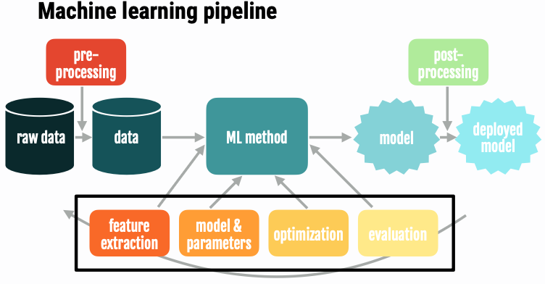
data collection and curation
…

Slide 5
COMMON Extensions to Linear Regression

Slide 6
What if linear regression is not powerful enough?

Slide 7


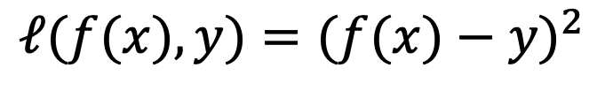
Square Loss
$$ℓ(f(x),y)=(f(x)−y)^{2}$$
x | y | f(x) | Square Loss | Absolute Loss
 | $300,000 | $300,000 | 0 | 0
 | $300,000 | $300,500 | 250,000 | 500
 | $300,000 | $400,000 | 1E+10 | 100,000
Square loss (least squares):
optimization problem is very nice
useful in practice
“least squares” linear regression
Not always useful enough!
Number of houses at distance d = O(d²)
Maybe a non-linear bonus for “large and nearby”
…

Slide 8
x | y | f(x)
 | $300,000 | $300,000
 | $300,000 | $300,500
 | $300,000 | $400,000
Not always useful enough!
Number of houses at distance d = O(d²)
…
Simple fix: replace x with ɸ(x)!
Example:
Now w^{T} ɸ(x) can fit any degree-2 polynomial…

Slide 9
“Modern DL systems do very well at text/images without feature engineering”
FE important when learning over structured data, eg from DB
Or when using linear classifiers

Slide 10
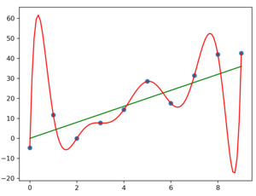
What if your basis functions make linear regression too powerful?
Overfitting symptoms: very large w components and very unstable predictions: replacing w_{i} with w_{i} + 𝜺 gives very different predictions

Slide 11
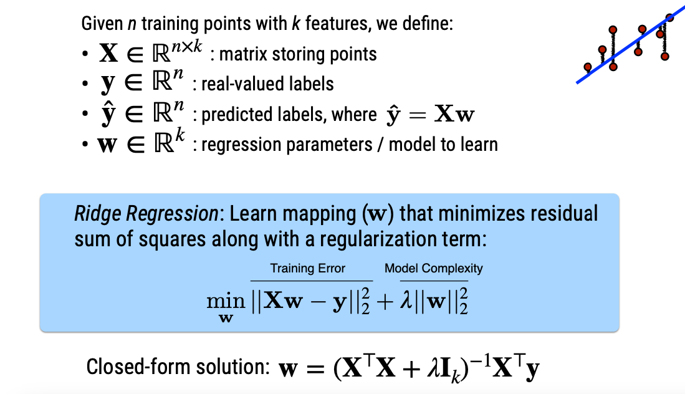
Regularization (ridge regression)
Our usual squared loss!
Penalty for large weights

Slide 12
Regularization (ridge regression)
e.g., regularization, drop out, number of epochs, learning rate, momentum term, network sizes, architectural variants, …
Other ways of finding w
Batch gradient descent
Stochastic gradient descent
…
What about setting λ ?
Hyperparameters aren’t set by the learning method. How do you choose them?
The model class (e.g., linear regression, …) another choice

Slide 14
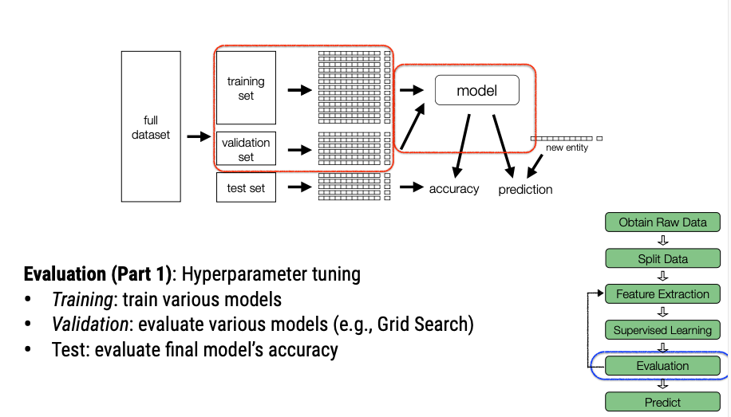
Hyperparameter tuning
Ideally only once when everything else has been finalized

Slide 15
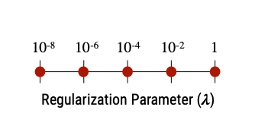

Grid search
Scale often not linear
Try out multiple values of λ
Pick the one that is best on the validation set
Validation set should be independent of the test set
“Best” does not have to be according to the loss the learner is optimizing.
Loss ~ Variance
More natural measure is sqrt(L), i.e., “root mean squared error” (RMSE)
Maybe guessing low is worse than guessing high

Slide 16
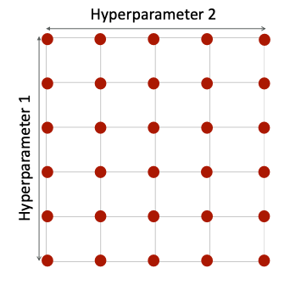
Grid search
Grid search gets expensive fast…we’ll come back to this later in the course!
With multiple hyperparameters you need to test all combinations of the parameters.
e.g., regularization, drop out, number of epochs, learning rate, momentum term, network sizes, architectural variants, …

Slide 17
Kernels: On Beyond Feature Extraction

Slide 18
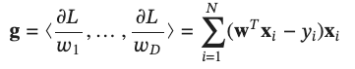
Recall: gradient descent for linear regression
Initialize w₀
For t=1, … until converged:
Compute gradient g
Update: w_{t} = w_{t-1} - ⍺ g
We know that this converges: it will eventually find the optimal w*
What does that tell us about w* ???

Slide 19
Recall: gradient descent for linear regression
Initialize w₀
For t=1, … until converged:
Compute gradient g
Update: w_{t} = w_{t-1} - ⍺ g
w* must be equal a linear combination of gradient updates g
Each g is a weighted combination of examples x_{i} …. so …

Slide 20
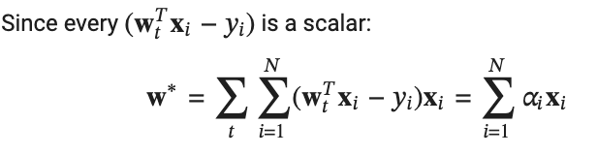
Recall: gradient descent for linear regression
w* must be expressible as a linear combination of examples
w* must be equal a linear combination of gradient updates g
Each g is a weighted combination of examples x_{i} …. so …

Slide 21
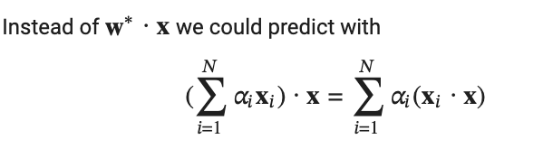
Recall: gradient descent for linear regression
What does that tell us about w* ?
Maybe we don’t even need it!
Nearest neighbor like predictor
A prediction for y based on x_{i}
Similarity of x to x_{i}

Slide 22
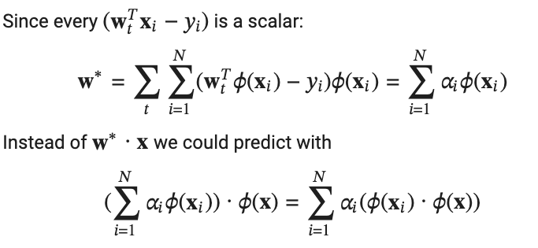

Recall: gradient descent for linear regression
Now consider this with feature extraction ɸ
“Kernel functions are all you need!” ™
Nearest neighbor like predictor
Definition: a kernel function is
At prediction time all you do is compute dot-product similarity after applying ɸ.

Slide 23
Recap
x | y | f(x)
 | $300,000 | $300,000
 | $300,000 | $300,500
 | $300,000 | $400,000
Not always useful enough!
Number of houses at distance d = O(d²)
…
Simple fix: replace x with ɸ(x)!
Example:
Now w^{T} ɸ(x) can fit any degree-2 polynomial…

Slide 24
The kernel “trick”
Polynomial kernel:
for d=2
$${\left(\left\langle x_{1,}x_{2}\right\rangle ∙\left\langle {x′}_{1,}{x′}_{2}\right\rangle +1\right)}^{2}$$
$${= \left(x_{1}{x′}_{1}+x_{2}{x′}_{2}+1\right)}^{2}$$
=$\left(x_{1}{x′}_{1}+x_{2}{x′}_{2}+1\right)\left(x_{1}{x′}_{1}+x_{2}{x′}_{2}+1\right)$
${=\left(x_{1}{x′}_{1}\right)}^{2}$+2$\left(x_{1}{x^{′}}_{1}x_{2}{x^{′}}_{2}\right)+2{(x}_{1}{x′}_{1})$+${ \left(x_{2}{x′}_{2}\right)}^{2}$+2($x_{2}{x′}_{2})$+1
$$≅\left\langle {1,x}_{1,}x_{2},x_{1}x_{2},x_{1}^{2},x_{2}^{2}\right\rangle ∙\left\langle {1,x′}_{1,}{x′}_{2},{x′}_{1}{x′}_{2},{x′}_{1}^{2},{x′}_{2}^{2}\right\rangle$$
$$=\left\langle {1,\sqrt{2}x}_{1,}{\sqrt{2}x}_{2},{\sqrt{2}x}_{1}x_{2},x_{1}^{2},x_{2}^{2}\right\rangle ∙\left\langle {1,\sqrt{2}x′}_{1,}{\sqrt{2}x′}_{2},{\sqrt{2}x′}_{1}{x′}_{2},{x′}_{1}^{2},{x′}_{2}^{2}\right\rangle$$

Slide 25
The kernel “trick”
Polynomial kernel:
Using d=2 is just as expressive as augmenting x with all the squared x_{i}’s and pairwise interaction terms!
Using d=3 is just as expressive as augmenting x with all the squared x_{i}’s and pairwise interaction terms and all the cubes and threeway interaction terms
…
But polynomial kernels are not more expensive to compute!

Slide 26
Some common kernels
Linear kernel:
Polynomial kernel:
Gaussian kernel (squared exponential, RBF):
Many other specialized ones for strings, trees, …

Slide 27
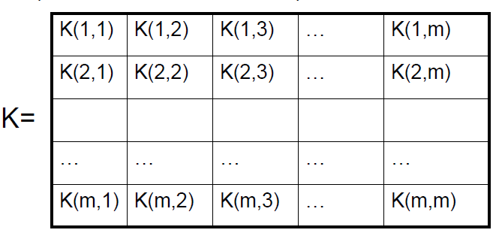
Talking about Kernels 101
K(x,x’) = K(x’,x) ➔ Gram matrix is symmetric
K(x,x) > 0 ➔ diagonal of K is positive ➔ K is positive semi-definite ➔ z^{T} K z >= 0 for all z
Gram matrix: K: k_{ij} = K(x_{i},x_{j})
The space that ɸ maps to is a reproducing kernel Hilbert space (RKHS).

Slide 28
How do we learn this?
How do we find the ⍺’s ?

Slide 29
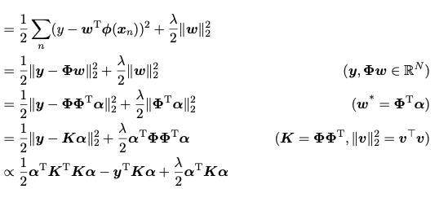
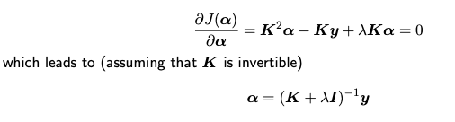
Exact Linear Kernel Regression
L(w)
(K + λ I)⍺ = y
Gram matrix: K: k_{ij} = K(x_{i},x_{j})
Note that K is N*N where N is the number of examples

Slide 30
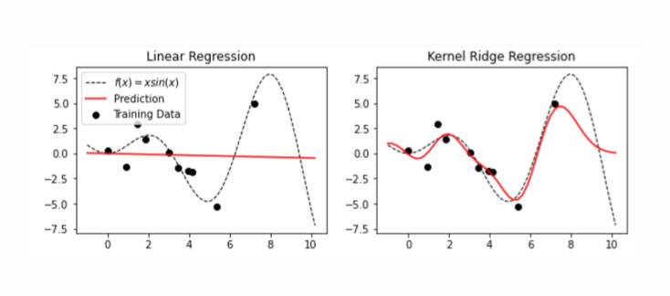
Exact Linear Kernel Regression

Slide 31
Kernels 101
Explicitly map from x to φ(x) – i.e. to the point corresponding to x in the Hilbert space (RKHS)
Implement φ
Duality: two ways to look at this
Observation about w*:
Optimize an expanded weight vector w in the usual way
“In the primal space”

Slide 32
Kernels 101
Implicitly map from x to φ(x) by defining a kernel function K
Implement K
Duality: two ways to look at this
Observation about w*:
Optimize ⍺’s directly
“In the dual space”

Slide 33
Kernels 101
Explicitly map from x to φ(x) – i.e. to the point corresponding to x in the Hilbert space (RKHS)
Implicitly map from x to φ(x) by defining a kernel function K
Duality: two ways to look at this
Observation about w*:
Optimize w using ɸ
Optimize ⍺’s directly using K
“In the primal space”
“In the dual space”

Slide 34
Comments on kernels
Dual-space optimization is hard to scale to large numbers of examples
The Gram matrix is O(N²)
Dual-space optimization is related to nearest neighbor problems and learned similarities
These are super important in big-N learning
Some kernel-based methods are very useful for specific tasks in large-N learning tasks
Eg Gaussian processes for hyperparameter tuning
More on this later!
It can be helpful to analyze feature augmentation/extraction methods as kernels
Example below: hash kernels
But first….

Slide 35
Sparse Gradients for Sparse Data for Linear/Logistic Regression

Slide 36
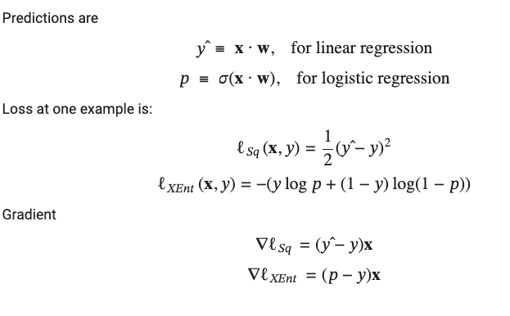
Summary: SGD for least squares and Logistic Regression
Initialize w₀
For i=1, … until converged:
Compute gradient g
Update: w_{i} = w_{i-1} - ⍺ g
Notes:
training loss bounces around

Slide 37
Summary: SGD for least squares and Logistic Regression
Compact representation:
w is a V-dimensional array of floats
w[t] is weight of term with integer id t
x is a sparse vector
internally a list of pairs: [(t₁, x[t₁]), … (t_{D}, x[t_{D}])]
A hash table is used to convert strings (“aardvark”) to term id’s (e.g., 5317)
For text problems:
x is a sparse document vector (e.g., TFIDF) weights
w is a dense vector of weights (one for each word in the vocabulary)
How do we represent x and w in our program?
Initialize w₀
For i=1, … until converged:
Compute gradient g
Update: w_{i} = w_{i-1} - ⍺ g
Remember we may be moving these around across the network…
Notes:
training loss bounces around

Slide 38
Summary: SGD for least squares and Logistic Regression
Why is x a sparse vector?
For text problems:
x is a sparse document vector (e.g., TFIDF) weights
w is a dense vector of weights (one for each word in the vocabulary)
Initialize w₀
For i=1, … until converged:
Compute gradient g
Update: w_{i} = w_{i-1} - ⍺ g
The gradient is zero where x is zero ➔ gradient is sparse
Notes:
training loss bounces around

Slide 39


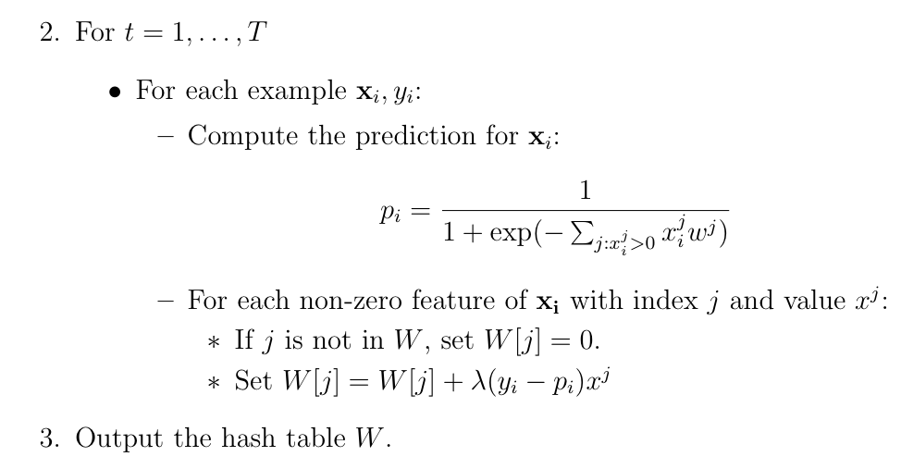
Sparse gradient updates
The algorithm:

Slide 40
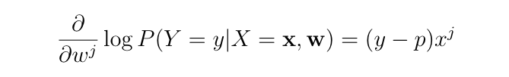
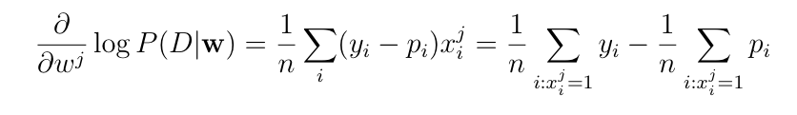
Sparsity can cause overfitting
Consider averaging the gradient over all the examples D={(x₁,y₁)…,(x_{n} , y_{n)}}
This will overfit badly with sparse features
e.g., if w^{j} is only in positive examples, its gradient is always positive !

Slide 41
Recap: overfitting with high-degree polynomial basis vectors
Symptoms: very large w components and very unstable predictions: replacing w_{i} with w_{i} + 𝜺 gives very different predictions

Slide 42
Recap: Ridge regression
Our usual squared loss!

Slide 43
Recap: Logistic Regression

Slide 44
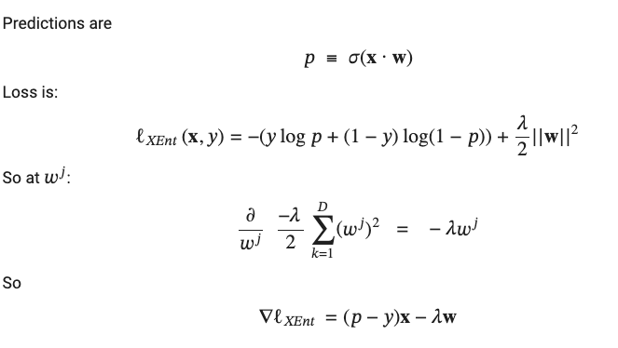
Regularized Logistic Regression
This update is not sparse

Slide 45
Regularized Logistic Regression
Question: Can you design a version of regularized SGD that is as efficient as the sparse unregularized version? (within constant factors)
This update is not sparse

Slide 46
The Hash Kernel

Slide 47
Recap: SGD for Logistic Regression

Slide 48
The “hash trick”
Assume a hash function h that maps string features to indices in W
an array V = <0…0>
hash j
V[j] = V[j]
array V

Slide 49
The “hash trick”: intuition
We’ve replaced our old set of features with new ones: x→ ɸ(x), where ɸ(x) might be shorter and less sparse
New feature might be sum of many old features that collide:
If most of the original sparse features aren’t too important for the task, this won’t hurt us (much)

Slide 50
The “hash trick”: pros/cons
Memory: Without the hash trick, vocabulary size usually grows with the dataset
For NLP tasks, usually V = O(sqrt(N))
Now it stays constant
Unless you change the hash table size
Compute:
Practically it’s much faster to ignore collisions
Debugging:
Now features are meaningless

Slide 51
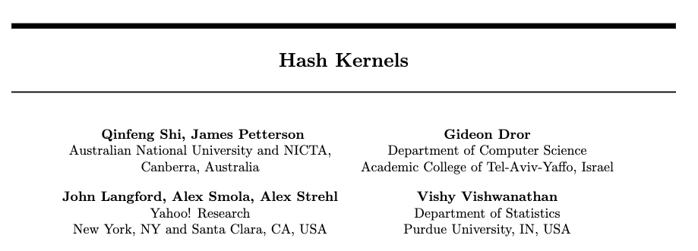
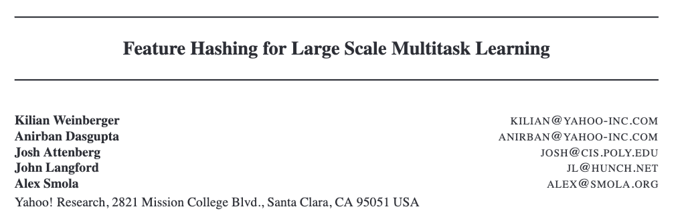
Proc of ML Research, 2009
2010

Slide 52

Motivation
Authors are interested in fast large-scale linear classifiers
Sparse regularized logistic regression, and linear SVMs
Treat the “hash trick” as a kernel
But solved in the primal space, so it’s really feature extraction compression? reduction?

Slide 53
Motivation
Hashing means we can introduce lots of features:
We can handle more than just words on a page:
If we care about misspelled terms like “Schmithuber” we can hash in all substrings up to some length

Slide 54
Motivation
If care about feature interactions
we just add the interactions we care about explicitly (like for quadratic feature example with linear regression) and then hash them away
Special case used for multiclass classification:
For documents in class “news” replace words like “tariff” with “tariff#news” and etc
Classify feature vectors like this as +1 (created from the true class) or 0 (created from an incorrect class)
Cycle through possible classes at test time and see which assigned class looks “most positive”

Slide 55
Formal Results
Q: How different is the original kernel K(x,x’) from the hash kernel?
A: there is a bias due to adding collisions, but it’s minimal

Slide 56
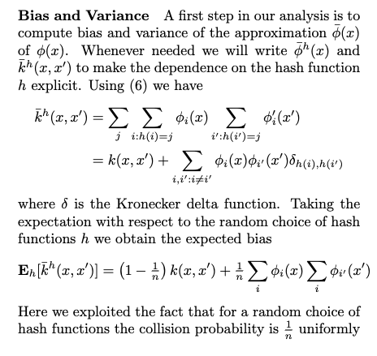
Formal Results
Q: How different is the original kernel K(x,x’) from the hash kernel?
A: there is a bias due to adding collisions, but it’s minimal
Note this doesn’t prove the hash kernel “works” – it does give some intuition that the hash trick won’t change the problem “too much”

Slide 57
Formal results
Observation: in NLP (especially with substrings and terms#class as features) there are often highly-correlated features “duplicates”
Or you can create duplicates explicitly by hashing “William#1”, “William#2”, “William#3”, etc.
Q: How much loss of information is there if you assume duplicates exist?
A: very little!
Eg 10k features, 10M hash buckets, 3 duplicates of each feature, Pr(all duplicates of any feature collide) ~= 1%

Slide 58
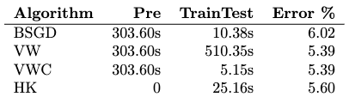
Experimental results
Hash kernel version of VW learner

Slide 59
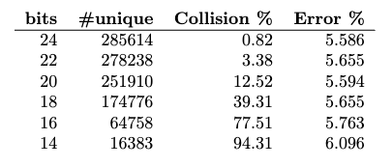

Experimental results

Slide 60
Spam filtering at Yahoo
From Weinberge et al 2010 paper
3.2M emails, 433k users
Emails have tokens and user-id. Features:
original tokens (hashed): “dear”, “sir”, “please”, ”accept”, …
original tokens paired with user id: “dear#wcohen”, “sir#wcohen”, …
Everything is put in one giant classifier
Intuition: the model will learn something from the general features and can refine the model with user-specific features if there is enough data from that user

Slide 61
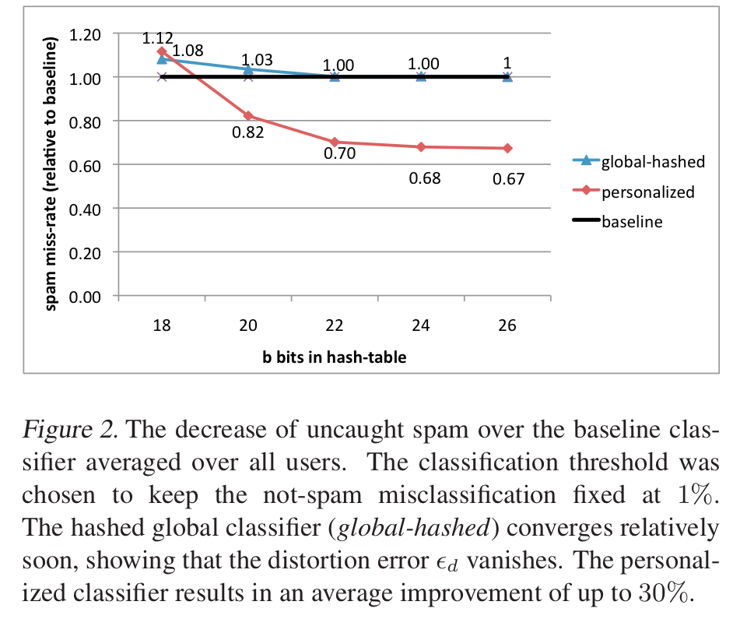
An example
2^26 entries = 1 Gb @ 8bytes/weight
Notes:
3,2M emails
400k users
40M tokens

Slide 62
Distributed Machine Learning

Slide 63
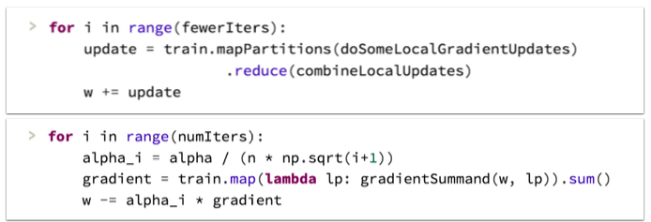
Recap: Parallel SGD?
Initialize w₀
For t=1, … until converged:
For each example x_{i}
Compute gradient
Update: w_{new} = w_{prev} - ⍺ g
Option 1: Make minibatch B larger and parallelize computation of B
E.g., vectorize the gradient computation and use a GPU
Alternative to batch: Run multiple SGD processes in parallel, and synchronize them occasionally
More on this later
Better suited to cluster-level parallelism
Harder to analyze and few formal guarantees

Slide 64

Distributed ML
https://arxiv.org/abs/2003.06307 2023 survey
Data parallelism
replicate the model and partition the data
our focus so far
Model parallelism (related to “pipeline parallelism”)
partition the model
e.g., each worker has different parts of a huge LLM
Tensor parallelism (related to “Zero Redundancy Optimizer, ZeRO”)
partition individual tensors/matrices operations

Slide 65
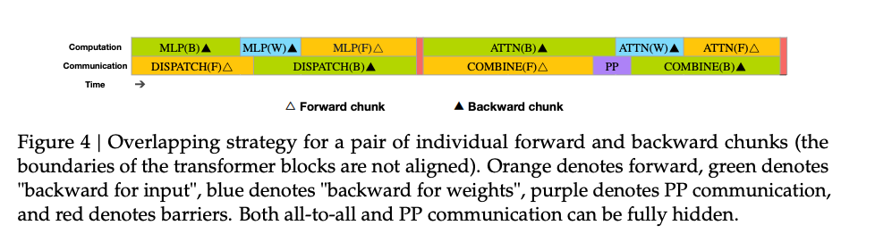
Distributed ML
https://arxiv.org/abs/2003.06307 2023 survey
Data parallelism
Model parallelism (related to “pipeline parallelism”)
Tensor parallelism (related to “Zero Redundancy Optimizer, ZeRO”)
Modern training systems often combine these:
DeepSeek-V3 used pipeline parallelism, data parallelism, and ZeRO + “expert parallelism” (another kind of model parallelism).
Also, compressed synchronization by communicating limited-precision updates

Slide 66
Distributed ML
Data parallelism
workers get parts (usually disjoint partitions) of the data and copies of the current model
workers optimize independently for a while
without communication
workers communicate and synchronize models
Decisions to consider:
when do you synchronize?
when is it ok to optimize a “stale” set of weights?
how do you synchronize?
how do you send information?
how do you compress or sparsify information?

Slide 67
Data Parallel ML: Maximal synchronization
Batch gradient descent

Slide 68
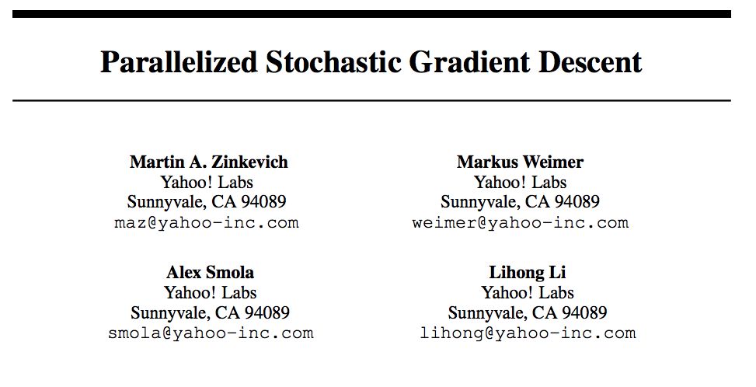
Data Parallel ML: Minimal synchronization

Slide 69
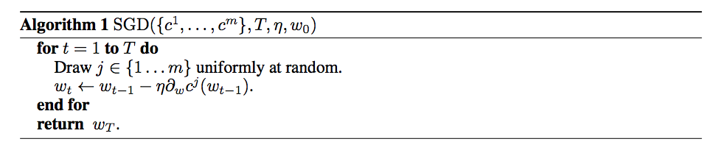
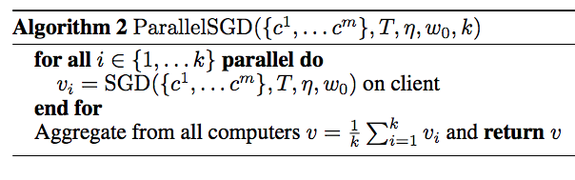
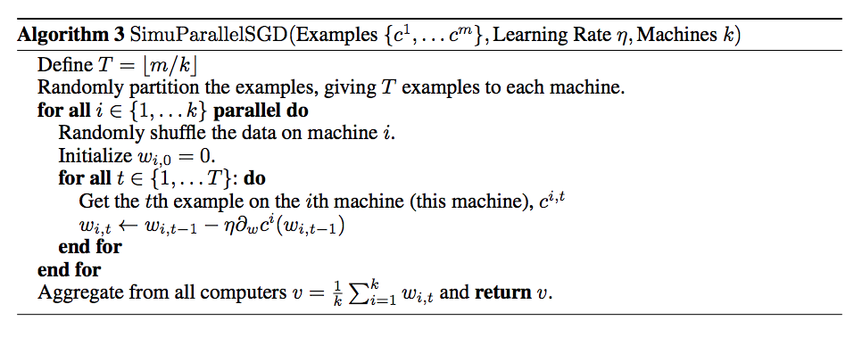
The data is not sharded into disjoint sets: all machines get all* the data
* Not actually all but as much as it will have time to look at
Think of this as an ensemble with limited training time…..

Slide 70
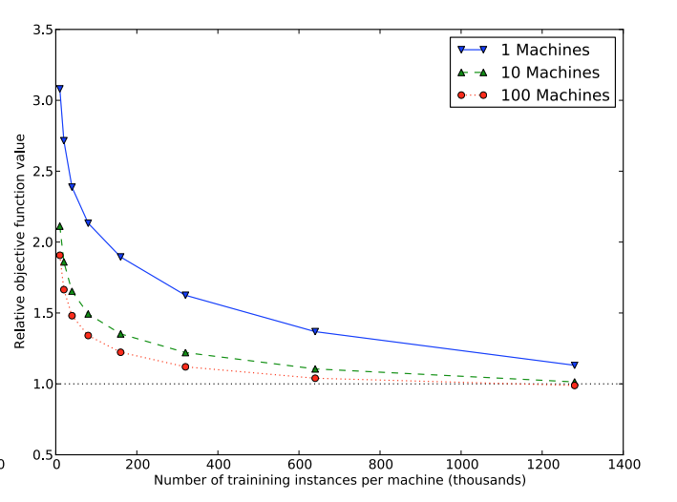
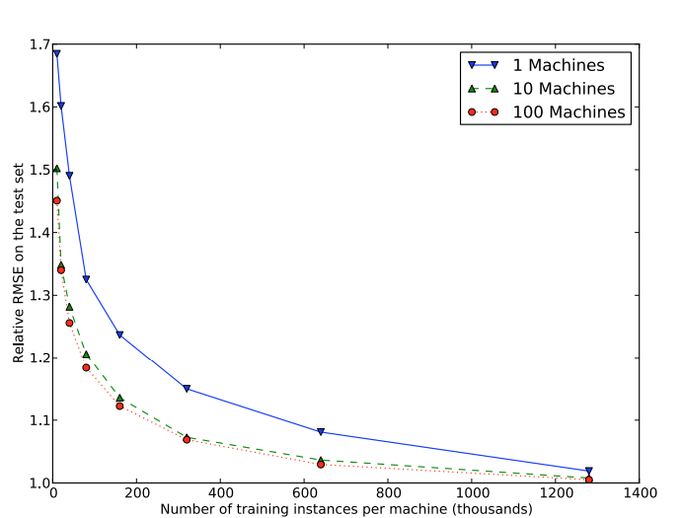
fewerIters=1
Training loss (L2)
Test loss (L2)
There is also a formal bound on regret relative to the best classifier
This is a convex optimization problem!

Slide 71
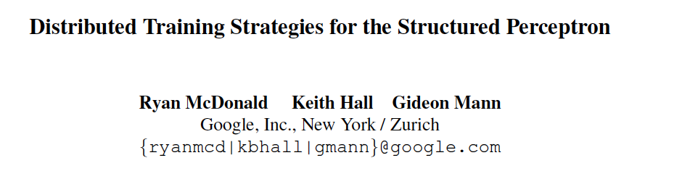
Data Parallel ML: Intermediate Synchronization
NAACL 2010

Slide 72
Parallel Perceptrons*
*similar to logistic regression with SGD
Simplest idea:
Split data into S “shards”
Train a perceptron on each shard independently
weight vectors are w⁽¹⁾ , w⁽²⁾ , …
Produce some weighted average of the w^{(i)}‘s as the final result
Theorem: this doesn’t always work.
Proof: by constructing an example where you can converge on every shard, and still have the averaged vector not separate the full training set – no matter how you average the components.

Slide 73
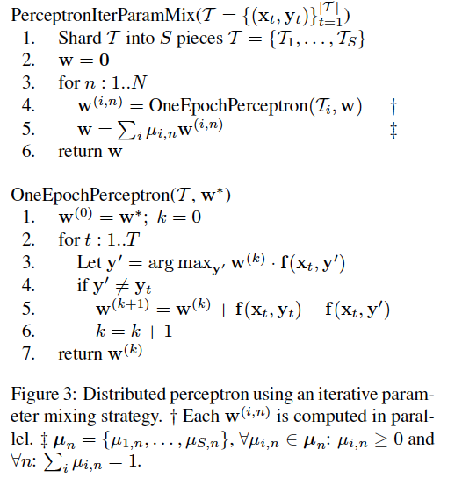
Parallel Perceptrons – take 2
Idea: do the simplest possible thing iteratively.
Split the data into shards
Let w = 0
For n=1,…
Train a perceptron on each shard with one pass starting with w
Average the weight vectors (somehow) and let w be that average
Extra communication cost:
redistributing the weight vectors
done less frequently than if fully synchronized, more frequently than if fully parallelized

Slide 74
Parallelizing perceptrons – take 2
w (previous)
Instances/labels
Split into example subsets
Instances/labels – 1
Instances/labels – 2
Instances/labels – 3
Compute local vk’s
w -1
w- 2
w-3
Combine by some sort of weighted averaging
w
Notes:
Rennie, Shih, Teevan, and Karger (2003) Tackling the Poor Assumptions of Naive Bayes Text Classifiers.
lingpipe-blog.com/.../rennie-shih-teevan-and-karger-2003-tackling-p...
Feb 16, 2009 – Rennie, Shih, Teevan, Karger (2003) Tackling the Poor Assumptions of Naive Bayes Text Classifiers. In ICML. Rennie et al. introduce four ...
Tackling the - AAAI

Slide 75
Results
Perceptrons are guaranteed to converge
Given the data has a compact “radius” and there is a classifier with “large margin”
The parallel “iterative parameter mixing” method is also guaranteed to converge in the same conditions
But not to converge faster

Slide 76
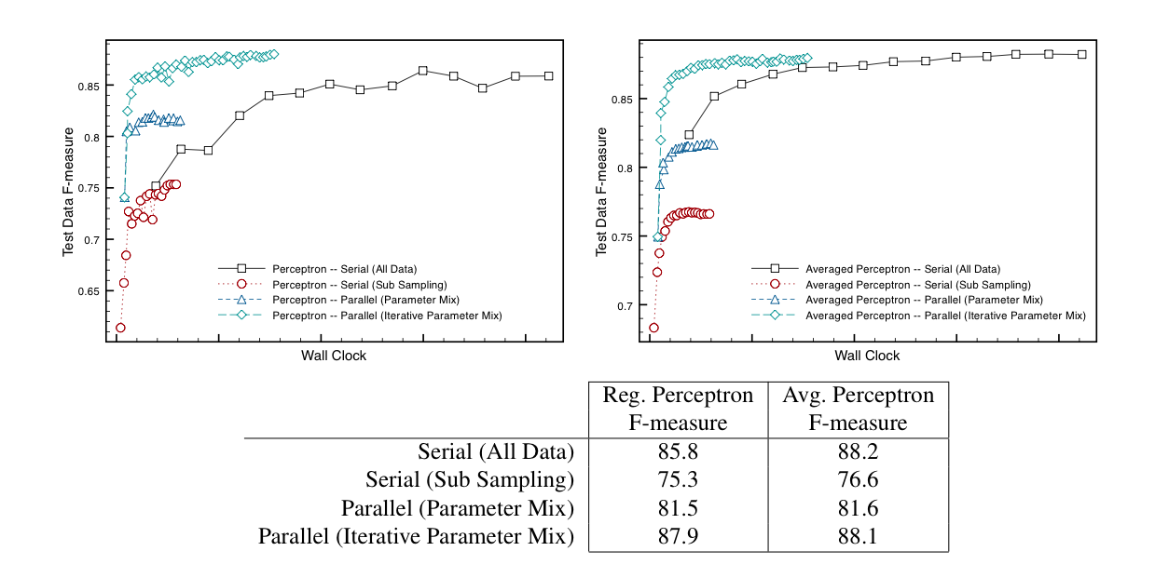
Results

Slide 77
Distributed ML
Data parallelism
workers get parts (usually disjoint partitions) of the data and copies of the current model
workers optimize independently for a while
without communication
workers communicate and synchronize models
Decisions to consider:
when do you synchronize?
when is it ok to optimize a “stale” set of weights?
how do you synchronize?
how do you send information?
how do you compress or sparsify information?

Slide 78
Distributed ML
Data parallelism
workers get parts (usually disjoint partitions) of the data and copies of the current model
workers optimize independently for a while
without communication
workers communicate and synchronize models
Decisions to consider:
when do you synchronize?
when is it ok to optimize a “stale” set of weights?
synchronization strategies are best viewed as more hyperparameters

