Slide 1

10-605 / 10-405

Slide 2
Recap: the course so far
Why bigdata is important in ML
History of bigdata in ML
Scalable computation on clusters
MapReduce
Spark and iteration
Sample Spark workflows
Learning as optimization
MLE for binomials, linear regression, logistic regression, k-means clustering
exact solutions, gradient descent (batch, parallel, stochastic), EM and EM-like methods

Slide 3
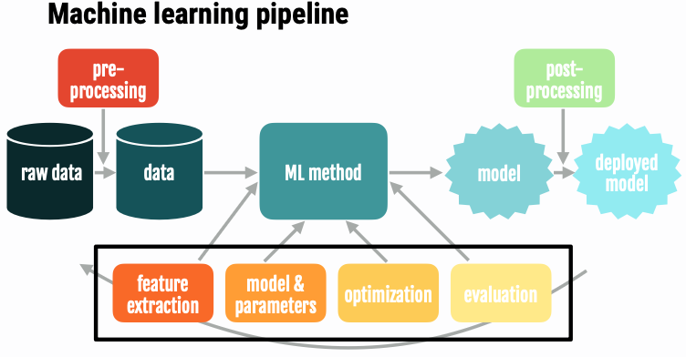
Recap: the course so far
“Craft” of ML
feature extraction / augmentation
kernel methods – working a different feature space
regularization and sparsity ⬅ more today
hyperparameter tuning
the hash trick and efficiency
discussing a paper and some formal results
distributed ML ⬅ starting today

Slide 4
Sparse Gradients for Sparse Data for Linear/Logistic Regression

Slide 5
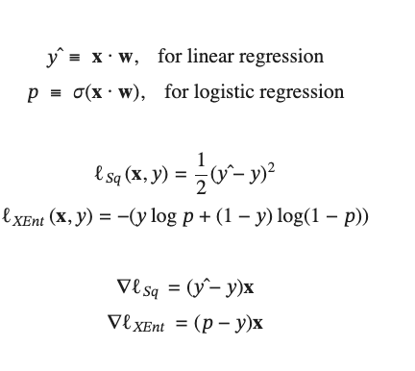
Summary: SGD for least squares and Logistic Regression
For text problems:
x is a sparse document vector (e.g., TFIDF weights)
w is a dense vector of weights (one for each word in the vocabulary)
The gradient is zero where x is zero ➔ gradient is sparse
Initialize w₀
For i=1, … until converged:
Compute gradient g = ▽ℓ
Update: w_{i} = w_{i-1} - ⍺ g
Notes:
training loss bounces around

Slide 6
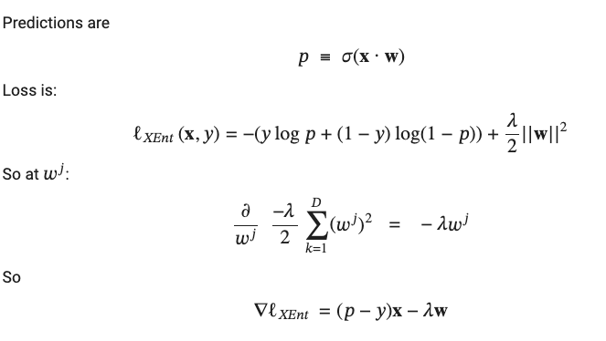
Regularized Logistic Regression
Question: Can you design a version of regularized SGD that is as efficient as the sparse unregularized version? (within constant factors)
This update is not sparse

Slide 7

Learning as optimization for regularized logistic regression
Final algorithm:
Initialize hashtable W
For each iteration t=1,…T
For each example (x_{i},y_{i})
p_{i} = …
For each feature W[j]
W[j] = W[j] - ⍺ λW[j]
If x_{i}^{j}>0 then
W[j] = W[j] + ⍺ (p_{i} - y_{i} )x_{j}

Slide 8
Learning as optimization for regularized logistic regression
Final algorithm:
Initialize hashtable W
For each iteration t=1,…T
For each example (x_{i},y_{i})
p_{i} = …
For each feature W[j]
W[j] *= (1 - ⍺ λ )
If x_{i}^{j}>0 then
W[j] = W[j] + ⍺ (p_{i} - y_{i} )x_{j}
“weight decay”

Slide 9
Learning as optimization for regularized logistic regression
Final algorithm:
Initialize hashtable W
For each iteration t=1,…T
For each example (x_{i},y_{i})
p_{i} = …
For each feature W[j]
If x_{i}^{j}>0 then
W[j] *= (1 - ⍺ λ )^{A}
W[j] = W[j] + ⍺ (p_{i} - y_{i} )x_{j}
A is number of examples seen since the last time we did an x>0 update on W[j]

Slide 10
Learning as optimization for regularized logistic regression
Final algorithm:
Initialize hashtables W, A and set k=0
For each iteration t=1,…T
For each example (x_{i},y_{i})
p_{i} = …
For each feature W[j]
If x_{i}^{j}>0 then
W[j] *= (1 - ⍺ λ )^{k-A[j]}
W[j] = W[j] + ⍺ (p_{i} - y_{i} )x_{j}
A[j] = k
k = “clock” reading
A[j] = clock reading last time feature j was “active”
we implement the “weight decay” update using a “lazy” strategy: weights are decayed in one shot when a feature is “active”
One more ”weight decay” step needed at end of SGD

Slide 11
Distributed Machine Learning

Slide 12
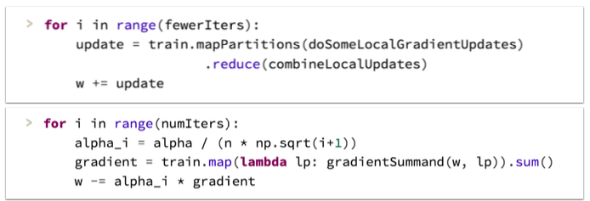
Recap: Parallel SGD?
Initialize w₀
For t=1, … until converged:
For each example x_{i}
Compute gradient
Update: w_{new} = w_{prev} - ⍺ g
Option 1: Make minibatch B larger and parallelize computation of B
E.g., vectorize the gradient computation and use a GPU
Option 2: Run multiple SGD processes in parallel, and synchronize them occasionally
More on this later
Better suited to cluster-level parallelism
Harder to analyze and few formal guarantees

Slide 13
Today’s Focus
High-level view of the space of different options for how to parallelize ML
Today: mostly for cluster architectures
Data Parallel
Model Parallel
Tensor Parallel

Slide 14

Distributed ML
https://arxiv.org/abs/2003.06307 2023 survey
Data parallelism
replicate the model and partition the data
our focus so far
Model parallelism (related to “pipeline parallelism”)
partition the model
e.g., each worker has different parts of a huge LLM
Tensor parallelism (related to “Zero Redundancy Optimizer, ZeRO”)
partition individual tensors/matrices operations

Slide 15
Distributed ML
https://arxiv.org/abs/2003.06307 2023 survey
Data parallelism
Model parallelism (related to “pipeline parallelism”)
Tensor parallelism (related to “Zero Redundancy Optimizer, ZeRO”)
Modern training systems often combine these:
DeepSeek-V3 used pipeline parallelism, data parallelism, and ZeRO + “expert parallelism” (another kind of model parallelism).
Also, compressed synchronization by communicating limited-precision updates, and …

Slide 16
Distributed ML
Data parallelism
workers get parts (usually disjoint partitions) of the data and copies of the current model
workers optimize independently for a while
without communication
workers communicate and synchronize models
Decisions to consider:
when do you synchronize?
when is it ok to optimize a “stale” set of weights?
how do you synchronize?
how do you send information?
how do you compress or sparsify gradients?

Slide 17
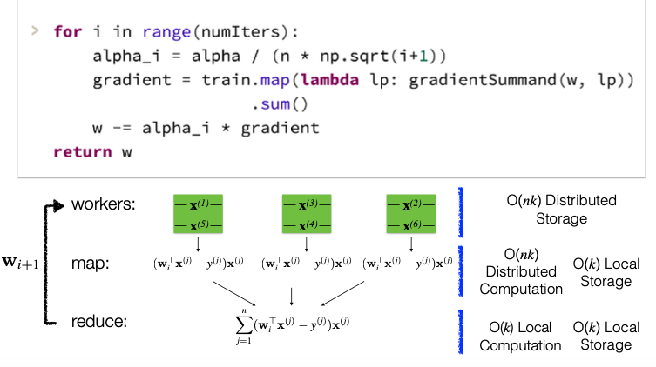
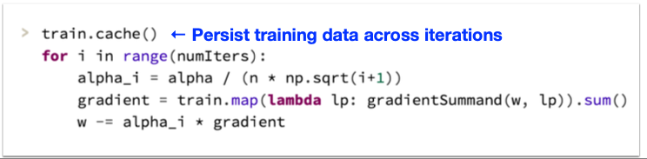
Data Parallel ML: Maximal synchronization: batch gradient (recap)

Slide 18
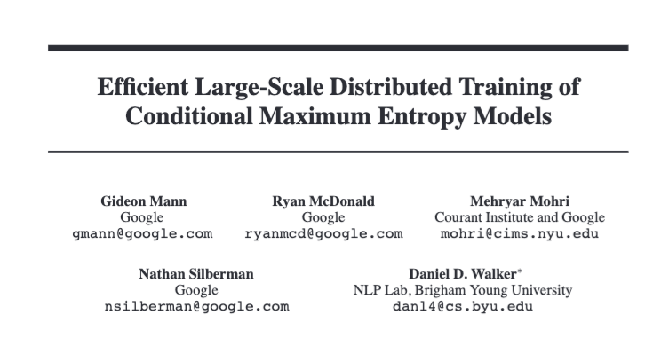
Data Parallel ML: Minimal synchronization 1
NeurIPS 2009

Slide 19
Data Parallel ML: Minimal synchronization 1
ML models they compared:
Distributed batch gradient
Two minimal-synchronization methods
Learn P different logistic regression classifiers from P different shards with batch gradient descent for each shard
Combine predictions by majority vote
Combine weight vectors by averaging
All methods are comparable in CPU time and accuracy but minimal-synchronization methods use 1000x less network bandwidth
Can prove lower variance than one shard but not lower bias

Slide 20
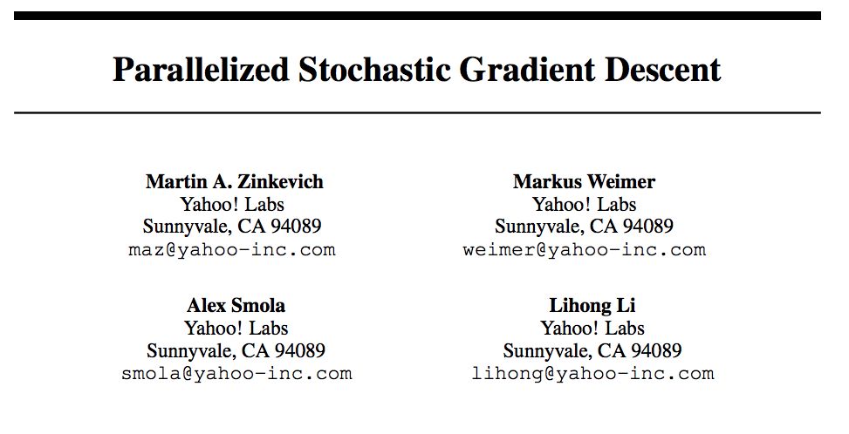
Data Parallel ML: Minimal synchronization 2
NeurIPS 2010

Slide 21
Data Parallel ML: Minimal synchronization 2
Comparisons
The minimal-synchronization method
Learn P different logistic regression classifiers from T examples each with stochastic gradient descent in a shard
Combine weight vectors by averaging
Can make formal bounds on the variance and expectation of the averaged parameter vector
relative to a single SGD run over T examples

Slide 22
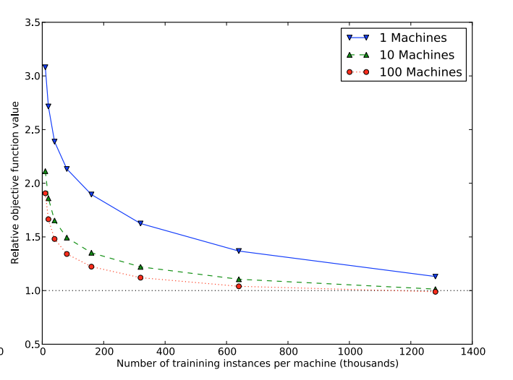
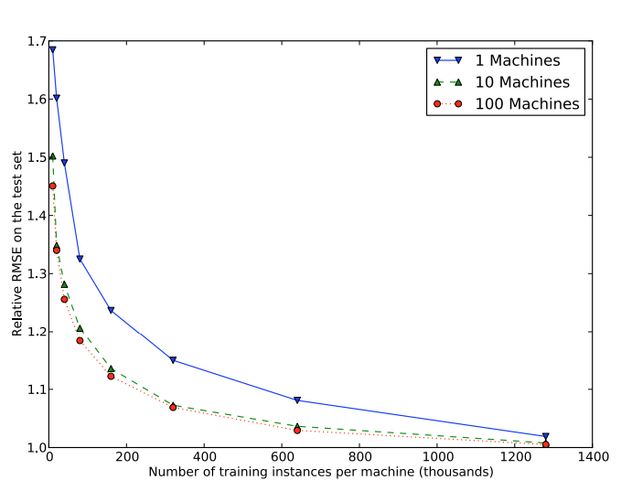
Training loss
Test loss
Note: This is a convex optimization problem!

Slide 23
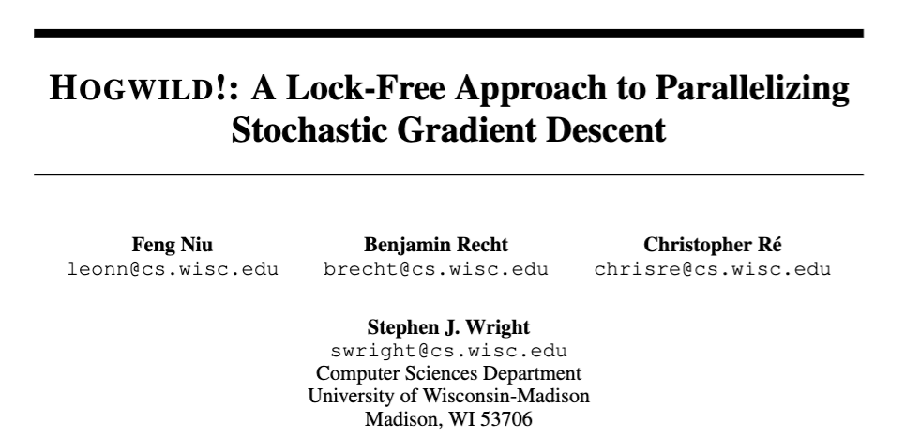
Data Parallel ML: Minimal synchronization 3
NeurIPS 2011

Slide 24
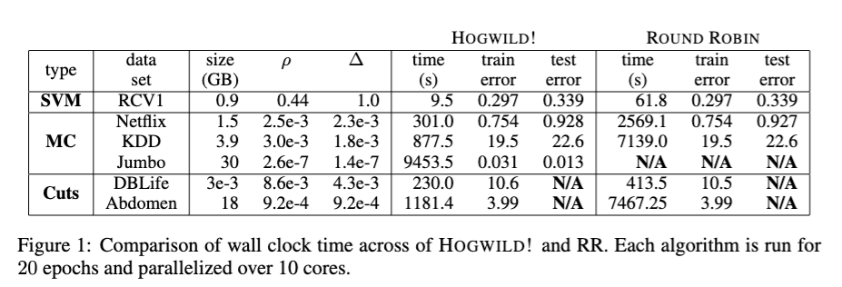
Data Parallel ML: Minimal synchronization 3
Setting:
Multiple SGD processes on a multicore CPU with shared memory
Sparse gradient updates
Matrix factorization
SVM with sparse features
No locking when you update gradients!
One process’s update might overwrite another
But that’s just making GD more stochastic

Slide 25
Data Parallel ML: Minimal synchronization 3
HogWild! optimization still in use
e.g. FastText:
hash trick, n-grams, learned word representations, hierarchical softmax, and HogWild! optimization
very fast learner/classifier with ~ 20 threads on CPUs with fast RAID disks

Slide 26
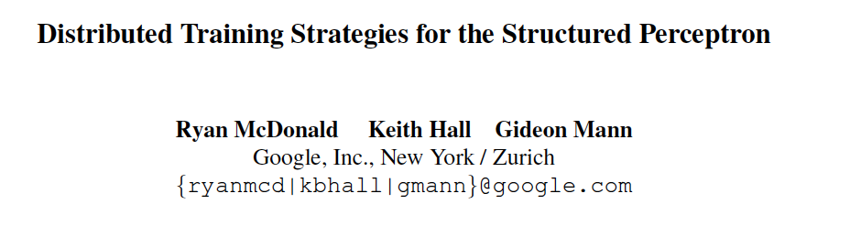
Data Parallel ML: Intermediate Synchronization
NAACL 2010

Slide 27
Parallel Perceptrons*
*similar to logistic regression with SGD
Simplest idea (minimal synchronization):
Split data into S “shards”
Train a perceptron on each shard independently
weight vectors are w⁽¹⁾ , w⁽²⁾ , …
Produce some weighted average of the w^{(i)}‘s as the final result
Theorem: this doesn’t always work (for perceptrons).
Proof: by constructing an example where you can converge on every shard, and still have the averaged vector not separate the full training set – no matter how you average the components.

Slide 28
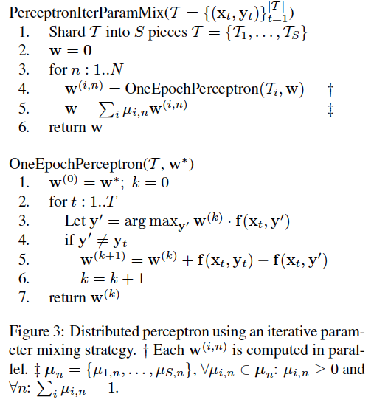
Parallel Perceptrons – take 2
Idea: do the simplest possible thing iteratively.
Split the data into shards
Let w = 0
For n=1,…
Train a perceptron on each shard with one pass starting with w
Average the weight vectors and let w be that average
Extra communication cost:
redistributing the weight vectors
done less frequently than if fully synchronized, more frequently than if fully parallelized

Slide 29
Parallelizing perceptrons – take 2
w (previous)
Instances/labels
Split into example subsets
Instances/labels – 1
Instances/labels – 2
Instances/labels – 3
Compute local vk’s
w -1
w- 2
w-3
Combine by averaging
w
Notes:
Rennie, Shih, Teevan, and Karger (2003) Tackling the Poor Assumptions of Naive Bayes Text Classifiers.
lingpipe-blog.com/.../rennie-shih-teevan-and-karger-2003-tackling-p...
Feb 16, 2009 – Rennie, Shih, Teevan, Karger (2003) Tackling the Poor Assumptions of Naive Bayes Text Classifiers. In ICML. Rennie et al. introduce four ...
Tackling the - AAAI

Slide 30
Results
Background: Perceptrons are guaranteed to converge
Given the data has a compact “radius” and there is a classifier with “large margin”
The parallel “iterative parameter mixing” method is also guaranteed to converge in the same conditions ☺
But not to converge faster ☹

Slide 31
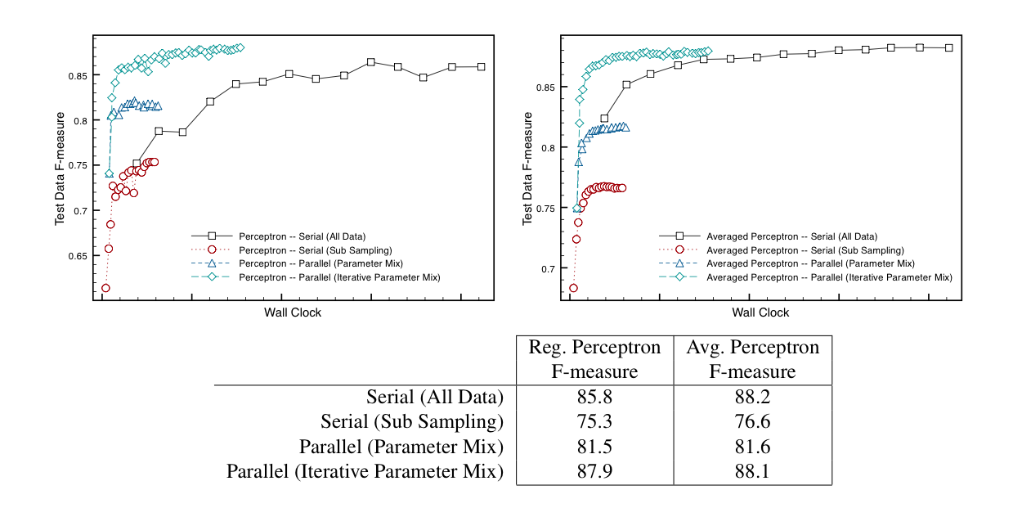
Results

Slide 33
Distributed ML
Data parallelism
workers get parts (usually disjoint partitions) of the data and copies of the current model
workers optimize independently for a while
without communication
workers communicate and synchronize models
Decisions to consider:
when do you synchronize?
this is a hyperparameter you must tune
how do you synchronize?
how do you send information?
how do you compress or sparsify information?

Slide 34
Distributed ML
Data parallelism
workers get parts (usually disjoint partitions) of the data and copies of the current model
workers optimize independently for a while
without communication
workers communicate and synchronize models
Decisions to consider:
when do you synchronize?
this is a hyperparameter you must tune
how do you synchronize?
how do you send information?
how do you compress or sparsify information?

Slide 35
All-reduce

Slide 36
Recap Parallel SGD
Initialize w₀
For t=1, … until converged:
For each example x_{i}
Compute gradient
Update: w_{new} = w_{prev} - ⍺ g
Common pattern in ML:
Reduce (e.g., aggregate gradients) information from many workers
Distribute aggregation to all workers
Allreduce combines reduce and distribution

Slide 37
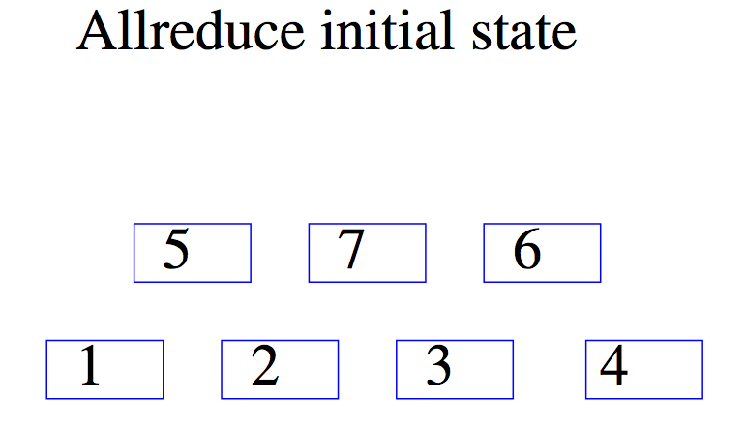
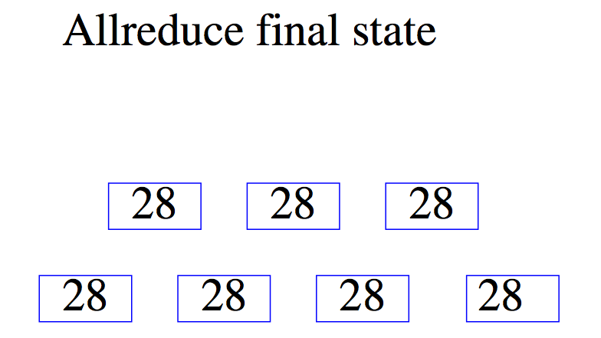

Slide 38
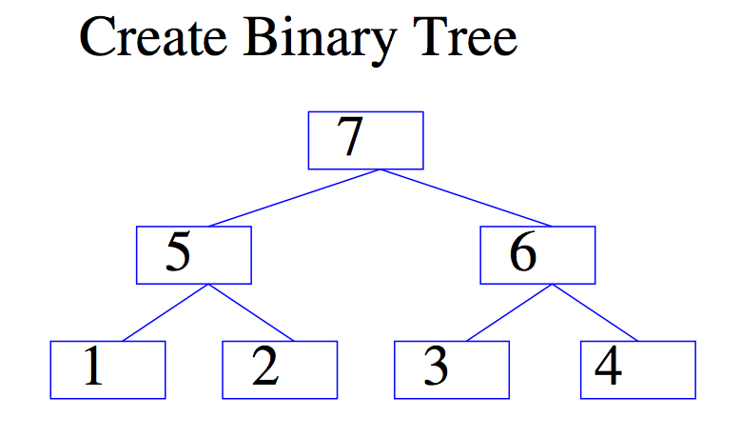
Separate process constructs a spanning tree of the compute nodes in the cluster and then acts as a server

Slide 39
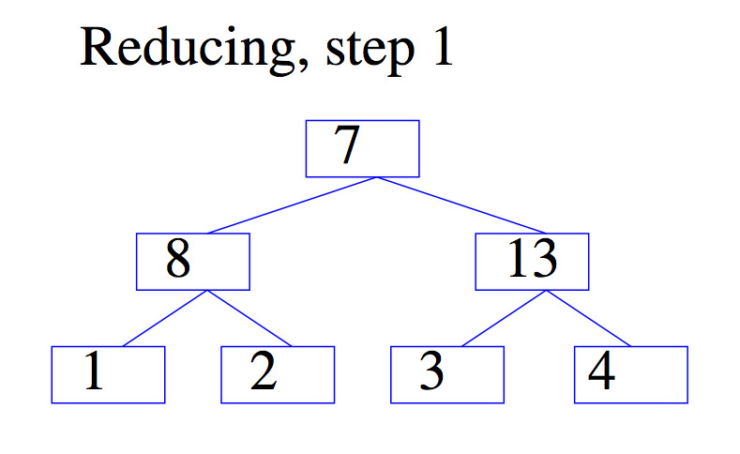
5
6
Workers all execute the same code, contains AllReduce calls.
Workers block and synchronize when they AllReduce.
Server tells them where to transmit information.

Slide 40
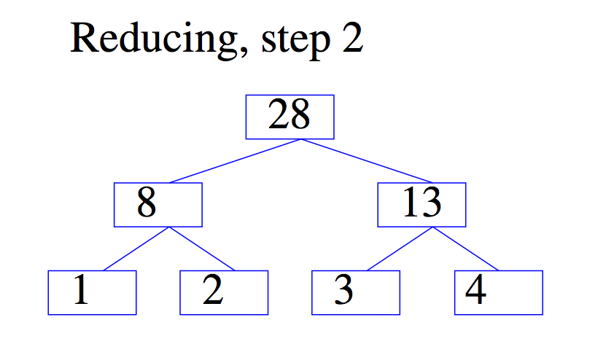
7

Slide 41
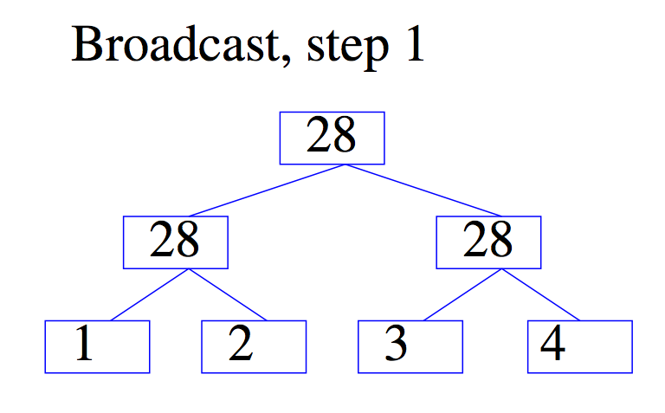

Slide 42
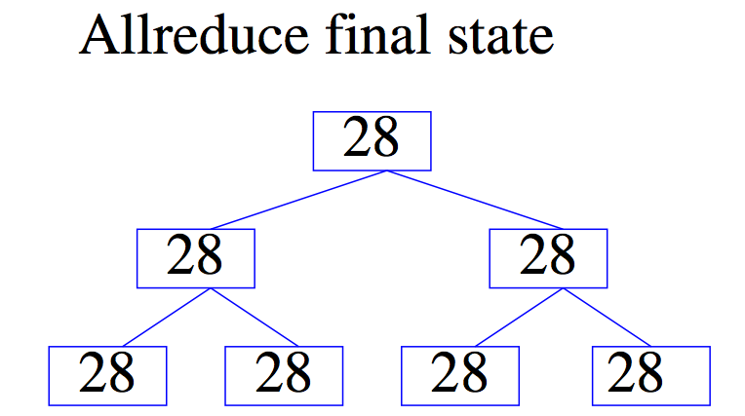
AllReduce process ends and workers go “back to work”

Slide 43
Parallel SGD with AllReduce
In parallel, on each of k workers with N/k examples each:
w = [initial weight vector]
For e = 1, …, num_epochs:
For i = 1, …, num_local_examples:
w += SGD_update(w, x_{i}, y_{i})
w = AllReduce(w)
return w
Final weight vector is average:
# blocks until the operation completes

Slide 44
Tree AllReduce Discussion
Advantages
Minimizes the number of links and hence amount of data transmitted
Leads to a convenient architecture
A bunch of independent learning processes with occasional synchronization
For Hadoop this reduces overhead for medium-scale jobs
Disadvantages
No redundancy so potentially fragile
Important point!
GPU clusters have different bandwidth constraints and tend to use different flavors of AllReduce (e.g., ring AllReduce)

Slide 45
Parameter Servers

Slide 46

Parameter Server (PS)
Worker Machines
Server Machines
Extensions: push/pull interface to send/receive most recent copy of (subset of) parameters, blocking is optional
Extension: can block until push/pulls with clock < (t – τ ) complete
[Smola et al 2010, Ho et al 2013, Li et al 2014]
Notes:
Data parallelism naturally leads to the parameter server abstraction.
Data is distributed among worker machines.
Parameters are distributed on parameter server machines, served to workers via a key-value interface.

Slide 47

Data parallel learning with PS
Parameter Server
Parameter Server
Parameter Server
w₁
w₁
w₂
w₂
w₃
w₃
w₄
w₄
w₅
w₅
w₆
w₆
w₇
w₇
w₈
w₈
w₉
w₉
w₄
w₆
w₃
w₅
w₈
w₉
w₁
w₇
w₂
Data
Data
Data
Data
Split Data Across Machines
Notes:
Different parts of the model can be stored on different parameter servers.
Workers just retrieve the parts it needs from the corresponding machines.

Slide 48
Data parallel learning with PS
Parameter Server
Parameter Server
Parameter Server
w₁
w₁
w₂
w₂
w₃
w₃
w₄
w₄
w₅
w₅
w₆
w₆
w₇
w₇
w₈
w₈
w₉
w₉
Different parts of the model on different servers.
Workers retrieve the part needed as needed
Data
Data
Data
Data
Split Data Across Machines
Notes:
Different parts of the model can be stored on different parameter servers.
Workers just retrieve the parts it needs from the corresponding machines.

Slide 49
Abstraction used for Data parallel learning with PS
Key-Value API for workers:
get(key) → value
add(key, delta)
Model
Model
Model
Notes:
Parameter servers use a simple key-value store API.
Get: retrieve values from server, and generate delta.
Add: send delta to servers and generate new model.
Key advantage: algorithms look like single thread. No need to create complicated pipeline of joins, maps, etc. like in MapReduce.

Slide 50
Parallel SGD with PS
w = [initial weight vector]
In parallel, on each of k workers with N/k examples each:
For e = 1, …, num_epochs:
For i = 1, …, num_local_examples:
For each non-zero update 𝛿_{j} to param j
ps.add(j, 𝛿_{j} )
Final weight vector is on param server!
# stored on param server

Slide 51
Param Server Discussion
Advantages
Convenient programming model
Very powerful when parameters are sparse and vectors can be “sharded” across difference PS machines
Disadvantages
Prone to bottlenecks
Avoiding bottlenecks often involves tricks (e.g., SSP, limited synchronization when you access/updated parameters) that can delay convergence unpredictably

Slide 52
Distributed ML
Data parallelism
workers get parts (usually disjoint partitions) of the data and copies of the current model
workers optimize independently for a while
without communication
workers communicate and synchronize models
Decisions to consider:
when do you synchronize?
when is it ok to optimize a “stale” set of weights?
how do you synchronize?
how do you send information?
how do you compress or sparsify information?

Slide 53
Distributed ML
Most distributed ML is a carefully-chosen combination of standard tricks
Sometimes if you know something about the problem you are optimizing you can do something special…
DeepSeek-V3 used pipeline parallelism, data parallelism, and ZeRO + “expert parallelism” (another kind of model parallelism).
Also, compressed synchronization by communicating limited-precision updates

Slide 54
Matrix Factorization

Slide 55
Recovering latent factors in a matrix
m columns
v11 | …
… | …
 | vij
n rows
 |  |  | …
 |  |  |  | vnm

Slide 56
Recovering latent factors in a matrix
K * m
~
x1 | y1
x2 | y2
.. | ..
… | …
xn | yn
a1 | a2 | .. | … | am
b1 | b2 | … | … | bm
v11 | …
… | …
 | vij
n * K
 |  |  | …
 |  |  |  | vnm

Slide 57
What is this for?
K * m
~
x1 | y1
x2 | y2
.. | ..
… | …
xn | yn
a1 | a2 | .. | … | am
b1 | b2 | … | … | bm
v11 | …
… | …
 | vij
n * K
 |  |  | …
 |  |  |  | vnm

Slide 58
MF for collaborative filtering

Slide 59

What is collaborative filtering?

Slide 60
Recovering latent factors in a matrix
m movies
v11 | …
… | …
 | vij
n users
 |  |  | …
 |  |  |  | vnm
V[i,j] = user i’s rating of movie j

Slide 61
Recovering latent factors in a matrix
m movies
m movies
~
x1 | y1
x2 | y2
.. | ..
… | …
xn | yn
a1 | a2 | .. | … | am
b1 | b2 | … | … | bm
v11 | …
… | …
 | vij
n users
 |  |  | …
 |  |  |  | vnm
V[i,j] = user i’s rating of movie j

Slide 62
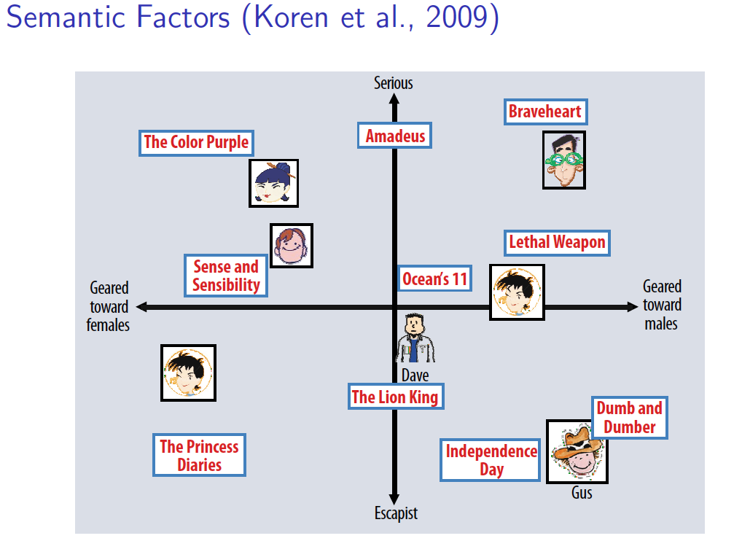

Slide 63
MF for image modeling

Slide 64
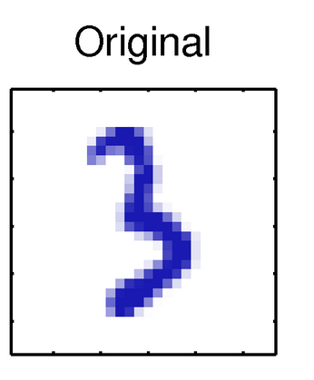
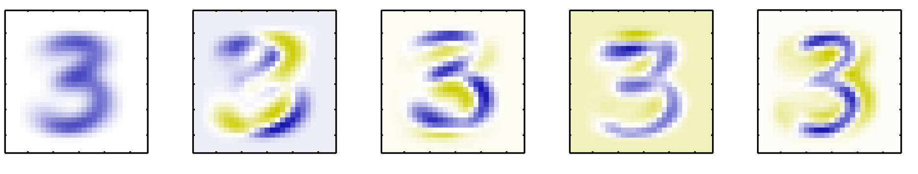
MF for images
P1
weights for
2 prototypes
10,000 pixels
1000 * 10,000,00
~
x1 | y1
x2 | y2
.. | ..
… | …
xn | yn
a1 | a2 | .. | … | am
b1 | b2 | … | … | bm
v11 | … |  | … | …
… | …
 | vij
1000 images
P2
 |  |  | …
 |  |  |  | vnm
V[i,j] = pixel j in image i

Slide 65
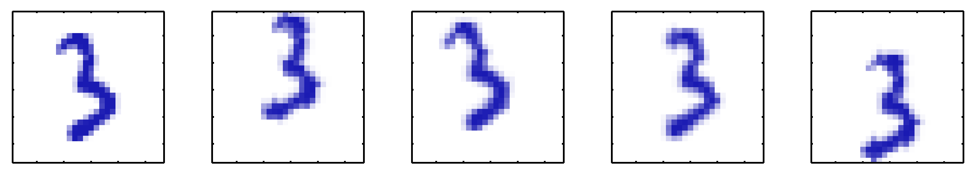
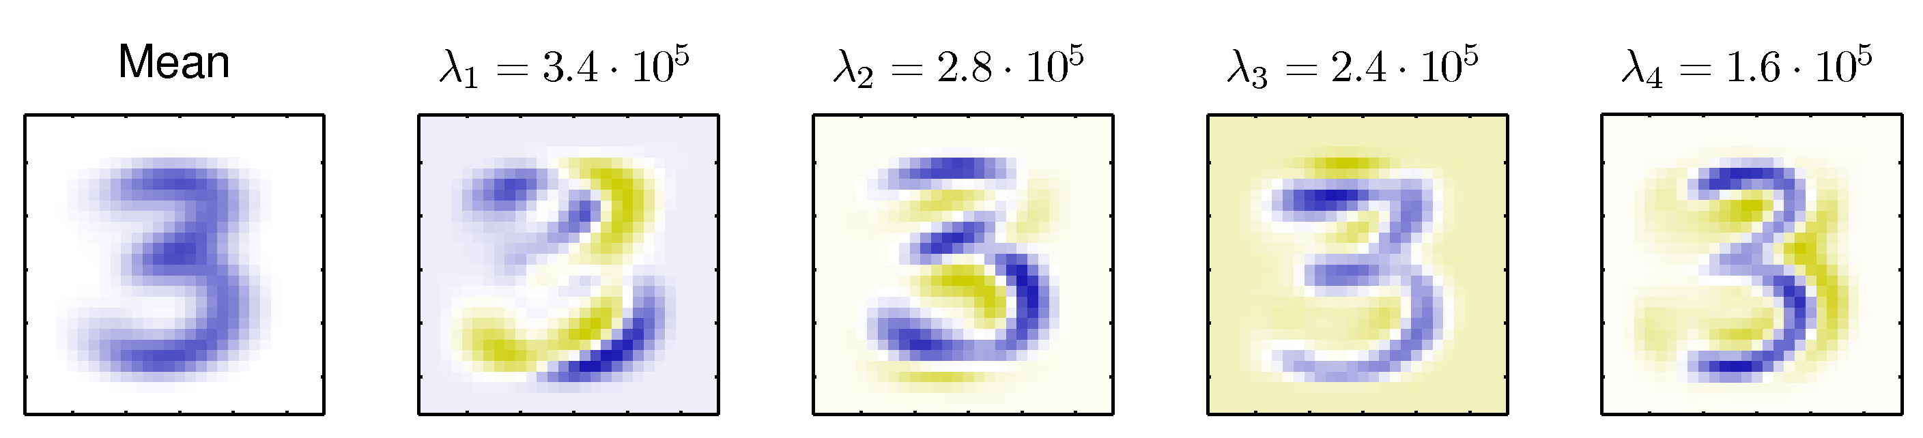
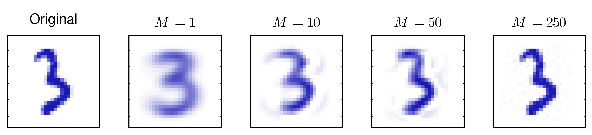

Slide 66
MF for modeling text

Slide 67
The Neatest Little Guide to Stock Market Investing
Investing For Dummies, 4th Edition
The Little Book of Common Sense Investing: The Only Way to Guarantee Your Fair Share of Stock Market Returns
The Little Book of Value Investing
Value Investing: From Graham to Buffett and Beyond
Rich Dad’s Guide to Investing: What the Rich Invest in, That the Poor and the Middle Class Do Not!
Investing in Real Estate, 5th Edition
Stock Investing For Dummies
Rich Dad’s Advisors: The ABC’s of Real Estate Investing: The Secrets of Finding Hidden Profits Most Investors Miss
https://technowiki.wordpress.com/2011/08/27/latent-semantic-analysis-lsa-tutorial/
Notes:
https://technowiki.wordpress.com/2011/08/27/latent-semantic-analysis-lsa-tutorial/

Slide 68
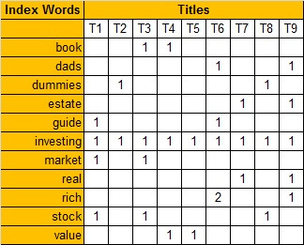
TFIDF counts would be better
https://technowiki.wordpress.com/2011/08/27/latent-semantic-analysis-lsa-tutorial/
Notes:
https://technowiki.wordpress.com/2011/08/27/latent-semantic-analysis-lsa-tutorial/

Slide 69
Recovering latent factors in a matrix
m terms
doc term matrix
~
x1 | y1
x2 | y2
.. | ..
… | …
xn | yn
a1 | a2 | .. | … | am
b1 | b2 | … | … | bm
v11 | …
… | …
 | vij
n documents
 |  |  | …
 |  |  |  | vnm
V[i,j] = TFIDF score of term j in doc i

Slide 70
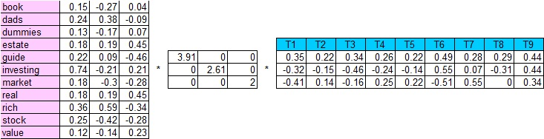
=

Slide 71
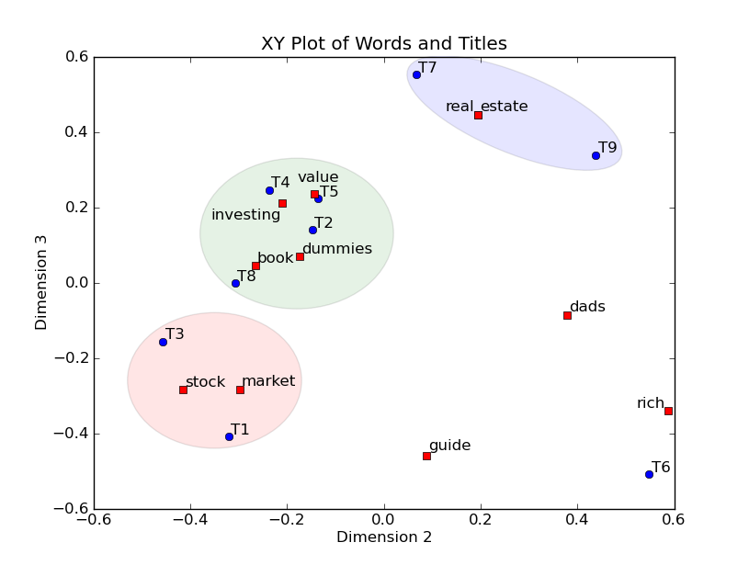
Investing for real estate
Rich Dad’s Advisor’s: The ABCs of Real Estate Investment …

Slide 72
The little book of common sense investing: …
Neatest Little Guide to Stock Market Investing

Slide 73
MF is like clustering

Slide 74
Recap: k-means clustering
An EM-like algorithm:
Initialize k cluster centroids
E-step: associate each data instance with the closest centroid
Find expected values of cluster assignments given the data and centroids
M-step: recalculate centroids as an average of the associated data instances
Find new centroids that maximize that expectation

Slide 75
k-means Clustering
centroids

Slide 76
Parallelizing k-means

Slide 77
Parallelizing k-means

Slide 78
Parallelizing k-means

Slide 79
k-means on MapReduce
Mappers read data portions and centroids
Mappers assign data instances to clusters
Mappers compute new local centroids and local cluster sizes
Reducers aggregate local centroids (weighted by local cluster sizes) into new global centroids
Reducers write the new centroids

Slide 80
k-means as MF
indicators for r clusters
cluster means
original data set
~
M
0 | 1
1 | 0
.. | ..
… | …
xn | yn
a1 | a2 | .. | … | am
b1 | b2 | … | … | bm
v11 | …
… | …
 | vij
n examples
Z
X
 |  |  | …
 |  |  |  | vnm

Slide 81
Matrix Factorization as Optimization

Slide 82
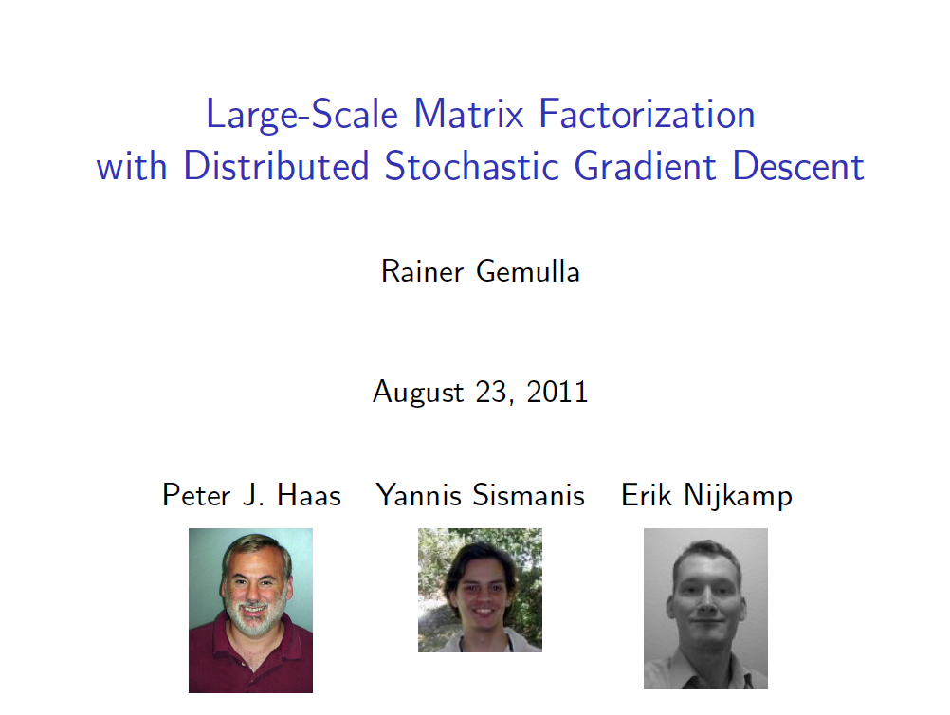

KDD 2011

Slide 83
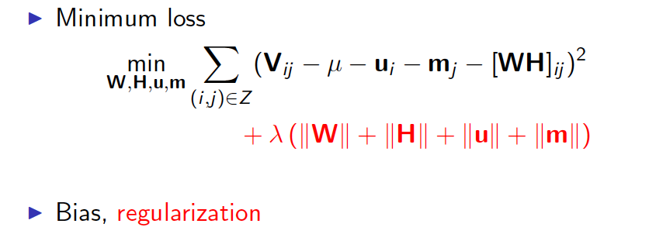

Recovering latent factors in a matrix as optimization
r
m movies
m movies
~
W
x1 | y1
x2 | y2
.. | ..
… | …
xn | yn
a1 | a2 | .. | … | am
b1 | b2 | … | … | bm
v11 | …
… | …
 | vij
n users
H
Z is non-zero entries
(matrix completion)
V
 |  |  | …
 |  |  |  | vnm
V[i,j] = user i’s rating of movie j

Slide 84
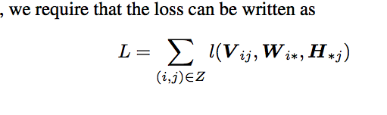
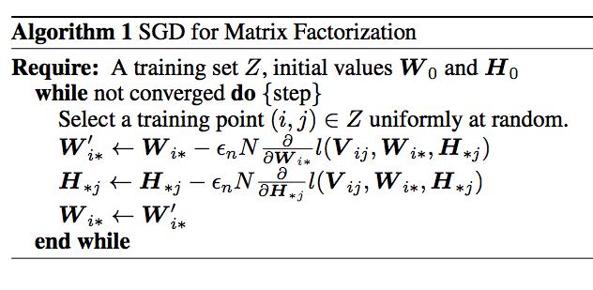
Matrix factorization as SGD
step size
why does this work?

Slide 85
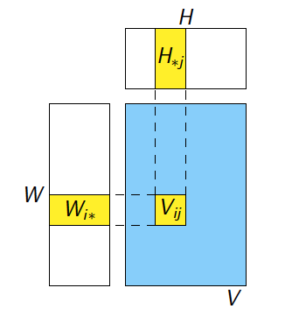
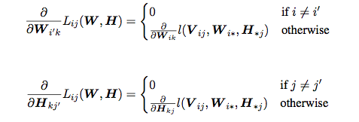
Matrix factorization as SGD - why does this work? Here’s the key claim:

Slide 86




Checking the claim
Think for SGD for logistic regression
LR loss = compare y and ŷ = dot(w,x)
similar but now update w (user weights) and x (movie weight)

Slide 87
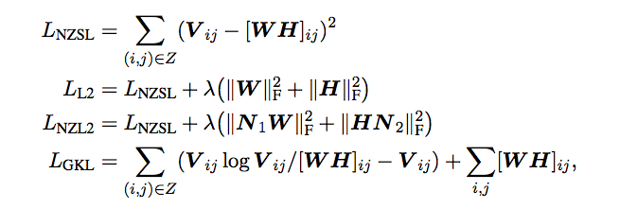
What loss functions are possible?
N1, N2 - diagonal matrixes, sort of like IDF factors for the users/movies
“generalized” KL-divergence

Slide 88
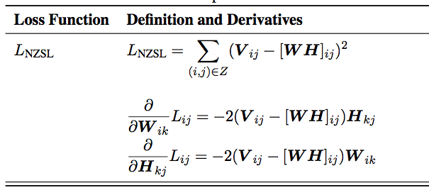
What loss functions are possible?

Slide 89
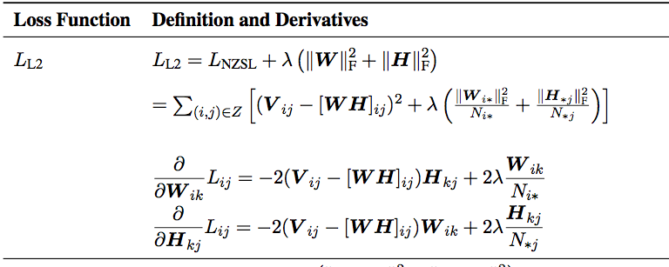
What loss functions are possible?

Slide 90
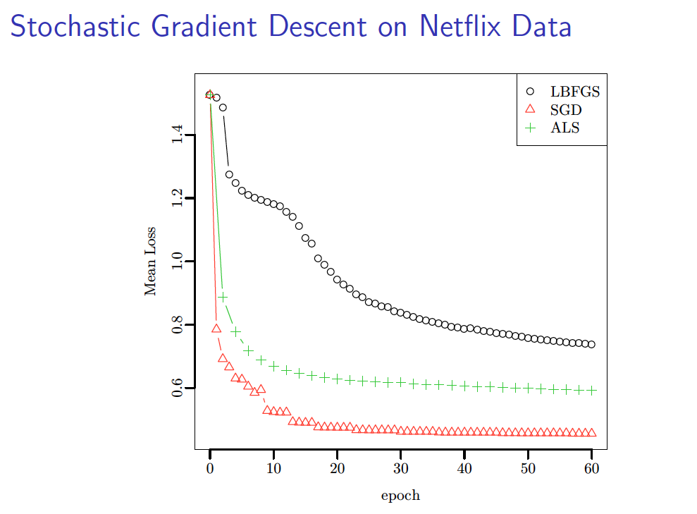
ALS = alternating least squares

Slide 91
KDD 2011
talk pilfered from → …..

Slide 92
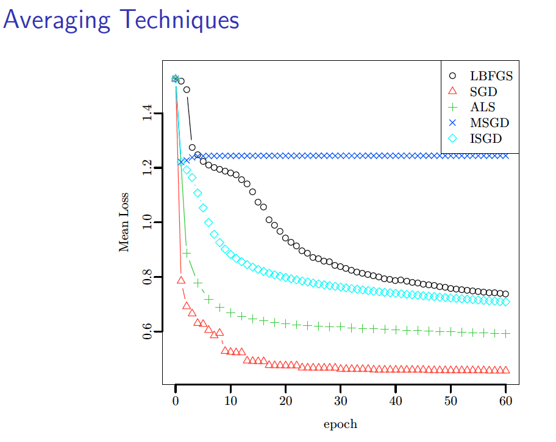
iterative SGD, no mixing
limited memory quasi-Newton
param mixing
alternating least squares
IPM

Slide 93
Matrix factorization as SGD - why does this work? Here’s the key claim:

Slide 94
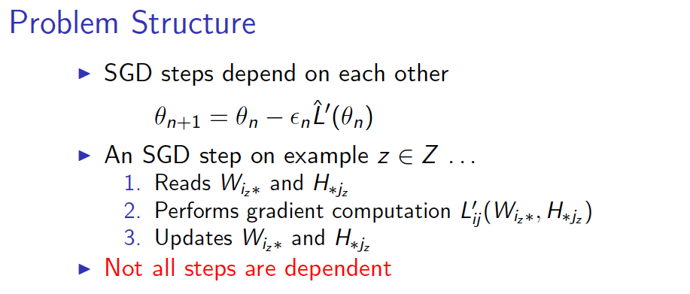
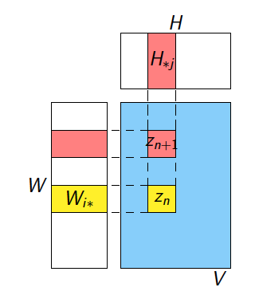
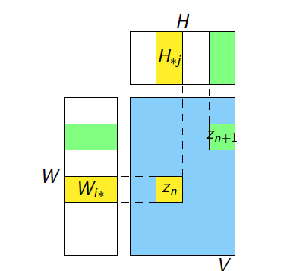
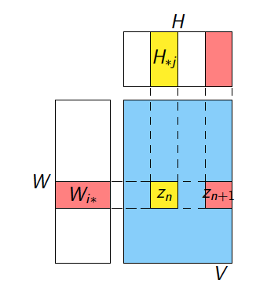

Slide 95
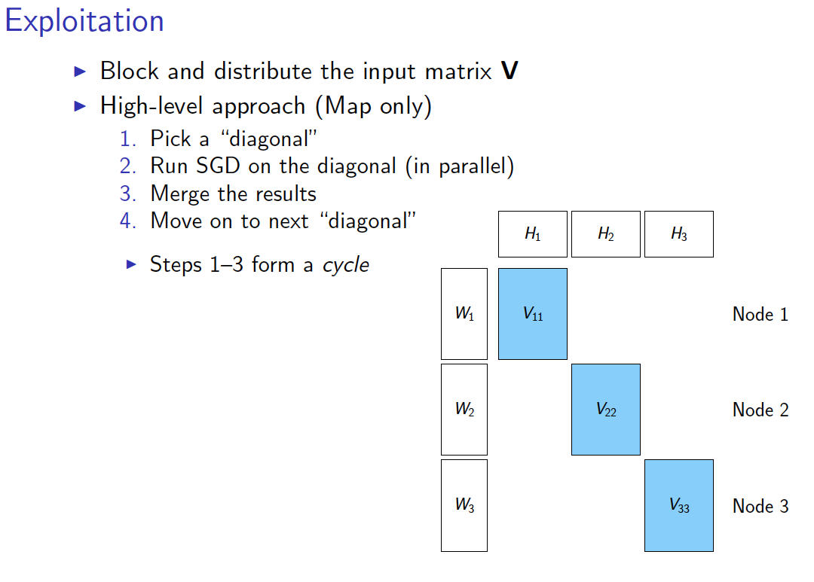

Slide 96
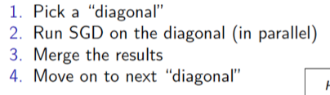
 | H1 | H2 | H3
W1 | V ₁₁
W2 |  | V ₂₂
W3 |  |  | V ₃₃
 | H1 | H2 | H3
W1 |  | V ₁₂
W2 |  |  | V ₂₃
W3 | V ₃₁
 | H1 | H2 | H3
W1 |  |  | V ₁₃
W2 | V ₂₁
W3 |  | V ₃₂
Node 1
Node 2
Node 3
Diag 1
Diag 2
Diag 3
Epoch 1

Slide 97
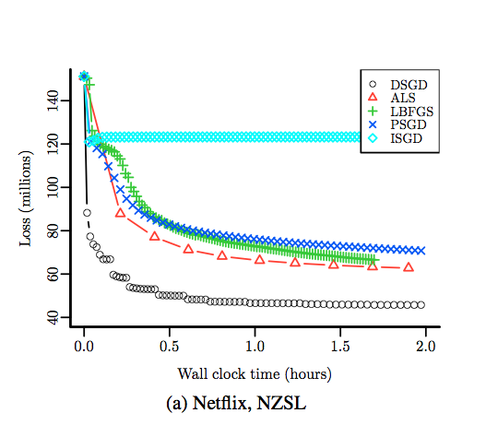

Slide 98
iterative SGD, no mixing
limited memory quasi-Newton
param mixing
alternating least squares
IPM

