Slide 1
10-605 / 10-405 Map-Reduce and Spark
Machine Learning from Large Datasets

Slide 2

Monday’s recap
Administrivia that’s “in the syllabus”
History of big data for ML
To learn something complex you need lots and lots of data – the more the better!
Deep learning in general, and LLMs in particular, need big data
Big models are not enough
Working with big data means understanding how to do ML efficiently
Starting with standard complexity analysis and the cost of operations
Best case for i/o bound tasks is sequential access to data (from disk or from a network)

Slide 3
COST OF OPERATIONS

Slide 4
What computers act like
small and fast
Store | Size |  | Typical Access Time
L1 Cache | 128 Kb |  | 1ns
L2 Cache | 16 Mb | 100x | 4ns | 4x
Main memory | 8Gb (up to 192Gb) | 500x | 100ns - reference | 25x
 | Read 1Mb sequentially |  | 1000ns | 10x
Disk | 320Gb | 40x
 | Read 1Mb sequentially |  | 500,000ns | 500x
 | Seek |  | 2,000,000ns | 4x
big and slow
Notes:
500 mph – plane
1 mph – slow walk

Slide 5
What computers act like
Store | Size |  | Typical Access Time
L1 Cache | 128 Kb |  | 1ns
L2 Cache | 16 Mb | 100x | 4ns | 4x
Main memory | 8Gb (up to 192Gb) | 500x | 100ns - reference | 25x
 | Read 1Mb sequentially |  | 1000ns | 10x
SSD | Read 1Mb sequentially |  | 20,000ns | 20x
 | Read 4k random-access |  | (similar)
Disk | 320Gb | 40x
 | Read 1Mb sequentially |  | 500,000ns | 25x
Network | Send 1Mb in same datacenter |  | (similar) | ~ 1x
Disk | Seek |  | 2, 000,000ns | 4x

Slide 6
Visualize the cost of operations
https://samwho.dev/numbers/
Notes:
look at 2025!

Slide 7
Visualize the cost of operations
But memory gets cheaper over time, right?
Yes but
Data gets bigger
Disk gets cheaper also

Slide 8
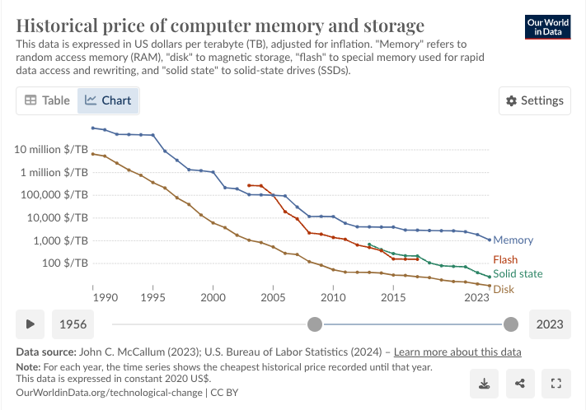
Visualize the cost of operations
https://ourworldindata.org/grapher/historical-cost-of-computer-memory-and-storage?time=1990..latest

Slide 9
Summary: What do we count?
Big data comes from a disk, or the network
Getting data is slow
Memory access/instructions are qualitatively different from disk access
Memory is best when you stream through data sequentially
Seeks are qualitatively different from sequential reads on disk
Best case for data processing: stream through the data once in sequential order, as it’s found on disk.

Slide 10
Density Estimates and NAÏVE BAYES

Slide 11
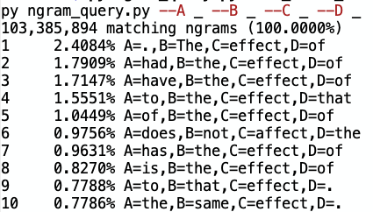
The Joint Density
Data:
All 5-grams that appear >= 40 times in a corpus of 1M English books
approx 80B words
5-grams: 30Gb compressed, 250-300Gb uncompressed
Each 5-gram contains frequency distribution over years
Wrote code to compute
Pr(A,B,C,D,E|C=affect or C=effect)
Pr(any subset of A,…,E|any other fixed values of A,…,E with C=affect V effect)
Observations [from playing with data]:
Mostly effect not affect
Most common word before affect is not
After not effect most common word is a
…

Slide 12
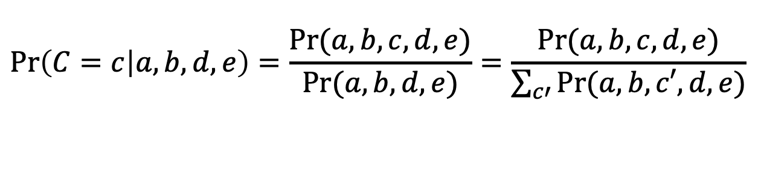
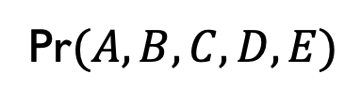


The Joint Can Be Used To Implement A Classifier
The joint density:
Pr$(A, B, C, D, E)$
A “brute force” joint density estimate is a big table based on max likelihood estimates (MLEs)
A classifier for C based on the joint density estimator:
$$\operatorname{Pr}\left(C=c | a,b,d,e\right)=\frac{Pr⁡(a,b,c,d,e)}{Pr⁡(a,b,d,e)}=\frac{Pr⁡(a,b,c,d,e)}{\sum_{c′}{Pr⁡(a,b,c′,d,e)}}$$
and predict
$${argmax}_{c}Pr⁡(C=c|a,b,d,e)$$
or just
$${argmax}_{c}Pr⁡(a,b,c,d,e)$$

Slide 13
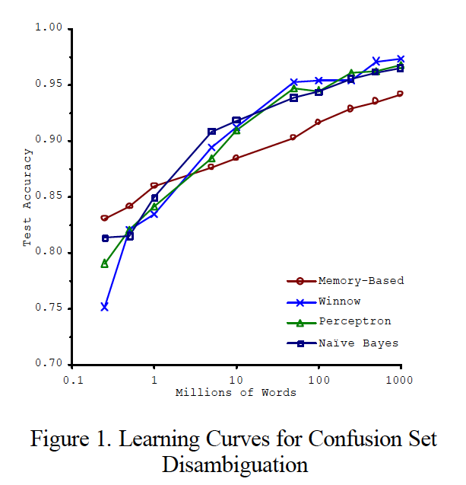
An experiment: how useful is that classifier?
Extracted all affect/effect 5-grams from an old Reuters corpus
about 20k documents
about 723 n-grams, 661 distinct
Financial news, not novels or textbooks
Tried to predict center word with:
Pr(C|A=a,B=b,D=d,E=e)
Of 723 examples:
622 have no data for a,b,d,e (!)
Of the 101 that do have data
100 predictions are correct
only 1 is wrong
5% error

Slide 14
An experiment: how useful is that classifier?
Extracted all affect/effect 5-grams from an old Reuters corpus
about 20k documents
about 723 n-grams, 661 distinct
Financial news, not novels or textbooks
Tried to predict center word with “backoff” estimates:
Pr(C|A=a,B=b,D=d,E=e)
then Pr(C|A=a,B=b,D=d)
then Pr(C|B=b,D=d)
then Pr(C|B=b)
then Pr(C)
Pattern | Used | Errors
P(C|A,B,D,E) | 101 | 1
P(C|A,B,D) | 157 | 6
P(C|B,D) | 163 | 13
P(C|B) | 244 | 78
P(C) | 58 | 31
17.8% error overall

Slide 15
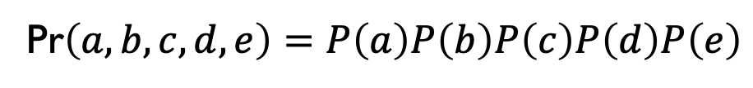
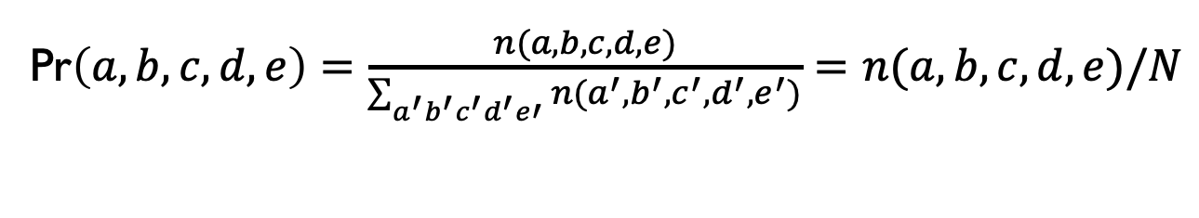
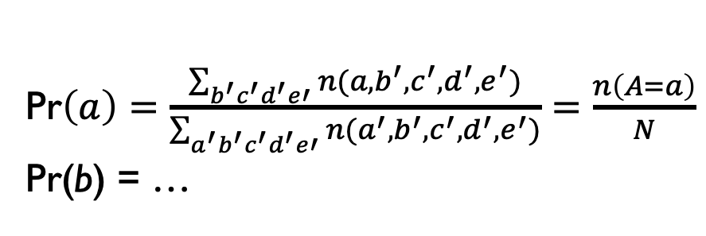
A “naïve” estimate of joint probability
The (brute force) joint density estimator uses MLEs:
Pr$\left(a, b, c, d, e\right)=\frac{n(a,b,c,d,e)}{\sum_{a^{′}b^{′}c^{′}d^{′}e′}{n(a^{′},b^{′},c^{′},d^{′},e^{′})}}=n(a,b,c,d,e)/N$
The naïve estimator assumes independence:
Pr$\left(a, b, c, d, e\right)=P\left(a\right)P\left(b\right)P\left(c\right)P\left(d\right)P\left(e\right)$
Pr$\left(a\right)=\frac{\sum_{b^{′}c^{′}d^{′}e′}{n(a,b^{′},c^{′},d^{′},e^{′})}}{\sum_{a^{′}b^{′}c^{′}d^{′}e′}{n(a^{′},b^{′},c^{′},d^{′},e^{′})}}=\frac{n\left(A=a\right)}{N}$
Pr(b) = …

Slide 16
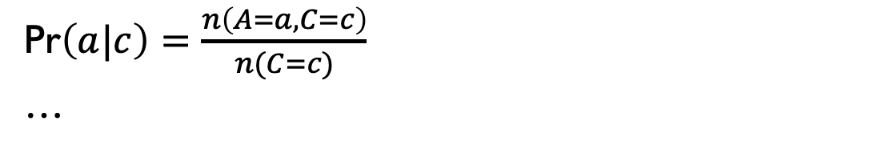

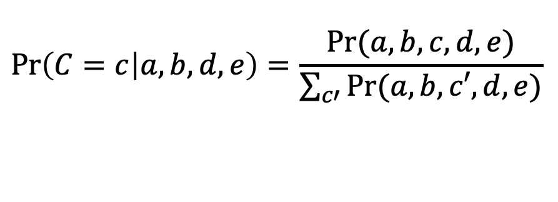
A “naïve” but useful estimate of joint probability
If you want to use this to predict C you need can’t assume everything is independent of C….so….
$$Pr\left(a, b, c, d, e\right)=Pr\left(a|c\right)Pr\left(b|c\right)Pr\left(d|c\right)Pr\left(e|c\right)Pr(c)$$
Pr$\left(a|c\right)=\frac{n\left(A=a,C=c\right)}{n(C=c)}$
…
$$\operatorname{Pr}\left(C=c | a,b,d,e\right)=\frac{Pr⁡(a,b,c,d,e)}{\sum_{c′}{Pr⁡(a,b,c′,d,e)}}$$
and predict
$${argmax}_{c}Pr⁡(C=c|a,b,d,e)$$
or just
$${argmax}_{c}Pr⁡(a,b,c,d,e)$$

Slide 17
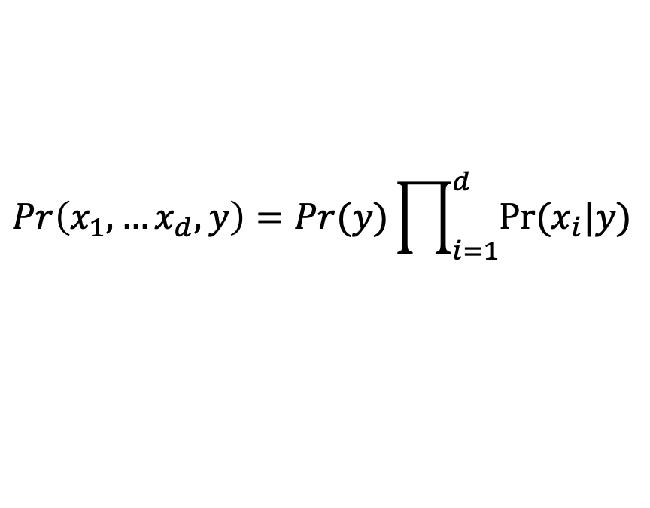
Naïve Bayes refinement - 1
In n-grams we look at Pr(b)=Pr(second word is “b”), etc.
For long documents you usually don’t keep track of where a word appears, so:
$$Pr\left(x_{1},…x_{d},y\right)=Pr(y)\prod_{i=1}^{d}{Pr⁡(x_{i}|y)}$$
Pr$\left(x_{i}|y\right)=\text{Pr}\left(x|y\right)=\frac{n(word x appears in doc with label y) }{n(words in corpus)}$
This computation is a lot like the wordcount example: you just need to count co-occurrences of words with classes instead of words themselves.

Slide 18
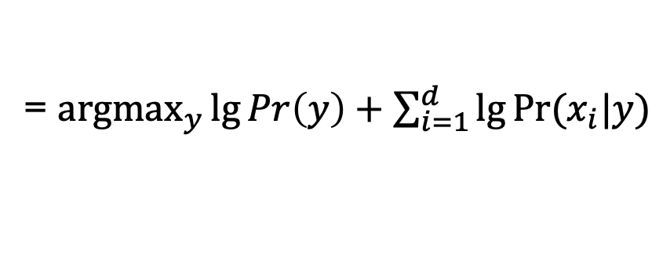
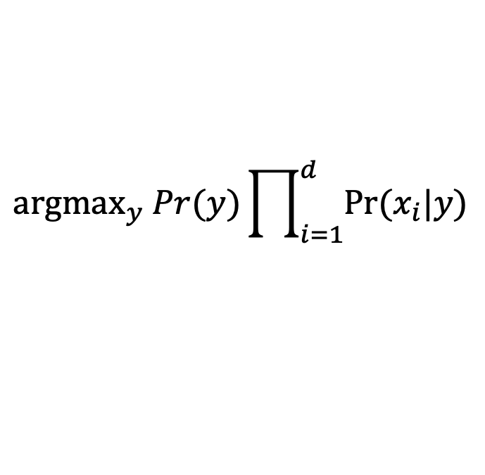
Naïve Bayes refinement - 2
For numeric stability it’s best to compute with logs:
$${\text{argmax}}_{y} Pr(y)\prod_{i=1}^{d}{Pr⁡(x_{i}|y)}$$
= ${\text{argmax}}_{y}\lg{Pr\left(y\right)+\sum_{i=1}^{d}{\lg{Pr⁡(x_{i}|y}})}$
Note: the argmax makes sense

Slide 19
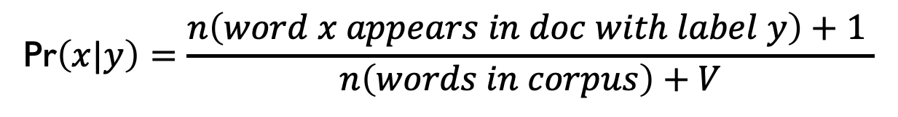
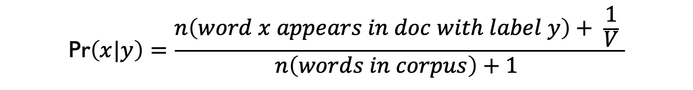
Naïve Bayes refinements
You also usually smooth the estimates, e.g.:
$$\text{Pr}\left(x|y\right)=\frac{n\left(word x appears in doc with label y\right)+1 }{n\left(words in corpus\right)+V}$$
or
$$\text{Pr}\left(x|y\right)=\frac{n\left(word x appears in doc with label y\right)+ \frac{1}{V} }{n\left(words in corpus\right)+1 }$$
where V is the number of words.
This is usually a terrible density estimator but often is a pretty good classifier!

Slide 20
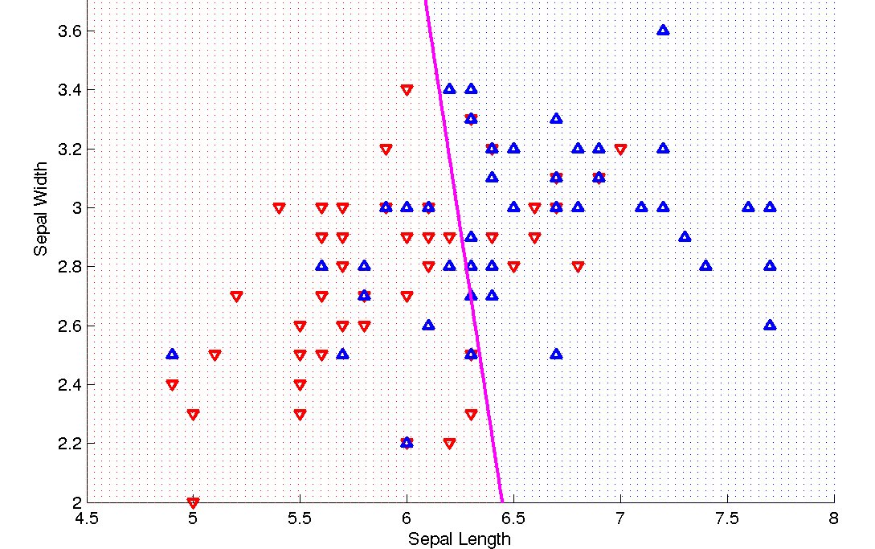
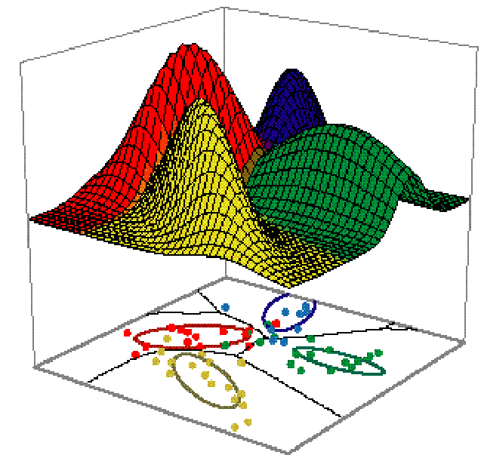
Classification vs Density Estimation
Classification
Density Estimation

Slide 21

Classification vs density estimation

Slide 22
DISTRIBUTED PROCESSING FOR LARGE FILES

Slide 23
Linear-time Tasks
Best case, with one machine:
Input is many small things stored sequentially on disk
”Small” means “fits in main memory”
“constant size” is a good approximation to this
Aka I can “stream” through them
To produce output, you make one pass in which you process each thing independently of all the others in the dataset and output one or more “things” for each input “thing”
Relaxation: you can make a fixed number of passes
Then everything is constant memory and linear time
If there’s one output for each input it’s like a Python map
If there are zero or one outputs it’s like a Python filter
>>> map(lambda x:x*2, range(0, 20, 2))
[0, 4, 8, 12, 16, 20, 24, 28, 32, 36]
>>> filter(lambda x: x % 8 == 0, range(0, 20, 2))
[0, 8, 16]

Slide 24
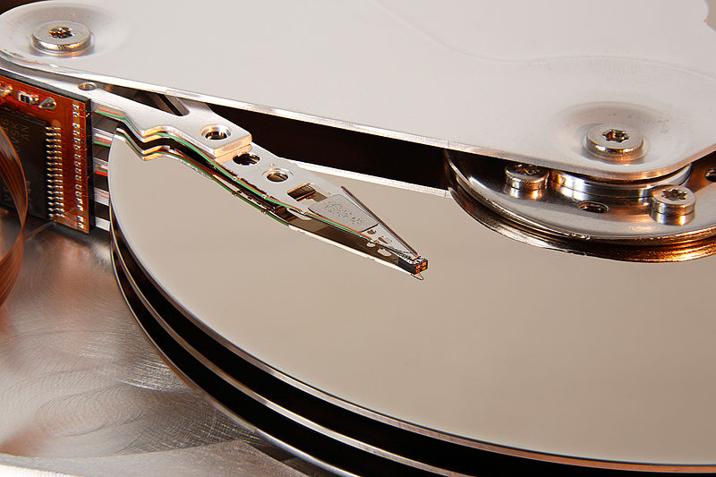
Embarassingly Parallel Tasks
Better case, with P machines, each with it’s own disk:
Partition the input evenly across each machine
Each piece of the dataset is called a shard
Run the mapper independently on each of the P machines.
If there is a chain of mappers, run the whole chain independently on each machine
If necessary collect all the outputs together
But it might be better to keep the shards separate
Advantages:
We have made the process faster
We have many machines and many disks
…
Disadvantages:
there’s a lot we can’t do in this way

Slide 25
Embarrassingly parallel (or not) ?
Examples, where input is a list of (small) documents
Classify documents by language
Remove non-English documents
Tokenize all the documents
Split documents into sentences
Any chain of the operations above
…
Find the most frequent words in the corpus?
Find the most frequent sentences in the corpus
Discard the longest 10% and the shortest 10% of the documents
Detect duplicate documents
Detect similar pairs of documents
Where input is a list of rows in a database relation
Any projection (subset the relation)
Add a new computed field
Join two relations
…

Slide 26
Another nearly-linear operation
Sorting is O(n log n), nearly linear

Slide 27
How does sorting help?
Examples, where input is a list of (small) documents
Classify documents by language
Remove non-English documents
Tokenize all the documents
Split documents into sentences
Any chain of the operations above
…
Find the most frequent words in the corpus?
Find the most frequent sentences in the corpus
Discard the longest 10% and the shortest 10% of the documents
Detect duplicate documents
Detect similar pairs of documents
Where input is a list of rows in a database relation
Any projection (subset the relation)
Add a new computed field
Join two relations
…

Slide 28
Similarity and duplicate detection
Similarity can be high for descriptions of distinct items:
AERO TGX-Series Work Table -42'' x 96'' Model 1TGX-4296 All tables shipped KD AEROSPEC- 1TGX Tables are Aerospec Designed. In addition to above specifications; - All four sides have a V countertop edge ...
AERO TGX-Series Work Table -42'' x 48'' Model 1TGX-4248 All tables shipped KD AEROSPEC- 1TGX Tables are Aerospec Designed. In addition to above specifications; - All four sides have a V countertop ..
Similarity can be low for descriptions of identical items:
Canon Angle Finder C 2882A002 Film Camera Angle Finders Right Angle Finder C (Includes ED-C & ED-D Adapters for All SLR Cameras) Film Camera Angle Finders & Magnifiers The Angle Finder C lets you adjust ...
CANON 2882A002 ANGLE FINDER C FOR EOS REBEL® SERIES PROVIDES A FULL SCREEN IMAGE SHOWS EXPOSURE DATA BUILT-IN DIOPTRIC ADJUSTMENT COMPATIBLE WITH THE CANON® REBEL, EOS & REBEL EOS SERIES.

Slide 29
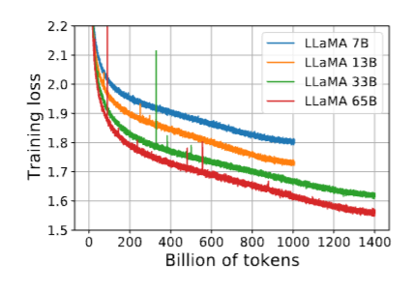
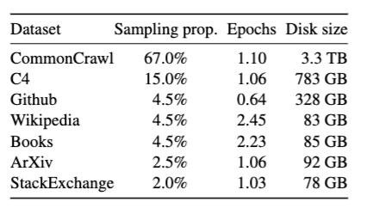
Compute Scaling Laws = Data Scaling Laws
Llama 1 (2023) training mixture

Slide 30
Small-vocabulary word count: high level view
doc 1
doc 2
doc 3
….
“ctr[w1] +=1”
“ctr[w2] +=1”
…
Counter Data Structure
(in memory)
Counting logic
“Messages”
Aside: we’re moving to a parallel setting where “messages” makes more sense.
Stream thru docs
Notes:
why not on disk?

Slide 31
Small-vocabulary word count: high level view
doc 1
doc 2
doc 3
….
“ctr[w1] +=1”
“ctr[w2] +=1”
…
Counter Data Structure
(on disk)
Counting logic
“Messages”
Disk seeks will make this very slow!!
Stream thru docs
Notes:
why not on disk?

Slide 32
Large-vocabulary word count: distributed counters
doc 1
doc 2
doc 3
….
Counter Data Structure 1
(in memory 1)
“ctr[w1] +=1”
“ctr[w2] +=1”
…
…
Counting logic
Message Router
“Messages”
Counter Data Structure P
(in memory P)
Streaming machine
Machines 1,…,P
Workable but expensive

Slide 33
Large-vocabulary word count with sorting
doc 1
doc 2
doc 3
….
ctr[w1] += 1
ctr[w1] += 1
….
“ctr[w1] +=1”
“ctr[w2] +=1”
Logic to process messages
…
Counting logic
Sort
It’s easy to process messages without a big memory – because all the messages for a single word have been put together
Pass 1
Pass 2
Sorting

Slide 34
Map-Reduce is Distributed Stream-and-Sort: Map, Shuffle-Sort, Reduce
Map Process 1
Distributed Shuffle-Sort
doc 1
doc 2
doc 3
….
C[x1] += D1
C[x1] += D2
….
tmp 1
tmp 2
tmp 3
Merge Tmp Files
combine counter updates
Counting logic
Partition/Sort
…
Reducer 1
tmp n
doc 1
doc 2
doc 3
….
tmp 1
C[x2] += D1
C[x2] += D2
….
tmp 2
Merge Tmp Files
tmp 3
Counting logic
combine counter updates
Partition/Sort
…
Reducer 2
Map Process 2

Slide 35
Partitioning Messages for Word Count
Reducer Machine 1
The shuffle/sort phrase:
The (key,value) pairs from each mapper are partitioned, sorted by key, and sent to reducers.
You need all the messages for the same word to be sent the same reducer.
Partitioning by a hash of the key (the word) often works.
The reduce phase:
Each reducer will scan through the sorted key-value pairs.
ctr[x1] += d1
ctr[x1] += d2
….
Logic to combine counter updates
ctr[x2] += d1
ctr[x2] += d2
….
combine counter updates
Reducer Machine 2

Slide 36
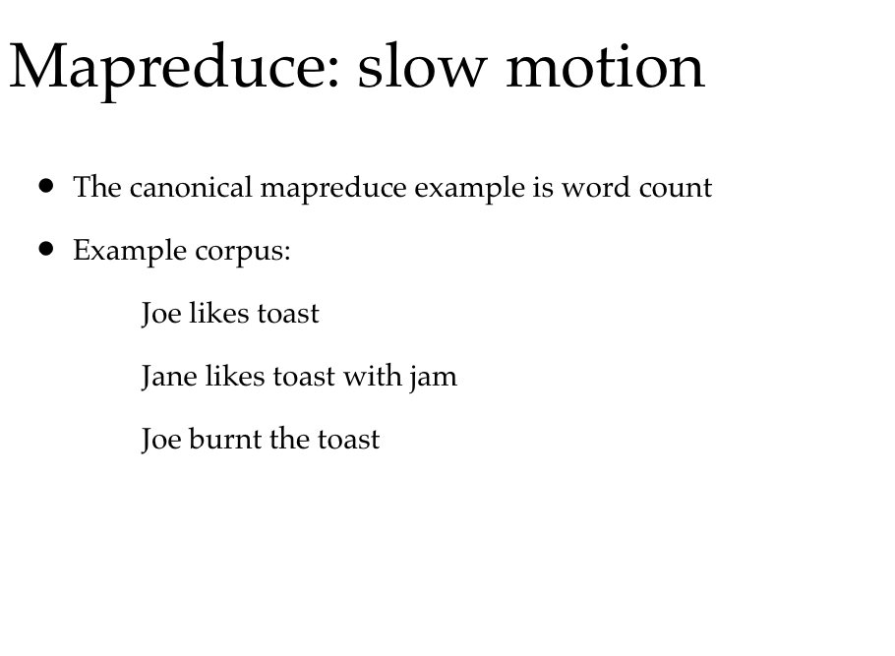

Slide 37
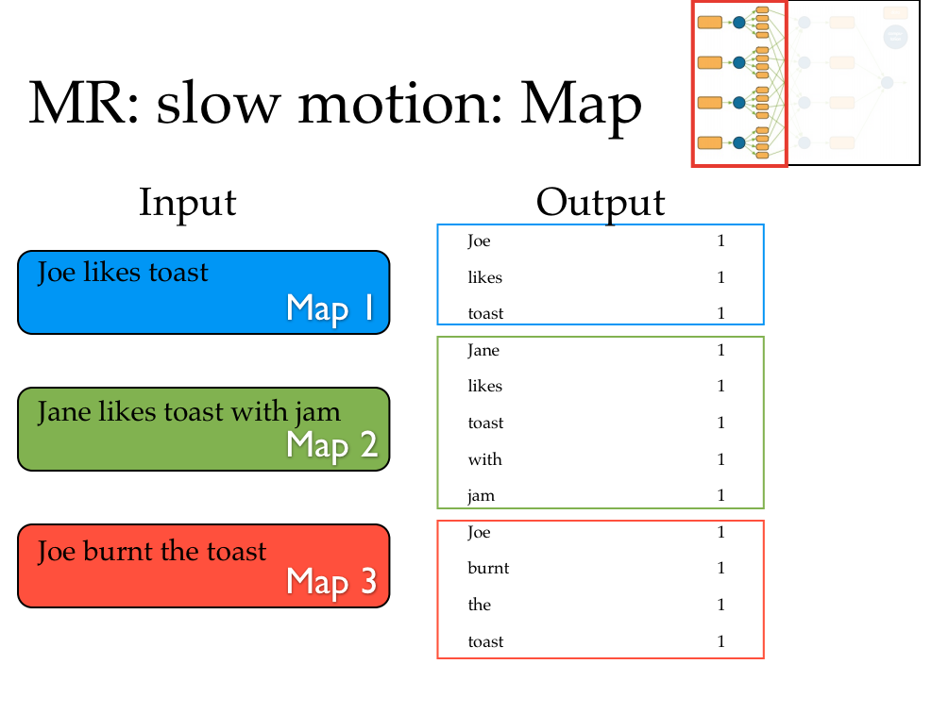

Slide 38
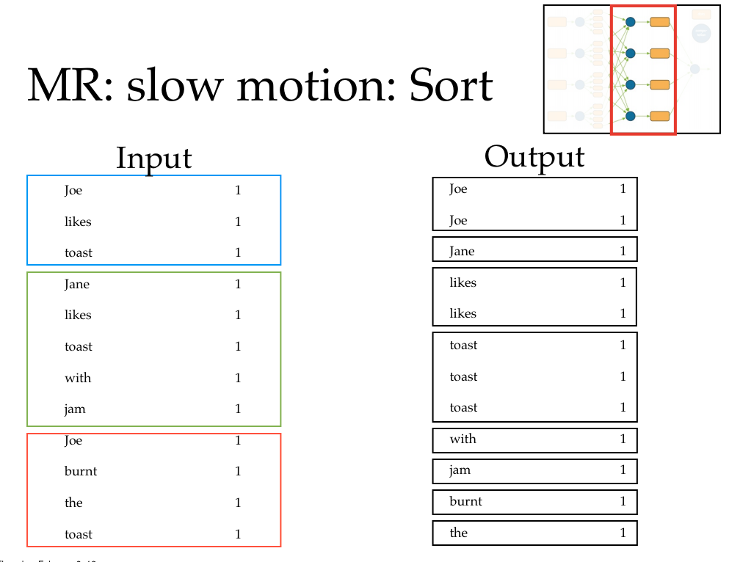

Slide 39
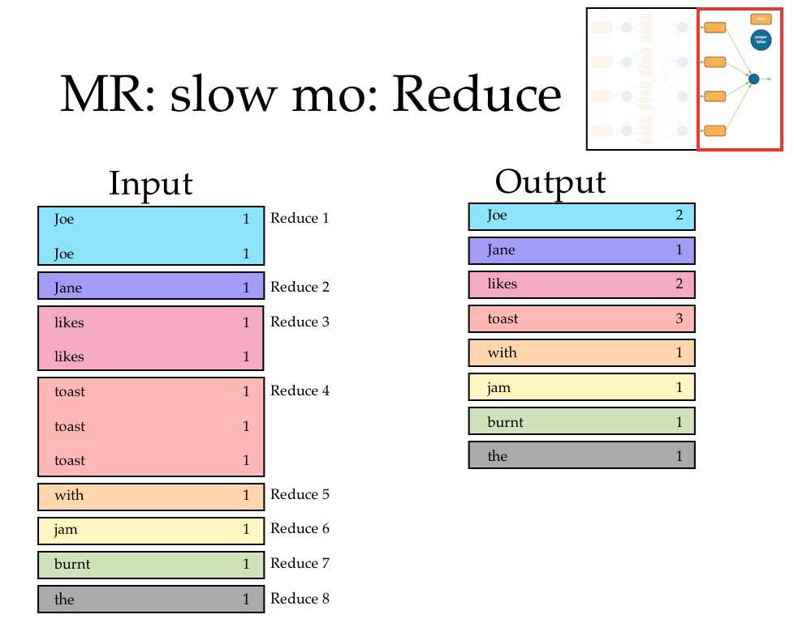

Slide 40
Map-Reduce FRAMEWORKS

Slide 41
Frameworks
Google’s Map-Reduce Framework
Published in 2008
Hadoop: Open source Java version
Apache Flume, Apache Beam
FLINK
Spark
…
MRS
BashReduce – 52 line implementation

Slide 42
Frameworks
What is really needed in practice?
Robustness
If you run a job on thousands of cheap machines, hardware failures happen!
“Dead” versus “Slow” is hard to detect
Main way to get robustness is redundancy
Multiple copies of the data
Backup runs for slow-finishing processes

Slide 43
Frameworks
What else is really needed in practice?
Distributing the data
Managing and inspecting processes
Inspecting process logs and other debugging support

Slide 44
Frameworks
More comments on debugging:
Debug your code by running it locally first
Be careful about how information is shared
In local processes information can be shared many ways
In distributed systems sharing is constrained so that it’s efficient
Beside the “messages” there are usually ways to “broadcast” files to every worker
For example the code the workers run ☺
But often something works locally but not in the cluster
Be careful about weird corner cases in the data
Like that one line in a million that crashes your code
Because when you run it on 10 million lines it will crash

Slide 45
Abstractions For Map-Reduce

Slide 46
Abstractions On Top Of Map-Reduce
Some obvious streaming processes:
for each row in a table
Transform it and output the result
Decide if you want to keep it with some boolean test, and copy out only the ones that pass the test
Example: stem words in a stream of word-count pairs:
(“aardvarks”,1) ➔ (“aardvark”,1)
Proposed syntax:
table2 = MAP table1 TO λ row : f(row))
f(row)➔row’
Example: apply stop words
(“aardvark”,1) ➔ (“aardvark”,1)
(“the”,1) ➔ deleted
Proposed syntax:
table2 = FILTER table1 BY λ row : f(row))
f(row)➔ {true,false}

Slide 47
Abstractions On Top Of Map-Reduce
A non-obvious? streaming processes:
for each row in a table
Transform it to a list of items
Splice all the lists together to get the output table (flatten)
This is closer to the low-level Mapper setting, since a Map process can send any number of messages downstream
Proposed syntax:
table2 = FLATMAP table1 TO λ row : f(row))
f(row)➔list of rows
Example: tokenizing a line
“I found an aardvark” ➔ [“i”, “found”,”an”,”aardvark”]
“We love zymurgy” ➔ [“we”,”love”,”zymurgy”]
..but final table is one word per row
“i”
“found”
“an”
“aardvark”
“we”
“love”
…

Slide 48
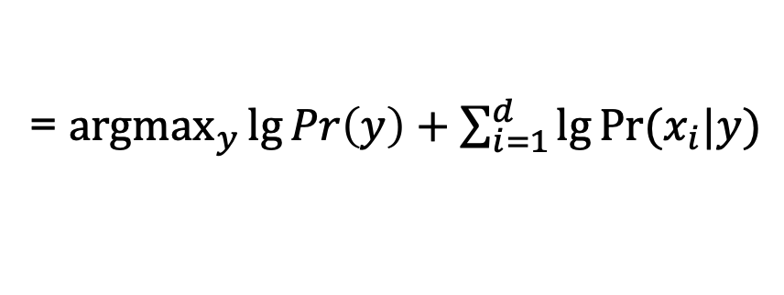
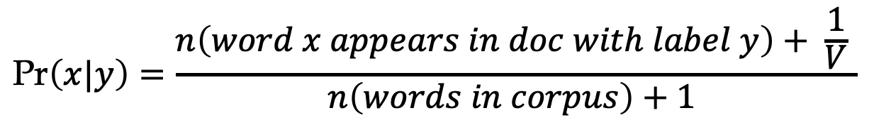
flashback: Naïve Bayes
Predicted y for doc x₁,…,x_{d}
= ${\text{argmax}}_{y}\lg{Pr\left(y\right)+\sum_{i=1}^{d}{\lg{Pr⁡(x_{i}|y}})}$
where
$$\text{Pr}\left(x|y\right)=\frac{n\left(word x appears in doc with label y\right)+ \frac{1}{V} }{n\left(words in corpus\right)+1 }$$

Slide 49
naïve Bayes at test time
keys
n
X=w₁ Y=sports
X=w₁ Y=news
X=..
X=w₂ Y=…
X=…
…
5245
1054
2120
37
3
…
Extended wordcount that will count word,label pairs
w | Counts associated with w
aardvark | n[w^Y=sports]=2
agent | n[w^Y=sports]=1027, n[w^Y=news]=564
… | …
zynga | n[w^Y=sports]=21, n[w^Y=news]=4464

Slide 50
naïve Bayes at test time
How to implement this with map-reduce?
The general case:
We’re taking rows from a table
In a particular format (event,count)
Applying a function to get a new value
The word for the event
And grouping the rows of the table by this new value
Output pairs (f(row),row) with a mapper process
Shuffle-sort pairs by key – which is f(row)
Reduce and aggregate by appending together all the values associated with the same key
Proposed syntax:
GROUP table BY λ row : f(row)
Could define f via: a function, a field of a defined record structure, …
f(row)➔field

Slide 51
Doc1: “I found an aardvark”
Doc2: “We love zymurgy”
…
w | DocId
found | doc1
aardvark | doc1
…
zymurgy | doc2
… | ..
Proposed syntax:
JOIN table1 BY λ row : f(row),
table2 BY λ row : g(row)
w | Counters
aardvark | n[w^Y=sports]=2
agent | n[w^Y=sports]=…
agent | n[w^Y=sports]=…
agent | n[w^Y=sports]=…
… | n[w^Y=sports]=…
zynga | n[…]
zynga | n[…]
How to implement this with map-reduce? Similar to group-by

Slide 52
Spark: A High-Level Dataflow Language

Slide 53
Spark
Set of concise dataflow operations (“transformation”)
Dataflow operations are embedded in an API together with “actions”
Hadoop: Too low level
missing abstractions
hard to specify a workflow
latency is very high
Spark addresses these issues
Also: Spark is good for iterative operations
E.g., PageRank, E/M, k-means clustering, …
Spark lowers cost of repeated reads
Notes:
change

Slide 54
Spark
Data abstraction
Sharded files → Resilient Distributed Datasets
RDDs are immutable
They are partitioned and sharded
You access them with high level operations that can be implemented by short Map-Reduce pipelines
You can mark RDDs as ‘persistent’ (the data is saved for debugging, reuse, etc) and RDDs can persist on disk or in memory
Memory-cached RDDs use a lot of cluster memory but are very useful
Two types of operations on RDDs
Transformations – lazy, return a ‘plan’ to make some change
Actions – eager, usually force execution of a map-reduce pipeline, and return some Python object
Notes:
change

Slide 55
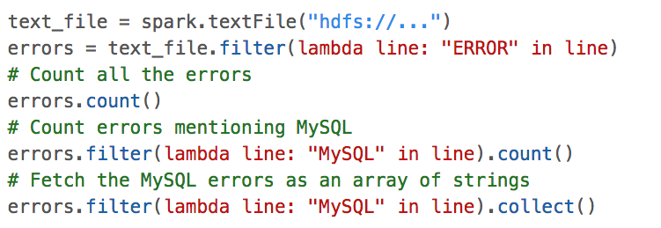
Spark examples
spark is a spark context object – sometimes sc

Slide 56
Spark examples
errors is a transformation, and thus a data strucure that explains HOW to do something
count() is an action: it will actually execute the plan for errors and return a value.
everything is sharded (i.e., partitioned)
errors.filter() is a transformation
collect() is an action

Slide 57

Spark examples
everything is sharded … and the shards are stored in memory of worker machines not local disk (if possible, and if you ask)
# modify errors to be stored in cluster memory
subsequent actions will be much faster
You can also persist() an RDD on disk.

Slide 58
Spark examples
everything is sharded … and the shards are stored in memory of worker machines not local disk (if possible)
persist-on-disk works because the RDD is read-only (immutable)
# modify errors to be stored in cluster memory
You can also persist() an RDD on disk, which means it is stored somewhere for debugging purposes (or re-use).

Slide 59

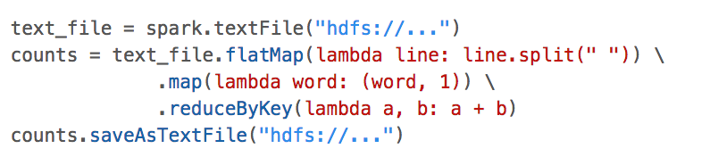
Spark examples: wordcount
the action
transformation on (key,value) pairs , which are special

Slide 60
Recap: Distributed Stream-and-Sort: Map, Shuffle-Sort, Reduce
Map Process 1
Distributed Shuffle-Sort
Reducer 1
doc 1
doc 2
doc 3
….
C[x1] += D1
C[x1] += D2
….
Spill 1
Spill 2
Spill 3
Merge Spill Files
Logic to combine counter updates
Counting logic
Partition/Sort
…
Spill n
doc 1
doc 2
doc 3
….
Spill 1
C[x2] += D1
C[x2] += D2
….
Spill 2
Merge Spill Files
Spill 3
Counting logic
combine counter updates
Partition/Sort
…
Reducer 2
Map Process 2

Slide 61
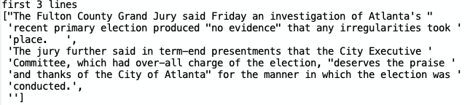
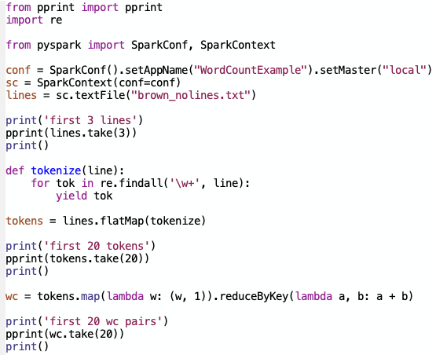
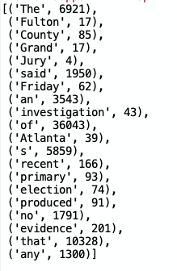
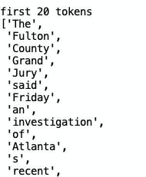
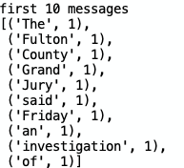
Classic PySpark examples: wordcount

Slide 62
Spark examples: wordcount

Slide 63
Spark examples: wordcount
Tokenization and converting to messages is done in parallel over each partition of the RDD lines
reduceByKey does a shuffle-sort, doing a pairwise reduce of each “run” of messages

Slide 64
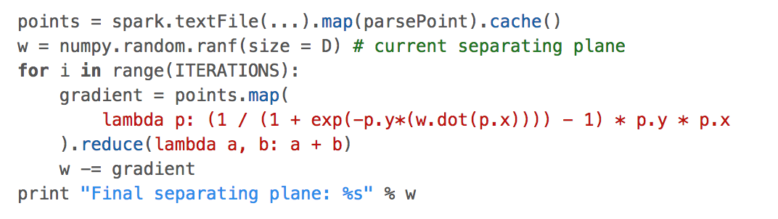
Classic park examples: batch logistic regression
p.x and w are vectors, from the numpy package
p.x and w are vectors, from the numpy package. Python overloads operations like * and + for vectors.
reduce is an action – it produces a numpy vector

Slide 65
Spark examples: batch logistic regression
Important note: numpy vectors/matrices are not just “syntactic sugar”.
They are much more compact than something like a list of python floats.
numpy operations like dot, *, + are calls to optimized C code
a little python logic around a lot of numpy calls is pretty efficient

Slide 66
Spark examples: batch logistic regression
w is defined outside the lambda function, but used inside it
So: python builds a closure – code including the current value of w – and Spark ships it off to each worker. So w is copied, and must be read-only.

Slide 67
Spark examples: batch logistic regression
dataset of points is cached in cluster memory to reduce i/o

Slide 68
Spark examples: batch logistic regression
The lambda function, including the current value of w, is broadcast to the workers
gradient computation is done in parallel, locally on each worker, using data kept in memory.
summing the gradient vectors is done in parallel, and intermediate sums are set across the network
updating the weights is done on the local machine

Slide 69
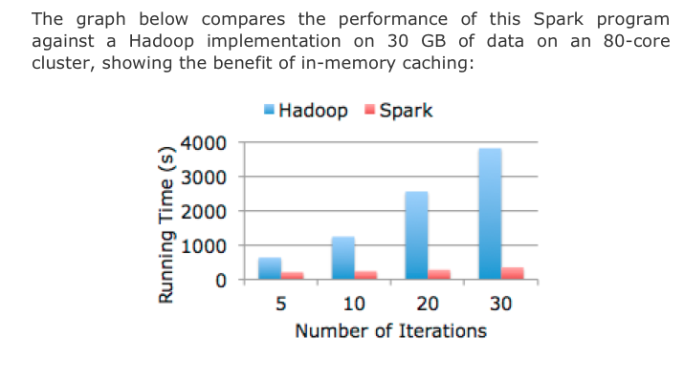
Spark logistic regression example

