Slide 1
10-605 / 10-405 Map-Reduce and Spark Sample Workflows
Machine Learning from Large Datasets

Slide 2
Announcements
AWS accounts:
see Piazza for a new todo item
don’t delay!
HW1 patched
HW1 extension
HW1/HW2 delayed by 2 days

Slide 3
Map-Reduce: An Origin Story
How hacks to handle large datasets with small memory evolved into Hadoop, Spark, Flume, …

Slide 4
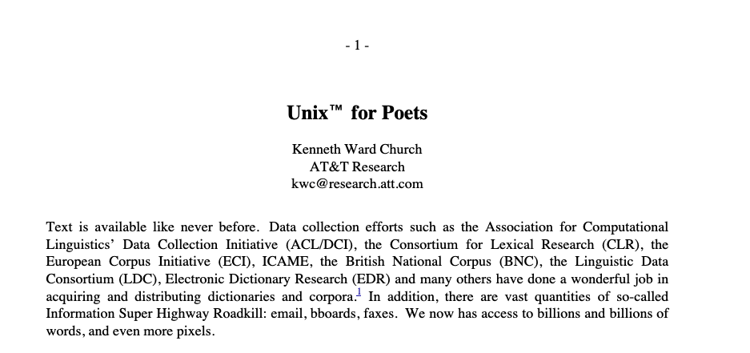
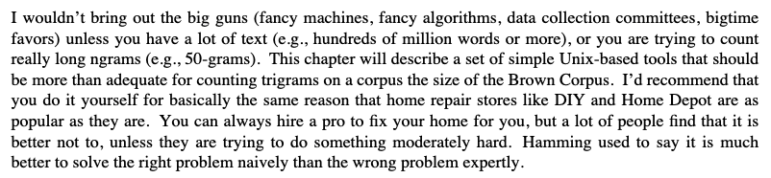
c. 1994

Slide 5
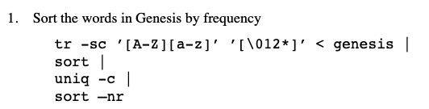
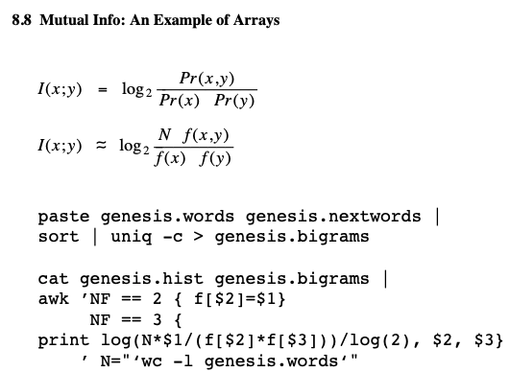

Slide 6
Handling large corpora
Stream through files and transform them
Combine as needed with sorting
Sorting is O(n log n), nearly linear
You can sort big data with a merge sort
sort subsets small enough to fit in memory
merge pairs datasets repeatedly
this can be done in constant memory and linear time

Slide 7
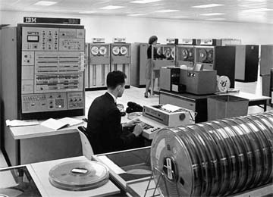
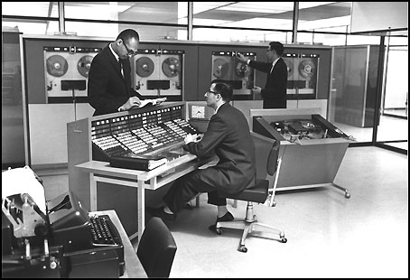
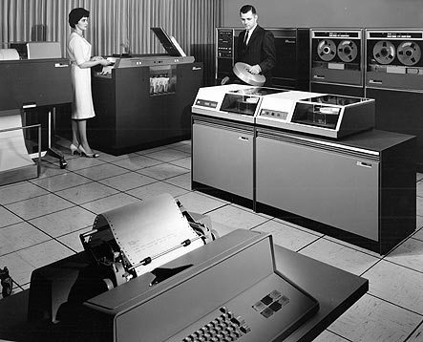


Slide 8
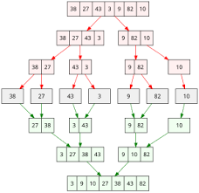

Slide 9

Alternative visualization

Slide 10
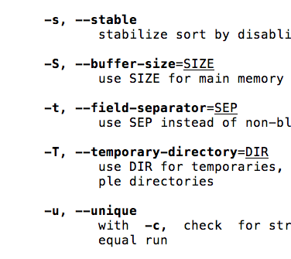
Unix Sort
Load as much as you can into memory (S) and do an in-memory sort [usually quicksort].
If you have more to do, then spill this sorted buffer out on to disk, and get more data…
Finally, merge your spill buffers.
O(n log n/S) – runs being merged are size S

Slide 11
Large-vocabulary word count with sorting
doc 1
doc 2
doc 3
….
ctr[w1] += 1
ctr[w1] += 1
….
“ctr[w1] +=1”
“ctr[w2] +=1”
Logic to process messages
…
Counting logic
Sort
Pass 1
Pass 2
Sorting

Slide 12
Large-vocabulary word count
# first pass - put one word on each line
with open(tmp_file1, 'w') as tmp_fp1:
for line in open(input_file):
words = [tok.lower()
for tok in re.findall('\w+', line)]
for word in words:
tmp_fp1.write(f'{word}\n')
# sort the words, so we have runs of identical words
cmd = sh.Command('/usr/bin/sort')
cmd(tmp_file1, _out=tmp_file2)

Slide 13
Large-vocabulary word count
# first pass - put one word on each line
with open(tmp_file1, 'w') as tmp_fp1:
for line in open(input_file):
words = [tok.lower()
for tok in re.findall('\w+', line)]
for word in words:
# making the `message` more explicit
tmp_fp1.write(word + ` ` + `1` + `\n`)
# sort the words, so we have runs of identical words
cmd = sh.Command('/usr/bin/sort')
cmd(`-k1`, tmp_file1, _out=tmp_file2)

Slide 14
Large-vocabulary word count
# second pass - count length of each run of identical words
with open(output_file, 'w') as out_fp:
def flush_and_empty(ctr):
for word, count in ctr.items():
out_fp.write(f'{count}\t{word}\n')
return collections.Counter()
ctr = collections.Counter()
for line in open(tmp_file2):
word = line.rstrip()
if word not in ctr:
# we're starting a new run of identical words
# so output the count for the last run
ctr = flush_and_empty(ctr)
ctr[word] += 1
# output counts for the last run of words
flush_and_empty(ctr)
findall
first
flush_and_empty
flush_and_empty
flush_and_empty
for
for
for
for
for
identical
if
if
import
import
import
import
in
in
in
in
in
in

Slide 15
Large-vocabulary word count
# second pass - count length of each run of identical words
with open(output_file, 'w') as out_fp:
def flush_and_empty(ctr):
for word, count in ctr.items():
out_fp.write(f'{count}\t{word}\n')
return collections.Counter()
ctr = collections.Counter()
for line in open(tmp_file2):
word = line.rstrip()
if word not in ctr:
# we're starting a new run of identical words
if len(ctr) >= MAX_CTR_SIZE:
ctr = flush_and_empty(ctr)
ctr[word] += 1
# output counts for the last run of words
flush_and_empty(ctr)
findall
first
flush_and_empty
flush_and_empty
flush_and_empty
for
for
for
for
for
identical
if
if
import
import
import
import
in
in
in
in
in
in
Notes:
This is the wrong place to buffer things

Slide 16
Large-vocabulary word count
# second pass - count length of each run of identical words
with open(output_file, 'w') as out_fp:
def flush_and_empty(ctr):
for word, count in ctr.items():
out_fp.write(f'{count}\t{word}\n')
return collections.Counter()
ctr = collections.Counter()
for line in open(tmp_file2):
word, delta = parse_message(line)
if word not in ctr:
# we're starting a new run of identical words
ctr = flush_and_empty(ctr)
ctr[word] += delta
# output counts for the last run of words
flush_and_empty(ctr)
findall 1
first 1
flush_and_empty 1
flush_and_empty 1
flush_and_empty 1
for 1
for 1
for 1
for 1
for 1
identical 1
if 1
if 1
import 1
import 1
import 1
import 1
in 1
in 1
in 1
in 1
in 1
in 1

Slide 17
Parallelizing Stream And Sort

Slide 18
Next step: Doing ”Stream and Sort” In Parallel
doc 1
doc 2
doc 3
….
ctr[w1] += 1
ctr[w1] += 1
….
“ctr[w1] +=1”
“ctr[w2] +=1”
Logic to process messages
…
Counting logic
Sort
Pass 1
Pass 2
Sorting
Easy to parallelize!
Also route messages to the “right” machine
Easy to parallelize
if routed carefully

Slide 19
Stream and Sort Counting → Distributed Counting
Sort key
doc 1
doc 2
doc 3
….
ctr[x1] += d1
ctr[x1] += d2
….
Spill 1
Spill 2
Merge Spill Files
Spill 3
Logic to combine counter updates
Counting logic
…
Sort
“ctr[x] +=d”
Pass 1: Mapper
Pass 2: Reducer
Observation: you can “reduce” in parallel (correctly) if no sort key is split across machines

Slide 20
Stream and Sort Counting → Distributed Counting
Reducer Machine 1
doc 1
doc 2
doc 3
….
ctr[“alice”] += d1
ctr[“alice”] += d2
….
Spill 1
Merge Spill Files
combine counter updates
Spill 2
Spill 3
Counting logic
…
Sort
ctr[“bob”] += d3
ctr[“joe”] += d4
….
“ctr[x] +=d”
Spill 4
Merge Spill Files
Mapper Machine
combine counter updates
Sort needs to partition data appropriately
(into multiple “shards”)
Reducer Machine 2

Slide 21
Stream and Sort Counting → Distributed Counting
Reducer Machine 1
doc 1
doc 2
doc 3
….
ctr[“alice”] += d1
ctr[“bob”] += d2
….
Spill 1
Merge Spill Files
combine counter updates
Spill 2
Spill 3
Counting logic
…
Sort
ctr[“bob”] += d3
ctr[“joe”] += d4
….
“ctr[x] +=d”
Spill 4
Merge Spill Files
Mapper Machine
combine counter updates
Sort needs to partition data appropriately, i.e., by the sort key
Reducer Machine 2

Slide 22
Simple way to partition: hash the sort key
Mapper Machine 1
Reducer Machine 1
doc 1
doc 2
….
ctr[x1] += d1
ctr[x1] += d2
….
Spill 1
Spill 2
Partition/Sort
Spill 3
Merge Spill Files
Logic to combine counter updates
Counting logic
…
Spill n
doc 1
doc 2
….
ctr[x2] += d1
ctr[x2] += d2
….
Spill 1
Spill 2
Merge Spill Files
Spill 3
Counting logic
combine counter updates
Partition/Sort
…
Mapper Machine 2
Reducer Machine 2
Notes:
mappers share knowledge of HOW to partition

Slide 23
Stream and Sort Counting → Distributed Counting
Mapper Machine 1
Reducer Machine 1
doc 1
doc 2
….
ctr[x1] += d1
ctr[x1] += d2
….
Spill 1
Spill 2
Partition/Sort
Spill 3
Merge Spill Files
Logic to combine counter updates
Counting logic
…
Spill n
doc 1
doc 2
….
ctr[x2] += d1
ctr[x2] += d2
….
Spill 1
Spill 2
Merge Spill Files
Spill 3
Counting logic
combine counter updates
Partition/Sort
…
Mapper Machine 2
Reducer Machine 2

Slide 24
Stream and Sort Counting → Distributed Counting
Mapper Machine 1
doc 1
doc 2
….
Mapper/counter machines run the “Map phase” of map-reduce
Input different subsets of the total inputs
Output (sort key,value) pairs
The (key,value) pairs are partitioned based on the key
Mappers share knowledge about how to partition
Spill 1
Spill 2
Partition/Sort
Spill 3
Counting logic
…
Spill n
doc 1
doc 2
….
Spill 1
Spill 2
Spill 3
Counting logic
Partition/Sort
…
Mapper Machine 2

Slide 25
Stream and Sort Counting → Distributed Counting
Reducer Machine 1
The shuffle/sort phrase:
(key,value) pairs from each partition are sent to the right reducer
The reducer will sort/merge the “spill files” together to get all the pairs with the same key together.
The reduce phase:
Each reducer will scan through the sorted key-value pairs.
ctr[x1] += d1
ctr[x1] += d2
….
Merge Spill Files
Logic to combine counter updates
ctr[x2] += d1
ctr[x2] += d2
….
Merge Spill Files
combine counter updates
Reducer Machine 2

Slide 26
Stream and Sort Counting → Distributed Counting
Reducer Machine 1
Keys (for partitioning) and sorting are common elements of many map-reduce frameworks.
Ideally the partitions will be similar size – but you also need to assign keys to partitions quickly.
Random hashing is often fine, but not when some keys have lots of messages and some have few.
ctr[x1] += d1
ctr[x1] += d2
….
Merge Spill Files
Logic to combine counter updates
ctr[x2] += d1
ctr[x2] += d2
….
Merge Spill Files
combine counter updates
Reducer Machine 2

Slide 27
Map-Reduce is Distributed Stream-and-Sort: Map, Shuffle-Sort, Reduce
Map Process 1
Distributed Shuffle-Sort
Reducer 1
doc 1
doc 2
doc 3
….
C[x1] += D1
C[x1] += D2
….
Spill 1
Spill 2
Spill 3
Merge Spill Files
Logic to combine counter updates
Counting logic
Partition/Sort
…
Spill n
doc 1
doc 2
doc 3
….
Spill 1
C[x2] += D1
C[x2] += D2
….
Spill 2
Merge Spill Files
Spill 3
Counting logic
combine counter updates
Partition/Sort
…
Reducer 2
Map Process 2

Slide 28
More About Spark

Slide 29
Spark is MapReduce++
Data abstraction
Sharded files → Resilient Distributed Datasets
RDDs are immutable
They are partitioned / sharded
You access them with high level operations that can be implemented by short Map-Reduce pipelines
You can mark RDDs as ‘persistent’ (the data is saved for debugging, reuse, etc) and RDDs can persist on disk or in memory
Memory-cached RDDs use a lot of cluster memory but are very useful
Two types of operations on RDDs
Transformations – lazy, return a ‘plan’ to make some change
Actions – eager, usually force execution of a map-reduce pipeline, and return some Python object
Notes:
change

Slide 30
Many Things Are Built On Spark
DB-like data processing
SparkSQL
Spark DataFrames
ML libraries
MLlib
Graph libraries
GraphX
…
We’re mostly not covering these here!
Notes:
change

Slide 31
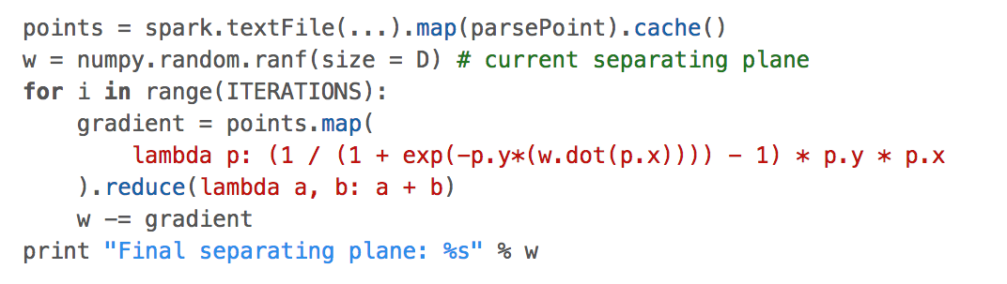
Why is Caching in Memory Important?
Notes:
change

Slide 32
Map Process 1
Distributed Shuffle-Sort
Reducer 1
point 1
point 2
point 3
….
d/dw point1
…
….
Spill 1
Spill 2
Spill 3
Merge Spill Files
add pointwise gradients
Gradient logic
Partition/Sort
…
Spill n
gradient
point 7,356,701
point 7,356,702
point 7,356,703
….
Spill 1
d/dw point 7..001
….
Spill 2
Merge Spill Files
Spill 3
Gradient logic
Partition/Sort
add pointwise gradients
…
Reducer 2
Map Process 2
w

Slide 33
Why is Caching in Memory Important?
Without caching the training data, you need to load it all the data from disk in each iteration.
With caching, communication/disk storage is only need for the weights.
ML is all about iterative optimization.
Notes:
change

Slide 34
Why Transformations and Actions?
For large data it’s important to have an explicit representation of the “code” you want to run
For optimization
e.g. a sequence of .map() transformations
For distribution to workers
For recovery from errors
…
Spark’s transformations are like “code”
This happens over and over in different contexts
Databases have query languages and query optimizers
Tensorflow and PyTorch have “computation graphs”
…
Language-like packages in Python are not different
Notes:
change

Slide 35
Why Transformations and Actions?
Actions give you a way to use Spark interactively
Use them when you debug
Avoid them as intermediate steps in a “production” pipeline
They are bottlenecks!
Notes:
change

Slide 36
Cost of Transformations
Some transformations can run as a single cheap “mapper” process
Each partition is transformed independently, so you don’t need to move data around
The data keys are unchanged, so you don’t need to re-partition the data
Examples:
filter(f), sample(…), mapValues(f), …
map(f, preservesPartioning=True)
foreach(f) # only runs f, doesn’t update RDD
Notes:
change

Slide 37
Cost of Transformations
Some transformations require an expensive shuffle-sort
reduceByKey, join, intersection, subtract, groupBy, sortBy,…
partitionByKey, repartition, ..
It’s not always obvious when a shuffle-sort will be needed
But if you understand the map-reduce layer you can make a good guess
Notes:
change

Slide 38
Communication without RDDs
Broadcast variables can be used to share constants, config information, and small data structures to all workers.
Like closures in a function call, they are copied to every worker
Worker-driven hanges to a broadcast variable are not broadcast back
Helpful for implementing a “map-side” join
b = sc.broadcast(obj)
if b.value > 10:
…
Notes:
change

Slide 39
Communication without RDDs
Accumulators are shared counters
Generally used for monitoring progress
You don’t know the order in which accumulators will be incremented
You can define your own accumulator classes
Workers can’t read the accumulator’s values
Notes:
change

Slide 40
Communication without RDDs
Closures sent to workers as an argument of a transformation or action
Notes:
change

Slide 41
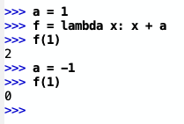
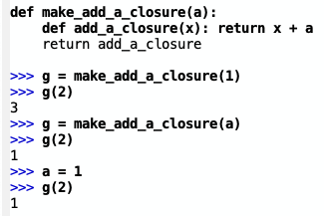
Communication without RDDs
Closures sent to workers as an argument of a transformation or action
note: lambda’s in Python are sometimes surprising!
be careful and/or be explicit!
Notes:
change

Slide 42
Communication without RDDs
Closures sent to workers as an argument of a transformation or action
Q: how does Spark determine what values to package up with the code that it sends to workers?
Good practice: don’t make this too complicated
Notes:
change

Slide 43
Some SAMPLE MR WORKFLOWS

Slide 44
Comparing COUNTS in Two Corpora

Slide 45
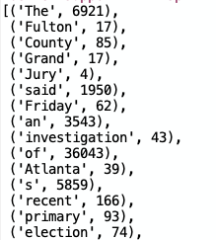
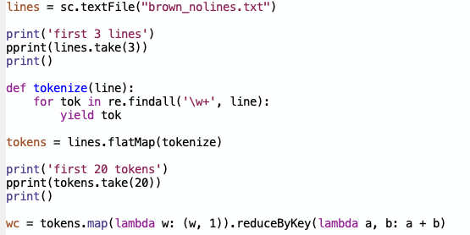
Classic PySpark examples: wordcount

Slide 46
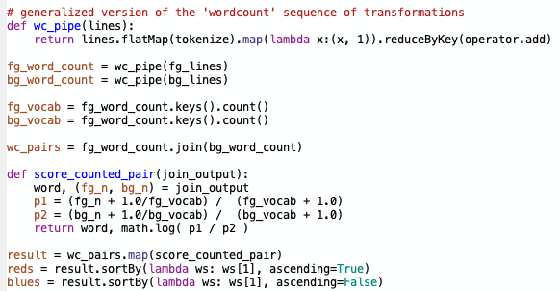
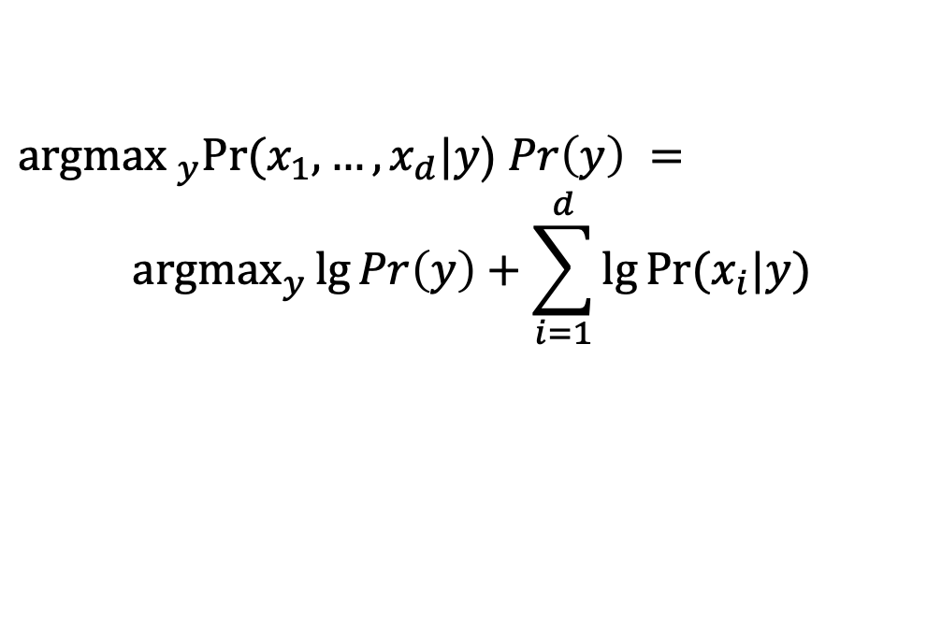


$$Pr⁡(w|\text{fg}\text{_}\text{corpus}\text{)}$$
$$Pr⁡(w|\text{bg}\text{_}\text{corpus}\text{)}$$
Naïve Bayes:
${\text{argmax} }_{y}Pr⁡(x_{1},…,x_{d}|y$) $Pr\left(y\right) =$
$${\text{argmax}}_{y}\lg{Pr\left(y\right)+\sum_{i=1}^{d}{\lg{Pr⁡(x_{i}|y}})}$$

Slide 47
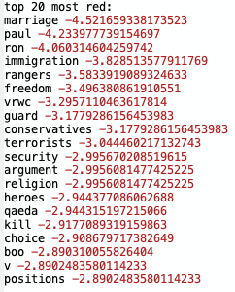
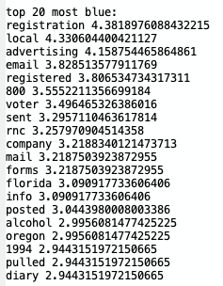

Slide 48
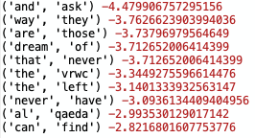
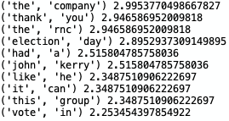
Comparing Bigrams
Problem: many of the common bigrams don’t seem to have meaning as a phrase….
A Language Model Approach to Keyphrase Extraction (2003)

Slide 49
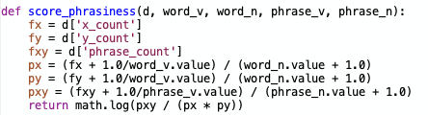
Scoring bigrams as phrases
 | explanation
word_v | #distinct words
phrase_v | #distinct phrases
word_n | #words in corpus
phrase_n | #phrases in corpus
xy | phrase
x | first word
y | second word
As a phrase “x y”
As a random co-occurrence of x and y

Slide 50
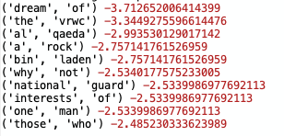
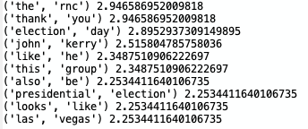
Comparing Phrases
Unfiltered
Filtered for high “phrasiness”

Slide 51
Comparing bigrams and compute filter by phrasiness

Slide 52
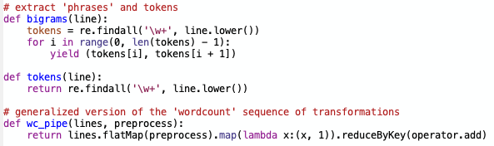
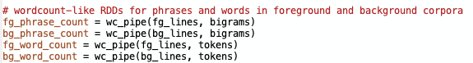

The pipeline – basic counts

Slide 53

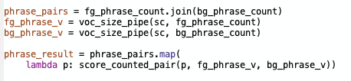
The pipeline w/o filtering

Slide 54
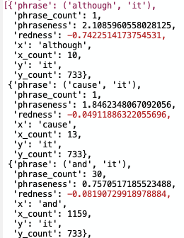
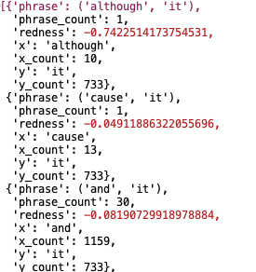
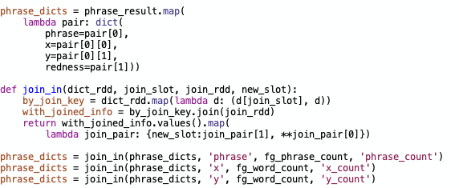
Filtering phrases
Joins change shape of the data
This gets awkward…

Slide 55
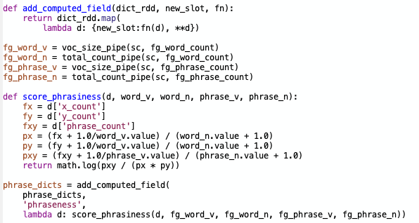
Filtering phrases

Slide 56
PageRank

Slide 57
Google’s PageRank
Inlinks are “good” (recommendations)
Inlinks from a “good” site are better than inlinks from a “bad” site
but inlinks from sites with many outlinks are not as “good”...
“Good “ and “bad” are relative.
web site xxx
web site xxx
web site xxx
web site a b c d e f g
web
site
pdq pdq ..
web site yyyy
web site a b c d e f g
web site yyyy

Slide 58
Google’s PageRank
web site xxx
Imagine a “pagehopper” that always either
follows a random link, or
jumps to random page
web site xxx
web site a b c d e f g
web
site
pdq pdq ..
web site yyyy
web site a b c d e f g
web site yyyy

Slide 59
Google’s PageRank (Brin & Page, http://www-db.stanford.edu/~backrub/google.html)
web site xxx
Imagine a “pagehopper” that always either
follows a random link, or
jumps to random page
PageRank ranks pages by the amount of time the pagehopper spends on a page:
or, if there were many pagehoppers, PageRank is the expected “crowd size”
web site xxx
web site a b c d e f g
web
site
pdq pdq ..
web site yyyy
web site a b c d e f g
web site yyyy

Slide 60
PageRank in Memory
Let u = (1/N, …, 1/N)
dimension = #nodes N
Let A = adjacency matrix: [a_{ij}=1 ⬄ i links to j]
Let W = [w_{ij} = a_{ij}/outdegree(i)]
w_{ij} is probability of jump from i to j
Let v⁰ = (1,1,….,1)
or anything else you want
Repeat until converged:
Let v^{t+1} = cu + (1-c) v^{t}W
c is probability of jumping “anywhere randomly”

Slide 61
PageRank in Spark

Slide 62
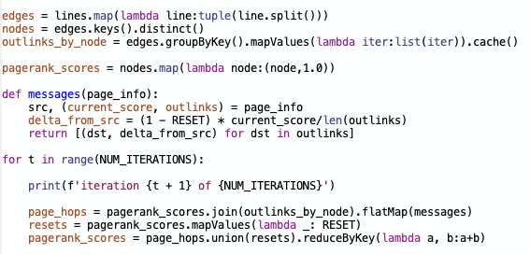
A Slow Implementation
nodes: list of string ids
outlinks_by_node: list of (src, [out1, .. ])
v⁰ = (1,1,….,1)
w_{ij} is probability of jump from i to j
(1-c) v^{t}W
(1-c) v^{t}W
after sum
cu
v^{t+1} = cu + (1-c) v^{t}W

Slide 63
A Slow Implementation
outlinks
scores
10 iterations on small graph locally is 10min
5 iterations is 30sec
hops
resets
scores
…

Slide 64
A Slow Implementation
Notes:
what’s the fix? move reset out of the loop and/or make it NOT depend on scores

Slide 65
Fixing A Slow Implementation

Slide 66
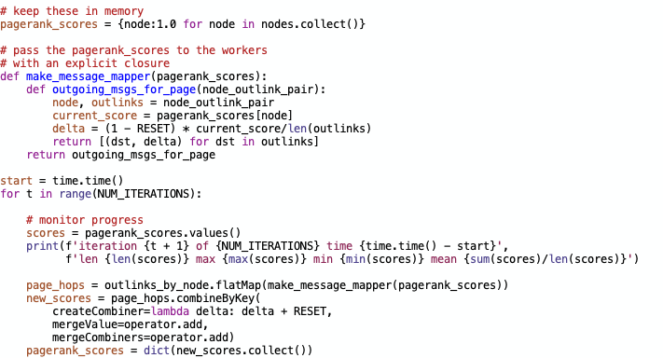
Keeping v in memory
Explicit closure
Convert values to “combiner” (accumulator type)
Merge value with accumulator
Separately merge two accumulators
Leads to important optimizations because combine can happen on mapper side
Notes:
“different contract” - basically if order of reduce operations doesn’t matter you are ok

Slide 67
An example from Ron Bekkerman k-means in Map-Reduce

Slide 68
Example: k-means clustering
An EM-like algorithm:
Initialize k cluster centroids
E-step: associate each data instance with the closest centroid
Find “expected values” of cluster assignments given the data and centroids
M-step: recalculate centroids as an average of the associated data instances
Find new centroids that “maximize that expectation”
And repeat…

Slide 69
k-means Clustering
centroids

Slide 71
Example: k-means clustering
An EM-like algorithm:
Initialize k cluster centroids
E-step: associate each data instance with the closest centroid
M-step: recalculate centroids as an average of the associated data instances

Slide 72
Parallelizing k-means

Slide 73
Parallelizing k-means

Slide 74
Parallelizing k-means

Slide 75
k-means on MapReduce
Mappers read data partitions + centroids
Mappers assign data instances to clusters
Mappers compute new local centroids and local cluster sizes
Reducers aggregate local centroids (weighted by local cluster sizes) into new global centroids
Reducers write the new centroids

Slide 76
Questions
Mappers read data portions and centroids
Mappers assign data instances to clusters
Mappers compute new local centroids and local cluster sizes
Reducers aggregate local centroids (weighted by local cluster sizes) into new global centroids
Reducers write the new centroids
What should be in memory and what should be in an RDD?
How many Shuffle-Sorts are needed for one pass?
Assume we can map through documents

Slide 77
Questions
Mappers read data portions and centroids
Mappers assign data instances to clusters
Mappers compute new local centroids and local cluster sizes
Reducers aggregate local centroids (weighted by local cluster sizes) into new global centroids
Reducers write the new centroids
Sketch:
Map only: With all centroids in mapper memory, assign each doc to a centroid
outputting docid → centroid index
(Shuffle-sort: Count number of docs per centroid)
Map-Reduce: join docs to centroids
Map-Reduce: average doc weights for each centroid

Slide 78
k-means in Apache Pig: input data
Assume we need to cluster documents
Stored in a 3-column table D:
Initial centroids are k randomly chosen docs
Stored in table C in the same format as above
Document | Word | Count
doc1 | Carnegie | 2
doc1 | Mellon | 2

Slide 79
k-means in Apache Pig: E-step
D_C = JOIN C BY w, D BY w;
PROD = FOREACH D_C GENERATE d, c, i_{d} * i_{c} AS i_{d}i_{c} ;
PROD_{g} = GROUP PROD BY (d, c);
DOT_PROD = FOREACH PROD_{g} GENERATE d, c, SUM(i_{d}i_{c}) AS dXc;
SQR = FOREACH C GENERATE c, i_{c} * i_{c} AS i_{c}²;
SQR_{g} = GROUP SQR BY c;
LEN_C = FOREACH SQR_{g} GENERATE c, SQRT(SUM(i_{c}²)) AS len_{c};
DOT_LEN = JOIN LEN_C BY c, DOT_PROD BY c;
SIM = FOREACH DOT_LEN GENERATE d, c, dXc / len_{c};
SIM_{g} = GROUP SIM BY d;
CLUSTERS = FOREACH SIM_{g} GENERATE TOP(1, 2, SIM);

Slide 80
k-means in Apache Pig: M-step
D_C_W = JOIN CLUSTERS BY d, D BY d;
D_C_W_{g} = GROUP D_C_W BY (c, w);
SUMS = FOREACH D_C_W_{g} GENERATE c, w, SUM(i_{d}) AS sum;
D_C_W_{gg} = GROUP D_C_W BY c;
SIZES = FOREACH D_C_W_{gg} GENERATE c, COUNT(D_C_W) AS size;
SUMS_SIZES = JOIN SIZES BY c, SUMS BY c;
C = FOREACH SUMS_SIZES GENERATE c, w, sum / size AS i_{c} ;

Slide 81
Matrix Multiplication in Spark

Slide 82
k-means on MapReduce
Mappers read data portions and centroids
Mappers assign data instances to clusters
Mappers compute new local centroids and local cluster sizes
Reducers aggregate local centroids (weighted by local cluster sizes) into new global centroids
Reducers write the new centroids
Need to compute distance (inner product) between every instance and every centroid.

Slide 83
Doc ids | Word | Count
doc1 | Carnegie | 2
doc1 | Mellon | 2
…
A[docid,word]=count
Centroid id | Word | Weight
doc1 | Carnegie | 0.854
doc1 | Mellon | 1.275
….
B[docid,word]=weight
Computing all pairwise distances is sparse matrix multiplication
C = A.dot(B.T)

Slide 84
