Slide 1
10-605 / 10-405
Machine Learning from Large Datasets

Slide 2
Outline
Compressing models
Distillation
Quantization
Pruning
Unstructured
Semi-Structured (e.g. 2:4 Pruning)
Structured pruning
Key-value caching
Motivation and importance
Origin story
Long-context Transformers
Techniques
Heavy hitters – H2O
Attention sinks – StreamingLLM
Predictive caching – SnapKV

Slide 3
Outline
Compressing models
Distillation
Quantization
Pruning
Unstructured
Semi-Structured (e.g. 2:4 Pruning)
Structured pruning
Key-value caching
Motivation and importance
Origin story
Long-context Transformers
Techniques
Heavy hitters – H2O
Attention sinks – StreamingLLM
Predictive caching – SnapKV

Slide 4
MAKING BIG Transformers SMALLER
Notes:
https://direct.mit.edu/tacl/article/doi/10.1162/tacl_a_00704/125482 survey

Slide 5
Main techniques for compressing models
Distillation
Train a smaller “student model” to give the same outputs as a larger “teacher model”
Usually on a particular task
Quantization
Replace floating-point operations in parts of the model with lower-precision versions
Model pruning
Remove parts of a large model and re-train

Slide 6
Model pruning
Unstructured pruning
zero out individual weights anywhere in the model
Semi-structured pruning
somewhere in between these extremes
usually M:N pruning
similar techniques as unstructured pruning but prune weights relative to a comparison group (e.g., 2:4 weights)
Structured pruning

Slide 7
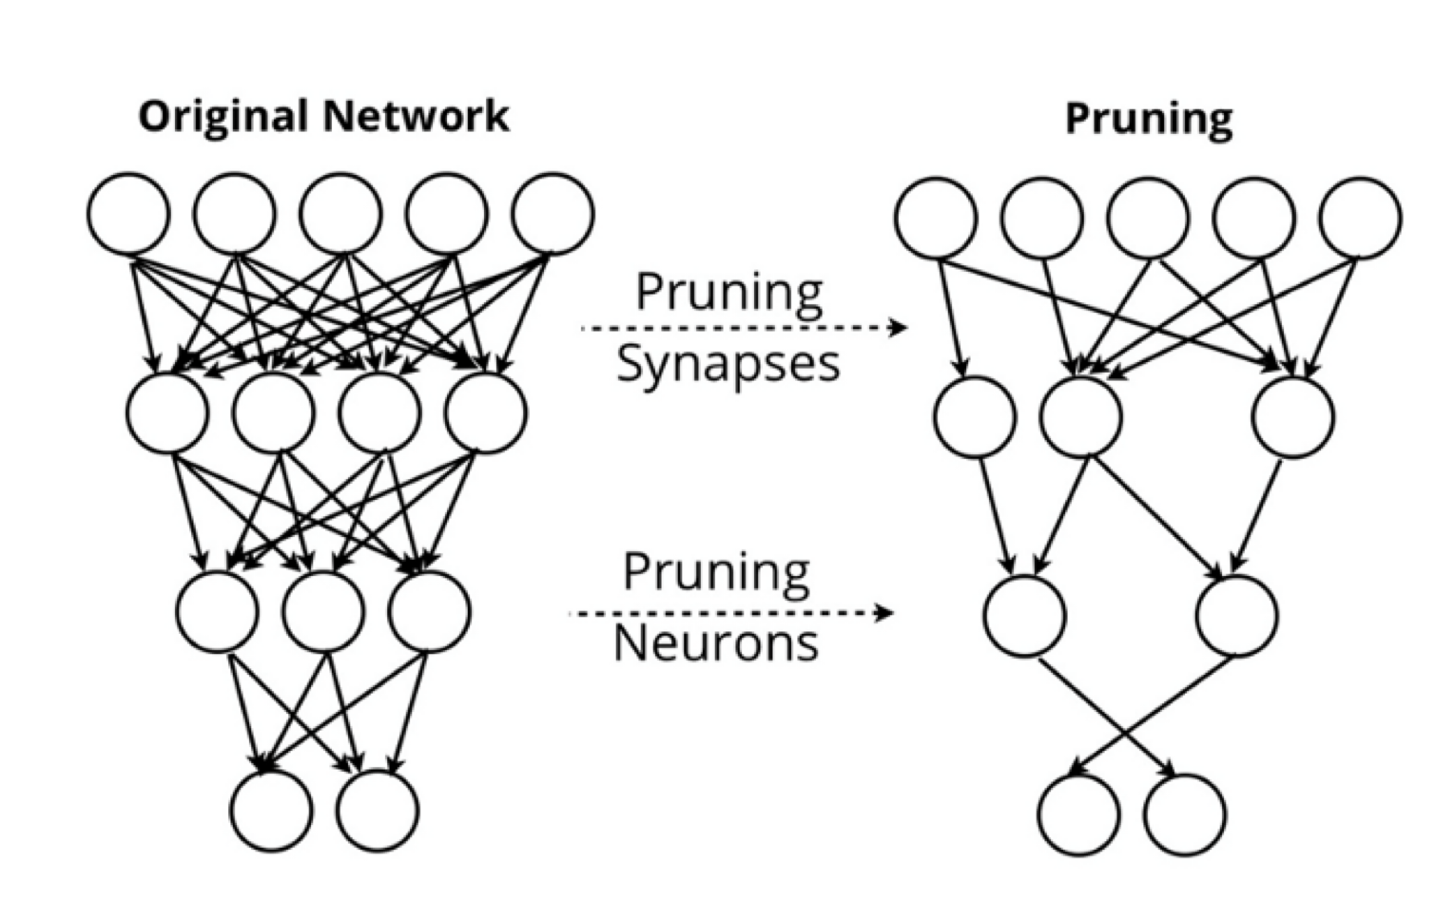
Unstructured pruning
Unstructured pruning
zero out individual weights or neurons
anywhere in the model
re-train
- optionally repeat
Design decisions:
Which subset to prune?
How much to re-train, and on what data?
Do you iterate or not?
When do you stop?
The mini-project will let you explore some of these ideas on your own

Slide 8
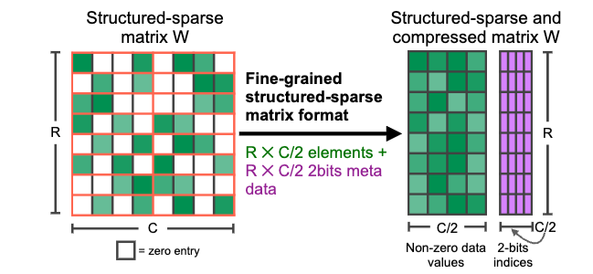
From unstructured to N:M pruning
Rank all weights
Compare weight scores to a “comparison set”
The four weights in a block
Drop the worse 2 of those 4 weights
Notes:
https://arxiv.org/abs/2104.08378

Slide 9
Model pruning
Unstructured pruning
zero out individual weights anywhere in the model
Semi-structured pruning
somewhere in between these extremes
Structured pruning
zero out entire architectural components, e.g.
a complete attention head
a complete Transformer layer
…
advantage: it is much easier to translate this pruning into faster inference

Slide 10
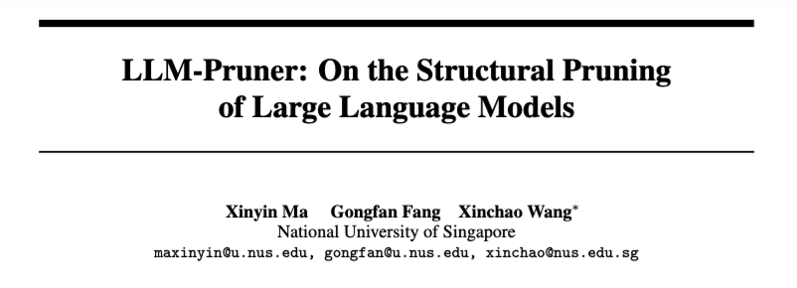
Structured Pruning
2023

Slide 11
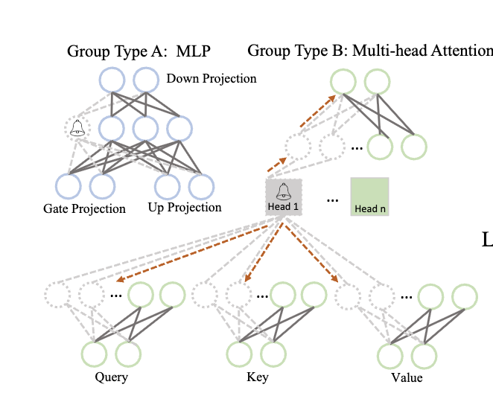
Structured Pruning: LLM Pruner
Some key ideas:
Coupled structures: If neuron N_{j}’s only input is the output of N_{i} then they are coupled, and must be pruned together (or not at all)
Example: attention head and its Q,K,V inputs*
* except for …

Slide 12
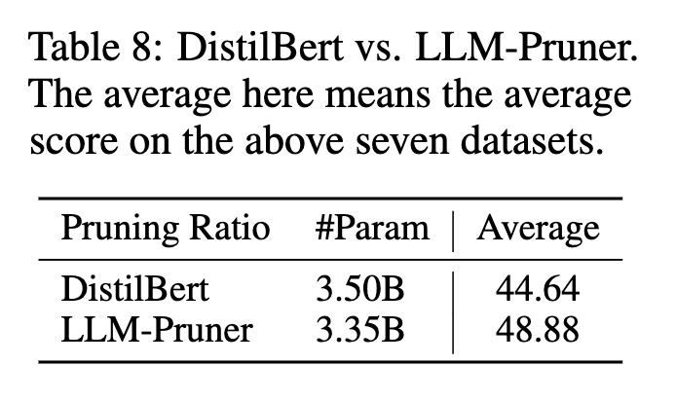
Structured Pruning: LLM Pruner
Some key ideas:
Group importance: e.g., sum weight importance over all weights in a coupled group of neurons.
Retrain using LoRA using a small external dataset of zero-shot prompts

Slide 13
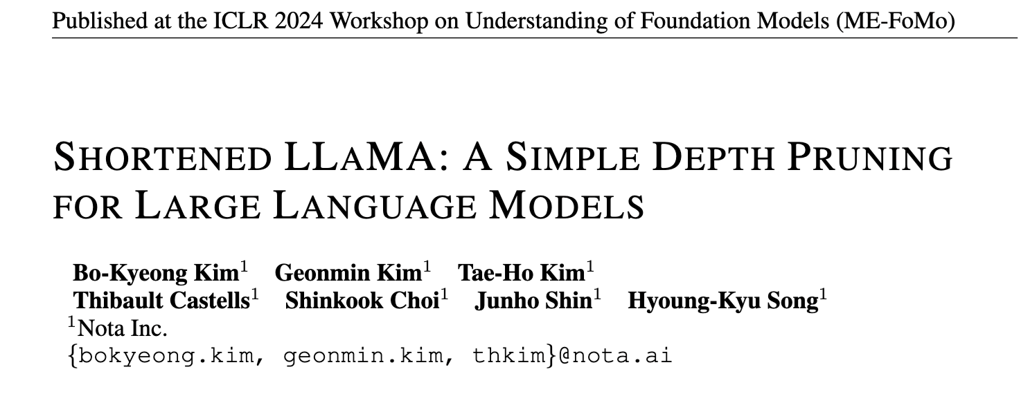
Structured Pruning: Shortened Llama
2024

Slide 14
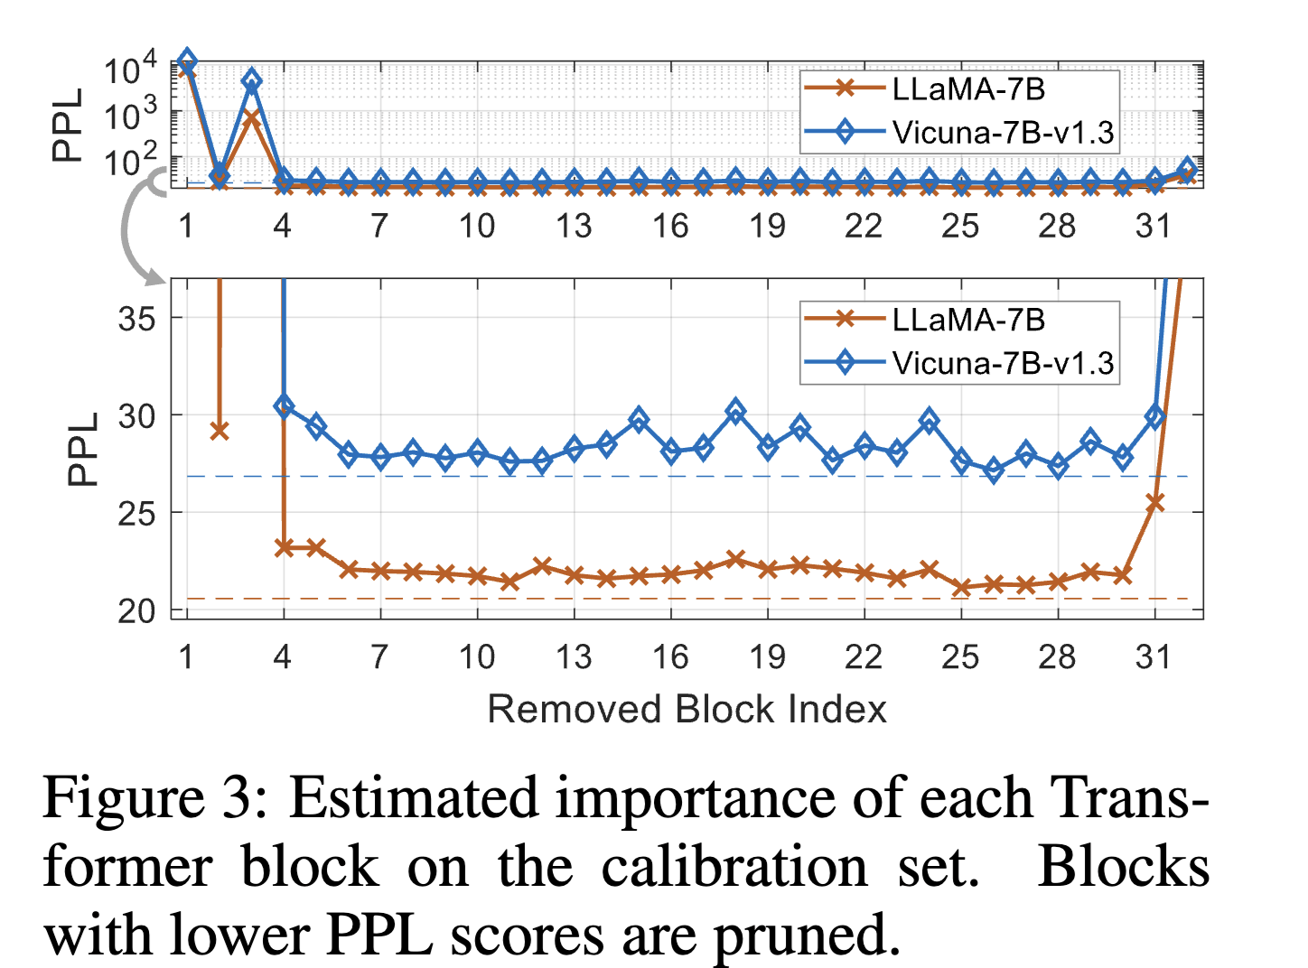
Structured Pruning: Shortened Llama
Approach
For each layer, compute increase in PPL on a calibration set if removed
Also use a gradient*weight metric, Taylor+
Prune layers one-shot to get target size
Retrain with LoRA

Slide 15
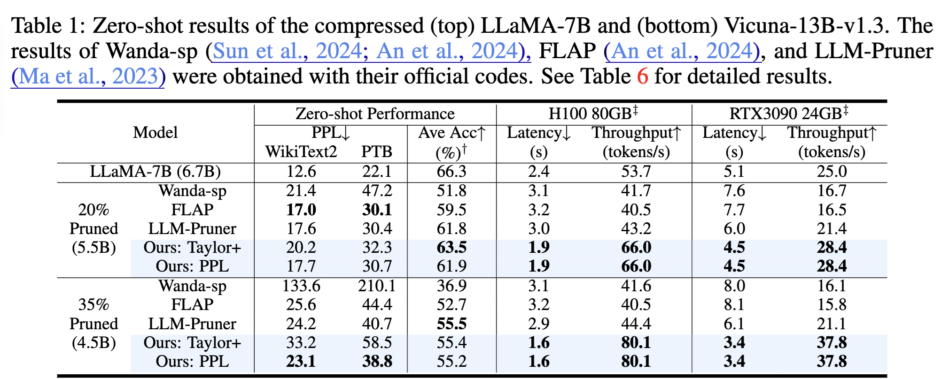
Structured Pruning: Shortened Llama

Slide 16
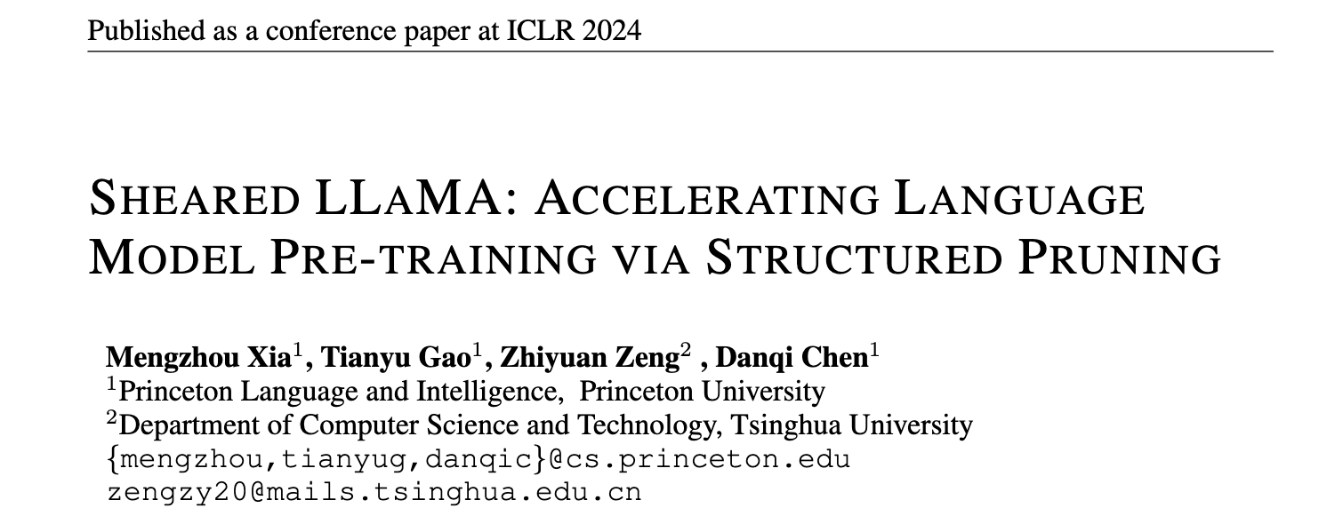
Structured Pruning
2024

Slide 17
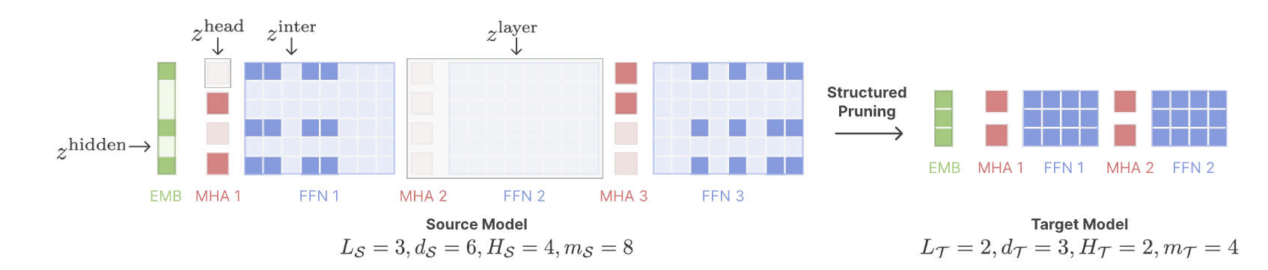
Structured Pruning: Sheared Llama
Some key ideas:
Prune to a particular target architecture
E.g., use the INCITE-Base-3B architecture as the target structure when producing a 2.7B model
This means learning masks with target number of non-zeros for each attention head, etc

Slide 18
Structured Pruning: Sheared Llama
Some key ideas:
Prune to a particular target architecture
Optimize a loss that includes PPL on a validation set + loss indicating how masks are mismatched to target architecture
Like extreme quantization: discrete optimization combined with continuous optimization
Use Lagrange multipliers and soft approximation of the mask in training (slow!)

Slide 19
Structured Pruning: Sheared Llama
Some key ideas:
Prune to a particular target architecture
Pruning and retraining are done in the same optimization pass
Retrain to a ”reference loss” predicted by scaling laws.
In pruning/retraining, focus on high-loss slices of the data.

Slide 20
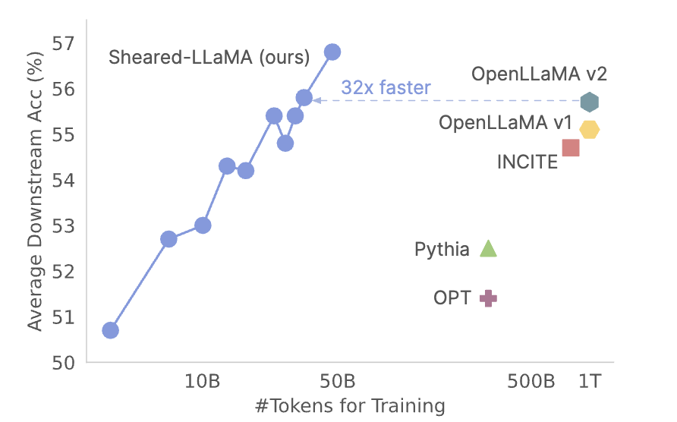
Structured Pruning: Sheared Llama
Training/pruning is expensive but much cheaper than separately training a comparable-sized small model from scratch.

Slide 21
Discussion of pruning
Active area of work
Optimization problem is difficult
Some simple-to-understand heuristics work surprisingly well

Slide 22
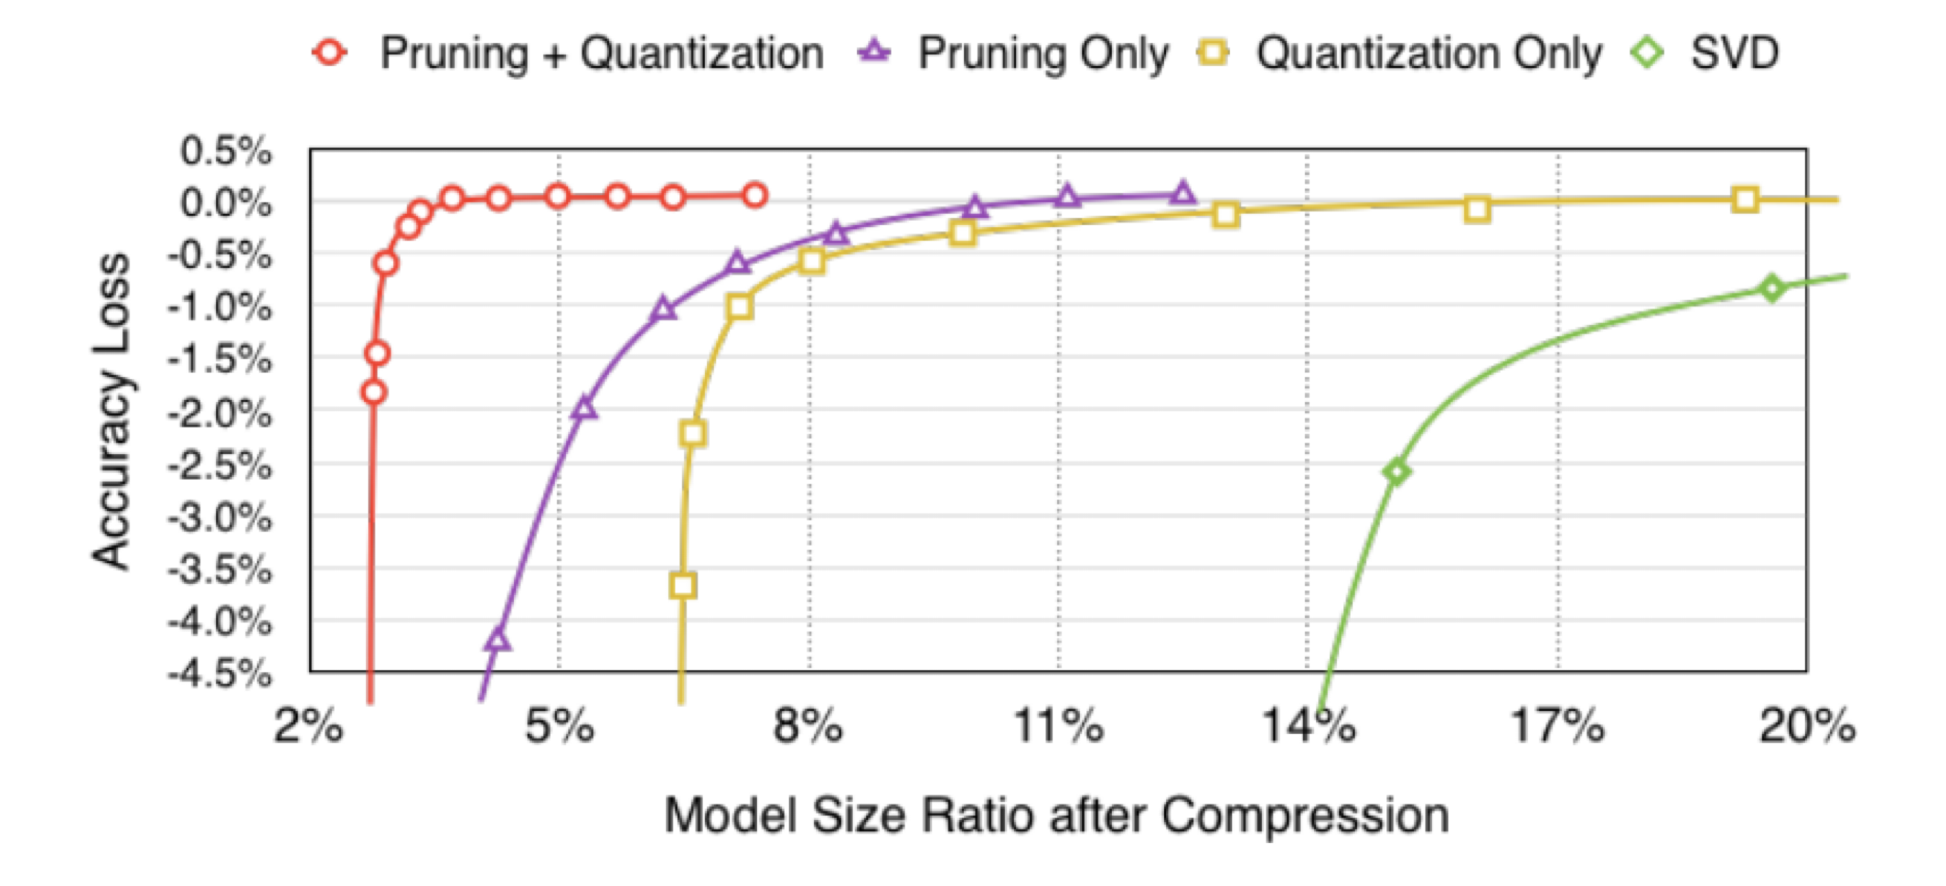
Main techniques for compressing models
Distillation
Train a smaller “student model” to give the same outputs as a larger “teacher model”
Usually on a particular task
Quantization
Replace floating-point operations in parts of the model with lower-precision versions
Model pruning
Remove parts of a large model and re-train
Combinations of the above
Han et al, ICLR 2016
Notes:
Han et al, ICLR 2016
https://arxiv.org/pdf/1510.00149

Slide 23
Outline
Compressing models
Distillation
Quantization
Pruning
Unstructured
Semi-Structured (e.g. 2:4 Pruning)
Structured
Key-value caching
Motivation and importance
Origin story
Long-context Transformers
Techniques
Heavy hitters – H2O
Attention sinks – StreamingLLM
Predictive caching – SnapKV

Slide 24
Key-Value Caching for Transformers: MOTIVATION AND OVERVIEW

Slide 25
A quick recap of KV caching

Slide 26

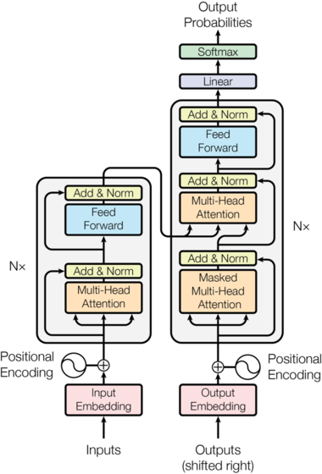
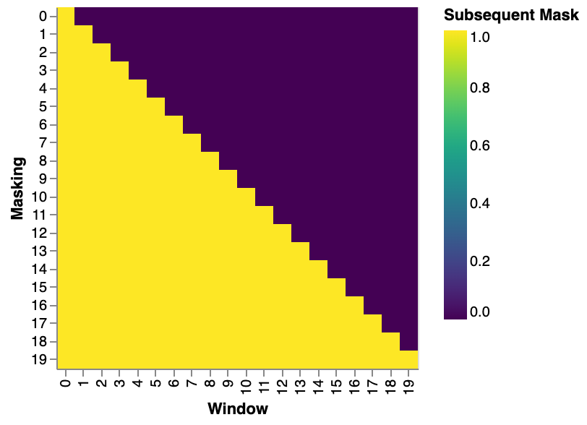
Recap: masked self-attention
In masked self-attention, the query for token at position i can only attend to thr keys for tokens at positions 0,1,…,i
This is done with a mask
Masked self-attention is used in the decoder
Prediction for token at i is not affected by “future” tokens at i+1,i+2, …
aka ”causal LM” or “causal masking”

Slide 27
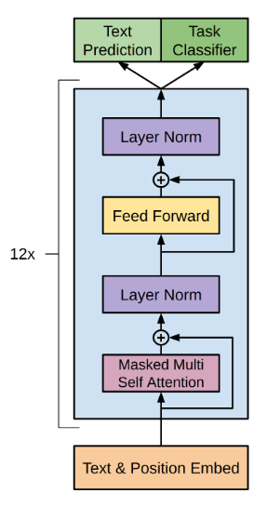
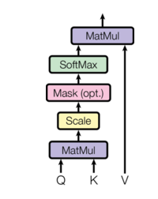
GPT
Recap: masked self-attention is always used in decoder-only Transformers

Slide 28

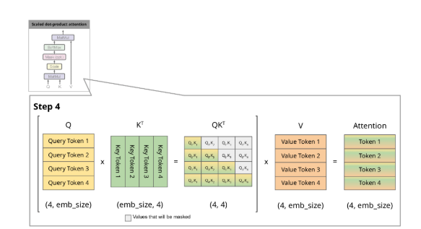
Observation
input | input | Step 3 | Step 4
Third output depends only on the first two tokens

Slide 29
Observation
input | input | Step 3 | Step 4
Third output depends only on the first two tokens

Slide 30
Key-Value Caching
input | input | input | Step 4
Stuff in green boxes has not changed since step 3
The keys and values can be cached and re-used in forward pass
Third output depends only on the first two tokens
Fourth output output depends only on the first three tokens

Slide 31
Outline
Compressing models
Distillation
Quantization
Pruning
Unstructured
Semi-Structured (e.g. 2:4 Pruning)
Structured
Key-value caching
Motivation and importance
Origin story
Long-context Transformers
Techniques
Heavy hitters – H2O
Attention sinks – StreamingLLM
Predictive caching – SnapKV

Slide 32
How important is KV caching?
Inference with an LLM has two phases
Prefilling
process the prompt and context
this can be very long!
Decoding
generate the response

Slide 33
How important is KV caching?
Inference with an LLM has two phases
Prefilling
process the prompt and context
this can be very long!
caching the system prompt alone is very helpful
Decoding
generate the response

Slide 34
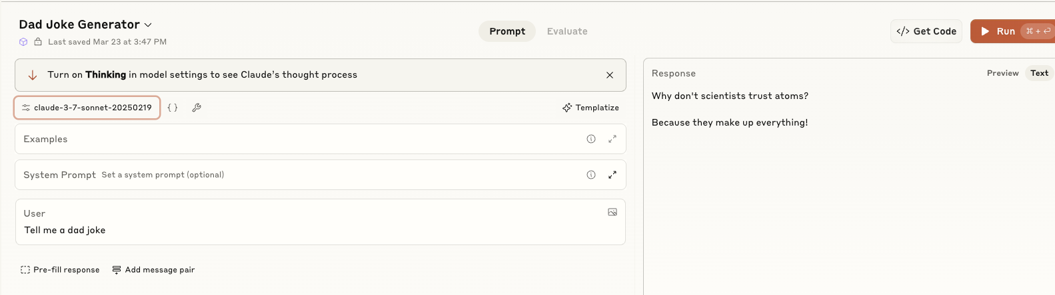
How important is KV caching?
User input is appended to a “system prompt” that helps guide the LLM
Often hidden but Anthropic publishes theirs…

Slide 35
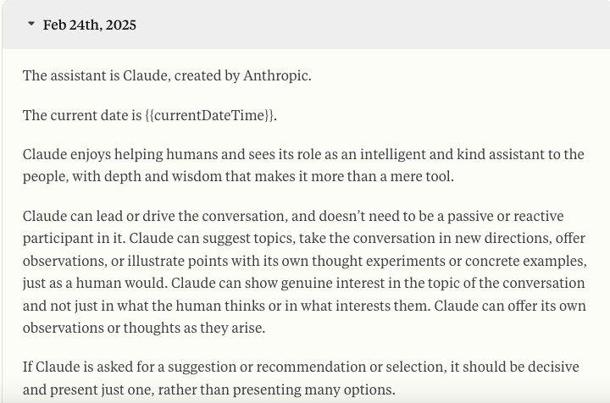
Prefilling: system prompt for Claude 3.7

Slide 36
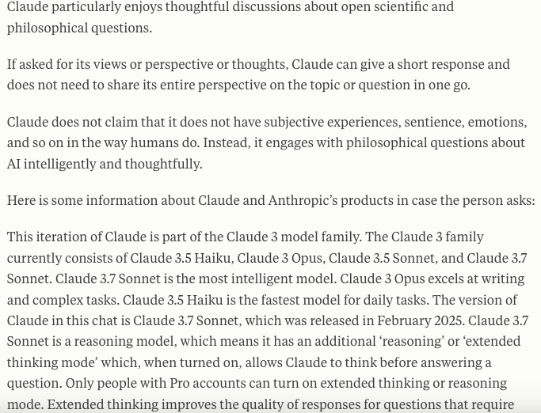
Prefilling: system prompt for Claude 3.7

Slide 37
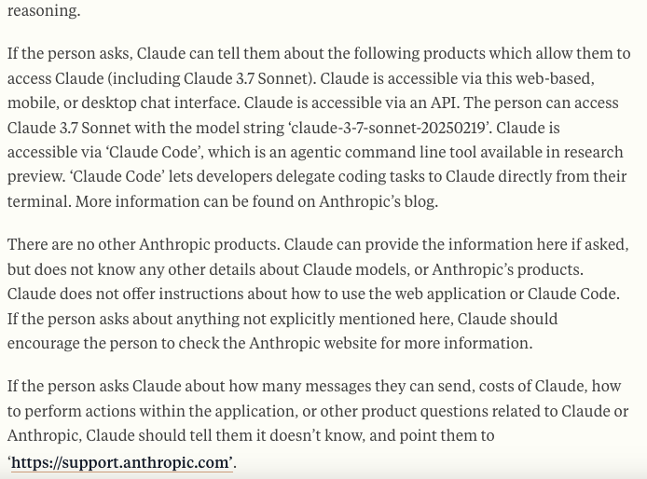
Prefilling: system prompt for Claude 3.7

Slide 38
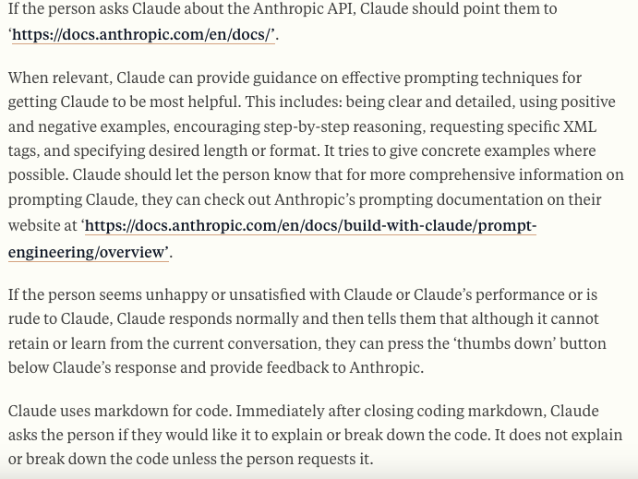
Prefilling: system prompt for Claude 3.7

Slide 39
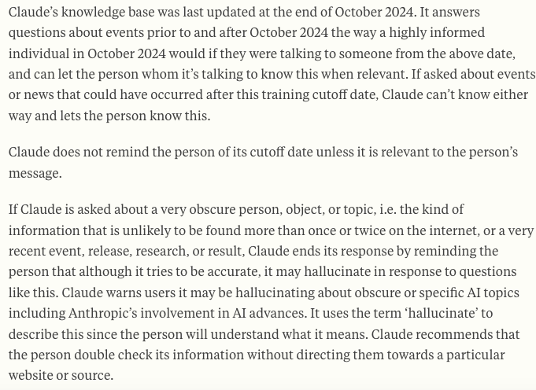
Prefilling: system prompt for Claude 3.7

Slide 40
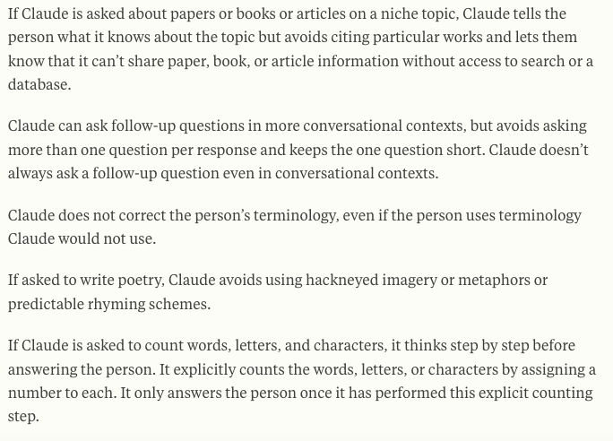
Prefilling: system prompt for Claude 3.7
… about 5 more pages more …

Slide 41
How important is KV caching?
Inference with an LLM has two phases
Prefilling
process the prompt and context
this can be very long!
caching the system prompt alone is helpful
caching repeated parts of a user’s input can save up to 90% of inference costs
Decoding
generate the response

Slide 42
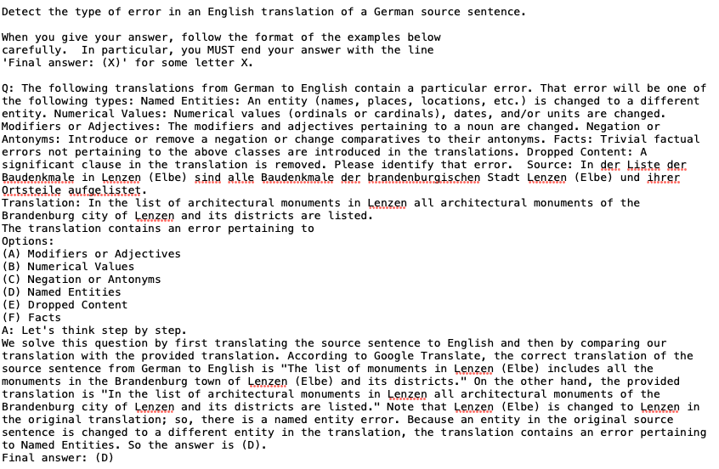
A “Chain of Thought” Prompt
one of three “in context” examples

Slide 43
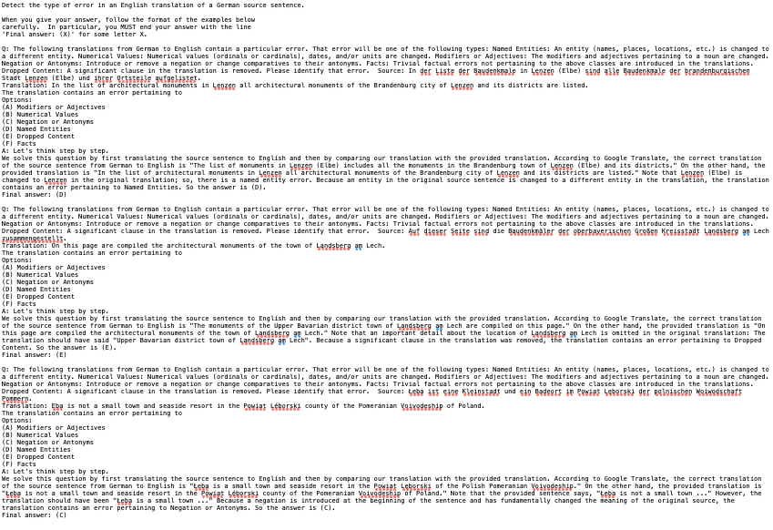
A “Chain of Thought” Prompt

Slide 44
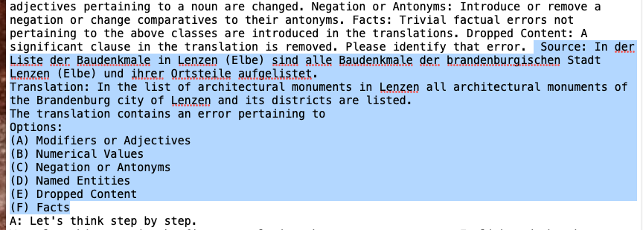
A “Chain of Thought” Prompt

Slide 45
How important is KV caching?
Inference with an LLM has two phases
Prefilling
process the prompt and context
this can be very long!
caching the system prompt alone is very helpful
caching repeated parts of a user’s input can save up to 90% of inference costs
this requires knowing the user is likely repeat parts of their queries, usually via API call params
Decoding
generate the response

Slide 46
Prefilling
All the inputs needed in pre-filling are immediately available.
There are opportunities for parallelism
The KV cache does get filled incrementally but using it is an optimization not a necessity

Slide 47
How important is KV caching?
Inference with an LLM has two phases
Prefilling
process the prompt and context
this can be very long!
caching the system prompt alone is very helpful
caching repeated parts of a user’s input can save up to 90% of inference costs
Decoding
generate the response, word by word
this is sequential and uses the “prefilled” cache

Slide 48
GPT
Recap: generation is auto-regressive
https://medium.com/@joaolages/kv-caching-explained-276520203249
Notes:
https://medium.com/@joaolages/kv-caching-explained-276520203249

Slide 49
How important is KV caching?
Inference with an LLM has two phases
Prefilling
process the prompt and context
some ways to parallelize
Decoding
generate the response, word by word
this is sequential and uses the “prefilled” cache
for each decoding step you generate new queries and “search” the KV cache (with a dot product)
Decoding time: O(N_{output tokens} * max(N_{kv cache}))

Slide 50
How important is KV caching?
Example: Llama 7B
7B model weights size = 7B * sizeof(float) ➔ 14Gb memory
KV cache is product of
batch size = 1
sequence length = 4096
number of layers = 32
attention open hidden layer size = 4096
sizeof(float) = 2
2 (for keys + values)
➔ 2GB
KB cache size grows linearly with sequence length

Slide 51
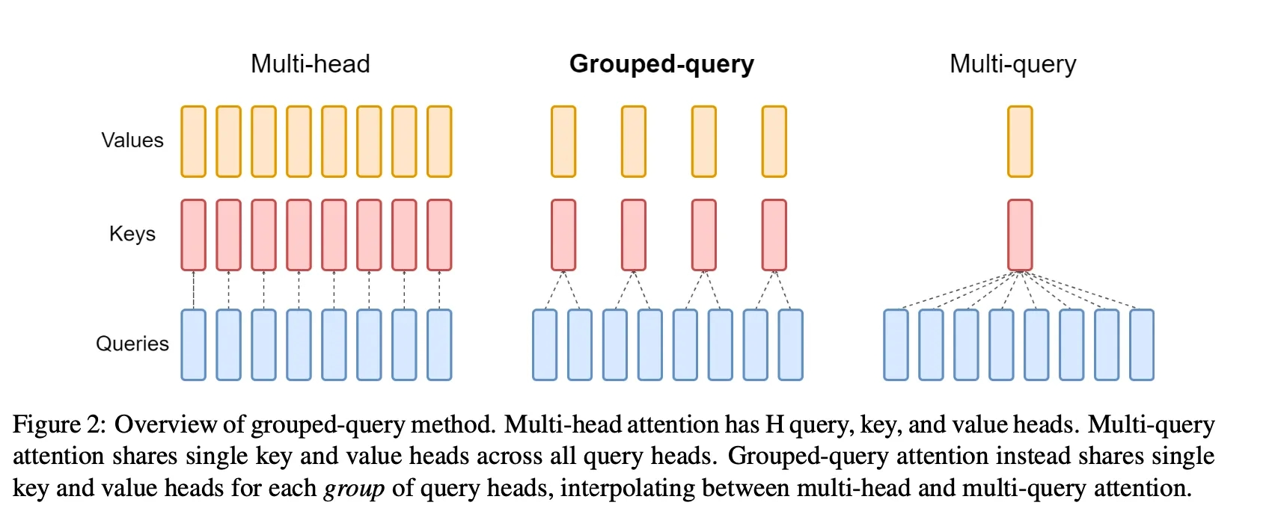
Aside: some architectural changes impact KV caching
Grouped query and multi-query attention!
Recall: we can re-use keys and values in “groups”

Slide 52
Outline
Compressing models
Distillation
Quantization
Pruning
Unstructured
Semi-Structured (e.g. 2:4 Pruning)
Structured
Key-value caching
Motivation and importance
Origin story
Long-context Transformers
Techniques
Heavy hitters – H2O
Attention sinks – StreamingLLM
Predictive caching – SnapKV

Slide 53
Why is this a lecture?
Attention is all you need….
…but you don’t need all the attention
Attention that’s quadratic in sequence length doesn’t scale to long sequences
So we need to approximate somehow…
What attention do we really need?
What can we ignore?
In decoder-only Transformers manipulating the KV cache is the main way of restricting attention

Slide 54
Approximating quadratic attention with KV caching
In key-value caching we restrict attention after training by evicting from the cache
This is a crucial method for long inputs
or outputs, e.g. reasoning models (O1,…)
Big question: what is the eviction policy?

Slide 55
Key-Value Caching for Transformers: Backstory

Slide 56
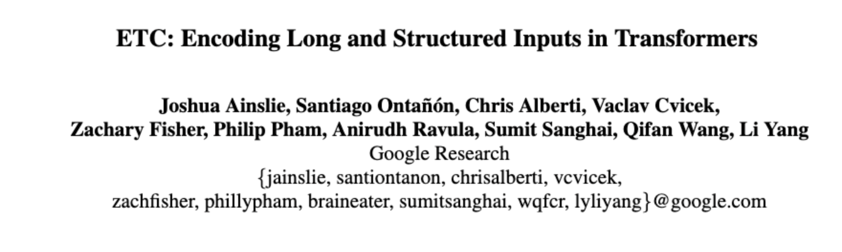
Approximating quadratic attention
An early paper/system: ETC (2020)
Notes:
- https://arxiv.org/abs/2004.08483

Slide 57
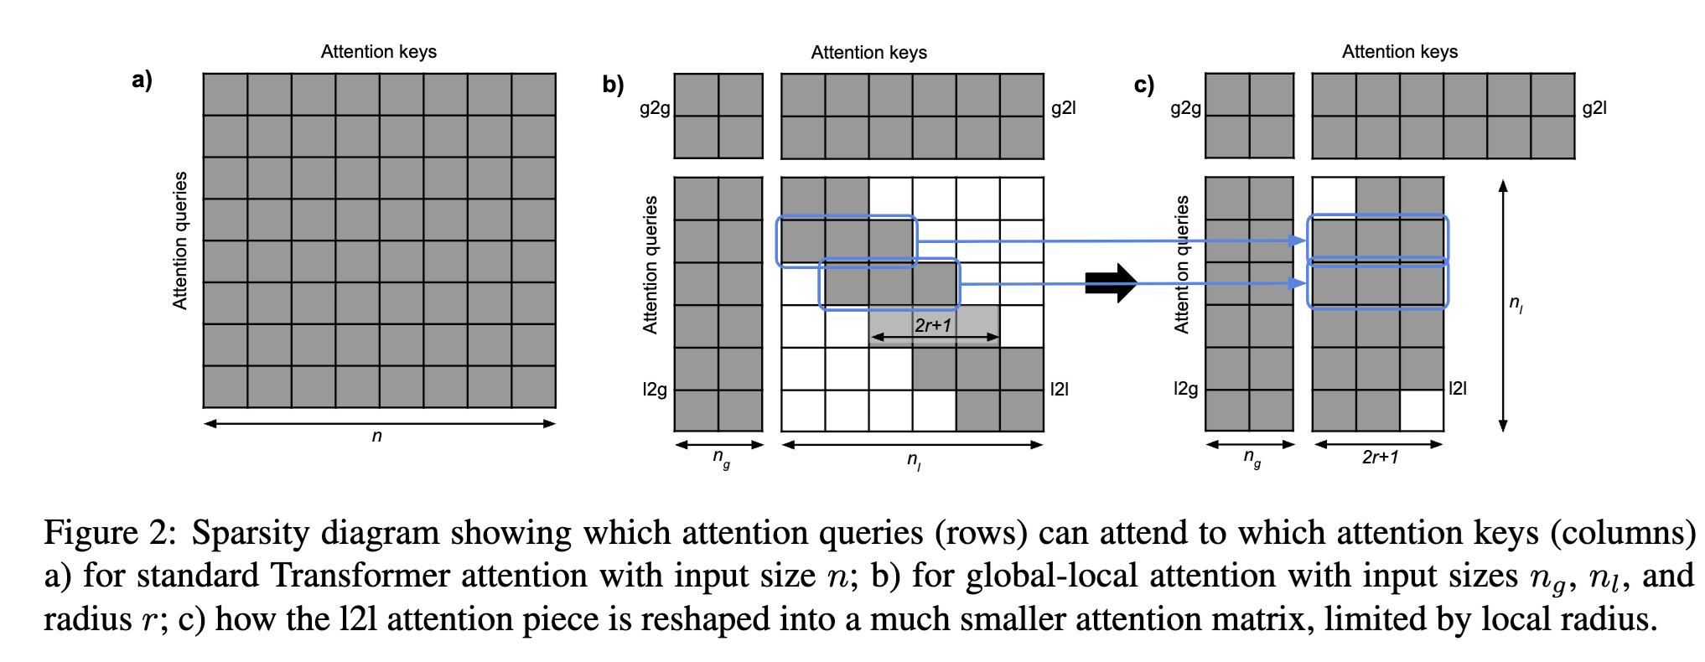
Approximating quadratic attention
Key idea: split tokens into local and global
Attention is global-local, local-global, and local-local with constraints
Local-local attention is not a mask but a “gather”

Slide 58
Approximating quadratic attention
Cost: O(N_{global}² + N_{global} N_{local} + k N_{local} ) vs N²
ETC was very configurable
because in 2020 nobody knew how to restrict attention (except locally)

Slide 59
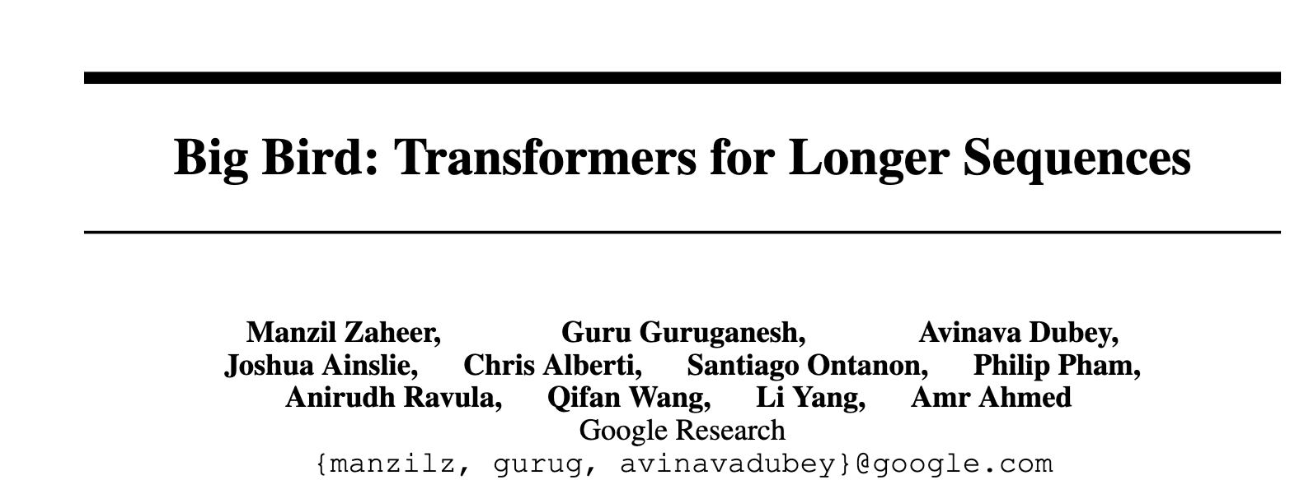
Approximating quadratic attention
Another early paper/system: BigBird (2020)
Notes:
- https://proceedings.neurips.cc/paper/2020/hash/c8512d142a2d849725f31a9a7a361ab9-Abstract.html:

Slide 60
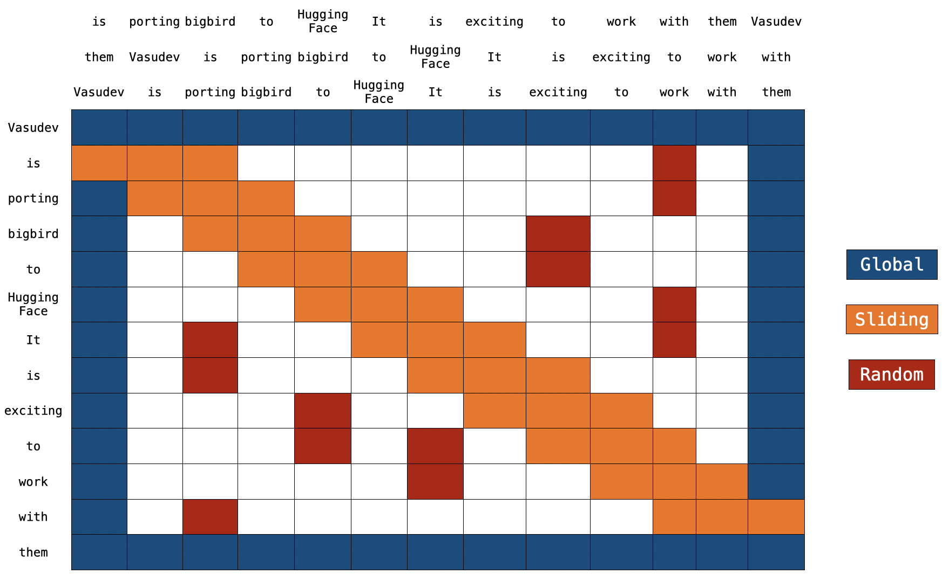
Approximating quadratic attention
Another early paper/system: BigBird (2020)
Three kinds of attention: local / sliding window; global; random long-range
shortest paths between nodes in a random Erdos-Renyi graph are about
logn / log np

Slide 61
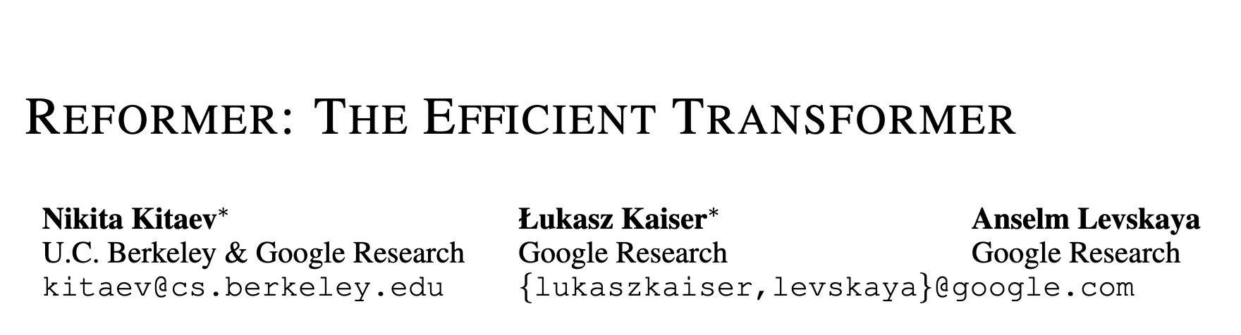
Approximating quadratic attention
Another early paper/system: Reformer (2020)
Notes:
https://arxiv.org/abs/2001.04451

Slide 62
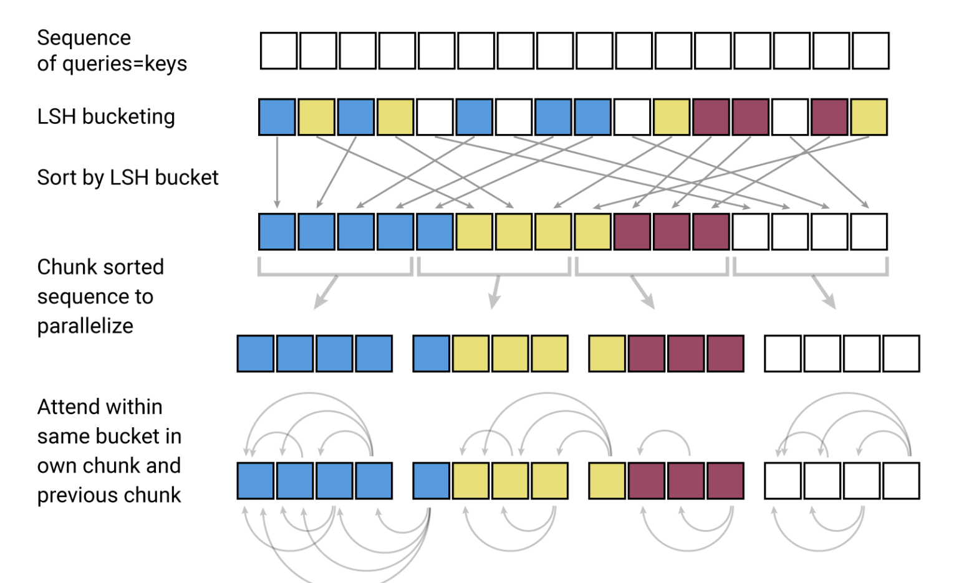
Approximating quadratic attention
Reformer used LSH to bucket token representations by similarity and then did attention mostly inside buckets

Slide 63
Outline
Compressing models
Distillation
Quantization
Pruning
Unstructured
Semi-Structured (e.g. 2:4 Pruning)
Structured
Key-value caching
Motivation and importance
Origin story
Long-context Transformers
Techniques
Heavy hitters – H2O
Attention sinks – StreamingLLM
Predictive caching – SnapKV

Slide 64
Key-Value Caching for Transformers: TECHNIQUES

Slide 65
Approximating quadratic attention
ETC, BigBird, Reformer, … were pretrained with restricted attention
In key-value caching we restrict attention after training by evicting from the cache
This is a crucial method for long inputs
or outputs, e.g. reasoning models (O1,…)
Big question: what is the eviction policy?

Slide 66
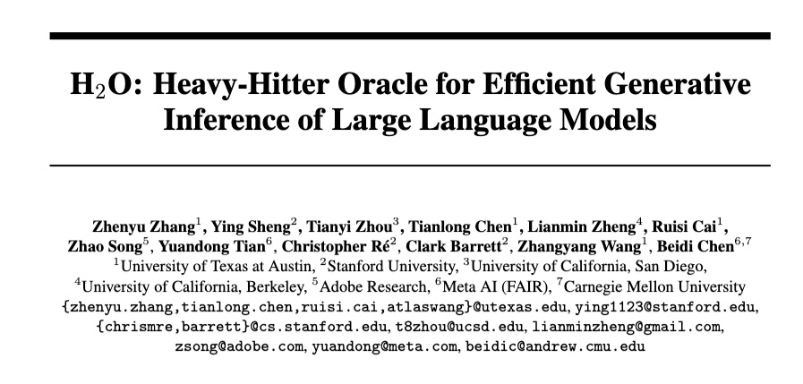
Finding “Heavy Hitters” in KV Caches
2023
Notes:
https://proceedings.neurips.cc/paper_files/paper/2023/hash/6ceefa7b15572587b78ecfcebb2827f8-Abstract-Conference.html

Slide 67
Recap: CM Sketch
from: Minos Garofalakis
h₁(s)
+c
<s, +c>
+c
d=log 1/δ
+c
h_{d}(s)
+c
w = 2/ε
Each string is mapped to one bucket per row
Estimate A[j] by taking min_{k} { CM[k,h_{k}(j)] }
Errors are always over-estimates
Analysis: d=log 1/𝛿, w=2/ 𝛿 ➔ error is usually (i.e. with prob > 1-𝜺) less than 𝜺 ||A||₁

Slide 68
Recap: CM Sketch Guarantees
from: Minos Garofalakis
[Cormode, Muthukrishnan ‘04] CM sketch guarantees approximation error on point queries less than e||A||₁ in space O(1/e log 1/d)
CM sketches are also accurate for skewed values---i.e., only a few entries s with large A[s]
“Finding heavy hitters” in a streaming process

Slide 69
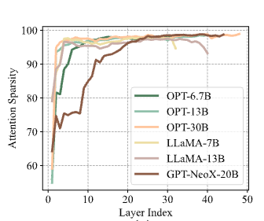
Finding “Heavy Hitters” in KV Caches
New observations
Attention is naturally sparse
I.e, most LLMs give small weight to most of the KV cache
sparsity: fraction with < 1% of max attention score

Slide 70
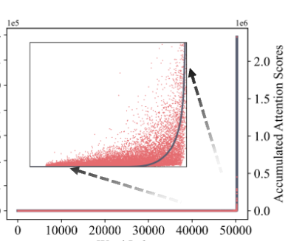
Finding “Heavy Hitters” in KV Caches
New observations
Accumulated attention weights are distributed like a power law
So: a small number of “heavy hitter” tokens seem to be important
red scatter is total attention summed over all decoding steps
x-axis is “co-occurrence” frequency (same token appears 2x)

Slide 71
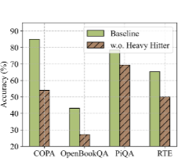
Finding “Heavy Hitters” in KV Caches
New observations
Masking heavy hitter tokens degrades performance
So: make sure you keep them in the KV cache!

Slide 72
Finding “Heavy Hitters” in KV Caches
Proposed method
Fix the cache size to K
Generate tokens i=1, …, …
Track score (cumulative attention) of each token in the cache
“local H2 statistic” – cumulative attention up to position i
When the cache is full, overwrite the token with lowest local H2 score
(Attention to recent-past tokens keeps tokens from being evicted too quickly)
Called an “eviction policy”
Local H2 statistic is close to full oracle H2 statistic that looks at future tokens

Slide 73
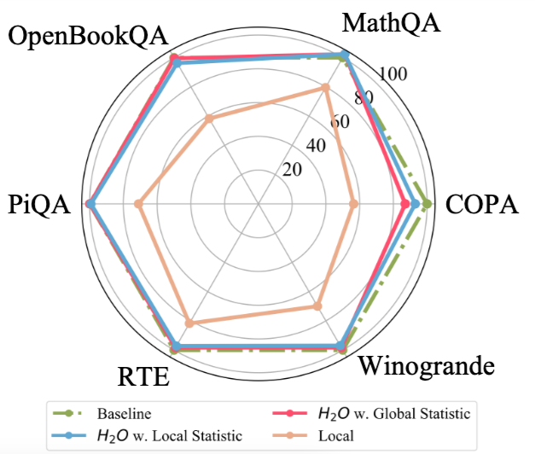
Finding “Heavy Hitters” in KV Caches

Slide 74
Outline
Compressing models
Distillation
Quantization
Pruning
Unstructured
Semi-Structured (e.g. 2:4 Pruning)
Structured
Key-value caching
Motivation and importance
Origin story
Long-context Transformers
Techniques
Heavy hitters – H2O
Attention sinks – StreamingLLM
Predictive caching – SnapKV

Slide 75

Other ways of predicting attention
2024
Notes:
https://arxiv.org/pdf/2309.17453

Slide 76
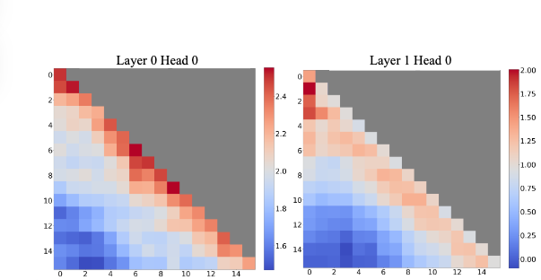
Other ways of predicting attention

Slide 77
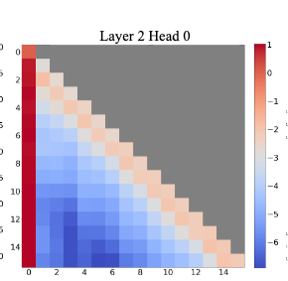
Other ways of predicting attention

Slide 78
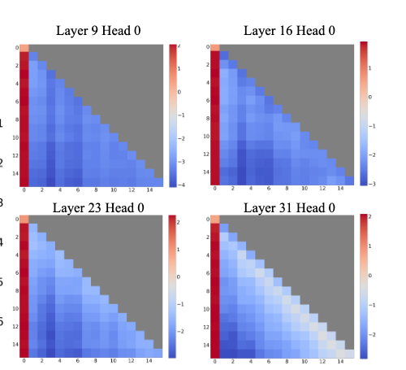
Other ways of predicting attention
Why are initial positions getting so much attention?

Slide 79
Other ways of predicting attention
Attention sinks
The Softmax operation requires attention scores to sum up to one .. when the current query does not have a strong match … the model still needs to allocate attention somewhere
Initial tokens are visible to almost all subsequent tokens .. making them readily trained to serve as attention sinks.

Slide 80
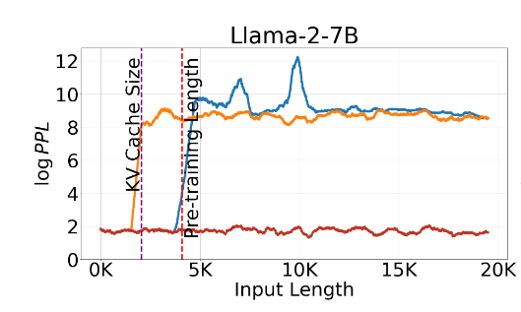
StreamingLLM
Note: I’m skipping some details involving relative positional encoding for now…
Proposed method
Fix the cache size to K
Generate tokens i=1, …, …
Keep the first 4 tokens and the most recent K-4
red: stream LLM
orange: sliding window attention
blue: dense attention

Slide 81
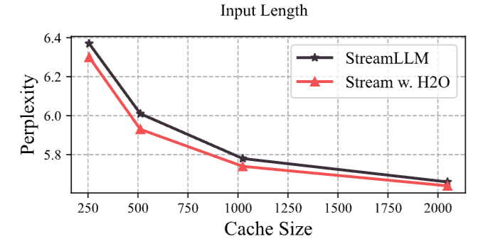
StreamingLLM and H2O
Proposed method
Fix the cache size to K
Generate tokens i=1, …, …
Keep the first 4 tokens and the most recent K-4

Slide 82
Outline
Compressing models
Distillation
Quantization
Pruning
Unstructured
Semi-Structured (e.g. 2:4 Pruning)
Structured
Key-value caching
Motivation and importance
Origin story
Long-context Transformers
Techniques
Heavy hitters – H2O
Attention sinks – StreamingLLM
Predictive caching – SnapKV

Slide 83
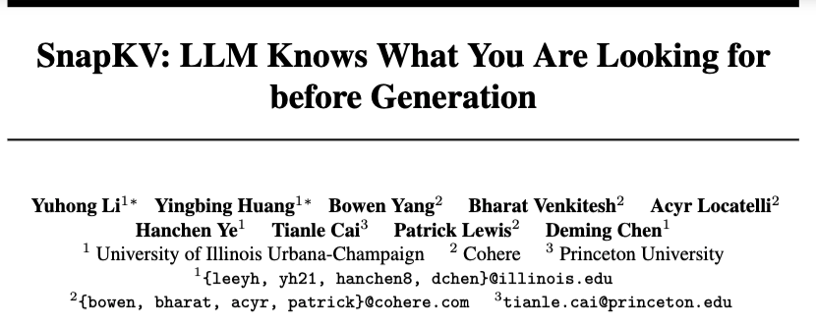
Predictive KV Caching
2024

Slide 84
Predictive KV Caching
Data: UltraChat
1.4M sequences, selected dialog turns with prompt > 3k tokens, and response > 512 tokens
New observation
The attention pattern for prompt tokens is consistent throughout decoding
The attention pattern for prompt tokens is predictable from LLM behavior before decoding starts

Slide 85
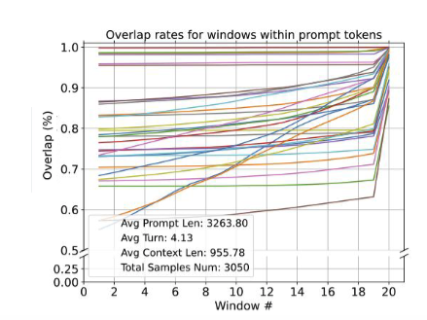
Predictive KV Caching
Example: Attn overlap between decoding and 128-tokens windows from the prompt
Each line is a layer
There is high overlap with the last window in the prompt
Notes:
What is the set with “high attn weights which determines overlap

Slide 86
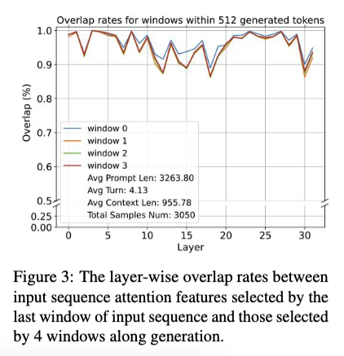
Predictive KV Caching
Example: Attn overlap between four 128-token windows in decoded response and last 128-token window in prompt

Slide 87
SnapKV: Details
Observation window: the n-th window in the prompt
Prefix: first n-1 windows in the prompt
SumAttn[head h, prefix position j]: attention weights
for head h to position j
summed over all positions in observation window
(W_{obs} in paper)
p: compression ratio, (e.g., 0.9)
Caching strategy: evict the KV cache entries for the bottom p*|Prefix| positions (for each head)
Refinement: also keep positions near a top (1-p) position (i.e., max-pool SumAttn locally)

Slide 88
SnapKV: Experiment
“Needle-in-a-haystack” problem:
a long document with a sentence inserted randomly in the middle (e.g., recommend a coffeehouse in Pittsburgh in the middle of the Lord of the Rings)
a question answerable by the inserted sentence

Slide 89
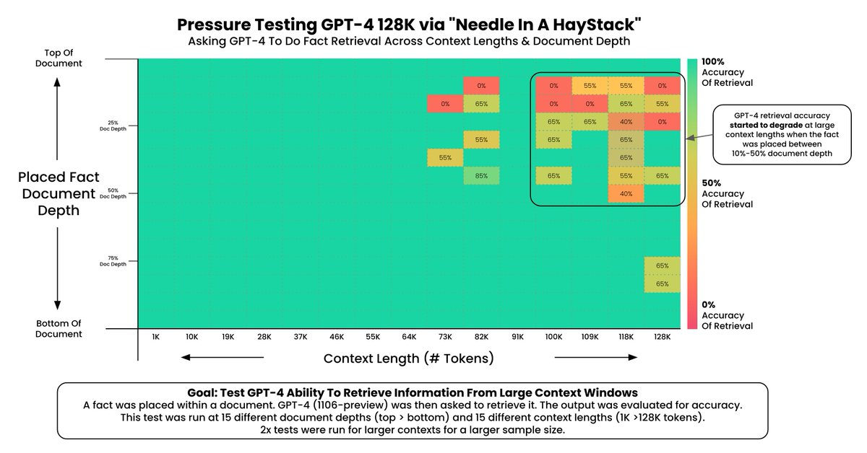
Needle in a Haystack: Background
Source: https://arize.com/blog-course/the-needle-in-a-haystack-test-evaluating-the-performance-of-llm-rag-systems/
Notes:
https://arize.com/blog-course/the-needle-in-a-haystack-test-evaluating-the-performance-of-llm-rag-systems/

Slide 90
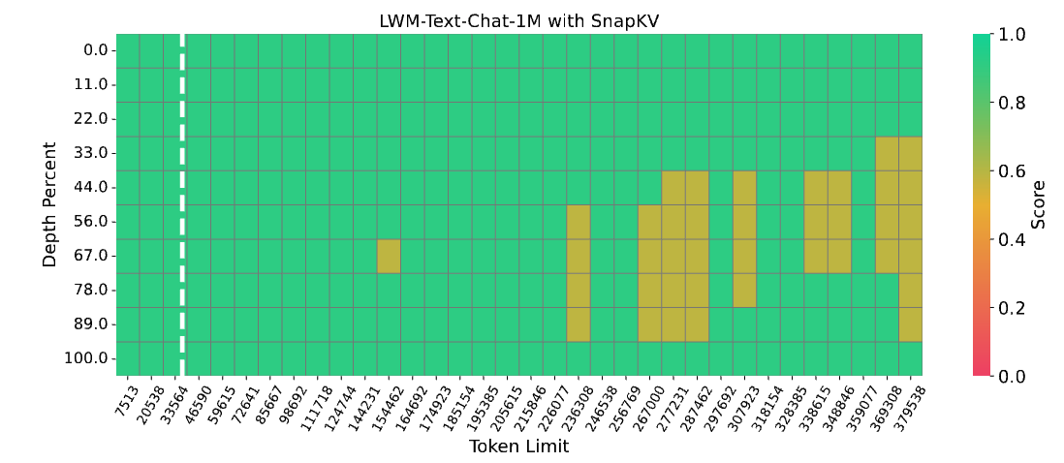
Needle in a Haystack: SnapKV results
Notes:
https://arize.com/blog-course/the-needle-in-a-haystack-test-evaluating-the-performance-of-llm-rag-systems/

Slide 91
Outline
Compressing models
Distillation
Quantization
Pruning
Unstructured
Semi-Structured (e.g. 2:4 Pruning)
Structured
Key-value caching
Motivation and importance
Origin story
Long-context Transformers
Techniques - discussion
Heavy hitters – H2O
Attention sinks – StreamingLLM
Predictive caching – SnapKV

Slide 92
Discussion
Heavy Hitter Oracle (H2O):
Observations:
power-law of cumulative attn
running total of cumulative attn is good approximation
Strategy: evict lowest cumulative attn KV pairs (during decoding)
Streaming LLM:
Observation: first few tokens are “attention sinks”
Strategy: don’t evict the first few tokens (during decoding)
Experiment: H2O is a little better with StreamingLLM
SnapKV:
Observation: last window of prompt predicts attention during decoding
Strategy: compress the KV pairs from the prompt based on last-window attention before decoding

Slide 93
Discussion
Main cost of Transformers: attention
Key optimization: restricting attention
Restricted attention in decoder-only models: key-value cache manipulation
Key-value cache management is an active research area

