Slide 1
10-605 / 10-405
Machine Learning from Large Datasets

Slide 2
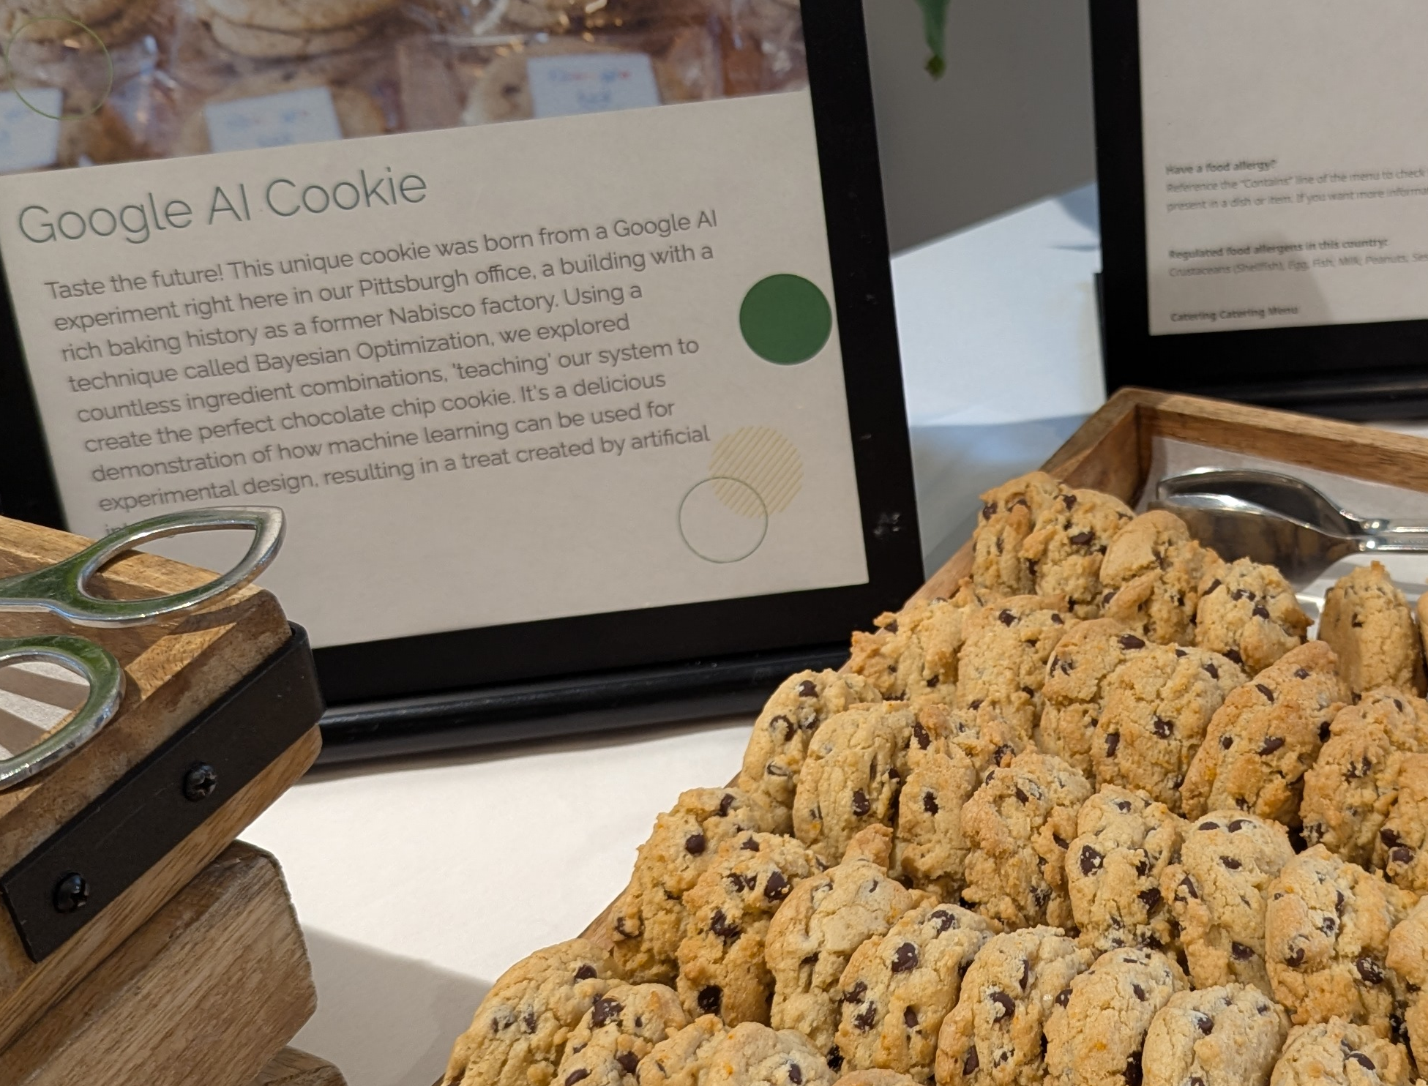

Slide 3
Outline
Quick review of distillation
Model Quantization
Model Pruning
Some motivation
Some approaches

Slide 4
MAKING BIG Transformers SMALLER

Slide 5
Main techniques for compressing models
Distillation
Train a smaller “student model” to give the same outputs as a larger “teacher model”
Usually on a particular task
Model pruning
Remove parts of a large model and re-train
Quantization
Replace floating-point operations in parts of the model with lower-precision versions

Slide 6
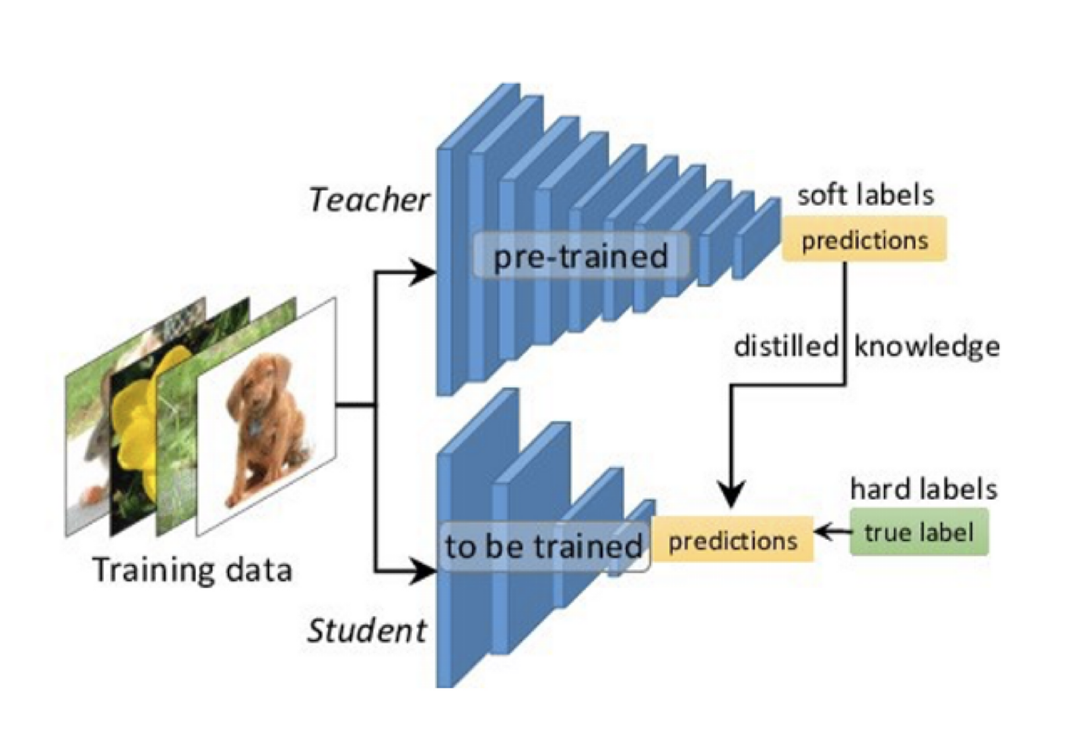
Distillation
Typically we distill a model on lots and lots of data only labeled by the teacher (transfer set)
Notes:
https://arxiv.org/pdf/1503.02531

Slide 7
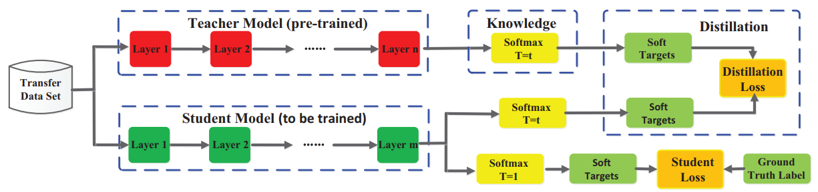
Distillation
Hinton’s model distillation approach: from https://arxiv.org/pdf/2006.05525
Notes:
https://arxiv.org/pdf/1503.02531

Slide 8
Main techniques for compressing models
Distillation
Train a smaller “student model” to give the same outputs as a larger “teacher model”
Usually on a particular task
Model pruning – more later!
Remove parts of a large model and re-train
Quantization
Replace floating-point operations in parts of the model with lower-precision versions
Notes:
STOPPED HERE

Slide 9
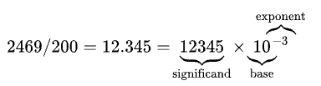
Quantization: Background
Scientific notation:
±

Slide 10
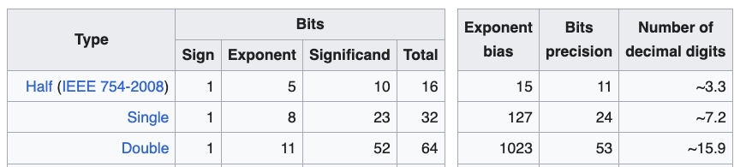
Quantization: Background
Scientific notation:
±
Subtract bias from stored exponent to get true exponent, so float range of exponents is [-126, 127]
IEEE standards for hardware:

Slide 11
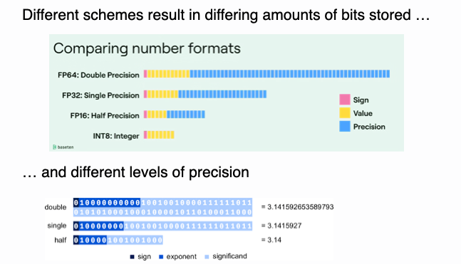
Quantization: Background

Slide 12
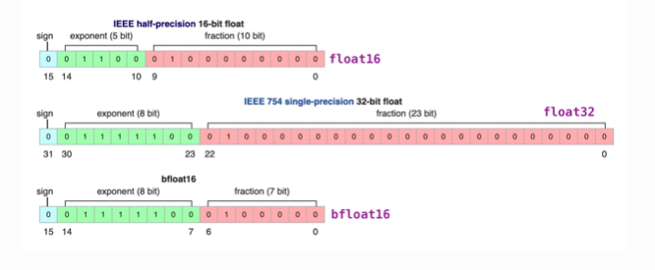
Quantization: Background
PyTorch, TensorFlow, many accelerators, … support bfloat16 as well
Some chips support fp8 but training with it is tricky (see DeepSeek)
…but training with 16 bit floats often works
Traditionally: train with float32…then it’s easy to truncate to bfloat16 for inference.

Slide 13
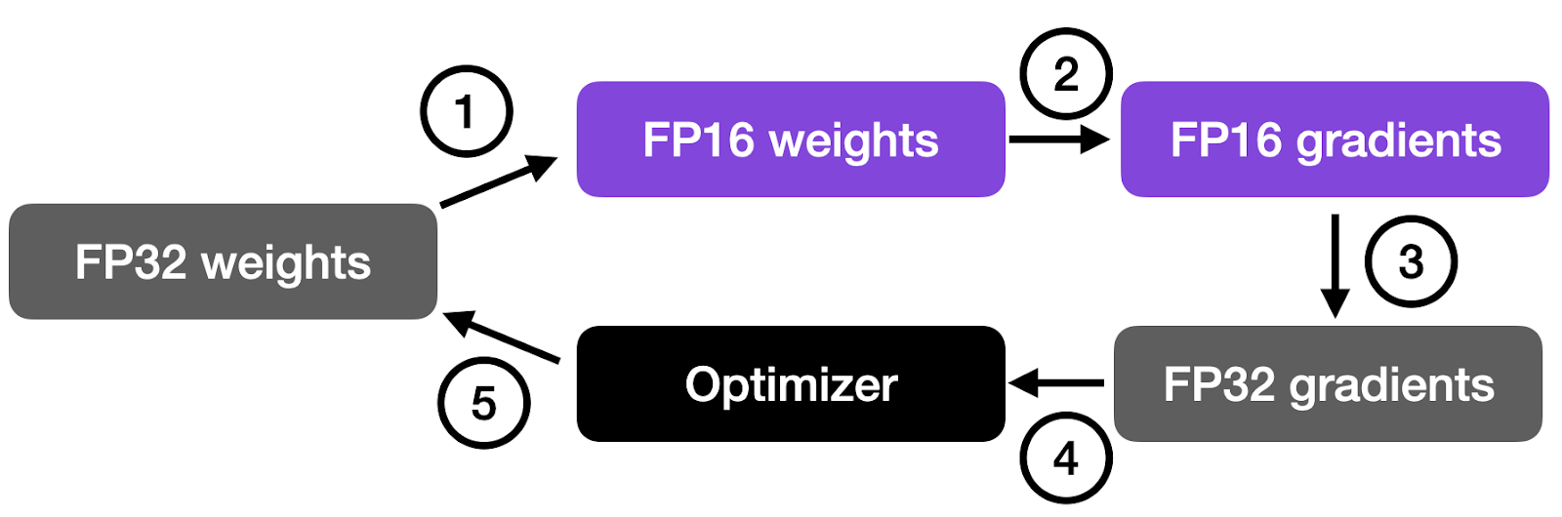
Quantization: Background
Working with even fp32 requires some care
E.g., accelerators support “fused multiply add” (FMA)
FMA(x,y,z)=round(x*y + z) != round(round(x*y) + z)
Dot product computation is chain of FMAs
FP16 usually is part of mixed precision training
optimizer accumulates gradients and scales them (by learning rate)
Matmul precision can also be adjusted
Notes:
https://sebastianraschka.com/blog/2023/llm-mixed-precision-copy.html

Slide 14
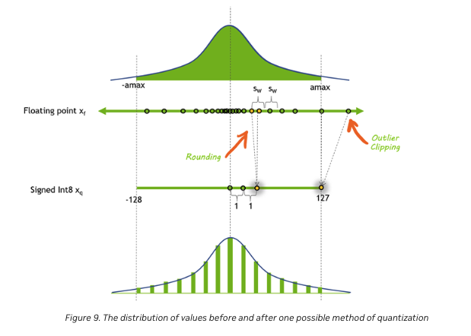
Quantization: Beyond 16 bits
Notes:
https://developer.nvidia.com/blog/mastering-llm-techniques-inference-optimization/

Slide 15
Quantization: Beyond 16 bits
Going from fp32 → int8 or int4 requires some tricks:
Quantize different parts of the model differently
quantize(x; S, Z) = round(x/S + Z)
S is “scale”
Z is “zero point”
S, Z are set for this model slice to get the needed range [⍺,β]
do as much as you can in quantized space instead of quantizing and de-quantizing frequently (the FMA trick)
complete matmul, conv2D-BatchNorm-ReLU
Quantize dynamically
set S, Z after you see the activation values
Don’t quantize everything
eg bias layers aren’t usually quantized
Notes:
https://leimao.github.io/article/Neural-Networks-Quantization/
Note: these tricks need to be h/w and library aware!

Slide 16
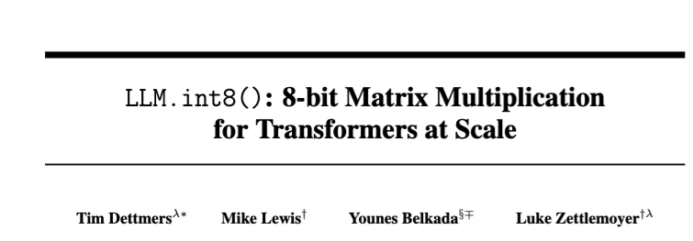
Quantization: Beyond 16 bits
2022
Notes:
https://proceedings.neurips.cc/paper_files/paper/2022/file/c3ba4962c05c49636d4c6206a97e9c8a-Paper-Conference.pdf

Slide 17
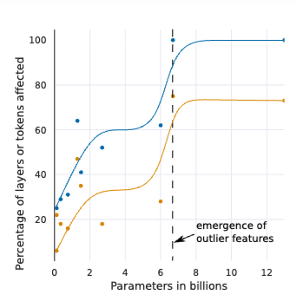
Quantization: Beyond 16 bits
Feature: any single dimension of a token representation
Outlier feature: magnitude >= 6 in 25% of the layers and 6% of “sequence dimensions”
sequence dimension: token positions
Observation: outliers are
probabilistic in smaller models (in some layers and not others)
systematic in larger models (most layers)
Notes:
https://proceedings.neurips.cc/paper_files/paper/2022/file/c3ba4962c05c49636d4c6206a97e9c8a-Paper-Conference.pdf

Slide 18
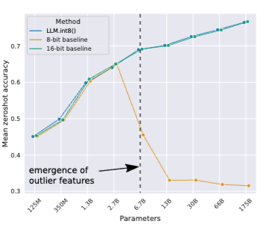
Quantization: Beyond 16 bits
Feature: any single dimension of a token representation
Outlier feature: magnitude >= 6 in 25% of the layers and 6% of “sequence dimensions”
sequence dimension: token positions
Observation: outliers are
probabilistic in smaller models (in some layers and not others)
systematic in larger models (most layers)
Hypothesis: outlier features are why int8 stops working!
Notes:
https://proceedings.neurips.cc/paper_files/paper/2022/file/c3ba4962c05c49636d4c6206a97e9c8a-Paper-Conference.pdf

Slide 19
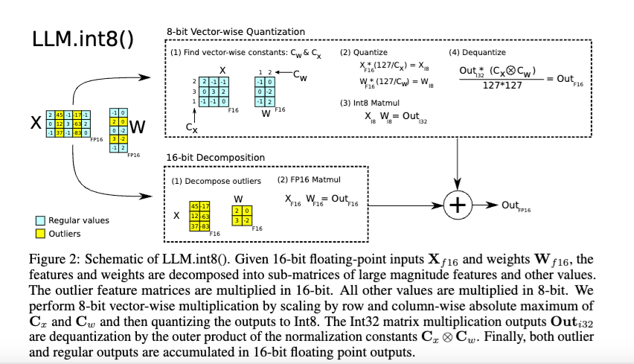
Quantization: Beyond 16 bits
Going from fp32 → int8 or int4 requires some tricks:
Mixed-precision quantization – keep large “outlier” features (which are consistently in fixed locations)
Notes:
https://proceedings.neurips.cc/paper_files/paper/2022/file/c3ba4962c05c49636d4c6206a97e9c8a-Paper-Conference.pdf

Slide 20
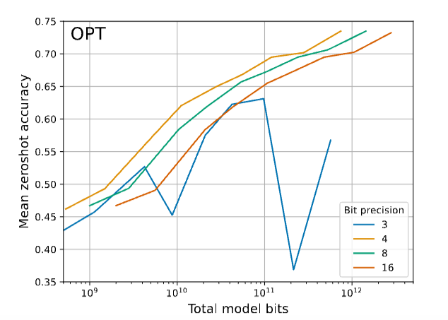
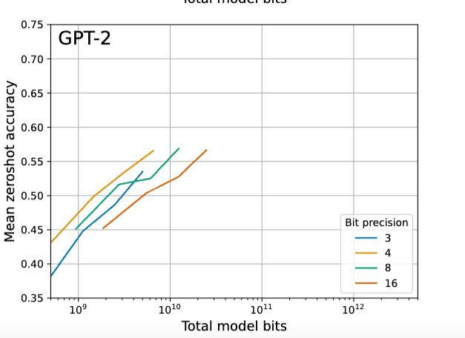
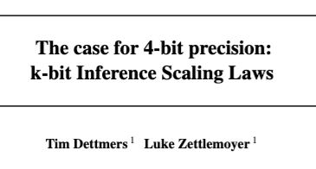
Quantization: Performance Tradeoffs
2023
Notes:
https://openreview.net/forum?id=i8tGb1ab1j

Slide 21
Quantization: Beyond 4 bits
You can also adjust training
add “quantization layers” at training
introduce the same sort of “noise” that quantization introduces
learned network will be more robust to quantization “noise”
Notes:
https://openreview.net/forum?id=i8tGb1ab1j

Slide 22
Quantization: Beyond 4 bits
Quantization-aware training
(de)quantization operations are not differentiable
partial solutions
approximate the ops
use “straight through estimation” (STE) of gradients
extreme quantization requires methods quantize vectors by combining vectors from a “codebook”
similar to product quantization
e.g. ”additive quantization”
learning should ideally jointly optimize the continuous parts (codebook values) and discrete parts (assignment of values to code)
this can’t be done with gradient descent only
Notes:
https://openreview.net/forum?id=i8tGb1ab1j

Slide 23
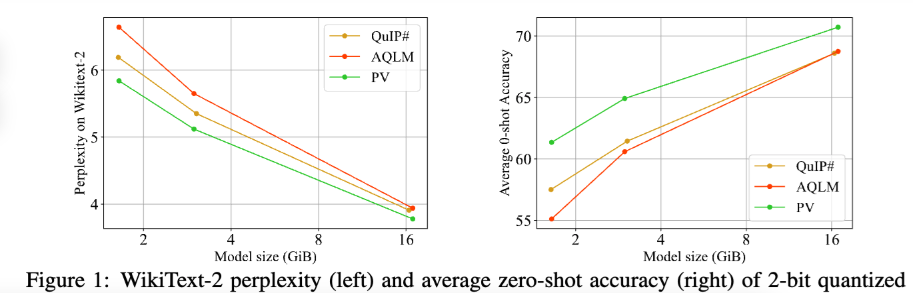
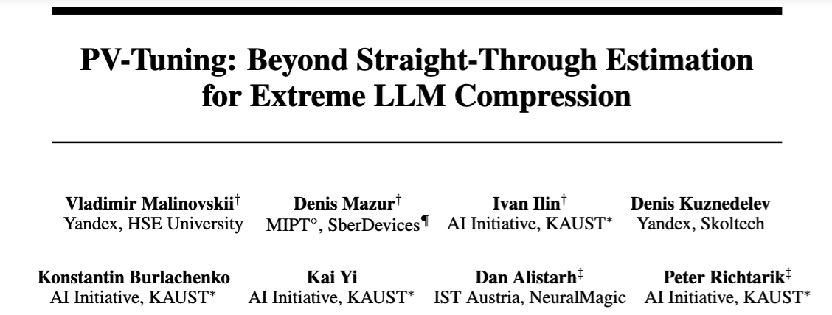
Quantization: Performance Tradeoffs
2024
Notes:
https://openreview.net/forum?id=i8tGb1ab1j

Slide 24
Main techniques for compressing models
Distillation
Train a smaller “student model” to give the same outputs as a larger “teacher model”
Usually on a particular task
Model pruning
Remove parts of a large model and re-train
Quantization
Replace floating-point operations in parts of the model with lower-precision versions

Slide 25
Outline
Quick review of distillation
Model Quantization
Model Pruning
Some motivation
Some approaches
Unstructured pruning
Semi-structured pruning
N:M pruning
Structured pruning

Slide 26
Intuitions about compression methods
Quantization
You need more precision for learning than for inference
Distillation
It may be easier to optimize a big model than a smaller model
optimizer is searching a less constrained space
Learning a big model for a hard pre-training task may require that model to learn something about many useful subtasks
A small model might be able to learn how to replicate the large models’s behavior on one subtask
Same for pruning?

Slide 27
AsiDE: Semantically Meaningful Neurons?

Slide 28
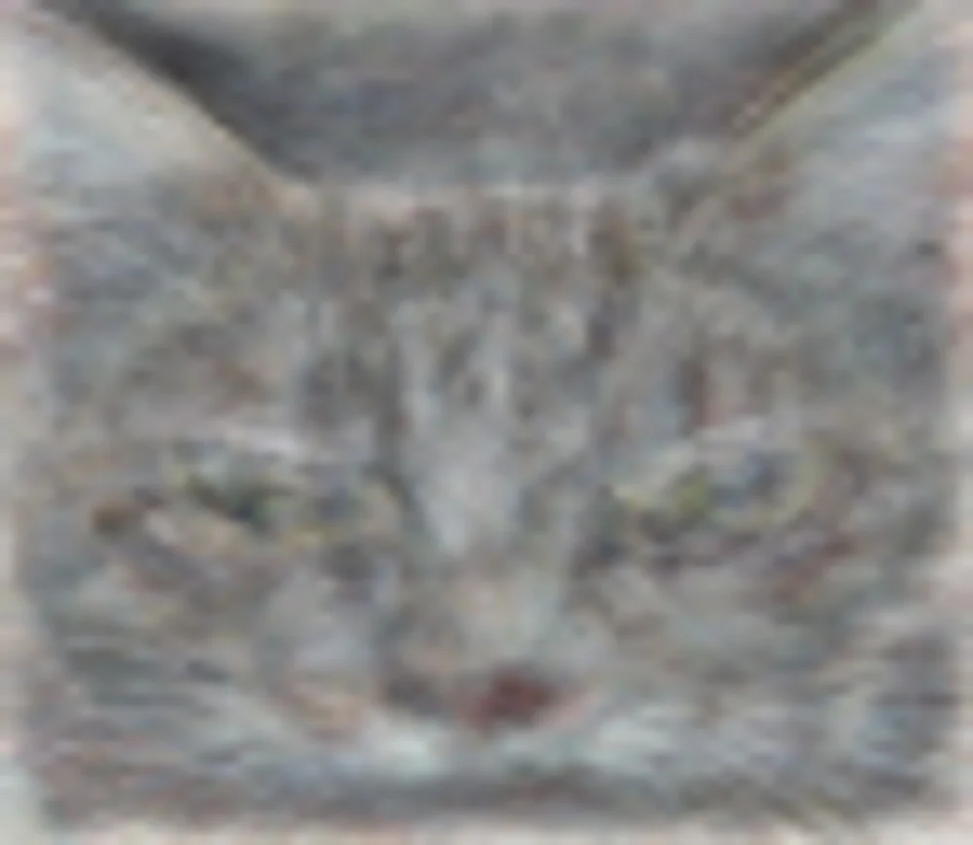
The Cat Neuron Paper

Slide 29
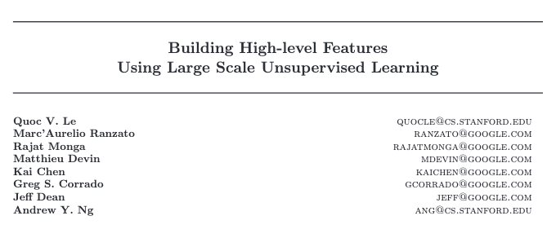
The Cat Neuron Paper
2012 ICML

Slide 30
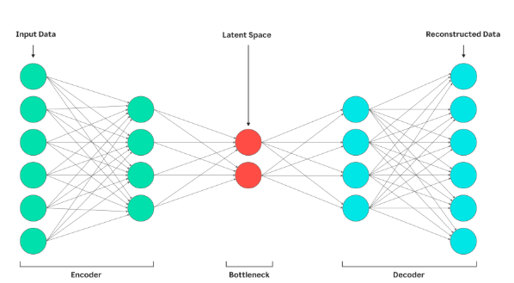
Background: AutoEncoders
Autoencoder is DL version of matrix completion
input and target output are the same
in between is an ANN with a “bottleneck” layer
data has to be compressed ➔ generalized
Notes:
https://static.googleusercontent.com/media/research.google.com/en//archive/unsupervised_icml2012.pdf

Slide 31
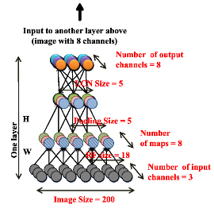
The Cat Neuron
Data:
10M YouTube videos
one 200x200 color image from each
Architecture:
autoencoder with
local receptive fields (like CNN but less sharing)
pooling and normalization
Scale:
1B params
trained on 1000 16-core machines, model- and data-parallel, async SGD
Notes:
https://static.googleusercontent.com/media/research.google.com/en//archive/unsupervised_icml2012.pdf

Slide 32
The Cat Neuron
Experiment:
Test every neuron for performance at classifying face images
37k images, mostly ”aligned”
13k faces, rest distractor images from ImageNet
tried 20 different thresholds for each image
Baseline: “no face” is 64.8% accurate
Best single neuron is 81.7% accurate
Notes:
https://static.googleusercontent.com/media/research.google.com/en//archive/unsupervised_icml2012.pdf

Slide 33
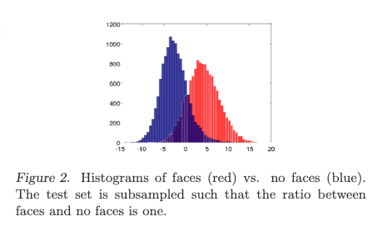
The Cat Neuron
Histogram of scores on a balanced test set
Notes:
https://static.googleusercontent.com/media/research.google.com/en//archive/unsupervised_icml2012.pdf

Slide 34
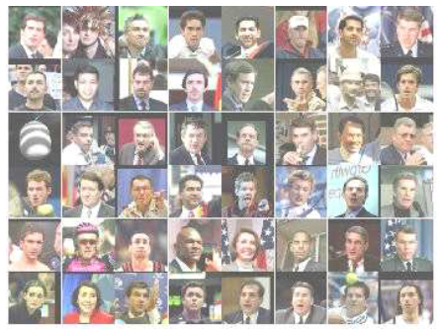
The Cat Neuron
Test inputs with highest activation
Notes:
https://static.googleusercontent.com/media/research.google.com/en//archive/unsupervised_icml2012.pdf

Slide 35

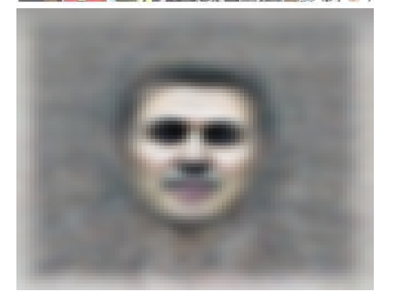
The Cat Neuron
“Ideal” input for the face neuron
Gradient descent to find best input given fixed parameters (H is pooling weights)
“Subject to…”: after each gradient step, re-normalize the constructed image
Notes:
https://static.googleusercontent.com/media/research.google.com/en//archive/unsupervised_icml2012.pdf

Slide 36
The Cat Neuron
Experiment 2: Same but with cat images
Notes:
https://static.googleusercontent.com/media/research.google.com/en//archive/unsupervised_icml2012.pdf

Slide 37
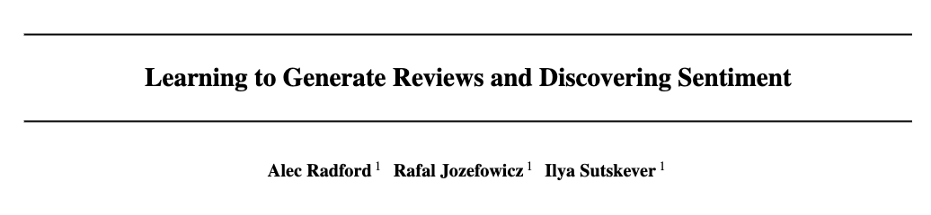
The Sentiment Neuron
2017
Notes:
https://arxiv.org/pdf/1704.01444

Slide 38
The Sentiment Neuron
Data
82M Amazon product reviews
Architecture
Single layer “multiplicative” LSTM, 4096 units
hybrid of LSTM and an alternative kind of RNN
not widely used AFAIK
Model is trained to generate the review data
A logistic regression classifier is trained using the LSTM’s representation as input for tasks like paraphrase detection, semantic relatedness, ….
The classifier uses L1 regularization
Notes:
https://arxiv.org/pdf/1704.01444

Slide 39
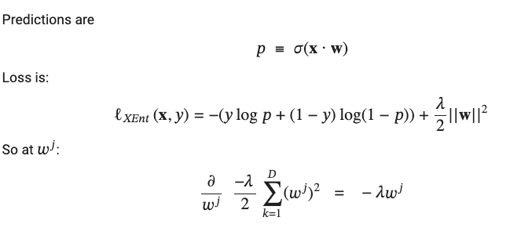

Recap: Regularized Logistic Regression
L2 regularizer

Slide 40

L1-Regularized Logistic Regression
“lasso”
L1 regularizer
L1 regularizer encourages sparse weights (many are zero)

Slide 41
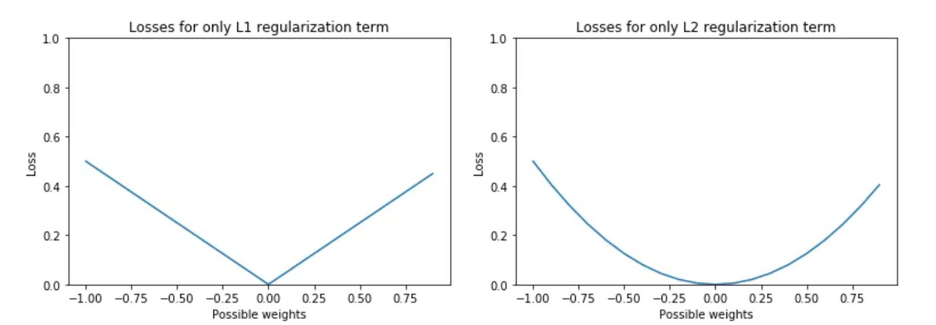
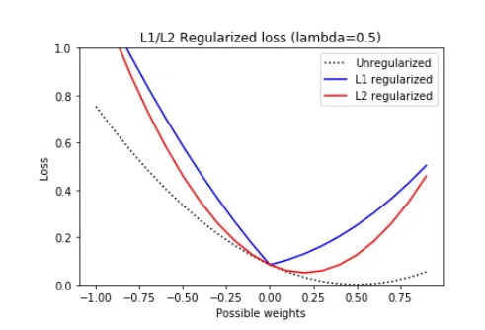
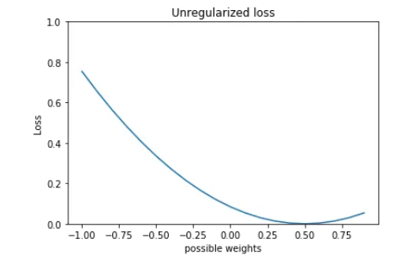
L1-Regularized Logistic Regression

Slide 42
The Sentiment Neuron
Data
82M Amazon product reviews
Architecture
Single layer “multiplicative” LSTM, 4096 units
hybrid of LSTM and an alternative kind of RNN
not widely used AFAIK
Model is trained to generate the review data
A logistic regression classifier is trained using the LSTM’s representation as input for tasks like paraphrase detection, semantic relatedness, ….
The classifier uses L1 regularization
Notes:
https://arxiv.org/pdf/1704.01444

Slide 43
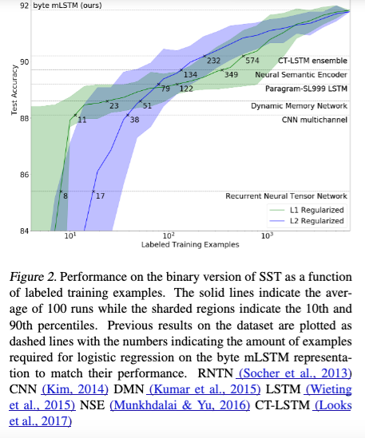
The Sentiment Neuron
Accuracy on the Stanford Sentiment TreeBank dataset (SST)
Notes:
https://arxiv.org/pdf/1704.01444

Slide 44
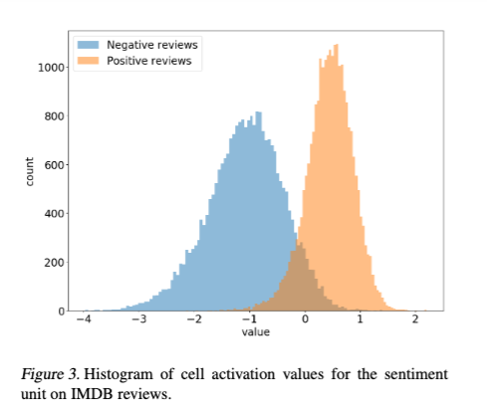
The Sentiment Neuron
As before, there is a single feature that is highly correlated with sentiment
It’s easy to find looking at the L1 classifier weights:
“By inspecting the relative contributions of features on various datasets, we discovered a single unit within the mLSTM that directly corresponds to sentiment.”
Notes:
https://arxiv.org/pdf/1704.01444

Slide 45
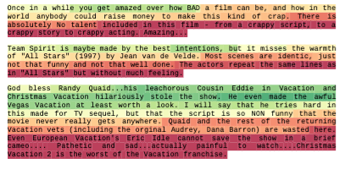

The Sentiment Neuron
Notes:
https://arxiv.org/pdf/1704.01444

Slide 46
Outline
Quick review of distillation
Model Quantization
Model Pruning
Some motivation
Some approaches

Slide 47
Model pruning
Unstructured pruning
zero out individual weights anywhere in the model
Structured pruning
zero out entire architectural components, e.g.
a complete attention head
a complete Transformer layer
…
Semi-structured pruning
somewhere in between these extremes

Slide 48
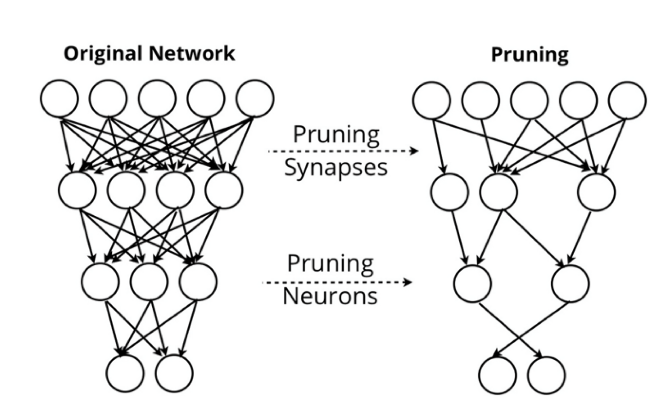
Unstructured pruning
Unstructured pruning
zero out individual weights or neurons
anywhere in the model
re-train
- optionally repeat
Design decisions:
Which subset to prune?
How much to re-train, and on what data?
Do you iterate or not?
When do you stop?
HW5 will let you explore some of these ideas on your own

Slide 49
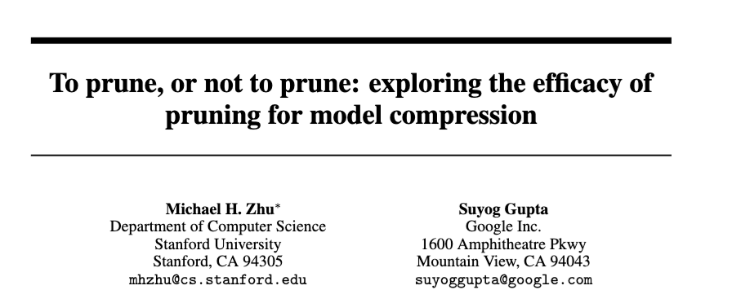
Unstructured pruning
A sample paper…
2017
Notes:
https://arxiv.org/pdf/1710.01878

Slide 50
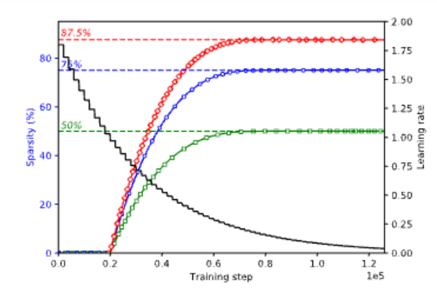
Unstructured pruning
Design decisions:
Which subset to prune?
How much to re-train, and on what data?
Do you iterate or not?
When do you stop?
For each layer to prune:
Repeat i=1,…,t:
Sort weights by |w_{j}|
Zero* out weights to reach sparsity s_{i}
*by adjusting a binary mask
Re-train for n steps (also adjusting learning rate)

Slide 51
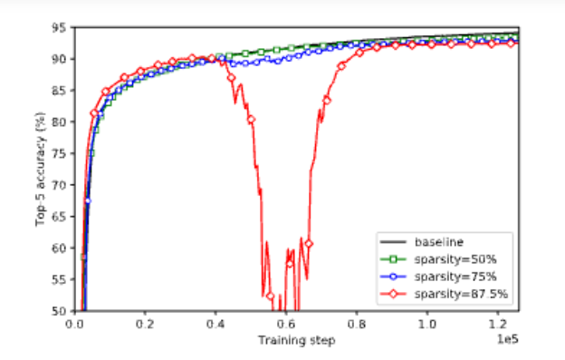
Unstructured pruning
Observations (on CNNs):
pruning only occasionally causes major degradation in performance
performance recovers quickly with re-training
performance only slightly degrades even with lots of sparsity
For each layer to prune:
Repeat i=1,…,t:
Sort weights by |w_{j}|
Zero* out weights to reach sparsity s_{i}
*by adjusting a binary mask
Re-train for n steps (also adjusting learning rate)

Slide 52
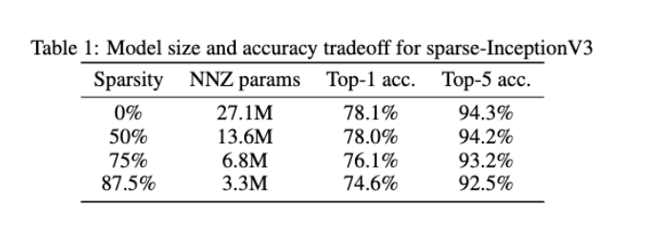
Unstructured pruning
Observations (on CNNs):
performance only slightly degrades even with lots of sparsity
e.g., setting 87.5% of the weights to zeros increases error by 2% decrease in accuracy

Slide 53
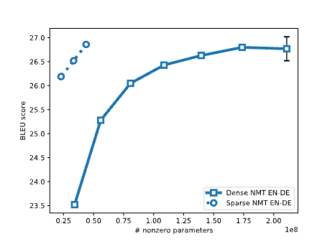
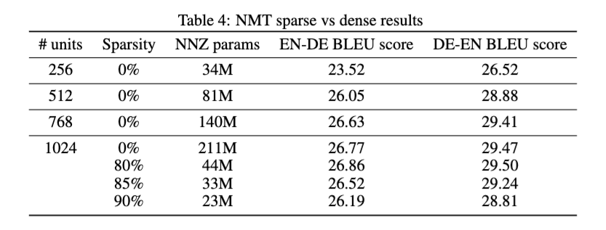
Unstructured pruning
Observations (on LSTMs):
large pruned models often outperform smaller dense models!

Slide 54
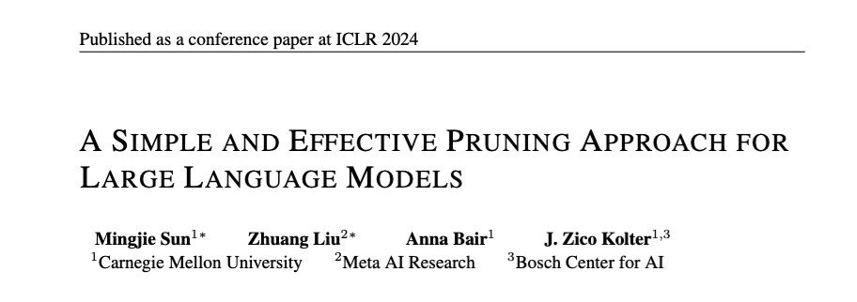
Unstructured pruning
Notes:
https://arxiv.org/abs/2306.11695

Slide 55

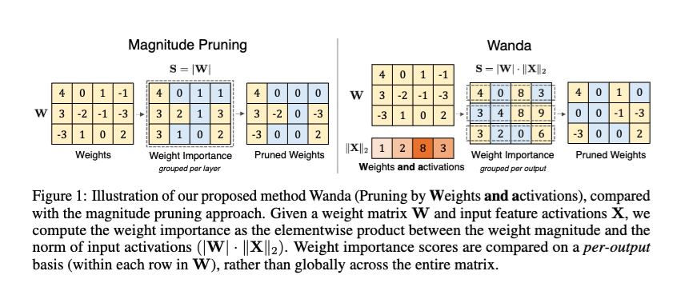
Unstructured pruning

Slide 56
Recap: Quantization: Beyond 16 bits
Going from fp32 → int8 or int4 requires some tricks:
Mixed-precision quantization – keep large “outlier” features (which are consistently in fixed locations)
Notes:
https://proceedings.neurips.cc/paper_files/paper/2022/file/c3ba4962c05c49636d4c6206a97e9c8a-Paper-Conference.pdf

Slide 57
Unstructured pruning
Small weights can have a large effect on output values when they are multiplied by large “outlier” activations.

Slide 58
Unstructured pruning: Wanda
Design decisions:
Which subset to prune?
How much to re-train, and on what data?
Do you iterate or not?
When do you stop?
Rank weights in “comparison group” by score S_{ij}
Don’t re-train
Don’t iterate

Slide 59
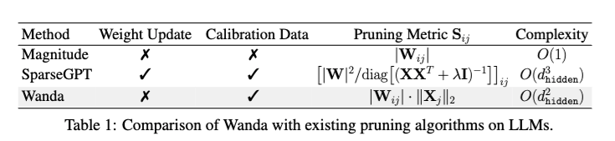
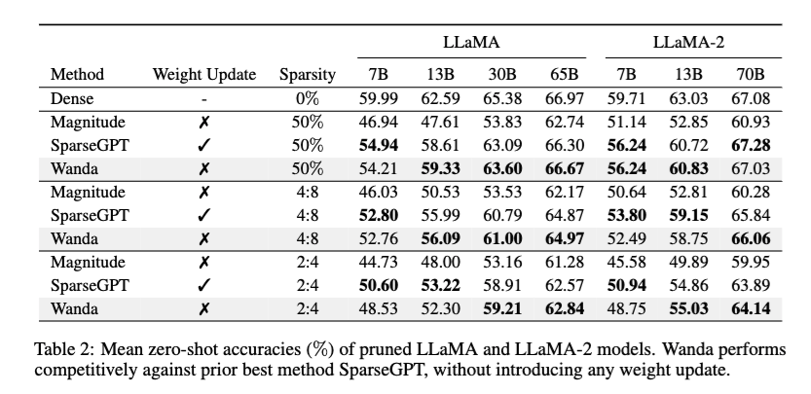
Unstructured Pruning

Slide 60
Unstructured pruning
WANDA shows that the metric used for pruning can be important
What other metrics are plausible?

Slide 61
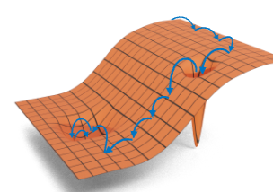
Recall: Stochastic gradient descent
For non-convex problems SGD/GD find a local minimum. SGD tends to find “flat”, not “sharp” local minima.
Variants of SGD are almost always used in deep learning.
sample a “minibatch” of examples B<<N
approximate the gradient using them
“on average” this is the right direction
take a step in that direction
repeat….
SGD is very memory-efficient!
Notes:
training loss bounces around

Slide 62
Unstructured pruning
WANDA shows that the metric used for pruning can be important
What other metrics are plausible?
What other metrics are available?
Gradients
non-zero when you are iterating or calibrating on something not the training data
steep gradient means the weight has an impact
Hessians (curvature)
Small weight/gradient in a “sharp” minima may be unstable and become important when something else is pruned
Approximated in some optimizers (AdaGrad)

Slide 63
Unstructured pruning
HW5 looks at similar setting: prune a large model to
preserve performance on a task
decrease the number of non-zero (NNZ) parameters
Caveat: in real life more zeros does not mean that a model is faster to run, or takes up less space on a GPU
Why?

Slide 64

Aside: sparse vs dense matrix operations
Consider dot product – easy to parallelize!
Sparse dot product
a = [(i1, a_{i1}), …,. (ik, a_{ik})]
b = [(j1, b_{j1}), …,. (jl, b_{jl})]
lists of nonzero values
sorted by index
Algorithm: merge the two lists to find common NZ indices [(c1, a_{c1}, b_{c1}), ….]
Sorting/sparse matrices are generally not supported on TPUs and GPUs

Slide 65
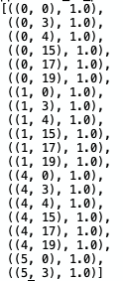
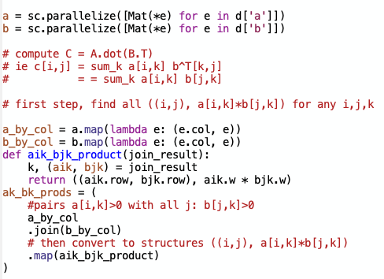
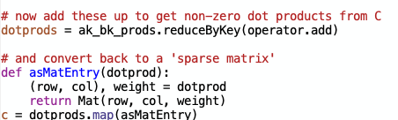

Slide 66
Unstructured pruning
HW5 looks at similar setting: prune a large model to
preserve performance on a task
decrease the number of non-zero (NNZ) parameters
Caveat: in real life more zeros does not mean that a model is faster to run, or takes up less space on a GPU
Why? Unstructured sparsity is not supported by GPUs/TPUs

Slide 67
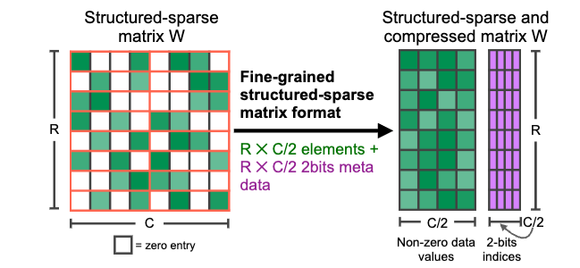
What sparse operations are supported?
Nvidia supports 2:4 sparse matrices
General version is “N:M”
In each contiguous block of 4 weights at least 2 are zero.
Notes:
https://arxiv.org/abs/2104.08378

Slide 68
From unstructured to N:M pruning
Rank all weights
Compare weight scores to a “comparison set”
The four weights in a block
Drop the worse 2 of those 4 weights
Notes:
https://arxiv.org/abs/2104.08378

Slide 69
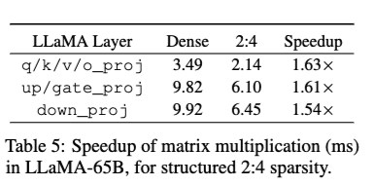
What sparse operations are supported?
Nvidia supports 2:4 sparse matrices
General version is “N:M”
In each contiguous block of 4 weights at least 2 are zero.
Speeds for WANDA using semi-structured N:M pruning
Notes:
https://arxiv.org/abs/2104.08378

Slide 70
What sparse operations are supported?
Nvidia supports 2:4 sparse matrices
General version is “N:M”
In each contiguous block of 4 weights at least 2 are zero.
Notes:
https://arxiv.org/abs/2104.08378

Slide 71
Model pruning
Unstructured pruning
zero out individual weights anywhere in the model
Structured pruning
zero out entire architectural components, e.g.
a complete attention head
a complete Transformer layer
…
Semi-structured pruning
somewhere in between these extremes
N:M pruning is the most common variant

Slide 72
Model pruning
Unstructured pruning
zero out individual weights anywhere in the model
Structured pruning
zero out entire architectural components, e.g.
a complete attention head
a complete Transformer layer
…
Semi-structured pruning
somewhere in between these extremes

Slide 73

Structured Pruning: Shortened Llama
2024
Notes:
https://openreview.net/forum?id=18VGxuOdpu

Slide 74

Structured Pruning: Shortened Llama
Approach
For each layer, compute increase in PPL on a calibration set if removed
Also use a gradient*weight metric, Taylor+
Prune layers one-shot to get target size
Retrain with LoRA

Slide 75

Structured Pruning: Shortened Llama

Slide 76

Structured Pruning
2023
Notes:
https://proceedings.neurips.cc/paper_files/paper/2023/file/44956951349095f74492a5471128a7e0-Paper-Conference.pdf

Slide 77

Structured Pruning: LLM Pruner
Some key ideas:
Coupled structures: If neuron N_{j}’s only input is the output of N_{i} then they are coupled, and must be pruned together (or not at all)

Slide 78

Structured Pruning: LLM Pruner
Some key ideas:
Group importance: e.g., sum weight importance over all weights in a group.
Retrain using LoRA using a small external dataset of zero-shot prompts

Slide 79

Structured Pruning
2024
Notes:
https://arxiv.org/pdf/2310.06694

Slide 80

Structured Pruning: Sheared Llama
Some key ideas:
Prune to a particular target architecture
E.g., use the INCITE-Base-3B architecture as the target structure when producing a 2.7B model
This means learning masks with target number of non-zeros for each attention head, etc

Slide 81
Structured Pruning: Sheared Llama
Some key ideas:
Prune to a particular target architecture
Optimize a loss that includes PPL on a validation set + loss indicating how masks are mismatched to target architecture
Use Lagrange multipliers and soft approximation of the mask in training (slow!)

Slide 82
Structured Pruning: Sheared Llama
Some key ideas:
Prune to a particular target architecture
E.g., use the INCITE-Base-3B architecture as the target structure when producing a 2.7B model
This means learning masks with target number of non-zeros for each attention head, etc

Slide 83
Structured Pruning: Sheared Llama
Some key ideas:
Prune to a particular target architecture
Optimize a loss that includes PPL on a validation set + loss indicating how masks are mismatched to target architecture
Use Lagrange multipliers and soft approximation of the mask in training (slow!)

Slide 84
Structured Pruning: Sheared Llama
Some key ideas:
Prune to a particular target architecture
Pruning and retraining are done in the same optimization pass
Retrain to a ”reference loss” predicted by scaling laws.
In pruning/retraining, focus on high-loss slices of the data.

Slide 85

Structured Pruning: Sheared Llama
Training/pruning is expensive but much cheaper than separately training a comparable-sized small model from scratch.

Slide 86

Main techniques for compressing models
Distillation
Train a smaller “student model” to give the same outputs as a larger “teacher model”
Usually on a particular task
Model pruning
Remove parts of a large model and re-train
Quantization
Replace floating-point operations in parts of the model with lower-precision versions
Combinations?
Notes:
Han et al, ICLR 2016
https://arxiv.org/pdf/1510.00149

