Slide 1
10-605 / 10-405
Machine Learning from Large Datasets

Slide 2
Outline – last week
Review of how to learn retrievers
Contrastive learning
DPR and Contreiver
Using decoder-only LLMs for retrieval
query expansion
generating encodings
Retrieval-augmented generation (RAG)
The original RAG paper
The fusion-in-decoder (FiD) paper
A case study: optimizing inference for FiD
Systems: FiDO, LUMEN, GLIMMER
Incorporating principles from RAG, FiD in decoder-only LLMS

Slide 3
Outline – today
RAG
Quick Review of last week
Contrastive learning
DPR and Contreiver, RAG, FiD
A case study: optimizing inference for FiD
FiDO
LUMEN
Some new RAG systems
GLIMMER
Decoder-only systems related to RAG/FiD (new work)
“Embarrassingly parallel” ML tricks (new work)
Branch-train-merge and -mix: very parallel LLM pre-training
Task vectors: very parallel LLM fine-tuning

Slide 4
Retrieval Augmented LLMs A RECAP

Slide 5
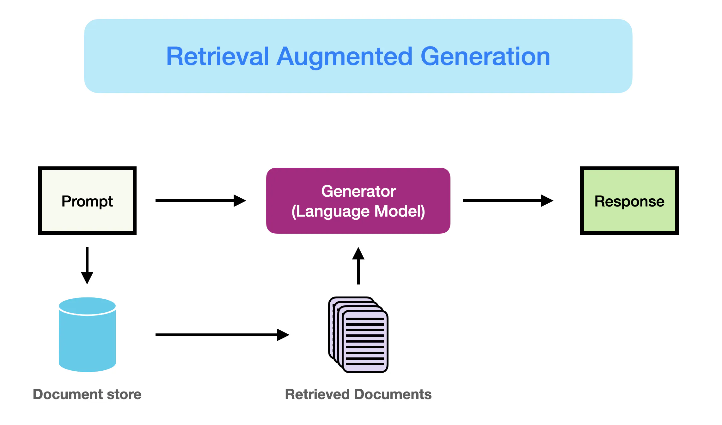
Access new information (not available during model pretraining)
Better access “long tail” information that is mentioned infrequently in pre-training documents
Needs strong retrieval

Slide 6
Recap: The Dense Passage Retriever (DPR)
Process several QA datasets to get triples:
(question, gold passage id, gold answer span)
Triples give positive question/passage examples (q_{i}, p_{i}) encoded in d=768 dimensions by pre-trained BERT
Q is mini-batch of B questions, P is B passages, S = QP^{T} is (B x B) matrix of similarity scores
score is positive for q_{i}, p_{j} iff i=j
“in-batch negatives” trick
also add as additional hard negatives
1-2 passages with high TFIDF score to q which do not contain the answer span

Slide 7
Recap: Contriever vs DPR
Same NT-Xent contrastive loss
One BERT encoder instead of two
Data augmentation tricks explored
Independent cropping
Random token deletion
Negatives were from
in-batch negatives
momentum contrast (MoCo)
MoCo: dynamic dictionary queue and averaging last two models to find hard negatives

Slide 8
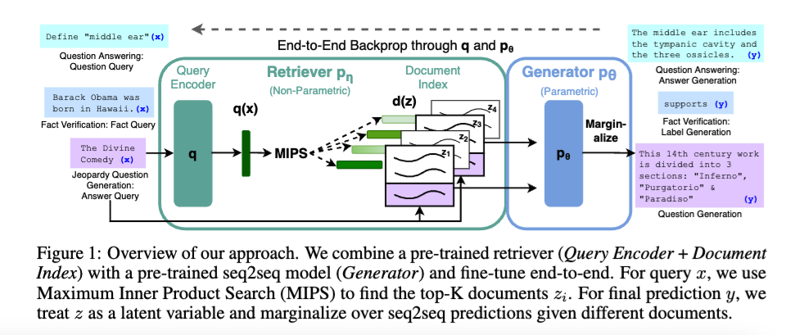
Recap: The OG RAG paper
sort of
returns top K docs

Slide 9




Recap: The OG RAG paper
updated in training
frozen – not updated!
Even simpler decoding strategy
$$p\left(y | x\right)= \prod_{i}^{N}{p(y_{i}|x,z_{1},…,z_{K},y_{1:i−1})}$$
based on DPR
returns top K docs
based on BART
(BERT-sized encoder-decoder)

Slide 10
Recap: Discussion of RAG
RAG is now generic term for using retrieval as preprocessing step for LLMs
Simplest case is fixed retriever, and appending all docs to the question to form LLM input
No custom learner / model / model-combination!
Simple case improves immediately whenever
LLM improves
retriever improves
Appending docs scales poorly when many documents are used
but there are some tricks to improve that
$$p\left(y | x\right)= \prod_{i}^{N}{p(y_{i}|x,z_{1},…,z_{K},y_{1:i−1})}$$

Slide 11
Recap: Discussion of RAG
RAG is now generic term for using retrieval as preprocessing step for LLMs
Simplest case is fixed retriever, and appending all docs to the question to form LLM input
No custom learner / model / model-combination!
Simple case improves immediately whenever
LLM improves
retriever improves
Appending docs scales poorly when many documents are used
but there are some tricks to improve that ➔ FiD

Slide 12
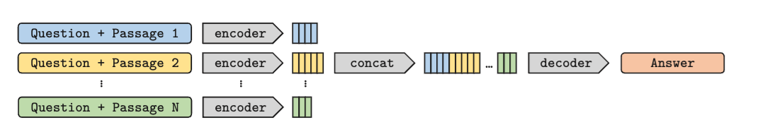
Recap: Fusion in Decoder (FiD)
In open-book QA, often
Questions q and answer a are short: k=O(10)
Passages are longer: m=O(100)
Retrieving and appending N passages:
Encoder = O(Nm + k)²
Decoder = O(k * (Nm + k))
Trick:
cross-encode q with each passage separately: O(N(k+m)²)
decode, attending to all: O(k * N(m + k))
O(N² m²) ignoring k
O(N m)
O(N m²)
O(N m)
quadratic in N → linear in N
we lose cross-attention between tokens in different passages
can afford to retrieve more docs

Slide 13
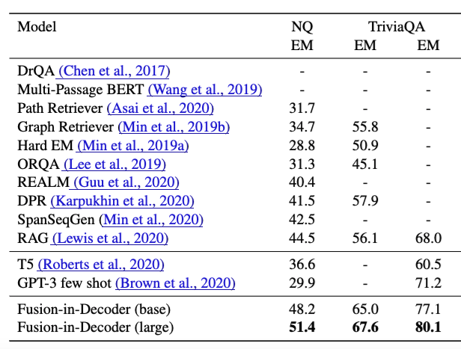
Recap: FiD Experiments
N = 100 passages

Slide 14
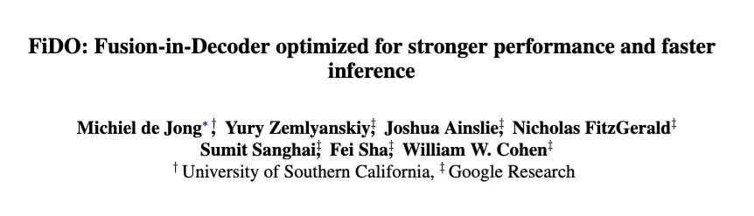
Recap: FiD Optimized (FiDO)
2023
Notes:
https://arxiv.org/pdf/2212.08153

Slide 15
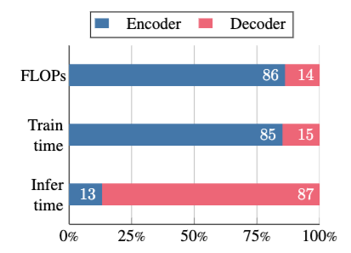



Recap: Fusion in Decoder (FiD)
FLOP analysis: Encoder is 6x as expensive as decoder!
Predicted by counting FLOPS for all the matmuls and assuming n_{t} << n_{s} and n_{t} << d
n_{t} tokens in decoder output
n_{s} tokens in all encoder input
…but at inference time decoding is slowest. Why?
Predicted by memory/FLOPs:
What’s the fix?
Multilayer perceptron
self-attention
cross-attention

Slide 16
Recap: Fusion in Decoder Optimized (FiDO)
Speeding up performance:
Layer sparse attention (LSA): perform cross attention only on every K-th layer (K=6)
Load fewer key-value entries from encoder on avg
Multi-query attention (MQ)
Creates fewer key-value entries
Compensate for performance loss:
Scale the decoder up!
Use T5-XL decoder with T5-Base encoder, etc
Decoder
Encoder
Decoder

Slide 17
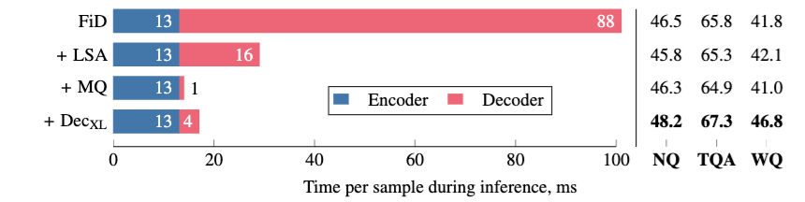
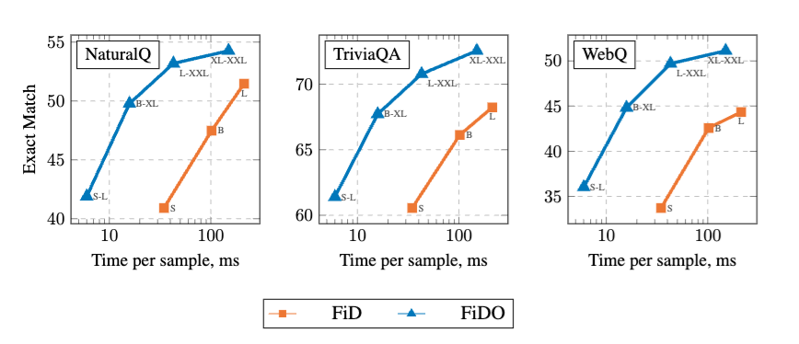
Recap: Fusion in Decoder Optimized (FiDO)

Slide 18
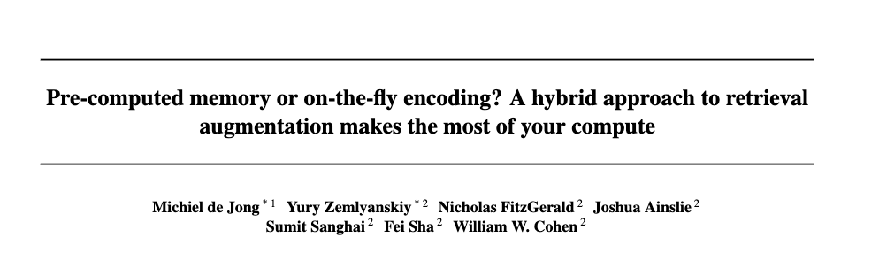
Recap: LUMEN: FiD with caching
2023
Notes:
https://arxiv.org/pdf/2212.08153

Slide 19
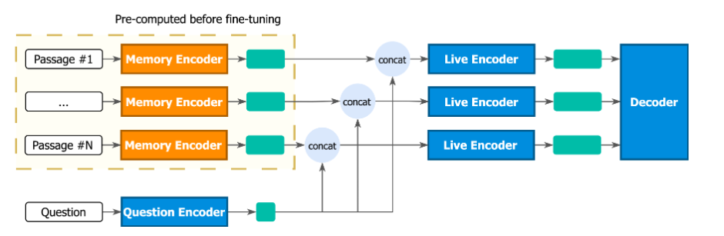
Recap: LUMEN: FiD with caching
The first N-K layers of the FiD encoder
The last K layers of the FiD encoder
FiD decoder
Passages are encoded and stored off-line for every document
Notes:
https://arxiv.org/pdf/2212.08153

Slide 20
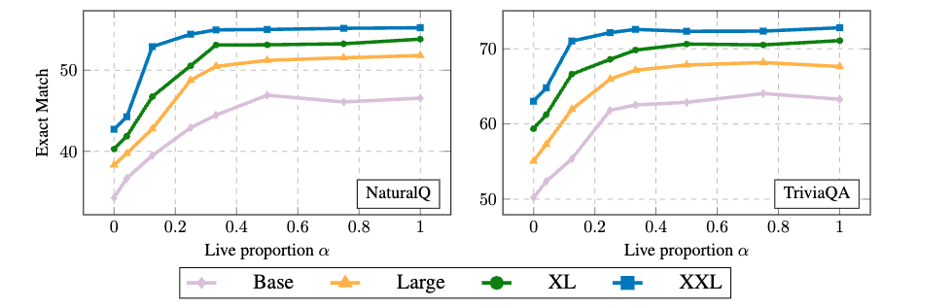
Recap: LUMEN: FiD with caching
As you scale up you can do a larger fraction of the work off-line

Slide 21
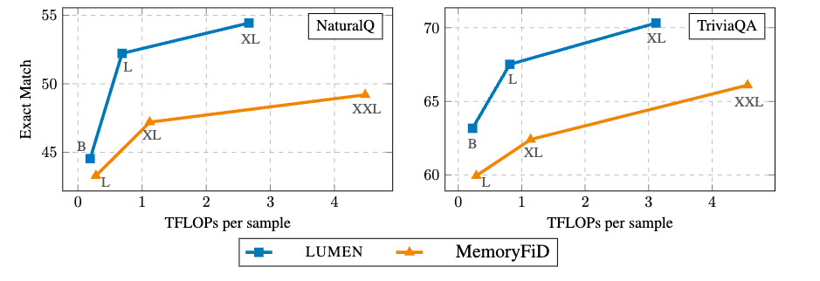
Recap: LUMEN: FiD with caching
Using 2/3 offline and 1/3 live is better than doing everything off-line

Slide 22
Outline – today
RAG
Quick Review of last week
Contrastive learning
DPR and Contreiver, RAG, FiD
A case study: optimizing inference for FiD
FiDO
LUMEN
Some new RAG systems
GLIMMER
Decoder-only systems related to RAG/FiD (new work)
“Embarrassingly parallel” ML tricks (new work)
Branch-train-merge and -mix: very parallel LLM pre-training
Task vectors: very parallel LLM fine-tuning

Slide 23
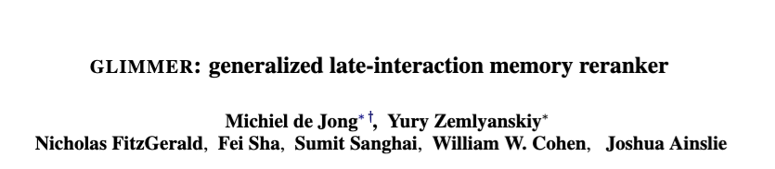
GLIMMER: LUMEN with reranking
2023
Notes:
https://arxiv.org/pdf/2212.08153

Slide 24
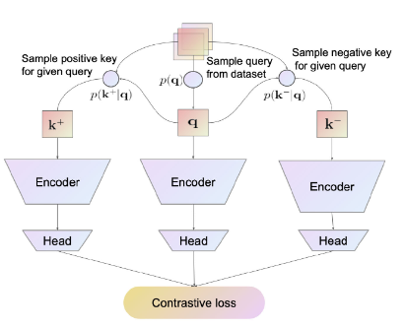
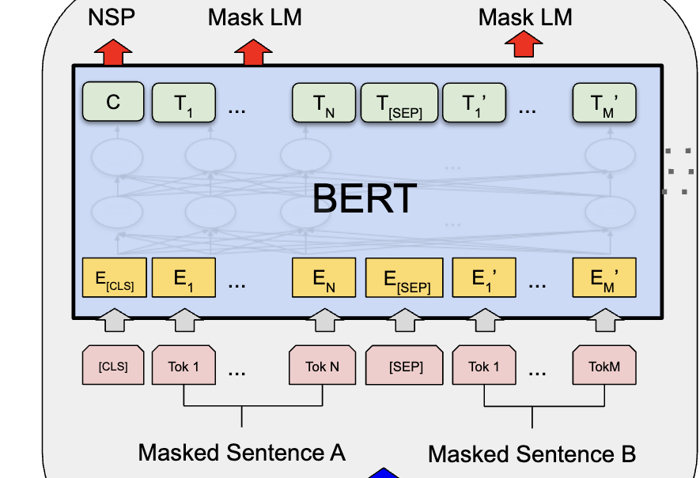
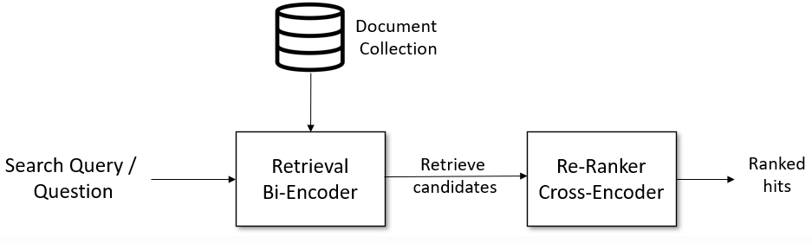
Recap: Cross-Encoders
relevance of i-th candidate to query
query
i-th candidate
c₁, c2, … c_{N}

Slide 25
Recap: LUMEN=FiD with caching
Similar to cross-encoding
Except for using LUMEN’s trick of pre-computing the first few layers of the encodings independently
Notes:
https://arxiv.org/pdf/2212.08153

Slide 26
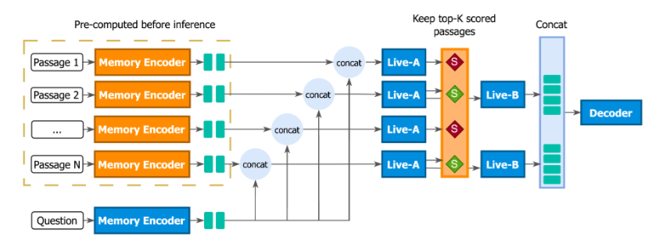

GLIMMER=LUMEN with reranking
Trained with “perplexity distillation loss”
log p_{LM} = perplexity of answer a for a decoder using only d_{i}, q
train to reduce KL between predicted scores and p_{k} – w a temperature in the softmax
Notes:
Generalized LateInteraction Memory Reranker
https://arxiv.org/pdf/2306.10231
https://storage.prod.researchhub.com/uploads/papers/2022/08/12/2208.03299v1.pdf – ppl dis loss

Slide 27
GLIMMER=LUMEN with reranking
Trained with “perplexity distillation loss”
Only the top few documents are presented to the decoder
Notes:
Generalized LateInteraction Memory Reranker
https://arxiv.org/pdf/2306.10231
https://storage.prod.researchhub.com/uploads/papers/2022/08/12/2208.03299v1.pdf – ppl dis loss

Slide 28
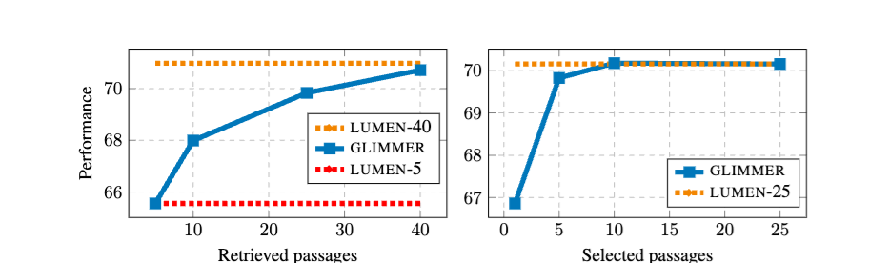
GLIMMER=LUMEN with reranking
select top 5
of 25 retrieved
Notes:
Generalized LateInteraction Memory Reranker
https://arxiv.org/pdf/2306.10231
https://storage.prod.researchhub.com/uploads/papers/2022/08/12/2208.03299v1.pdf – ppl dis loss

Slide 29
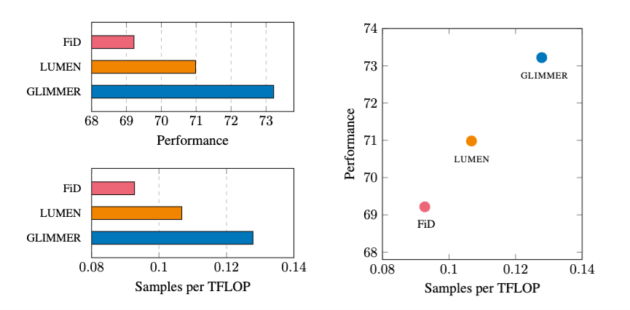
GLIMMER=LUMEN with reranking
Average performance on multiple tasks from the KILT dataset
Retrieve 25 passages, rerank, and decode with top 5
Notes:
Generalized LateInteraction Memory Reranker
https://arxiv.org/pdf/2306.10231
https://storage.prod.researchhub.com/uploads/papers/2022/08/12/2208.03299v1.pdf – ppl dis loss

Slide 30
Outline – today
RAG
Quick Review of last week
Contrastive learning
DPR and Contreiver, RAG, FiD
A case study: optimizing inference for FiD
FiDO
LUMEN
Some new RAG systems
GLIMMER
Decoder-only systems related to RAG/FiD (new work)
“Embarrassingly parallel” ML tricks (new work)
Branch-train-merge and -mix: very parallel LLM pre-training
Task vectors: very parallel LLM fine-tuning

Slide 31
“FiD” WITH DECODER-ONLY LLMS

Slide 32
Main ideas in FiD and extensions
Analog for decoder-only LLMs
In encoder
cross-encoder q+p1, q+p2, … separately
restricting cross-attention
In decoder
attend to everything as you generate
Extensions
FiDO: optimize performance to avoid decoder bottlenecks
LUMEN: pre-compute encoder outputs
GLIMMER: add reranking
Parallel Context Windows (PCW) - 2023
FlashAttention (2023) and FlexAttention (2024)—also improve decoder bottlenecks
TurboRAG, Blockwise Sparse Attention - 2024
Dynamic Blockwise Sparse Attention - 2025

Slide 33
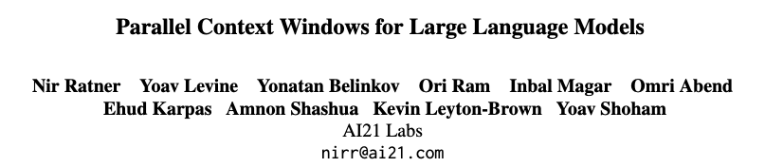
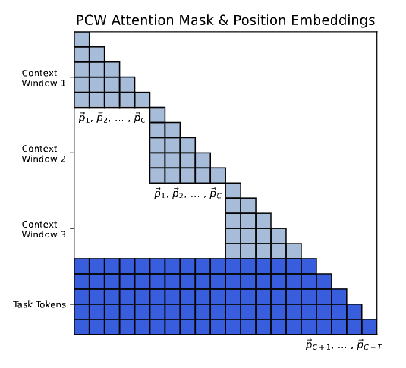
2023
Context tokens: retrieved document(s) for RAG, in-context examples, …
Task tokens: question for RAG, test input for ICL, …
I believe also output tokens are task tokens
Key idea: cross-attend within a context window, and cross-attend between task tokens and all context windows.
Very similar to FiD
if question/answer are task tokens
no post-training required
Notes:
https://arxiv.org/pdf/2212.10947

Slide 34
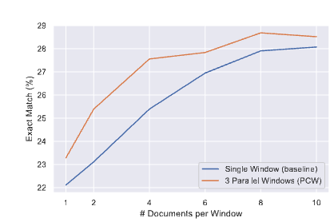
2023
Context tokens: retrieved document(s) for RAG, in-context examples, …
Task tokens: question for RAG, test input for ICL, …
I believe also output tokens are task tokens
Key idea: cross-attend within a context window, and cross-attend between task tokens and all context windows.
Good results for NQ (vs conventional RAG system) and ICL (especially classification with many classes)
Very similar to FiD
if question/answer are task tokens
Implemented with attention masks rather than parallel generation of keys and values

Slide 35
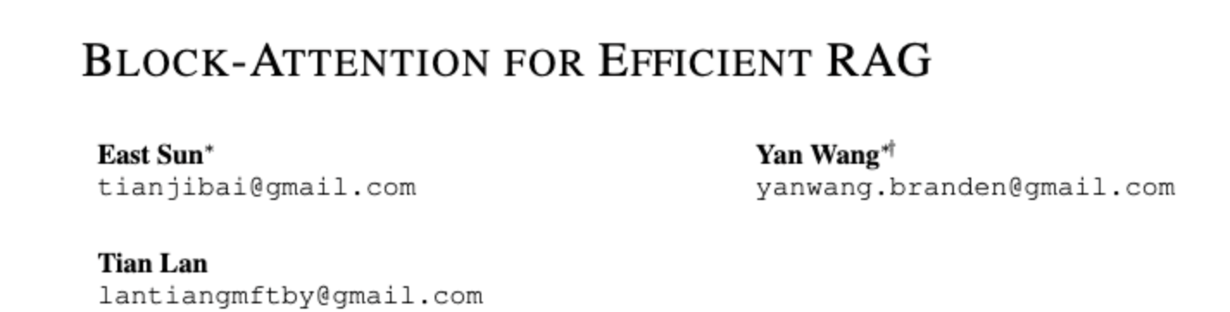
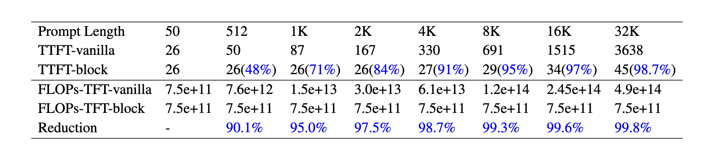
2024
Context tokens: retrieved document(s) for RAG, in-context examples, …
Task tokens: question for RAG, test input for ICL, …
Key idea: same as PCW except
cache the independently-produced KV pairs of the documents
load KV pairs for relevant docs directly
fine-tune for a short time (100-1000 steps)
TTFT = Time To First Token
FLOPS also for first token
Notes:
https://arxiv.org/pdf/2409.15355

Slide 36
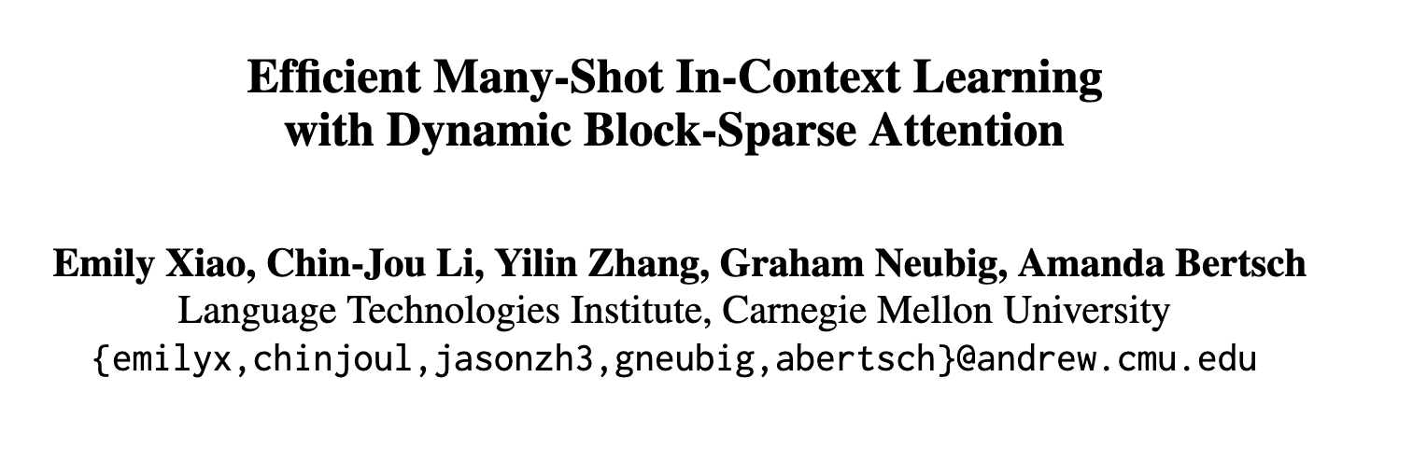
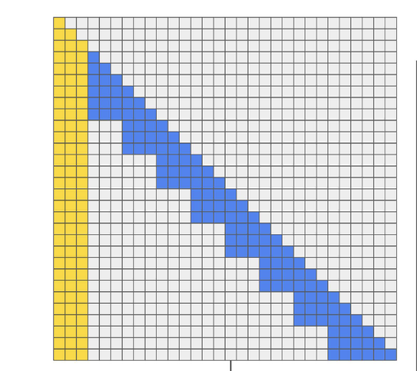
2025
Key idea: same as Block-Attention except
experiments are on ICL instead of RAG
cache the independently-produced KV pairs of the documents
evaluate addition of KV pairs computed for retrieved documents
retrieve ICL examples with BM25
avoid fine-tuning
clever use of StreamingLLM trick of “attention sink”
don’t mess with position encodings
Notes:
https://arxiv.org/pdf/2503.08640

Slide 37
DBSA: Details
Baseline: many-shot learning
Given n ICL examples
encode n/k blocks of ICL examples containing
k demonstrations
a shared “anchor block”
load all blocks into a KV cache
add the usual positional encoding features
Implemented with FlexAttention
Doesn’t actually encode the masked blocks
50 examples/block, 30k and 90k training examples for classification tasks

Slide 38
DBSA: Details
Dynamic example selection
Given a query q*
retrieve m<n encoded blocks (with BM25)
load retrieved blocks and anchor block into a KV cache and add positional encoding
retrieve 30% of the available training examples

Slide 39
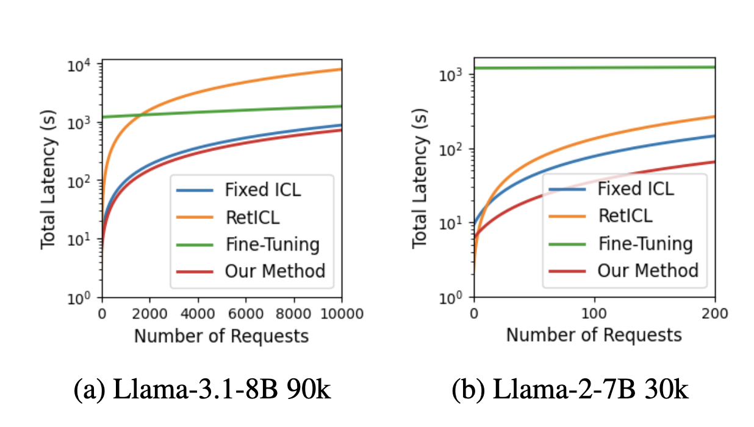
DBSA: Results
Total latency including set-up time

Slide 40
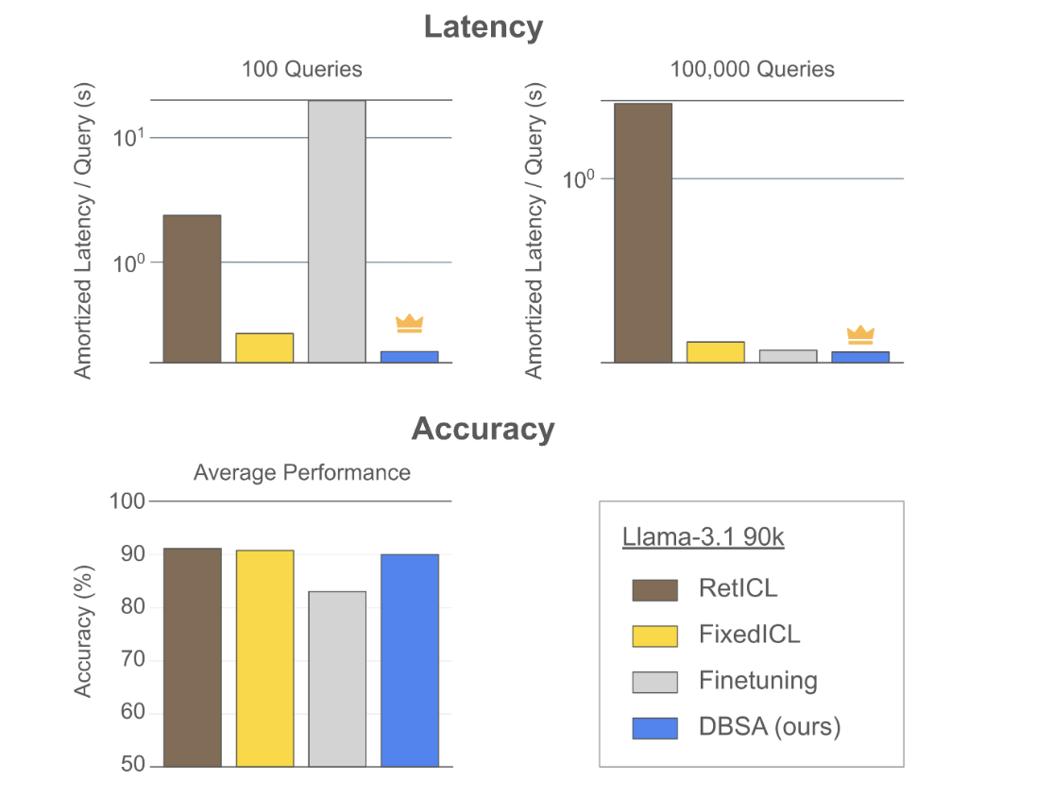
DBSA: Results

Slide 41
Outline – today
RAG
Quick Review of last week
Contrastive learning
DPR and Contreiver, RAG, FiD
A case study: optimizing inference for FiD
FiDO
LUMEN
Some new RAG systems
GLIMMER
Decoder-only systems related to RAG/FiD (new work)
“Embarrassingly parallel” ML tricks (new work)
Branch-train-merge and -mix: very parallel LLM pre-training
Task vectors: very parallel LLM fine-tuning

Slide 42
Discussion of RAG/FiD
Recent history (going 3-4 years back)
(Mostly) modular retrieval, reranking, generation augmented by retrieved context
then closer integration of the components in LLM systems
mainly for better efficiency
secondarily for better outputs
Current work
integration of similar ideas into decoder-only LLM
use of key-value caching
use of fast flexible restricted attention schemes
still active area

Slide 43
Outline – today
RAG
Quick Review of last week
Contrastive learning
DPR and Contreiver, RAG, FiD
A case study: optimizing inference for FiD
FiDO
LUMEN
Some new RAG systems
GLIMMER
Decoder-only systems related to RAG/FiD (new work)
“Embarrassingly parallel” ML tricks (new work)
Branch-train-merge and -mix: very parallel LLM pre-training
Task vectors: very parallel LLM fine-tuning

Slide 44
Branch-Train-Merge

Slide 45
Recap: Distributed ML
Data parallelism
workers get parts (usually disjoint partitions) of the data and copies of the current model
workers optimize independently for a while
without communication
workers communicate and synchronize models
Decisions to consider:
when do you synchronize?
when is it ok to optimize a “stale” set of weights?
how do you synchronize?
how do you send information?
how do you compress or sparsify information?

Slide 46
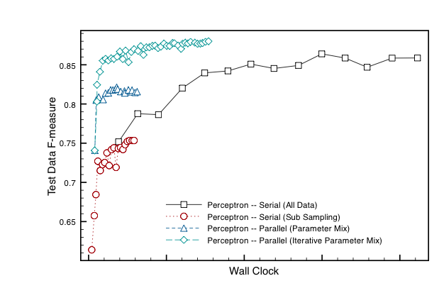
Recap: Comparing synchronization approaches for perceptron training
iterative parameter mixing
model averaging with no synchronization
one model on 1/p of the data

Slide 47
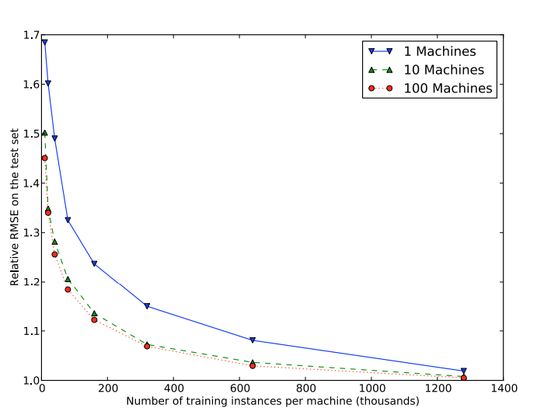
Recap: Comparing synchronization approaches for SGD and logistic regression
1 model
10 model average, no synchronization
100 model average, no synchronization

Slide 48
Recap: Distributed ML
Data parallelism
workers get parts (usually disjoint partitions) of the data and copies of the current model
workers optimize independently for a while
without communication
workers communicate and synchronize models
Decisions to consider:
when do you synchronize?
never: just average at the end
“Embarrassingly parallel”

Slide 49
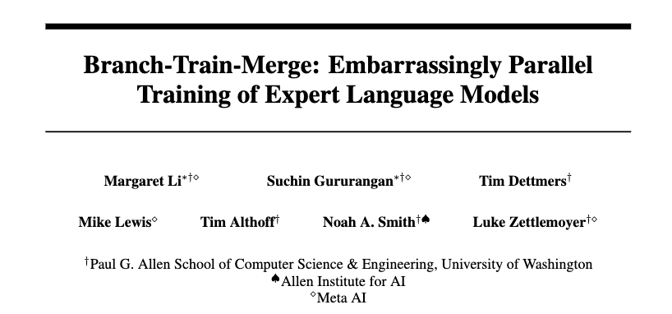
2022
Notes:
https://arxiv.org/pdf/2208.03306

Slide 50
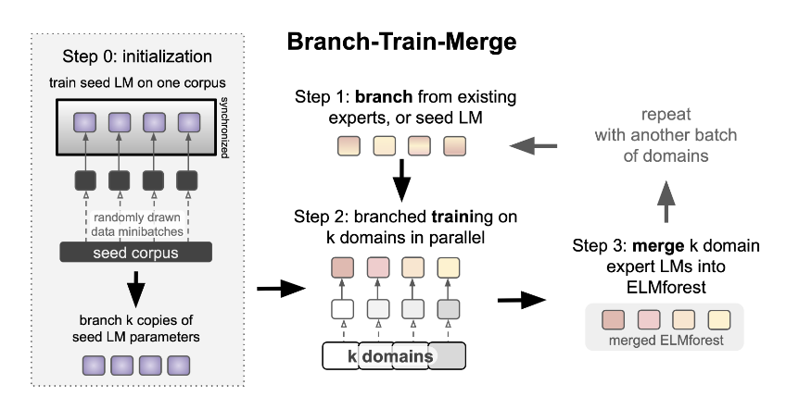
BTM: Key ideas
small GPT 𝜃
merge?
ELM = expert LM
𝜃₁, 𝜃₂, …, 𝜃_{k}
ELMForest = group of ELMs
Notes:
GPT3 clone but small (1.3B)

Slide 51

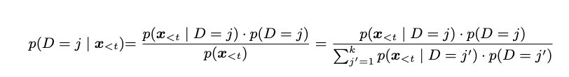
BTM: Key ideas
Merge option 1: at inference time
D: a domain for inference—assume it’s an existing domain 1..n
x_{<t} : a text prefix—eval is mostly on perplexity/LM
X_{t} : probability distribution over next token
Preferred approach: exponential moving average of the domain posterior, update every 1000 tokens
Domain posterior
Using just top k=3 domains is ok
Notes:
GPT3 clone but small (1.3B)

Slide 52
BTM: Key ideas
Merge option 2: parameter averaging
preferred approach: weight by domain posterior
Domain posterior
Notes:
GPT3 clone but small (1.3B)

Slide 53
BTM: Key ideas
merged with parameter averaging
small GPT 𝜃
ELM = expert LM
𝜃₁, 𝜃₂, …, 𝜃_{k}
ELMForest = group of ELMs
Notes:
GPT3 clone but small (1.3B)

Slide 54
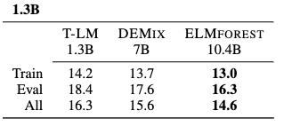
BTM: Experiments with 8 domains
compute-matched perplexity with 8 train/8 eval domains
50% of compute for “seed” model 𝜃
inference-time model merging
Notes:
GPT3 clone but small (1.3B)

Slide 55
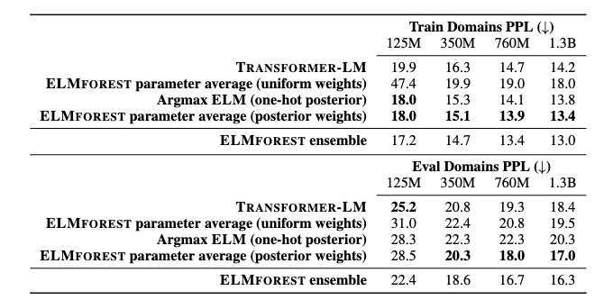
BTM: Experiments with 8 domains
compute-matched perplexity with 8 train/8 eval domains
50% of compute for “seed” model 𝜃
parameter mixing model merging
Notes:
GPT3 clone but small (1.3B)

Slide 56
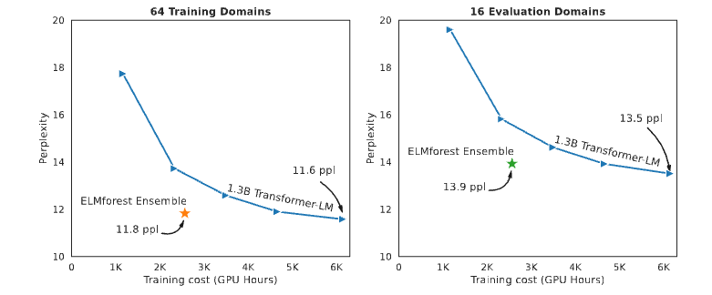
BTM: Training costs
Notes:
GPT3 clone but small (1.3B)

Slide 57
Outline – today
RAG
Quick Review of last week
Contrastive learning
DPR and Contreiver, RAG, FiD
A case study: optimizing inference for FiD
FiDO
LUMEN
Some new RAG systems
GLIMMER
Decoder-only systems related to RAG/FiD (new work)
“Embarrassingly parallel” ML tricks (new work)
Branch-train-merge: very parallel LLM pre-training
Branch-train-mix: very parallel LLM pre-training
Task vectors: very parallel LLM fine-tuning

Slide 58
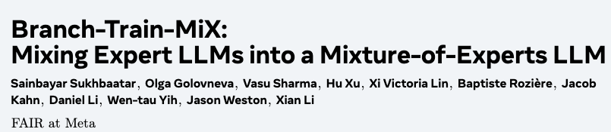
2024
Notes:
https://arxiv.org/pdf/2403.07816

Slide 59
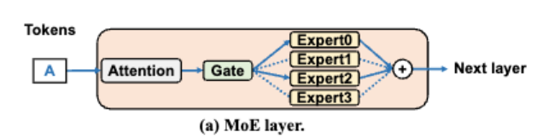


Background: Mixture of Experts (MoE)
combine
with
where in training G(x) = SoftMax
and at inference time
graphics: https://arxiv.org/pdf/2504.02263
Notes:
https://arxiv.org/pdf/2504.02263

Slide 60
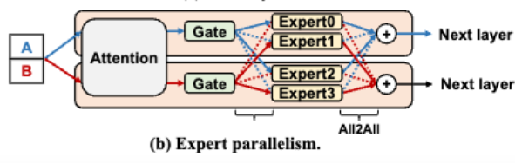
Background: Expert Parallelism
This can be parallelized!
Each processor hosts a subset of the experts
All-to-all communication before and after the expert layer
Often need to train to “balance” the experts with an extra loss term

Slide 61
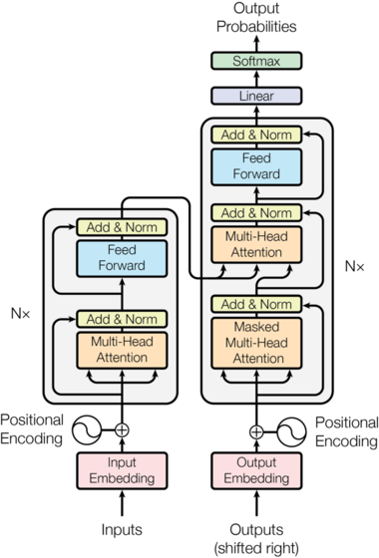
Background: Expert Parallelism
In Transformers MoE is used for the FFN layers so tokens are routed to the experts
Examples:
Switch Transformers
1T param model from 2022
OG ChatGPT (according to rumors)
Mixtral models (Early 2024)
Llama 4 series (last week)

Slide 62
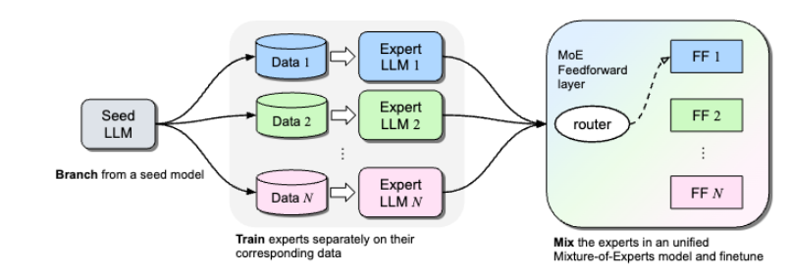
2024
Branch and Train as in Branch-train-merge
Mix the expert LMs by
Making each FFN an expert for the corresponding MoE FFN layer
Parameter averaging all other parameters
Finetune everything (notice gates have new parameters)
Notes:
https://arxiv.org/pdf/2403.07816
y

Slide 63
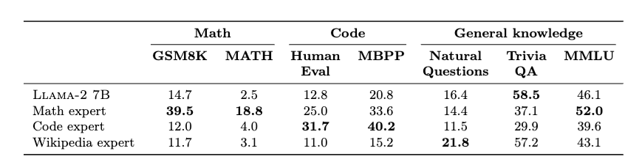
BTX details
Llama-2 7B
Train experts on three domains
Math (201B tokens)
Code (210B tokens)
Wikipedia (42B tokens)
and also keep the old model as a fourth expert
Finetune another 80B tokens
Evaluate on benchmark tasks (not perplexity)
The experts are different
Notes:
https://arxiv.org/pdf/2403.07816
trivia has leaked

Slide 64
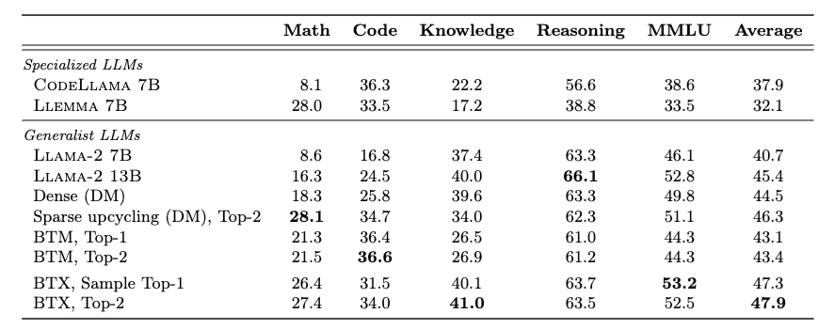
BTX results
math specialist
“data matched”
*
* BTX with no parallel training stage
Notes:
https://arxiv.org/pdf/2403.07816
trivia has leaked

Slide 65
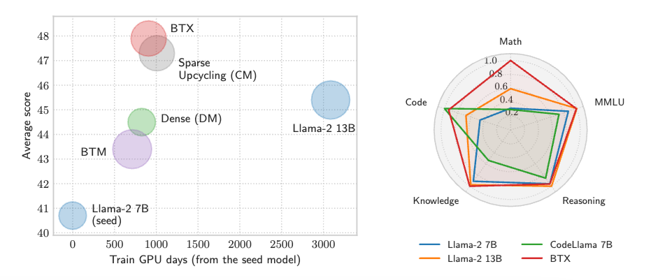
BTX results
Notes:
https://arxiv.org/pdf/2403.07816
trivia has leaked

Slide 66
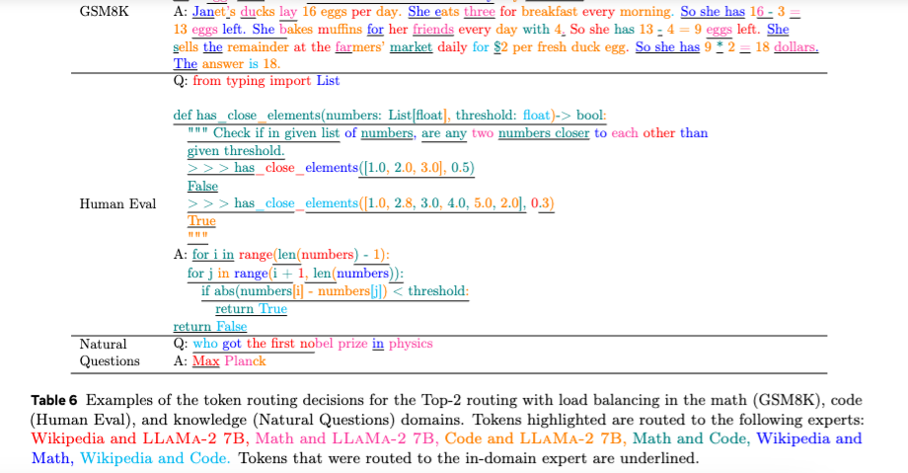
BTX results
Notes:
https://arxiv.org/pdf/2403.07816
trivia has leaked

Slide 67
Outline – today
RAG
Quick Review of last week
Contrastive learning
DPR and Contreiver, RAG, FiD
A case study: optimizing inference for FiD
FiDO
LUMEN
Some new RAG systems
GLIMMER
Decoder-only systems related to RAG/FiD (new work)
“Embarrassingly parallel” ML tricks (new work)
Branch-train-merge: very parallel LLM pre-training
Branch-train-mix: very parallel LLM pre-training
Task vectors: very parallel LLM fine-tuning

Slide 68
Task vectors

Slide 69
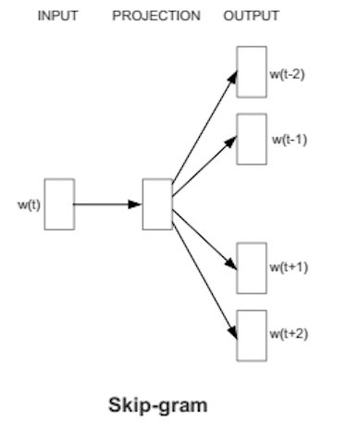
Recap: skip-gram embeddings (word2vec)
Training data:
positive examples are pairs of words w(t), w(t+j) that co-occur
You want to train over a very large corpus (100M words+) and hundreds+ dimensions
Training data:
negative examples are samples of pairs of words w(t), w(t+j) that don’t co-occur

Slide 70
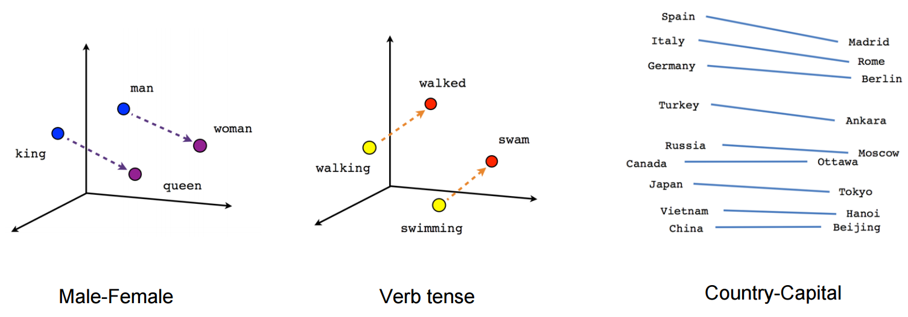
Recap: Results from word2vec
A number of properties of word2vec were surprising and mysterious! until they were explained by Omer Levy and Yoav Goldberg a couple of years later
Notes:
https://aclanthology.org/W14-1618.pdf

Slide 71
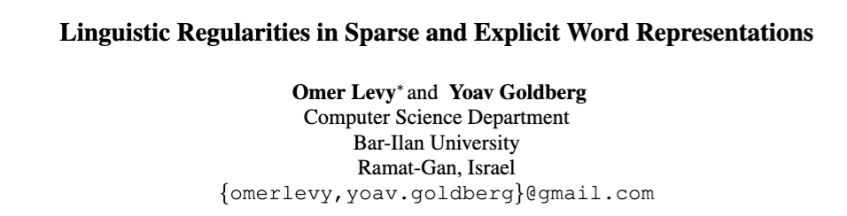
2014
Notes:
https://aclanthology.org/W14-1618.pdf

Slide 72



2014
Notation for analogies:
e.g.,
Word2vec method is “3CosAdd”:
=
=
i.e., b* (queen) should be:
similar to b (king)
similar to a* (woman)
different from a (man)

Slide 73
Recap: distributional clustering (with LSH)
Common task: distributional clustering
for a word w, v(w) is sparse vector of words that co-occur with w
cluster the v(w)’s
…guards at Pentonville prison in North London discovered that an escape attempt…
An American Werewolf in London is to be remade by the son of the original director…
…UK pop up shop on Monmouth Street in London today and on Friday the brand…
v(London): Pentonville, prison, in, North, …. and, on Friday

Slide 74
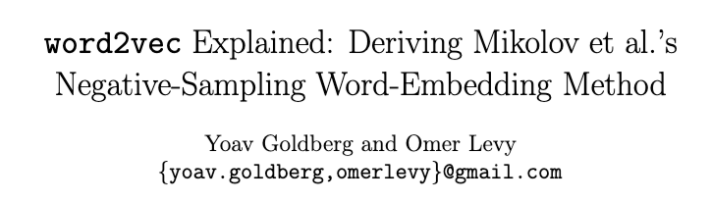
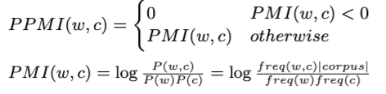
Q: what if you use the original sparse (unfactored) PPMI word vectors for analogies?
Background
2014
Key idea: these two vectors are closely related
word2vec embedding of w=“London”
distributional representation of w=“London”
with context words c weighted by “positive pointwise mutual information”
word2vec embeddings are matrix factorization of the PPMI matrix
Notes:
https://arxiv.org/pdf/1402.3722

Slide 75
2014
Notation for analogies:
e.g.,
Word2vec method is “3CosAdd”:
=
=
i.e., b* (queen) should be:
similar to b (king)
similar to a* (woman)
different from a (man)

Slide 76


2014
Observation: old-school sparse vectors also work for analogies
word2vec →
sparse PPI vectors →
but not as well as word2vec using 3CosAdd rule
i.e., b* (queen) should be:
similar to b (king)
similar to a* (woman)
different from a (man)
3CosMul
*scale sims to [0,1]
Notes:
scale embedding sims to 0,1

Slide 77

2014
word2vec →
sparse PPI vectors →
word2vec →
sparse PPI vectors →
So: old-school sparse vectors also work for analogies.
Notes:
scale embedding sims to 0,1

Slide 78
Discussion: Analogies
It would be great if vector-based representations did have more modularity: e.g., add ”past tense” to a word sense
Notes:
https://aclanthology.org/W14-1618.pdf

Slide 79



Studied task vectors for tasks t:
$τ_{t}$ = (fine tuned model weights) – (pre-trained model weights)
Examples: if 𝜃 is the pre-trained model weights
𝜃 $+ τ_{t}$ = ???
𝜃 –${ τ}_{t}$ = ???
Notes:
https://arxiv.org/pdf/2212.04089

Slide 80

Experiment with task negation
𝜃 = pre-trained GPT2
Fine-tune GPT2 on CivilComments datasets
t_{nice}: toxicity < 0.2
t_{toxic}: toxicity > 0.8
Assess toxicity of 1000 outputs with a classifier
𝜃
𝜃 + 𝜏_{toxic}
𝜃 + 𝜏_{nice}
same magnitude
𝜃 - 𝜏_{toxic}
Subtracting the task vector is a way of “forgetting” how to perform that task!

Slide 81


Experiment with scaled task negation
𝜃 = pre-trained GPT2
Fine-tune GPT2 on CivilComments datasets
t_{nice}: toxicity < 0.2
t_{toxic}: toxicity > 0.8
Assess toxicity of 1000 outputs with a classifier
𝜃
𝜃 + 𝜏_{toxic}
𝜃 + 𝜏_{nice}
same magnitude
𝜃 - $λ$𝜏_{toxic}
Scaling factor $λ$ is set with validation data
Pick largest $λ$ where perplexity is < 16.9 (i.e., baseline + 0.5 bits)

Slide 82


Experiment with scaled task negation
𝜃 = pre-trained CLIPS
Fine-tune on 8 different image tasks
See if the resulting models forgets that task while maintaining performance on control task (ImageNet classification)
Report average over all tasks
smaller model
larger model
𝜃
𝜃 + 𝜏
𝜃 - $λ$𝜏

Slide 83

Experiments with task analogies
Objective: sentiment analysis on reviews from Yelp
Data available
unlabeled reviews from Yelp
sentiment data from Amazon reviews
unlabeled Amazon reviews
Approach: build task vectors for
𝜏_{YelpLM}: language modeling on Yelp
𝜏_{AmazonLM}: language modeling on Amazon
𝜏_{AmazonSentiment}: sentiment prediction on Amazon
Finally use
λ₁𝜏_{AmazonSentiment} + (λ₂𝜏_{YelpLM} — λ₃𝜏_{AmazonLM})

Slide 84

Experiments with task analogies
Objective: sentiment analysis on reviews from Yelp
Data available
unlabeled reviews from Yelp Amazon
sentiment data from Amazon Yelp reviews
unlabeled Amazon Yelp reviews
Approach: build task vectors for
𝜏_{YelpLM}: language modeling on Yelp
𝜏_{AmazonLM}: language modeling on Amazon
𝜏_{YelpSentiment}: sentiment prediction on Amazon Yelp
Finally use
λ₁𝜏_{YelpSentiment} + (λ₂𝜏_{AmazonLM} — λ₃𝜏_{YelpLM})

Slide 85

Experiments with task analogies
Objective: improve performance on rare slices of data
Image classification tasks with CLIP, slices are based on a image style and class.
Also using λ’s picked by validation sets

Slide 86


Experiments with task analogies
Collect 200 images of kings, queens, women, men.
Fine-tune CLIP models on each category, using 1000 ImageNet classes as negative examples
(class name ”something”)

Slide 87


Experiment: adding many task vectors
𝜃 = pre-trained T5-base
For each of four common NLP tasks:
Fine tune a model (task vector 𝜏*)
Look for compatible checkpoints on HuggingFace (vectors 𝜏₁, …, 𝜏_{n})
Compare 𝜏* and 𝜏* + $λ\sum_{i}{τ_{i}}$ (select λ with validation set)
𝜃
𝜃 + 𝜏*
Note the training for the subtasks is embarrassingly parallel

Slide 88

Experiment: adding different task vectors
weighted sum of task vectors for 2 vision tasks
show accuracy normalized by FT accuracy
and compared to zero-shot accuracy
Note the training for the subtasks is embarrassingly parallel

Slide 89


Experiment: adding different task vectors
weighted sum of task vectors for k vision tasks
show accuracy normalized by accuracy of multitask FT on all 8 tasks
each point is different subset of training tasks
Compare 𝜏* and 𝜏* + $λ\sum_{i}{τ_{i}}$ (select λ with validation set)
Note the training for the subtasks is embarrassingly parallel

Slide 90


Summary: task vectors for tasks t:
$τ_{t}$ = (fine tuned model weights) – (pre-trained model weights)
can be combined by
subtracting a task ~= “forgetting” a behavior, like toxicity
combining vectors analogically
adding multiple vectors to create an ensemble
Why does this work?
Task vectors are mostly orthogonal except when tasks are related
MNIST / SVHN both digits; GTRSB is reading traffic signs
EuroSAT / RESISC45 are sat images
Notes:
https://arxiv.org/pdf/2212.04089

Slide 91

Summary: task vectors for tasks t:
$τ_{t}$ = (fine tuned model weights) – (pre-trained model weights)
can be combined by
subtracting a task ~= “forgetting” a behavior, like toxicity
combining vectors analogically
adding multiple vectors to create an ensemble
Why does this work?
“Weight disentanglement”
Notes:
https://proceedings.neurips.cc/paper_files/paper/2023/file/d28077e5ff52034cd35b4aa15320caea-Paper-Conference.pdf

Slide 92



2023
Disentanglement error:
Disentanglement error of ⍺₁𝜏₁ and ⍺₂𝜏₂ with dist(f,g)=1 if labels different
Notes:
https://proceedings.neurips.cc/paper_files/paper/2023/file/d28077e5ff52034cd35b4aa15320caea-Paper-Conference.pdf

Slide 93
Aside
2023
Theory:
close enough to an initial 𝜃, for a large enough network, weight changes produce an approximately linear effect
task vectors that stay in the linear regime should combine linearly
but fine-tuning can take 𝜏 outside the linear regime
but it’s possible to measure if this happened
it’s also possible to fine-tune inside the linear area by using a kernel
this helps make task arithmetic a little better for larger models
Notes:
https://proceedings.neurips.cc/paper_files/paper/2023/file/d28077e5ff52034cd35b4aa15320caea-Paper-Conference.pdf

Slide 94

2023
Focus on merging models for different tasks
Question: how do you merge models when there is some “entanglement”? Can you improve on task arithmetic?
Notes:
https://www.researchgate.net/profile/Leshem-Choshen-2/publication/371291070_Resolving_Interference_When_Merging_Models/links/6481cc4a79a722376518d1d6/Resolving-Interference-When-Merging-Models.pdf

Slide 95


Question: how do you merge models when there is some “entanglement”?
only keep the top k% of each task vector’s weights
average acc on 11 task vectors

Slide 96

Question: how do you merge models when there is some “entanglement”?
only keep the top k% of each task vector’s weights
avoid sign conflicts
let $y\left[i\right]=sign(\sum_{t}{τ_{t}[i]}$) # ‘dominant’ sign at i
let $T^{i}=\left\{t : {sign(τ}_{t}\left[i)\right]=sign(y\left[i\right])\right\}$ # same sign as y at i
let 𝜏* $\left[i\right]= \frac{1}{|T^{i}|}\sum_{t∈T^{i}}{τ_{t}[i]}$ # avg of same-sign vectors
TIES-Merge – TrIm, Elect Sign, and Merge

Slide 97

11 NLP / 8 vision datasets; k=20% and λ=1 w/o validation set
only keep the top k% of each task vector’s weights
avoid sign conflicts
let $y\left[i\right]=sign(\sum_{t}{τ_{t}[i]}$) # ‘dominant’ sign at i
let $T^{i}=\left\{t : {sign(τ}_{t}\left[i)\right]=sign(y\left[i\right])\right\}$ # same sign as y at i
let 𝜏* $\left[i\right]= \frac{1}{|T^{i}|}\sum_{t∈T^{i}}{τ_{t}[i]}$ # avg of same-sign vectors
TIES-Merge – TrIm, Elect Sign, and Merge

Slide 98


Slide 99

accuracy / FT accuracy merging multiple tasks

Slide 100

Notes:
https://arxiv.org/pdf/2307.13269

Slide 101

LoraHub: Method
LoRA-train FLAN-T5-Large on 20 randomly selected tasks from FLAN training set
The LoRA matrices for task t are A_{t} B_{t}
Combine:
Optimize weights w with L1-regularized ppx loss on 5-shot training data using black-box optimization (like Vizier)
Other results:
20 LoRA tasks with lowest avg loss on the BBH examples: 35.4
FLAN-T5-XL: 36.5

Slide 102


2024
Post-Hoc Adaptive Tokenwise Gating Over and Ocean of Specialized Adapters (PHATGOOSE)
Notes:
https://arxiv.org/pdf/2402.05859

Slide 103
PHATGOOSE methods
LoRA-train FLAN-T5-Large on 166 tasks from FLAN training set
Train a sigmoid gate for each LoRA:
on the same data for 100 steps
At inference time, route tokens to to the top 3 LoRA modules (softmax-weighted)

Slide 104


PHATGOOSE results
LoRA-train FLAN-T5-Large on
166 tasks from FLAN training set
The training tasks from T0
Evaluate zero-shot on novel tasks

