Slide 1
10-605 / 10-405
Machine Learning from Large Datasets

Slide 2
Outline
Review of how to learn retrievers
Contrastive learning
DPR and Contreiver
Using decoder-only LLMs for retrieval
query expansion
generating encodings
Retrieval-augmented generation (RAG)
The original RAG paper
The fusion-in-decoder (FiD) paper
A case study: optimizing inference for FiD
Systems: FiDO, LUMEN, GLIMMER
Incorporating principles from RAG, FiD in decoder-only LLMS

Slide 3
Retrieval Augmented LLMs A RECAP

Slide 4
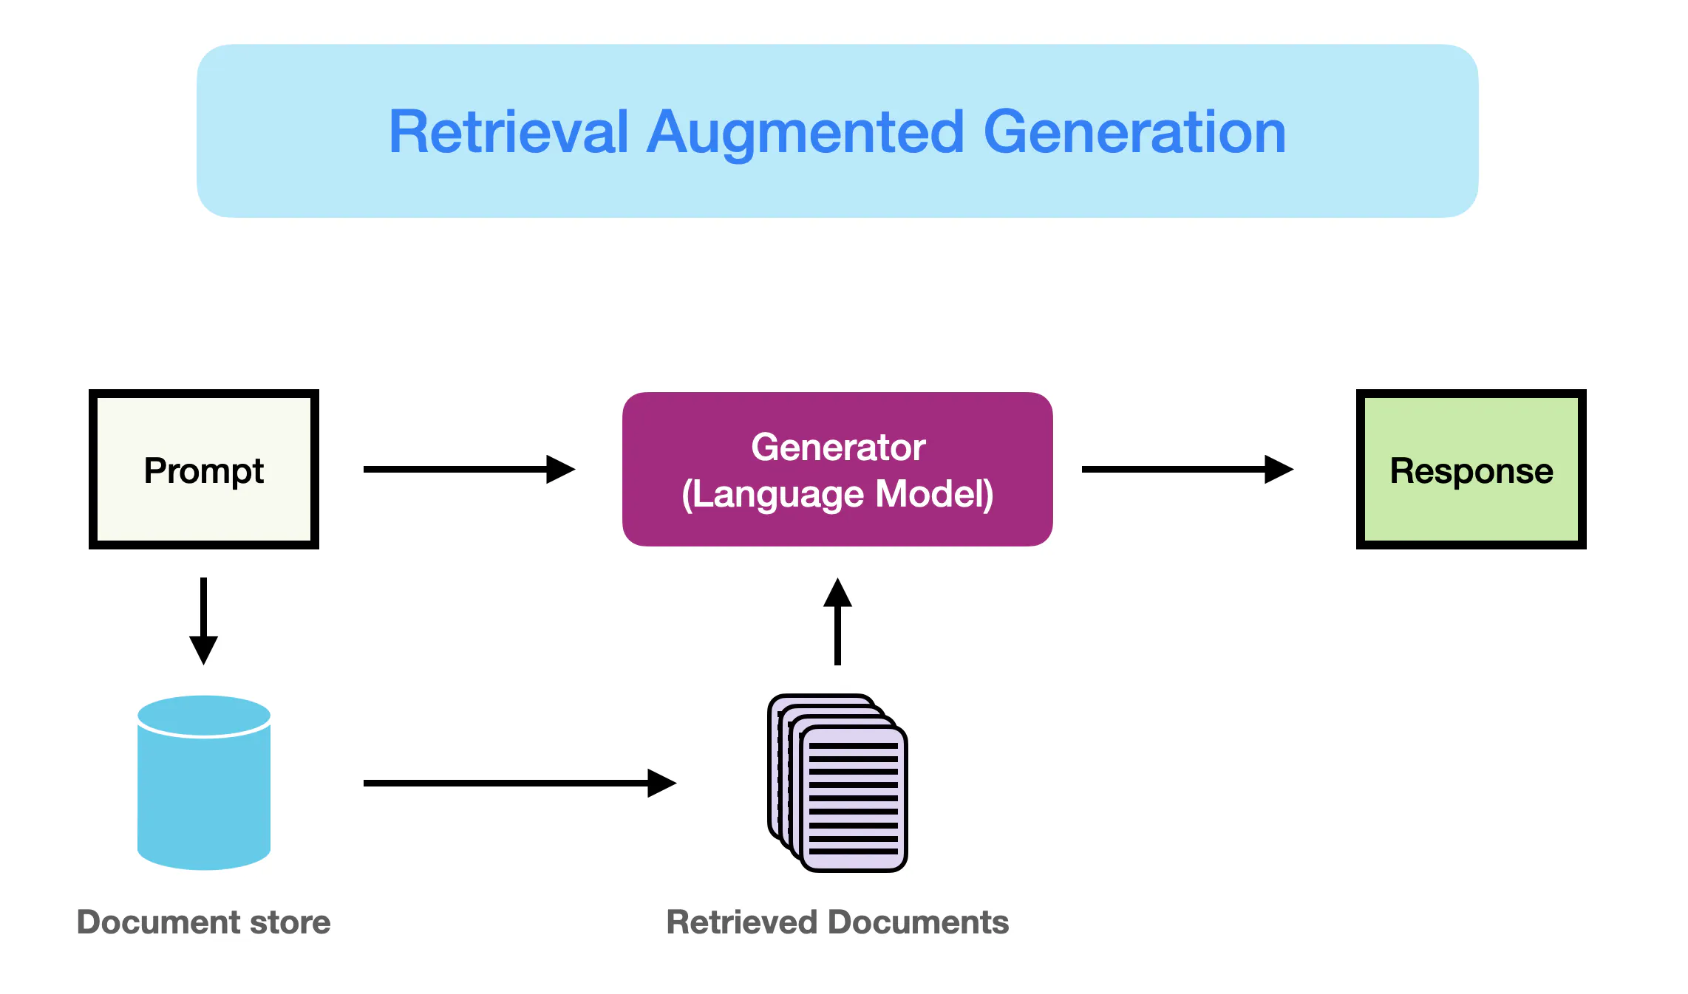
Access new information (not available during model pretraining)
Better access “long tail” information that is mentioned infrequently in pre-training documents
Needs strong retrieval

Slide 5
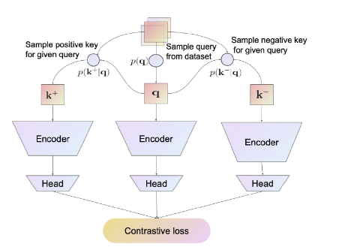
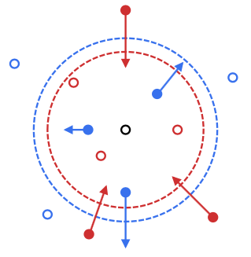
Contrastive learning for retrieval
Contrastive learners are very widely used
Usually a fairly large model
"Projection head” to compress large representation
Loss usually needs positive and negative retrievals for q
Contrastive loss fine-tunes the large encoder (and the projection head)

Slide 6
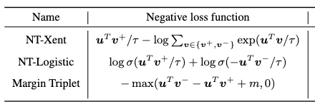

Contrastive learning: losses
NT-Xent: normalized temperature-scale cross-entropy

Slide 7
The Dense Passage Retriever (DPR)
Process several QA datasets to get triples:
(question, gold passage id, gold answer span)
Triples give positive question/passage examples
Use in-batch negatives with batches of p,q pairs
pair is positive for q_{i}, p_{j} iff i=j
“in-batch negatives” trick
also add as additional hard negatives
1-2 passages with high TFIDF score to q which do not contain the answer span

Slide 8
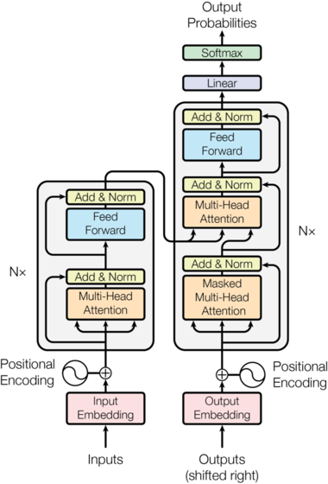
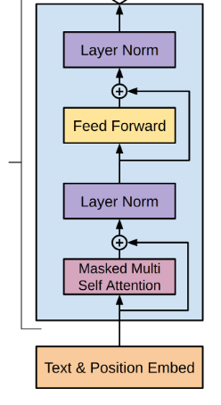
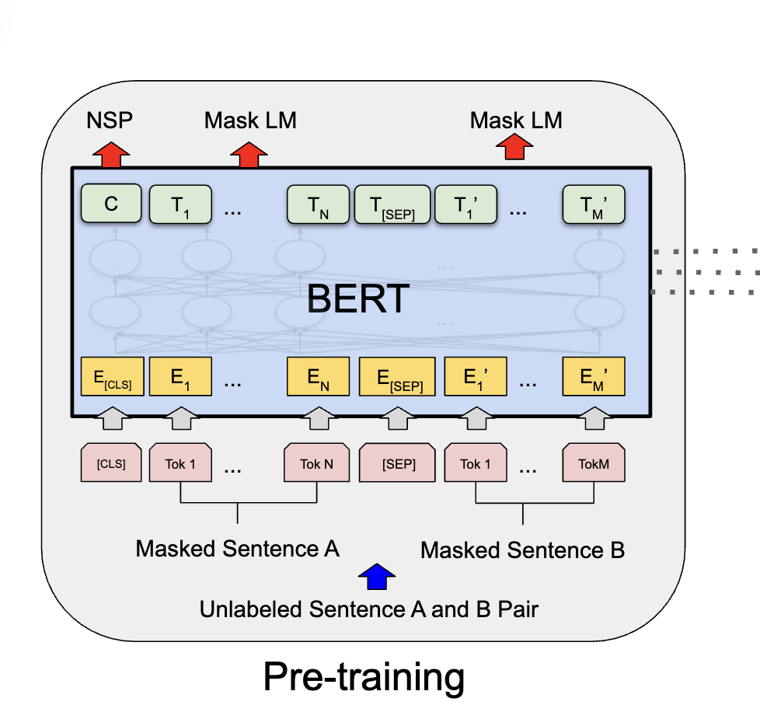
Discussion of DPR
Encoder used in DPR:
BERT with [CLS] token
The obvious choice in 2020
Still a very good choice
Encoder-only and encoder-decoder models have a “bottleneck”
Decoder only
Encoder only
Encoder-decoder

Slide 9
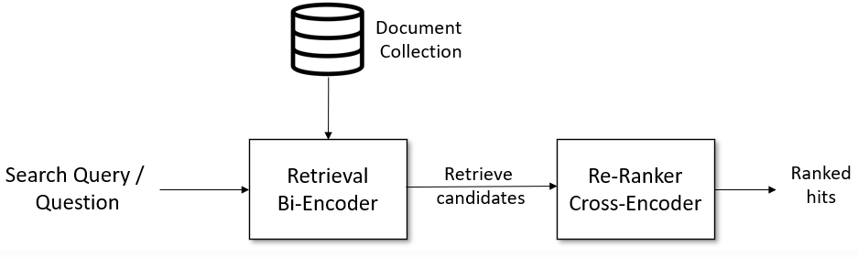
Cross-Encoders
relevance of i-th candidate to query
query
i-th candidate
c₁, c2, … c_{N}

Slide 10
Mega-batching and Dynamic Dictionaries
Assume we have
A dataloader that streams through mini-batches
An SGD trainer than learns from the mini-batchers
Idea: modify data stream
Keep a queue of the M most recently-seen examples
Add to each mini-batch the hardest negative example in the queue
Advantage:
Queue size is independent of batch size
Notes:
https://openaccess.thecvf.com/content_CVPR_2020/papers/He_Momentum_Contrast_for_Unsupervised_Visual_Representation_Learning_CVPR_2020_paper.pdf

Slide 11
Momentum Encoders
If recent checkpoints are unstable
Consider an ensemble of several recent checkpoints
e.g., vote with them
Averaging the weights of similar models is a good approximation to an ensemble
E.g., using the most recent two models:
$θ_{∗}$ = ${α θ}_{t−1}+(1−$ $α$) $θ_{t}$
Similar to a momentum term in optimization

Slide 12
Contriever vs DPR
Same NT-Xent contrastive loss
One BERT encoder instead of two
Data augmentation tricks used
Independent cropping
Random token deletion
Negatives were from
in-batch negatives
momentum contrast (MoCo)
MoCo: dynamic dictionary queue and averaging last two models to find hard negatives

Slide 13
Independent cropping
Given a paragraph p create a pair (a, b) where
a and b are both independently chosen subsequences of the text
length of a and b are either fixed or sampled
Note a and b will be similar size, not sentence vs paragraph
p
..Zebras have four gaits: walk, trot, canter and gallop. They are generally slower than horses, but their great stamina helps them outrun predators. When chased, a zebra will zigzag from side to side...
a
b
four gaits: walk, trot, canter and gallop. They are generally
great stamina helps them outrun predators. When chased

Slide 14
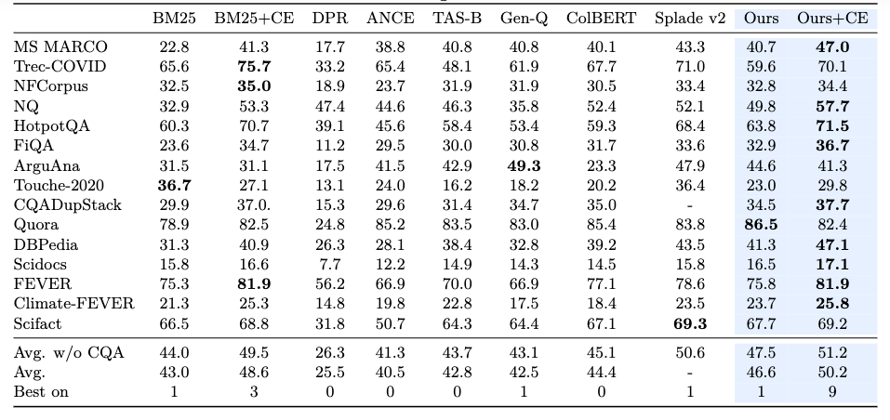
Contriever
Best configuration
Random cropping
Tokens deleted from a, b with probability 0.1
MoCo

Slide 15
Retrieval WITH Modern Decoder-Only LLMS

Slide 16
Recap: Discussion of DPR
But … everybody is working on improving decoder-only LLMs, so it would be great if we could use them!
Encoder used in DPR:
BERT with [CLS] token
The obvious choice in 2020
Still a very good choice
Encoder-only and encoder-decoder models have a “bottleneck”
Decoder only
Encoder only
Encoder-decoder

Slide 17
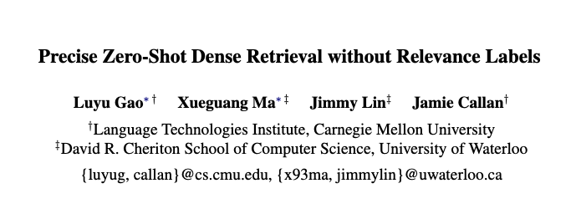
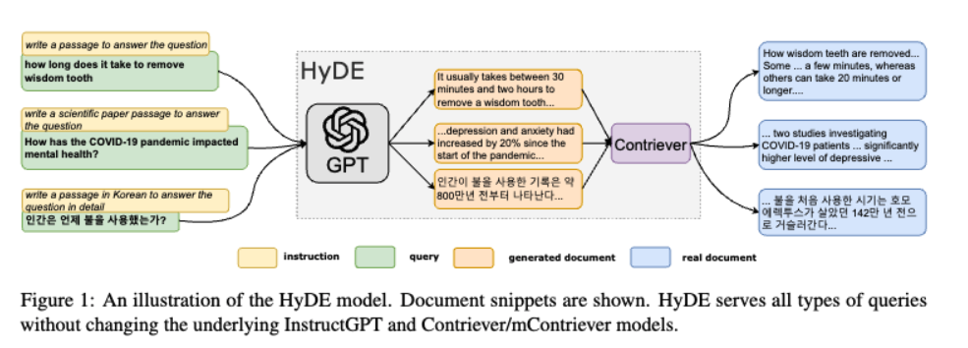
2023
Notes:
https://aclanthology.org/2023.acl-long.99.pdf

Slide 18
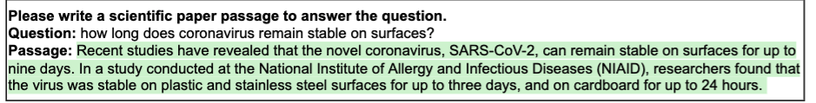
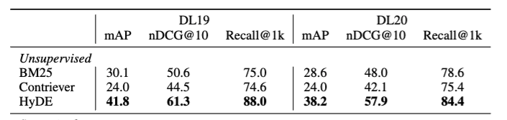
Hypothetical Document Embedding (HyDE)
Details
prompt model (InstructGPT) to convert question q to a query document d
sample N documents d₁, …, d_{N}, by generation with temperature T
query vector for Contriever is average of embeddings for q and d₁, …, d_{N}
Notes:
see also MSR query2doc
https://arxiv.org/pdf/2304.14233 and LameR gets similar results concatenating generated documents to the query and using a sparse retriever

Slide 19
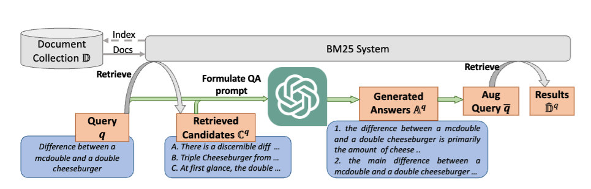
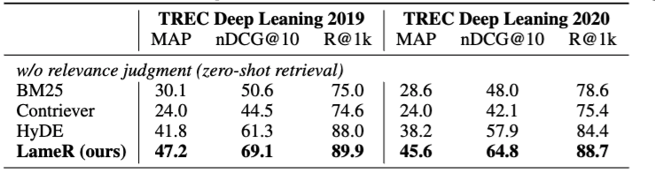
Language Model as Retriever (LameR)
https://arxiv.org/pdf/2304.14233 2023 Shen et al
Notes:
see also MSR query2doc
https://arxiv.org/pdf/2304.14233 and LameR gets similar results concatenating generated documents to the query and using a sparse retriever

Slide 20
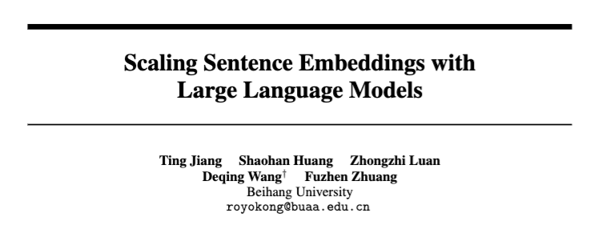
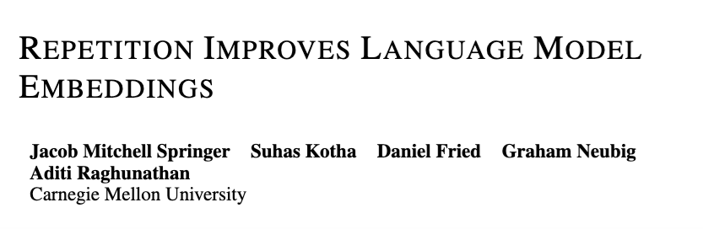
Decoder-only models as encoders?
2023
PromptEOL
2025
Echo embeddings
Notes:
https://openreview.net/pdf?id=Ahlrf2HGJR – mistral 7B
and https://arxiv.org/pdf/2307.16645

Slide 21

PromptEOL: Key ideas
To summarize a sentence x
Prompt the model with
Take the last hidden state of Transformer as representation
Then
Use 300 sentence/word pairs as ICL demonstrations
Train the representations contrastively with
This sentence: “x” means in one word:

Slide 22
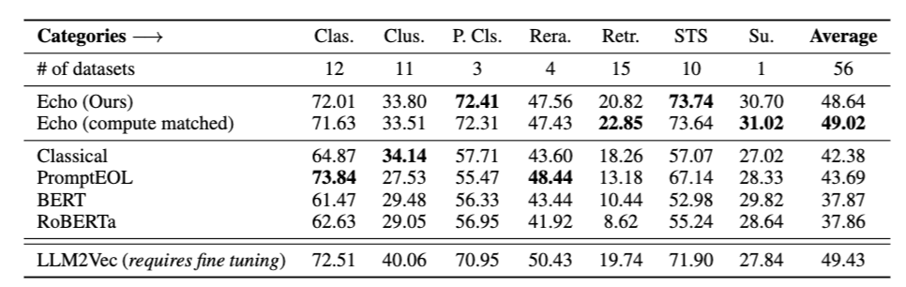
Echo embeddings: key ideas
To summarize a sentence x
Prompt the model with
Mean-pool the tokens for x as the representation
Rewrite the sentence: x; rewritten sentence: x

Slide 23
Summary: Decoders and Retrieval
For query expansion:
use LLMs to expand a query so it will be more like indexed documents
modular extension to any retrieval system
HyDE, LameR, query2doc, …
Generally useful, not always necessary
For encoding documents:
Active research area
PrompEOL, echo embeddings, …

Slide 24
Outline
Review of how to learn retrievers
Contrastive learning
DPR and Contreiver
Using decoder-only LLMs for retrieval
query expansion
generating encodings
Retrieval-augmented generation (RAG)
The original RAG paper
The fusion-in-decoder (FiD) paper
A case study: optimizing inference for FiD
Systems: FiDO, LUMEN, GLIMMER
Incorporating principles from RAG, FiD in decoder-only LLMS

Slide 25
Retrieval Augmented LLMs: SOME ExampleS

Slide 26
Incorporating retrieval into a LLM gives it access to the information in a corpus
RAG is an alternative to using a larger LM with more knowledge in its parameters

Slide 27
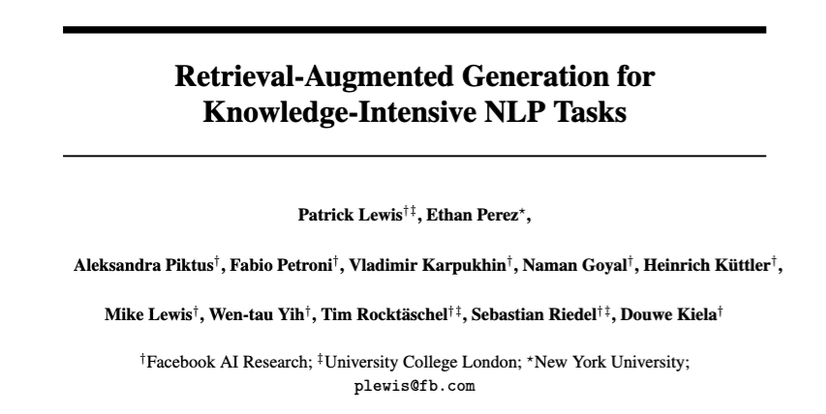
The OG RAG paper
2020
Notes:
https://arxiv.org/pdf/2005.11401

Slide 28
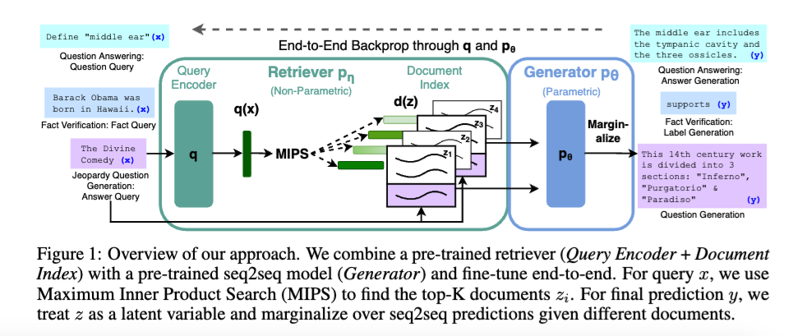
The OG RAG paper
sort of
returns top K docs

Slide 29


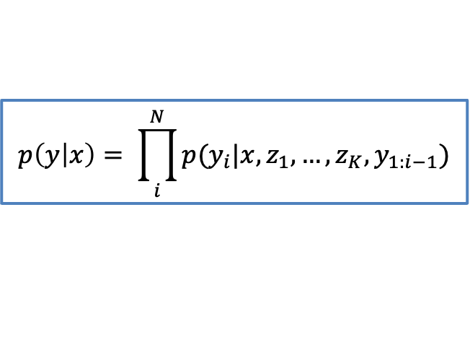
The OG RAG paper
Even simpler
and now almost always used
$$p\left(y | x\right)= \prod_{i}^{N}{p(y_{i}|x,z_{1},…,z_{K},y_{1:i−1})}$$
returns top K docs

Slide 30



The OG RAG paper
updated in training
frozen – not updated!
based on DPR
returns top K docs
based on BART
(BERT-sized encoder-decoder)

Slide 31
The OG RAG paper
Index needs to rebuilt when BERT_{d} changes
updated in training
frozen – not updated!
Re-indexing is slow and complicated

Slide 32
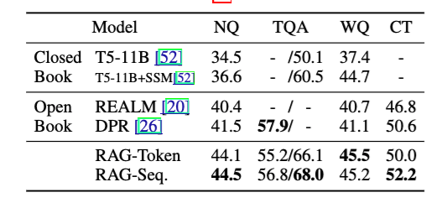
Experiments with RAG
Natural
Questions
TriviaQA
test1/2
Web
Questions
TREC

Slide 33
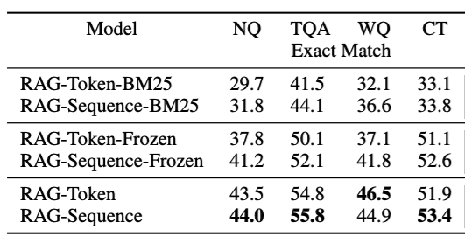
Experiments with RAG
Natural
Questions
Web
Questions
TriviaQA
test1/2
TREC
DPR retriever
Learned queries
There was a lot of later work on end-to-end RAG training but most of it did not catch on in the end

Slide 34
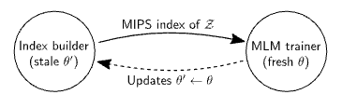
RAG vs REALM
REALM (Retrieval augmented LM, 2020):
full joint training of retriever and generator
requires periodic re-indexing
one process reindexes:
look for latest checkpoint,
loads and reindexes Wikipedia
second process generates training data
get query/answer
augment with top-K docs from latest index
third process trains both models
in practice few systems tried to jointly train afterwards
using REALM’s approach is complex
independently-trained retrieval systems got better
Notes:
https://proceedings.mlr.press/v119/guu20a.html?ref=http://githubhelp.com

Slide 35
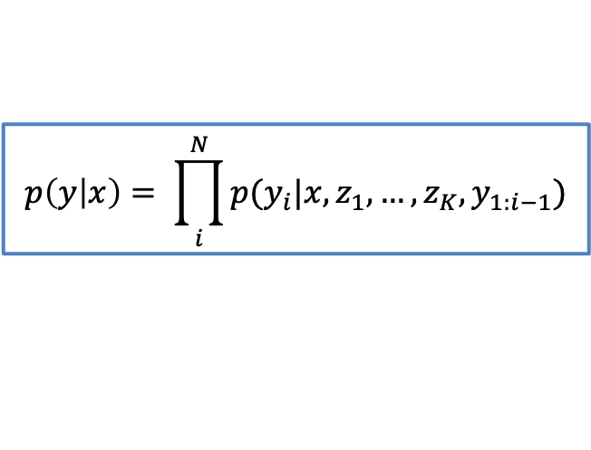
RAG: discussion
RAG is now generic term for using retrieval as preprocessing step for LLMs
Simplest case is fixed retriever, and appending all docs to the question to form LLM input
No custom learner / model / model-combination!
Simple case improves immediately whenever
LLM improves
retriever improves
Appending docs scales poorly when many documents are used
but there are some tricks to improve that
$$p\left(y | x\right)= \prod_{i}^{N}{p(y_{i}|x,z_{1},…,z_{K},y_{1:i−1})}$$

Slide 36
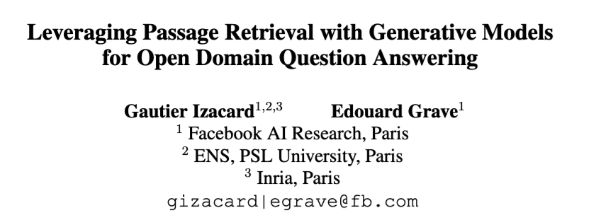
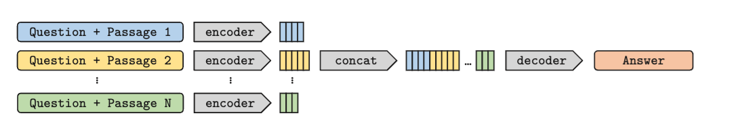
Fusion in Decoder (FiD)
2021
Notes:
https://arxiv.org/abs/2007.01282

Slide 37
Fusion in Decoder (FiD)
In open-book QA, often
Questions q and answer a are short: k=O(10)
Passages are longer: m=O(100)
Retrieving and appending N passages:
Encoder = O(Nm + k)²
Decoder = O(k * (Nm + k))
Trick:
cross-encode q with each passage separately: O(N(k+m)²)
decode, attending to all: O(k * N(m + k))
O(N² m²) ignoring k
O(N m)
O(N m²)
O(N m)
quadratic in N → linear in N
we lose cross-attention between tokens in different passages
can afford to retrieve more docs

Slide 38
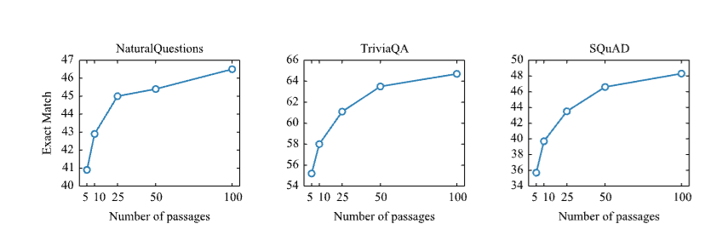
FiD Experiments

Slide 39
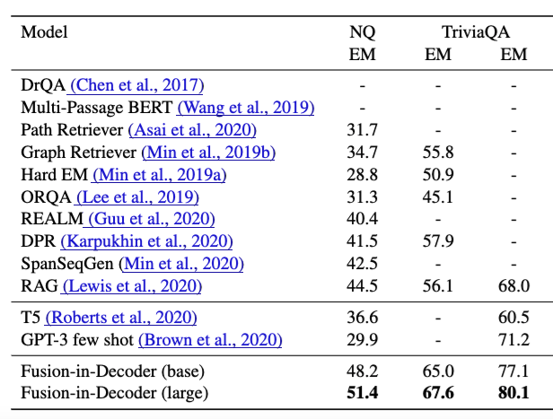
FiD Experiments
N = 100 passages

Slide 40
Fusion in Decoder (FiD): Discussion
FiD is nearly as simple as RAG to implement
Small change from existing Encoder-Decoder like T5
Somewhat more expensive in training/inference
You can train mostly with small N and then train a little further with larger N
In practice larger N helps more than joint training on many cases
FiD was the “strong baseline” for most open-book QA work done with encoder-decoder models

Slide 41
Outline
Review of how to learn retrievers
Contrastive learning
DPR and Contreiver
Using decoder-only LLMs for retrieval
query expansion
generating encodings
Retrieval-augmented generation (RAG)
The original RAG paper
The fusion-in-decoder (FiD) paper
A case study: optimizing inference for FiD
Systems: FiDO, LUMEN, GLIMMER
Incorporating principles from RAG, FiD in decoder-only LLMS

Slide 42
Optimizing FiD

Slide 43
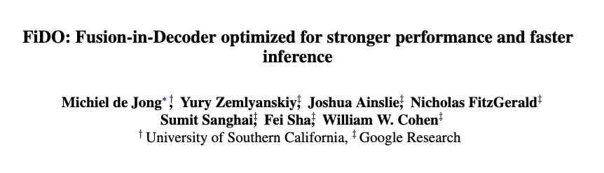
FiD Optimized (FiDO)
2023
Notes:
https://arxiv.org/pdf/2212.08153

Slide 44
Fusion in Decoder (FiD)
FiD is nearly as simple as RAG to implement
Small change from existing Encoder-Decoder like T5
More expensive in training/inference
Question: Is adapting a pre-trained T5 the most efficient architecture for inference?

Slide 45
Fusion in Decoder (FiD)
Encoding: we cross-encode 100 passages with full cross-attention to the question (and inside a passage)
At decoding time we generate a (usually short) answer to the question

Slide 46
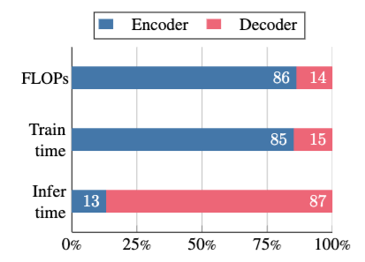
Fusion in Decoder (FiD)
FLOP analysis: Encoder is 6x as expensive as decoder!
…but at inference time decoding is slowest. Why?

Slide 47
Recap: LLM inference
Inference with an LLM has two phases
Prefilling / Encoding
process the prompt and context
for RAG and Encoder/Decoder models the context is large and structured
some ways to parallelize
Decoding
generate the response, word by word
this is sequential and uses the keys-values from encoding/prefilling

Slide 48
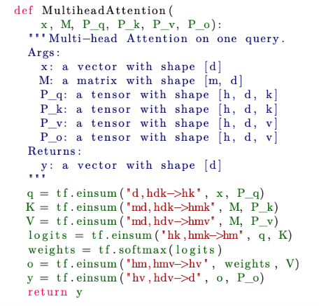
Performance analysis
Fast Transformer Attention: … Shazeer 2019 https://arxiv.org/pdf/1911.02150
Notation (one query):
d: token encoding dim
m: #things to maybe attend to
h: #heads
k: dim of queries and keys
aside: P_q = what we called W_{Q}
construct the query q for X
construct keys and values from M
parallel over all heads
dot prod similarities and attn scores
attn-weighted sum of values
project back to dimension of x
Notes:
https://arxiv.org/pdf/1911.02150

Slide 49
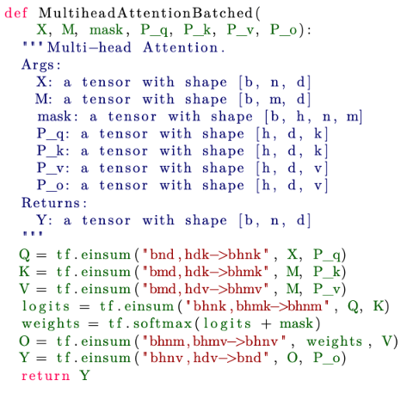
Performance analysis
Encoder / prefilling: batched MHA with batches of different positions in a sequence
Notation:
b: batch size
n: different positions in seq
d: token encoding dim
m: #things to maybe attend to
h: #heads
k: dim of queries and keys
construct the query Q for X
construct keys and values from M
dot prod similarities and attn scores
attn-weighted sum of values
project back to dimension of x
Notes:
https://arxiv.org/pdf/1911.02150

Slide 50
Performance analysis
Encoder / prefilling: batched MHA with batches of different positions in a sequence
Notation:
b: batch size
n: different positions in seq
d: token encoding dim
m: #things to maybe attend to
h: #heads
k: dim of queries and keys
Assume
m=n
k=v=d/h
n < d
FLOPS: O(bnd²)
Matmul: mk,kn → mn uses mnk² FLOPS
Q: bnd,dkh → bhnk
= bnd,d(d/h)h → bhn(d/h)
= bnd,dd matmul uses bnd² FLOPS
Notes:
https://arxiv.org/pdf/1911.02150

Slide 51
Performance analysis
Encoder / prefilling: batched MHA with batches of different positions in a sequence
Notation:
b: batch size
n: different positions in seq
d: token encoding dim
m: #things to maybe attend to
h: #heads
k: dim of queries and keys
Assume
m=n
k=v=d/h
n < d
FLOPS: O(bnd²)
Memory:
O(bnd) +
O(bhn²) +
O(d²)
…because
X,M,Q,K,V,O,Y
logits, weights
P’s
Notes:
https://arxiv.org/pdf/1911.02150

Slide 52

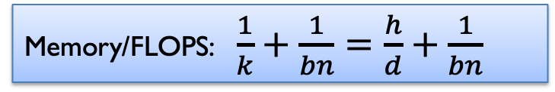
Performance analysis
Encoder / prefilling: batched MHA with batches of different positions in a sequence
Claim: FLOPs/sec <= FLOPs/byte * bytes/sec
moving data from HBM to Matmul units is “slow”
Memory/FLOPS: $\frac{1}{k}+\frac{1}{bn}=\frac{h}{d}+\frac{1}{bn}$
This is nice and low!
FLOPS: O(bnd²)
Memory:
O(bnd) +
O(bhn²) +
O(d²)
…because
X,M,Q,K,V,O,Y
logits, weights
P’s
Notes:
https://arxiv.org/pdf/1911.02150

Slide 53
Recap: LLM inference
Inference with an LLM has two phases
Prefilling / Encoding
process the prompt and context
for RAG and Encoder/Decoder models the context is large and structured
recap: I said “some ways to parallelize”
by batching inputs for different positions
Decoding
generate the response, word by word
this is sequential and uses the keys-values from encoding/prefilling

Slide 54
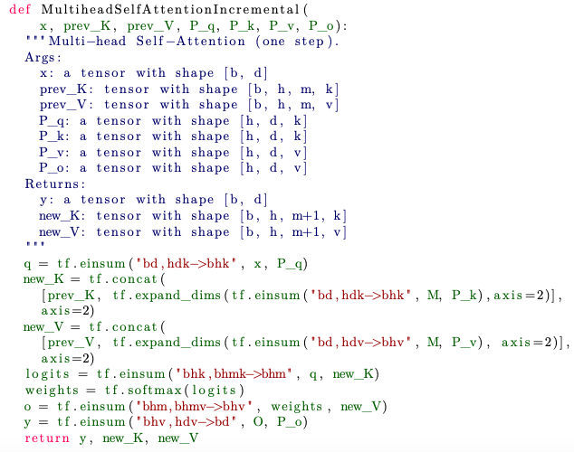
Performance analysis
Decoding: extend KY cache K and V
Notation:
b: batch size
n: different positions in seq
d: token encoding dim
m: #things to maybe attend to
h: #heads
k: dim of queries and keys
construct the query q for x
compute new keys and values and
update key-value cache
attn-weighted sum of values
project back to dimension of x
Notes:
https://arxiv.org/pdf/1911.02150

Slide 55
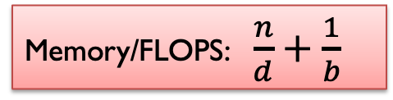
Performance analysis
Decoding: extend KY cache K and V
More memory transfer
Less compute
Memory/FLOPS: $\frac{n}{d}+\frac{1}{b}$
This is not small if n is large … which it is for RAG/FiD
construct the query q for x
compute new keys and values and
update key-value cache
attn-weighted sum of values
project back to dimension of x
Notes:
https://arxiv.org/pdf/1911.02150

Slide 56



Fusion in Decoder (FiD)
FLOP analysis: Encoder is 6x as expensive as decoder!
Predicted by counting FLOPS for all the matmuls and assuming n_{t} << n_{s} and n_{t} << d
n_{t} tokens in decoder output
n_{s} tokens in all encoder input
…but at inference time decoding is slowest. Why?
Predicted by memory/FLOPs:
What’s the fix?
Multilayer perceptron
self-attention
cross-attention

Slide 57
Fusion in Decoder Optimized (FiDO)
Speeding up performance:
Layer sparse attention (LSA): perform cross attention only on every K-th layer (K=6)
Load fewer key-value entries from encoder on avg
Multi-query attention (MQ)
Creates fewer key-value entries
Compensate for performance loss:
Scale the decoder up!
Use T5-XL decoder with T5-Base encoder, etc
Decoder
Encoder
Decoder

Slide 58
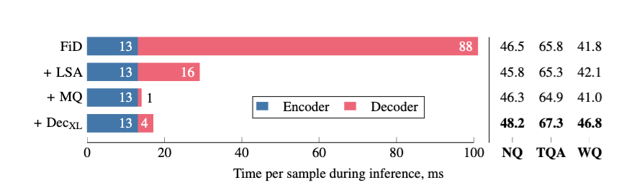
Fusion in Decoder Optimized (FiDO)

Slide 59
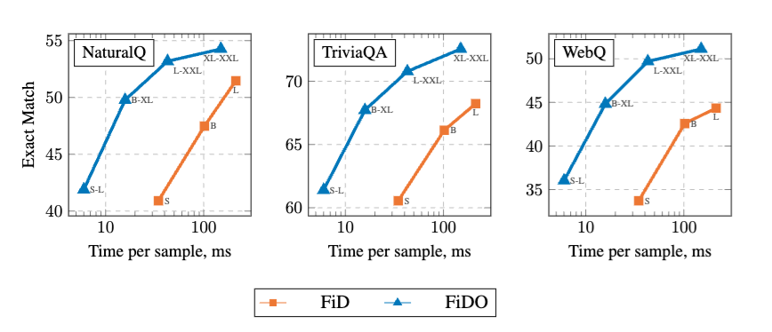
Fusion in Decoder Optimized (FiDO)

Slide 60
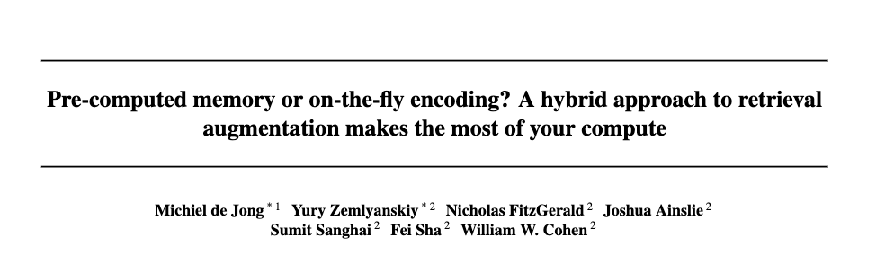
LUMEN: FiD with caching
2023
Notes:
https://arxiv.org/pdf/2212.08153

Slide 61

LUMEN: FiD with caching
An attractive seeming idea
Index every document in Wikipedia
with DPR, Contreiver, …
Store the BERT embeddings for every doc along with its vector index
Given a question
retrieve the first K doc embeddings
use these together with the question to generate an answer
…
Notes:
https://arxiv.org/pdf/2212.08153

Slide 62
LUMEN: FiD with caching
Store the BERT embeddings for every doc along with its vector index
Given a question
retrieve the first K doc embeddings
use these together with the question to generate an answer
Problem: it doesn’t work well to encode documents independently of the question for generation
…
lookup
question
Notes:
https://arxiv.org/pdf/2212.08153

Slide 63
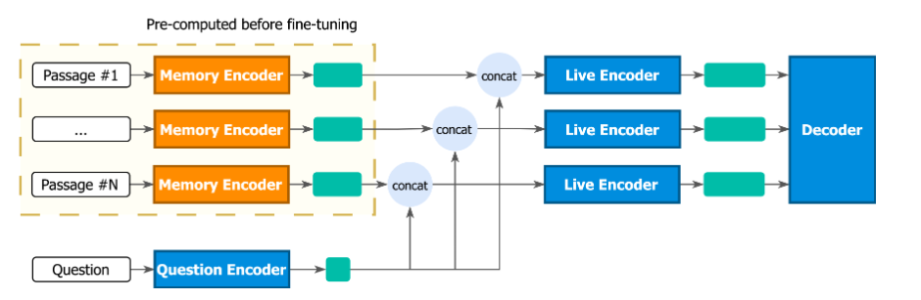
LUMEN: FiD with caching
The first N-K layers of the FiD encoder
The last K layers of the FiD encoder
FiD decoder
Passages are encoded and stored off-line for every document
Notes:
https://arxiv.org/pdf/2212.08153

Slide 64
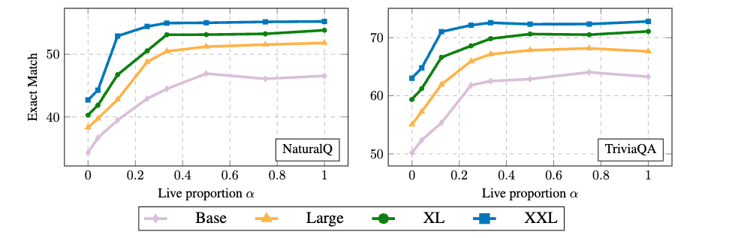
LUMEN: FiD with caching
As you scale up you can do a larger fraction of the work off-line

Slide 65
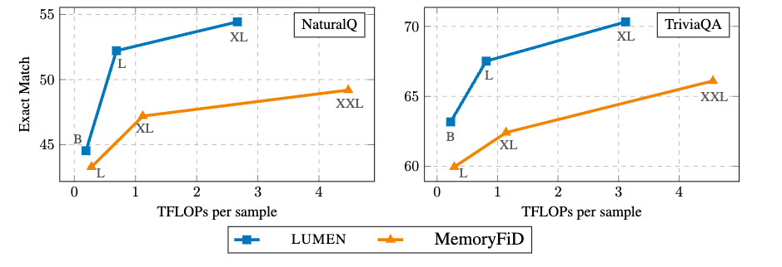
LUMEN: FiD with caching
Using 2/3 offline and 1/3 live is better than doing everything off-line

Slide 66
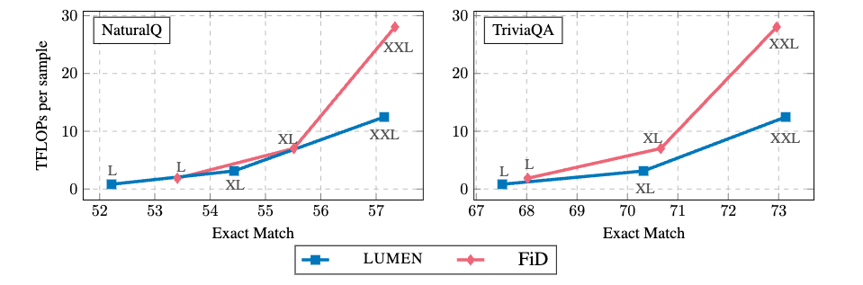
LUMEN: FiD with caching
As you scale up there are larger benefits from doing the off-line computation

Slide 67
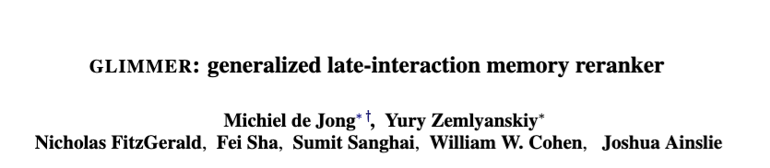
GLIMMER: LUMEN with reranking
2023
Notes:
https://arxiv.org/pdf/2212.08153

Slide 68
Recap: Cross-Encoders
relevance of i-th candidate to query
query
i-th candidate
c₁, c2, … c_{N}

Slide 69
Recap: LUMEN=FiD with caching
Similar to cross-encoding
Except for using LUMEN’s trick of pre-computing the first few layers of the encodings independently
Notes:
https://arxiv.org/pdf/2212.08153

Slide 70
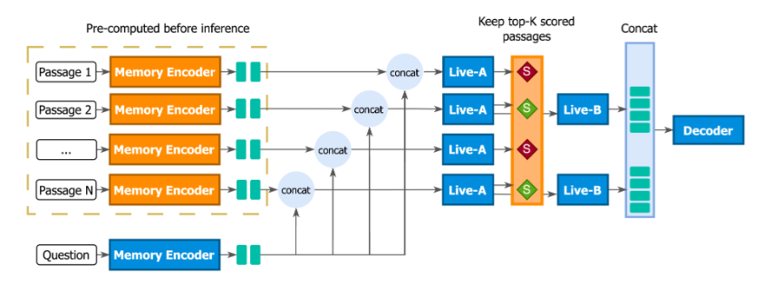

GLIMMER=LUMEN with reranking
Trained with “perplexity distillation loss”
log p_{LM} = perplexity of answer a for a decoder using only d_{i}, q
train to reduce KL between predicted scores and p_{k} – w a temperature in the softmax
Notes:
Generalized LateInteraction Memory Reranker
https://arxiv.org/pdf/2306.10231
https://storage.prod.researchhub.com/uploads/papers/2022/08/12/2208.03299v1.pdf – ppl dis loss

Slide 71
GLIMMER=LUMEN with reranking
Trained with “perplexity distillation loss”
Only the top few documents are presented to the decoder
Notes:
Generalized LateInteraction Memory Reranker
https://arxiv.org/pdf/2306.10231
https://storage.prod.researchhub.com/uploads/papers/2022/08/12/2208.03299v1.pdf – ppl dis loss

Slide 72
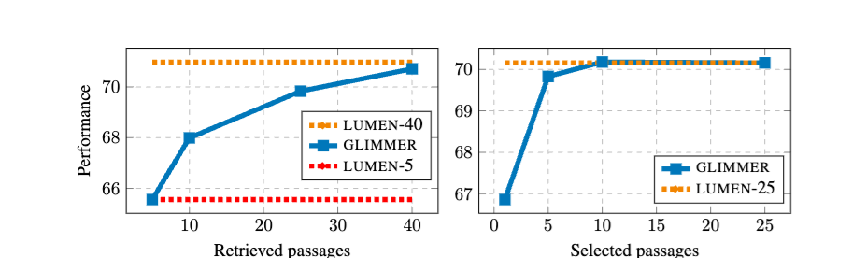
GLIMMER=LUMEN with reranking
select top 5
of 25 retrieved
Notes:
Generalized LateInteraction Memory Reranker
https://arxiv.org/pdf/2306.10231
https://storage.prod.researchhub.com/uploads/papers/2022/08/12/2208.03299v1.pdf – ppl dis loss

Slide 73
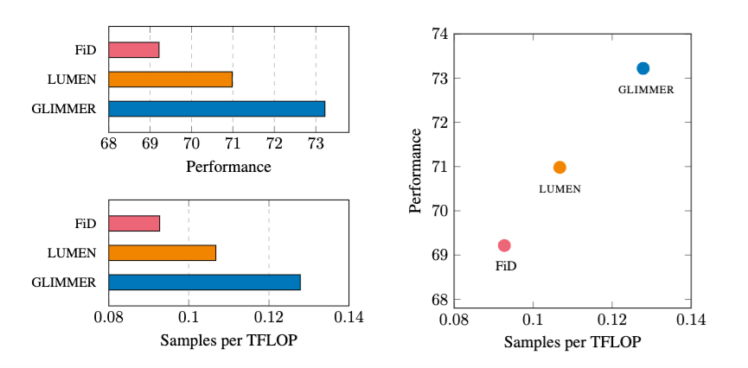
GLIMMER=LUMEN with reranking
Average performance on multiple tasks from the KILT dataset
Retrieve 25 passages, rerank, and decode with top 5
Notes:
Generalized LateInteraction Memory Reranker
https://arxiv.org/pdf/2306.10231
https://storage.prod.researchhub.com/uploads/papers/2022/08/12/2208.03299v1.pdf – ppl dis loss

Slide 74
Outline
Review of how to learn retrievers
Contrastive learning
DPR and Contreiver
Using decoder-only LLMs for retrieval
query expansion
generating encodings
Retrieval-augmented generation (RAG)
The original RAG paper
The fusion-in-decoder (FiD) paper
A case study: optimizing inference for FiD
Systems: FiDO, LUMEN, GLIMMER
Incorporating principles from RAG, FiD in decoder-only LLMS

Slide 75
FiD-Like SYSTEMS WITH DECODER-ONLY LLMS

Slide 76
Main ideas in FiD and extensions
Analog for decoder-only LLMs
In encoder
cross-encoder q+p1, q+p2, … separately
restricting cross-attention
In decoder
attend to everything as you generate
Extensions
FiDO: optimize performance to avoid decoder bottlenecks
LUMEN: pre-compute encoder outputs
GLIMMER: add reranking
Parallel Context Windows (PCW) - 2023
FlashAttention (2023) and FlexAttention (2024)—also improve decoder bottlenecks
TurboRAG, Blockwise Sparse Attention - 2024
Dynamic Blockwise Sparse Attention - 2025

Slide 77
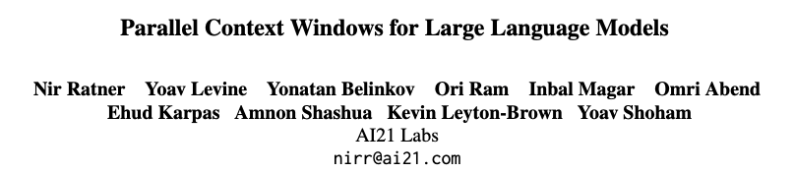
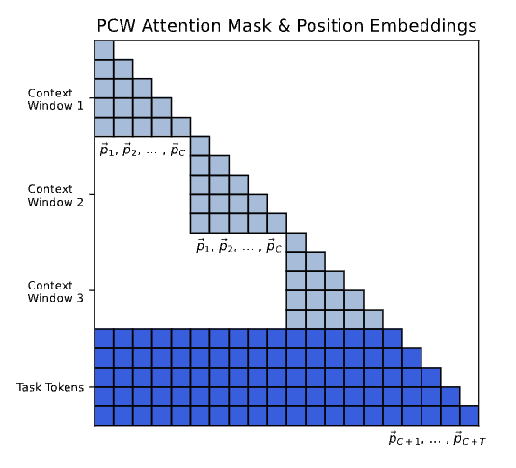
2023
Context tokens: retrieved document(s) for RAG, in-context examples, …
Task tokens: question for RAG, test input for ICL, …
I believe also output tokens are task tokens
Key idea: cross-attend within a context window, and cross-attend between task tokens and all context windows.
Very similar to FiD
if question/answer are task tokens
no post-training required
Notes:
https://arxiv.org/pdf/2212.10947

Slide 78
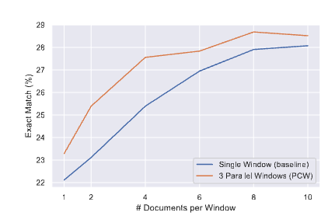
2023
Context tokens: retrieved document(s) for RAG, in-context examples, …
Task tokens: question for RAG, test input for ICL, …
I believe also output tokens are task tokens
Key idea: cross-attend within a context window, and cross-attend between task tokens and all context windows.
Good results for NQ (vs conventional RAG system) and ICL (especially classification with many classes)
Very similar to FiD
if question/answer are task tokens
Implemented with attention masks rather than parallel generation of keys and values

Slide 79


2024
Context tokens: retrieved document(s) for RAG, in-context examples, …
Task tokens: question for RAG, test input for ICL, …
Key idea: same as PCW except
cache the independently-produced KV pairs of the documents
load KV pairs for relevant docs directly
fine-tune for a short time (100-1000 steps)
TTFT = Time To First Token
FLOPS also for first token
Notes:
https://arxiv.org/pdf/2409.15355

Slide 80


2025
Key idea: same as Block-Attention except
experiments are on ICL instead of RAG
cache the independently-produced KV pairs of the documents
evaluate addition of KV pairs computed for retrieved documents
retrieve ICL examples with BM25
avoid fine-tuning
clever use of StreamingLLM trick of “attention sink”
don’t mess with position encodings
Notes:
https://arxiv.org/pdf/2503.08640

Slide 81
DBSA: Details
Baseline: many-shot learning
Given n ICL examples
encode n/k blocks of ICL examples containing
k demonstrations
a shared “anchor block”
load all blocks into a KV cache
add the usual positional encoding features
Implemented with FlexAttention
Doesn’t actually encode the masked blocks
50 examples/block, 30k and 90k training examples for classification tasks

Slide 82
DBSA: Details
Dynamic example selection
Given a query q*
retrieve m<n encoded blocks (with BM25)
load retrieved blocks and anchor block into a KV cache and add positional encoding
retrieve 30% of the available training examples

Slide 83

DBSA: Results
Total latency including set-up time

Slide 84

DBSA: Results

