Slide 1
10-605 / 10-405
Machine Learning from Large Datasets

Slide 2
Recap: the course so far
Why bigdata is important in ML / history of bigdata in ML
Scalable computation on clusters
MapReduce, Spark and iteration, Spark workflows
Learning as optimization
MLE for binomials, linear regression, logistic regression, k-means clustering
exact solutions, gradient descent (batch, parallel, stochastic), EM and EM-like methods (for k-means)
“Craft” of ML
feature extraction / augmentation/ kernels
regularization and sparsity hyperparameter tuning
the hash trick and efficiency
distributed ML – interaction with sparsity etc

Slide 3
Recap: the course so far
Why bigdata is important in ML / history of bigdata in ML
Tool: Scalable computation on clusters
MapReduce, Spark and iteration, Spark workflows
Tool: Learning as optimization
MLE for binomials, linear regression, logistic regression, k-means clustering
Tools: exact solutions, gradient descent (batch, parallel, stochastic), EM and EM-like methods (for k-means)
“Craft” of ML
Tool: feature extraction / augmentation/ kernels
Tool: regularization and sparsity hyperparameter tuning
Tool: the hash trick and efficient SGD
Tool: distributed ML – interaction with sparsity, AllReduce

Slide 4
Today’s tool
Randomized algorithms
Probabilistically grounded approximate data structures that are useful in ML/bigdata settings
Today:
Bloom Filters
CountMin Sketches
Examples of how they have been used

Slide 5
Motivating Bloom Filters: Variant of the Hash Trick

Slide 6

Proc of ML Research, 2009

Slide 7
Recap: Formal results
Observation: in NLP (especially with substrings and terms#class as features) there are often highly-correlated features “duplicates”
Or you can create duplicates explicitly by hashing “William#1”, “William#2”, “William#3”, etc.
Q: How much loss of information is there if you assume duplicates exist?
A: very little!
Eg 10k features, 10M hash buckets, 3 duplicates of each feature, Pr(all duplicates of any feature collide) ~= 1%

Slide 8
Recap: of feature hashing with duplicates
Hash each feature multiple times with different hash functions
Now, each w has k chances to not collide with another useful w’
An easy way to get multiple hash functions
Generate some random strings s₁,…,s_{L}
Let the k-th hash function for w be the ordinary hash of concatenation w•s_{k}

Slide 9
A variant of feature hashing
a!=b are binary vectors
Hash each feature multiple times with different hash functions
Now, each w has k chances to not collide with another useful w’
An easy way to get multiple hash functions
Generate some random strings s₁,…,s_{L}
Let the k-th hash function for w be the ordinary hash of concatenation w•s_{k}
V(a)
1 | 0 | 1 | 0
0 | 1 | 1 | 0
1 | 0 | 1 | 0
1 | 1 | 0 | 0
V(a)
1 | 0 | 1 | 0
1 | 0 | 1 | 0
1 | 1 | 2 | 0
V(b)
V(b)
1 | 1 | 1 | 0

Slide 10
A variant of feature hashing
Why would this work?
Claim (Shi et al): with 100,000 features and 100,000,000 buckets:
k=1 ➔Pr(any feature duplication) ≈1
k=2 ➔Pr(any feature duplication) ≈0.4
k=3 ➔ Pr(any feature duplication) ≈0.01

Slide 11
Hash Trick - Insights
Save memory: don’t store hash keys
Allow collisions
even though it distorts your data some
Let the learner (downstream) take up the slack
Bloom filters are another famous trick that exploits these insights….

Slide 12
Bloom Filters

Slide 13
Bloom filters
A noisy “set” where you can test membership (and that’s it)
Interface to a Bloom filter
BloomFilter(int maxSize, double p);
void bf.add(String s); // insert s
bool bd.contains(String s);
// If s was added return true;
// else with probability at least 1-p return false;
// else with probability at most p return true;
Notes:
note a hash table would do this in constant time and storage
the hash trick does this as well

Slide 14
Bloom filters
An implementation
Allocate M bits, bit[0]…,bit[1-M]
Pick K hash functions hash(1,2),hash(2,s),….
E.g: hash(i,s) = hash(s+ randomString[i])
To add string s:
For i=1 to k, set bit[hash(i,s)] = 1
To check contains(s):
For i=1 to k, test bit[hash(i,s)]
Return “true” if they’re all set; otherwise, return “false”
We’ll discuss how to set M and K soon, but for now:
Let M = 1.5*maxSize // less than two bits per item!
Let K = 2*log(1/p) // about right with this M

Slide 15
Bloom filters
0 | 0 | 0 | 0 | 0 | 0 | 0 | 0 | 0 | 0
bf.add(“fred flintstone”):
h1
h2
h3
0 | 1 | 1 | 0 | 0 | 0 | 0 | 1 | 0 | 0
bf.add(“barney rubble”):
h1
h2
h3
1 | 1 | 1 | 0 | 0 | 1 | 0 | 1 | 0 | 0

Slide 16
Bloom filters
1 | 1 | 1 | 0 | 0 | 1 | 0 | 1 | 0 | 0
bf.contains (“fred flintstone”):
h1
h2
1 | 1 | 1 | 0 | 0 | 1 | 0 | 1 | 0 | 0
bf.contains(“barney rubble”):
h1
h2
h3
1 | 1 | 1 | 0 | 0 | 1 | 0 | 1 | 0 | 0

Slide 17
Bloom filters
1 | 1 | 1 | 0 | 0 | 1 | 0 | 1 | 0 | 0
bf.contains(“wilma flintstone”):
h1
h2
h3
1 | 1 | 1 | 0 | 0 | 1 | 0 | 1 | 0 | 0
bf.contains(“wilma flintstone”):
h1
h2
h3
1 | 1 | 1 | 0 | 0 | 1 | 0 | 1 | 0 | 0

Slide 18



Bloom filters: analysis
Analysis (m bits, k hashers):
Assume hash(i,s) is a random function
Look at Pr(bit j is unset after n add’s):
… and Pr(collision) = Pr(all k bits set)
…. fix m and n and minimize f(m,n,k) for k:
f(m,n,k) =
k =

Slide 19


Bloom filters
Analysis:
Plug optimal k=m/n*ln(2) back into Pr(collision):
Now we can fix any two of p, n, m and solve for the 3rd:
E.g., the value for m in terms of n and p:
f(m,n) =

Slide 20
Bloom filters
Interface to a Bloom filter
BloomFilter(int maxSize /* aka n */, double p);
void bf.add(String s); // insert s
bool bd.contains(String s);
// If s was added return true;
// else with probability at least 1-p return false;
// else with probability at most p return true;
I.e., a noisy “set” where you can test membership (and that’s it)
Notes:
note a hash table would do this in constant time and storage
the hash trick does this as well

Slide 21
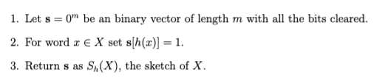
Bloom filters: a slightly different version
Building one sketch with one hash function:
each
Building t sketches with t hash functions:
=
Notes:
note a hash table would do this in constant time and storage
the hash trick does this as well

Slide 22

Bloom filters: a slightly different version
Building one sketch with one hash function:
Building t sketches with t hash functions:
=
Test membership with AND of all the sketches:
Notes:
note a hash table would do this in constant time and storage
the hash trick does this as well

Slide 23
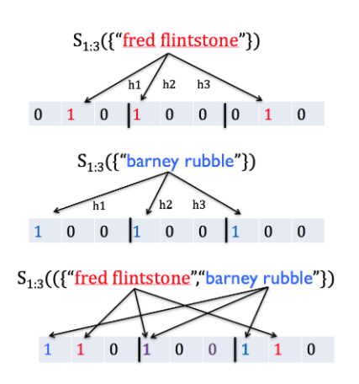
Bloom filters: a slightly different version
Notes:
note a hash table would do this in constant time and storage
the hash trick does this as well

Slide 24


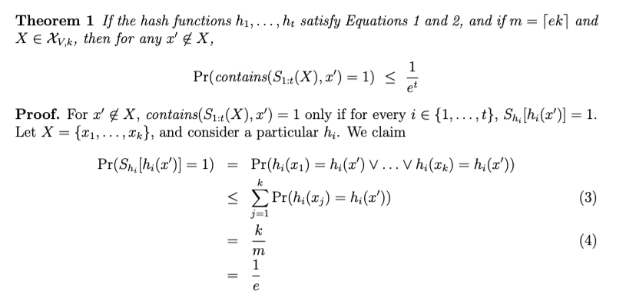
Bloom filters: a slightly different version
Probability over random choice of h_{i}
(1) Assume for all a, i, x:
(2) Assume for all a, b, i, j, x, x’:
up to k elements of set of size V
…then repeatedly apply (2)
Notes:
note a hash table would do this in constant time and storage
the hash trick does this as well

Slide 25


Bloom filters: a slightly different version
Notes:
note a hash table would do this in constant time and storage
the hash trick does this as well

Slide 26
Bloom filters: demo

Slide 27
What do you do with a Bloom filter?

Slide 28
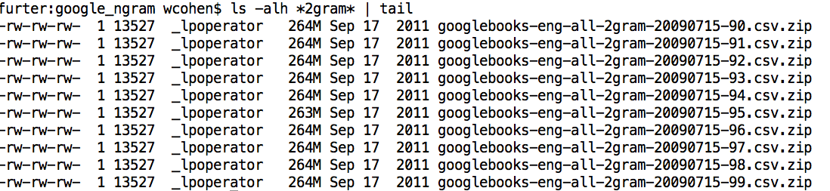
Some uses of Bloom filters
An example application
Finding items in “sharded” data
Easy if you know the sharding rule
Harder if you don’t (like Google n-grams)

Slide 29
Some Uses of Bloom filters
An example application
Finding items in “sharded” data
Easy if you know the sharding rule
Harder if you don’t (like Google n-grams)
Simple idea:
Build a BF of the contents of each shard
To look for key, load in the BF’s one by one, and search only the shards that (probably) contain key
Analysis: you won’t miss anything, you might look in some extra shards
You’ll hit O(1) extra shards if you set p=1/#shards

Slide 30
Some Uses of Bloom filters
An example application
discarding singleton features from a classifier
Scan through data once and check each w:
if bf1.contains(w): bf2.add(w)
else bf1.add(w)
Now:
bf1.contains(w) ⬄ w appears >= once
bf2.contains(w) ⬄ w appears >= 2x
Then train, ignoring words not in bf2

Slide 31
Some Uses of Bloom filters
An example application
discarding rare features from a classifier
seldom hurts much, can speed up experiments
Scan through data once and check each w:
if bf1.contains(w):
if bf2.contains(w): bf3.add(w)
else bf2.add(w)
else bf1.add(w)
Now:
bf2.contains(w) ⬄ w appears >= 2x
bf3.contains(w) ⬄ w appears >= 3x
Then train, ignoring words not in bf3

Slide 32
The Count-Min Sketch

Slide 33
A variant of feature hashing
Hash each feature multiple times with different hash functions
Now, each w has k chances to not collide with another useful w’
Get multiple hash functions as in Bloom filters
Part Bloom filter, part hash kernel
but predates either, called “count-min sketch” -- Cormode and Muthukrishnan

Slide 34
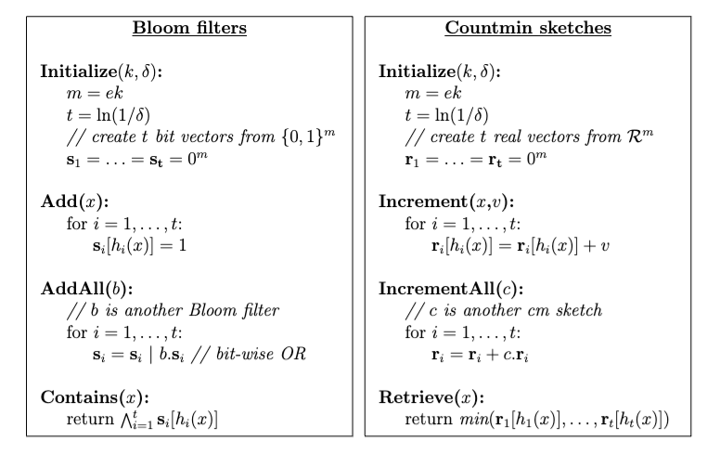
Bloom Filter→Count-min sketch
CM sketch maps x to a number a[x]
But you can only update a[x] by incrementing it

Slide 35
Bloom Filter→Count-min sketch

Slide 36
Bloom Filter→Count-min sketch
Implementation
Allocate a matrix CM with d rows, w columns
Pick d hash functions h₁(s),h₂(s),….
To increment counter A[s] for s by c
For i=1 to d, set CM[i, hash(i,s)] += c
To retrieve value of A[s]:
For i=1 to d, retrieve M[i, hash(i,s)]
Return minimum of these values
Similar idea s Bloom filter:
if there are d collisions, you return a value that’s too large; otherwise, you return the correct value.

Slide 37

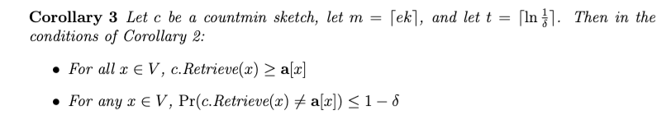
Count-min sketch results
Suppose a[x] is the value that x “should have” in the sketch: i.e., if the increment calls for x were with values v₁, …, v_{J} then
By the same argument used for the Bloom filter:

Slide 38

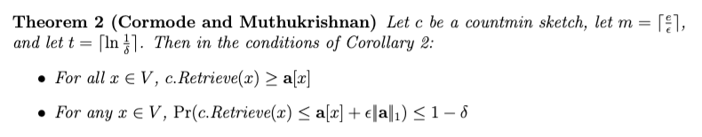
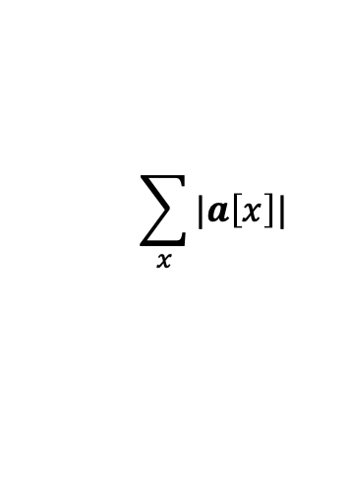
Count-min sketch results
$$\sum_{x}{|a\left[x\right]|}$$
Suppose denotes the L1 norm:

Slide 39
CM Sketch Structure
from: Minos Garofalakis
h₁(s)
+c
<s, +c>
+c
d=log 1/δ
+c
h_{d}(s)
+c
w = 2/ε
Each string is mapped to one bucket per row
Estimate A[j] by taking min_{k} { CM[k,h_{k}(j)] }
Errors are always over-estimates
Analysis: d=log 1/𝛿, w=2/𝜺 ➔ error is usually less than 𝜺||A||₁
i.e. with prob > 1-𝛿

Slide 40
from: Minos Garofalakis
<s, +c>
c
c
You can find the sum of two sketches by doing element-wise summation
c
c
<t, +d>
d
+
d
Also, you can compute a weighted sum of MC sketches
d
d
d
c
Same result as adding <s,+c> and then <t,+d> to an empty sketch
c+d
c
d
d
c

Slide 41
CM Sketch Guarantees
from: Minos Garofalakis
Assuming ||A||₁ is often reasonable:
Estimating a multinomial: if A[s] = Pr(s|…) then ||A||₁ = 1
Multiclass classification: if A_{x}[s] = Pr(x in class s) then ||A_{x}||₁ is probably small, since most x’s will be in only a few classes

Slide 42
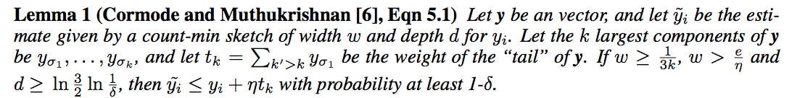
CM Sketch Guarantees
from: Minos Garofalakis
[Cormode, Muthukrishnan ‘04] CM sketch guarantees approximation error on point queries less than 𝜺||A||₁ in space O(1/𝜺 log 1/𝛿)
CM sketches are also accurate for skewed values---i.e., only a few entries s with large A[s]

Slide 43
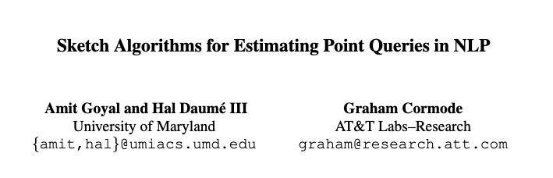
Applications of Count-Min Sketches 1

Slide 44

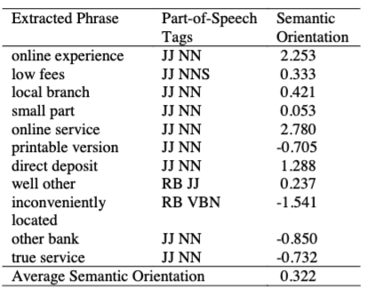
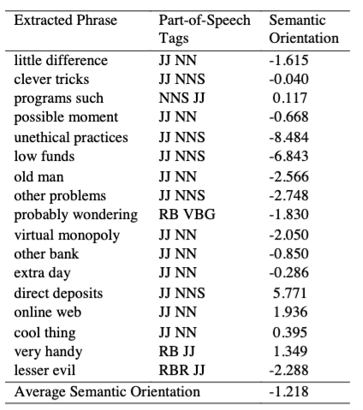
Background
2002

Slide 45
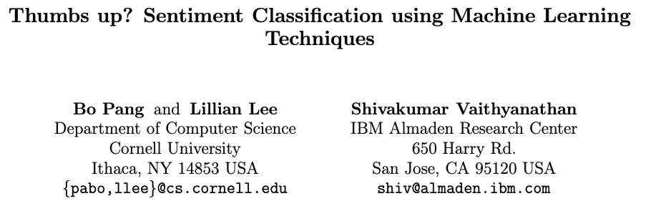
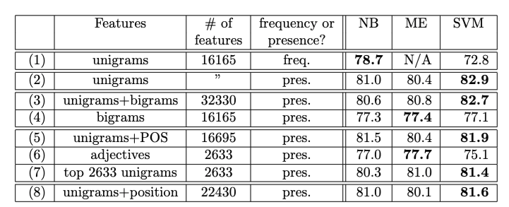
Background
2002 – 12,000+ citations
Dataset of movie reviews (pos, negative)

Slide 46


An Application of a Count-Min Sketch
Problem: find the semantic orientation of a review (positive or negative) using a large corpus.
Idea:
positive words co-occur more frequently than expected near other positive words; likewise for negative words
so pick a few pos/neg seeds and compute
x appears near y

Slide 47
An Application of a Count-Min Sketch
x appears near y
Turney, 2002 used two seeds, “excellent” and “poor”
In general, SO(w) can be written in terms of logs of products of counters for w, with and without seeds

Slide 48
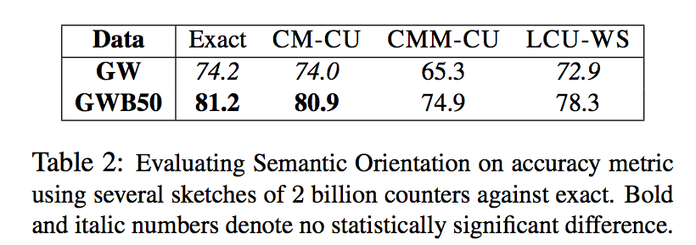
An Application of a Count-Min Sketch
Use 2B counters, 5 hash functions, “near” means a 7-word window, GigaWord (10 Gb) and GigaWord + Web news 50 Gb)

Slide 49
An Application of a Count-Min Sketch
CM-CU: CM with “conservative update” - for <j,+c> increment counters just enough to make the new estimate for j grow by c

