Slide 1
10-605 / 10-405
Machine Learning from Large Datasets

Slide 2
Recap: the course so far
Tool: Scalable computation on clusters
MapReduce, Spark and iteration, Spark workflows
Tool: Learning as optimization
MLE for binomials, linear regression, logistic regression, k-means clustering
Tools: exact solutions, gradient descent (batch, parallel, stochastic), EM and EM-like methods (for k-means)
“Craft” of ML
Tool: feature extraction / augmentation/ kernels
Tool: regularization and sparsity hyperparameter tuning
Tool: the hash trick and efficient SGD
Tool: distributed ML – interaction with sparsity, AllReduce
Tool: Randomized algorithms
Bloom filter (a randomized set)
Count-Min sketch (a randomized mapping x →R+ )
Today: locality sensitive hashing (LSH)

Slide 3
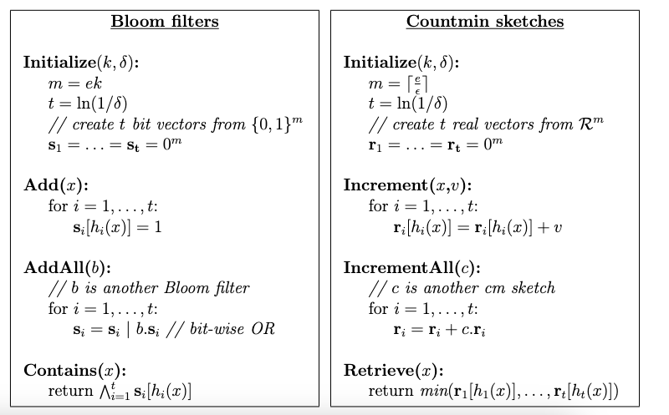
Bloom filter / Count-min sketch

Slide 4


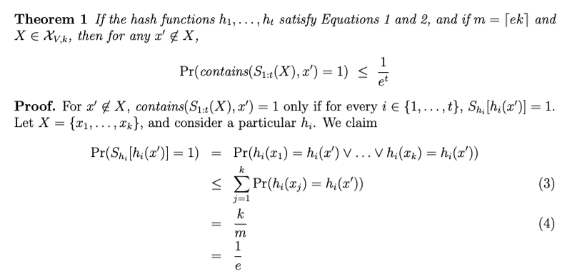
Bloom filters: the math
Probability over random choice of h_{i}
(1) Assume for all a, i, x:
(2) Assume for all a, b, i, j, x, x’:
up to k elements of set of size V
…then repeatedly apply (2)
Notes:
note a hash table would do this in constant time and storage
the hash trick does this as well

Slide 5


Bloom filters: the math
< 𝛿
Notes:
note a hash table would do this in constant time and storage
the hash trick does this as well

Slide 6

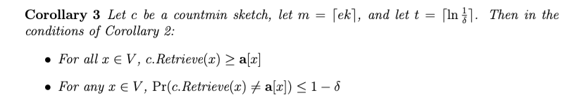
Count-min sketch results
Suppose a[x] is the value that x “should have” in the sketch: i.e., if the increment calls for x were with values v₁, …, v_{J} then
By the same argument used for the Bloom filter:

Slide 7
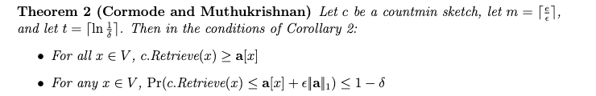
Count-min sketch results
Suppose a[x] is the value that x “should have” in the sketch: i.e., if the increment calls for x were with values v₁, …, v_{J} then
By the similar argument used for the Bloom filter:
Notes:
note: L1-norm of a is sort of like size of set k
m = 1/k

Slide 8
CM-Sketch: the math
recap of BF math
Pr(excess in r[h(x)] due to collisions with other x’) > 𝜺 ||a||₁) < 1/e
…then repeatedly apply (2)
Notes:
note a hash table would do this in constant time and storage
the hash trick does this as well

Slide 9




CM-Sketch: the math
Goal: show that for a particular hash function t and x
Pr(excess in r[h(x)] due to collisions with other x’) > 𝜺 ||a||₁) < 1/e
for hash function t
Markov
inequality
Expectation is:
So the goal is to show:
= 1/e
Notes:
could write Markov ineq as P(X >= cE[X]) < (1 / c E[X]) * E[X] = 1/c

Slide 10

CM-Sketch: the Markov Inequality
when X is a random variable that has non-negative real values
≥
c
Notes:
note a hash table would do this in constant time and storage
the hash trick does this as well

Slide 11
Count-min sketch result: recap

Slide 12


An Application of a Count-Min Sketch
Problem: find the semantic orientation of a review (positive or negative) using a large corpus.
Idea:
positive words co-occur more frequently than expected near other positive words; likewise for negative words
so pick a few pos/neg seeds and compute
x appears near y

Slide 13
An Application of a Count-Min Sketch
x appears near y
Turney, 2002 used two seeds, “excellent” and “poor”
In general, SO(w) can be written in terms of logs of products of counters for w, with and without seeds

Slide 14
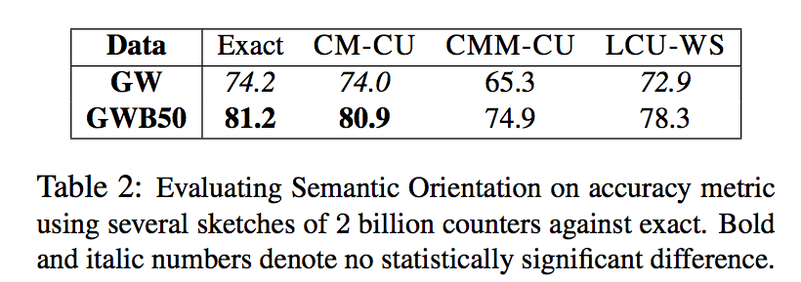
An Application of a Count-Min Sketch
CM-CU: CM with “conservative update” - for <j,+c> increment counters just enough to make the new estimate for j grow by c

Slide 15
Locality Sensitive Hashing (LSH)

Slide 16
LSH: key ideas
Goal:
map feature vector x to bit vector bx
ensure that bx preserves “similarity”

Slide 17
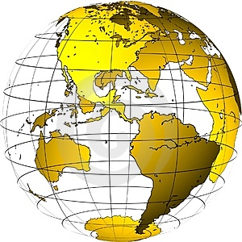
Random Projections

Slide 18
Random projections
u
+
+
+
+
+
+
+
+
+
-
-
-
-
-
-
-
-
-
-u
2γ

Slide 19
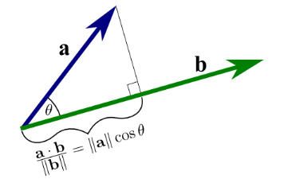
Random projections
+
+
example x1
+
+
+
+
+
+
+
-
-
-
-
-
-
-
-
-
unit weight vector w
Notes:
distance is dot product w . x1

Slide 20
Random projections
Consider two points.
If they are close their projections will always be close
+
+
+
+
+
+
+
+
+
-
-
-
-
-
-
-
-
-

Slide 21
Random projections
Consider two points.
If they are distant their projections might be distant …
+
+
+
+
+
+
+
+
+
-
-
-
-
-
-
-
-
-
When will the projections be close?

Slide 22
Random projections
To make two points “close” we need to project to a direction nearly orthogonal to the line between them
+
+
+
+
+
+
+
+
+
-
-
-
-
-
-
-
-
-

Slide 23
LSH: key ideas
Goal:
map feature vector x to bit vector bx
ensure that bx preserves “similarity”
Basic idea: use random projections of x
Repeat many times:
Pick a random hyperplane r by picking random weights for each feature (say from a Gaussian)
Compute the inner product of r with x
Record if x is “close to” r (r.x>=0)
the next bit in bx
Theory says that if x’ and x have small cosine distance then bx and bx’ will have small Hamming distance

Slide 24
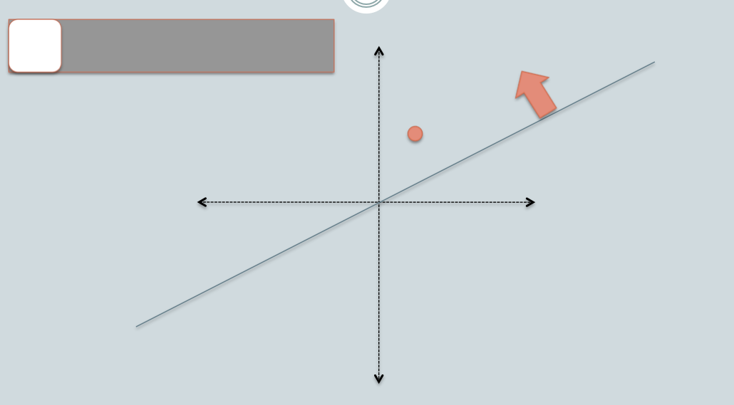
[Slides: Ben van Durme]

Slide 25
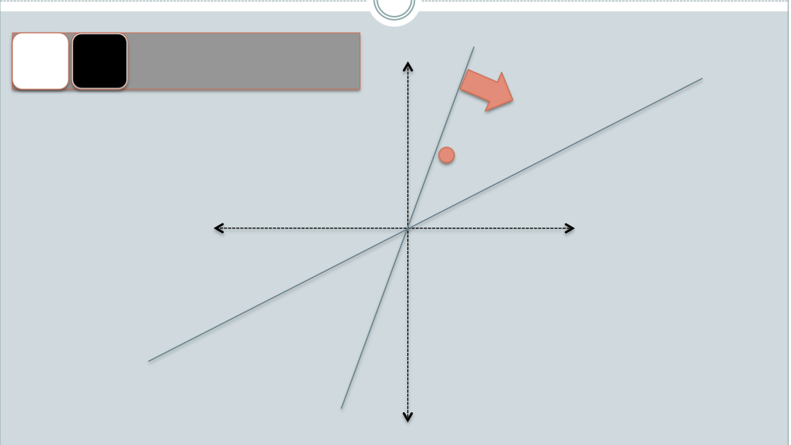
[Slides: Ben van Durme]

Slide 26
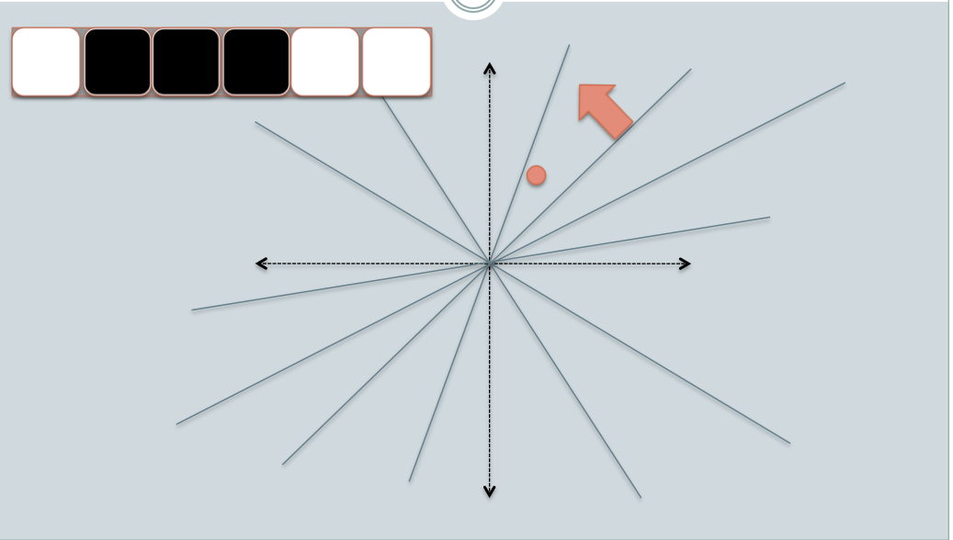
[Slides: Ben van Durme]

Slide 27
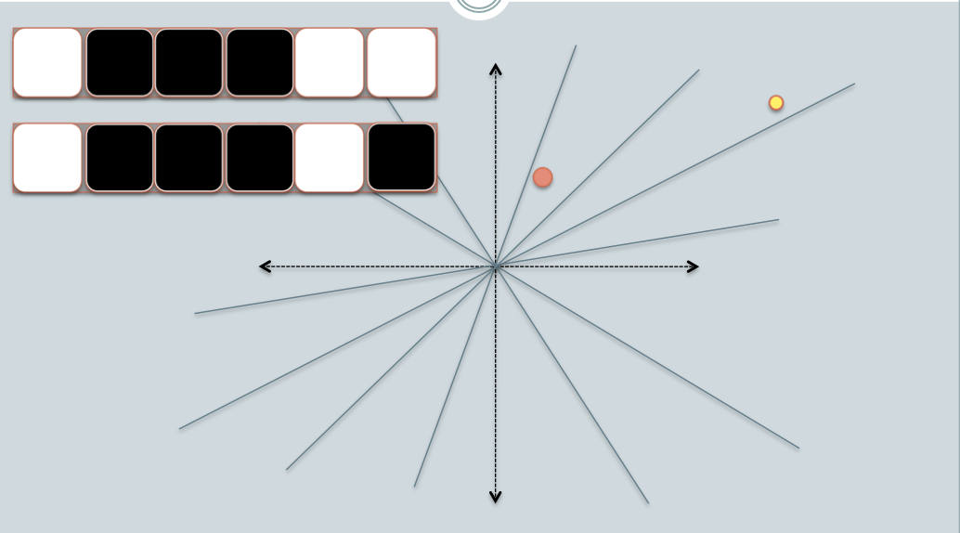
[Slides: Ben van Durme]

Slide 28
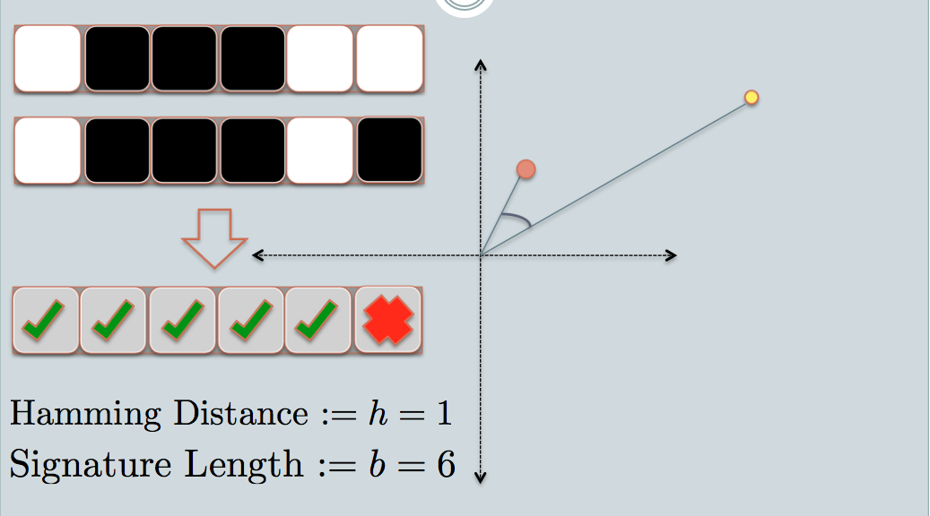
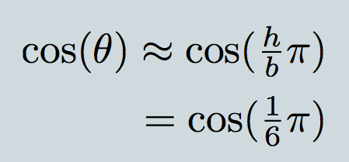
For unit-length vectors cosine similarity = dot product similarity

Slide 29
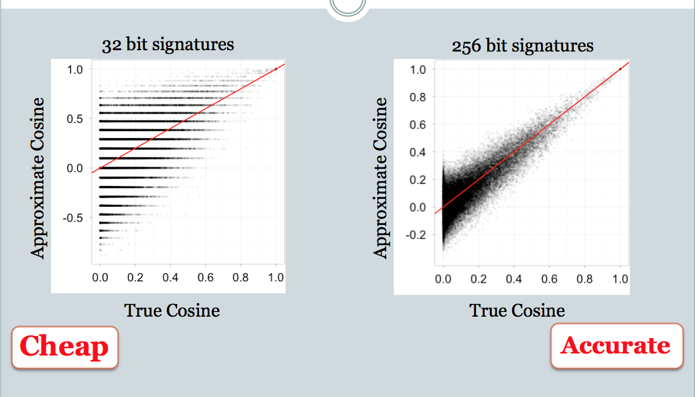
“Collisions are your friend” – they indicate similarity

Slide 30
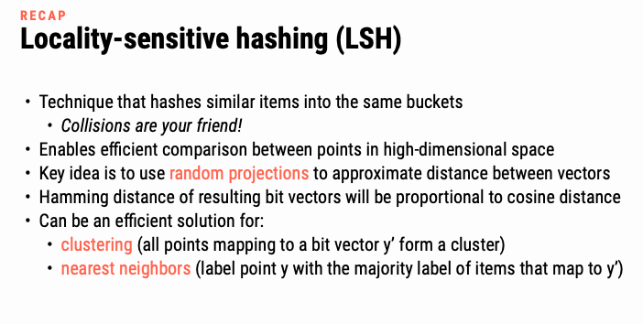

Slide 31
LSH applications
Compact storage of data
and we can still compute similarities
LSH also gives very fast approximations:
approx nearest neighbor method
just look at other items with bx’=bx
also very fast nearest-neighbor methods for Hamming distance
very fast clustering
cluster = all things with same bx vector

Slide 32
Extension/Application: Online LSH and Pooling

Slide 33
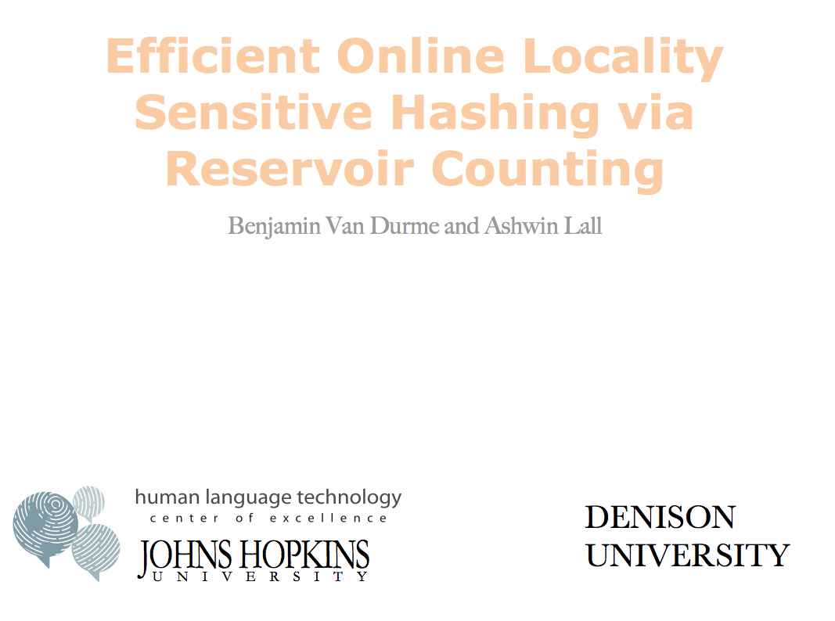


2010

Slide 34
LSH algorithm
Naïve algorithm:
Initialization:
For i=1 to outputBits:
For each feature f:
Draw r(f,i) ~ Normal(0,1)
Given an instance x
For i=1 to outputBits:
LSH[i] =
sum(x[f ]*r[i,f ] for f with non-zero weight in x) > 0 ? 1 : 0
Return the bit-vector LSH

Slide 35
LSH algorithm
But: storing the k classifiers is expensive in high dimensions
For each of 256 bits, a dense vector of weights for every feature in the vocabulary
Storing seeds and random number generators:
Possible but somewhat fragile

Slide 36
LSH: “pooling” (van Durme)
Alternative algorithm:
Initialization:
Create a pool:
Pick a random seed s
For i=1 to poolSize:
Draw pool[i] ~ Normal(0,1)
For i=1 to outputBits:
Devise a random hash function hash(i,f):
Given an instance x
For i=1 to outputBits:
LSH[i] = sum(
x[f] * pool[hash(i, f ) % poolSize] for f in x) > 0 ?
1 : 0
Return the bit-vector LSH

Slide 37
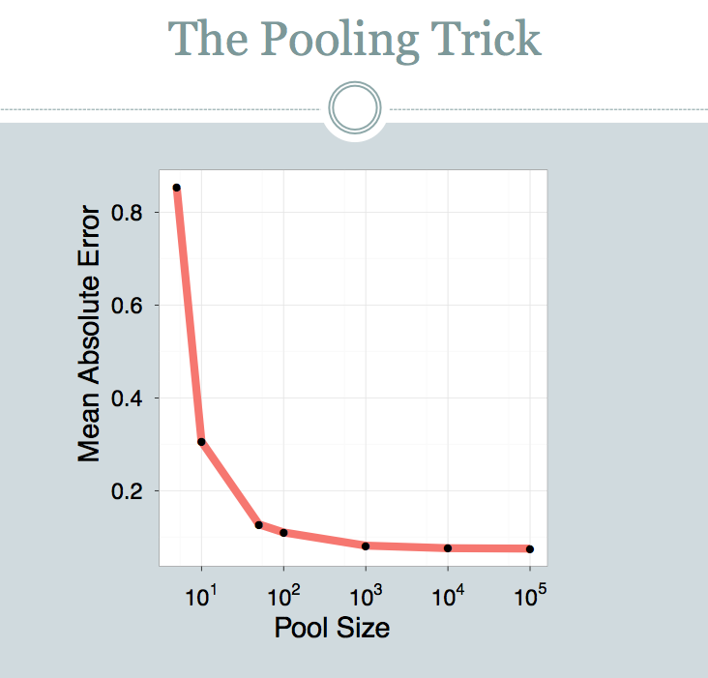

Slide 38
LSH: key ideas: pooling
Advantages:
with pooling, this is a compact re-encoding of the data
you don’t need to store the r’s, just the pool

Slide 39
Locality Sensitive Hashing (LSH) in an On-line Setting

Slide 40
Recap: using a Count-Min Sketch
x appears near y
Turney, 2002 used two seeds, “excellent” and “poor”
In general, SO(w) can be written in terms of logs of products of counters for w, with and without seeds

Slide 41
LSH: key ideas: online computation
This SO trick is based on another common task: distributional clustering
for a word w, v(w) is sparse vector of words that co-occur with w
cluster the v(w)’s
…guards at Pentonville prison in North London discovered that an escape attempt…
An American Werewolf in London is to be remade by the son of the original director…
…UK pop up shop on Monmouth Street in London today and on Friday the brand…
v(London): Pentonville, prison, in, North, …. and, on Friday

Slide 42
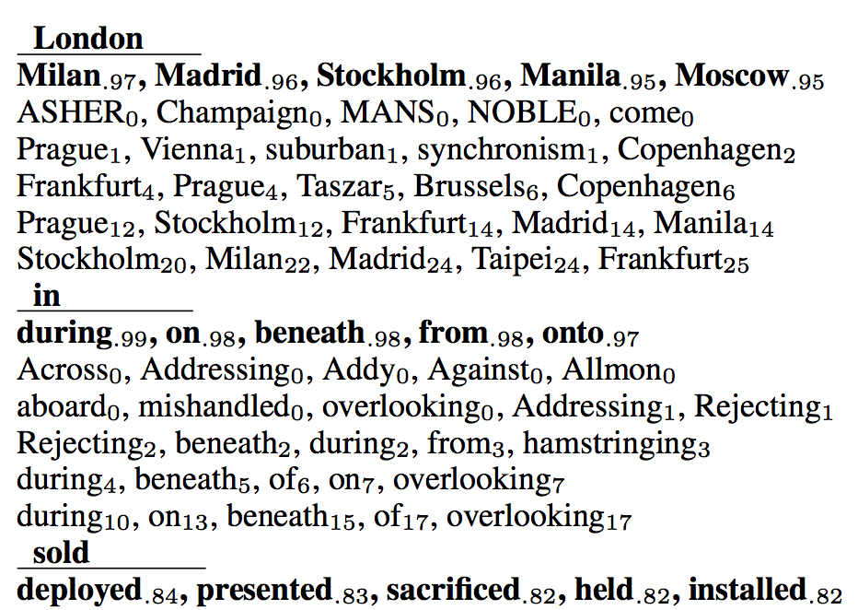
LSH: key ideas: online computation
Common task: distributional clustering
for a word w, v(w) is sparse vector of words that co-occur with w
cluster the v(w)’s – or here, compute similarities
is similar to:
is similar to:
is similar to:

Slide 43
LSH: key ideas: online computation
Common task: distributional clustering
for a word w, v(w) is sparse vector of words that co-occur with w
cluster the v(w)’s
Levy, Omer, Yoav Goldberg, and Ido Dagan. "Improving distributional similarity with lessons learned from word embeddings." Transactions of the Association for Computational Linguistics 3 (2015): 211-225.
v(w) is very similar to a word embedding (eg, from word2vec or GloVE)

Slide 44
LSH: key ideas: online computation
Construct LSH(v(w)) for each word w in the corpus
stream through the corpus once
use minimal amount of memory
ideally no more than size of output
…guards at Pentonville prison in North London discovered that an escape attempt…
An American Werewolf in London is to be remade by the son of the original director…
…UK pop up shop on Monmouth Street in London today and on Friday the brand…
v(London): Pentonville, prison, in, North, …. and, on Friday
LSH(v(London)): 0101101010111011101
LSH(v(Monmouth)): 0111101000110010111
…

Slide 45
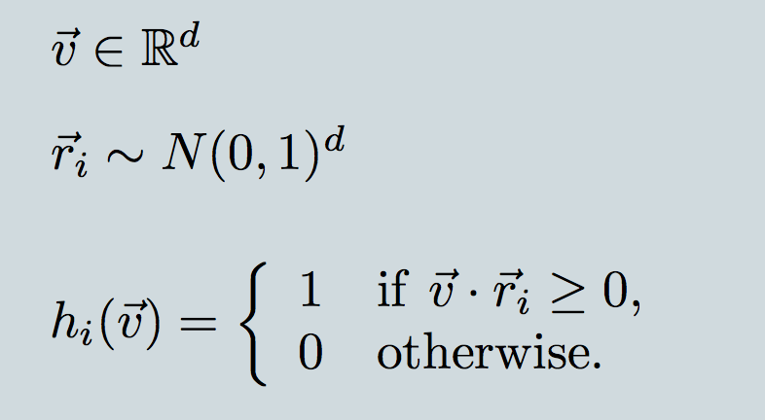
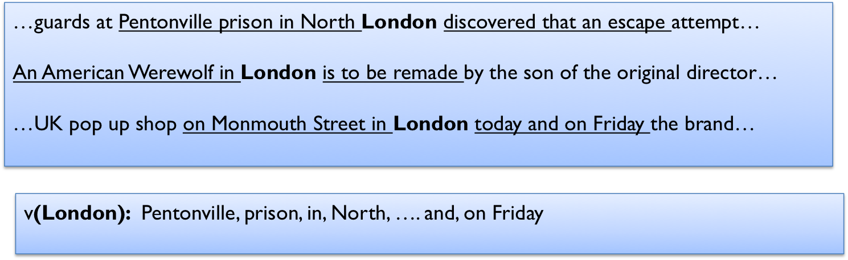
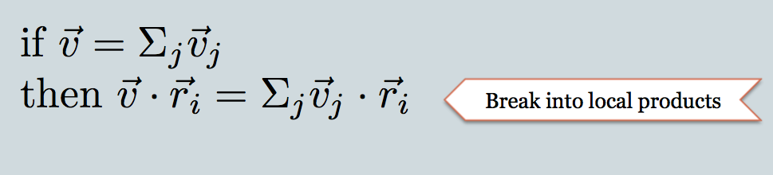
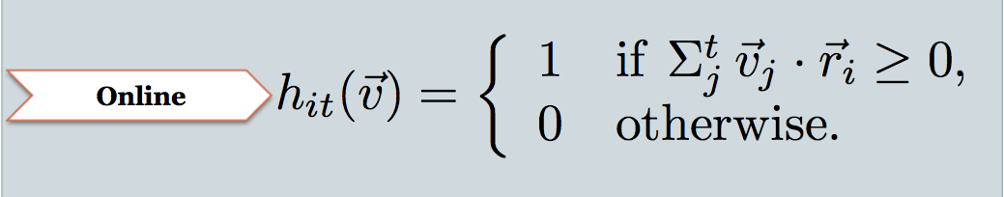
v is context vector; d is vocab size
r_{i} is i-th random projection
h_{i}(v) i-th bit of LSH encoding
because context vector is sum of mention contexts
these come one by one as we stream thru the corpus
keep this as H[w][i]
threshold later on

Slide 46
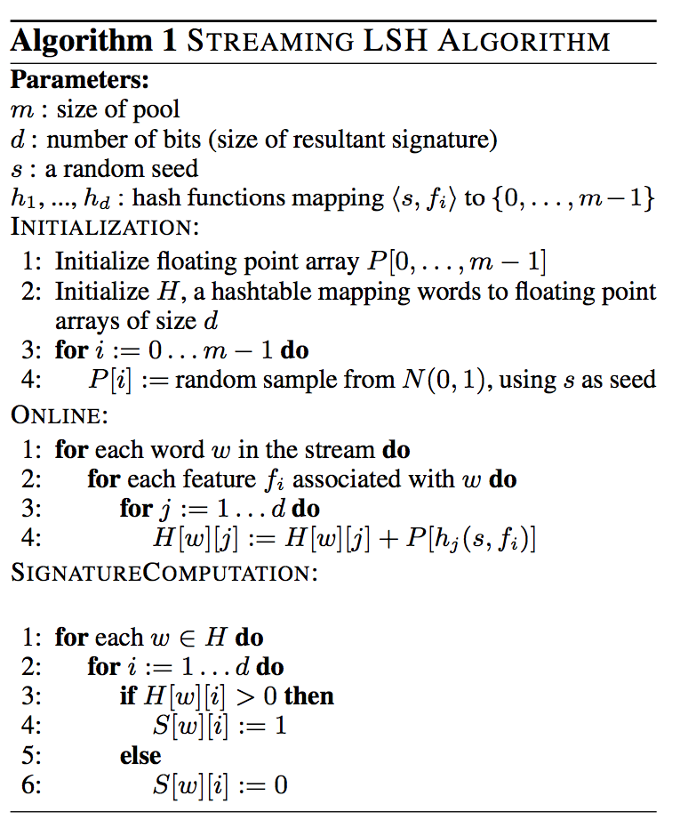
weight of f_{i} in r_{j}
j-th hash of f_{i}
compress H[w][j] to bits

Slide 47
Comments
Tricks in this paper
saving calls to random() with pooling
computing word distribution vectors incrementally
and at each increment compress, via random projection, to d real numbers
thresholding the random projections to a bit

Slide 48
Experiment
Corpus: 700M+ tokens, 1.1M distinct bigrams
For each, build a feature vector of words that co-occur near it, using on-line LSH
Check results with 50,000 actual vectors

Slide 49
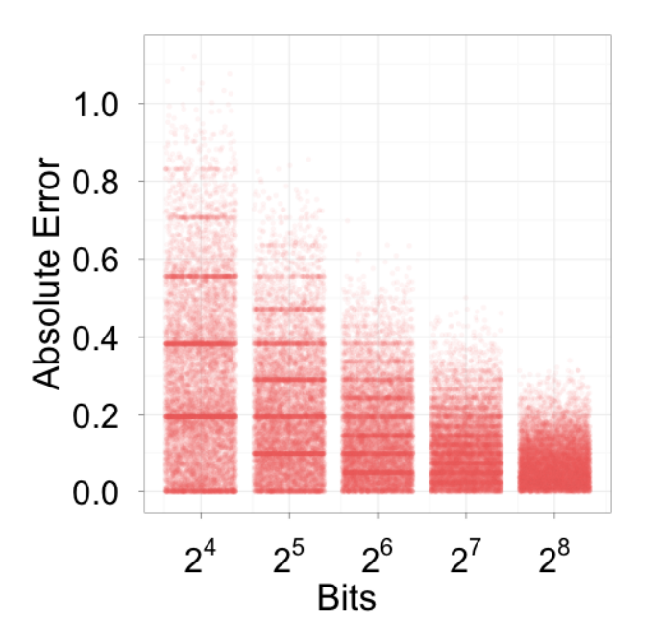
Experiment

Slide 50
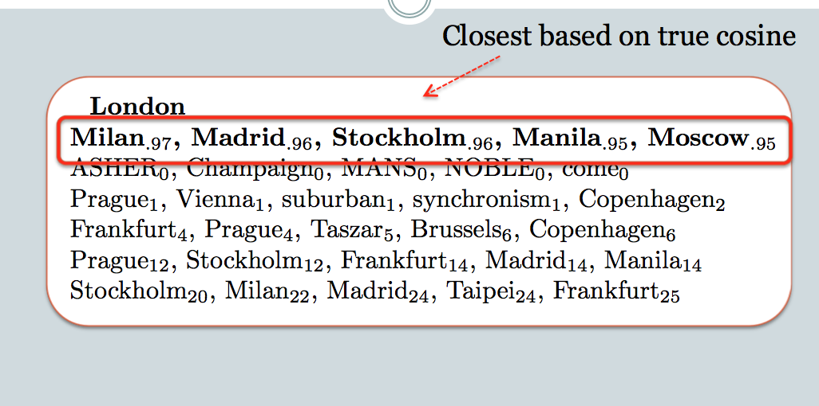
16
32
64
128
256

Slide 51
LSH: Applications and Alternatives

Slide 52
LSH: key ideas
LSH can be used to compress a set of vectors
while preserving some information about their similarity
LSH can also be used to index a set of vectors
k-NN search maps a query vector qx to the k most similar vectors x₁,…,x_{k} in a collection
16
32
64
128
256
Notes:
highlight the distances

Slide 53
LSH: key ideas
LSH can be used to compress a set of vectors
while preserving some information about their similarity
LSH can also be used to index a set of vectors
approximate k-NN search maps a query vector qx to an approximation of the k most similar vectors x₁,…,x_{k} in a collection
16
32
64
128
256

Slide 54
LSH for k-NN search
LSH can be used to compress a set of vectors
while preserving some information about their similarity
LSH can also be used to index a set of vectors
approximate k-NN search maps a query vector qx to an approximation of the k most similar vectors x₁,…,x_{k} in a collection
vectors in the same LSH bin as qx will be similar
more generally: vectors with low Hamming distance with be similar
An inverted index mapping LSH bitstrings b to vectors that map to b is a useful tool for fast k-NN algorithms
Notes:
https://arxiv.org/pdf/1307.2982

Slide 55
LSH for k-NN search
Subproblem: given a bit vector q find the closest bit vector, h, in a collection
We could look at all buckets with Hamming distance 0, then 1, then 2, … but there are 2^{k} buckets of distance k
Multi-index hashing is better approach
start out with a long code h
break it into m equal-size bitstrings h⁽¹⁾, …, h^{(m)}
claim: if Hamming(h,g) < r, then for some z, Hamming(h^{(z)},g ^{(z)}) < r/m
Example if m=4:
h and g differ in 3 bits ➔ one of the four sub-bitstrings has Hamming(h^{(z)},g ^{(z)}) <= 1
h and g differ in 7 bits ➔ one of the four sub-bitstrings has Hamming(h^{(z)},g ^{(z)}) <= 1
Notes:
https://arxiv.org/pdf/1307.2982

Slide 56
LSH for k-NN search
Old: look at buckets with Hamming distance 0 to g, then 1, … ➔ 2^{n}
New: look at subbuckets Hamming distance 0 to g^{(z)}, then 1 … ➔ m*2^{n/m}
Fast in practice!
Multi-index hashing is better approach
start out with a long code h – say n bits
break it into m equal-size bitstrings h⁽¹⁾, …, h^{(m)}
claim: if Hamming(h,g) < r, then for some z, Hamming(h^{(z)},g ^{(z)}) < r/m
Example if m=4:
h and g differ in 3 bits ➔ one of the four sub-bitstrings has Hamming(h^{(z)},g ^{(z)}) <= 1
h and g differ in 7 bits ➔ one of the four sub-bitstrings has Hamming(h^{(z)},g ^{(z)}) <= 1
Notes:
https://arxiv.org/pdf/1307.2982

Slide 57
k-means for k-NN search
Notes:
https://arxiv.org/pdf/1307.2982

Slide 58
k-means Clustering
Each vector x is mapped to a unique centroid
centroids

Slide 59
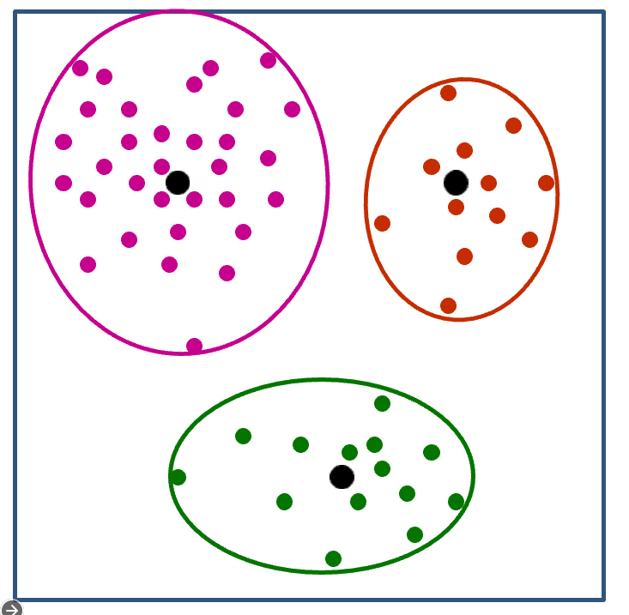
k-means and k-NN
Find centroid i closest to qx
Find element x in cluster i closest to qx
Not guaranteed to find the closest neighbor
You can make guarantees using the triangle inequality if you precompute distances between x and its centroid and check multiple centroids

Slide 60
J-means for k-NN search
Does J-means help you find points close to qx?
After you have learned the j clusters of n objects
Find centroid i closest to qx
O(J) distance computations
Find element x in cluster i closest to qx
O(N/J) distance computations
Overall comparison
if J=sqrt(N): O(J) + O(N/J) beats O(N)
If this isn’t enough you can try running J-means internally in each cluster and so on
Build a tree of depth d
O(d J ) * O(N / J^{d})
Notes:
https://arxiv.org/pdf/1307.2982

Slide 61
Vector quantization
We can use the same data structure to either
find approximate k-NN’s to qx
map qx to a centroid that is similar
centroid is an approximate encoding of qz
With a hierarchical clustering and millions of centroids this will be a good approximation of qx
but it is compact to describe (as a path through the J-means tree)
so k-means also compresses a set of vectors, like LSH
Notes:
https://arxiv.org/pdf/1307.2982

Slide 62
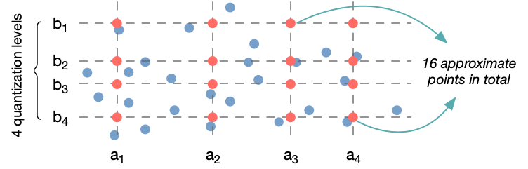
Product quantization for k-NN search

Slide 63
Product quantization for k-NN search
Another trick:
split x into m equal-size vectors x⁽¹⁾, …, x^{(m)}
just like we did with bitstrings for multi-index hashing
build a J-means indices for each of the m sets of subvectors
to “encode” qx find closest centroids to qx⁽¹⁾, …, qx^{(m)}
call them c⁽¹⁾, …, c^{(m)}
call the concatenation c
there are J^{m} possible c’s
The larger space of encodings means PQ can be very accurate
Theory says that the encoding loss is lower for qx,c pairs that are highly similar
there are the important ones
Notes:
https://arxiv.org/abs/1908.10396 - sanjiv paper

Slide 64
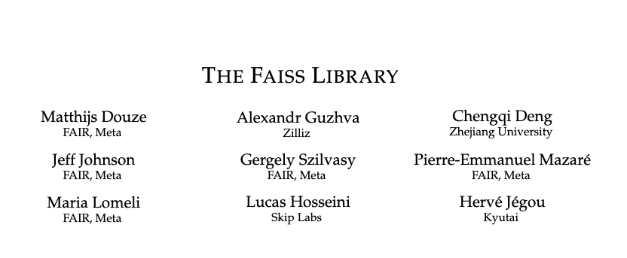
A Recent Survey
2024

