Slide 1
10-605 / 10-405
Machine Learning from Large Datasets

Slide 2
Outline – today
“Embarrassingly parallel” ML tricks (new work)
Branch-train-merge and -mix: very parallel LLM pre-training
Task vectors: very parallel LLM fine-tuning
Scaling up GenAI evals

Slide 3
Task vectors

Slide 4
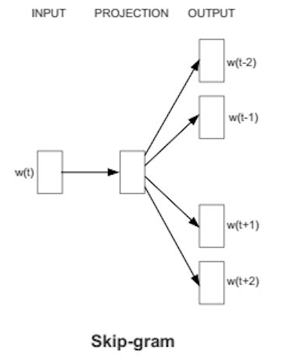
Recap: skip-gram embeddings (word2vec)
Training data:
positive examples are pairs of words w(t), w(t+j) that co-occur
You want to train over a very large corpus (100M words+) and hundreds+ dimensions
Training data:
negative examples are samples of pairs of words w(t), w(t+j) that don’t co-occur

Slide 5
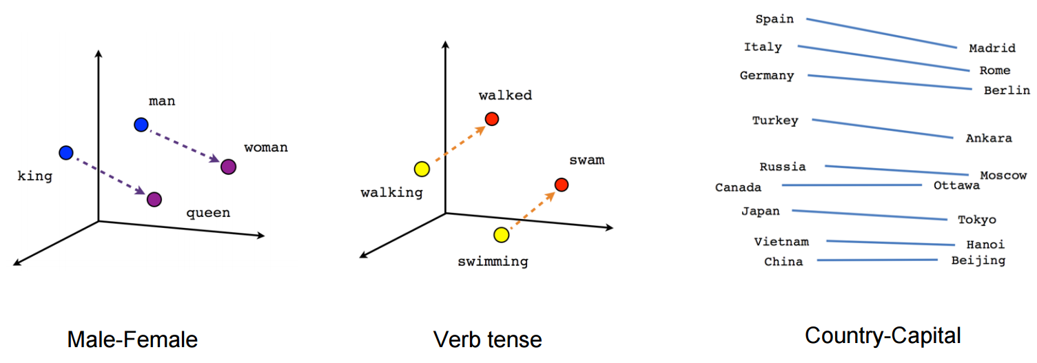
Recap: Results from word2vec
A number of properties of word2vec were surprising and mysterious! until they were explained by Omer Levy and Yoav Goldberg a couple of years later
Notes:
https://aclanthology.org/W14-1618.pdf

Slide 6
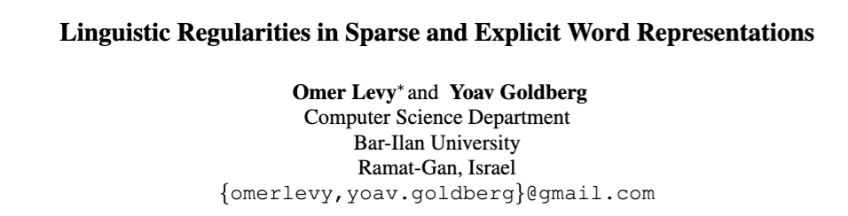
2014
Notes:
https://aclanthology.org/W14-1618.pdf

Slide 7


2014
Notation for analogies:
e.g.,
Word2vec method is “3CosAdd”:
=
i.e., b* (queen) should be:
similar to b (king)
similar to a* (woman)
different from a (man)

Slide 8
Recap: distributional clustering (with LSH)
Common task: distributional clustering
for a word w, v(w) is sparse vector of words that co-occur with w
cluster the v(w)’s
…guards at Pentonville prison in North London discovered that an escape attempt…
An American Werewolf in London is to be remade by the son of the original director…
…UK pop up shop on Monmouth Street in London today and on Friday the brand…
v(London): Pentonville, prison, in, North, …. and, on Friday

Slide 9
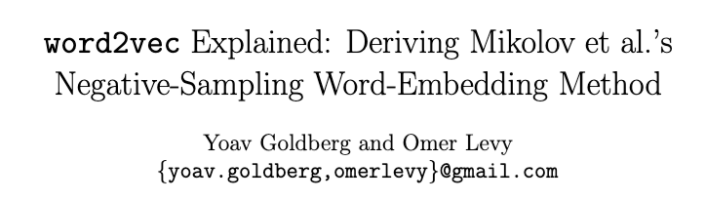
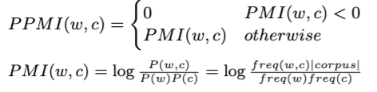
Q: what if you use the original sparse (unfactored) PPMI word vectors for analogies?
Background
2014
Key idea: these two vectors are closely related
word2vec embedding of w=“London”
distributional representation of w=“London”
with context words c weighted by “positive pointwise mutual information”
word2vec embeddings are matrix factorization of the PPMI matrix
Notes:
https://arxiv.org/pdf/1402.3722

Slide 10
2014
Notation for analogies:
e.g.,
Word2vec method is “3CosAdd”:
=
i.e., b* (queen) should be:
similar to b (king)
similar to a* (woman)
different from a (man)

Slide 11
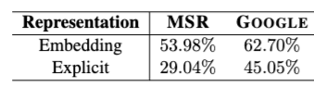

2014
Observation: old-school sparse vectors also work for analogies
word2vec →
sparse PPI vectors →
but not as well as word2vec using 3CosAdd rule
but … is this the best way to compute analogies?
i.e., b* (queen) should be:
similar to b (king)
similar to a* (woman)
different from a (man)
3CosMul
*scale sims to [0,1]
Notes:
scale embedding sims to 0,1
note only right if the target word is ranked first among thousands in the vocab (including possible synonyms)

Slide 12
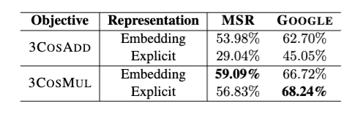
2014
word2vec →
sparse PPI vectors →
word2vec →
sparse PPI vectors →
So: old-school sparse vectors also work for analogies.
Notes:
scale embedding sims to 0,1

Slide 13
Discussion: Analogies
It would be great if vector-based representations had modularity: e.g., add "past tense” to a word sense
Notes:
https://aclanthology.org/W14-1618.pdf

Slide 14
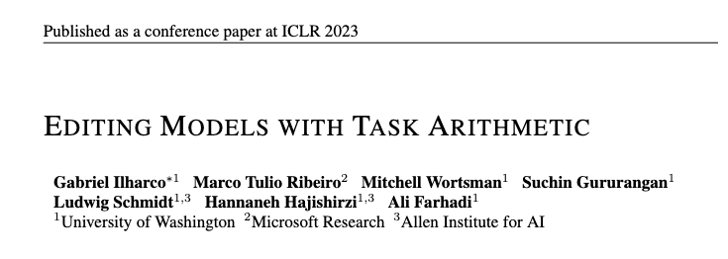
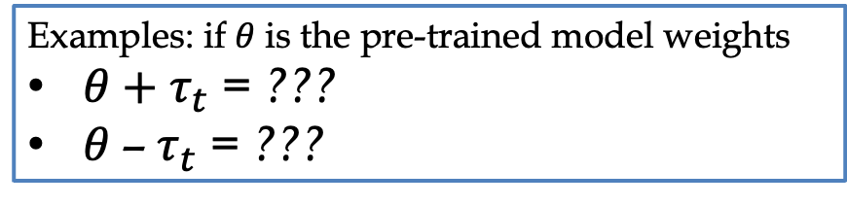
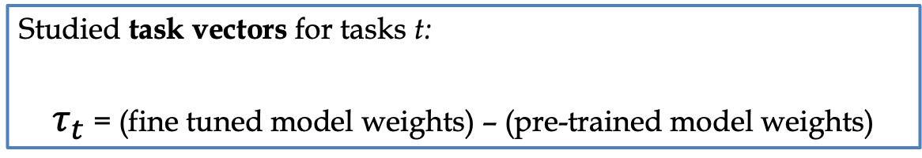
Studied task vectors for tasks t:
$τ_{t}$ = (fine tuned model weights) – (pre-trained model weights)
Examples: if 𝜃 is the pre-trained model weights
𝜃 $+ τ_{t}$ = ???
𝜃 –${ τ}_{t}$ = ???
Notes:
https://arxiv.org/pdf/2212.04089

Slide 15
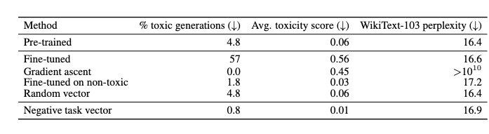
Experiment with task negation
𝜃 = pre-trained GPT2
Fine-tune GPT2 for generation on CivilComments datasets
t_{nice}: toxicity < 0.2
t_{toxic}: toxicity > 0.8
Assess toxicity of 1000 outputs with a classifier
𝜃
𝜃 + 𝜏_{toxic}
𝜃 + 𝜏_{nice}
same magnitude
𝜃 - 𝜏_{toxic}
Subtracting the task vector is a way of “forgetting” how to perform that task!

Slide 16

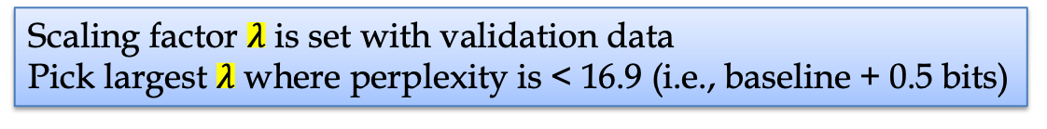
Experiment with scaled task negation
𝜃 = pre-trained GPT2
Fine-tune GPT2 for generation on CivilComments datasets
t_{nice}: toxicity < 0.2
t_{toxic}: toxicity > 0.8
Assess toxicity of 1000 outputs with a classifier
𝜃
𝜃 + 𝜏_{toxic}
𝜃 + 𝜏_{nice}
same magnitude
𝜃 - $λ$𝜏_{toxic}
Scaling factor $λ$ is set with validation data
Pick largest $λ$ where perplexity is < 16.9 (i.e., baseline + 0.5 bits)

Slide 17
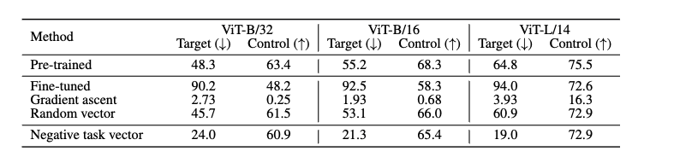

Experiment with scaled task negation
𝜃 = pre-trained CLIPS
Fine-tune on 8 different image tasks
See if the resulting models forgets that task while maintaining performance on control task (ImageNet classification)
Report average over all tasks
smaller model
larger model
𝜃
𝜃 + 𝜏
𝜃 - $λ$𝜏

Slide 18
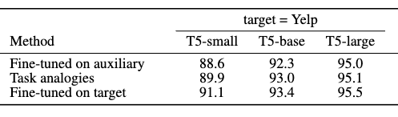
Experiments with task analogies
Objective: sentiment analysis on reviews from Yelp
Data available
unlabeled reviews from Yelp
sentiment data from Amazon reviews
unlabeled Amazon reviews
Approach: build task vectors for
𝜏_{YelpLM}: language modeling on Yelp
𝜏_{AmazonLM}: language modeling on Amazon
𝜏_{AmazonSentiment}: sentiment prediction on Amazon
Finally use
λ₁𝜏_{AmazonSentiment} + (λ₂𝜏_{YelpLM} — λ₃𝜏_{AmazonLM})

Slide 19
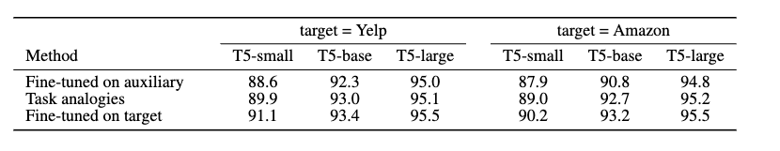
Experiments with task analogies
Objective: sentiment analysis on reviews from Yelp
Data available
unlabeled reviews from Yelp Amazon
sentiment data from Amazon Yelp reviews
unlabeled Amazon Yelp reviews
Approach: build task vectors for
𝜏_{YelpLM}: language modeling on Yelp
𝜏_{AmazonLM}: language modeling on Amazon
𝜏_{YelpSentiment}: sentiment prediction on Amazon Yelp
Finally use
λ₁𝜏_{YelpSentiment} + (λ₂𝜏_{AmazonLM} — λ₃𝜏_{YelpLM})

Slide 20
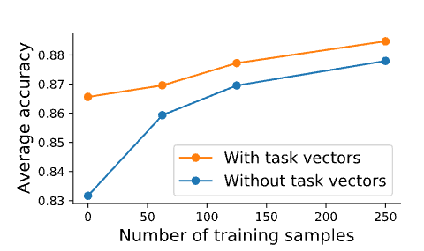
Experiments with task analogies
Objective: improve performance on rare slices of data
Image classification tasks with CLIP, slices are based on a image style and class.
Also using λ’s picked by validation sets

Slide 21
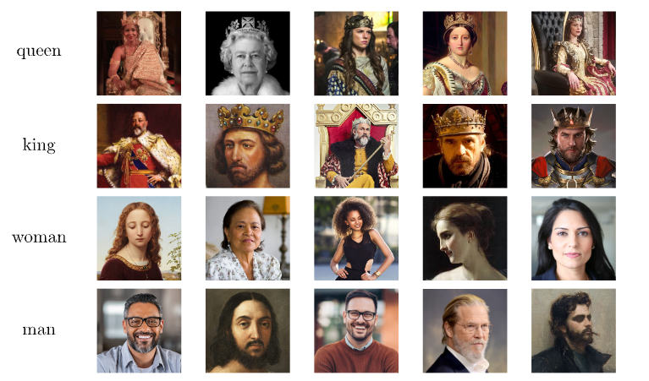
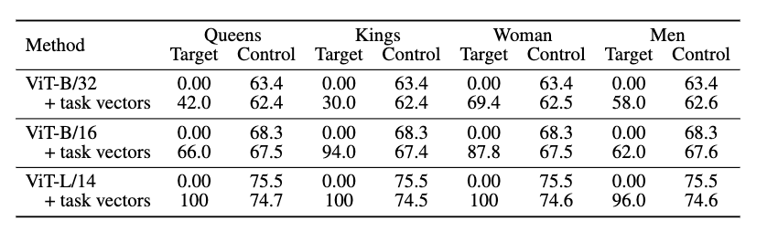
Experiments with task analogies
Collect 200 images of kings, queens, women, men.
Fine-tune CLIP models on each category, using 1000 ImageNet classes as negative examples
(class name ”something”)

Slide 22
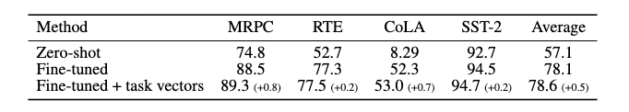
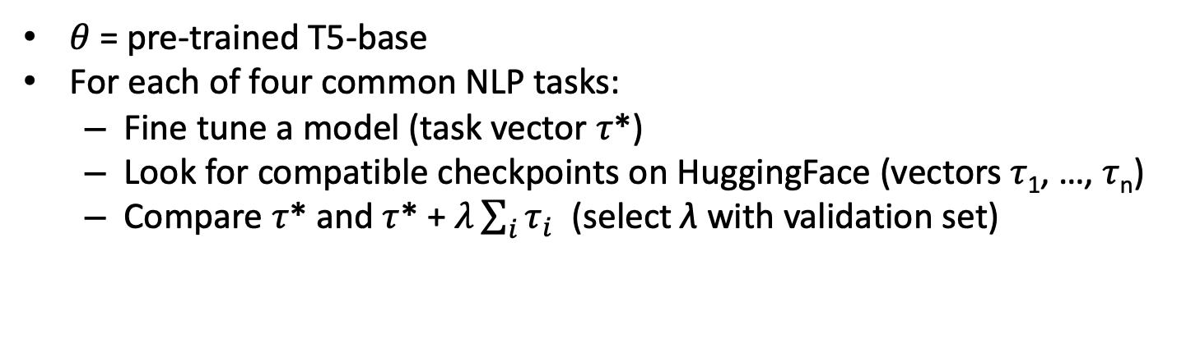
Experiment: adding many task vectors
𝜃 = pre-trained T5-base
For each of four common NLP tasks:
Fine tune a model (task vector 𝜏*)
Look for compatible checkpoints on HuggingFace (vectors 𝜏₁, …, 𝜏_{n})
Compare 𝜏* and 𝜏* + $λ\sum_{i}{τ_{i}}$ (select λ with validation set)
𝜃
𝜃 + 𝜏*
Note the training for the subtasks is embarrassingly parallel

Slide 23
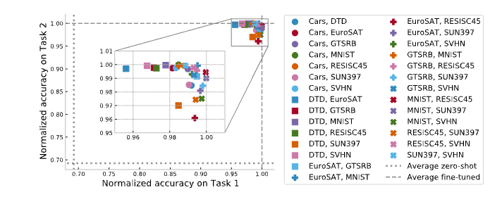
Experiment: adding different task vectors
weighted sum of task vectors for 2 vision tasks
show accuracy normalized by FT accuracy
and compared to zero-shot accuracy
Note the training for the subtasks is embarrassingly parallel

Slide 24
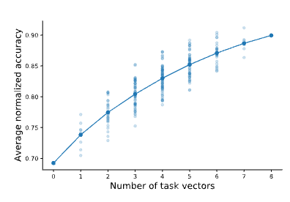
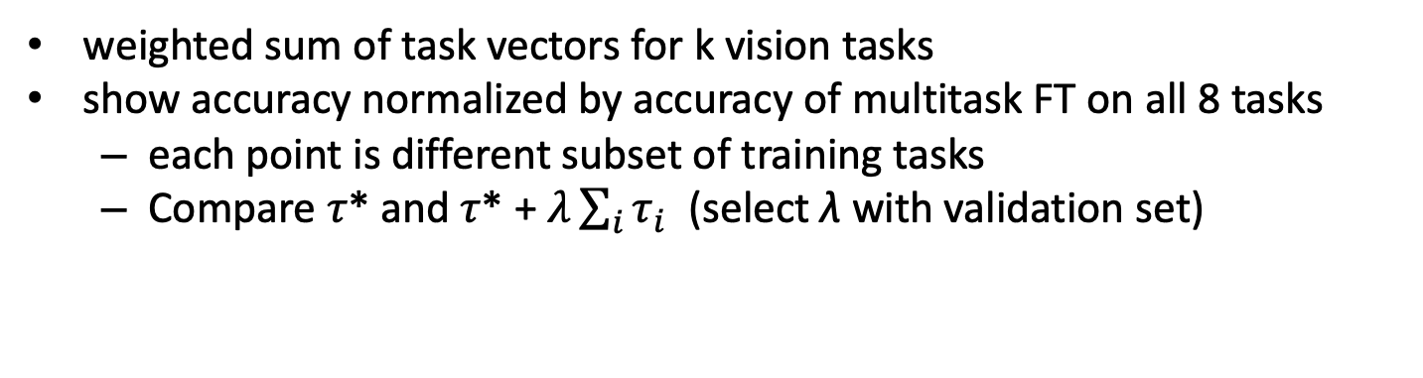
Experiment: adding different task vectors
weighted sum of task vectors for k vision tasks
show accuracy normalized by accuracy of multitask FT on all 8 tasks
each point is different subset of training tasks
Compare 𝜏* and 𝜏* + $λ\sum_{i}{τ_{i}}$ (select λ with validation set)
Note the training for the subtasks is embarrassingly parallel

Slide 25
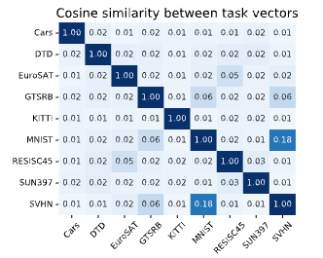
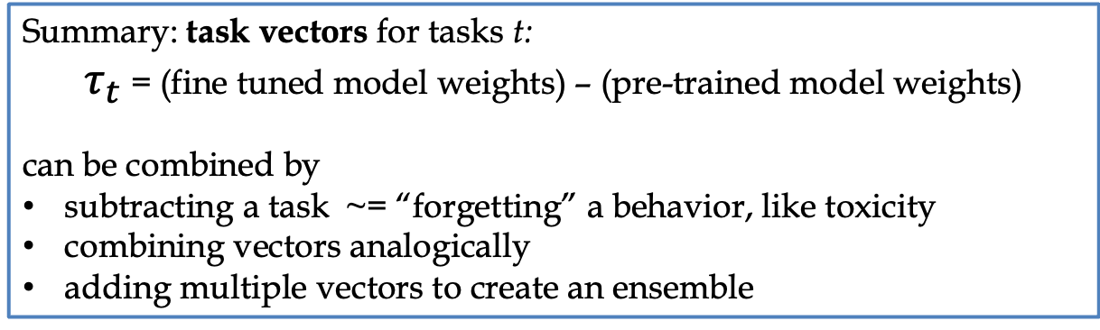
Summary: task vectors for tasks t:
$τ_{t}$ = (fine tuned model weights) – (pre-trained model weights)
can be combined by
subtracting a task ~= “forgetting” a behavior, like toxicity
combining vectors analogically
adding multiple vectors to create an ensemble
Why does this work?
Task vectors are mostly orthogonal except when tasks are related
MNIST / SVHN both digits; GTRSB is reading traffic signs
EuroSAT / RESISC45 are sat images
Notes:
https://arxiv.org/pdf/2212.04089

Slide 26
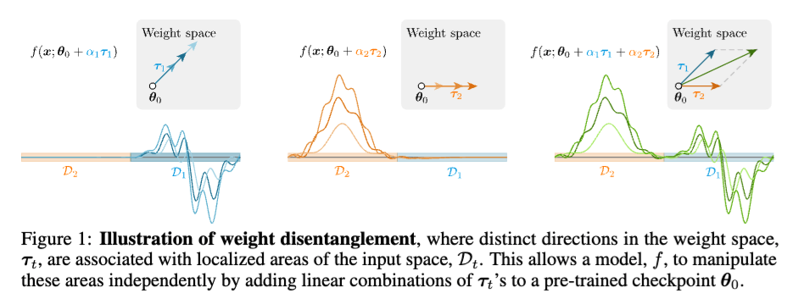
Summary: task vectors for tasks t:
$τ_{t}$ = (fine tuned model weights) – (pre-trained model weights)
can be combined by
subtracting a task ~= “forgetting” a behavior, like toxicity
combining vectors analogically
adding multiple vectors to create an ensemble
Why does this work?
“Weight disentanglement”
Notes:
https://proceedings.neurips.cc/paper_files/paper/2023/file/d28077e5ff52034cd35b4aa15320caea-Paper-Conference.pdf

Slide 27
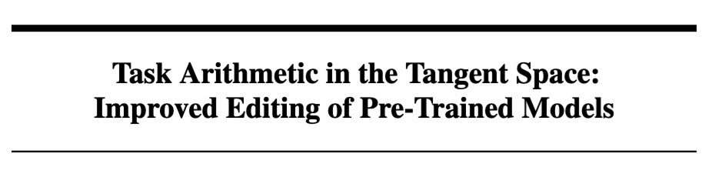

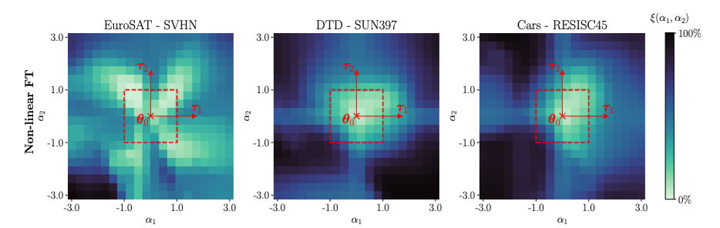
2023
Disentanglement error:
Disentanglement error of ⍺₁𝜏₁ and ⍺₂𝜏₂ with dist(f,g)=1 if labels different
Notes:
https://proceedings.neurips.cc/paper_files/paper/2023/file/d28077e5ff52034cd35b4aa15320caea-Paper-Conference.pdf

Slide 28
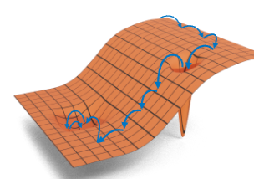
Aside
2023
Theory:
close enough to an initial 𝜃, for a large enough network, weight changes produce an approximately linear effect
task vectors that stay in the linear regime should combine linearly
but fine-tuning can take 𝜏 outside the linear regime
but it’s possible to measure if this happened
it’s also possible to fine-tune inside the linear area by using a kernel
this helps make task arithmetic a little better for larger models
Notes:
https://proceedings.neurips.cc/paper_files/paper/2023/file/d28077e5ff52034cd35b4aa15320caea-Paper-Conference.pdf

Slide 29
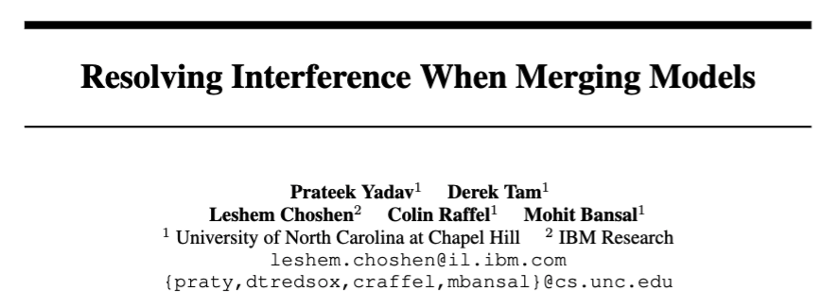
2023
Focus on merging models for different tasks
Question: how do you merge models when there is some “entanglement”? Can you improve on task arithmetic?
Notes:
https://www.researchgate.net/profile/Leshem-Choshen-2/publication/371291070_Resolving_Interference_When_Merging_Models/links/6481cc4a79a722376518d1d6/Resolving-Interference-When-Merging-Models.pdf

Slide 30
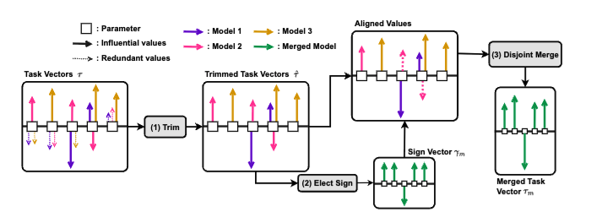
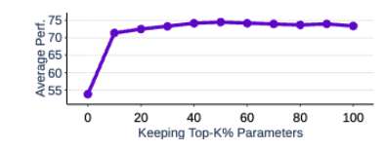
Question: how do you merge models when there is some “entanglement”?
only keep the top k% of each task vector’s weights
average acc on 11 task vectors

Slide 31
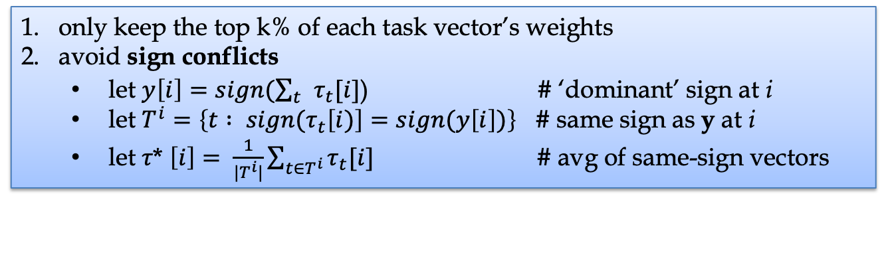
Question: how do you merge models when there is some “entanglement”?
only keep the top k% of each task vector’s weights
avoid sign conflicts
let $y\left[i\right]=sign(\sum_{t}{τ_{t}[i]}$) # ‘dominant’ sign at i
let $T^{i}=\left\{t : {sign(τ}_{t}\left[i)\right]=sign(y\left[i\right])\right\}$ # same sign as y at i
let 𝜏* $\left[i\right]= \frac{1}{|T^{i}|}\sum_{t∈T^{i}}{τ_{t}[i]}$ # avg of same-sign vectors
TIES-Merge – TrIm, Elect Sign, and Merge

Slide 32
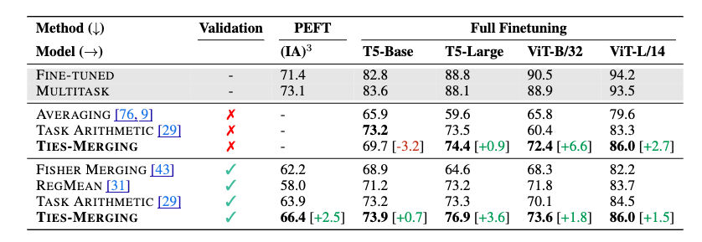
11 NLP / 8 vision datasets; k=20% and λ=1 w/o validation set
only keep the top k% of each task vector’s weights
avoid sign conflicts
let $y\left[i\right]=sign(\sum_{t}{τ_{t}[i]}$) # ‘dominant’ sign at i
let $T^{i}=\left\{t : {sign(τ}_{t}\left[i)\right]=sign(y\left[i\right])\right\}$ # same sign as y at i
let 𝜏* $\left[i\right]= \frac{1}{|T^{i}|}\sum_{t∈T^{i}}{τ_{t}[i]}$ # avg of same-sign vectors
TIES-Merge – TrIm, Elect Sign, and Merge

Slide 33
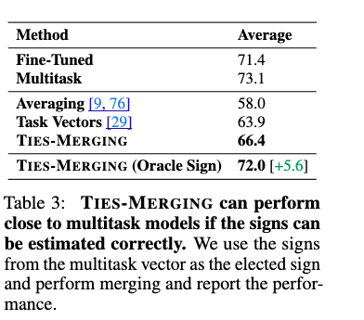

Slide 34
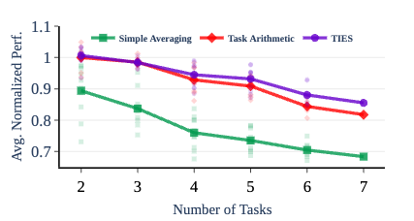
accuracy / FT accuracy merging multiple tasks

Slide 35
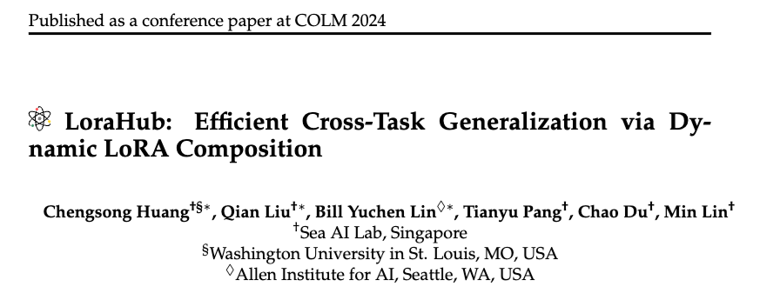
Notes:
https://arxiv.org/pdf/2307.13269

Slide 36
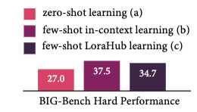
LoraHub: Method
LoRA-train FLAN-T5-Large on 20 randomly selected tasks from FLAN training set
The LoRA matrices for task t are A_{t} B_{t}
Combine:
Optimize weights w with L1-regularized ppx loss on 5-shot training data using black-box optimization (like Vizier)
Other results:
20 LoRA tasks with lowest avg loss on the BBH examples: 35.4
FLAN-T5-XL: 36.5

Slide 37
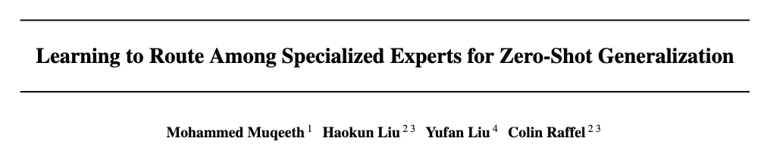
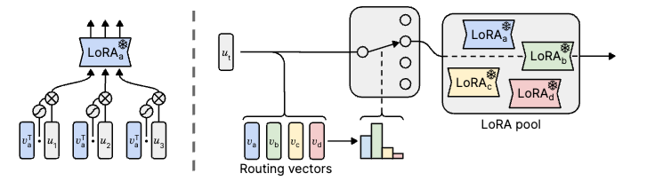
2024
Post-Hoc Adaptive Tokenwise Gating Over and Ocean of Specialized Adapters (PHATGOOSE)
Notes:
https://arxiv.org/pdf/2402.05859

Slide 38
PHATGOOSE methods
LoRA-train FLAN-T5-Large on 166 tasks from FLAN training set
Train a sigmoid gate for each LoRA:
on the same data for 100 steps
At inference time, route tokens to to the top 3 LoRA modules (softmax-weighted)

Slide 39
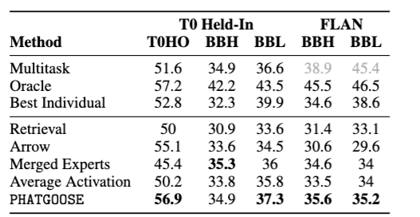
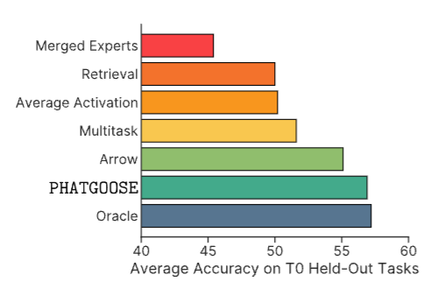
PHATGOOSE results
LoRA-train FLAN-T5-Large on
166 tasks from FLAN training set
The training tasks from T0
Evaluate zero-shot on novel tasks

Slide 40
Outline – today
“Embarrassingly parallel” ML tricks (new work)
Branch-train-merge and -mix: very parallel LLM pre-training
Task vectors: very parallel LLM fine-tuning
Scaling up GenAI evals

Slide 41
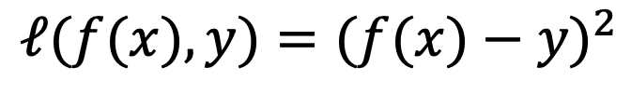
GenAI has changed how we evaluate ML
Pre-GenAI
ML systems were used for classification, regression, extraction from documents, …
the quality of an output (and a model) was easy to evaluate automatically
Square Loss
$$ℓ(f(x),y)=(f(x)−y)^{2}$$
x | y | f(x) | Square Loss | Absolute Loss
 | $300,000 | $300,000 | 0 | 0
 | $300,000 | $300,500 | 250,000 | 500
 | $300,000 | $400,000 | 1E+10 | 100,000

Slide 42
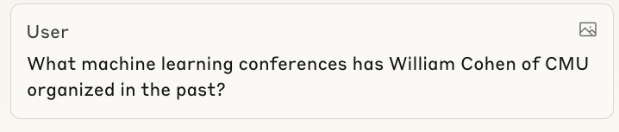
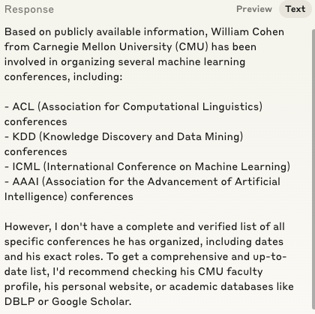
GenAI has changed how we evaluate ML

Slide 43
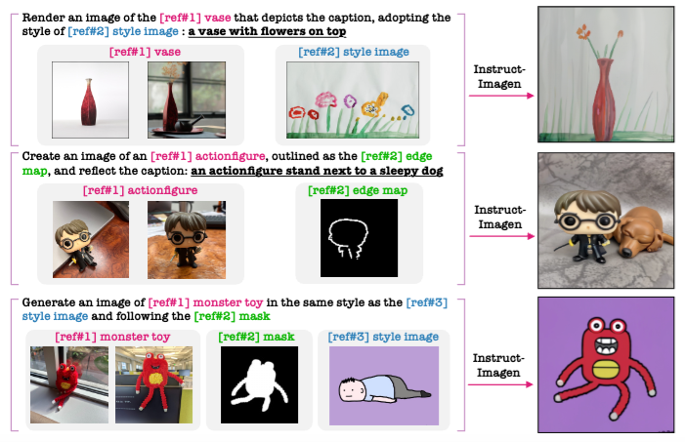
GenAI has changed how we evaluate ML

Slide 44
GenAI has changed how we evaluate ML
Pre-GenAI
ML systems were used for classification, regression, extraction from documents, …
the quality of an output (and a model) was easy to evaluate automatically
GenAI
system outputs often require care and effort to evaluate
good manual labels are expensive!
how can we scale up the evaluation of models?

Slide 45
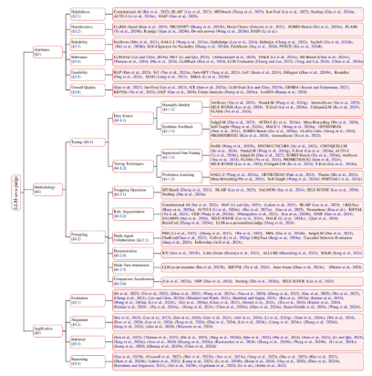
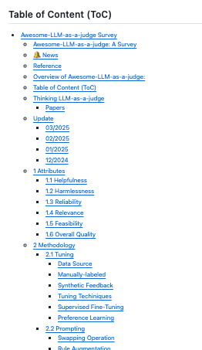
Scalable Evaluation: AI Judges
One solution: build an AI system to perform evaluation!
https://github.com/llm-as-a-judge/Awesome-LLM-as-a-judge
Notes:
https://github.com/llm-as-a-judge/Awesome-LLM-as-a-judge

Slide 46
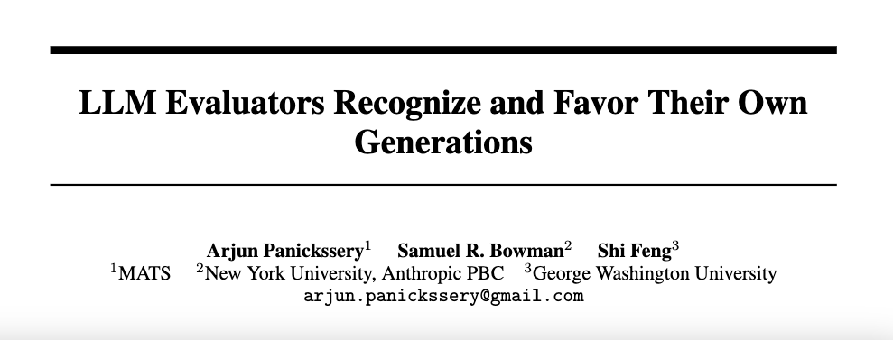
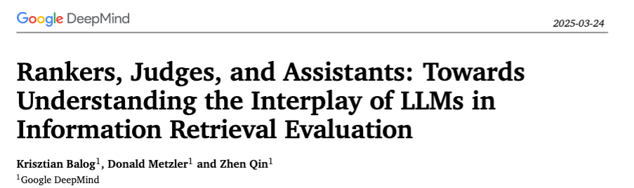
Scalable Evaluation: AI Judges
“We provide the first empirical evidence of LLM judges exhibiting significant bias towards LLM-based rankers. Furthermore, we observe limitations in LLM judges’ ability to discern subtle system performance differences… “ - Balog et al
One solution: build an AI system to perform evaluation!
… but is this a good idea?
NeurIPS 2024
Notes:
https://github.com/llm-as-a-judge/Awesome-LLM-as-a-judge

Slide 47

Scalable Evaluation: AI Judges
One solution: build an AI system to perform evaluation!
… but is this a good idea?
Notes:
https://github.com/llm-as-a-judge/Awesome-LLM-as-a-judge

Slide 48
Scalable Evaluation: AI Judges
“We provide the first empirical evidence of LLM judges exhibiting significant bias (statistically significant? but is it large?) towards LLM-based rankers…. we observe limitations in LLM judges’ ability to discern subtle system performance differences… “ - Balog et al
One solution: build an AI system to perform evaluation!
… but is this a good idea?
Arguments for:
much more data can be collected faster
my project is late / over budget
human labels are noisy
LLM-as-judge biases seem to be minor
Argument against: ML/GenAI systems are interconnected
We generate data for ML with GenAI (data augmentation)
We evaluate ML systems with GenAI
We pre-train ML systems on ML-filtered text
We pre-train ML systems on GenAI-produced text
Long-term, will subtle biases have subtle effects? or large effects?
Notes:
https://github.com/llm-as-a-judge/Awesome-LLM-as-a-judge

Slide 49
Information In Networks Is Weird
Example: Making decisions with data about other people’s choices as an input
Picking a crowded restaurant in a new city, instead of an empty one
You have little information about the food quality
But all those people can’t be wrong…?
Picking a popular course instead of a smaller one
…

Slide 50
Information In Networks Is Weird
Networks, Crowds, and Markets, 2010
Simple example [Easley & Kleinberg]:
An urn with a 50/50 chance of having:
2/3 red balls and 1/3 green balls; or
1/3 red balls and 2/3 green balls
An experiment: in each trial t=1,2,…
Researcher t will
sample one ball (and then replaces it)
guess what’s the majority class (red or green)
Everyone that guesses right gets a payoff
Nobody can change their guesses
private
public
Notes:
https://www.cs.cornell.edu/home/kleinber/networks-book/

Slide 51



Making decisions with other people’s choices as an input
Possible outcome:
A red ball: the guess is red
A red ball: the guess is red
A green ball: the guess is ___ ?
A green ball: the guess is ___ ?
$$p\left(U=r | rrg\right) =\frac{p\left(rrg | U=r\right)p(U=r)}{p(rrg)}$$
= $\frac{P\left(rrg | U=r\right)p(U=r)}{P\left(rrg | U=r\right)p\left(U=r\right)+p\left(rrg | U=g\right)p(U=g)}$ =
$$\frac{\frac{2}{3}\frac{2}{3}\frac{1}{3}\frac{1}{2}}{\frac{2}{3}\frac{2}{3}\frac{1}{3}\frac{1}{2}+\frac{1}{3}\frac{1}{3}\frac{2}{3}\frac{1}{2}}$$
= $\frac{4}{4+1}$
P(Rational sequential decision-making leads to a cascade) >= 1/9

Slide 52
Making decisions with other people’s choices as an input
[Salganic, Dodds, Watts – Science 2006]
Artificial music market
48 unknown songs, 14k participants
Participants listen, rate, and (maybe) download
Experiment 1:
“Independent world”: choose songs from a grid
“Social world” (x8): also see #prior downloads (weak signal)
Experiment 2:
“Independent world”: choose songs from a list
“Social world” (x8): list sorted by #prior downloads (stronger signal)
Results: based on average differences in market share
Inequality: compare different songs in same “world”
Unpredictability: compare same songs in different “worlds”

Slide 53

Making decisions with other people’s choices as an input
[Salganic, Dodds, Watts – Science 2006]
More social influence ➔ More skewed distributions of success

Slide 54

Making decisions with other people’s choices as an input
More social influence ➔ Less predictable which songs are successful
[Salganic, Dodds, Watts – Science 2006]

Slide 55

Making decisions with other people’s choices as an input: Schelling Segregation Model
Agents are two types of agents in a partially-filled grid
An agent is satisfied if more than k% of its neighbors are the same
In each cycle, unsatisfied agents move (randomly)
k=0.30
http://nifty.stanford.edu/2014/mccown-schelling-model-segregation/

Slide 56


Schelling Segregation Model
k=0.30
13 rounds

Slide 57


Schelling Segregation Model
k=0.30
10 rounds
k=0.50
20 rounds

Slide 58


Schelling Segregation Model
k=0.50
1/3 blue
86 rounds
k=0.25
0.15 blue
253 rounds

Slide 59
Scalable Evaluation: AI Judges
One solution: build an AI system to perform evaluation!
… but is this a good idea?
Arguments for:
much more data can be collected faster
my project is late / over budget
human labels are noisy
LLM-as-judge biases seem to be minor
Argument against: ML/GenAI systems are interconnected
We generate data for ML with GenAI (data augmentation)
We evaluate ML systems with GenAI
We pre-train ML systems on ML-filtered text
We pre-train ML systems on GenAI-produced text
Long-term, will subtle biases have subtle effects? or large effects?
No idea but large effects are definitely possible
Notes:
https://github.com/llm-as-a-judge/Awesome-LLM-as-a-judge

Slide 60
PPI: Statistically Unbiased AI Judges
One solution: build an AI system to perform evaluation!
… but is this a good idea?
Arguments for:
much more data can be collected faster
my project is late / over budget
human labels are noisy
LLM-as-judge biases seem to be minor
A small amount of human-labeled data can be used to correct for biases in a judge/autorater
statistical inference ➔ prediction-powered inference
Notes:
https://github.com/llm-as-a-judge/Awesome-LLM-as-a-judge

Slide 61

PPI: Statistically Unbiased AI Judges
One solution: build an AI system to perform evaluation!
… but is this a good idea?
Notes:
https://www.science.org/doi/full/10.1126/science.adi6000?casa_token=UKBrYB_jH6gAAAAA%3AcBNEc67rQIRWJqH_d3O_jFGMdyF3EZlz6R_dhEUQefUIilA5CpzRRHmv5OqBlXQ7YCFTfmM9x8E8bQ

Slide 62


PPI: Statistically Unbiased AI Judges
A simple example: human labels to estimate the probability of some binary property of a generation
Examples
No factual errors
No image of a human non-celebrity
Some citation is from a low-quality source
…
100 simulated labels
10 similar simulated labelings
blue and red: 95% confidence interval
➔ hill-climbing with small data is difficult
Notes:
https://github.com/llm-as-a-judge/Awesome-LLM-as-a-judge

Slide 63


PPI: Statistically Unbiased AI Judges
same 100 simulated labels
5000 autorated labels: 2% FP and 18% FN
unequal FP and FN ➔ autorater is biased
PPI combination of 10,000 biased autorater labels and 100 unbiased human labels. PPI lo and hi CI are solid lines, human labels alone are dotted
For PPI, true mean is in CI 95% of the time
Notes:
https://github.com/llm-as-a-judge/Awesome-LLM-as-a-judge

Slide 64

PPI: Statistically Unbiased AI Judges
Adding human labels until the human CI is the same width is the same as the PPI’s CI width.
PPI + 100 labels = 270 human labels
PPI combination of 10,000 biased autorater labels and 100 unbiased human labels. PPI lo and hi CI are solid lines, human labels alone are dotted
PI lets you scale impact of human labels by nearly 3x!
For PPI, true mean is in CI 95% of the time
Notes:
https://github.com/llm-as-a-judge/Awesome-LLM-as-a-judge

Slide 65

Method used here: rewrite the p(H) using autorater labels and Bayes Rule
Q | A | H | AR
baby at 100 in the bible | abraham | 1 | 1
who is rose the fall season 1 | val kaine | 0 | 0
… | … | … | …
H = Human labels QA pair “acceptable”
AR = Auto-rater ….
Stdev Bin(n,p) ~=
1 - p ~= 0
n can be large
p ~= 0
n can be large

Slide 66
General method for PPI
S_{n} = (x₁,h₁), … (x_{n},h_{n})
S̃_{N} = x̃₁, …, x̃_{N}
f(x) = a
E[H] = Prop(H : H ∊ S_{n} )
E[H] =
Prop(H|A : H,A ∊ S_{n} )
Prop(A : A ∊ S̃_{N} ) +
Prop(H|¬A : H,A ∊ S_{n} )
(1 - Prop(A : A ∊ S̃_{N} ))
small sample S_{n} = (x₁,y₁), … (x_{n},y_{n})
larger sample S̃_{N} = x̃₁, …, x̃_{N}
autorater function f(x)
an estimand, E[y]
a proxy estimand g(S_{n} , S̃_{N} , f)
method is correct iff
E[y] = E[g(S_{n} , S̃_{N} , f)]
a way to compute
the expectation of the proxy estimand
the variance of the proxy estimand
How do we compute the variance of the proxy estimand? The simple way is to be Bayesian…

Slide 67



General method for PPI
E[g(S_{n} , S̃_{N} , f)] =
Prop(H|A : H,A ∊ S_{n} ) * Prop(A : A ∊ S̃_{N} ) +
Prop(H|¬A : H,A ∊ S_{n} ) * (1 - Prop(A : A ∊ S̃_{N} ))
Look at the simplest case:
E[H] = Prop(H : H ∊ S_{n} )
E[H] = $\int{θ p\left(θ\right|S_{n})dθ}$
We construct a “credible interval” based on the parameter’s posterior given the data
equal-tailed CI gives same weight to higher/lower values, like a confidence interval
$p\left(θ\right|S_{n}$)

Slide 68


General method for PPI
E[g(S_{n} , S̃_{N} , f)] =
Prop(H|A : H,A ∊ S_{n} ) * Prop(A : A ∊ S̃_{N} ) +
Prop(H|¬A : H,A ∊ S_{n} ) * (1 - Prop(A : A ∊ S̃_{N} ))
For this case:
E[g] = $\int{\left(θ_{H|A}θ_{A}+θ_{H|¬A}{((1−θ}_{A}\right)dθ_{H|A}}dθ_{H|¬A}$d $θ_{A}$
We can use Monte Carlo integration to solve this and similar integrals:

Slide 69






General method for PPI
To compute integral and upper and lower bounds of CI g_{l} , g_{h} :
Assumes: parameter posteriors are independent and you can sample from each posterior
Histogram is a numerical approximation of the integral

Slide 70




2024
Machinery we developed:
Tools to do MCI over combinations of common posteriors for means and proportions
Used these to explore old and new methods for PPI…
Notes:
https://arxiv.org/abs/2405.06034

Slide 71


Bayesian PPI
Difference estimate
(old)
Bayesian version

Slide 72

Bayesian PPI
Stratified sampling: separately sample disjoint “strata” of a population (e.g., college degrees vs no-college degrees) and combine estimates in each strata
Lowers variance if individual strata have low variance
Stratified distance estimate: divide data intro ”strata” and do Bayesian PPI separately in each strata
=

Slide 73

Bayesian PPI: Results
SeaHorse: multilingual genAI labeling tasks
AQA: attributed question answering task

Slide 74

Background: Power Tuning for Difference Estimates
Difference estimate
(old)
Generalization (PPI++)
works for any λ, there is a good heuristic for setting it using S_{n}

Slide 75

Bayesian PPI: Coverage Results

Slide 76

Bayesian PPI: QA evals
2023
Observation: automated evals for QA don’t reflect human judgements very well!
Notes:
https://arxiv.org/pdf/2305.06984

Slide 77

Bayesian PPI: QA evals
Observation: automated evals for QA don’t reflect human judgements very well!

Slide 78

Bayesian PPI: QA evals

Slide 79

Bayesian PPI: QA evals

Slide 80

Bayesian PPI: QA evals
C I width
human labels: 3k AR labels

Slide 81

Bayesian PPI: for Side-by-Side Tests
Attributed QA dataset: many systems evaluated, many human labels, strong autoraters with confidence intervals
Use human acceptable/unacceptable ratings for individual outputs to construct synthetic SxS datapoints (system A <=> system B for x)
identify 59 systems pairs where A outperforms B with high confidence using all human-labeled data
determine how many pairs can be distinguished with classical vs PPI tests

Slide 82
Bayesian PPI: QA evals
2023
One claim of Kamaloo et al paper: closed book models were better than best open-book baseline!
Model | Examples | Acc (std eval) | Acc (Human) | Standard CI
FewShot InstructGPT | 300 | 50.5 | 75.8 | 70.4 - 80.4
FiD-KD (best baseline) | 300 | 61.2 | 73.1 | 67.6 - 77.9
Notes:
https://arxiv.org/pdf/2305.06984

Slide 83
Method | Confidence that FewShot > Baseline
Standard unpaired test | ~= 0.36
Standard paired test | ~= 0.55
PPI test with GPT-3 judge | ~= 0.88
Model | Examples | Acc (std eval) | Acc (Human) | Standard CI
FewShot InstructGPT | 300 | 50.5 | 75.8 | 70.4 - 80.4
FiD-KD (best baseline) | 300 | 61.2 | 73.1 | 67.6 - 77.9
Notes:
https://arxiv.org/pdf/2305.06984

Slide 84
Bayesian PPI: Summary
In favor:
It’s easy to explore new PPI approaches
Define a proxy estimand that uses the autorater
Use Monte Carlo integration to get the credible intervals
profit—e.g., 45% reduction in # labels
Against:
The only useful new methods were variants of stratification
Credible intervals are technically different from confidence intervals
Confidence interval: probability taken over experiment (e.g.. the sample drawn)
Credible interval: probability take over unknown parameter values
This can be hard to explain to decision-makers

Slide 85

NeurIPS 2024
Notes:
https://proceedings.neurips.cc/paper_files/paper/2024/file/c9fcd02e6445c7dfbad6986abee53d0d-Paper-Conference.pdf

Slide 86
Stratified PPI paper: Summary
Change 1: use a standard frequentist analysis
Establish confidence intervals instead of credible intervals
Change 2: only evaluate the stratified variant of PPI
Change 3: combine with recent results on active statistical inference (Zrnic and Candès, ICML 2024):
Analysis of which human labels should be collected for PPI tests
Short story: optimal strategy is to let
We approximate this to pick #human labels/strata
$$\operatorname{Pr}\left(collect label x\right) ∝ \sqrt{E[(\left(y−f\left(x\right))^{2}\right| x]}$$
Notes:
Zrnic and Candès (ICML 2024)

Slide 87

CI width
% reduction in CI width vs classical
effective sample size

Slide 88
PPI: Statistically Unbiased AI Judges
One solution: build an AI system to perform evaluation!
… but is this a good idea?
Arguments for:
much more data can be collected faster
my project is late / over budget
human labels are noisy
LLM-as-judge biases seem to be minor
Argument against: ML/GenAI systems are interconnected
We generate data for ML with GenAI (data augmentation)
We evaluate ML systems with GenAI
We pre-train ML systems on ML-filtered text
We pre-train ML systems on GenAI-produced text
Long-term, will subtle biases have subtle effects? or large effects?
Notes:
https://github.com/llm-as-a-judge/Awesome-LLM-as-a-judge

Slide 89
PPI: Statistically Unbiased AI Judges
One solution: build an AI system to perform evaluation!
… but is this a good idea?
Arguments for:
much more data can be collected faster
my project is late / over budget
human labels are noisy
LLM-as-judge biases seem to be minor
Remember:
A small amount of human-labeled data can be used to correct for biases in a judge/autorater
using prediction-powered inference / active inference
Notes:
https://github.com/llm-as-a-judge/Awesome-LLM-as-a-judge

