Slide 1

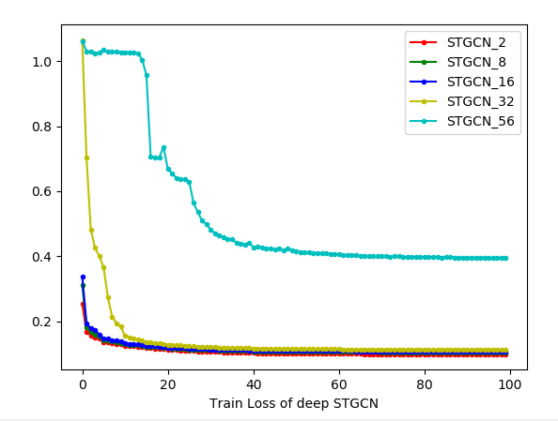
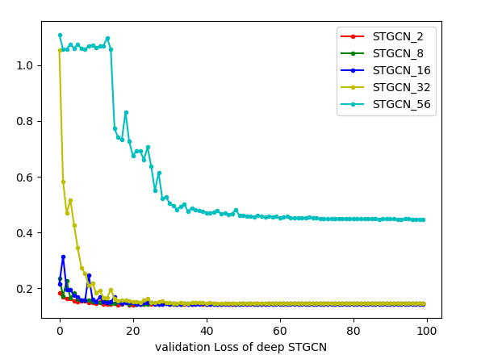
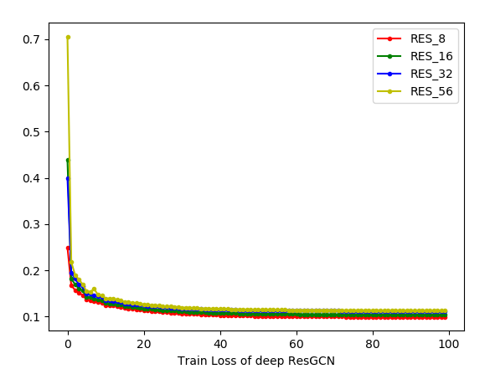
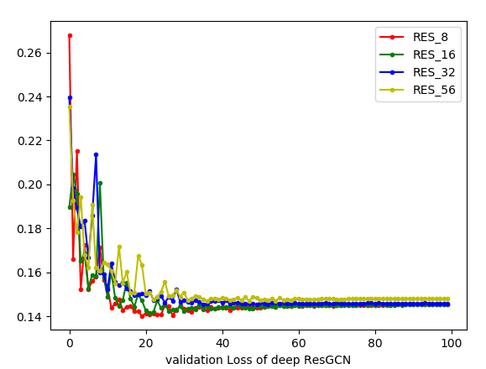
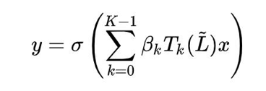
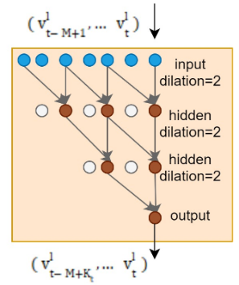
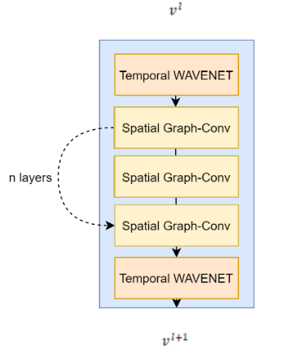
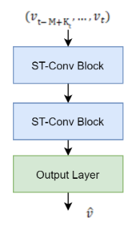
Traffic Flow Forecasting with Deep Graph Convolution Network
An exploration on the feasibility of stacked Deep GCN on traffic forecasting.
Student: Ip Pak Lon DB625471
Supervisor: Prof. Ryan Leong Hou U
Department of Computer
And Information Science
Faculty Of Science
And Technology
University of Macau
01
Introduction
04
Result
Macau government is increasingly aware of the concept of ‘smart city’ and is additively developing a strategy to solve the serious traffic problem and to achieve the goals of becoming ‘smart’. With the development of the technology of Artificial Intelligence and Big data, big Spatio-temporal data-driven smart traffic management becomes possible. Urban traffic data has two important features, one is the periodicity on time and the connective on spatial. Since the traffic network is on a non-euclidean domain, traditional convolution can not apply to graph data since the kernel does not fulfill the requirement of translation invariance. Therefore Graph Convolution Network (GCN) is introduced to perform the convolution on the graph. A Spatio-temporal graph convolution(ST-GCN) module is proposed to dynamically model the urban road traffic-flow.
We investigate the performance of different depth of GCN, the result has shown that the training loss and validation loss is increased as the layer increase, The model still can convergence to a good result when the depth under 32, when applying the 56 layers GCN the result significantly deteriorate. This phenomenon is mainly caused by the gradient vanishing during the propagation of gradient in such a deep model. Therefore base on the research of ResNet adding residual connection can intuitively solve this problem.
The residual connection has been proved as an essential role in training deeper network, after constructing the GCN with residual connection, the result is more stable comparing with platin deep GCN. It solved the gradient vanishing problem on the deep network, therefore the stacked of deep GCN become an available strategy.
The experiments of exploring the depth shown that the STGCN with 2 GCN layers and RESGCN with 8 layers get the best result on the datasets. Although using the ResNet structure solved the gradient descending problem, the performance does not monotone increasing with stacked CNN layers, the model gets the best result with 8 layers then the performance gets worse with the layer increased, there are 3 main problems: 1) The dataset only contains 228 nodes on the graph, the propagation does not need to go very deep to traverse on the whole graph, with 8 layers the message passing of the nodes gets the best result in the experiment. 2) The dataset is very dense since the road segment we pick is in center of the city, it does not need a very long message passing to traverse on the graph; 3) Applying GCN is similar to the heat-exchange process, applying deep GCN on a dense graph will cause an over-smooth problem, that is the value of each nodes convergence to similar value at the end.
02
Propose Model
The Graph convolution block use the ChebyNet module with kernel k as the graph convolution block, the change of conception field of graph convolution is implemented by adjusting the kernel size, We first produced the scaled Laplacian base on the adjacency matrix, then use Eigendecompositon to get the eigenvalue and eigenvector of spectral representation of the graph. the convolution is written as:
The temporal convolution block use the causal deligated convolution on time series, instead of using RNN which is very popular in time series analysis, using convolution can enhance the reaction speed and reduce the training difficulty of the model, besides, using causal and deligated structure can significantly reduce the computation cost and more likely to learn long term dependencies.
To learn the spatial and temporal dependencies, The STGCN combine TCN and GCN to construct an ST module, The STGCN block is built as a sandwich likes structure which is inspired by the bottleneck structure of ResNet, the top and the bottom set to be TCN block and stack n layers of GCN block inside. The block can be stacked or extended to different scales and complexity cases
Model | PEMSD7
 | MAE(15/30/45mins) | MAPE(15/30/45mins) | RMSE(15/30/45mins)
HA | 4.01 | 10.61 | 7.20
ARIMA | 5.55/5.86/6.27 | 12.92/13.94/15.2 | 9.00/9.13/9.38
FCNN | 2.74/4.02/5.04 | 6.38/9.72/12.38 | 4.75/6.98/8.58
FC-LSTM | 3.57/3.94/4.16 | 8.60/9.55/10.10 | 6.20//7.03/7.51
STGCN-2 | 2.244/2.974/3.685 | 5.264/7.071/8.892 | 3.987/5.577/7.011
RESGCN-8 | 2.243/2.987/3.3615 | 5.238/7.097/8.322 | 3.960/5.585/6.137
03
Dataset
05
Conclusion
We verify our model on real-world traffic datasets PEMSD7 which is collected by the Caltrans Performance Measurement System (PeMS) in real-time by over 39, 000 sensor stations. The dataset contains including a weighted adjacent matrix and historical speed data for 228 sensors. The dataset is fused to 5mins data base on the average speed of 30s data samples. The experiment picks the district 7 of Califonia containing 228 sensors. The dataset only contains the weekday of May and June of 2012, the dataset is separated in 3 parts the first 34 days data as the training dataset, 5 days data for validation, and 5 days data for evaluating.
Our work introduced an available method to build a deep model by stacking GCN layers and add the residual connection. Deep GCN model has a wider conception field, the model can learn further propagation pattern, however, further propagation did not monotone increase the performance. Since the eigendecomposition requires the graph to be symmetric, the traffic network is a directed graph, besides there are many one-way roads on the traffic network which mean the adjacency matrix itself should not be considered as a symmetric matrix. The propagate pattern of traffic flow is more similar to diffusion on a tree structure compared to diffusion on all neighbors as heat interchange.

