Slide 1
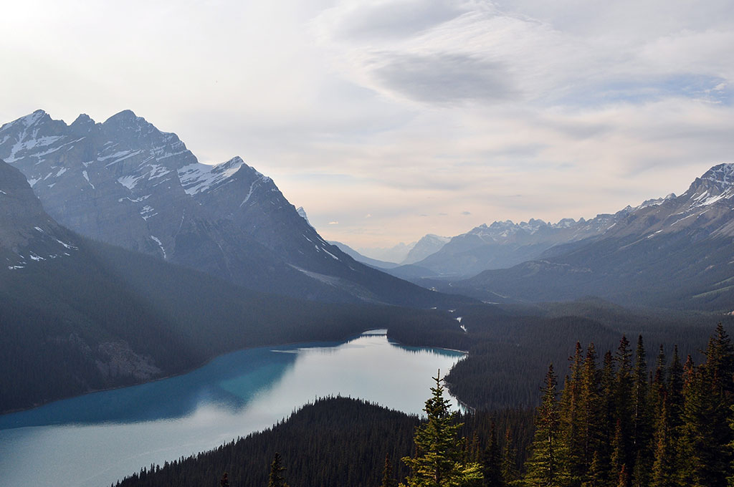

Terraform
for Java developers
Pavel Kryshtop
May 22, 2019

Slide 2
Agenda
What is terraform
Commands
Variables
Loops
Modules
State
Workspace
Examples

Slide 3
Terraform

