Slide 1
Reproducing FPGen: Validation and Performance Analysis Across Program Complexity
Final Project Presentation
Team-3:
Alexander LaChapelle
Nikhil Kumar Gattu

Slide 2
Introduction
Floating-point errors are a critical issue in numerical computing, affecting fields like scientific simulations, engineering, and finance.
These errors arise due to limited precision and can propagate over multiple operations, causing significant deviations in results.
Traditional methods like random testing and heuristic-based search (e.g S3FP) fail to systematically find worst-case floating-point errors.
FPGen, a symbolic execution-based tool, was proposed to systematically detect high-error inputs.
However, FPGen’s scalability on computationally complex numerical programs remains unexplored.
Our Research focuses on:
Replicating FPGen’s original study to verify its effectiveness.
Extending its evaluation to high-complexity programs to assess its scalability.

Slide 3
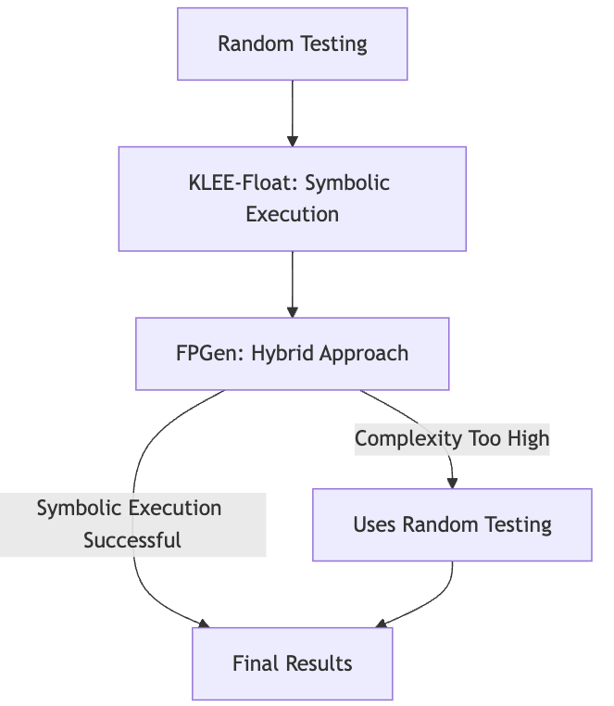
Background and Motivation
Floating-Point Errors: A Hidden Challenge
Precision loss & rounding errors impact scientific computing, finance, & engineering.
Errors accumulate, leading to critical failures (e.g catastrophic cancellation).
Why Traditional Methods Fail
Random testing & heuristics (S3FP, Xscope) struggle to find worst-case errors.
Symbolic execution (KLEE-Float) suffers from path explosion & solver constraints.
Floating-point exception detection ≠ precision loss detection.
Why FPGen?
Uses symbolic execution & inaccuracy checks to find worst-case floating-point errors.
Prior work proves effectiveness, but scalability for high-complexity programs is unknown.
Research Motivation
Can FPGen detect floating-point errors in highly complex programs?
How does complexity impact its performance?
Can it be applied to real-world numerical software?

Slide 4
Related Work
Alternative tools for error-inducing floating points
S3fp is often considered the baseline in generating error-inducing floating-point input, uses Binary Guided Random Testing (BGRT)
Xscope (Bayesian Optimization tool) can be used if we don't have access to source code
Challenges in Symbolic Execution for Floating-Point Programs
Symbolic Execution of Floating-point Programs (Zhang et al., 2022)
Evaluates scalability of floating-point symbolic execution tools like KLEE-Float.
Highlights SMT solver limitations in handling floating-point constraints.

Slide 5
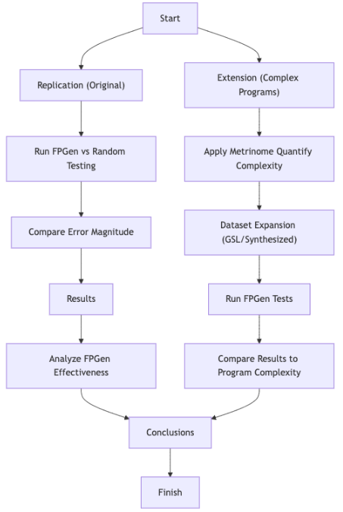
Approach
Goal: Evaluating FPGen for Floating-Point Error Detection
Replicate FPGen’s original evaluation to verify prior claims.
Extend FPGen’s evaluation to more computationally complex numerical programs.
Step 1: Repeat tests
Run the the tests on the original dataset (Reproducing the FPGen Benchmark Tests)
Comparing FPGen with Random Testing (S3FP Alternative)
Validating Results Against the Original Study
Step 2: Expand the test set
We expand the dataset beyond the original benchmarks by including programs from GSL and by creating synthetic test cases.
Step 3: Extended Analysis
Running FPGen on Extended Test Cases
Comparing FPGen Performance Across Complexity Levels

Slide 6
Evaluation Dataset
Replication Dataset (Original FPGen Benchmark)
Uses GitHub artifact dataset from FPGen’s original study
Includes common numerical operations like Summation functions, Statistical operations, Matrix computations from Gnu Scientific Library (GSL) and Meschach Library.
Extended Dataset (Complexity Augmentation)
To analyze FPGen’s performance on more complex numerical programs, we extend the dataset:
Adding additional tests from GSL.
Creating synthetic high-complexity programs:
Programs that compute summations raised to an arbitrarily high exponential power.
Deeply nested loops and higher branching structures to stress-test FPGen.

Slide 7
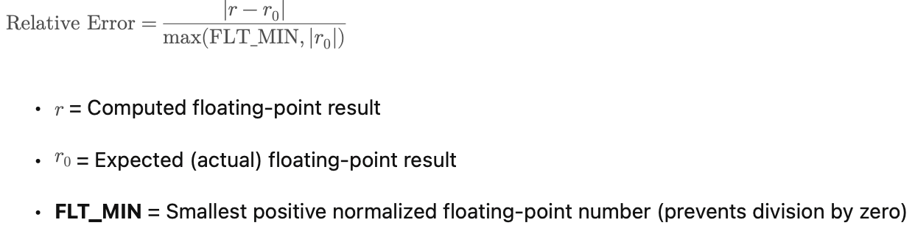
Evaluation Metrics
Error Magnitude (Relative Error)
Used to evaluate RQ1 (FPGen vs. Random Testing).
Measures floating-point precision loss in generated inputs.
Equation used in FPGen evaluation, adapted from Guo et al. (2020) \cite{10.1145/3377811.3380359}.

Slide 8
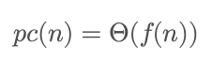
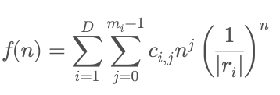

Complexity (Program Path Complexity)
Used to evaluate RQ2 (FPGen’s effectiveness in complex programs).
Where
• D = Number of distinct roots of the denominator polynomial q(z) .
• r_i = i th root of q(z) (characteristic equation of program execution paths).
• m_i = Multiplicity of r_i .
• c_{i,j} = Coefficients derived from the program’s control flow graph (CFG).
Need to Extract the Dominant Term (APC)
O(1) -> low complexity
O(n^2) -> branching increases polinomially
O(n^n) -> Exponencial -> high complexity.
Source: Christakis et al., 2016, PLDI (Path Complexity Predicts Symbolic Execution Path Explosion)

Slide 9
Results – RQ1
Routine | FPGen Error | Random Search Error | FPGen Improvement
dot | 1.92E-04 | 1.70E-12 | Yes
sum | 1.00E+00 | 0.00E+00 | Yes
mv | 7.03E-04 (8.94E-04 in original) | 0.00E+00 | Yes
conv | 2.04E-04 | 1.60E-13 (9.28E-13 in original) | Yes
qr | 2.59E-14 | 0.00E+00 | Yes
2norm | 2.21E-16 | 3.12E-16 | No
1norm | 0.00E+00 | 0.00E+00 | No
mm | 2.58E-14 | 1.11E-16 | Yes
lu | 2.73E+00 | 0.00E+00 | Yes
Compensated sum | 1.00E+00 | 0.00E+00 | Yes
Recursive sum | 1.00E+00 | 0.00E+00 | Yes
Pairwise sum | 1.32E-16 | 0.00E+00 | Yes

Slide 10
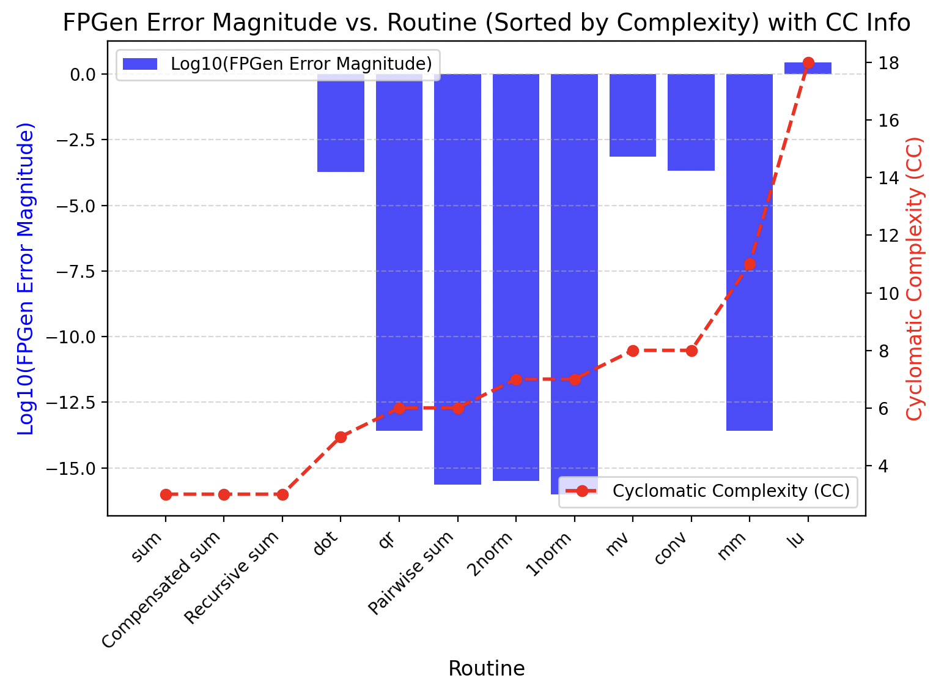
Results – RQ2
CC
5
3
8
8
6
7
7
11
18
3
3
6
NPath
12
4
72
36
24
12
12
216
3936
4
4
14
Routine | FPGen Error | APC | APC Fit
dot | 1.92E-04 | 12 | c
sum | 1.00E+00 | n | n
mv | 7.03E-04 | n | n
conv | 2.04E-04 | n | n
qr | 2.59E-14 | n | n
2norm | 2.21E-16 | 1.1487^n | x^n
1norm | 0.00E+00 | 1.1487^n | x^n
mm | 2.58E-14 | 1.1939^n | x^n
lu | 2.73E+00 | 1.3485^n | x^n
Compensated sum | 1.00E+00 | n^2 | n^2
Recursive sum | 1.00E+00 | n^2 | n^2
Pairwise sum | 1.32E-16 | 1.2885^n | x^n

Slide 11
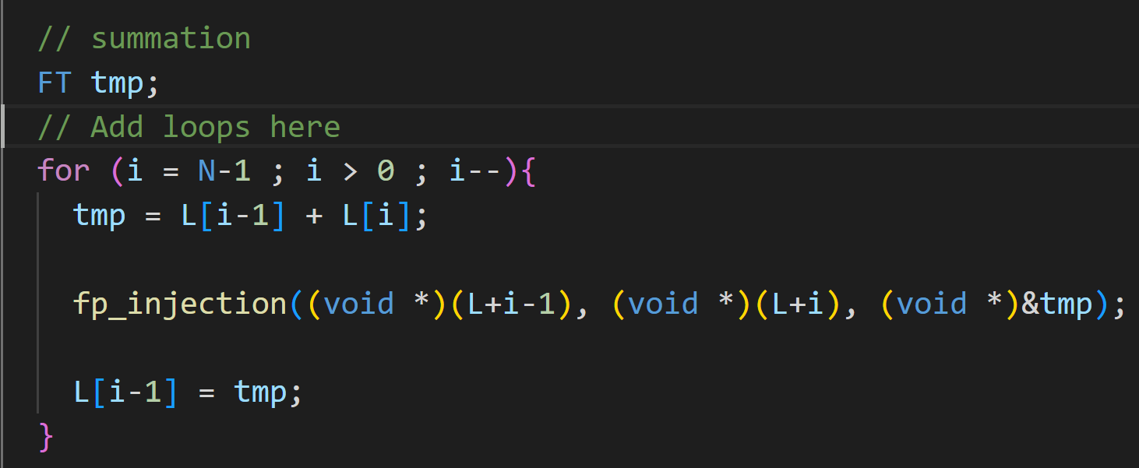
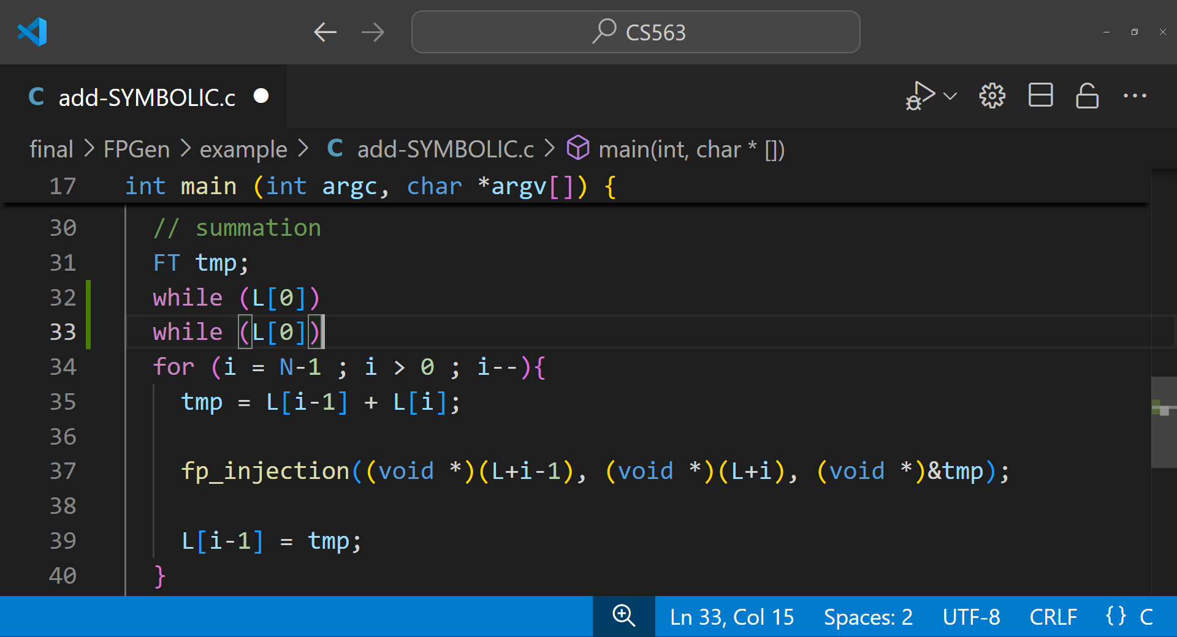
How to create complex test cases?
We want a repeatable change that we can use to fine-tune complexity across a spectrum, while still having exponential APC.
Routine | APC
lu | 1.3485^n
1loop | 1.2207^n
2loop | 1.2983^n
3loop | 1.3356^n
4loop | 1.3567^n
5loop | 1.3701^n
Looks like a good distribution, but even 1loop takes too long to execute symbolically. We can't make a set out of this (at least not with the time available).

Slide 12
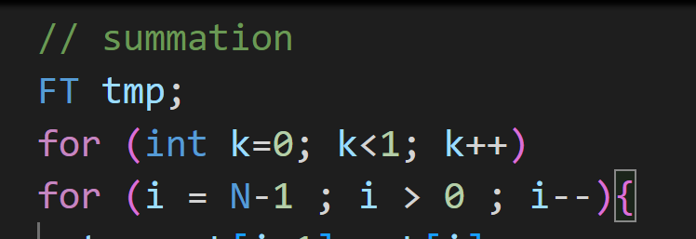
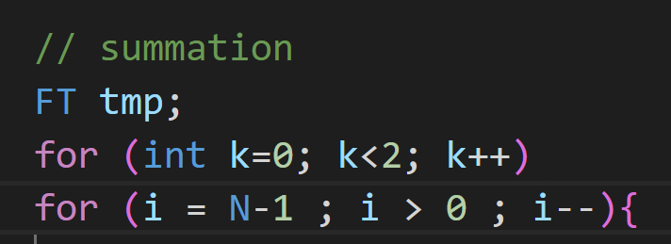
Complexity vs Path Explosion
What about simpler loops?
In synthetic data sets, this can be "gamed"
Routine | APC | K<1 Error | K<2 Error
lu | 1.3485^n
1loop | 1.1939^n |  | 0.00E+00
2loop | 1.2499^n
This increases all complexity metrics, but FPGen has no change in computation time or error
Supposedly less complex than lu, but I'm awake at 3 in the morning hoping it will finish
Same complexity

Slide 13
Novelty of the proposed solution considering state-of-the-art
Limitations of Existing Methods:
S3FP & Random Testing: Cannot systematically explore floating-point execution paths.
KLEE-Float: Struggles with floating-point constraints & path explosion.
Xscope: Detects exceptions, but not precision loss.
Our Novel Contribution:
Extends FPGen to high-complexity numerical programs (deep branching, recursion).
Uses Metrinome’s complexity metrics (CC, NPath, APC) to categorize program difficulty.
Expands dataset (GSL functions + synthetic high-complexity programs).
Evaluates FPGen’s scalability & symbolic execution performance on complex tasks.

Slide 14
Assumptions
FPGen’s effectiveness extends to complex programs
Assumes FPGen remains superior to random testing at all complexity levels.
Complexity metrics predict symbolic execution difficulty
Assumes Metrinome’s CC, NPath, APC correlate with FPGen’s performance.
Symbolic execution remains feasible
Assumes FPGen can analyze complex programs without excessive timeouts.
Floating-point errors are representative
Assumes errors in our dataset (GSL + synthetic tests) generalize to real-world cases.

Slide 15
Limitations
Path Explosion in High-Complexity Programs
FPGen struggles with deep branching and recursion, leading to timeouts in highly complex cases.
Solver Constraints & Approximation Issues
Floating-point constraints are hard to solve; FPGen sometimes falls back on approximation, reducing precision.
Limited Dataset Coverage
While we expanded the dataset, it may not fully represent all real-world floating-point applications.
Metrinome Metrics May Not Fully Capture FPGen’s Complexity
The correlation between CC, NPath, and APC with actual symbolic execution difficulty needs further validation.
Metrinome might not apply as well for floating point analysis

Slide 16
Conclusion
On real computing problems, we can confirm that FPGen is effective
Extending FPGen past its current complexity cases
Creating

Slide 17
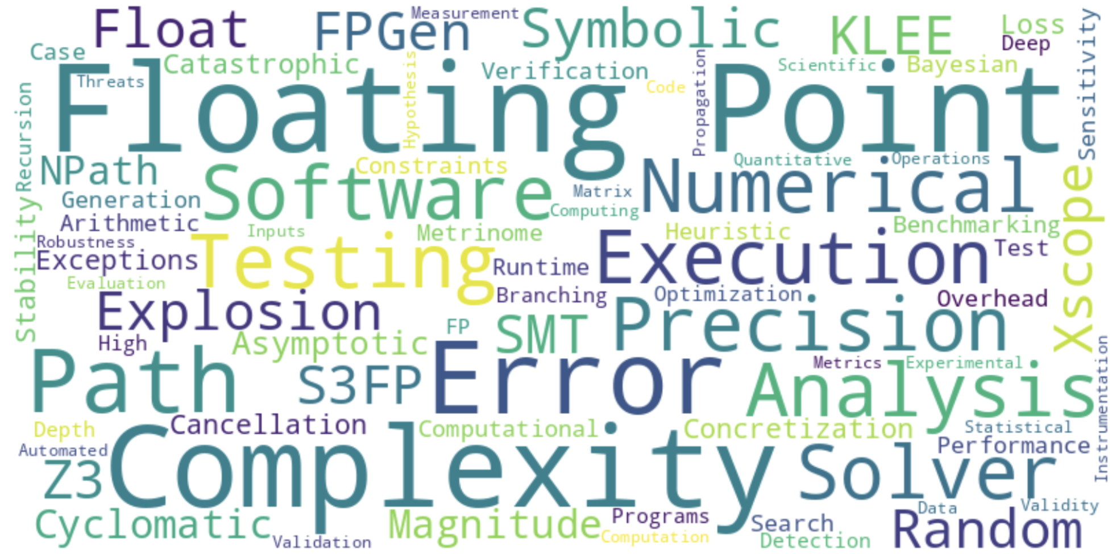

Slide 18
GitHub Repository
https://github.com/ajlachapelle/CS563-Final

Slide 19
Thankyou!

