Slide 1
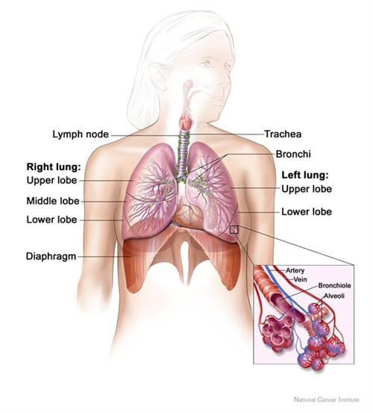
Respiratory System
College Nursing Level Structure, physiology, assessment, and priority care
Prepared for classroom presentation and study review
Focus: oxygenation, ventilation, and clinical nursing judgment

Slide 2
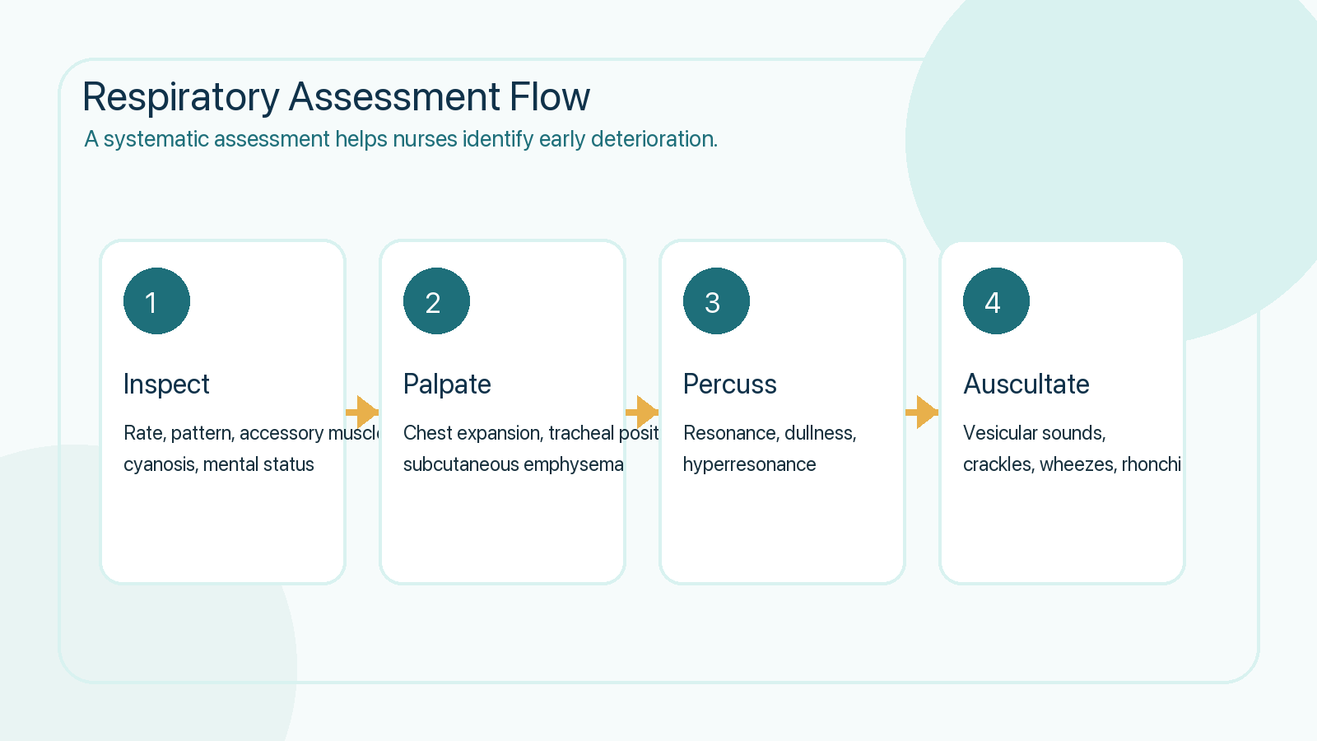
Learning Objectives
What nursing students should understand by the end of the slideshow
Identify the major structures of the upper and lower respiratory tract.
Explain how ventilation, perfusion, and diffusion support gas exchange.
Connect pulse oximetry, ABGs, and physical assessment to patient status.
Apply nursing priorities to common respiratory disorders and acute decline.

Slide 3
Core Anatomy
Key structures that support filtration, conduction, and gas exchange
Upper airway includes the nose, sinuses, pharynx, and larynx, which warm and humidify air.
Lower airway includes the trachea, bronchi, bronchioles, and alveoli.
The right lung has 3 lobes; the left lung has 2 lobes and a cardiac notch.
Pleura and negative intrathoracic pressure help keep the lungs expanded.
Clinical cue: alveoli are the primary gas-exchange units.

Slide 4
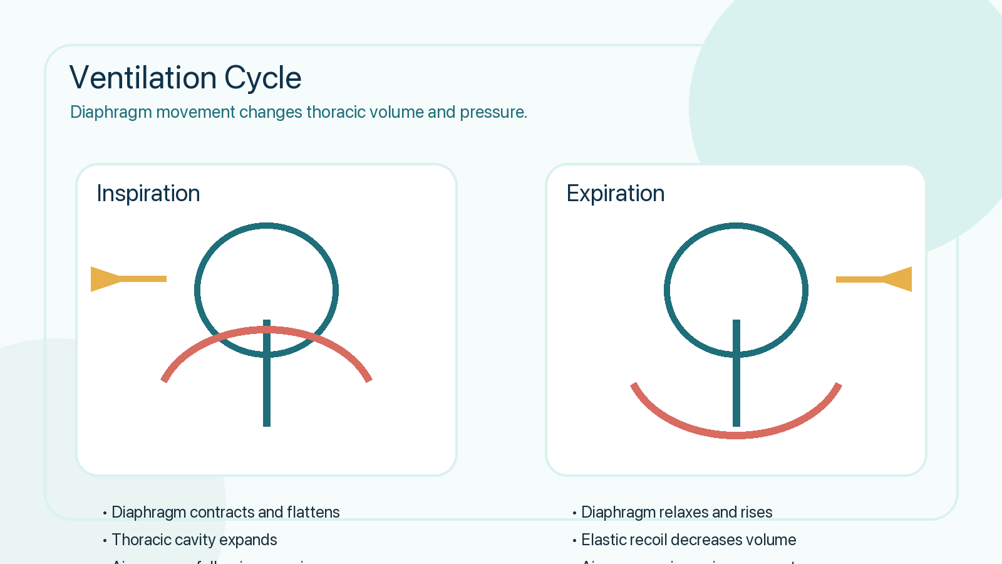
Ventilation Mechanics
How pressure changes move air in and out of the lungs

Slide 5
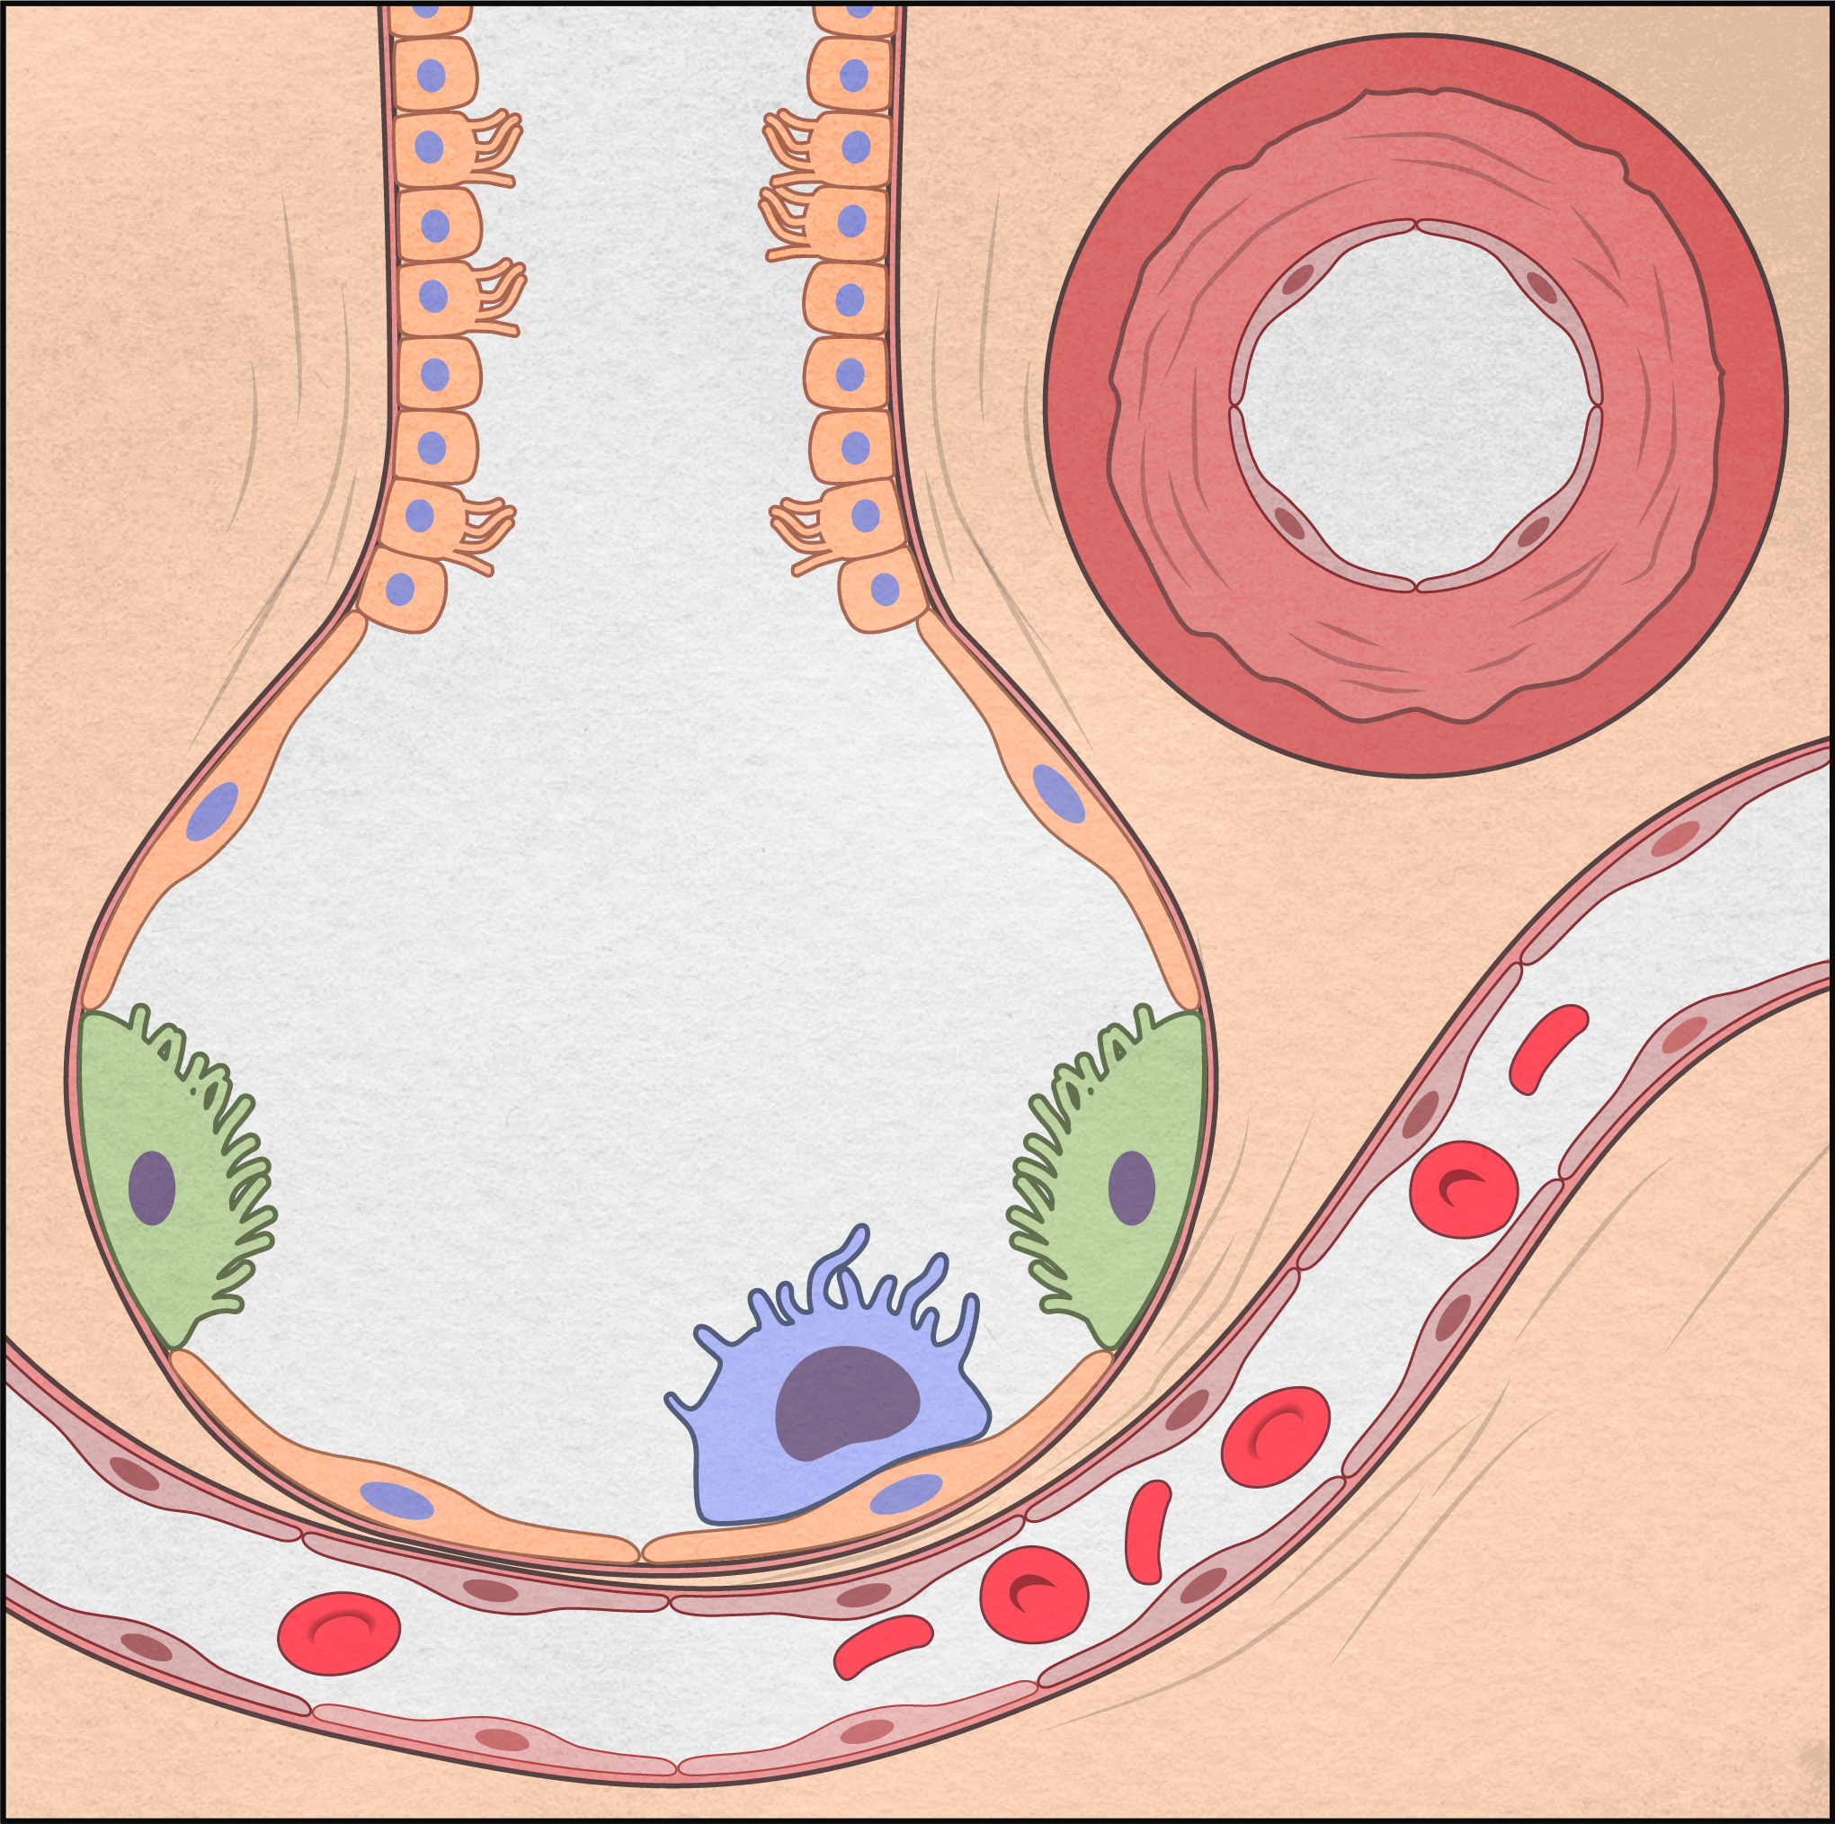
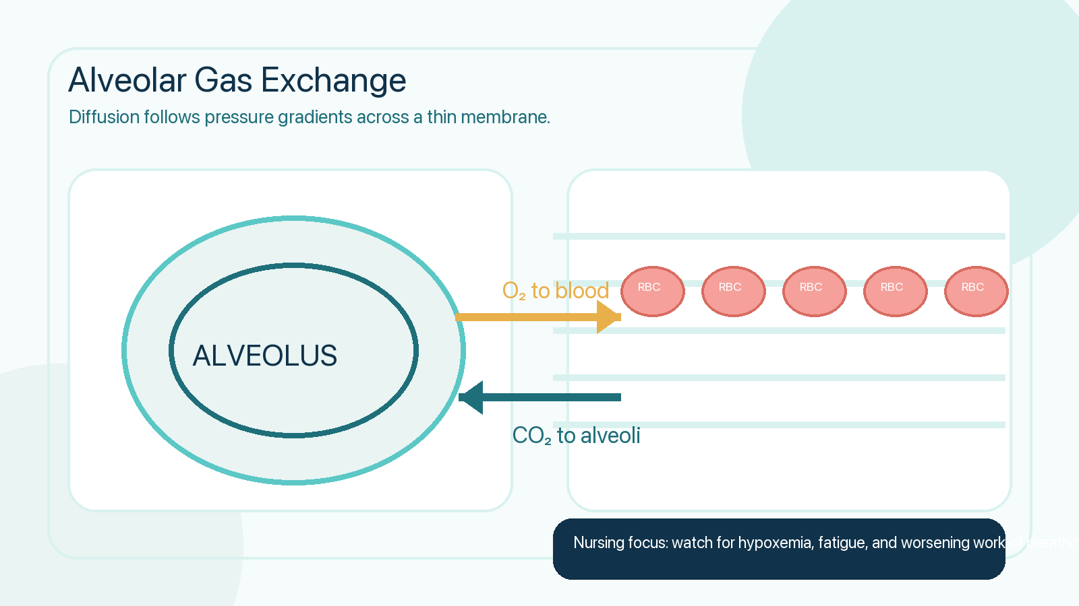
Gas Exchange and Transport
Oxygenation depends on alveoli, perfusion, and hemoglobin delivery

Slide 6
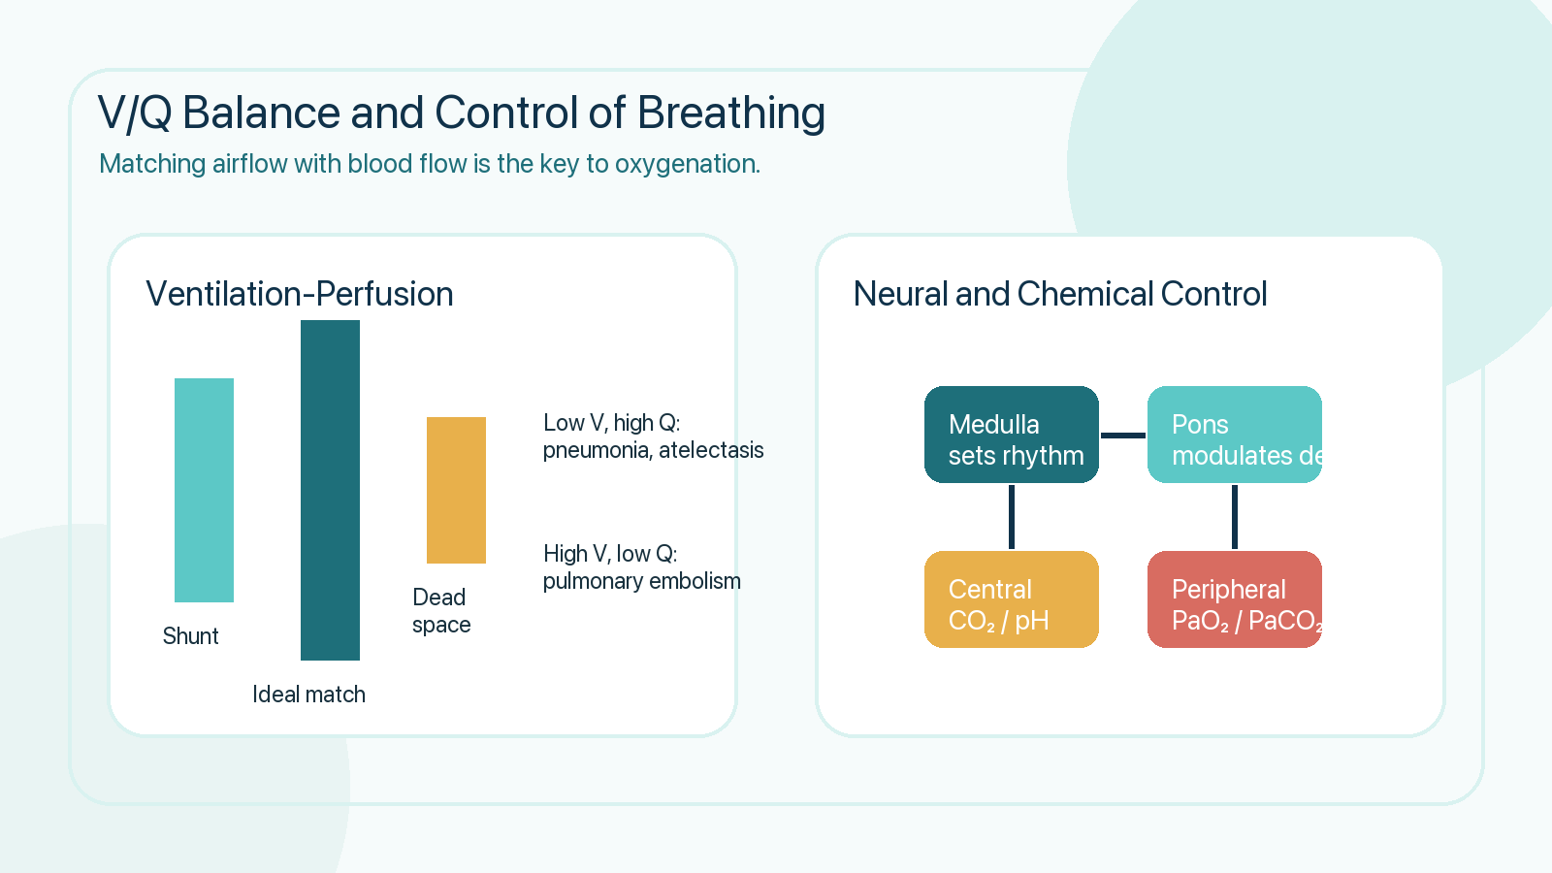
V/Q Match and Control of Breathing
Major concepts behind hypoxemia and respiratory drive

Slide 7
Respiratory Assessment
Bedside data that often signal trouble before lab values return
Red Flags
Increasing accessory muscle use
Silent chest or diminished air entry
Confusion, agitation, or lethargy
Cyanosis or rapidly falling SpO₂

Slide 8
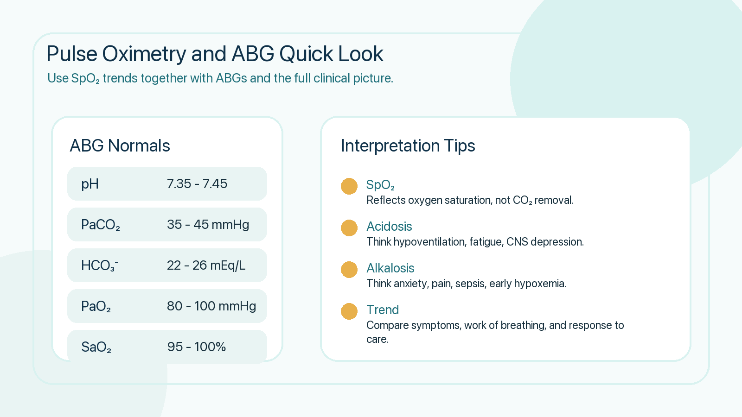
Pulse Oximetry and ABGs
Use trends and patient appearance, not just single numbers

Slide 9
Common Respiratory Disorders
High-yield conditions frequently encountered in nursing care
Asthma
COPD
Pneumonia
ARDS
Reversible airway inflammation and bronchoconstriction with wheeze and cough.
Chronic airflow limitation, hyperinflation, and frequent exacerbations.
Infection with inflammation, consolidation, and impaired oxygen diffusion.
Severe inflammatory lung injury with refractory hypoxemia and low compliance.
Nursing priority across disorders: recognize worsening oxygenation early and escalate promptly.

Slide 10
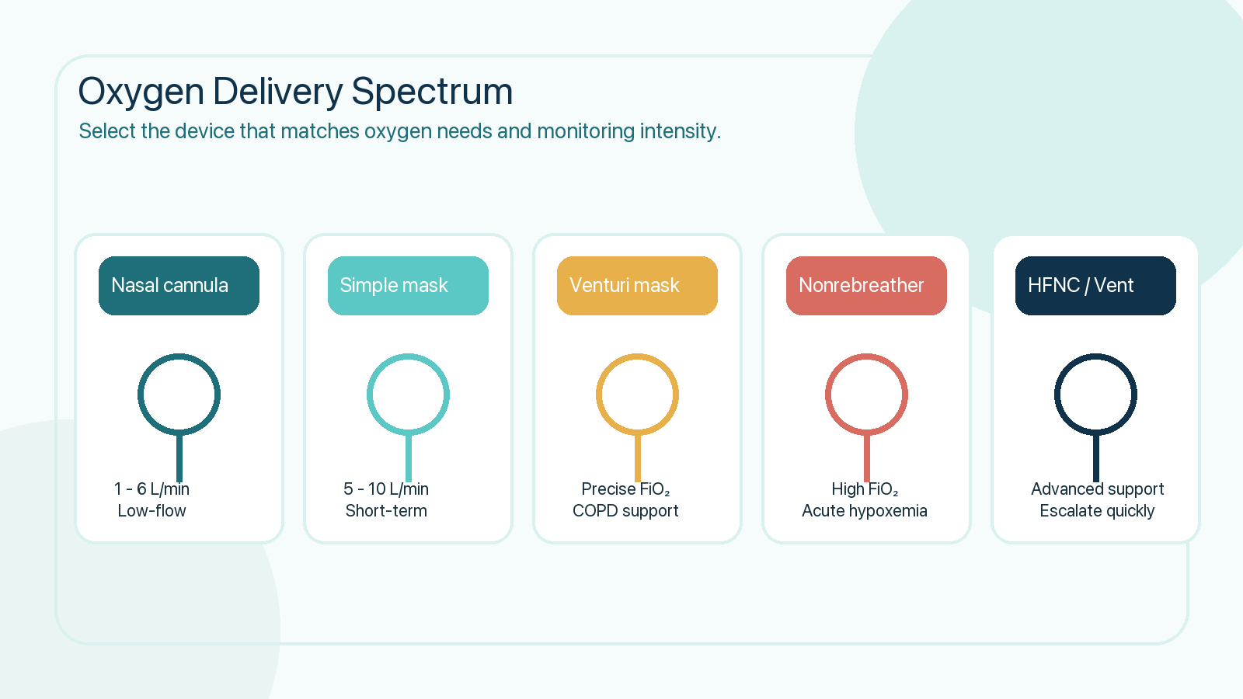
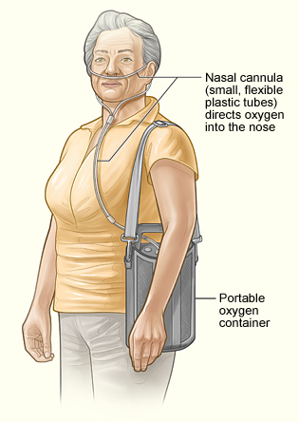
Oxygen Therapy and Priority Interventions
Match the treatment device to the severity of respiratory compromise
Safety: lowest effective FiO₂, humidify when needed, and follow oxygen fire precautions.

Slide 11
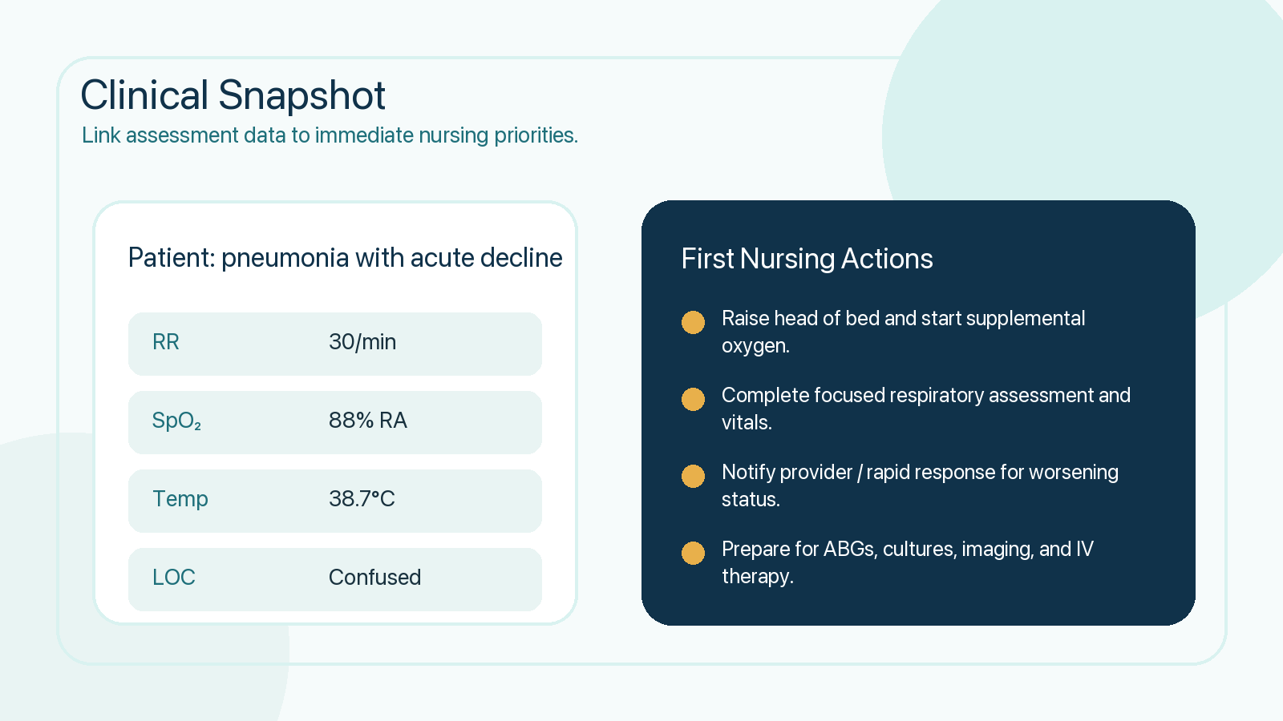
Clinical Application
From patient cues to action: what the nurse does first

Slide 12
Key Takeaways
References
Effective respiration requires a patent airway, adequate ventilation, intact diffusion, and perfusion.
Respiratory assessment findings often reveal deterioration before tests confirm it.
Pulse oximetry, ABGs, and mental-status changes should always be interpreted together.
Fast nursing interventions can prevent respiratory failure and improve outcomes.
Hinkle & Cheever. Brunner & Suddarth's Textbook of Medical-Surgical Nursing.
Lewis et al. Medical-Surgical Nursing: Assessment and Management of Clinical Problems.
American Association for Respiratory Care clinical resources.
National Heart, Lung, and Blood Institute education materials.
Designed for a college nursing audience with visual review aids for speaking or studying.

