Slide 1
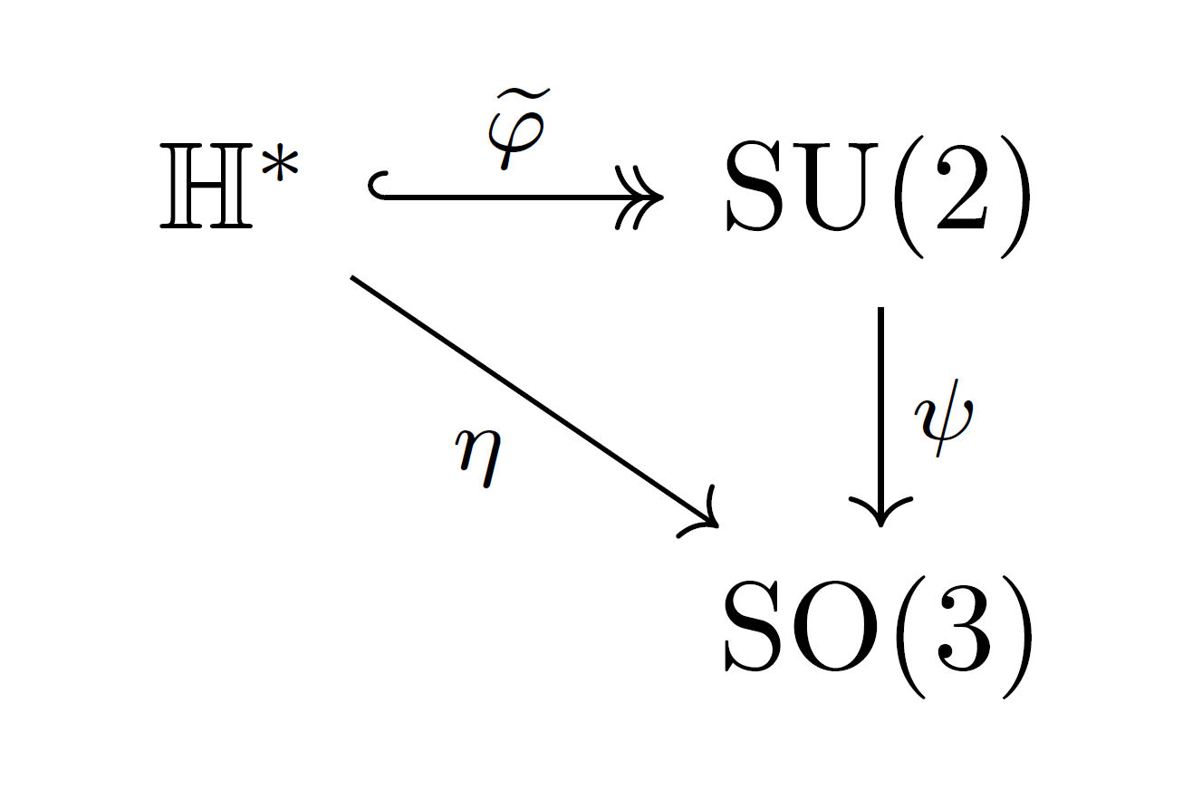
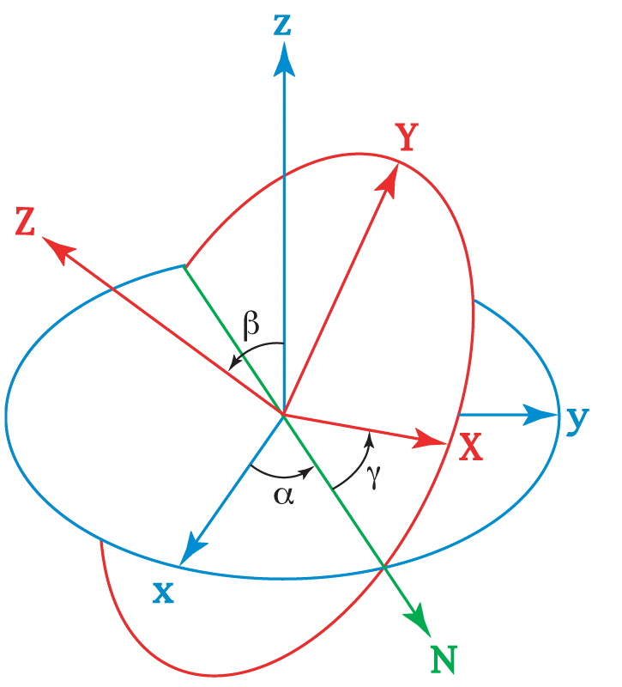




The Algebra of Rotations in$ℝ^{3}$
An Exploration of Representations by Quaternions,$SU(2),$and $SO(3)$
Nicholas Meyer nmeyer14@winona.edu Winona State University
Notes:
Look @ audience
Make eye contact
Always look happy
Um check!

Slide 2
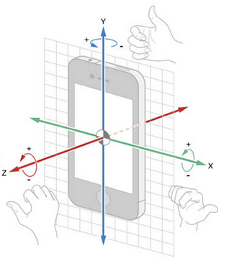
Outline
Euler Angles
Rodrigues Rotation Formula
Hamilton’s Quaternions
The Versor Convention
Matrices, Maps, and Morphisms!
Practical Application (Computer Animation!)

Slide 3
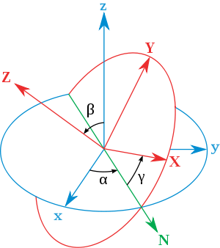
Euler Angles
1765- Euler studied the mechanics of rotating bodies
Decomposition of Motion
Need 6 parameters to rotate a on object
Many constraints on what the parameters can be
Suffers gimbal lock (local singularity in the rotation sequence)
Notes:
Use hands to demo translational and rotational motional

Slide 4
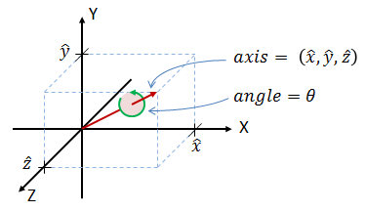

The Rodrigues Rotation Formula (RRF)
1840- Published paper using Euler’s Four Square Identity
If $\vec{v},\vec{e}∈ℝ^{3}$and |$\vec{e}$| = 1, to rotate $\vec{v}$ about $\vec{e}$ by some angle $ρ=2θ: {\vec{v}}_{rot}=\vec{v}\cos{θ}+\left(\vec{e}×\vec{v}\right)\sin{θ}+\vec{e}\left(\vec{e}∙\vec{v}\right)\sin{θ}$
Notes:
Olinde Rodrigues – French mathematician
so(3) -> SO(3) without using the matrix exponential

Slide 5
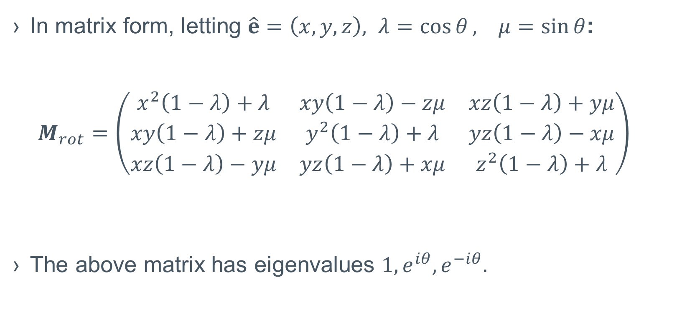
The Rodrigues Rotation Formula (Cont’d)
In matrix form, letting $\hat{e}=\left(x,y,z\right), λ=\cos{θ}, μ=sin⁡θ$:
$$M_{rot}=\left(\begin{matrix}x^{2}\left(1−λ\right)+λ & xy\left(1−λ\right)−zμ & xz\left(1−λ\right)+yμ \\ xy\left(1−λ\right)+zμ & y^{2}\left(1−λ\right)+λ & yz\left(1−λ\right)−xμ \\ xz\left(1−λ\right)−yμ & yz\left(1−λ\right)+xμ & z^{2}\left(1−λ\right)+λ\end{matrix}\right)$$
The above matrix has eigenvalues $1, e^{iθ},e^{−iθ}.$
Notes:
From product of Eigenvalues = Determinant ID, we have Det 1
ICBS that M_rot is orthogonal, hence M_rot is in SO(3)
Dim(SO(n)) = n*(n-1)/2 as a vector space
Since dim(SO(3)) = 3(3-1)/2 = 3, and M_rot is determined by 3 paramaters, (2 of x, y, z and h), the M_rots represent SO(3) up to transpose.

Slide 6
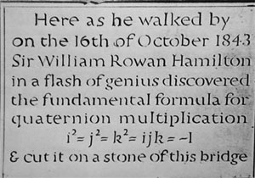
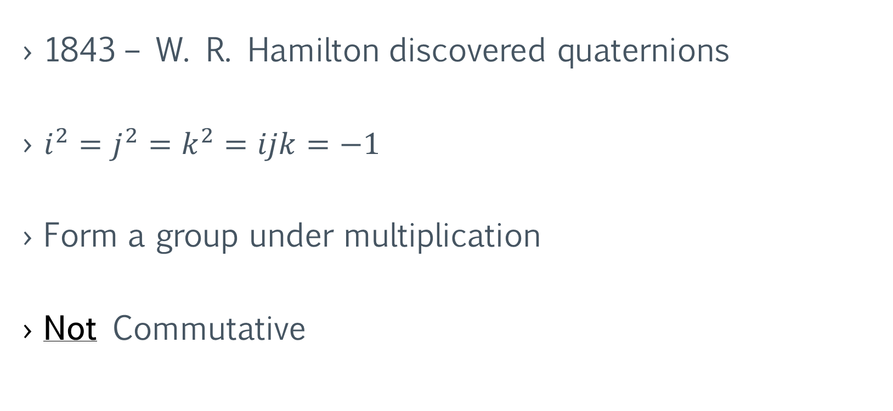
Hamilton’s Quaternions
1843 – W. R. Hamilton discovered quaternions
$i^{2}=j^{2}=k^{2}=ijk=−1$
Form a group under multiplication
Not Commutative
Notes:
Every morning in the Month of October 1843, Willan Edward Hamilton, son of WR Hamilton asked his father “Papa, can you multiply triples?” Always replied, “no, but I can add and subtract them” His mistake was thinking in 3D

Slide 7
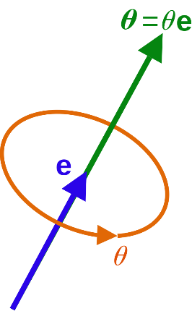
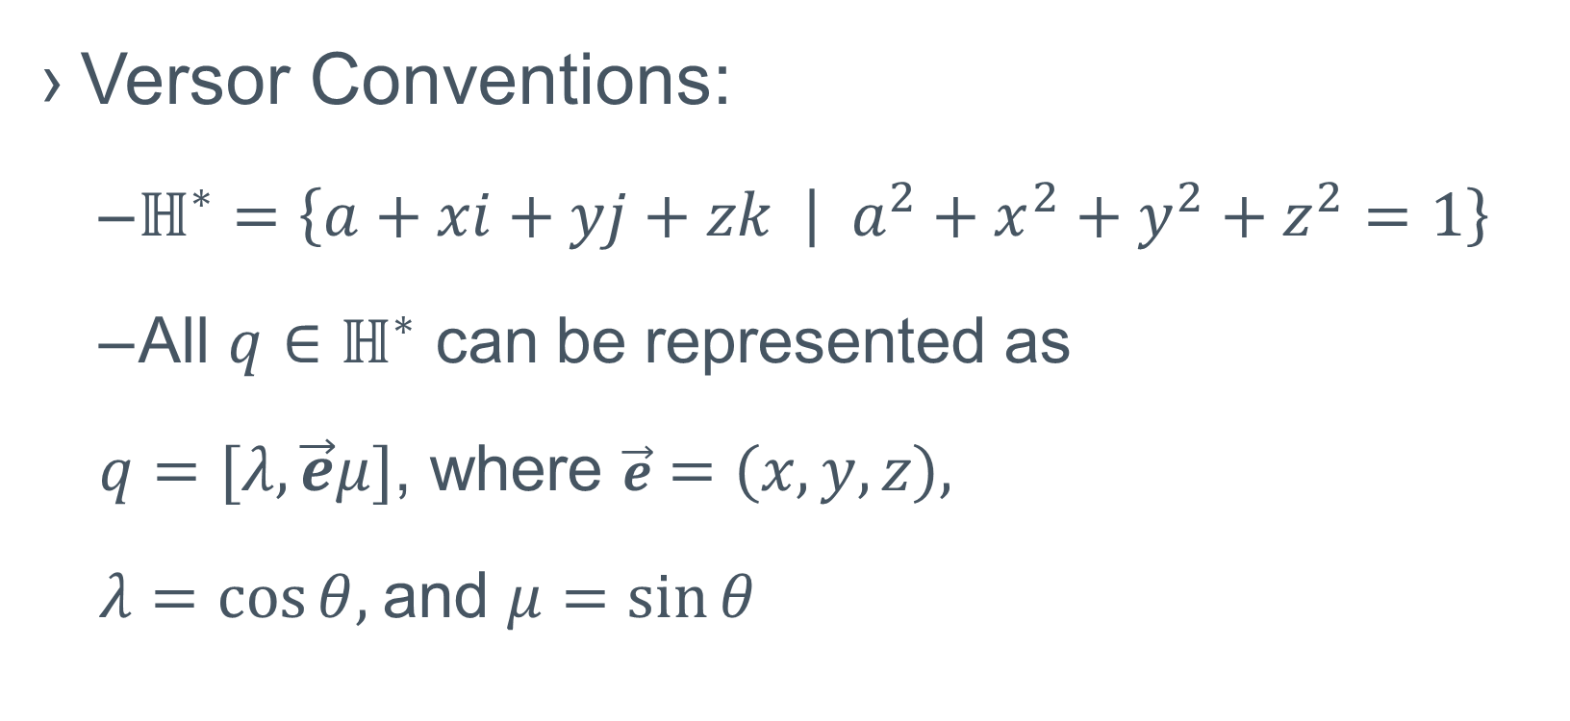
The Quaternions as Rotations (Versors!)
Versor Conventions:
$ℍ^{∗}=\left\{a+xi+yj+zk | a^{2}+x^{2}+y^{2}+z^{2}=1\right\}$
All $q∈ℍ^{∗}$ can be represented as
$q=[λ,\vec{e}μ]$, where $\vec{e}=\left(x,y,z\right),$
$λ=cos⁡θ,$and $μ=sin⁡θ$
Notes:
1874 - Jules Hoüel – “Théorie Élémentaire des Quantités Complexes” vol 4. Developed ideas in Spherical Trigonometry

Slide 8

Matrices, Maps, and Morphisms
Notes:
Say SULU and SOLO for group names. Introduce doible

Slide 9
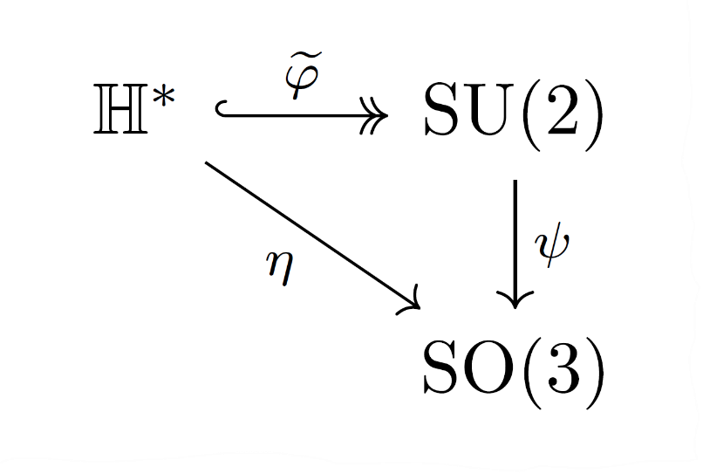

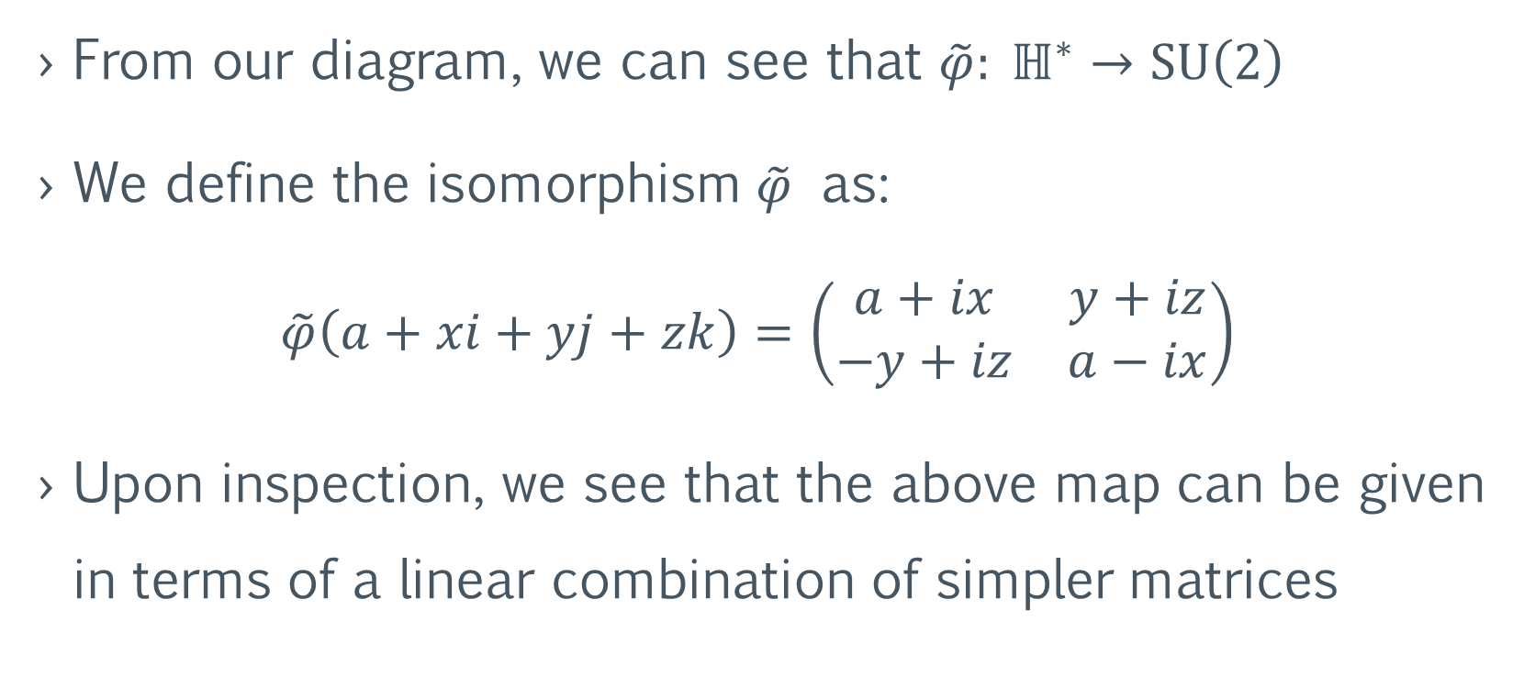
Quaternions and $SU(2)$
From our diagram, we can see that $\tilde{φ}: ℍ^{∗}→SU\left(2\right)$
We define the isomorphism $\tilde{φ}$ as:
$$\tilde{φ}\left(a+xi+yj+zk\right)=\left(\begin{matrix}a+ix & y+iz \\ −y+iz & a−ix\end{matrix}\right)$$
Upon inspection, we see that the above map can be given in terms of a linear combination of simpler matrices

Slide 10
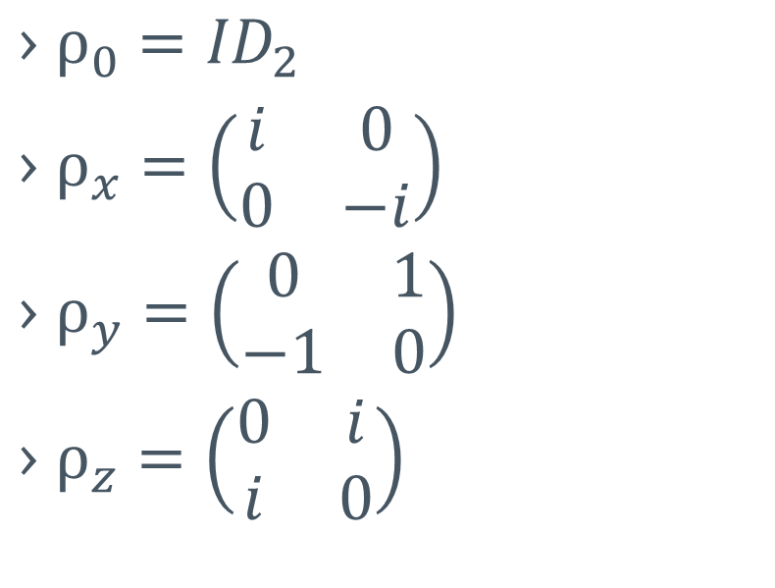
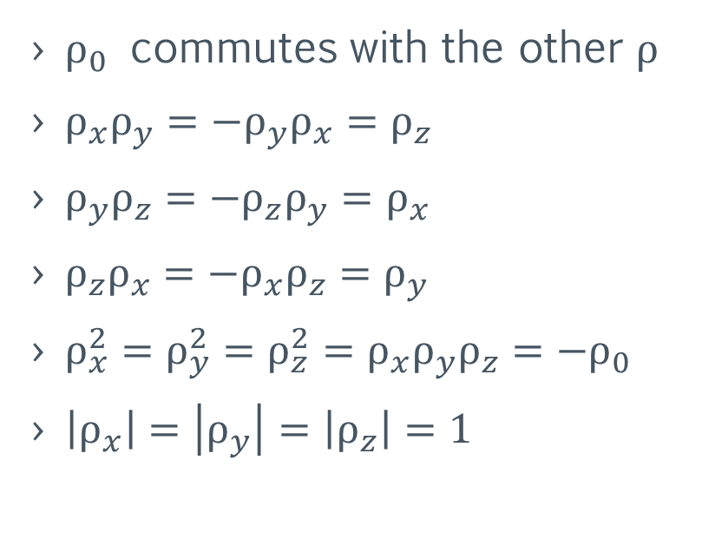
The Quaternion or “Rhotation” Matrices
The Matrices
Their products
$ρ_{0}={ID}_{2}$
$ρ_{x}=\left(\begin{matrix}i & 0 \\ 0 & −i\end{matrix}\right)$
$ρ_{y}=\left(\begin{matrix}0 & 1 \\ −1 & 0\end{matrix}\right)$
$ρ_{z}=\left(\begin{matrix}0 & i \\ i & 0\end{matrix}\right)$
$ρ_{0}$ commutes with the other $ρ$
$ρ_{x}ρ_{y}=−ρ_{y}ρ_{x}=ρ_{z}$
$ρ_{y}ρ_{z}=−ρ_{z}ρ_{y}=ρ_{x}$
$ρ_{z}ρ_{x}=−ρ_{x}ρ_{z}=ρ_{y}$
$ρ_{x}^{2}=ρ_{y}^{2}=ρ_{z}^{2}=ρ_{x}ρ_{y}ρ_{z}=−ρ_{0}$
$\left|ρ_{x}\right|=\left|ρ_{y}\right|=\left|ρ_{z}\right|=1$
Notes:
It is easy to show that the ρ_i form a basis set for SU(2) where the scalars come from R, under the condition that the coordinates, taken as a vector in R^4 has norm 1.
(Rho-tation matricies!)

Slide 11
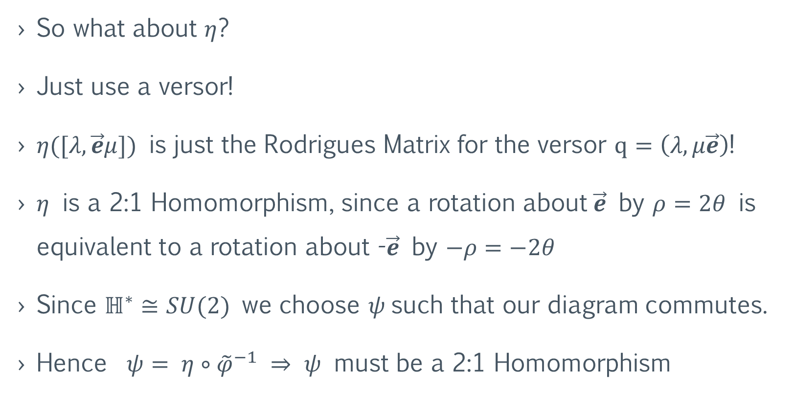
Quaternions and SO(3)
So what about $η$?
Just use a versor!
$η([λ,\vec{e}μ])$ is just the Rodrigues Matrix for the versor $q=\left(λ,μ\vec{e}\right)$!
$η$ is a 2:1 Homomorphism, since a rotation about$\vec{e}$ by $ρ=2θ$ is equivalent to a rotation about -$\vec{e}$ by $−ρ=−2θ$
Since $ℍ^{∗}≅SU(2)$ we choose $ψ$such that our diagram commutes.
Hence ${ψ= η∘\tilde{φ}}^{−1} ⇒$ $ψ$ must be a 2:1 Homomorphism
Notes:
The map ψ is very complicated and quite messy!

Slide 12
Demo

Slide 13
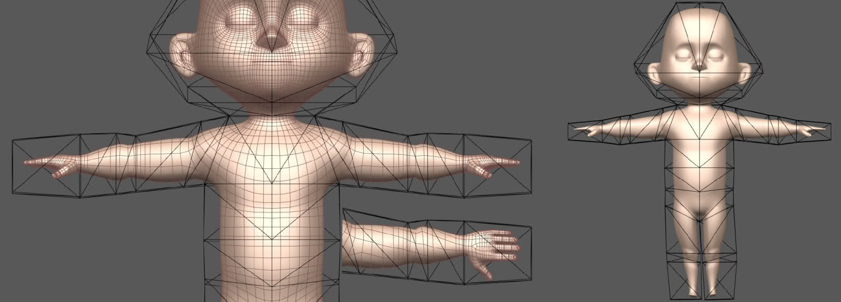
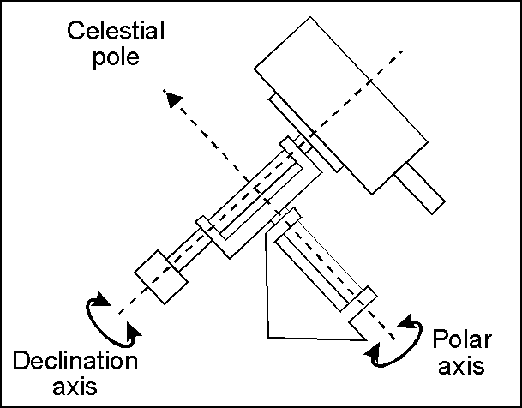
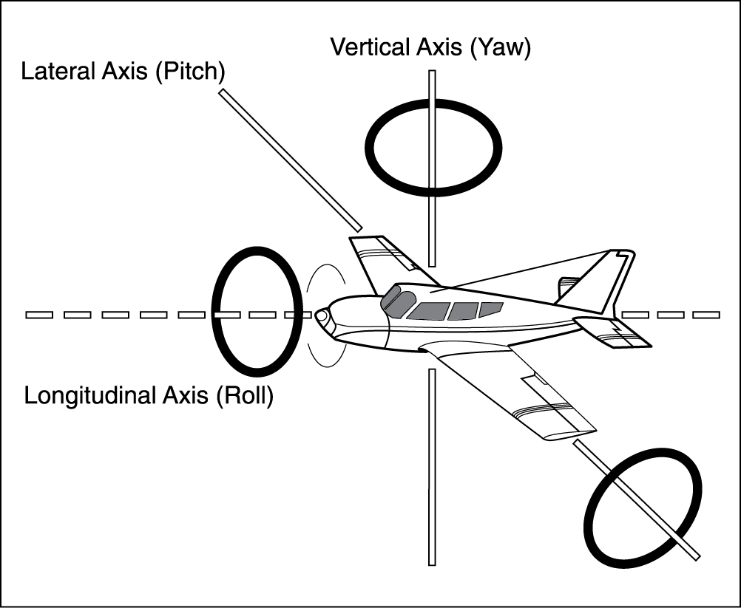
Applications
Computer Animation
Telescopy
Medical Imaging
Building Stab
Robotics
CAD Software
Statistics

Slide 14
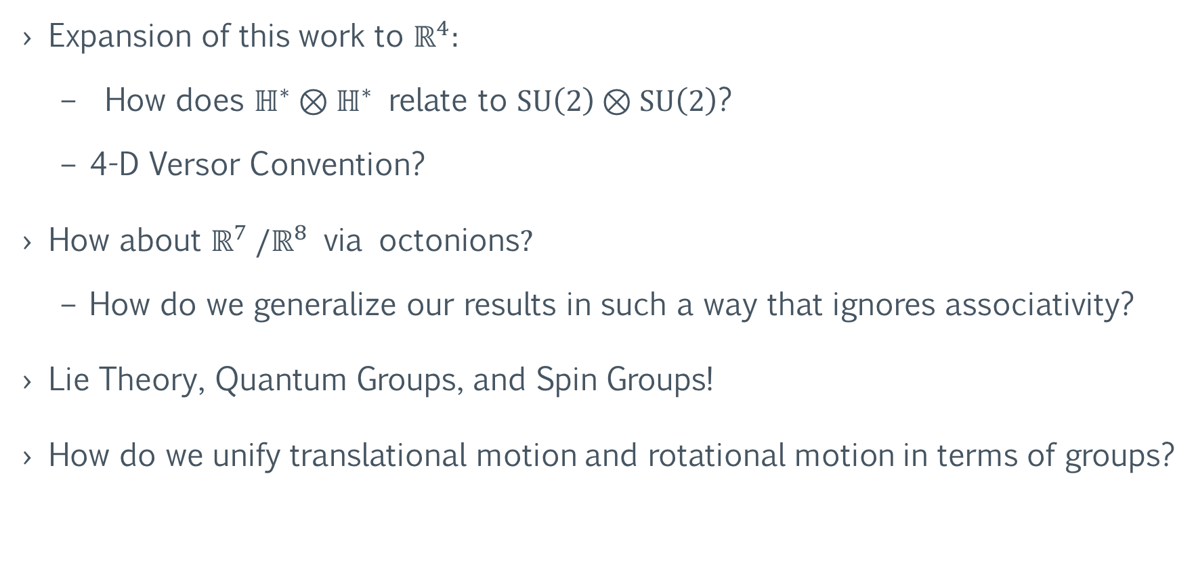
Further Studies:
Expansion of this work to $ℝ^{4}:$
How does $ℍ^{∗}⊗ℍ^{∗}$ relate to $\text{SU}\left(2\right)⊗\text{SU}\left(2\right)$?
4-D Versor Convention?
How about $ℝ^{7} /ℝ^{8} \text{via} \text{octonions}?$
How do we generalize our results in such a way that ignores associativity?
Lie Theory, Quantum Groups, and Spin Groups!
How do we unify translational motion and rotational motion in terms of groups?
Notes:
$\text{SU}\left(2\right)⊗\text{SU}\left(2\right)$ admits a 2:1 homomorphism onto$\text{SO}(4)$,

Slide 15
References:
Simon L. Altmann. Rotations, Quaternions, and Double Groups. Mineola, NY: Dover, 2005.
John H. Conwway and Derek A. Smith. On Quaternions and Octonions: Their Geometry, Arithmetic, and Symmetry. A K Peters, Ltd., 2003.
Jian S. Dia. “Euler-Rodrigues formula variations, quaternion conjugation and intrinsic connections”. Mechanism and Machine Theory 92 (2015), 144-152.
Govind S. Krishnaswami and Sonakshi Sachdev. “Algebra and Geometry of Hamilton’s quaternions”. Resonance – Journal of Science Education 21.6 (2016), pp. 529–433.
Cibelle Celestino Silva and Roberto de Andrade Martins. “Polar and axial vectors versus quaternions”. American Journal of Physics 70.9 (2002), pp. 958–963.
David Eberly. “Rotation Representations and Performance Issues”. Online. 2008.
Rhett Allain. “How Olympic Gymnasts Use Physics to Pull Off Those Crazy Twists”. Wired (August 2016). Online.

Slide 16
Acknowledgements
“This project has been sponsored by a student project grant from Winona State University.”
Advisors: Dr. Aaron Wangberg, Dr. Joyati Debnath
Special Thanks: Dr. Sarah Phan-Budd

Slide 17
Thank You!

