Slide 1
Why this review?
The clinical gap
No human trial has tested a 5-LOX inhibitor specifically in OIPN. But several agents intersecting the same oxidative-lipid-peroxidation ferroptosis pathway have been tested clinically.
This review's purpose
Systematically map what has been tried clinically on this pathway, quantify the pooled effect, and use the resulting evidence gap to justify and contextualize the dissertation's preclinical work.

Slide 2
Research Question
Population (P) | Adult patients (≥18 yrs) with cancer (predominantly colorectal, gastric, or other GI malignancies) receiving oxaliplatin-based chemotherapy (e.g., FOLFOX, XELOX/CAPOX regimens)
Intervention (I) | Pharmacological agents with mechanistic plausibility on the ferroptosis / oxidative-lipid-peroxidation axis — glutathione, alpha-lipoic acid, vitamin E (tocopherol), N-acetylcysteine, omega-3 fatty acids, calcium/magnesium infusions (as neuroprotectant comparator class)
Comparison (C) | Placebo, standard supportive care, or no intervention (chemotherapy alone)
Outcome (O) | Binary: Incidence/risk of Chemotherapy-Induced Peripheral Neuropathy (CIPN), defined as NCI-CTCAE Grade ≥2 neuropathy (or trial-defined "any CIPN" occurrence), reported as event counts per arm → Risk Ratio (RR) or Odds Ratio (OR)

Slide 3
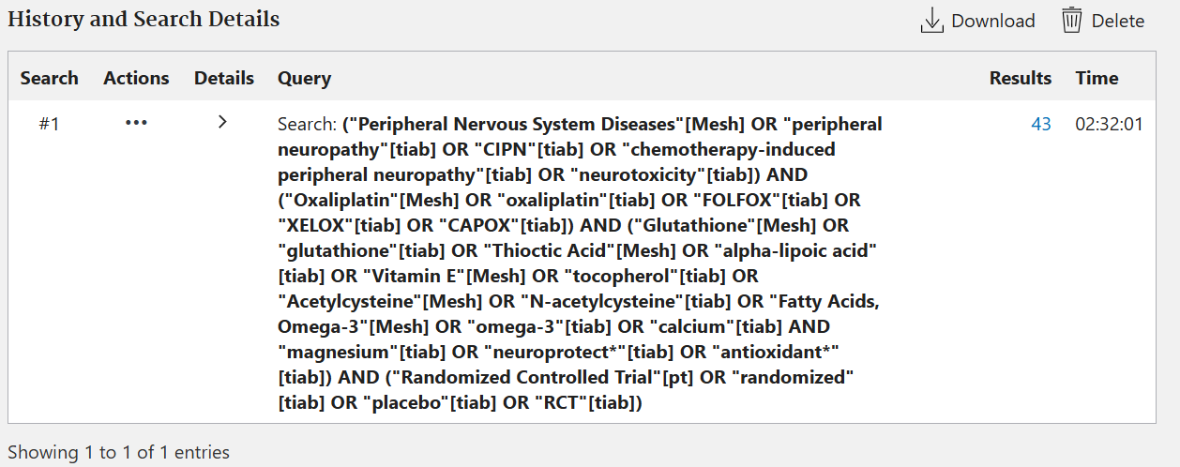

Boolean Search Strings(Pubmed)
Inclusion Criteria
Study design: Randomized controlled trials (RCTs) — parallel or crossover — comparing a ferroptosis-pathway-relevant agent vs. placebo/control in oxaliplatin-treated patients
Population: Adult cancer patients receiving oxaliplatin-containing regimens with no pre-existing peripheral neuropathy at baseline
Outcome reporting: Must report CIPN incidence as a discrete/binary endpoint (event counts, Grade ≥2 rate, or extractable RR/OR with 95% CI) using a validated grading tool (NCI-CTCAE, TNS, or similar)
Exclusion Criteria
Non-oxaliplatin chemotherapy agents (pure taxane, vincristine, or bortezomib-only cohorts) unless oxaliplatin subgroup data is separately extractable
Non-randomized designs (observational, single-arm, retrospective cohorts) and non-pharmacological interventions (e.g., cryotherapy, compression, exercise) — these dilute the ferroptosis-mechanism focus and would need a separate PICO
Studies reporting only continuous neuropathy severity scores with no extractable binary incidence/event data (would require a separate continuous-outcome meta-analysis arm)

Slide 4
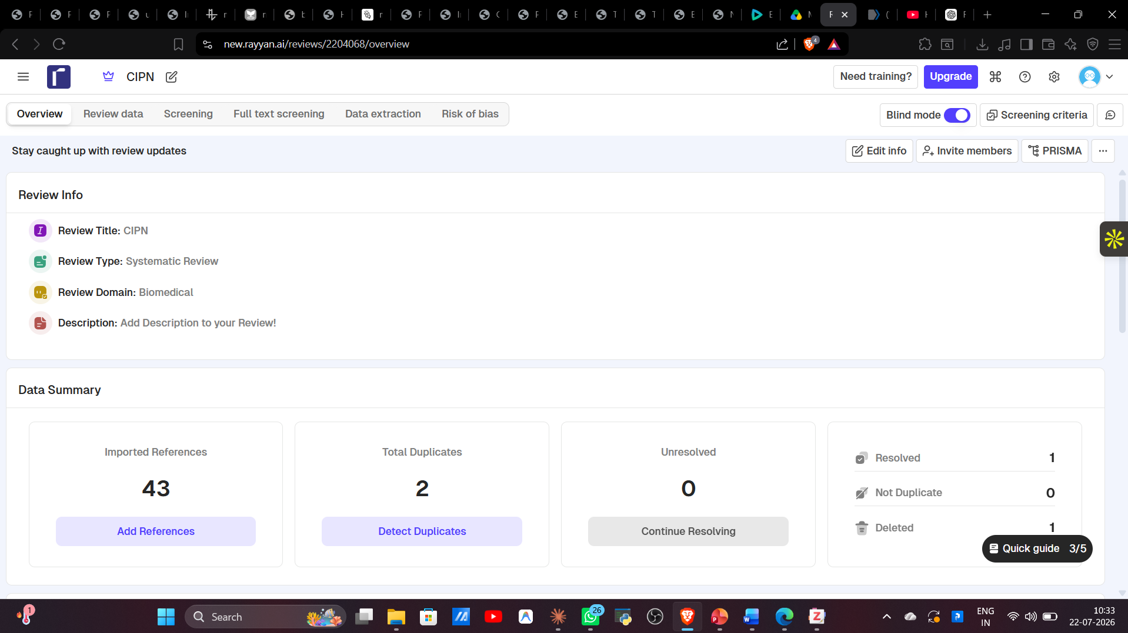
Deduplication

Slide 5
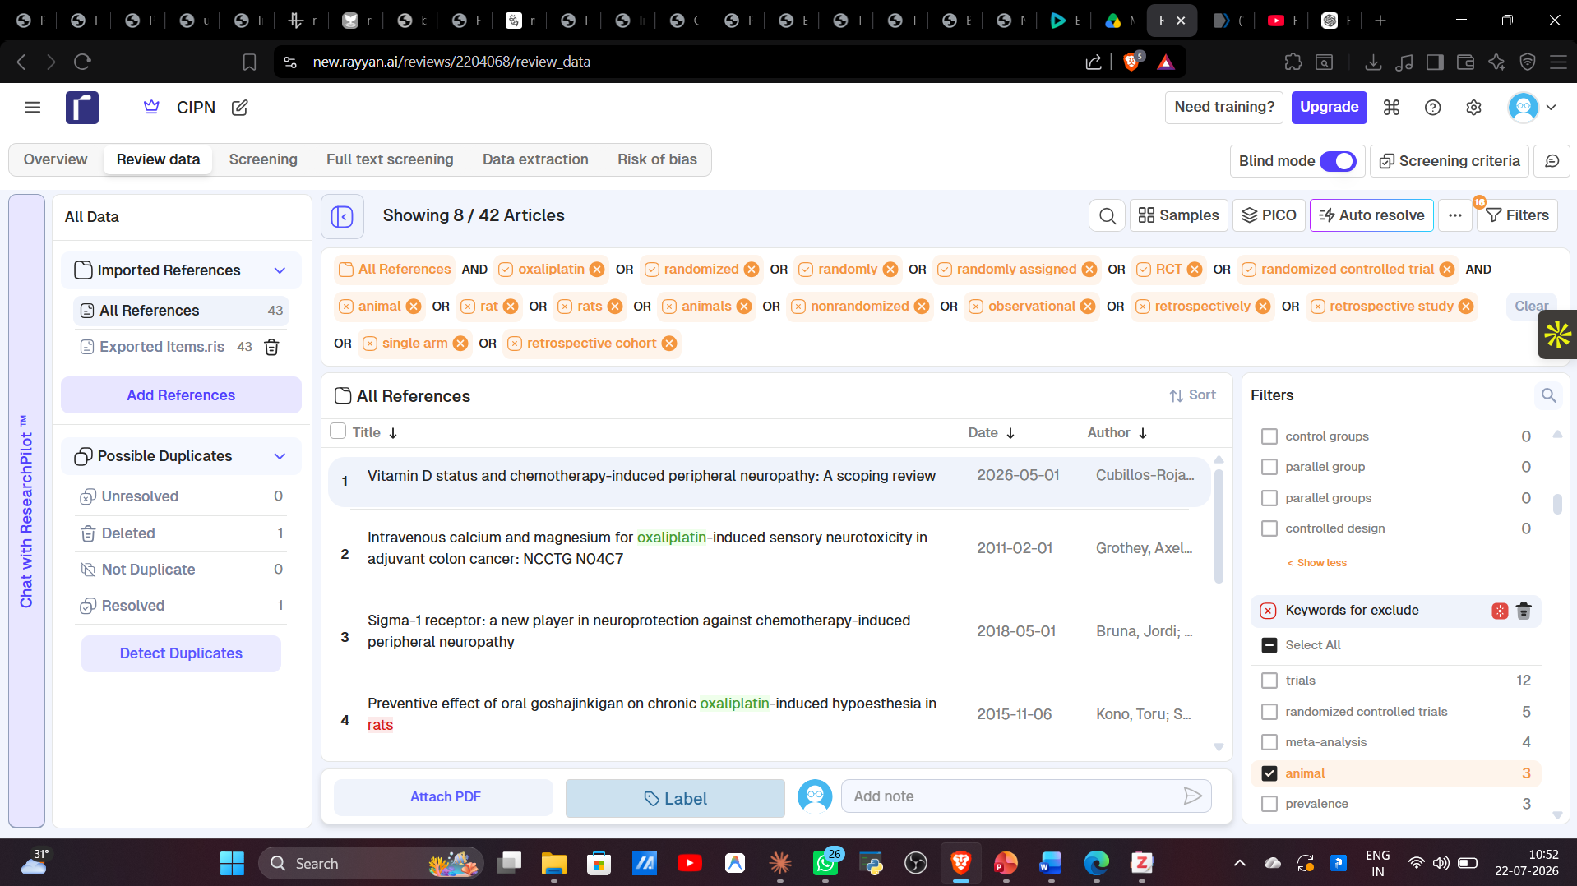
Inclusion and Exclusion Criteria

Slide 6
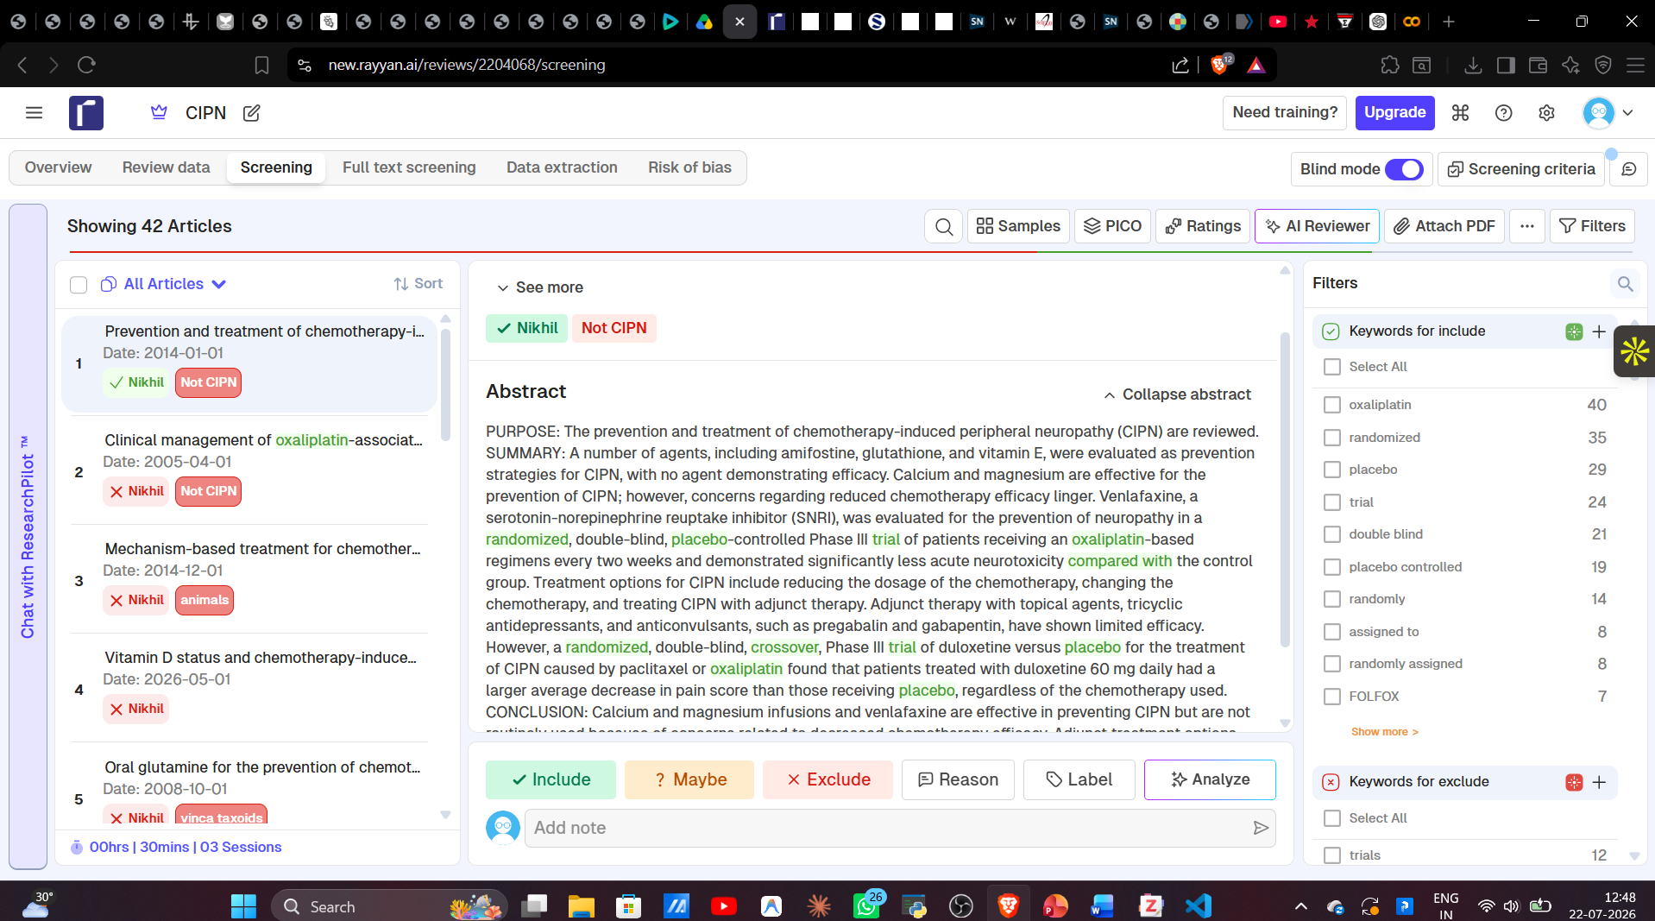
Title & Abstract Screening

Slide 7
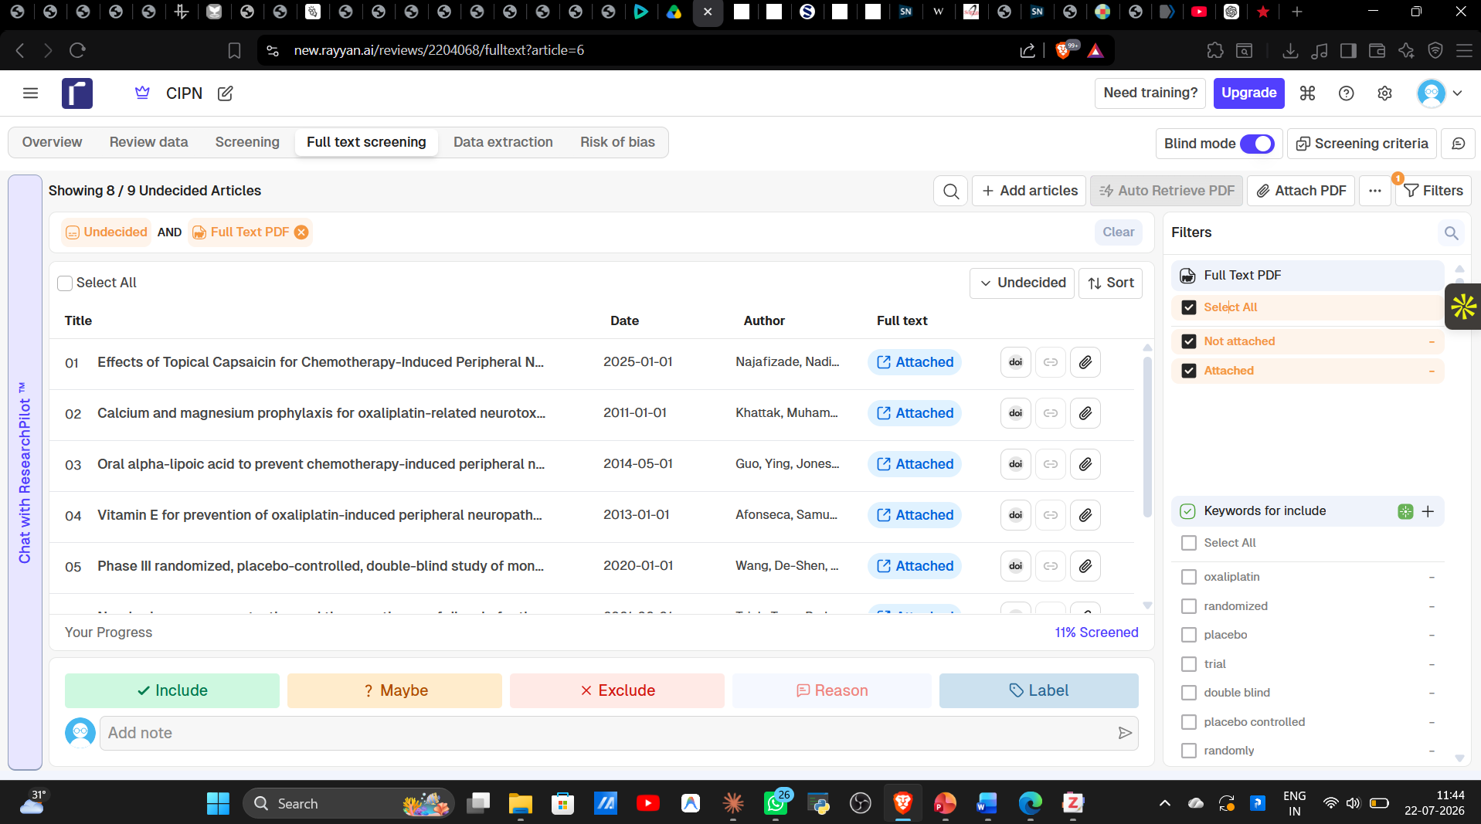
Full Text Screening

Slide 8
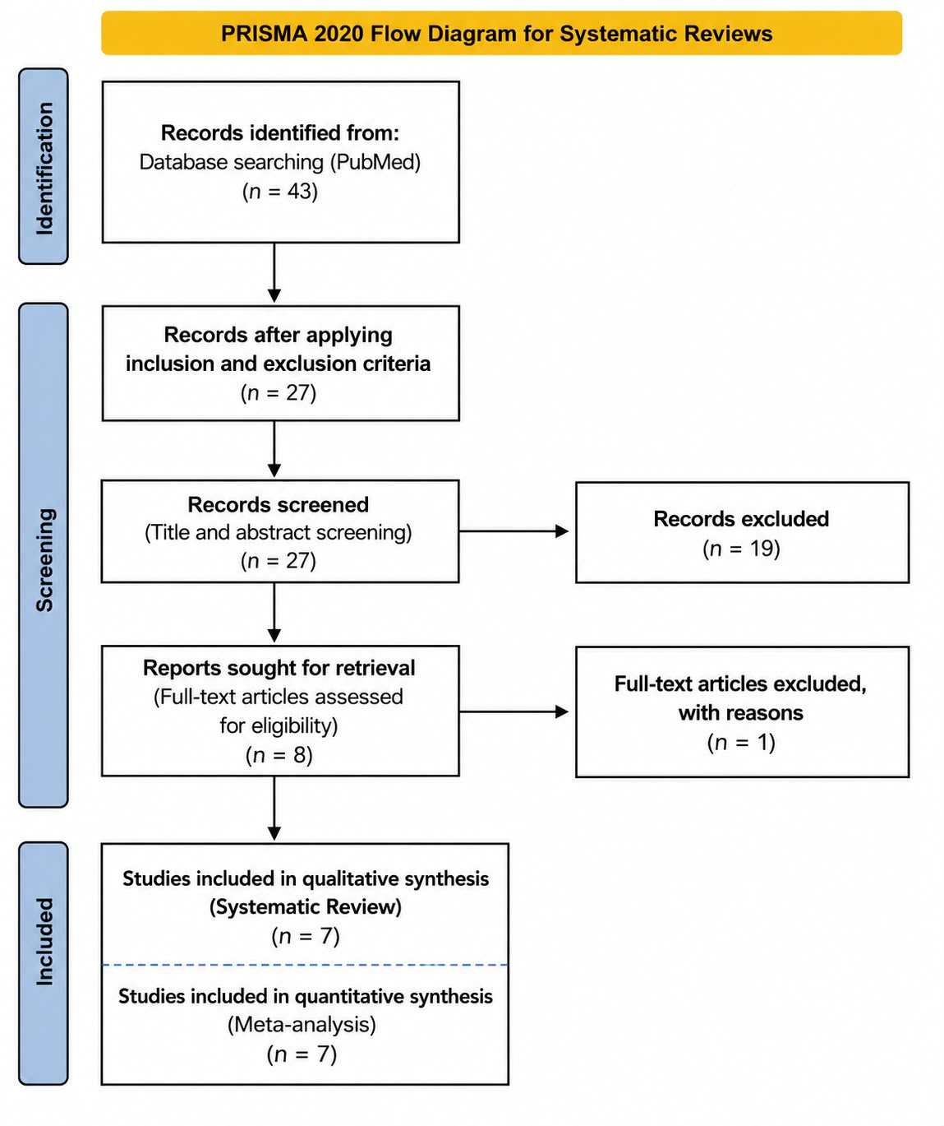
PRISMA FLOW DIAGRAM

Slide 9
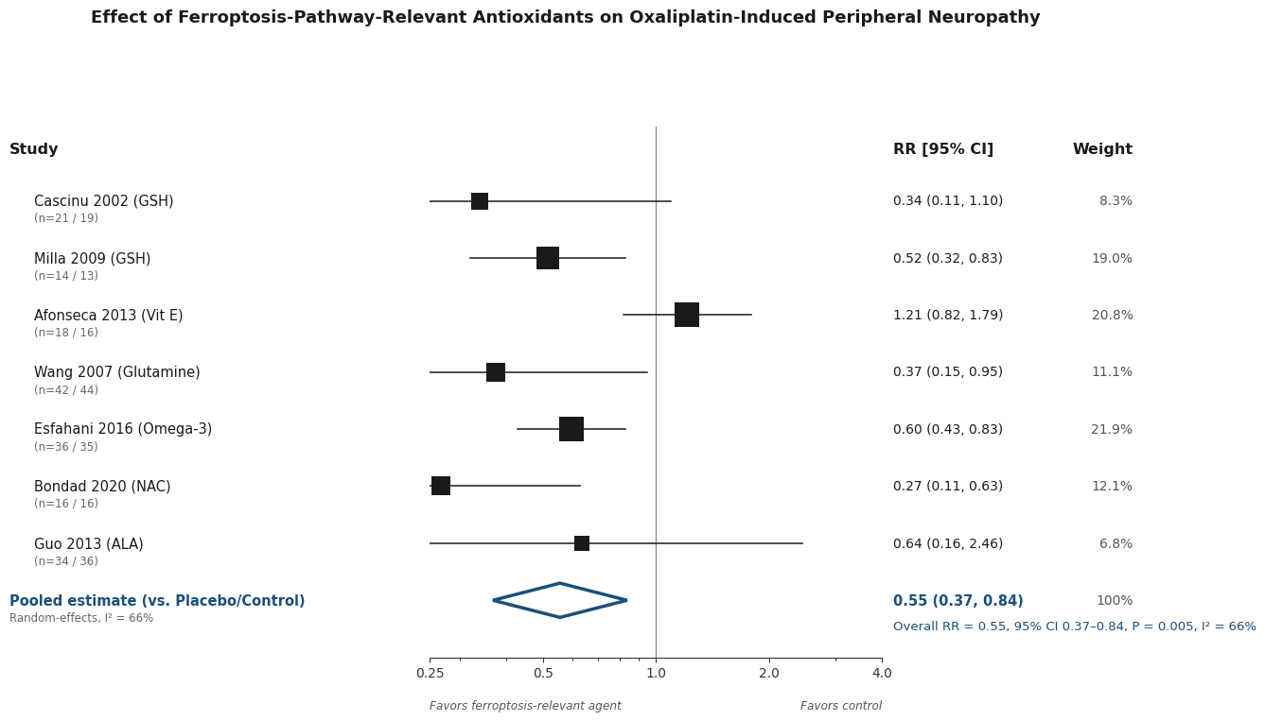


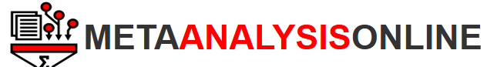
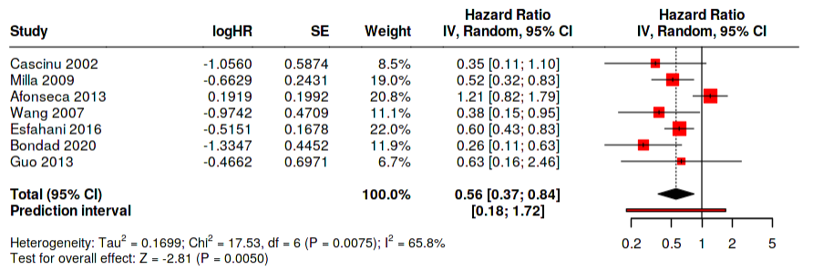
Forrest Plot

Slide 10
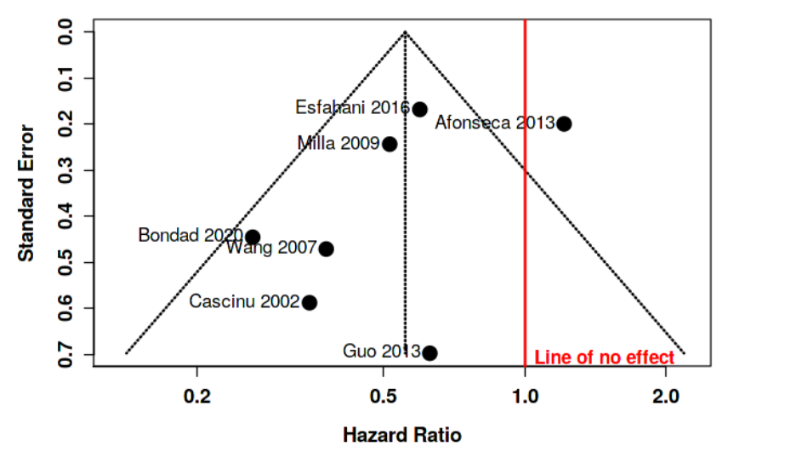
Funnel Plot
Conclusion: The funnel plot does not indicate a potential publication bias. The Egger's test does not support the presence of funnel plot asymmetry (intercept: -1.78, 95% CI:-4.39 - 0.82, t: -1.342, p-value: 0.237).

Slide 11
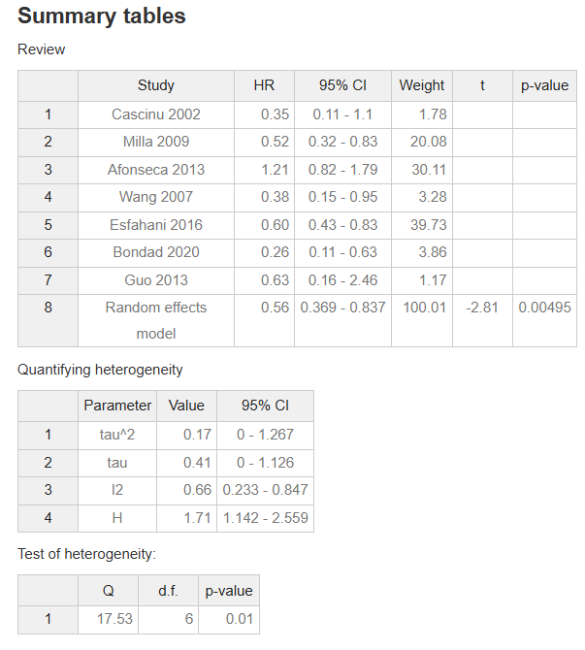
Interpretation
All together 7 studies were analyzed.
Based on the analysis performed using random effects model with inverse variance method to compare the hazard ratio (HR), there is a statistical difference, the summarized hazard ratio (HR) is 0.56 with a 95% confidence interval of 0.37 - 0.84.
The test for overall effect shows a significance at p<0.05.
A significant heterogeneity was detected (p= 0.01), suggesting inconsistent effects in magnitude and/or direction. The I2 value indicates that 66% of the variability among studies arises from heterogeneity rather than random chance.

