Slide 1
Facial recognition using eigenfaces
Nick Kallfa Fitchburg State University
Faculty sponsor: Dr. peter Staab

Slide 2
Intro/What am I doing
The human brain is pretty amazing in its ability to recognize faces
If you were asked to describe a person’s face in detail, what types of things would you say?
The mathematics behind my project ignores features we, as humans, would tend to focus on (eyes, ears, nose, mouth etc…)
The idea is to extract the meaningful information from an original set of images and encode it in a set of “ghostly” images that are called eigenfaces

Slide 3
The problem
Facial recognition
I would ultimately like to identify an unknown individual’s face by comparing it to the known faces that are in my set
Why is this useful?
Crime prevention/criminal investigations
Airport security (SmartGate in AU and NZ)
Social Media (Facebook, recent IPhone + Android apps)
Advertisements/Marketing

Slide 4
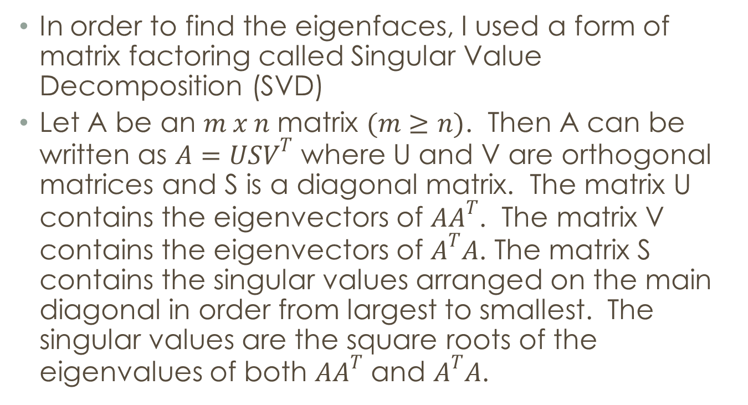
Singular Value Decomposition
In order to find the eigenfaces, I used a form of matrix factoring called Singular Value Decomposition (SVD)
Let A be an $m x n$ matrix $(m≥n)$. Then A can be written as $A=USV^{T}$ where U and V are orthogonal matrices and S is a diagonal matrix. The matrix U contains the eigenvectors of $AA^{T}$. The matrix V contains the eigenvectors of $A^{T}A$. The matrix S contains the singular values arranged on the main diagonal in order from largest to smallest. The singular values are the square roots of the eigenvalues of both $AA^{T}$ and $A^{T}A$.

Slide 5
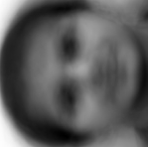
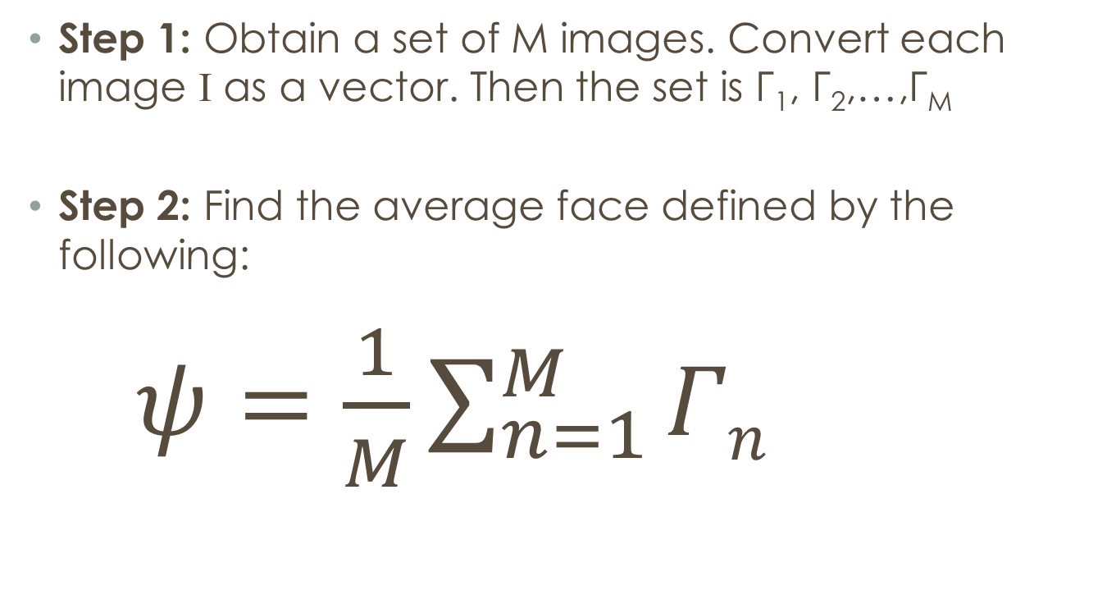
How?
Step 1: Obtain a set of M images. Convert each image I as a vector. Then the set is Γ₁, Γ₂,…,Γ_{M}
Step 2: Find the average face defined by the following:
$ψ=\frac{1}{M}\sum_{n=1}^{M}{Γn}$

Slide 6
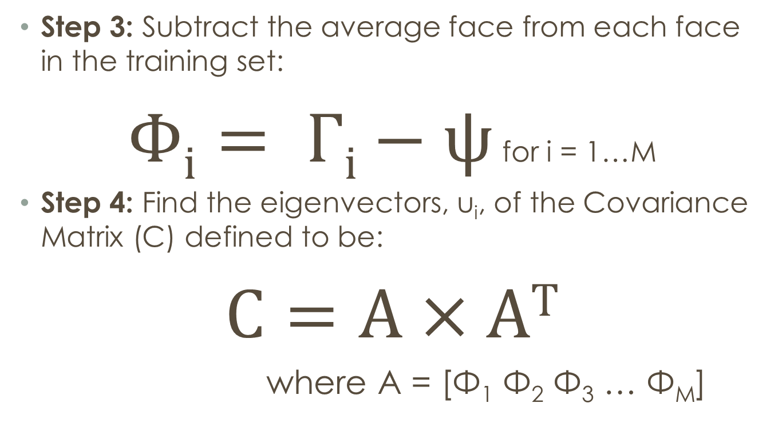
How ctd…
Step 3: Subtract the average face from each face in the training set:
$Φi= Γi−ψ$ for i = 1…M
Step 4: Find the eigenvectors, u_{i}, of the Covariance Matrix (C) defined to be:
$C=A×A$^{T}
where A = [Φ₁ Φ₂ Φ₃ … Φ_{M}]

Slide 7
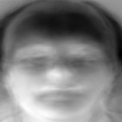
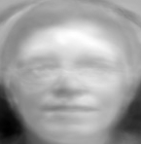
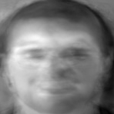
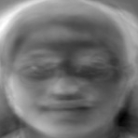
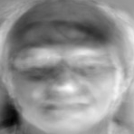
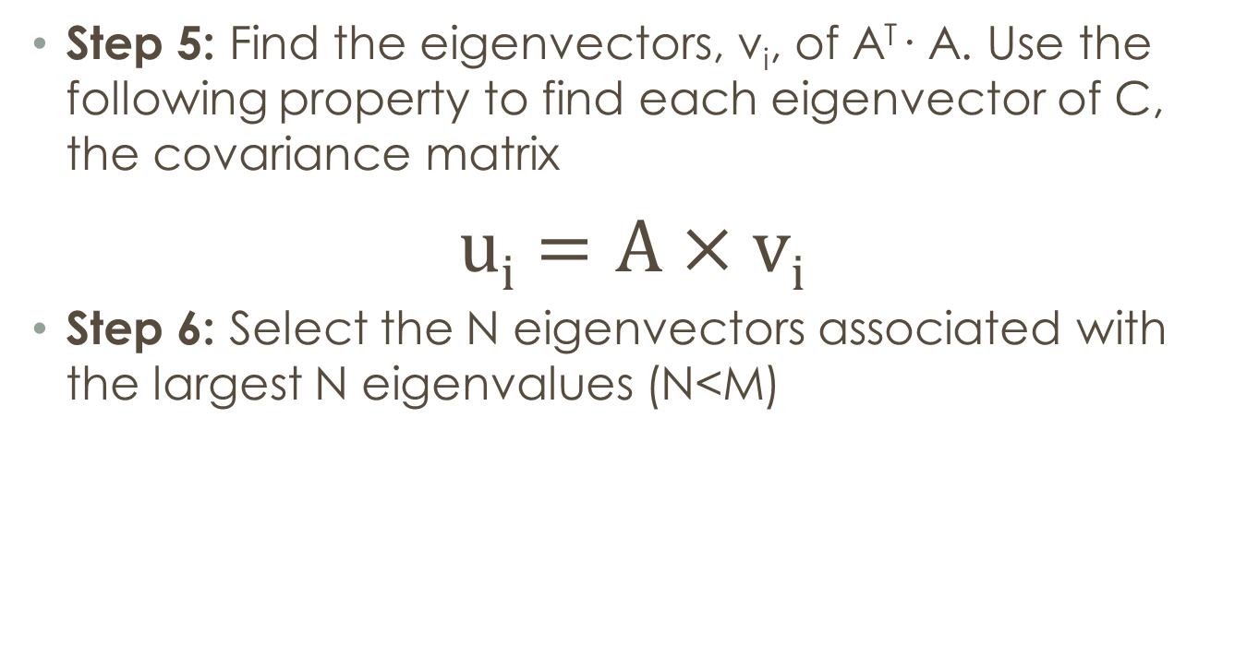
How ctd…
Step 5: Find the eigenvectors, v_{i}, of A^{T}· A. Use the following property to find each eigenvector of C, the covariance matrix
$ui=A×v$_{i}
Step 6: Select the N eigenvectors associated with the largest N eigenvalues (N<M)

Slide 8
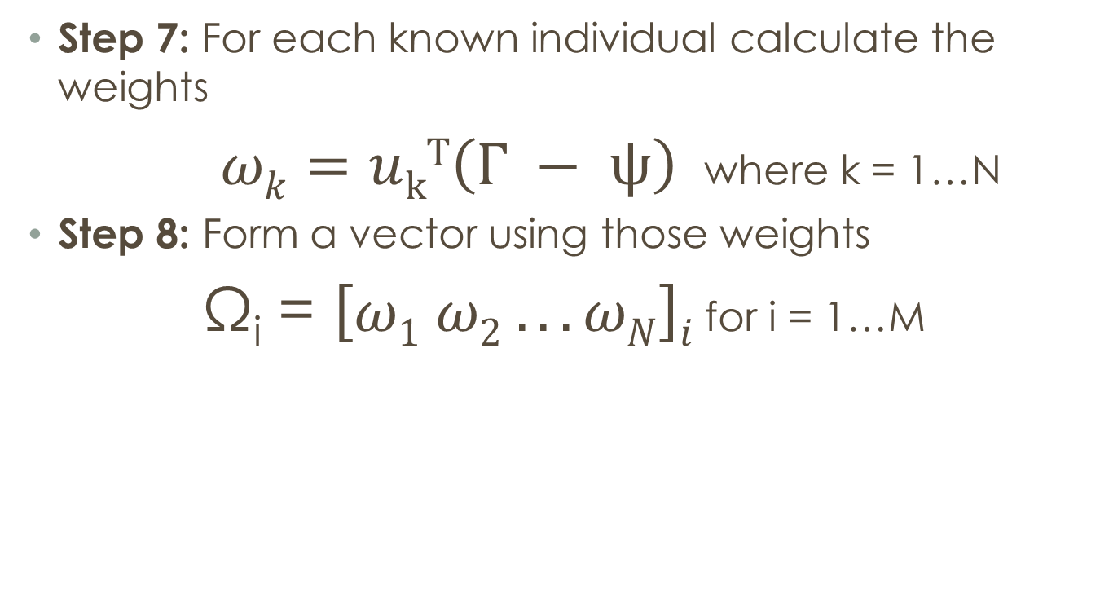
How ctd…
Step 7: For each known individual calculate the weights
$ωk=u$_{k}^{T}$\left(Γ − ψ\right)$ where k = 1…N
Step 8: Form a vector using those weights
Ω_{i} = $\left[ω1 ω2 . . . ωN\right]i$ for i = 1…M

Slide 9
How ctd…
Step 9: Calculate the class vector, Ω_{k}, by averaging all four of the weight vectors for each known individual

Slide 10
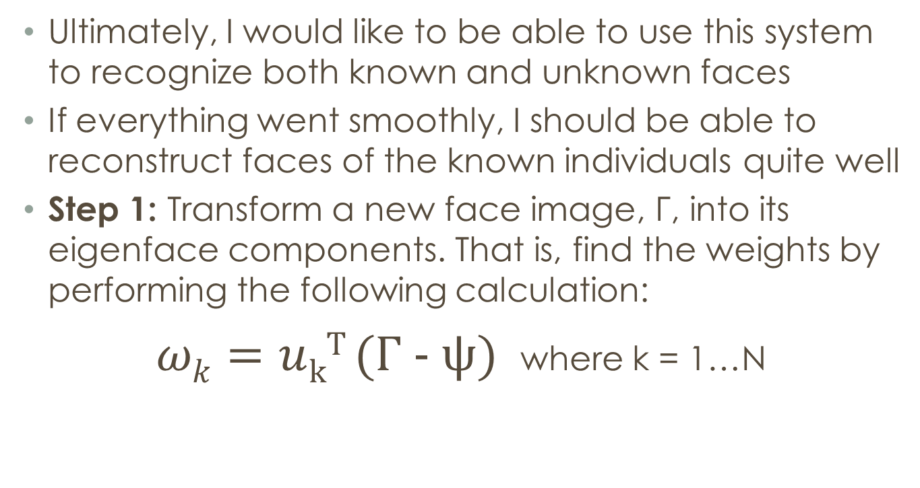
Recognition
Ultimately, I would like to be able to use this system to recognize both known and unknown faces
If everything went smoothly, I should be able to reconstruct faces of the known individuals quite well
Step 1: Transform a new face image, Γ, into its eigenface components. That is, find the weights by performing the following calculation:
$ωk=u$_{k}^{T} (Γ - ψ) where k = 1…N

Slide 11
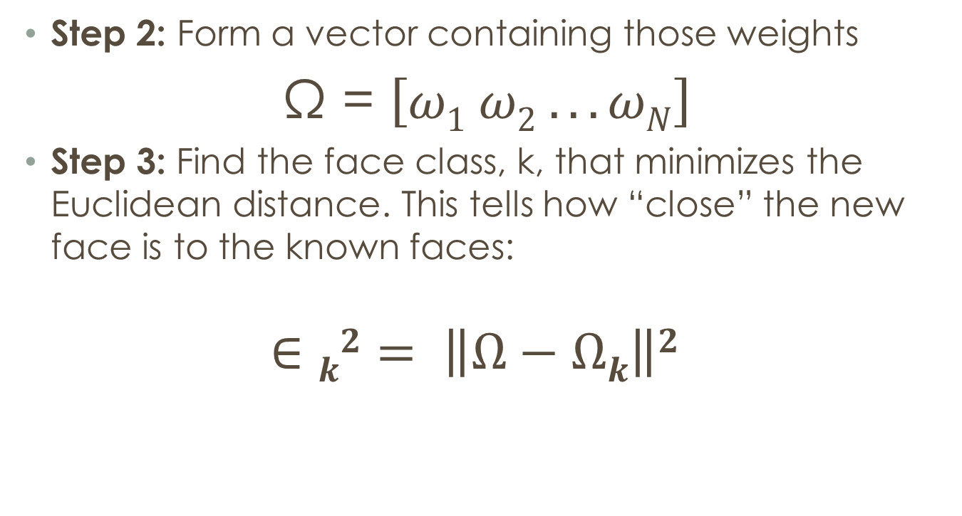
Recognition ctd…
Step 2: Form a vector containing those weights
Ω = $\left[ω1 ω2 . . . ωN\right]$
Step 3: Find the face class, k, that minimizes the Euclidean distance. This tells how “close” the new face is to the known faces:
$$∈k2= \left\|Ω−Ωk\right\|2$$

Slide 12
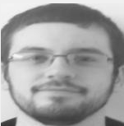
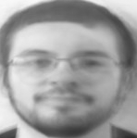
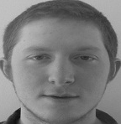
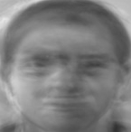
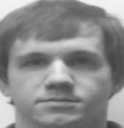
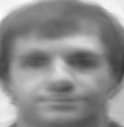
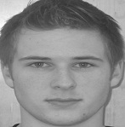
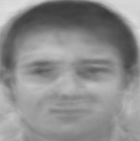

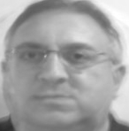
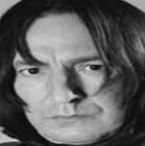
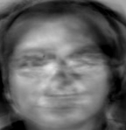
Reconstruction

Slide 13
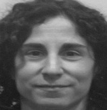
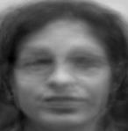

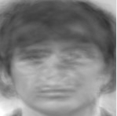

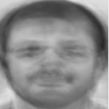
Identification
Belonged to the 21st face class and she was the 21st individual in my original set of images
Belonged to the 9th face class and he was the 9th individual in my original set of images
Belonged to the 17th face class and he was the 10th individual in my original set of images

Slide 14
Problems
Some things that could be done to improve my results:
Lighting
Orientation
Glasses
Smiling
Background
Centered
Photo Quality
# of images
Difficult to line up all the faces (eyes/mouth/ears etc… in same position)

Slide 15
References
Turk, Matthew and Pentland, Alex. (1991) Eigenfaces For Recognition. Journal of Cognitive Neuroscience Vol. 3, Num. 1
Trivedi, Shubhendu. Face Recognition Using Eigenfaces and Distance Classifiers: A Tutorial. Feb. 11 2009. http://onionesquereality.wordpress.com
Drexel University Eigenface Tutorial

