Slide 1
First Look at Protostars
High Fidelity Modeling of the Youngest Stars with Schooner
John Tobin, Patrick Sheehan
Rajeeb Sharma, Nick Reynolds
Oklahoma Supercomputing Symposium 2019

Slide 2
Collaborators
VANDAM Team:
  John Tobin (PI), Leslie Looney (Illinois), Zhi-Yun Li (Virginia), Claire Chandler (NRAO),Mike Dunham (CfA), Kaitlin Kratter (Arizona), Dominique Segura-Cox (Illinois), Sarah Sadavoy (MPIA), Laura Perez (NRAO), Carl Melis (UCSD), Robert Harris (Illinois), Lukasz Tychoniec (Leiden/AMU-Poland)
HOPS
  E. Furlan, W. J. Fischer, B. Ali, A. M. Stutz, T. Stanke, J. J. Tobin, S. T. Megeath, M. Osorio, L. Hartmann, N. Calvet, C. A. Poteet, J. Booker, P. Manoj, D. M. Watson, and L. Allen

Slide 3
Why Should You Care?
Big Questions
  Where did we come from?
  What else is out there?
  What will happen to us?

Slide 4
Why Should You Care?
Big Questions
  Where did we come from?
  What else is out there?
  What will happen to us?
Our Questions
  Where did we come from?
  What else is out there (locally)?
Notes:
Intro:
In astronom we try to answer some of the big questions.
Outro:
Now how do we answer or probe these questions? I understand not everyone is an astronomer much less focuses on stellar formation so let me give some background.

Slide 5
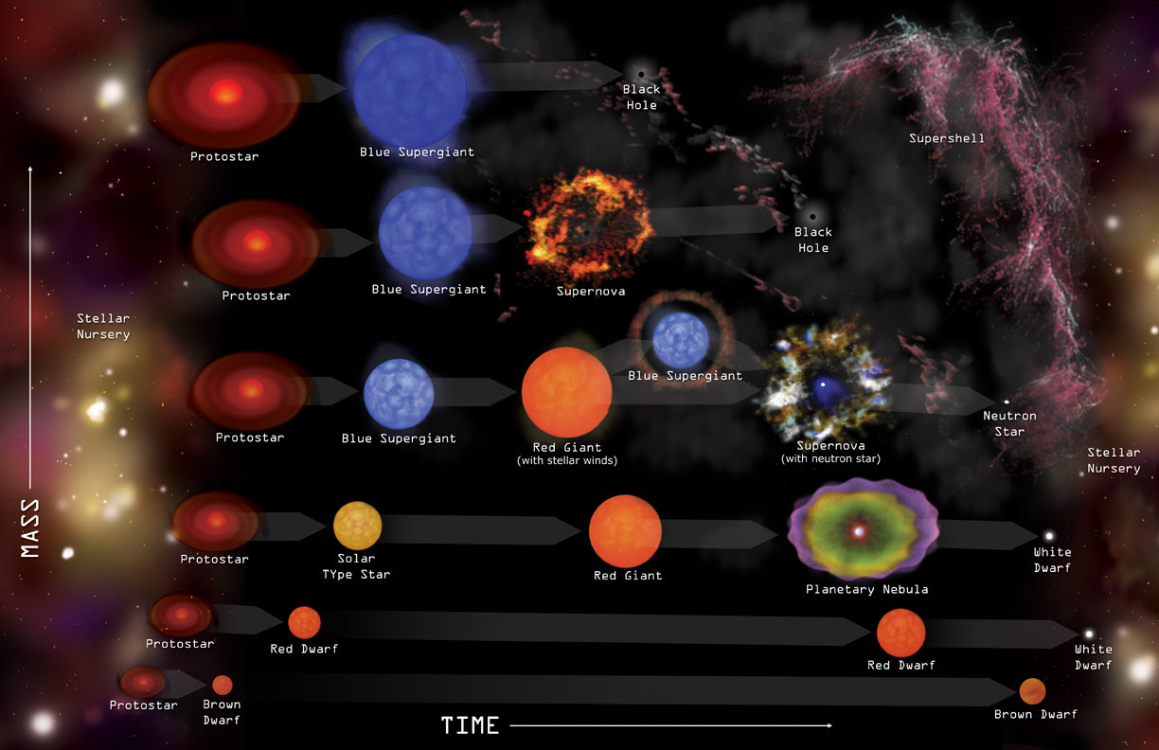

Slide 7
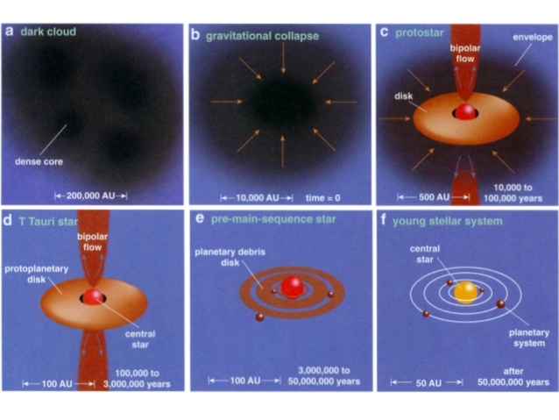

Slide 9
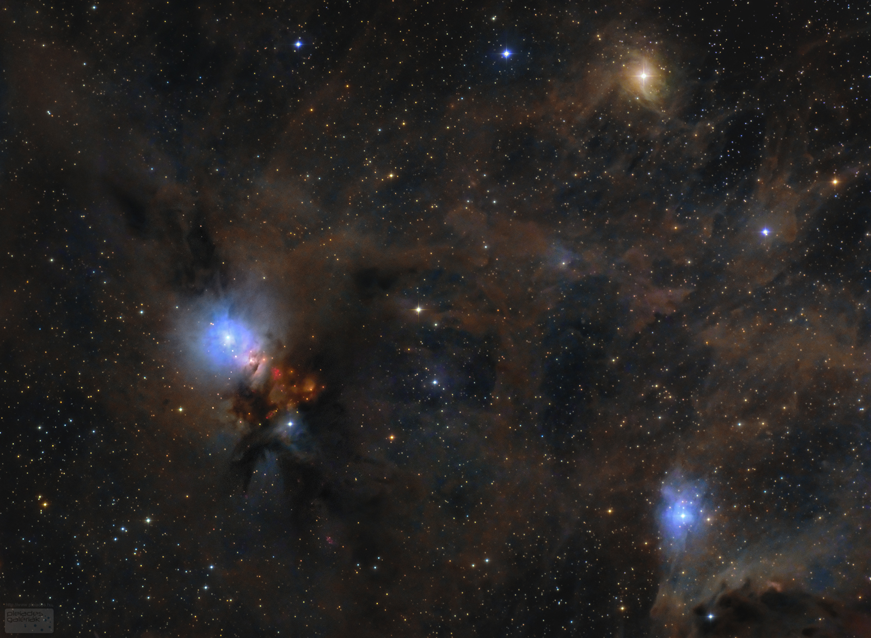
Perseus Molecular Cloud (Optical)

Slide 10
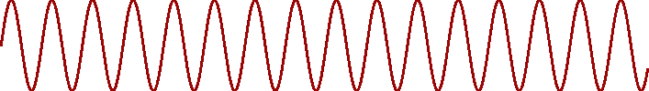
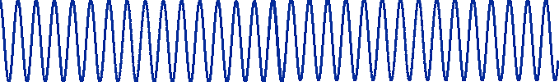
Dust Opacity
DUST

Slide 11
Dust Opacity
DUST
So longer wavelength, better we can “see through” the cloud

Slide 12
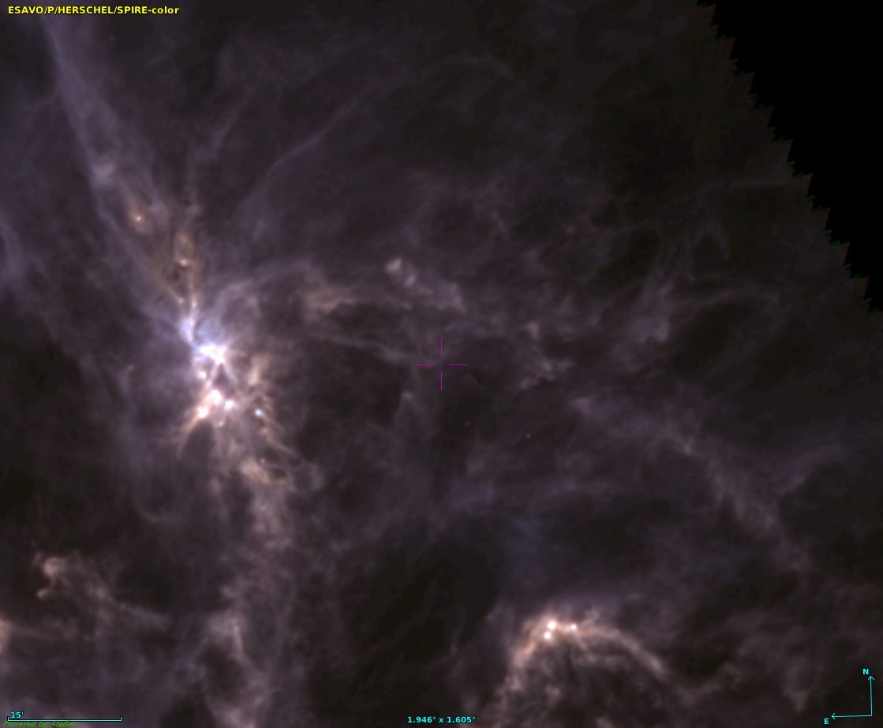
Perseus Molecular Cloud (Infrared)
Notes:
In slide:
So we went from Optical (400nm) to IR (100 micron) ~200x increase in wavelength
What if we go larger? Run into new problem. This one relates to engineering

Slide 13
Perseus Molecular Cloud (Optical)

Slide 14
Great!
We solved our problem of opacity

Slide 15
Not quite...

Slide 16
Resolution
Let’s say we want to resolve something 100pc (326 lyr) away with 10AU resolution and we want to use radio wavelengths (1000 µm), means we need a telescope a mile wide!!!
Unreasonable

Slide 17
Interferometry
Combine smaller telescopes to make an effective large telescope

Slide 18
Interferometry
Combine smaller telescopes to make an effective large telescope
ALMA (Chile)

Slide 19
Interferometry
Combine smaller telescopes to make an effective large telescope
VLA (New Mexico)

Slide 20
Interferometry
Combine smaller telescopes to make an effective large telescope
VLBI (Worldwide, EHT talk from Bouman)

Slide 21
Alright now we solved our problem. Let’s get data!

Slide 22
Data Types
Photometry
Spectroscopy

Slide 23
Data Types
Photometry
Spectroscopy
Tells us about dust:
- amount of material
- geometry
- fine structure
- morphology
Tells us about gas:
- amount of material
- moelcules
- kinematics
- temperature

Slide 24
Science Summary
We went from optical...

Slide 25
Science Summary
We went from optical to IR...

Slide 26
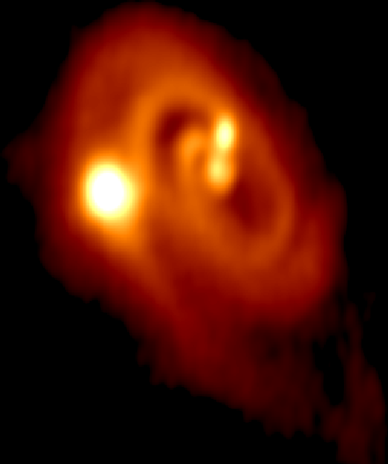
Science Summary
We went from optical to radio...

Slide 27
Science Summary
We went from optical to radio
Can now study properties of these systems individually and in bulk
We have information about dust and gas

Slide 28
Computation
We now have 20-40 parameters that are tightly correlated to fit
End goal: what are the parameters that “best” describe the system?
Estimate
parameters
Generate Model
Compute some “best fit”
Or Χ²
Rinse and Repeat
Sounds perfect for parallelization and Bayesian Statistics

Slide 29
Incoming MCMC methods (emcee) and openMPI

Slide 30
PDSPY Scalability

Slide 31
What’s the Catch?
Numerical Convergence of the individual models (can take up to 10 minutes)
Statistical convergence of the parameters or “walkers” (usually about 2000 timesteps)
Both of these take time: we are generating a robust model of a protostar and its disk, generating a suite of models (200-ish) to explore phase space, and allowing these models or “walkers” to converge (usually about 2000 timesteps)

Slide 32
What’s the Catch?
Numerical Convergence of the individual models (can take up to 10 minutes)
Statistical convergence of the parameters or “walkers” (usually about 2000 timesteps)
Both of these take time: we are generating a robust model of a protostar and its disk, generating a suite of models (200-ish) to explore phase space, and allowing these models or “walkers” to converge (usually about 2000 timesteps)
200 * 2000 * 10 minutes ≈ 60k hours!

Slide 33
Computing Specifics
Our personal systems: 2 x 28 physical core CPUs
That 60k hours is now ~ 1200 hours per source
  Better…. But we have ~100 sources and each one can be modelled multiple times (remember those molecules?)

Slide 34
Schooner
The supercomputer drastically changes the game for us
Typical requests:
  5-15 nodes (100 – 300 cores)
  Full allowed time (48 hours)
  15-5 separate runs (sometimes more or less depending on degeneracy)
CPU core performance focus (not GPU ready)

Slide 35
What do we get?

Slide 36
What do we get?

Slide 37
What are we answering?
How/when/where do stellar multiples form?
How/when/where do planets form?
When does chemical enrichment happen?
In answering these statistically, we can also ask, are we unique?

Slide 38
Impacts
We want to do this in a statistically robust and relatively unbiased way
This means more and larger observational surveys
More models
And a lot more collaborations!!!

Slide 39
Impacts
We want to do this in a statistically robust and relatively unbiased way
This means more and larger observational surveys
More models
And a lot more supercomputing time!!!
The group at OU is one of the forerunners in this field and are a part of global collaborations

