Slide 1
Introduction to Python
Nickalas Reynolds
The University of Oklahoma
REU Lecture 2018

Slide 2
Outline
Introduction
Fundamentals
Functions
Classes
Files
External Libraries
Packaging

Slide 3
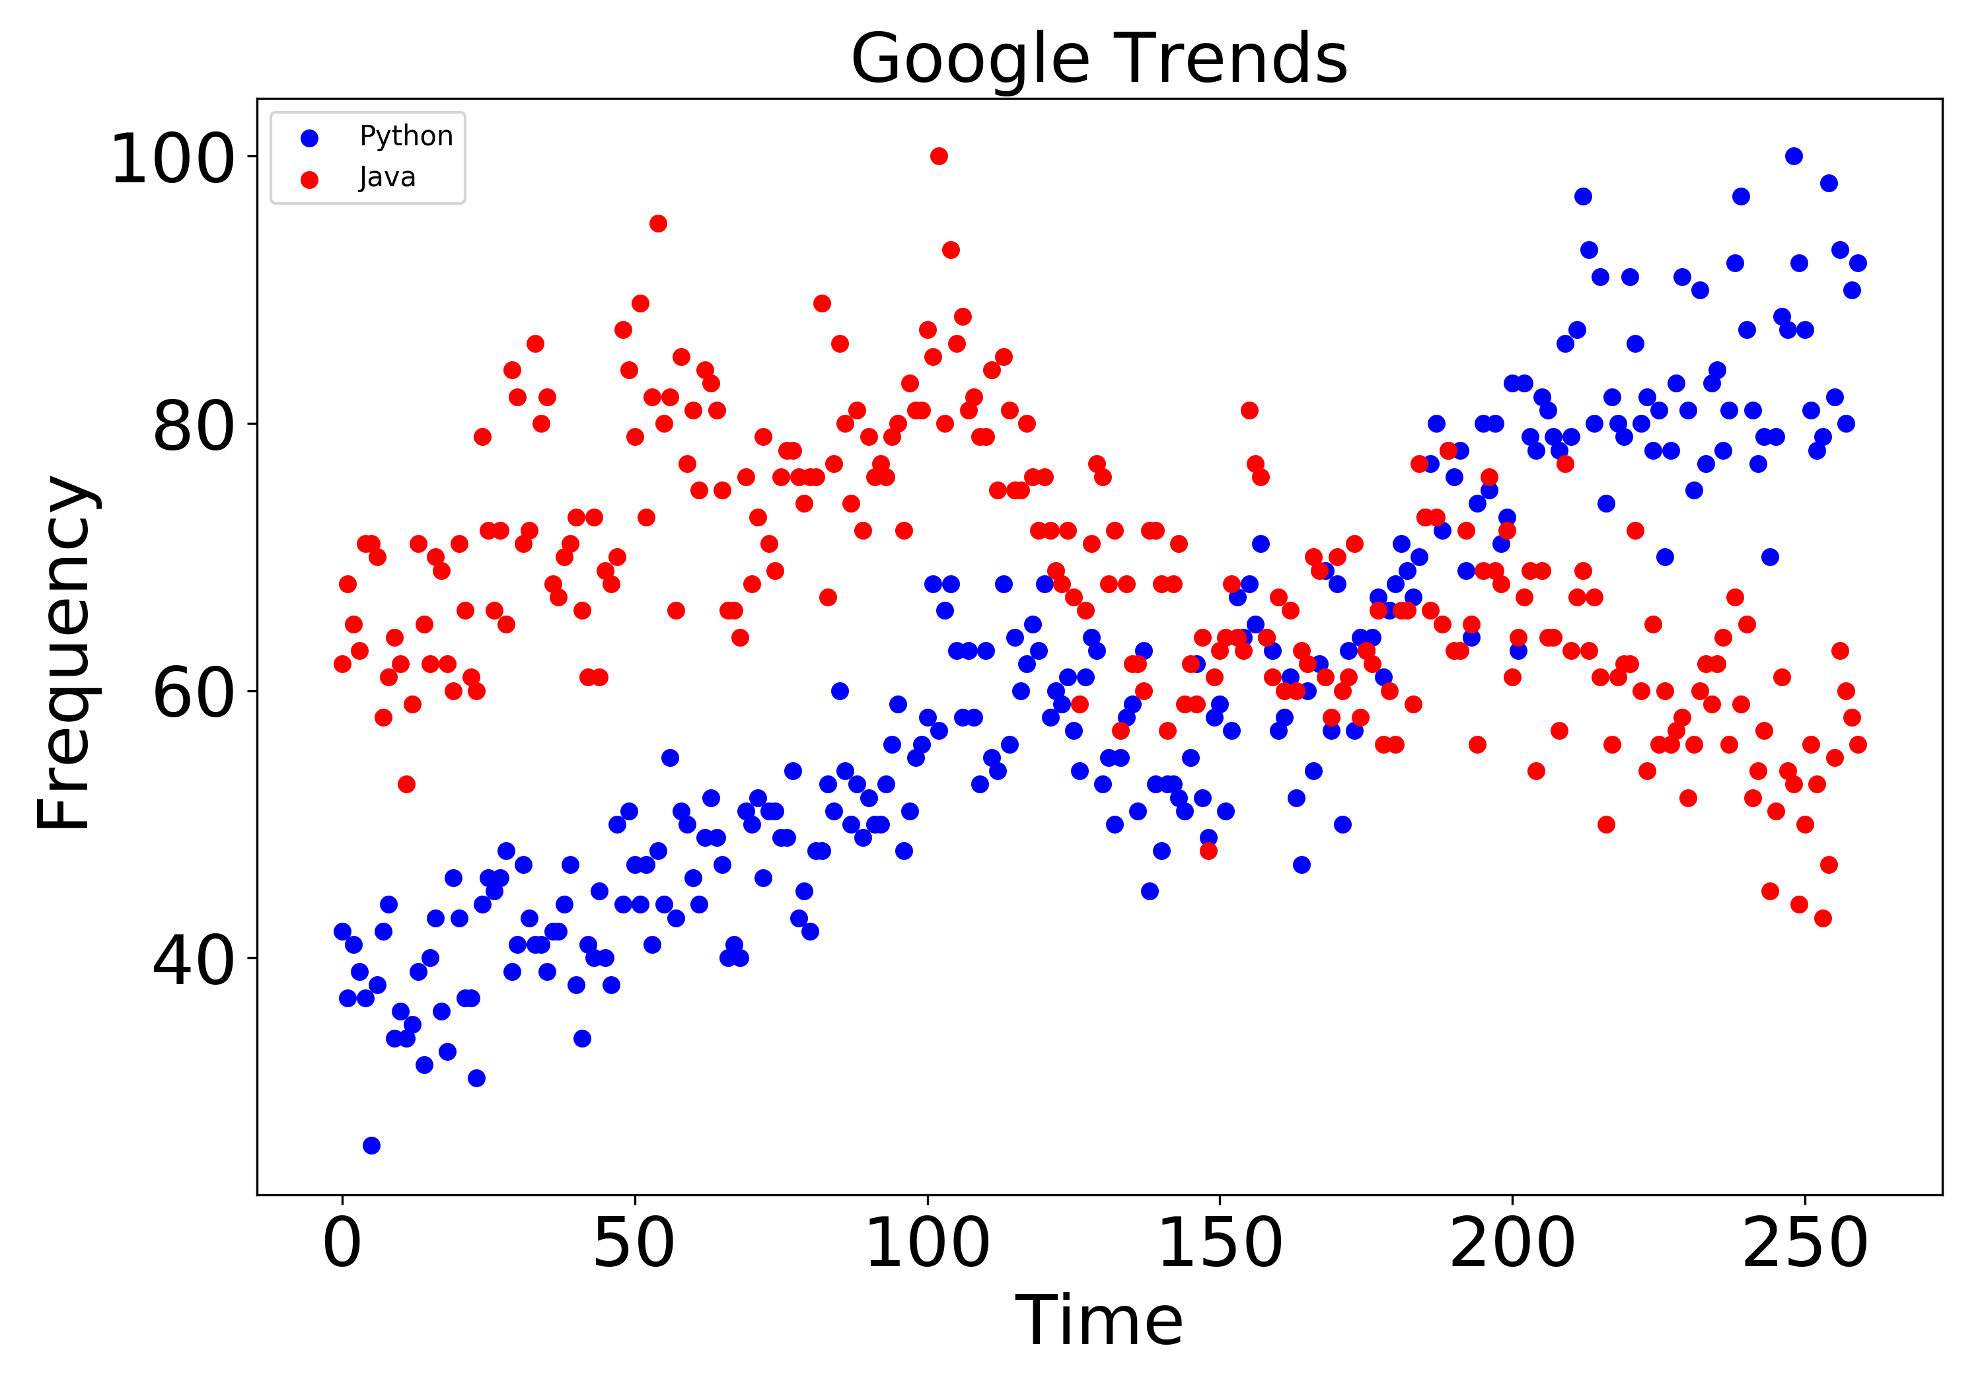
Python
‘’[Python] is a high-level, dynamically typed, object-oriented, interpreted programming language.’’ -Wiki
It has many uses in web programming, scripting, scientific computing, and ariticial intelligence.
It is growing in popularity every year (especially in STEM).

Slide 4
Pros/Cons
Pros
Cons
Readability
Object Oriented
Multiparadigm
Huge Community
Libraries usually online
Great at scripting
GUIs
Memory Management
Compiled at runtime
Backwards Compatibility
I am switching to Jupyter notebook after this but the slides are in html format so you can open with any browser

