Slide 1


Version Control
Git
Github
Nick Reynolds

Slide 2
Goal
Introduce version control and git and walk through the mechanics of
using it. Hopefully you walk away with a confidence to start using it and
learn on your own.

Slide 3
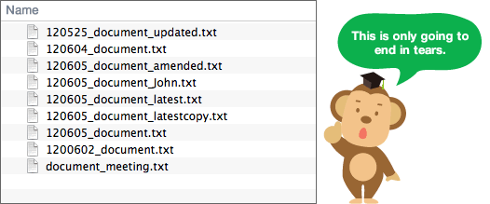
Motivation
Imagine you are writing a paper and you delete a
section during edits. The next day you decide you
want to keep that section, but you saved over the old
version! Maybe you decide to save a unique file for
every iteration... (edit1.pdf,edit2.pdf...)
Maybe you add a line of code to your programming project and now it breaks at runtime. If you can’t find that new line again you are left to sift through your code...

Slide 4
What is Version Control?
‘[VC] is the management of changes to documents, computer programs, large web sites, and other collections of information.’ -Wiki
[VC] allows you to:
- record iterations without saving them separately
- navigate these iterations and restore them if needed
In short: maintain a SINGLE set of files while tracking what
changes have occurred

Slide 5
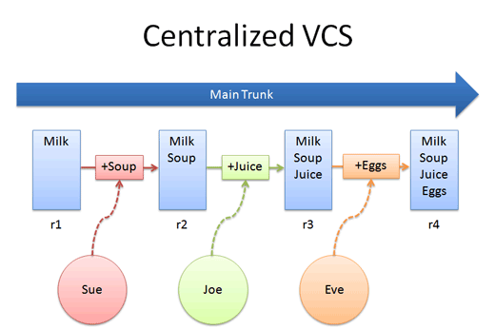

Slide 6
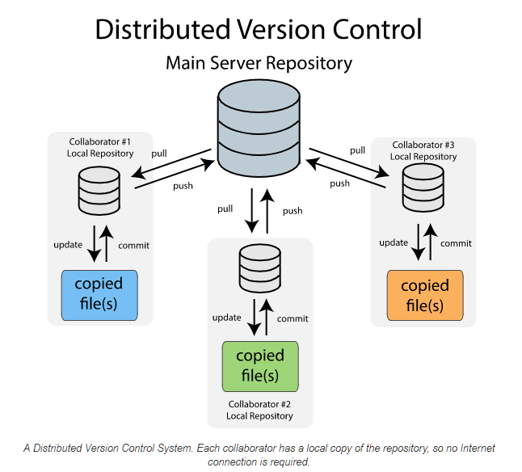

Slide 7

Git vs Github vs GitLab
Git is a popular distributed version control system created in 2005 by Linus Torvalds in response to the DVCS used for the development of the Linux kernel becoming a paid service.
Git has many nice features in addition to the ones that come from being DVCS (offline work, it is ‘small’, etc.)
GitHub is a web service that hosts Git repositories. It is best known for its website and is in many ways a social platform.
GitLab is similar to GitHub, however GitHub has focused more on a social aspect versus GitLab which is aimed towards enterprise (this is changing)

Slide 8
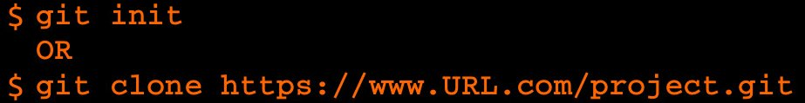
Starting with Git
Installation:
Chances are you already have it installed!
Otherwise, consult the official website:
<https://git-scm.com/book/en/v2/Getting-Started-Installing-Git>
Configure User
Create repository
Try cloning this repository <github.com/nickalaskreynolds/REU.git>

Slide 9
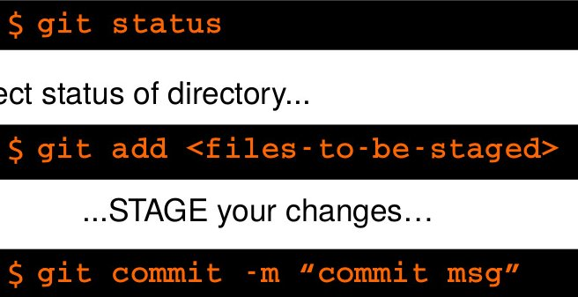

Functional Git
An understanding of how Git operates is needed. The history of changes in a repository come in the form of commits. Changes must be staged before they can be committed.
CHECK CHANGES...
...STAGE...
... and COMMIT them

Slide 10
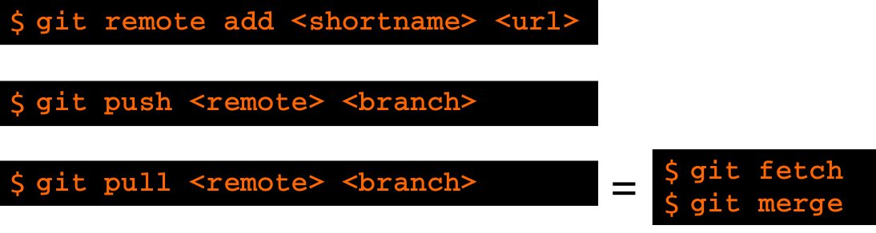
Remote Repositories
These are commands related to communicating with remote repositories.
=

Slide 11
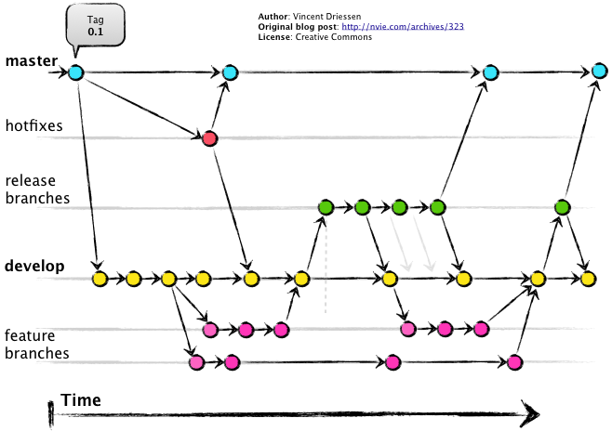

Slide 12
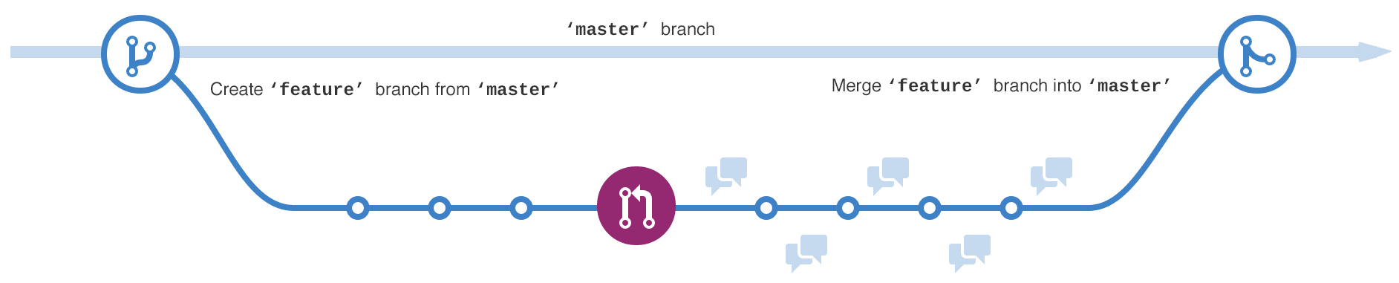
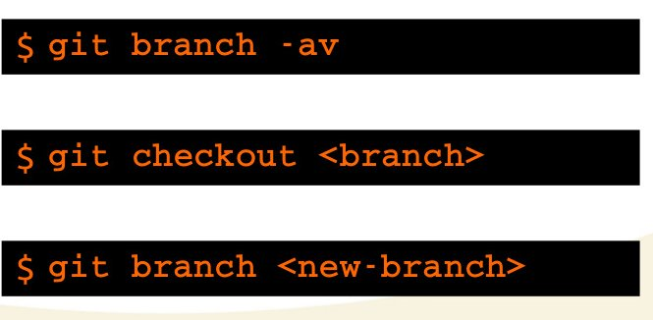
Branches
List all branches
Switch HEAD
Create new Branch from HEAD

Slide 14
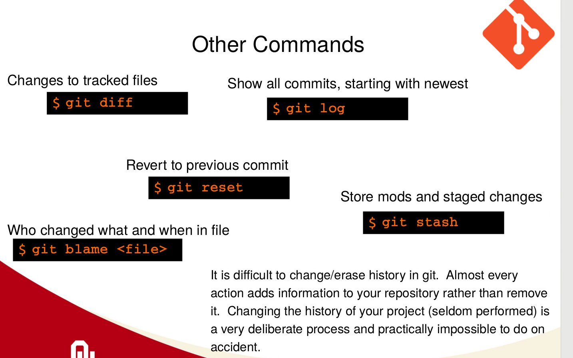
Other Commands
Differences of files
Show all commits, starting with newest
Who dun it?
Revert Changes
Store changes temporarily

Slide 15


