Slide 1
Chapter 6: Looping

Slide 2
Objectives
Learn about the loop structure
Create while loops
Use shortcut arithmetic operators
Create for loops
Create do…while loops
Nest loops
Improve loop performance
Java Programming, Eighth Edition

Slide 3
Learning About the Loop Structure
Loop
  A structure that allows repeated execution of a block of statements
Loop body
  A block of statements
  Executed repeatedly
Iteration
  One execution of any loop
Java Programming, Eighth Edition

Slide 4
Learning About the Loop Structure (cont’d.)
Three types of loops
  while
    The loop-controlling Boolean expression is the first statement
  for
    A concise format in which to execute loops
  do…while
    The loop-controlling Boolean expression is the last statement
Java Programming, Eighth Edition

Slide 5
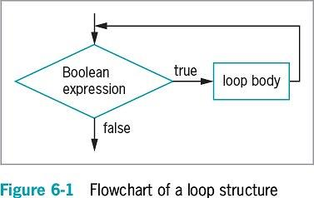
Learning About the Loop Structure (cont’d.)
Java Programming, Eighth Edition

Slide 6
Creating while Loops
while loop
  Executes a body of statements continually
    As long as the Boolean expression that controls entry into the loop continues to be true
  Consists of:
    The keyword while
    Followed by a Boolean expression within parentheses
    Followed by the body of the loop; can be a single statement or a block of statements surrounded by curly braces
Java Programming, Eighth Edition

Slide 7
Writing a Definite while Loop
Definite loop
  Performs a task a predetermined number of times
  Also called a counted loop
Write a definite loop
  Initialize the loop control variable
    The variable whose value determines whether loop execution continues
  While the loop control variable does not pass a limiting value, the program continues to execute the body of the while loop
Java Programming, Eighth Edition

Slide 8
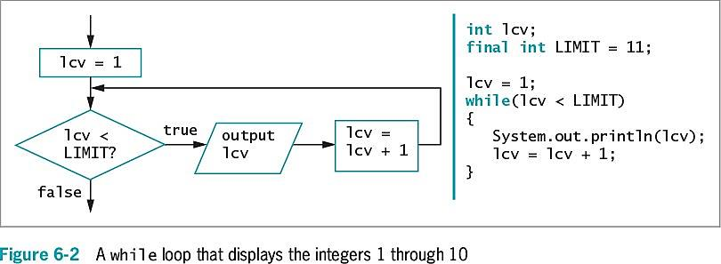
Writing a Definite while Loop (cont’d.)
Java Programming, Eighth Edition

Slide 9
Writing a Definite while Loop (cont’d.)
Write a definite loop (cont’d.)
  The body of the loop must include a statement that alters the loop control variable
Infinite loop
  A loop that never ends
  Can result from a mistake in the while loop
  Do not write intentionally
Java Programming, Eighth Edition

Slide 10
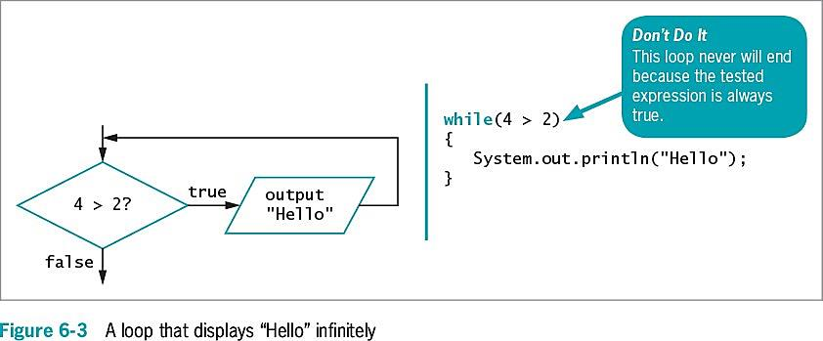
Writing a Definite while Loop (cont’d.)
Java Programming, Eighth Edition

Slide 11
Writing a Definite while Loop (cont’d.)
Suspect an infinite loop when:
  The same output is displayed repeatedly
  The screen remains idle for an extended period of time
To exit an infinite loop, press and hold Ctrl, then press C or Break
Java Programming, Eighth Edition

Slide 12
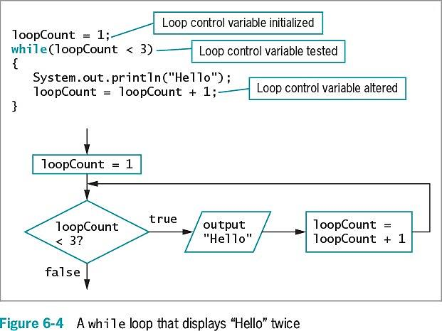
Writing a Definite while Loop (cont’d.)
Java Programming, Eighth Edition

Slide 13
Pitfall: Failing to Alter the Loop Control Variable Within the Loop Body
Prevent the while loop from executing infinitely
  The named loop control variable is initialized to a starting value
  The loop control variable is tested in the while statement
  If the test expression is true, the body of the while statement takes action
    Alters the value of the loop control variable
  The test of the while statement must eventually evaluate to false
Java Programming, Eighth Edition

Slide 14
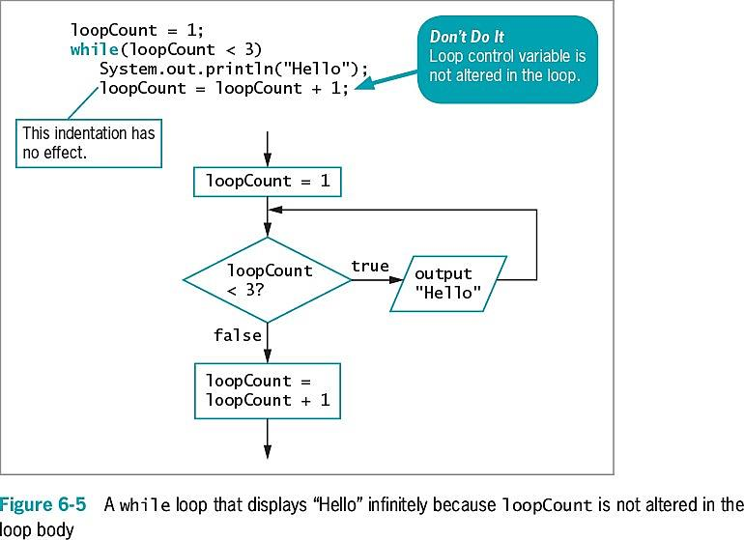
Pitfall: Failing to Alter the Loop Control Variable Within the Loop Body (cont’d.)
Java Programming, Eighth Edition

Slide 15
Pitfall: Unintentionally Creating a Loop with an Empty Body
Loop control variable
  A variable that is altered and stored with a new value
    loopCount = loopCount + 1
    The equal sign assigns a value to the variable on the left
  The variable should be altered within the body of the loop
Empty body
  A body with no statements
  Caused by misplaced semicolons
Java Programming, Eighth Edition

Slide 16
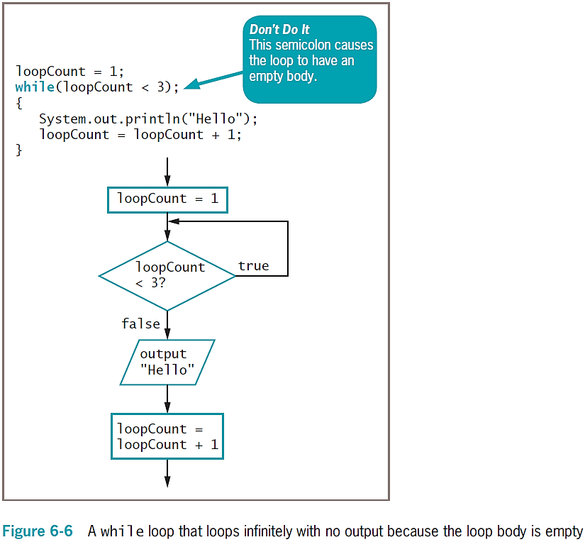
Pitfall: Creating a Loop with an Empty Body (cont’d.)
Java Programming, Eighth Edition

Slide 17
Altering a Definite Loop’s Control Variable
Incrementing the variable
  Alter the value of the loop control variable by adding 1
Decrementing the variable
  Subtract 1 from the loop control variable
Clearest and best method
  Start the loop control variable at 0 or 1
  Increment by 1 each time through the loop
  Stop when the loop control variable reaches the limit
Java Programming, Eighth Edition

Slide 18
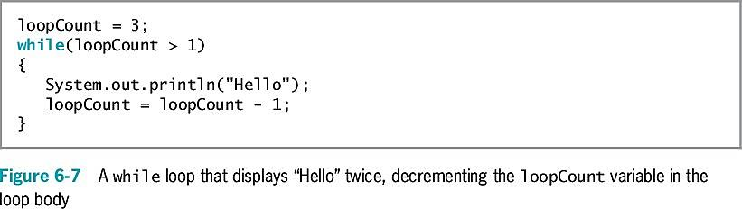
Altering a Definite Loop’s Control Variable (cont’d.)
Java Programming, Eighth Edition

Slide 19
Writing an Indefinite while Loop
Indefinite loop
  Altered by user input
    Controlled by the user
    Executed any number of times
Validating data
  Ensure a value falls within a specified range
  Use indefinite loops to validate input data
  If a user enters incorrect data, the loop repeats
Java Programming, Eighth Edition

Slide 20
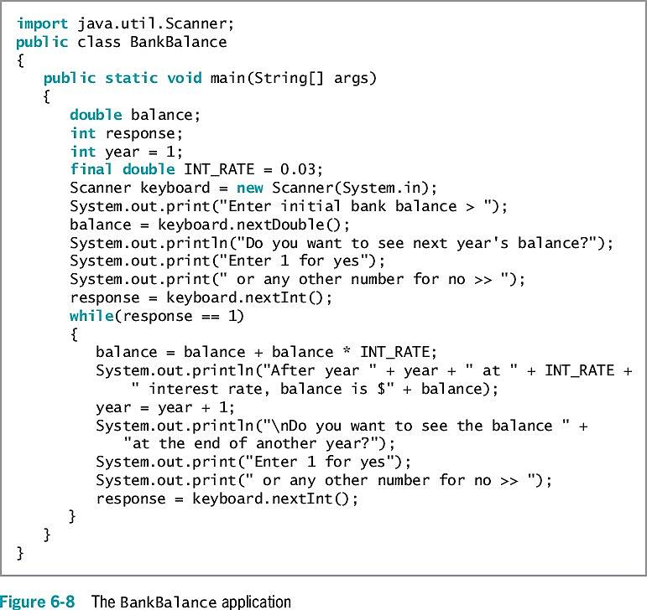
Writing an Indefinite while Loop (cont’d.)
Java Programming, Eighth Edition

Slide 21
Validating Data
Ensuring data falls within a specific range
Priming read
  Input retrieved before the loop is entered
  Within a loop, the last statement retrieves the next input value and checks the value before the next entrance of the loop
Java Programming, Eighth Edition

Slide 22
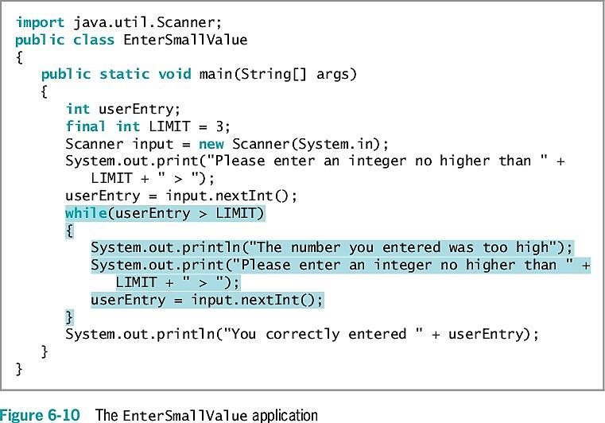
Validating Data (cont’d.)
Java Programming, Eighth Edition

Slide 23
Using Shortcut Arithmetic Operators
Accumulating
  Repeatedly increasing a value by some amount
Java provides shortcuts for incrementing and accumulating
  += add and assign operator
  -= subtract and assign operator
  *= multiply and assign operator
  /= divide and assign operator
  %= remainder and assign operator
Java Programming, Eighth Edition

Slide 24
Using Shortcut Arithmetic Operators (cont’d.)
Prefix increment operator and postfix increment operator
  ++someValue, someValue++
  Use only with variables
  Unary operators
    Use with one value
  Increase a variable’s value by 1
    No difference between operators (unless other operations are in the same expression)
Java Programming, Eighth Edition

Slide 25
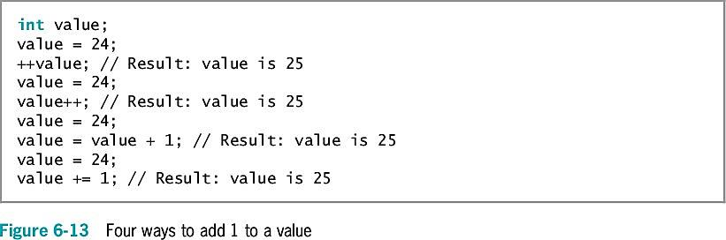
Using Shortcut Arithmetic Operators (cont’d.)
Java Programming, Eighth Edition

Slide 26
Using Shortcut Arithmetic Operators (cont’d.)
Prefix increment operator and postfix increment operator (cont’d.)
  Prefix ++
    The result is calculated and stored
    Then the variable is used
  Postfix ++
    The variable is used
    Then the result is calculated and stored
Prefix and postfix decrement operators
  --someValue
  someValue--
  Similar logic to increment operators
Java Programming, Eighth Edition

Slide 27
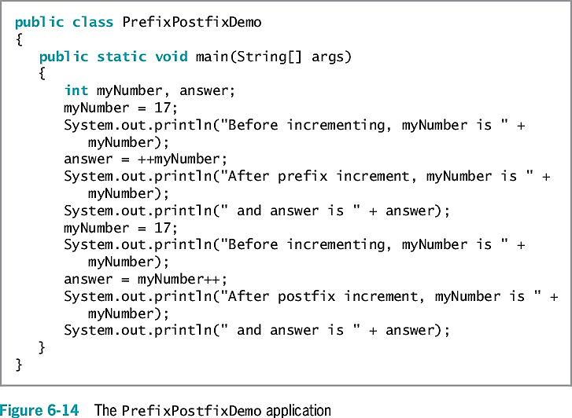
Using Shortcut Arithmetic Operators (cont’d.)
Java Programming, Eighth Edition

Slide 28
Creating a for Loop
for loop
  Used when a definite number of loop iterations is required
  One convenient statement indicates:
    The starting value for the loop control variable
    The test condition that controls loop entry
    The expression that alters the loop control variable
Java Programming, Eighth Edition

Slide 29
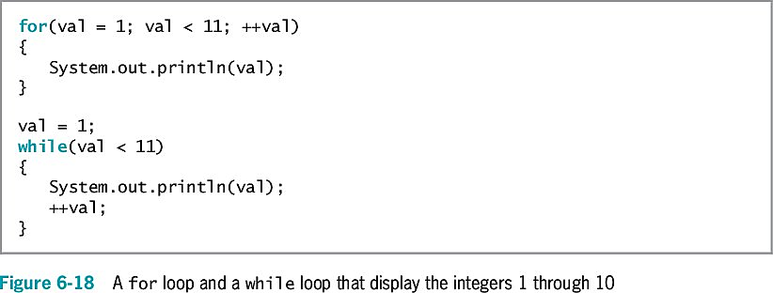
Creating a for Loop (cont’d.)
Java Programming, Eighth Edition

Slide 30
Creating a for Loop (cont’d.)
Other uses for the three sections of a for loop
  Initialization of more than one variable
    Place commas between separate statements
  Performance of more than one test using AND or OR operators
  Decrementing or performance of some other task
  Altering more than one value
You can leave one or more portions of a for loop empty
    Two semicolons are still required as placeholders
Java Programming, Eighth Edition

Slide 31
Creating a for Loop (cont’d.)
Use the same loop control variable in all three parts of a for statement
To pause a program:
  Use the for loop that contains no body (do-nothing loop)
    for(x = 0; x < 100000; ++x);
  Or use the built-in sleep() method
Java Programming, Eighth Edition

Slide 32
Learning How and When to Use a do…while Loop
do…while loop
  A posttest loop
  Checks the value of the loop control variable
    At the bottom of the loop
    After one repetition has occurred
  Performs a task at least one time
  You are never required to use this type of loop
  Use curly braces to block the statement
    Even with a single statement
Java Programming, Eighth Edition

Slide 33
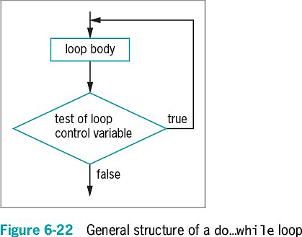
Learning How and When to Use a do…while Loop (cont’d.)
Java Programming, Eighth Edition

Slide 34
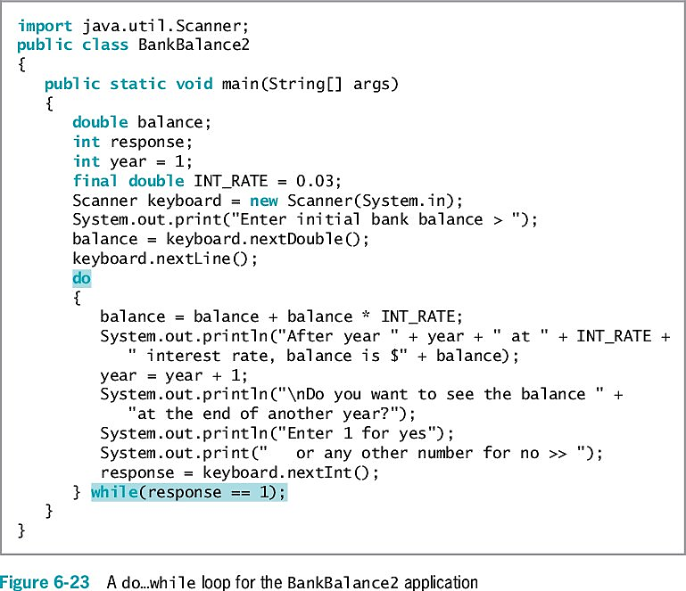
Learning How and When to Use a do…while Loop (cont’d.)
Java Programming, Eighth Edition

Slide 35
Learning About Nested Loops
Inner loop and outer loop
  An inner loop must be entirely contained in an outer loop
  Loops can never overlap
To print three mailing labels for each of 20 customers:
    for(customer = 1; customer <= 20; ++customer)
      for(color = 1; color <= 3; ++color)
      outputLabel ();
Java Programming, Eighth Edition

Slide 36
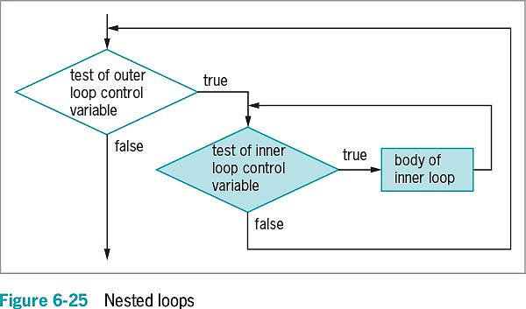
Learning About Nested Loops (cont’d.)
Java Programming, Eighth Edition

Slide 37
Improving Loop Performance
Make sure a loop does not include unnecessary operations or statements
Consider the order of evaluation for short-circuit operators
Make comparisons to zero (0)
Employ loop fusion to combine loops
Java Programming, Eighth Edition

Slide 38
Avoiding Unnecessary Operations
Do not use unnecessary operations or statements:
  Within a loop’s tested expression
  Within the loop body
Avoid:
  while (x < a + b)
  // loop body
Instead use:
  int sum = a + b;
  while(x < sum)
  // loop body
Java Programming, Eighth Edition

Slide 39
Considering the Order of Evaluation of Short-Circuit Operators
Short-circuit evaluation
  Each part of an AND or an OR expression is evaluated only as much as necessary to determine the value of the expression
Important to consider the number of evaluations that take place
  When a loop might execute many times
Java Programming, Eighth Edition

Slide 40
Comparing to Zero
Making a comparison to zero (0) is faster than making a comparison to any other value
To improve loop performance, compare the loop control variable to zero (0)
Do-nothing loop
  Performs no actions other than looping
Java Programming, Eighth Edition

Slide 41
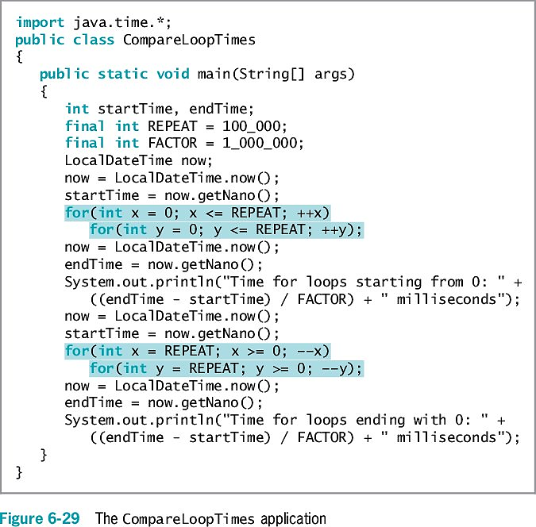
Comparing to Zero (cont’d.)
Java Programming, Eighth Edition

Slide 42
Employing Loop Fusion
Loop fusion
  A technique of combining two loops into one
  Will not work in every situation
Java Programming, Eighth Edition

Slide 43
Using Prefix Incrementing Rather than Postfix Incrementing
Prefix incrementing method
  ++x
  When the method receives a reference to x, the value is increased and the increased value is returned
Postfix incrementing method
  x++
  When the method receives a reference to x, a copy of the value is made and stored
  The value is incremented as indicated by the reference
  The copy is returned
  The extra time spent copying causes postfix incrementing to take longer
Java Programming, Eighth Edition

Slide 44
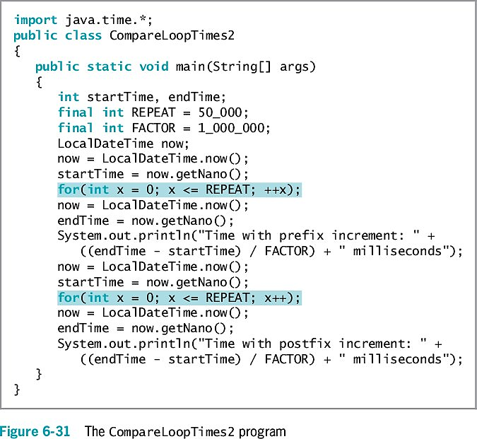
Using Prefix Incrementing Rather than Postfix Incrementing (cont’d.)
Java Programming, Eighth Edition

Slide 45
You Do It
Writing a Loop to Validate Data Entries
Working with Prefix and Postfix Increment Operators
Working with Definite Loops
Working with Nested Loops
Comparing Execution Times for Separate and Fused Loops
Java Programming, Eighth Edition

Slide 46
Don’t Do It
Don’t insert a semicolon at the end of a while clause
Don’t forget to block multiple statements that should execute in a loop
Don’t make the mistake of checking for invalid data using a decision instead of a loop
Don’t ignore subtleties in the boundaries used to stop loop performance
Don’t repeat steps within a loop that could just as well be placed outside the loop
Java Programming, Eighth Edition

Slide 47
Summary
The loop structure allows repeated execution of a block of statements
  Infinite loop
  Definite loop
  Nest loop
You must change the loop control variable within the looping structure
Use the while loop to execute statements while some condition is true
Java Programming, Eighth Edition

Slide 48
Summary (cont’d.)
Execute the while loop
  Initialize the loop control variable, test in the while statement, and alter the loop control variable
Prefix ++ and postfix ++
  Increase a variable’s value by 1
  The variable is used
    The result is calculated and stored
Unary operators
  Use with one value
Java Programming, Eighth Edition

Slide 49
Summary (cont’d.)
Binary operators
  Operate on two values
Shortcut operators +=, -=, *=, and /=
  Perform operations and assign the result in one step
for loop
  Initializes, tests, and increments in one statement
do…while loop
  Tests a Boolean expression after one repetition
Improve loop performance
  Do not include unnecessary operations or statements
Java Programming, Eighth Edition

