Slide 1
Main Drivers of Bank Customer Churn
Nick Amateau

Slide 2

Why Churn Matters
Customer churn is costly: up to 50% of an employee's annual salary.
Retaining customers is cheaper than acquiring new ones.
Predicting and understanding churn allows better retention strategies.
A deep understanding of how churn varies with factors like age, balance, credit score, and engagement allows banks to:
Create smarter retention strategies
Target at-risk customers early
Boost overall profitability

Slide 3

Data Overview
Dataset: Bank Customer Churn dataset
Rows: 10,000+ customers
Target variable: Churn (Yes/No — whether the customer left the bank)
Features included:
Demographic data (Age, Gender, Country)
Financial information (Credit Score, Balance, Estimated Salary)
Engagement data (Products owned, Tenure, Active Member status, Credit Card usage)

Slide 4
Predictive Model: Random Forest
I trained a Random Forest with 500 trees on 70% of the data to accurately capture complex relationships that drive customer churn.
The RMSE of the model is .3241
A random guess would result in an RMSE around 0.5. Our model achieved 0.3241, showing it captures real patterns and meaningfully improves churn prediction over guessing

Slide 5
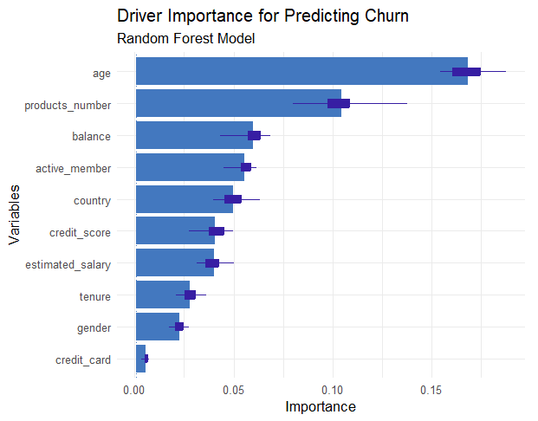
Variable Importance
Age is by far the most important driver of churn.
How many products a customer has is the second strongest predictor.
Balance is the third strongest driver.

Slide 6
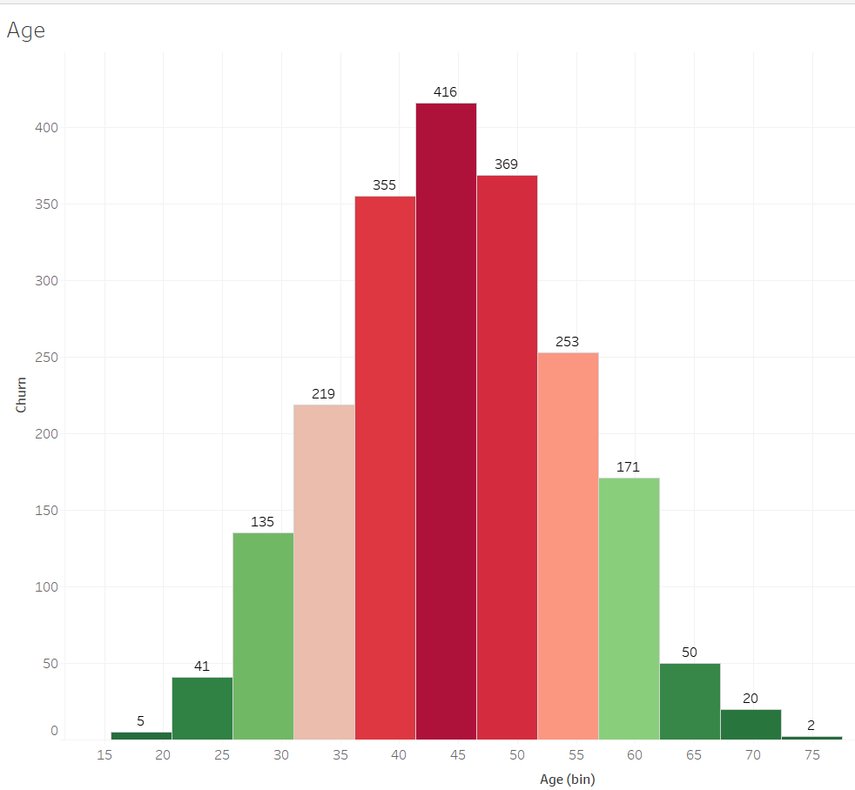
Main Driver: Age
Churn risk is highest among customers aged 35–50.
Outside of this range, customers are more loyal.
We should prioritize retention strategies focused on this middle-age group.

Slide 7
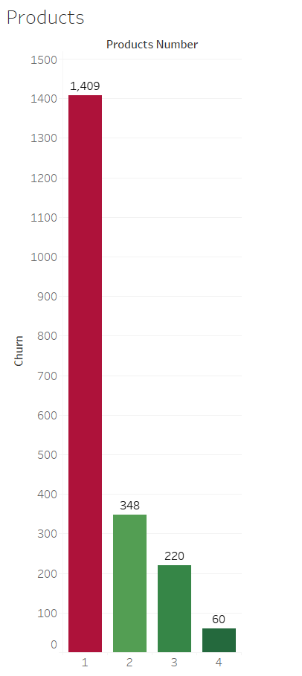
Main Driver: Products
Most churn happens among customers who only have 1 product.
Customers with 2+ products are significantly less likely to churn.
A cross-selling strategy focused on customers who currently have only one product. Encouraging these customers to add a second product, such as a savings account, credit card, or loan.

Slide 8
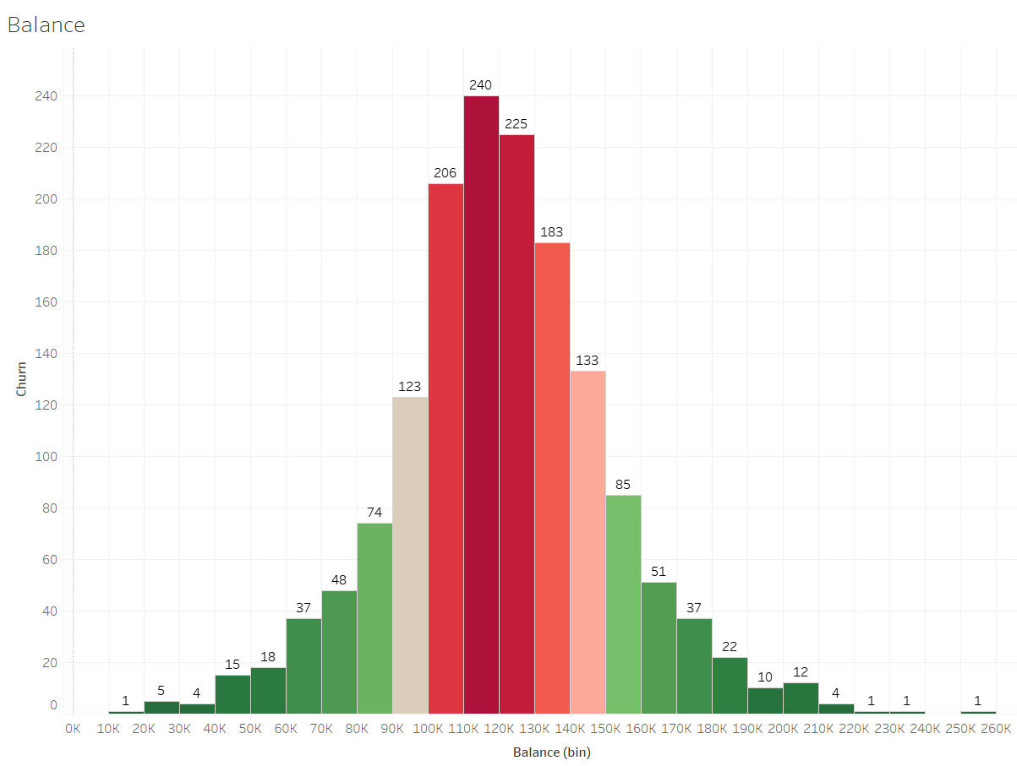
Main Driver: Balance
Churn risk is highest among customers with balances between $100K and $140K.
Customers with much higher or lower balances are more loyal.
We should target mid-balance customers with personalized offers to reduce their churn risk.

Slide 9
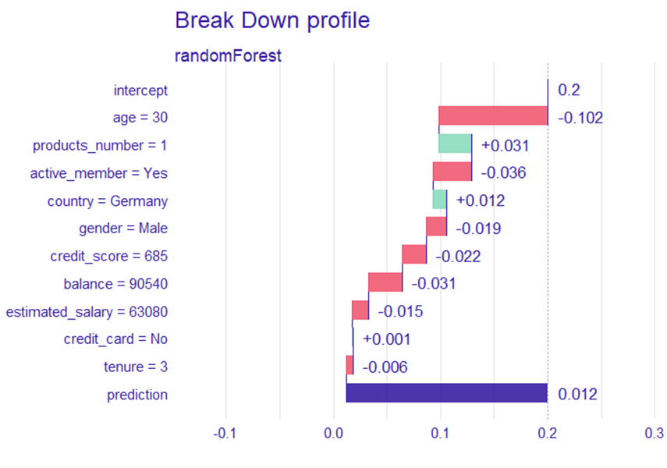
How the Model Built an Individual Prediction
Most characteristics of this customer — like their age, balance, and active membership — decreased their churn risk.
Only one factor, having just one product, really increased their risk, but the overall probability stayed very low.
The model predicts this customer has a 1.2% chance of churning. So, this customer is considered very low risk — almost certain to stay with the bank.

Slide 10
Final Takeaways and Recommendations
Churn is most likely among customers aged 35–50 and those with mid-range balances ($100K–$140K).
Customers with only one product are significantly more likely to leave the bank.
Most other factors (gender, credit card, salary) have minimal impact compared to these drivers.
Recommendations:
Prioritize retention efforts on middle-aged and mid-balance customers.
Launch cross-selling campaigns to increase the number of products per customer.
Focus engagement strategies on customers who are young and have balances near $100K–$140K.

