Slide 1
A Property Management System Written in C++
Nick Arlinghaus Computer Science Student
Will Hawkins III Faculty Advisor

Slide 2
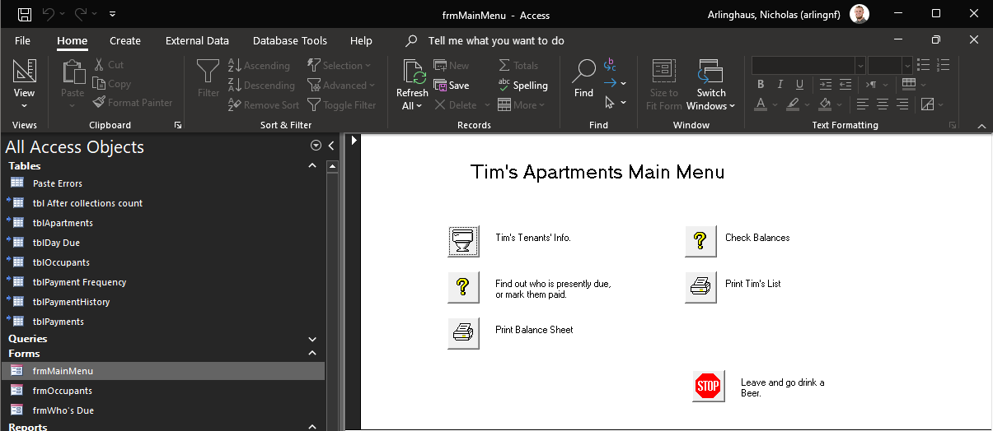
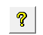

Goals
Problem: Family rental property business uses 30-year-old software to track rent collection income
MS Access Database with a basic VBA frontend
Some functionality no longer works, some are unused, some require workarounds
Very ugly, unintuitive by today’s standards
Solution: Develop a new solution that builds upon the previous one
Accomplishes the same goal (rent tracking) while adding others (utility tracking)
Uses open-source software on top of a MySQL database
Layout is straightforward and user-friendly

Slide 3
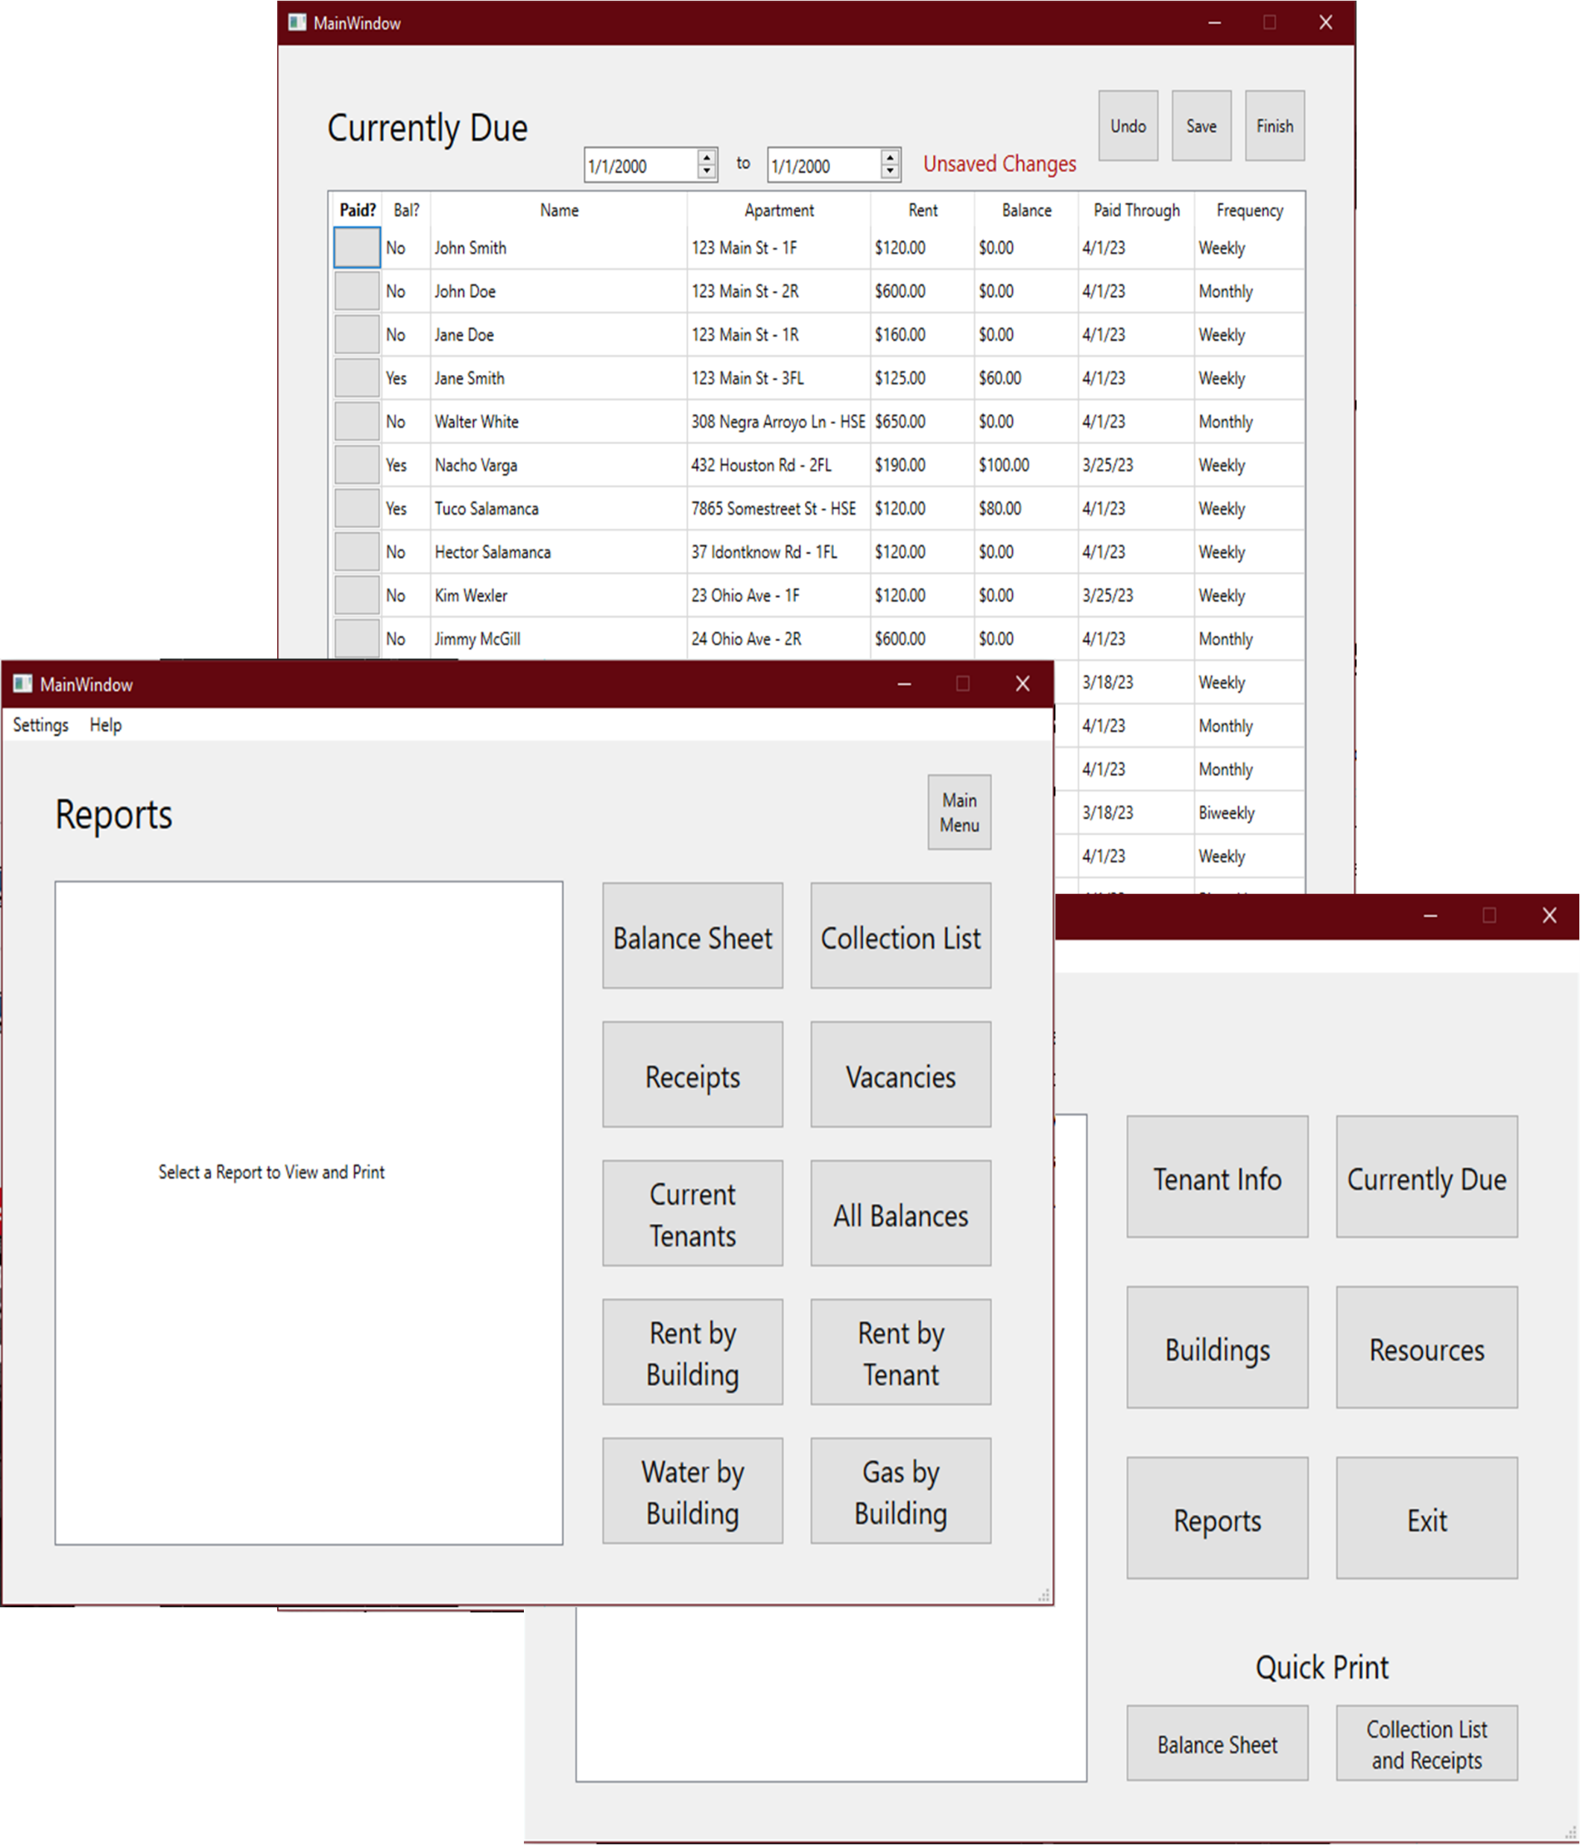

Intellectual Merits
Rental Property management software exists
Hard to find:
Locally hosted (no web browser)
Utility and rent tracking
Free, open source
¯\_(ツ)_/¯

Slide 4
Design
MySQL Database
Windows app on top of a MySQL database
App accepts data input from user and sends to database
Tenant Info
Building Info
Utility Reading
Rent Payment
App accesses data from database in order to generate reports
Income over time
Utility usage over time
App sends generated reports to printer
Input
Building Information
Utility Meter Readings
Tenant Information
Rent Payment Data
Application
Output (Reports)
Payment Totals/Time
Gas Usage/Time
Water Usage/Time
Printer

Slide 5
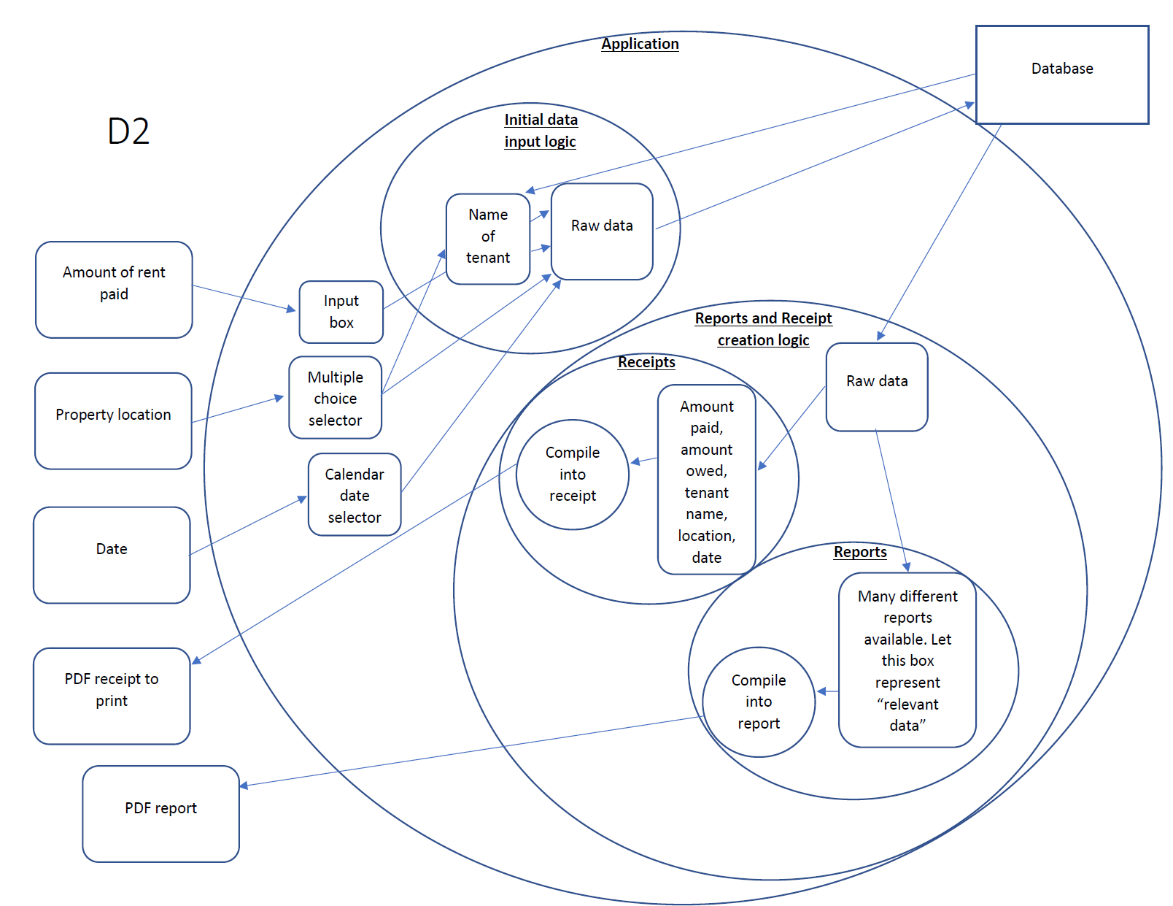
Design, cont.

Slide 6



technologies
Written in C++
…using the Qt 6.5 Framework
QMainWindow
QChart
QPrinter
QSqlDatabase
Using MySQL server 8.0.32 on the backend

Slide 7
milestones
Milestone | Due Date | Milestone | Due Date
Analyze structure of current database | Dec 15 | Create database | Feb 17
Design layout of new database | Dec 15 | Create landing page (main menu) | Feb 24
Analyze output features of current solution | Dec 15 | Implement inputs excluding utilities (buildings, tenants, rent collections) | Mar 17
Discuss desired features with target userbase | Dec 15 | Implement utility tracking | Mar 31
List primary output features of project | Dec 15 | Implement report creation | Apr 5
Research C++ GUI development | Feb 15 | Polish | Apr 5
Research proper way to communicate from C++ program to SQL database | Feb 15 | Deliver | Apr 6

Slide 8
Results
Accomplished up to the “Implement Inputs Excluding Utilities” stage
Still to go: implementing utilities and reports, polishing visually
Much more QA testing to be done before deployment
Plans beyond graduation
Android app: for use with a handheld POS system with built-in receipt printer
Server component on Windows machine for syncing data
Wireless automatic water meter entry: many buildings have wireless meters implemented by water district. Car-mounted device used to interpret this data.

Slide 9
Challenges
No experience with Qt Framework in general
Learn best by jumping in headfirst. Was able to get started with the help of the official documentation.
No practical experience designing databases
Enrolled in Database Management this semester. Was able to design and deploy a database based on knowledge from this course as well as online resources.
Connecting database to application
Ran into issues compiling plugin necessary for connecting to MySQL specifically. Overcame by paying attention to logs and following advice online from people in similar situations.

