Slide 1
Document Classification Problem: Does a Web Page Contain an Article?
Primary Technical Documentation
Nicholas Rummel
CSC498
Technical Mentor: Dr. Girard

Slide 2
Phase I: Analysis

Slide 3
Document Classification Problem
Given a web page, is there a document?
“Contains an article” problem
The article will be a block of text.
A web page with an article should not have content such as videos.
The project will not be extracting the article, just identifying that it exists.
Document classification follows a typical process, where it “analyzes the content of a document and recognizes its classification level, given pre-defined classification specification such as a taxonomical hierarchy.”
J. Park, J. Park, and J. Choi, “Web-Based Document Classification Using a Trie- Based Index Structure,” in Proceedings of the 2007 IEEE/WIC/ACM International Conferences on Web Intelligence and Intelligent Agent Technology - Workshops, Washington, DC, USA, 2007, pp. 52–55.

Slide 4
What is an article?
“By ‘article’ we mean a contiguous, coherent work of prose on a single topic or multiple closely related topics that alone comprises the main informational content of the page—news stories, encyclopedia entries, or a single blog post are considered articles, whereas a collection of headlines with brief summaries, a list of search results, or a set of blog posts are not.”
J. Pasternack and D. Roth, “Extracting Article Text from the Web with Maximum Subsequence Segmentation,” in Proceedings of the 18th International Conference on World Wide Web, New York, NY, USA, 2009, pp. 971–980.

Slide 5
Initial Thoughts About Problem
Why is the document classification problem a “problem”?
Research focuses on how to extract articles or how to label article categories
Why is there little research about this topic?
Experiments use datasets that are already articles or documents

Slide 6
Initial Thoughts for Solutions
Solutions?
Image-based? (Dr. Girard said to avoid this)
Neural Networks?
Content-based?
URL-Based?
Analyzing Meta-tags?

Slide 7
Topics from Scholarly Sources
Support Vector Machine (SVM)
Dr. Girard said SVMs are very similar to neural networks.
URL-Based Detection
Text Classification
Natural Language Processing
Document Object Model (DOM)
Visual Features
C4.5 Algorithm
Both papers discussed in primary objective use this algorithm.

Slide 8
Machine Learning

Slide 9
Support Vector Machine
Widely used for supervised machine learning with text and web page categorization
“The underlying idea is to map the training points to a higher-dimensional vector space and then to find a hyperplane separating most of the positive and negative training points.”
E. Baykan, M. Henzinger, L. Marian, and I. Weber, “A Comprehensive Study of Features and Algorithms for URL-Based Topic Classification,” ACM Trans Web, vol. 5, no. 3, p. 15:1–15:29, Jul. 2011.

Slide 10
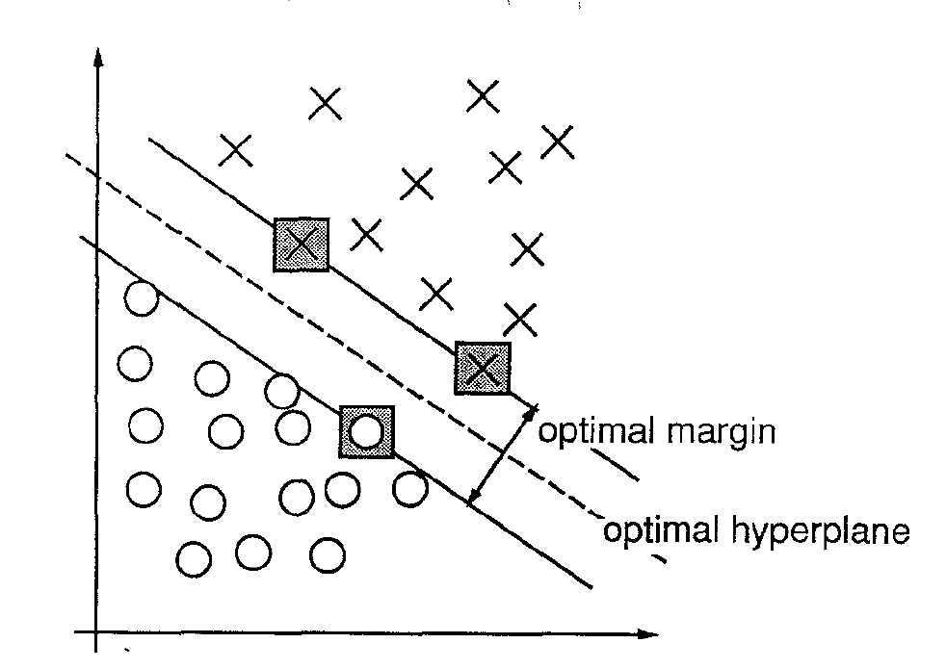
Support Vector Machine
C. Cortes and V. Vapnik, “Support-vector networks,” Mach. Learn., vol. 20, no. 3, pp. 273–297, Sep. 1995.

Slide 11
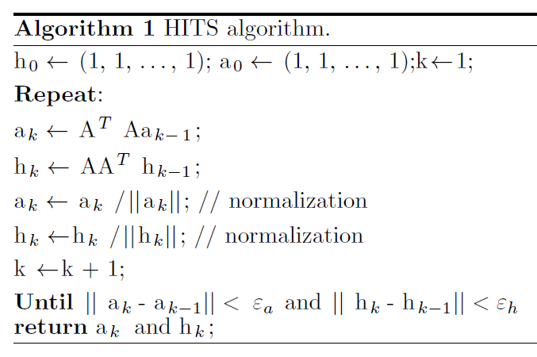
HITS Algorithm
M. N. Meadi, M. C. Babahenini, and A. Taleb Ahmed, “New use of the HITS algorithm for fast web page classification,” Turk. J. Electr. Eng. Comput. Sci., vol. 25, no. 3, pp. 2015–2032, Jun. 2017.

Slide 12
C4.5 Algorithm
A classification model that focuses on generating a classifier as a decision tree from training cases. Then it predicts which class new data belongs to
What are training cases? A set of data that is already classified.
Assumes that the outcome of a test for any case can be determined.
Tree “pruning” after initial decision tree is created to remove branches that do not help.
Supervised learning
Extension of Quinlan’s ID3 Algorithm
J. R. Quinlan, C4.5 - programs for machine learning. San Mateo, Calif: Kaufmann, 1998.

Slide 13
C4.5 Algorithm
Key Requirements:
Attribute-value description
Predefined classes
Discrete classes
Sufficient data
“Logical” classification models
J. R. Quinlan, C4.5 - programs for machine learning. San Mateo, Calif: Kaufmann, 1998.

Slide 14
SVM vs. C4.5
C4.5
Decision trees for predicting data classification
Decision trees undergo a “pruning” process
Easy to interpret data
Works with continuous and discrete data
SVM
Separates data points using a hyperplane, with a margin to decrease changes of misclassification
No decision trees
Using a kernel, the hyperplane can be mapped into 3 dimensions
Harder to interpret data

Slide 15
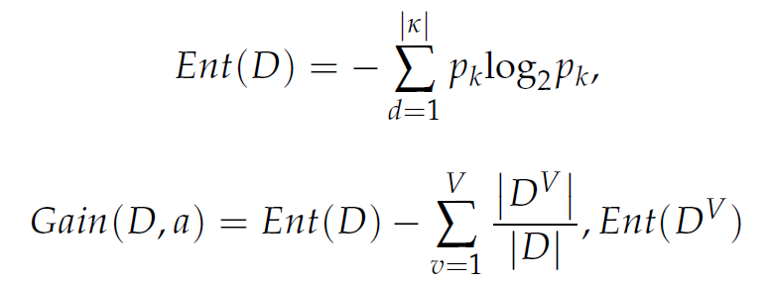
ID3 Algorithm
Yingying Wang, Yibin Li, Yong Song, Xuewen Rong, and Shuaishuai Zhang, “Improvement of ID3 Algorithm Based on Simplified Information Entropy and Coordination Degree,” Algorithms, vol. 10, no. 4, pp. 1–18, Dec. 2017.
Greedy machine learning algorithm invented by Ross Quinlan
Simpler than C4.5 Algorithm
General classification function that utilizes decision trees
Makes use of information gain as an attribute selection method
Information entropy and information gain equations:

Slide 16
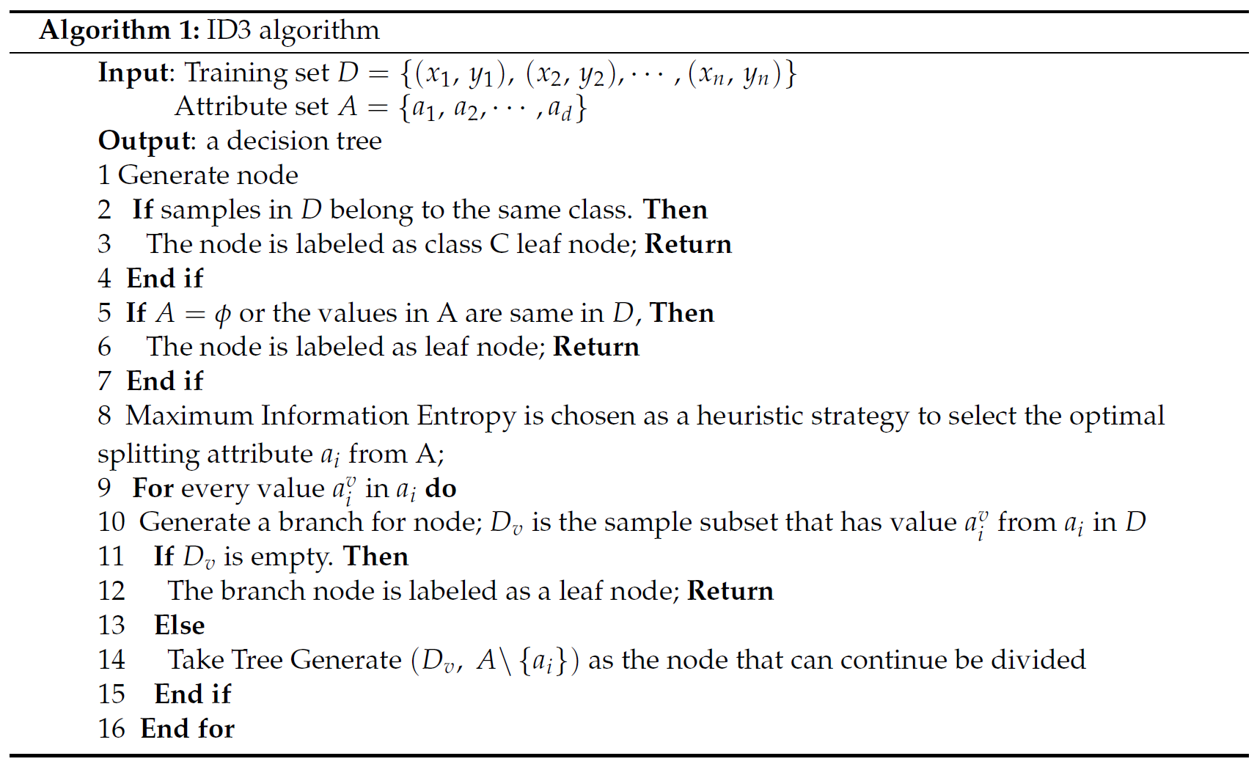
ID3 Algorithm
Yingying Wang, Yibin Li, Yong Song, Xuewen Rong, and Shuaishuai Zhang, “Improvement of ID3 Algorithm Based on Simplified Information Entropy and Coordination Degree,” Algorithms, vol. 10, no. 4, pp. 1–18, Dec. 2017.

Slide 17
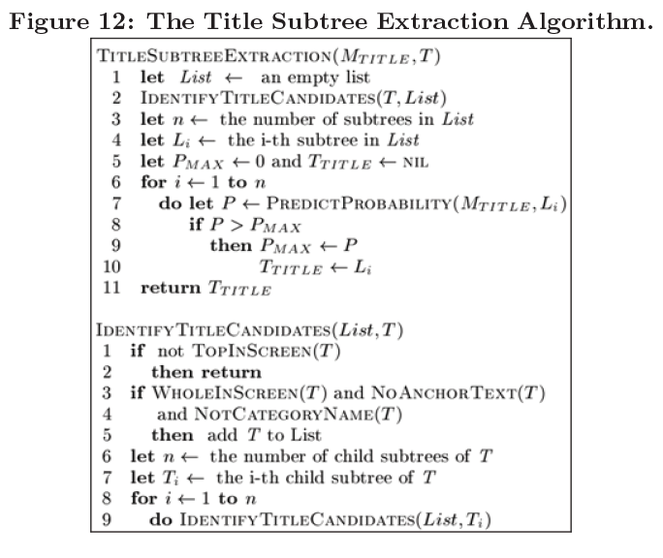
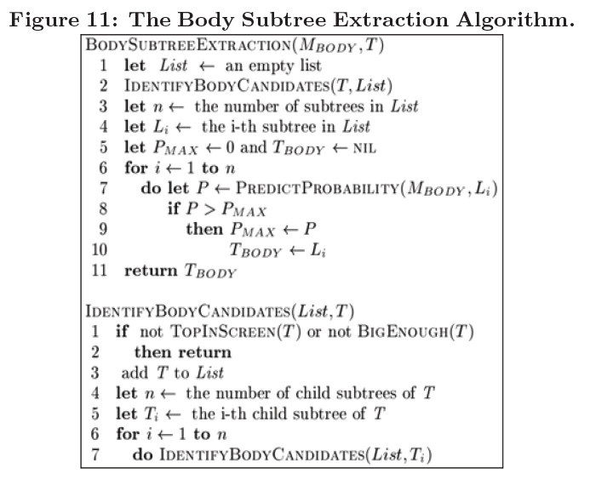
Title and Body Subtree Algorithms
J. Wang et al., “Can We Learn a Template- independent Wrapper for News Article Extraction from a Single Training Site?,” in Proceedings of the 15th ACM SIGKDD International Conference on Knowledge Discovery and Data Mining, New York, NY, USA, 2009, pp. 1345–1354.

Slide 18
URL-Based

Slide 19
Parsing URLs
Parsing URL into tokens to get information about the web page
Like crawlers in a search engine
“Each URL is lower-cased and split into a sequence of strings of letters at any punctuation marks, numbers, or other nonletter characters.”
E. Baykan, M. Henzinger, L. Marian, and I. Weber, “A Comprehensive Study of Features and Algorithms for URL-Based Topic Classification,” ACM Trans Web, vol. 5, no. 3, p. 15:1–15:29, Jul. 2011.

Slide 20
Link-Target Identification
Useful information contained within a URL
Six features for classification in a link:
A number, a date, a longer link length, slashes at the end, uses a reserved word, and the specific number of slashes.
R. Ferreira, R. Ferreira, R. D. Lins, H. Oliveira, M. Riss, and S. J. Simske, “Appling Link Target Identification and Content Extraction to Improve Web News Summarization,” in Proceedings of the 2016 ACM Symposium on Document Engineering, New York, NY, USA, 2016, pp. 197–200.

Slide 21
Delimiters for Parsing URLs
“Treating “/” as delimiters, we extract features from the URL string following the domain name of a webpage. The list of all unigrams and bigrams from URL strings that occur more than three times in the training dataset comprise the URL-term dictionary.”
S. D. Gollapalli, C. Caragea, P. Mitra, and C. L. Giles, “Improving Researcher Homepage Classification with Unlabeled Data,” ACM Trans Web, vol. 9, no. 4, p. 17:1–17:32, Oct. 2015.

Slide 22
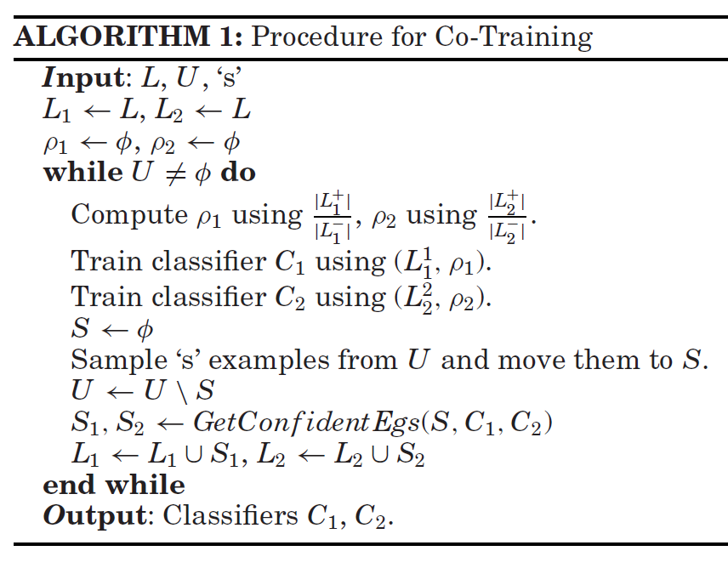
Co-Training Algorithm
J. Fan, P. Luo, S. H. Lim, S. Liu, P. Joshi, and J. Liu, “Article Clipper: A System for Web Article Extraction,” in Proceedings of the 17th ACM SIGKDD International Conference on Knowledge Discovery and Data Mining, New York, NY, USA, 2011, pp. 743–746.

Slide 23
Content-Based

Slide 24
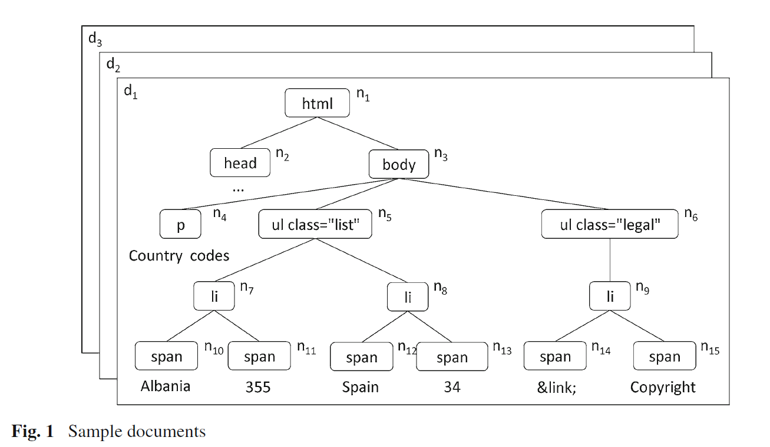
Document Object Model
Represents HTML content as a tree.
P. Jiménez and R. Corchuelo, “Roller: a novel approach to Web information extraction,” Knowl. Inf. Syst., vol. 49, no. 1, pp. 197– 241, Oct. 2016.

Slide 25
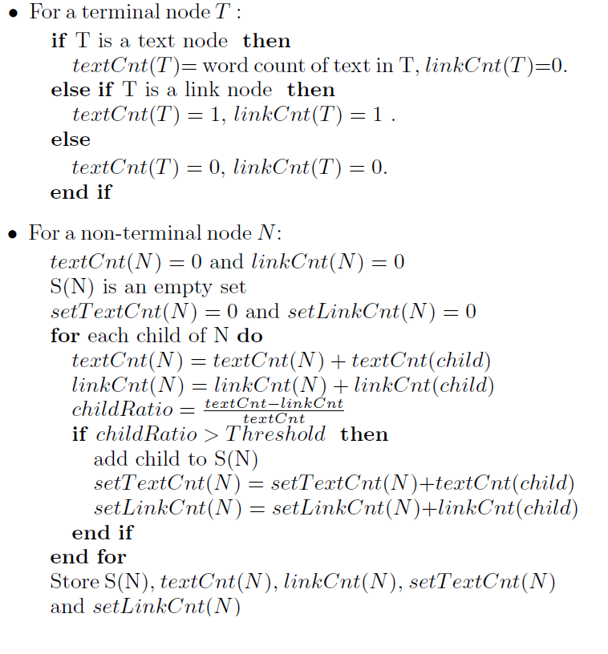
Traversing a DOM Tree
J. Prasad and A. Paepcke, “Coreex: Content Extraction from Online News Articles,” in Proceedings of the 17th ACM Conference on Information and Knowledge Management, New York, NY, USA, 2008, pp. 1391–1392.

Slide 26
Scoring Content in DOM
CoreEx uses a ratio
The amount of total text to number of links within page
J. Prasad and A. Paepcke, “Coreex: Content Extraction from Online News Articles,” in Proceedings of the 17th ACM Conference on Information and Knowledge Management, New York, NY, USA, 2008, pp. 1391–1392.
Roller normalizes each value and converts it to a rank. Each rank is a weighted ratio based on the standard deviation.
P. Jiménez and R. Corchuelo, “Roller: a novel approach to Web information extraction,” Knowl. Inf. Syst., vol. 49, no. 1, pp. 197– 241, Oct. 2016.

Slide 27
Visual Features
Detection of title, author, date, or other visual features in a web page.
Look at location and unique properties (i.e. font) of each visual feature.
“Title is a unique component of an article. Accordingly, it is often annotated with special html tags (H1-H6) and given visual prominence.”
J. Fan, P. Luo, S. H. Lim, S. Liu, P. Joshi, and J. Liu, “Article Clipper: A System for Web Article Extraction,” in Proceedings of the 17th ACM SIGKDD International Conference on Knowledge Discovery and Data Mining, New York, NY, USA, 2011, pp. 743–746.

Slide 28
Line-breaks as Visual Features
Line-breaks will occur due to either a CSS display property or due to one HTML tag, usually br or hr.
“Although the tag used to form a paragraph is different it is always true that there does not exist any line-break within a paragraph. Thus, generally speaking, we want to group the successive text leaf nodes between two line-breaks into a text segment.”
P. Luo, J. Fan, S. Liu, F. Lin, Y. Xiong, and J. Liu, “Web Article Extraction for Web Printing: A DOM+Visual Based Approach,” in Proceedings of the 9th ACM Symposium on Document Engineering, New York, NY, USA, 2009, pp. 66–69.

Slide 29
Primary Objective
The primary objective of this project is to assess the predictability of a news article existing in a web page using ID3 with the attributes outlined in “Extracting multiple news attributes based on visual features” [1] with and without URL identification attributes outlined in “Applying Link Target Identification and Content Extraction to improve Web News Summarization” [2]. (1.5 person-weeks over 1 semester)
[1] W. Liu, H. Yan, and J. Xiao, “Extracting multiple news attributes based on visual features,” J. Intell. Inf. Syst., vol. 38, no. 2, pp. 465–486, Apr. 2012.
[2] R. Ferreira, R. Ferreira, R. D. Lins, H. Oliveira, M. Riss, and S. J. Simske, “Appling Link Target Identification and Content Extraction to Improve Web News Summarization,” in Proceedings of the 2016 ACM Symposium on Document Engineering, New York, NY, USA, 2016, pp. 197–200.

Slide 30
Phase II: Hypothesis

Slide 31
Hypotheses
Adding URL-based attributes to the ID3 decision tree using content-based attributes increases the accuracy of identifying web pages with news articles.

Slide 32
Solution
Use a crawler to retrieve 330 web pages for dataset (50% contain articles, 50% does not contain articles)
Java, Eclipse IDE, HTTrack
Build visual feature detection for content
Build link identification
Implement ID3 Algorithm
Measure accuracy of detecting visual features with and without link identification

Slide 33
Goal Tree
Goal G1 Determine whether URL-based attributes with content-based attributes improves the accuracy of identifying news articles in web pages
Goal G1.2 Measure the accuracy without URL identification
Goal G1.3 Measure the accuracy with URL identification
Goal G1.1 (OP Pilot) Decide on extraction rules for the content’s attributes

Slide 34
Experiment Design (Block Design)
Factors | Values
URL Identification | {false, true}
Sample | Each of the 20 trials will randomly select the 300 web pages for the training set and the 30 web pages for the test set.
Block Design | Content-based Detection without URL Identification | Content-based Detection with URL Identification
Training Set: 300 pages | X | X
Test Set: 30 pages | X | X

Slide 35
Experiment Design: Estimated Run Time
Training set
300 pages/run ≈ 300 seconds * 2 runs ≈ 600 seconds ≈ 0.17 of an hour
Test set
1 page/2 sec ≈ 60 seconds * 2 runs ≈ 120 seconds ≈ 0.03 of an hour
Total per trial
0.20 of an hour
Overall Total
0.20 of an hour * 20 trials ≈ 4.00 hours

Slide 36
Phase III: Synthesis

Slide 37
Data Set
330 HTML web page files retrieved with HTTrack
33 pages were retrieved from each of the following news websites:
ABC, BBC, CBS, CNN, Fox News, Huffington Post, The New York Times, The Verge, Washington Post, and Yahoo News
Each file is labeled in the range: 001.html – 330.html
ready.csv – will be used for experiment
Contains important information about the dataset
Document number (1-330)
Path to file starting in dataset directory
Label as to whether the web page contains an article (1) or does not (0)
Each web page’s URL

Slide 38
Development
All code and related files are being stored in a private repo on GitHub
https://github.com/nickarummel/CSC499-Rummel-Research

Slide 39
DOM Java Library
When starting to program, I realized that I had no way of quickly accessing the HTML code and parsing it.
With permission from Dr. Girard, I am generating a Document Object Model (DOM) tree of the HTML code using an open-source library from MIT called Jsoup.

Slide 40
Note:
The upcoming slides is a list of what features need to be programmed. If an item is crossed out (strikethrough), then it is completed.

Slide 41
List of Visual Feature Rules Implemented
Title
Font size between 15 px and 45 px inclusively
Font color is black or blue
Located in top half of the page
Can be seen without paging down
Text length is between 8 and 50 characters
Text is not hyperlinked
Publication date
Font size less than or equal to 10 px
Font color is black, blue, or gray
Text length is less than or equal to 18 characters
Text is formatted as a date
Text is not hyperlinked

Slide 42
List of Visual Feature Rules Implemented
Author
Font size is less than or equal to 12 px
Text length is between 3 and 25 characters inclusively
Text includes a frequent word: author, by
Comment link
Font size is less than or equal to 12 px
Text length is between 6 and 15 characters inclusively
Text includes a frequent word: comment
Text is hyperlinked
Source
Font size is less than or equal to 12 px
Font color is black, gray, or brown
Text includes a frequent word: from, source
Text length is between 4 and 25 characters inclusively

Slide 43
List of Visual Feature Rules Implemented
Content
Font size between 6 px and 12 px inclusively
Font color is black
Can be seen without paging down
Text length is greater than 20 character
Category
Font size less than or equal to 12 pixels
Located in top half of the page
Can be seen without paging down
Text length is between 8 and 30 characters inclusively
Text contains a frequent word: >, ->, |

Slide 44
List of Visual Feature Rules Implemented
Related news links
Font size less than or equal to 12 pixels
Font color is black or blue
Located in bottom half of the page
Text is hyperlinked
Text contains a frequent word: related news, related links
As of 9/17/2018, visual feature detection rules and tests have been programmed and committed to GitHub repo.

Slide 45
List of Link Identification Rules Implemented
Link has an ID number
Link has a date
Link has a longer link length (contains title)
Link has a specific number of slashes (will be 4 slashes)
Link does not have a reserved word (video, slideshow, etc.)
Link does not have a slash at the end
As of 9/23/2018, link analysis rules and tests have been programmed and committed to GitHub repo.

Slide 46
Example ID3 Decision Tree from Code
Link has four slashes?
Yes - Article publication date exists?
Yes – Always no
Link does not contain reserve word?
No – Link has date?
No – Article Title Exists?
Yes – Link does not end with slash?
Yes – Always no
No – Article source exists?
Yes – Article author exists?
No – Article related news link exists?
Yes – Always no

Slide 47
Example ID3 Decision Tree from Code
Link has four slashes?
Yes - Article publication date exists?
Yes – Always no
Link does not contain reserve word?
No – Link has date?
No – Article Title Exists?
Yes – Link does not end with slash?
Yes – Always no
No – Article source exists?
Yes – Article author exists?
No – Article related news link exists?
Yes – Always no
Not Article
Article
Not Article
Article
Not Article
Article
Not Article
Not Article
Not Article

Slide 48
Phase IV: Validation

Slide 49
Results
Accuracy of Visual Features Only
Average: 51.50%
Standard Deviation: ± 9.46%
Maximum: 66.67%
Minimum: 30.00%
Accuracy of Visual Features and Link Analysis
Average: 50.50%
Standard Deviation: ± 13.04%
Maximum: 83.33%
Minimum: 26.67%

Slide 50
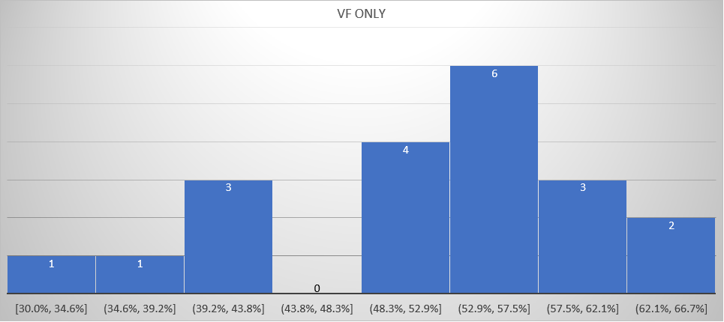
Histogram: Visual Features Only

Slide 51
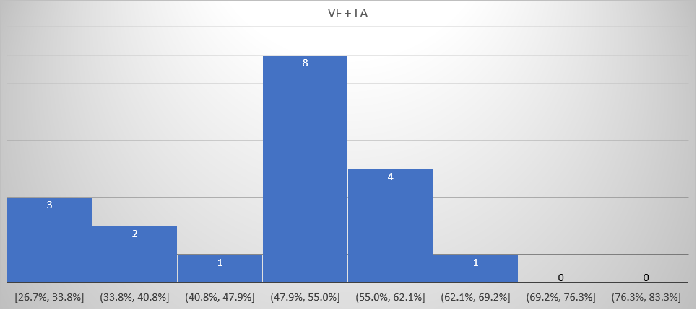
Histogram: Visual Features & Link Analysis

Slide 52
Statistical Analysis
Hypothesis:
H₀: μ₁ = μ₂
H_{a}: μ₁ > μ₂
Delta: 0.0299
Alpha: 0.05
Degrees of Freedom: 58

Slide 53
Statistical Analysis
Hypothesis:
H₀: μ₁ = μ₂
H_{a}: μ₁ > μ₂
T-Table Value: 2.660
T-Test Value: 0.334
0.334 < 2.660, fail to reject H₀

Slide 54
Result Conclusions
There is no difference in the average accuracy rate between visual feature and link analysis detection together and visual feature detection only.
Possible reasons why the results not statistically significant?
Visual feature rules from article (2012) does not match current technologies
ID3 is the precursor to a better decision tree algorithms (C4.5 and C5.0) that prune the tree.
The HTML contained many scripts that may not have rendered correctly when retrieved with HTTrack.
Visual features were styled with external CSS files that could not be retrieved.

Slide 55
Additional Trials
Accuracy of running all data through the tree (one trial)
VF Only
Test Set: 33.33%
Training Set: 52.33%
Result: Training data was 19% more accurate than test data in this trial.
VF + LA
Test Set: 26.67%
Training Set: 50.67%
Result: Training data was 24% more accurate than test data in this trial.
Argument
As expected, the training data was more accurate than the test data.

Slide 56
Additional Trials
Accuracy of running all data through the tree (one trial)
LA Only
Test Set: 40.00%
Training Set: 52.67%
Result: Training data was 12.67% more accurate than test data in this trial.
VF + LA
Test Set: 36.67%
Training Set: 55.67%
Result: Training data was 19% more accurate than test data in this trial.
Arguments
Link analysis only did slightly better than using both visual and link features.

Slide 57
Real-World Example of CNN Link
cnn.com/2018/11/04/business/amazon-holiday-shopping-prime/index.html
Has at least 4 slashes = true (5 slashes total)
Does not end with slash = true (ends with index.html)
Has date = true (2018/11/04)
Does not contain reserve word = true (does not have: gallery, video, image, slideshow, photo, episode, player)
Has ID number = false (does not exist)
Has longer length = true (68 characters total)
(Java code was able to verify this correctly)

Slide 58
Future Research
Use same visual feature and link analysis rulesets with a different machine learning technique (SVMs, Neural Networks, etc.)
Look at whether link analysis is better than visual feature detection.
Change the rulesets to match current technologies and re-run the experiment.

