Slide 1
Predicting the Likelihood
of a Stroke
DSCI 521 Final Project
Nick Babcock, Hannah Wurzel, Kunal Chhabria, Joey Chan

Slide 2
Project Overview
A stroke occurs when a blood vessel in the brain is blocked or bursts. This interrupts the flow of blood and oxygen to the brain, which can damage brain tissue and lead to many different complications. Studies show that some factors that can increase the risk of stroke are:
High blood pressure (hypertension)
Cigarette smoking or second hand smoke exposure
Diabetes (can be linked with having high glucose levels which is 126<)
Cardiovascular disease (heart disease)
Age - People age 55 or older have a higher risk of stroke than younger people do
Sex - Men have a higher risk of stroke than do women
Being overweight (BMI ≥ 25)
Sources: https://www.mayoclinic.org/diseases-conditions/stroke/symptoms-causes/syc-20350113
https://www.cancer.org/cancer/cancer-causes/diet-physical-activity/body-weight-and-cancer-risk/adult-bmi.html

Slide 3
Project Goals
Analyze our data to identify correlations between the human characteristics provided in our dataset and the event of having a stroke
Determine which characteristics most influence the likelihood of having a stroke
Build a prediction model to output the likelihood of a patient experiencing a stroke in the future

Slide 4
Stakeholders, Use, Intentions
This analysis could be useful to anyone with a vested interest in what can cause a stroke, such as medical professionals or everyday individuals. Whether you are taking preventative measures or simply conducting research, we hope our analysis can clearly illustrate what are some strong indicators of one’s chances of having a stroke in the future.
We hope this analysis can be useful to help build a model that will accurately predict the likelihood of a stroke occuring in all types of people. Predictions such as this could potentially be live-saving.
The intention of our analysis is to determine which human characteristics most influence the likelihood of one having a stroke. With this information, one could determine their chances of having a stroke given their current lifestyle and potentially influence one to make some healthy lifestyle changes.

Slide 5
The Data
Our data comes from a Kaggle dataset: Stroke Prediction Dataset
Consists of 12 descriptive attributes and 5110 rows representing different people
Contains 201 NA values in the bmi column which we decided to remove (~4%)
Contains 4861 people who did not have a stroke and only 249 people who had a stroke
After EDA we changed the categorical data into numerical data

Slide 6
Description of Our Dataset
Attribute Identifier | Description | Possible Values
gender | Sex of the patient | Male, Female, Other
age | Age of the patient (years) | 0.08 - 82.0
hypertension | Does patient have high blood pressure | 0 = no , 1 = yes
heart_disease | Does patient have a heart disease | 0 = no , 1 = yes
ever_married | Has the patient ever been married | No , Yes
work_type | Type of environment the patient works in | Children, government, never worked, private, self employed
residence_type | Type of environment the patient lives in | Rural, urban
avg_glucose_level | Patient’s average glucose level | 55.12 - 271.74
bmi | Patient’s body mass index | 10.3 - 97.6
smoking_status | What type of smoker is the patient | Smokes, formerly smoked, never smoked, unknown
stroke | Has this patient experienced a stroke | 0 = No , 1 = Yes

Slide 7
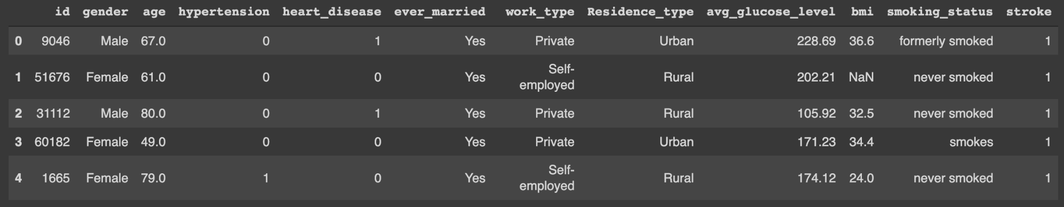
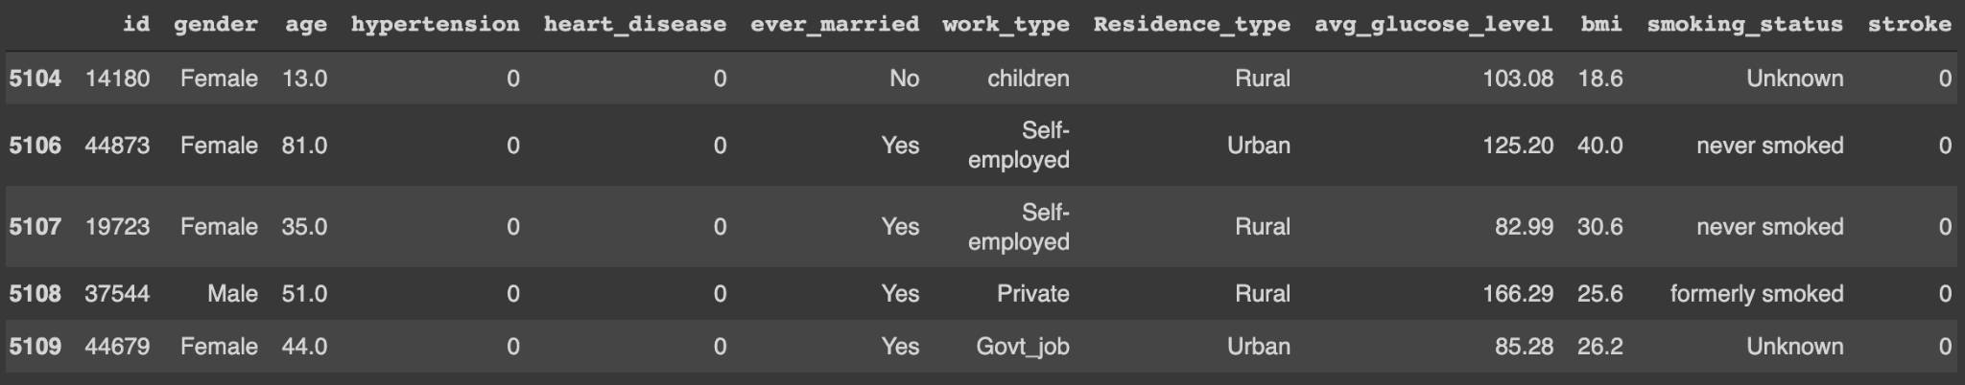
Exhibition of our Dataset

Slide 8
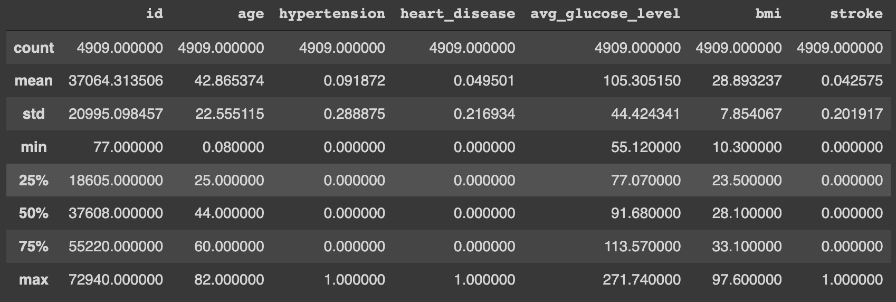
Description of Our Dataset Continued

Slide 9
Hypotheses
Hypotheses:
The higher the bmi, average glucose level, age, the higher the chance of having a stroke.
Smokers have a higher chance of having a stroke than non-smokers.
More men will have a stroke than women.

Slide 10
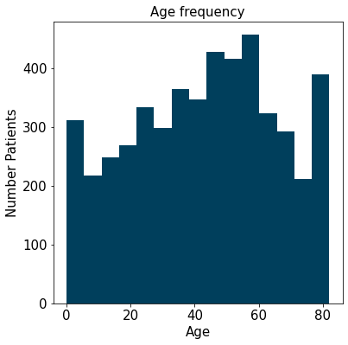
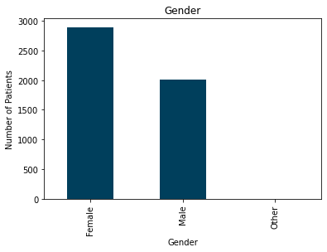
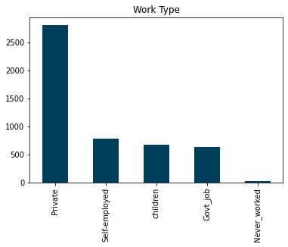
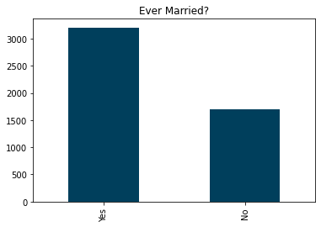
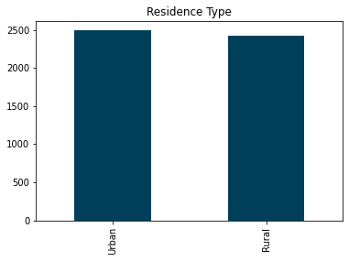
EDA
Personal
Attributes

Slide 11
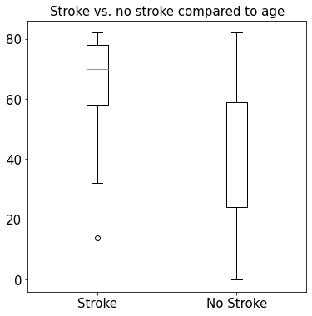
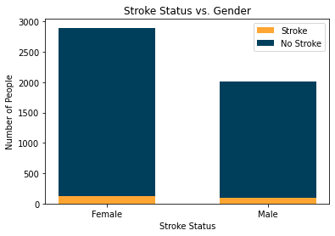
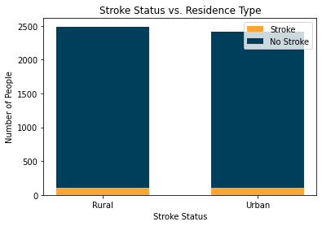
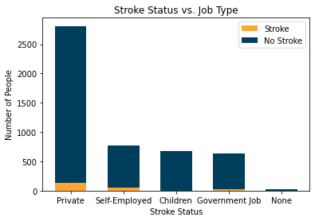
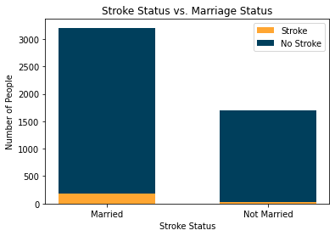
EDA
Personal
Attributes vs. Stroke Status
Notes:
notice very few people seem to of had a stroke.

Slide 12
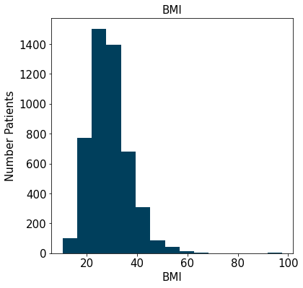
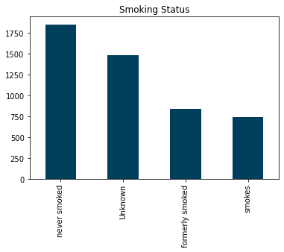
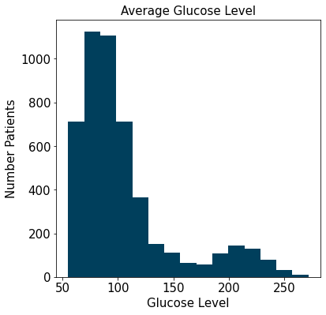
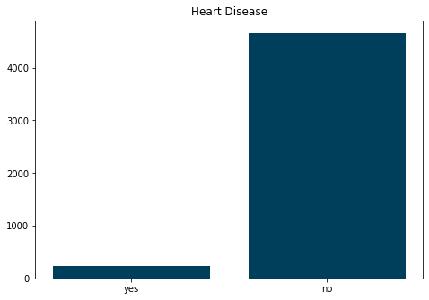
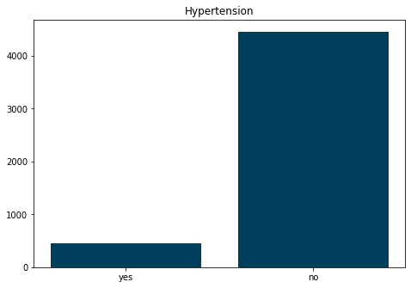
EDA
Health
Attributes

Slide 13
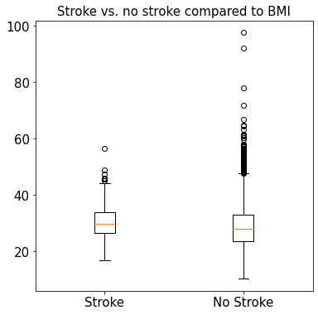
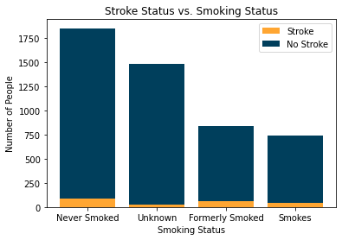
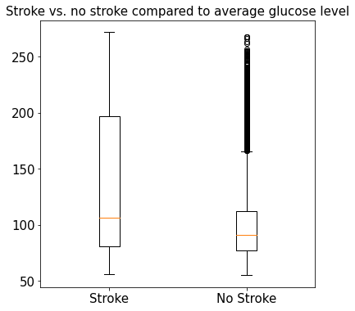
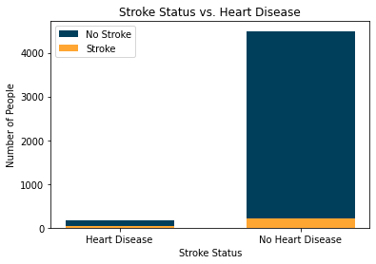
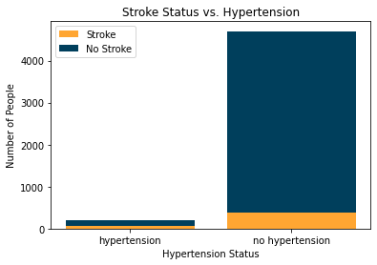
EDA
Health
Attributes vs. Stroke Status

Slide 14
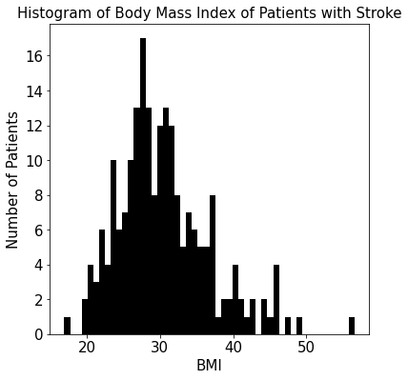
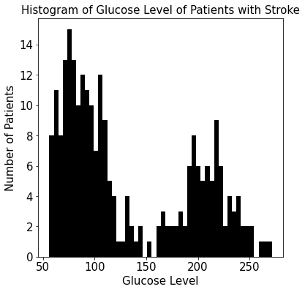
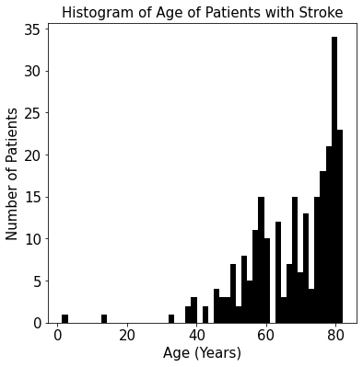
EDA
Health
Attributes vs. Stroke Status Continued
Mean BMI: 30.47129186602871
Std deviation BMI: 6.314291434635621
25+ is considered overweight
Mean glucose: 132.54473895582322
Std deviation glucose: 61.796591021509016
126+ is considered high
Mean age: 67.72819277108434
Std deviation age: 12.701836582054456
55+ is at higher risk

Slide 15
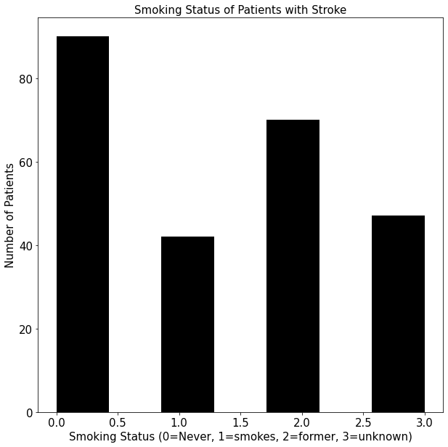
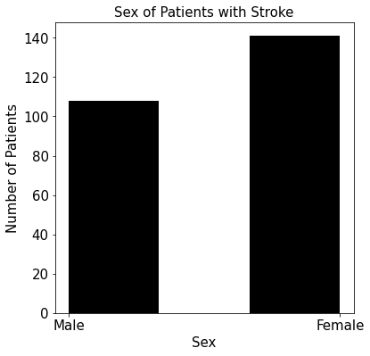
EDA
Health Attributes vs. Stroke Status Continued

Slide 16
Classification Models
Logistic Regression
K-Nearest Neighbors

Slide 17
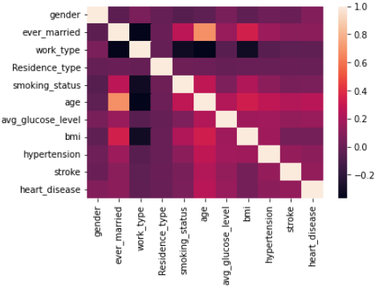
Confusion Matrix

Slide 18
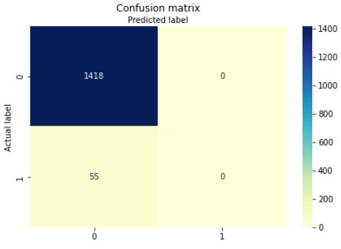
Logistic Regression & Confusion Matrix (Cont.)
Confusion matrix visualizes logistic regression model
70/30 split with test size at 30% of dataset
0 - True (Positive)
1 - False ( Negative)

Slide 19
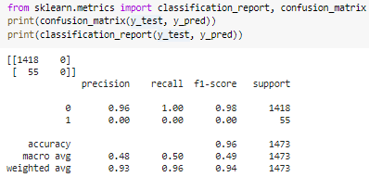
Logistic Regression & Confusion Matrix (Cont.)
Confusion matrix visualizes logistic regression model precision, recall, f1, and support scores
Unweighted mean scores
All inputs treated equally
Notes:
A macro-average will compute the metric independently for each class and then take the average

Slide 20
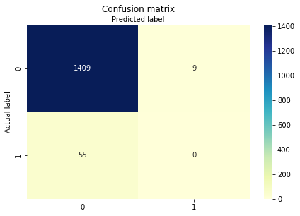
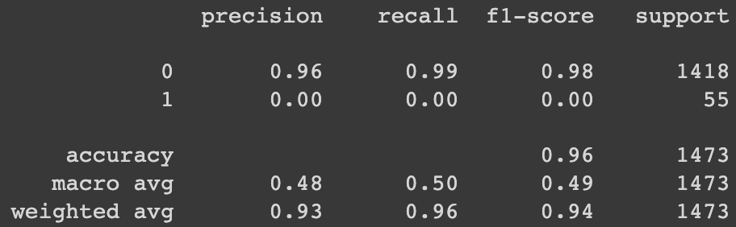
K-Nearest Neighbors Model
Data was split 70/30 into training and test
Imbalanced data demonstrated through low macro avg score and unequal distribution between classes
Notes:
A macro-average will compute the metric independently for each class and then take the average

Slide 21
Challenges and Limitations
Dataset is not nearly large enough for these models to perform well
Data is extremely unbalanced
Data is only taken from people in US which is not a good representation of people around the world
‘Unknown’ status for smokers creates a bias in results

