Slide 1
Intermediate R for Spatial Analysis
Fri 4th March, 9:30am – 4pm
Dr Nick Bearman
@nickbearmanuk
Department of Geography and Planning

Slide 2
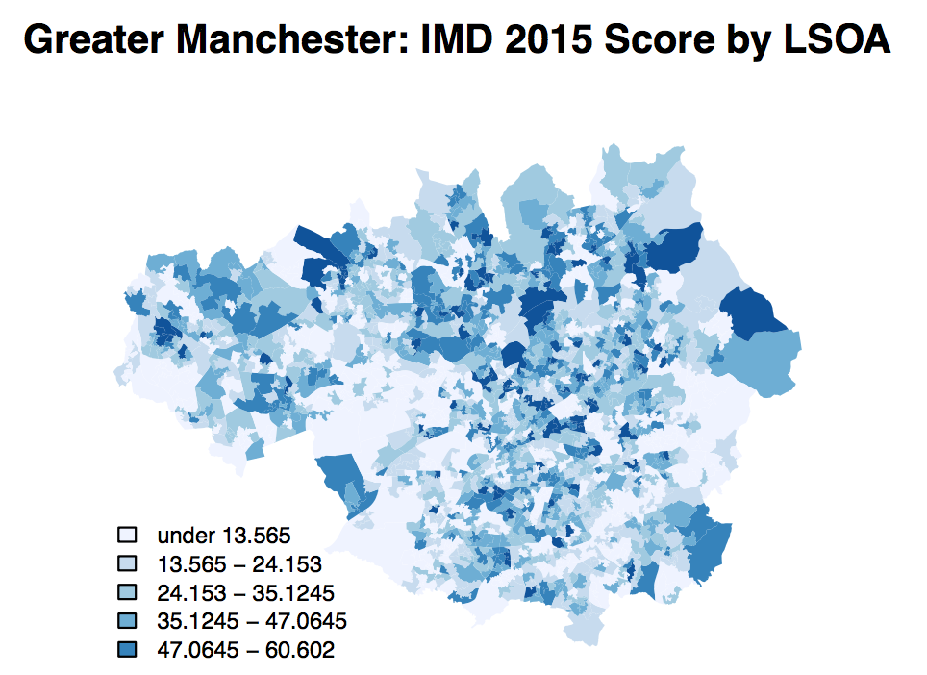
What will you get from the course?
Using a range of GIS software to perform a range of spatial analysis
RStudio and GeoDa
Develop your confidence in using RStudio
Data handling
Scripts
Functions

Slide 3
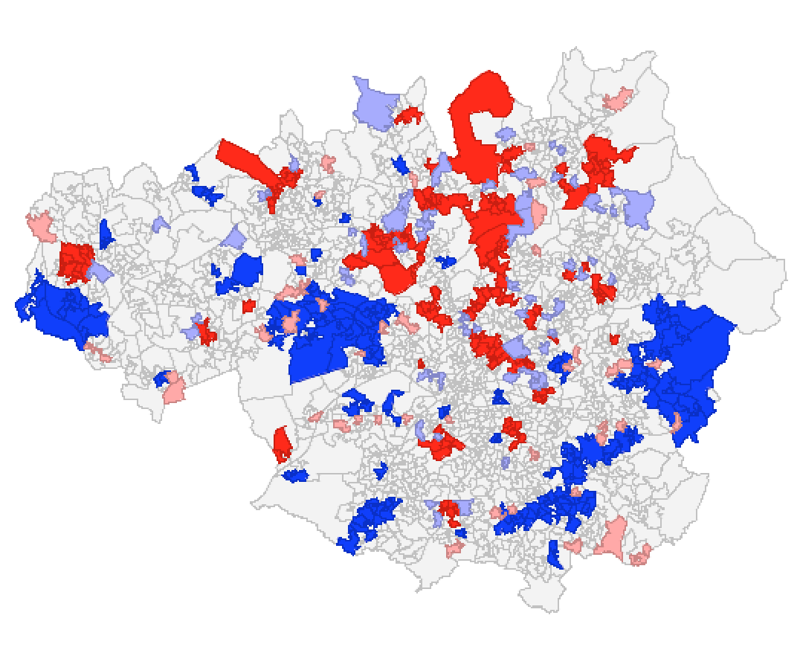
Course Outline
Intro
Toilets, fire alarm, breaks, presentation
Spatial Analysis & Decision Making
Spatial Autocorrelation
Clustering, Regression
RStudio
Buffers
Overlays
GeoDa
Spatial Autocorrelation / Clustering

Slide 4
Outline of the day
9:45 - 10:05am – Spatial data & EDA
10:05 - 10:45am – P.1 RStudio Map Making
10:45 - 11:15am – Spatial Analysis
11:15 - 12:30pm – P.2 Spatial Analysis
12:30 - 1:30pm – Lunch
1:30 - 1:45pm – Spatial Decision Making
1:45 - 3:00pm – P.3 Buffers / Intersections
3:00 - 3:15pm – Tea/Coffee
3:15 - 4pm/4:30pm – P.4 Regression
Notes:
Practical 2 – Bring Your Own Data

Slide 5
Exploratory Data Analysis
Data Analysis that is Exploratory
No formal hypothesis testing
Playing with and exploring the data
Usually start with descriptive statistics
Mean, St Dev, etc.
Usually first step to develop formal hypothesis

Slide 6
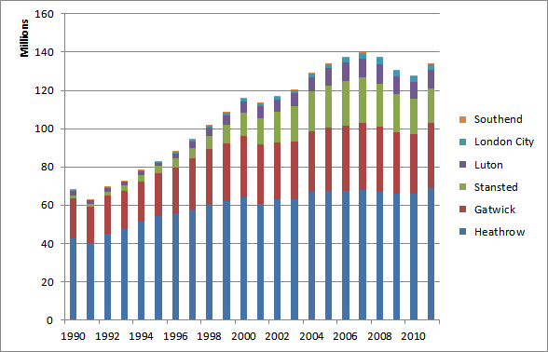
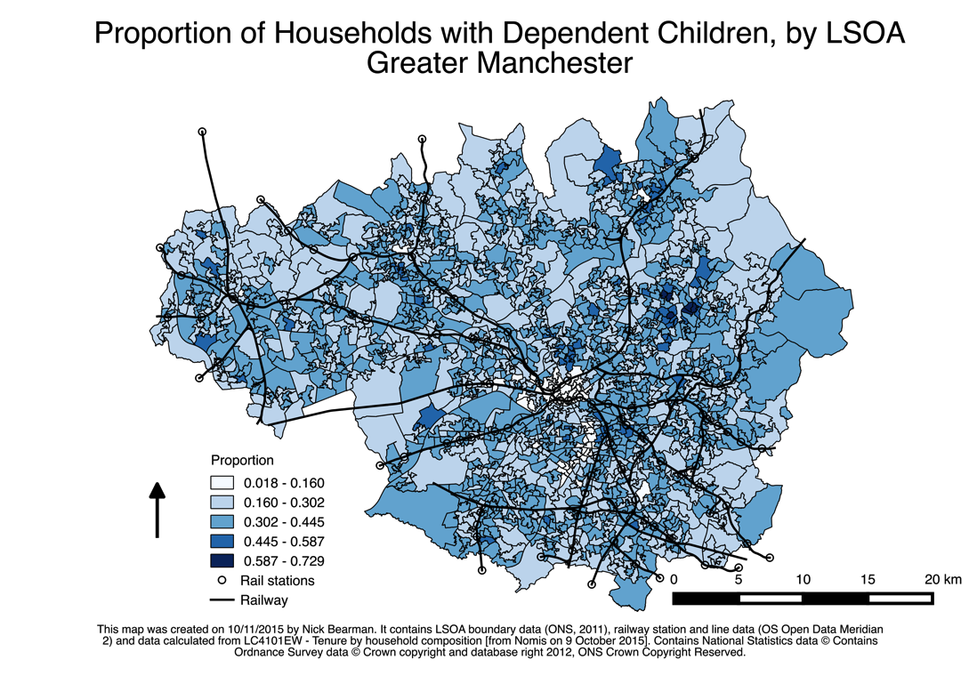
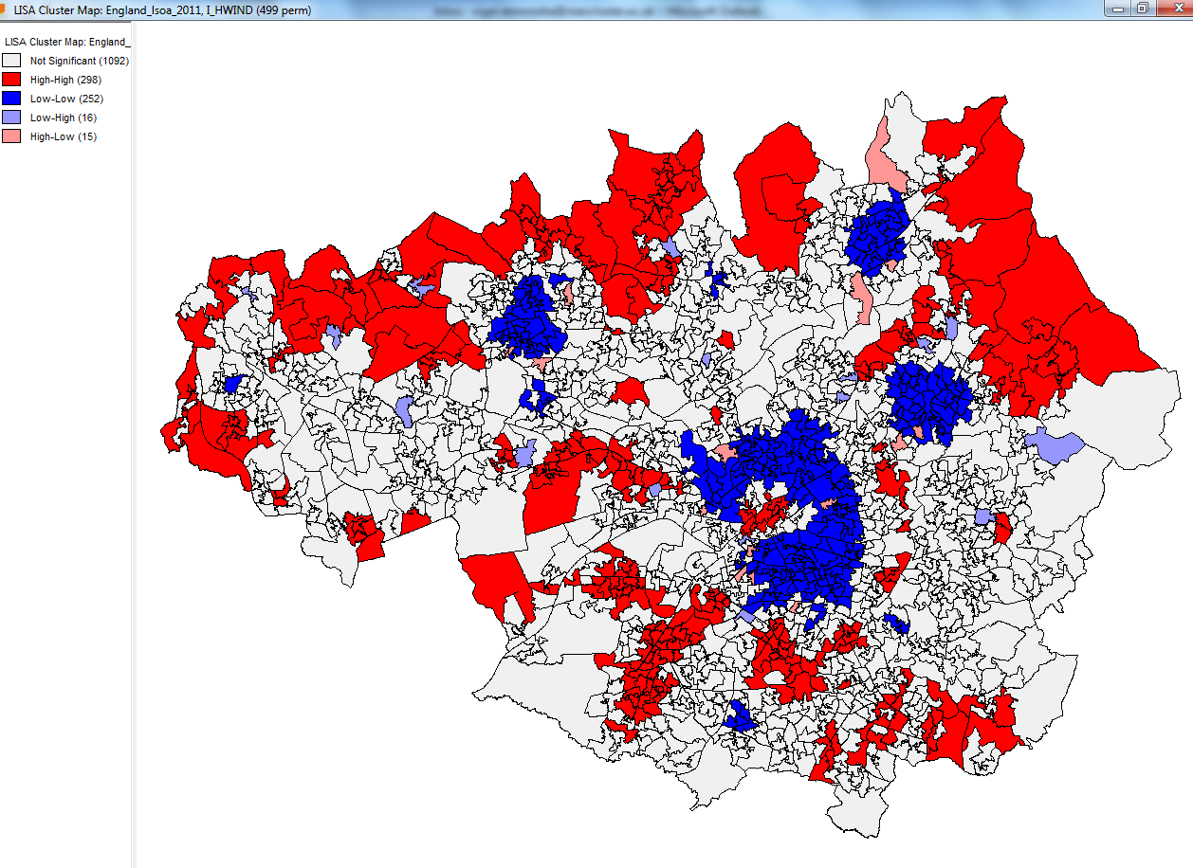
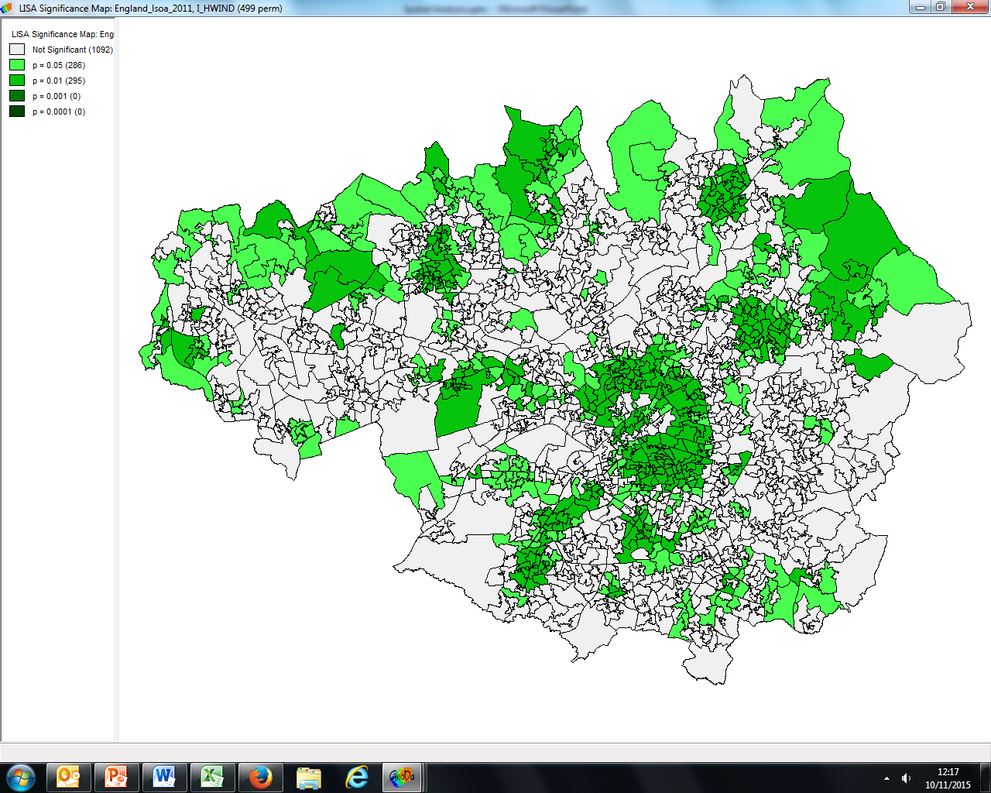
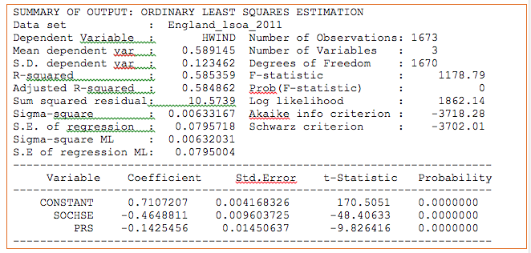
Three levels of data analysis
Numeric
Descriptive Maps
https://en.wikipedia.org/wiki/File:Passenger_numbers_for_London_Airports_in_a_bar_graph.png
Spatial Analytics
Notes:
Focus on 2 previously, 3 today.

Slide 7
Map Making & RStudio Recap
What is GIS / spatial data?
Why is selecting classes important?
Using RStudio
Read CSV / shapefiles
Manage data
Loops & Scripts
Libraries
(Spatial) Data Structure in R
Will do a quick recap

Slide 8
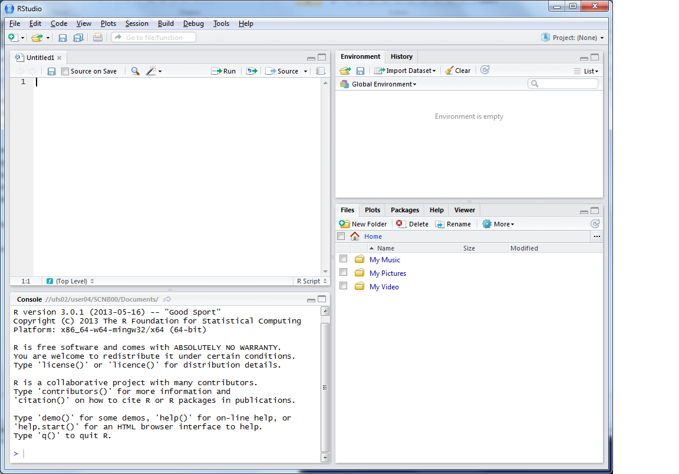


This is where you can write scripts
This lists the variables you have
Link to survey:
Here will show either your files (the files tab) or your plots (the plots tab)
This is the console where you can type in commands

Slide 9
Data Structure – Slot Names
Spatial*DataFrame
* = Points / Lines / Polygons
Slot Names slotNames(LSOA)
"data"
"polygons"
"bbox"
"proj4string"

Slide 10
Data Structure – Slot Names
Slot Names slotNames(LSOA)
"data” ”polygons” "bbox" "proj4string”
LSOA@data
LSOA@data$LSOA_CODE
@ and $
Try running
LSOA@proj4string

Slide 11
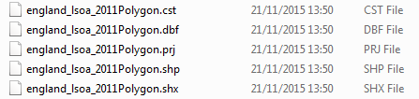
Shape Files
.shp the geometry (polygons) themselves
.shx extra geometry information
.dbf attribute information (dBase IV format)
.prj projection & coordinate system info
.cst text encoding
https://en.wikipedia.org/wiki/Shapefile
Notes:
Wikipedia can tell you more than you ever wanted to know about Shape file formats!

Slide 12
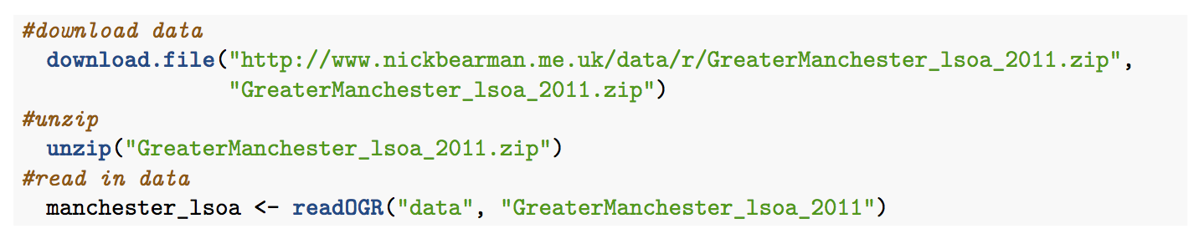
Some code wraps:

Slide 13
Practical 1 RStudio Map Making
Making Maps recap
Read spatial data & CSV in
Join data
Plot Map
Start a New Project
Write your code in a Script
Red and Green post-its

Slide 14
Outline of the day
9:45 - 10:05am – Spatial data & EDA
10:05 - 10:45am – P.1 RStudio Map Making
10:45 - 11:15am – Spatial Analysis
11:15 - 12:30pm – P.2 Spatial Analysis
12:30 - 1:30pm – Lunch
1:30 - 1:45pm – Spatial Decision Making
1:45 - 3:00pm – P.3 Buffers / Intersections
3:00 - 3:15pm – Tea/Coffee
3:15 - 4pm/4:30pm – P.4 Regression
Notes:
Practical 2 – Bring Your Own Data

Slide 15
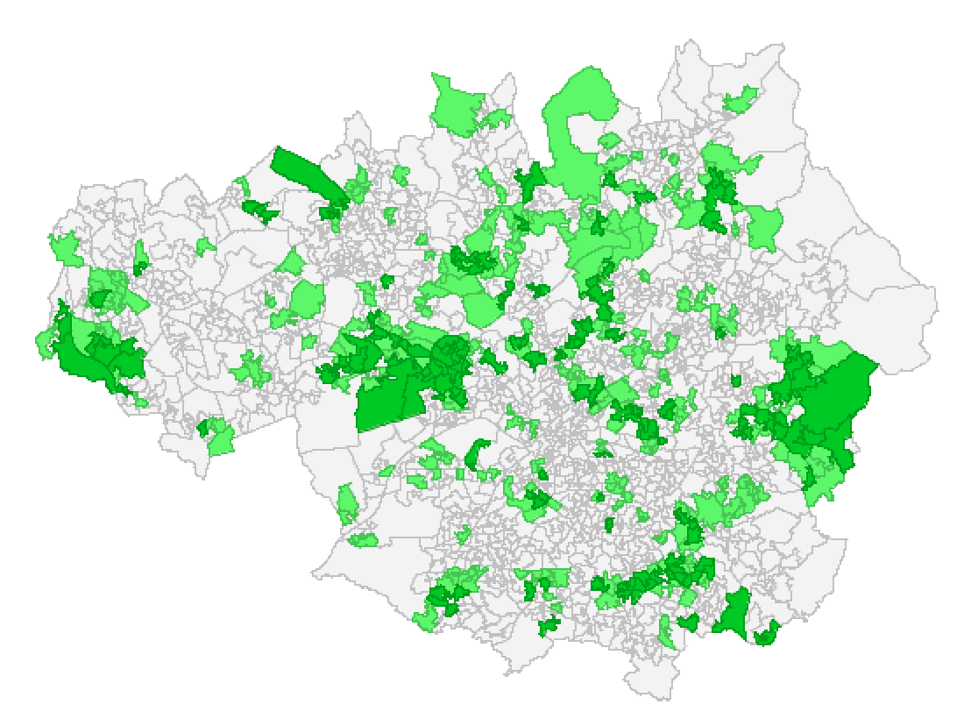
Spatial Analysis
Why are we interested in space?
Where things are have an impact
Sometimes just because of space and what they are next to
More often, because of some other variable that varies over space
Spatial Data
Many Advantages
Also Limitations

Slide 16
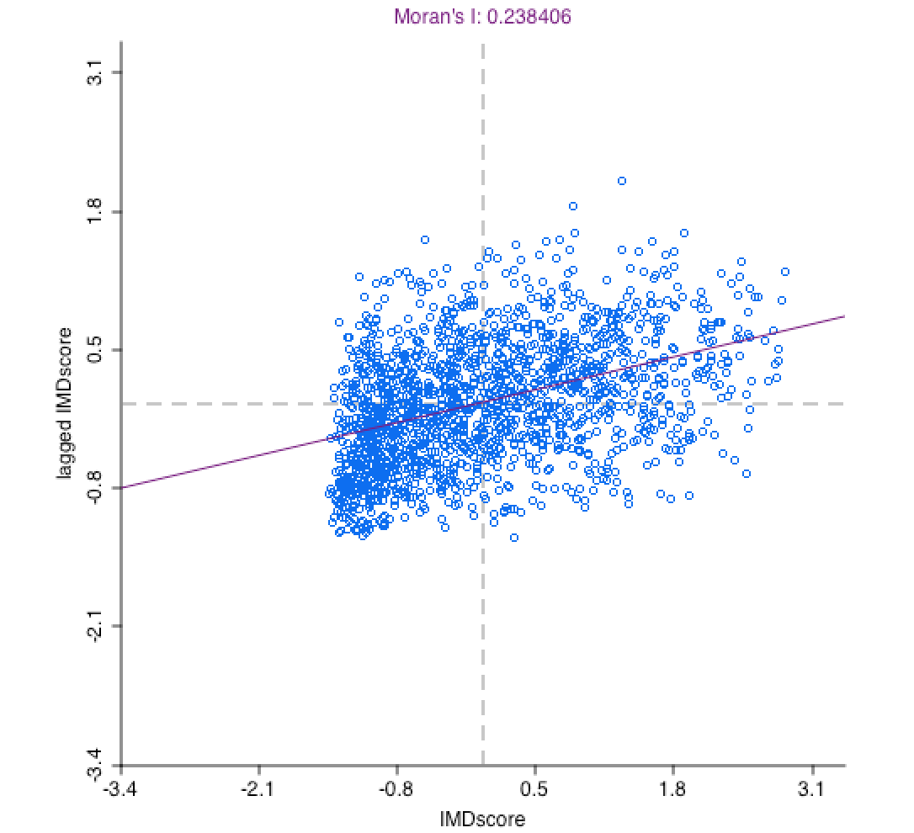
Challenges
Geocoding: locating individuals and events
Modifiable Areal Unit Problem
Spatial Dependence / Spatial Heterogeneity
Solutions
Diagnosing spatial autocorrelation
Global and local indicators
Mapping
Spatial regression techniques

Slide 17
Locating individuals and events
Location depends on research question and the availability of data
place of living or work?
geographic area of daily / yearly routines?
long-term longitudinal perspective?
at higher scale (e.g. neighbourhood, local authority)
To protect privacy geographical scale is often limited

Slide 18
Modifiable areal unit problem
“a problem arising from the imposition of artificial units of spatial reporting on continuous geographical phenomenon resulting in the generation of artificial spatial patterns” (Heywood, 1998)
“States and other forms of socio-political organization […] exercise their power in part through the ability to draw and redraw boundaries inside and around their territories” (Agnew, 2005)
Where (you) draw the boundaries is important
MPs in row over new seats set to push the boundaries
http://www.bbc.co.uk/news/uk-england-34701595
Gerrymandering (US) / How to Lie with Maps

Slide 19
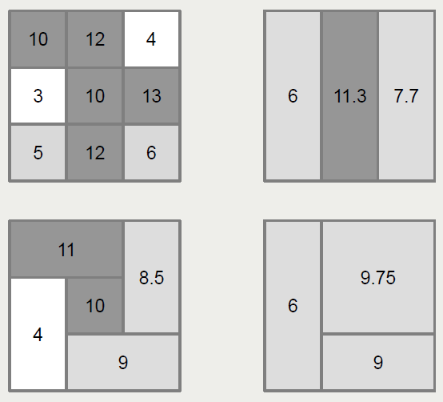
… an example …

Slide 20
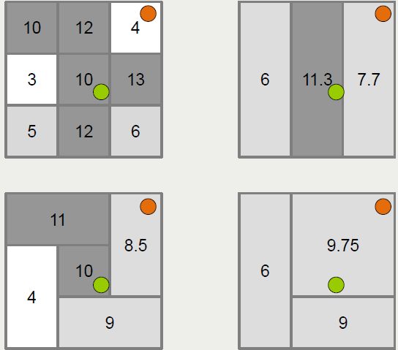
… and the potential for error

Slide 21
Ecological & individualistic fallacy
An ecological fallacy or ecological inference fallacy, is an error in the interpretation of statistical data in a study with macro data, whereby inferences about the nature of specific individuals are based solely upon aggregate statistics collected for the group to which those individuals belong.
Assuming every individual in the group has the group characteristics (e.g. IMD)
An individualistic fallacy or individualistic inference fallacy, is an error in the interpretation of statistical data in a study with micro data, whereby inferences about the nature of specific individuals are based solely upon individual statistics, not taking influences by the upper hierarchy contexts into account.
Assume everyone is individual, and no one is impacted by the group characteristics (e.g. IMD impacts)

Slide 22
Concepts of Spatial Dependence and Spatial Heterogeneity in Empirical Research
Spatial Dependence (2nd order spatial process)
Anselin (1988): “the existence of a functional relationship between what happens at one point in space and what happens elsewhere.“
Spatial Heterogeneity (1st order spatial process)
Not generated by spatial interaction. It refers to variation in relationships over space caused by the uniqueness of location or by spatially autocorrelated omitted variables].

Slide 23
Spatial dependence example
Prevalence of burglary
Income per household
1 | 2 | 3 | 4
5 | 6 | 7 | 8
9 | 10 | 11 | 12
13 | 14 | 15 | 16
1 | 2 | 3 | 4
5 | 6 | 7 | 8
9 | 10 | 11 | 12
13 | 14 | 15 | 16
low
medium
high
low
medium
high
Notes:
Spatial dependence – impact and relationship of space

Slide 24
Spatial heterogeneity example
Fertility levels
Female labour force participation
1 | 2 | 3 | 4
5 | 6 | 7 | 8
9 | 10 | 11 | 12
13 | 14 | 15 | 16
1 | 2 | 3 | 4
5 | 6 | 7 | 8
9 | 10 | 11 | 12
13 | 14 | 15 | 16
low
medium
high
low
medium
high
Notes:
Variation not caused by space, but by another variable (income)

Slide 25
Spatial autocorrelation
Spatial Autocorrelation can be
positive: clustering of high or low values
negative: clustering of neighbours with high and low values (chessboard pattern)
Effect of Spatial Autocorrelation in the error term is twofold:
it makes OLS-estimates of the t-test values unreliable
Positive Spatial Autocorrelation inflates the value of the r²-statistic, negative Spatial Autocorrelation deflates it.

Slide 26
Defining neighbours
To decide whether there is a spatial effect we need to calculate a neighbourhood weight. This can be base on:
Contiguity (adjacent spatial units)
Distance (between centroids of polygons)
Limited number of nearest neighbours
For the examples today we are using measures of contiguity.
Notes:
This is the weights file we have to create.

Slide 27
Contiguity measures
First order rook
First order queen
1 | 2 | 3 | 4
5 | 6 | 7 | 8
9 | 10 | 11 | 12
13 | 14 | 15 | 16
1 | 2 | 3 | 4
5 | 6 | 7 | 8
9 | 10 | 11 | 12
13 | 14 | 15 | 16

Slide 28
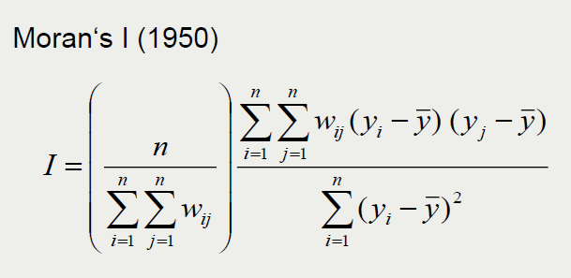
Global measure of spatial autocorrelation
Returns values of
1
Positive
0
None
-1
Negative
Spatial autocorrelation

Slide 29
Scatter plot of spatial autocorrelation
IMD in Greater Manchester

Slide 30

Clustering
Can look for unusual clusters
Where values are higher (or lower) than expected
Use univariate LISA:
To identify statistically significant clusters
Local Indicators of Spatial Autocorrelation
(Anselin, 1995)
Notes:
Image http://cdn3.hark.com/images/000/002/631/2631/original.gif
http://www.hark.com/collections/dtqzfmzlvm-lisa-simpson

Slide 31
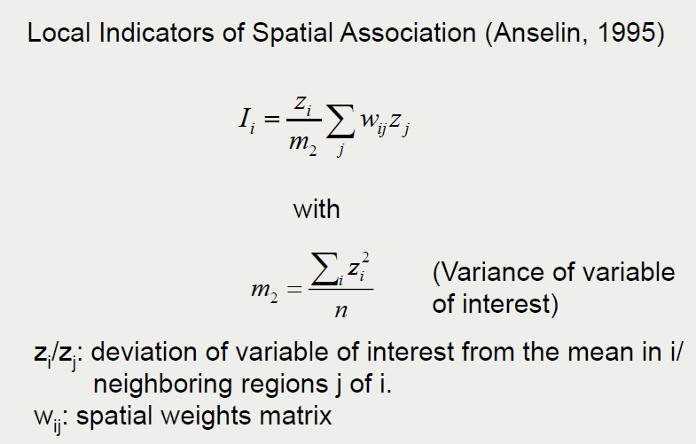
Local measures of spatial autocorrelation

Slide 32
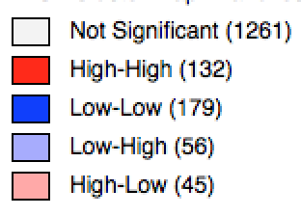
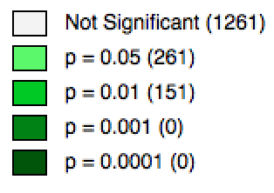
Local indicators of spatial autocorrelation (LISA maps)
IMD Score in Greater Manchester
White not significant
Red High surrounded by High
Blue Low surrounded by Low
Light blue Low surrounded by High
Pink High surrounded by Low
Notes:
High score = most deprived
Low score = least deprived

Slide 33
… and finally what might explain this
Geoda provides a regression model which allows you to take account of spatial lag (the effect of neighbouring areas) or spatial error (spatial heterogeneity)
It is best to try and fit a standard regression first so that you can compare the model fit criteria
In the practical exercise we will explore these options further

Slide 34
Practical 2 Performing Spatial Analysis
Using GeoDa & R for some analysis
Please experiment as we go through
Break at 12:30pm
Carry on with Practical 3 if you finish 2
I will do presentation after lunch

Slide 35
Lunch

Slide 36
Outline of the day
9:45 - 10:05am – Spatial data & EDA
10:05 - 10:45am – P.1 RStudio Map Making
10:45 - 11:15am – Spatial Analysis
11:15 - 12:30pm – P.2 Spatial Analysis
12:30 - 1:30pm – Lunch
1:30 - 1:45pm – Spatial Decision Making
1:45 - 3:00pm – P.3 Buffers / Intersections
3:00 - 3:15pm – Tea/Coffee
3:15 - 4pm/4:30pm – P.4 Regression
Notes:
Practical 2 – Bring Your Own Data

Slide 37
Spatial Decision Making
Using GIS to help us make a decision from a number of available options
Wide range of applications:
Where to site a paint factory?
Where can we site some wind turbines?
Which areas would benefit most from public transport?
Which areas find it hard to access a GP?
etc.

Slide 38
Spatial Decision Making
GIS allows us to answer (some) of these questions
But remember
CICO / Crap In -> Crap Out
Analysis is only as good as your data
And won’t provide all the answers

Slide 39
Deprivation & Transport
(Affordable) public transport can help with deprivation
The benefits of providing new public transport in deprived areas
https://www.jrf.org.uk/report/benefits-providing-new-public-transport-deprived-areas
Transport and Poverty: A Review of the Evidence
https://www.ucl.ac.uk/transport-institute/pdfs/transport-poverty

Slide 40
Deprivation & Transport
We will be looking at Metrolink tram in Greater Manchester
But principles can easily be applied to any other data
As you go through the practical:
How might these concepts be applied to your data?
What other spatial analysis techniques might be useful?

Slide 41
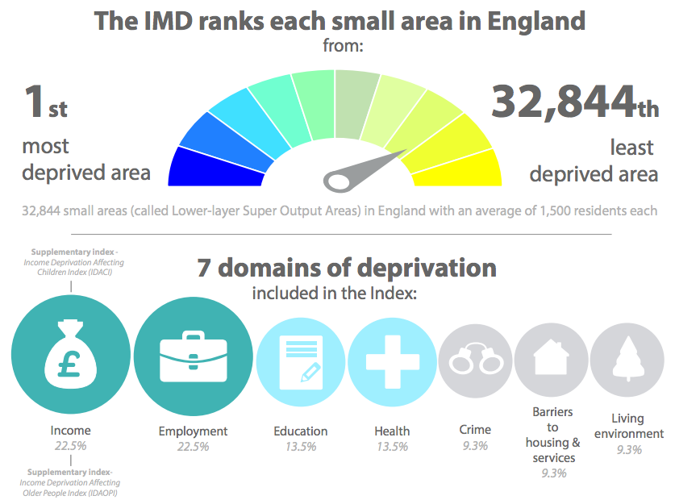
IMD – Index of Multiple Deprivation
Highest score
Lowest score
https://www.gov.uk/government/statistics/english-indices-of-deprivation-2015

Slide 42
Spatial Decision Making
We will be using
Point in Polygon
Buffers
Overlay & Averages

Slide 43
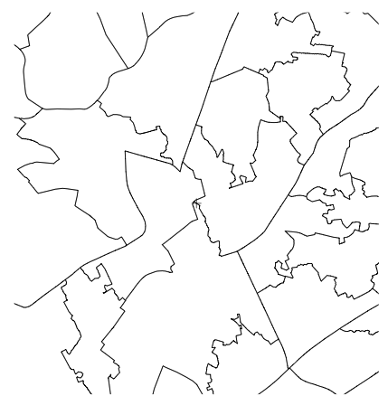
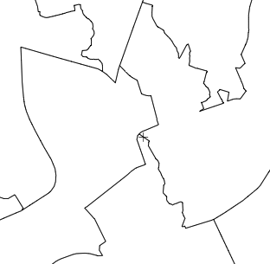
Point in Polygon
Notes:
Points are tram stations

Slide 44


Buffers
Notes:
Buffers around tram stations

Slide 45

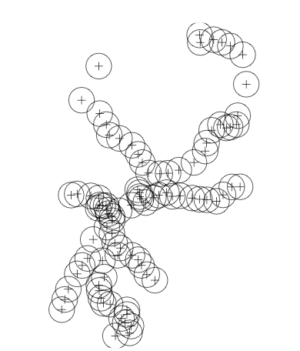
Buffers

Slide 46
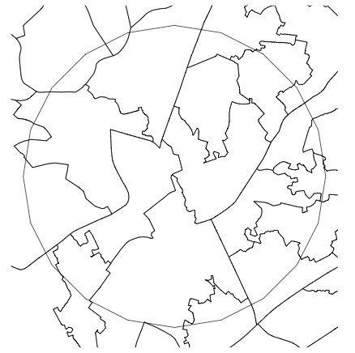
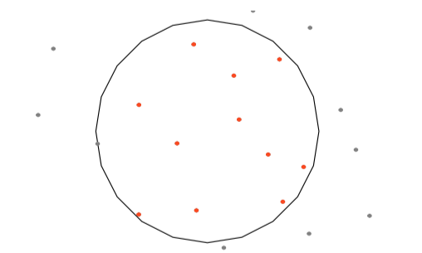
Point in Polygon
Notes:
Points (LSOAs) within Tram station buffers

Slide 47
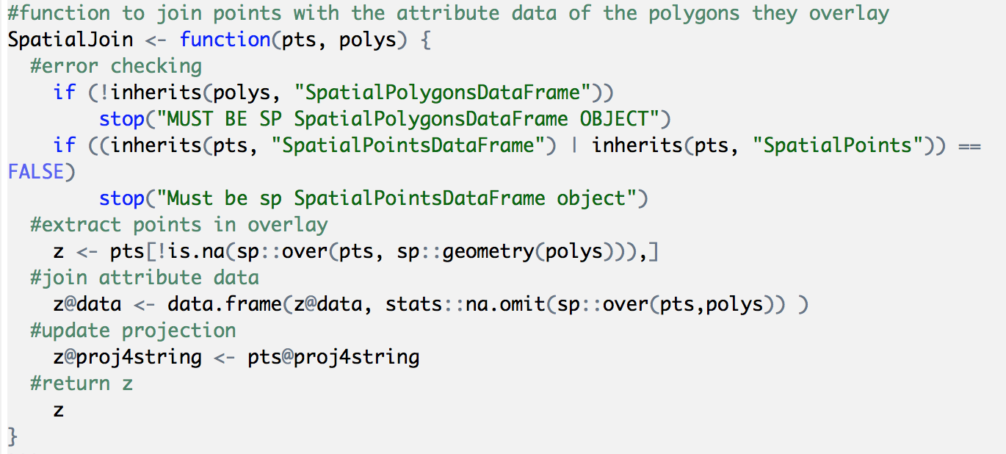
Functions
Make code easier to use
Have used many already
Any code can be made a function (maps)
Notes:
Key aspect to remember is inputs and outputs

Slide 48

Practical 3 Buffers and Intersections
Load Libraries
Things to think about:
What is easier / harder in RStudio compared to other software?
What other data could we use?
How else could we do the analysis?

Slide 49
Tea / Coffee

Slide 50
Outline of the day
9:45 - 10:05am – Spatial data & EDA
10:05 - 10:45am – P.1 RStudio Map Making
10:45 - 11:15am – Spatial Analysis
11:15 - 12:30pm – P.2 Spatial Analysis
12:30 - 1:30pm – Lunch
1:30 - 1:45pm – Spatial Decision Making
1:45 - 3:00pm – P.3 Buffers / Intersections
3:00 - 3:15pm – Tea/Coffee
3:15 - 4pm/4:30pm – P.4 Regression
Notes:
Practical 2 – Bring Your Own Data

Slide 51
Practical 4: Regression
Brief overview of Regression in GeoDa & R
Feel free to experiment
Or try some of the techniques we’ve discussed on your own data
Feedback is really important for me
bit.ly/1QmrFoB

Slide 52
What have you got from the course?
Using a range of GIS software to perform a range of spatial analysis
RStudio and GeoDa
Develop your confidence in using RStudio
Data handling
Scripts
Functions

Slide 53
Course Outline
Spatial Analysis & Decision Making
Spatial Autocorrelation
Clustering, Regression
RStudio
Buffers
Overlays
GeoDa
Spatial Autocorrelation / Clustering

Slide 54

Pros and Cons - R
+ scriptable
+ easily repeatable (change buffer)
+ custom analysis (& functions)
- steeper learning curve
- analysis gets very complex very quickly (poly in poly overlay)

Slide 55

References
Agnew, (2005) Sovereignty regimes: Territoriality and state authority in contemporary world politics, Annals of the Association of American Geographers, 437-461
Anselin, (1988) Spatial Econometrics: Methods and Models, vol.4. Studies in Operational Regional Science. Dordrecht: Springer Netherlands. http://link.springer.com/10.1007/978-94-015-7799-1
Anselin, L. (1995). Local Indicators of Spatial Association - LISA. Geographical Analysis 27, 93–115.
Brunsdon, C. & Comber L. (2015) An Introduction to R for Spatial Analysis and Mapping, Sage Publishing
Heywood (1998) Introduction to Geographical Information Systems. New York: Addison Wesley Longman.

Slide 56
Practical
Feedback is really important for me
bit.ly/1QmrFoB or
https://oxford.onlinesurveys.ac.uk/intermediate-r-for-spatial-analysis-4th-march-2016
Or email / phone / in person

