Slide 1


Confident Spatial Analysis in QGIS
Mon 12th Feb
10am – 4:00pm/4:30pm
Dr Nick Bearman
@nickbearmanuk

Slide 2
Welcome
Introductions
  Who are you?
    Name / organization / background
  What GIS have you done before?
    Basic QGIS / GIS is fine!
  What do you want from the course?
    What would you like to be able to do?

Slide 3
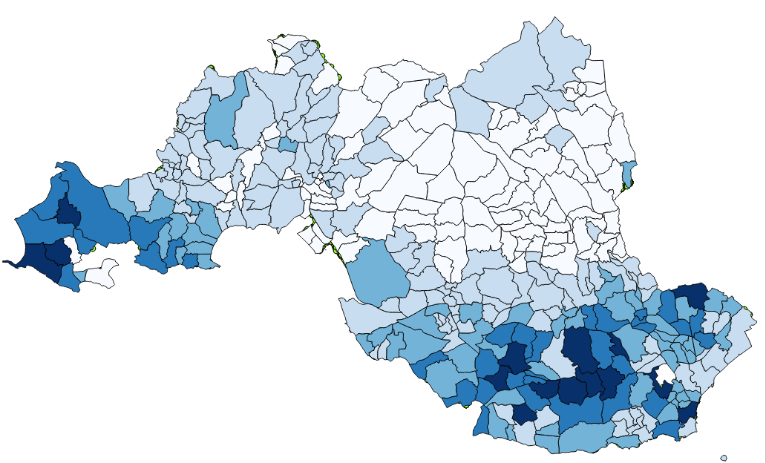
What will you get from today?
Finding GIS data and getting it into QGIS
Evaluating it – is is appropriate data?
Recap on coordinate systems – important!
GeoDa for non-spatial/spatial analysis
Join attributes
by location
Point in polygon
Clipping

Slide 4
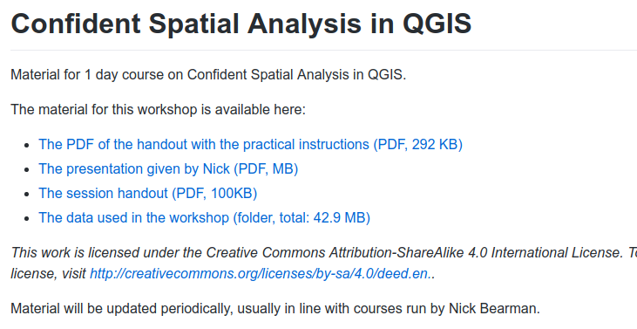
Housekeeping
Toilets
Fire Alarm
Breaks
Presentations, handouts and data online
  https://github.com/nickbearman/confident-spatial-analysis-qgis

Slide 5
Outline of the day
10:15am - 10:45am – Recap of GIS / spatial data
10:45am - 11:15am – P1: Recap of QGIS
11:15am - 11:45am – Using and evaluating data
11:45am - 12:30pm – P2: Crime, Houses Prices
12:30pm - 1:30pm – Lunch
1:30pm - 1:45pm – Recap and Analysis
1:45pm - 3:00pm – P3: Cardiff: LSOAs & IMD
3:00pm - 3:15pm – Tea/Coffee
3:15pm - 4pm/4:30pm – P4: Using your own data
Notes:
Practical 2 – Bring Your Own Data

Slide 6
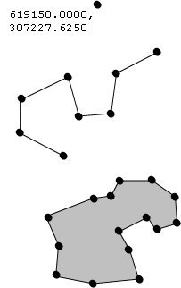
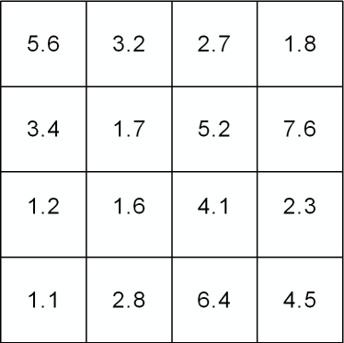

Vector and Raster data
Points, Lines & Polygons
Grid Based
Road networks
Rivers and lakes
Street addresses
or postcodes
Administrative areas/boundaries
Elevation
Temperature
Land cover
Population density
Light reflectance (in the form of satellite or aerial imagery)
Notes:
-Raster data is constructed by surveying or sampling at regular intervals on a grid layout.
e.g. soil sample every 500m, or interpolated (estimated) from contours.
-Usually assigned a colour in GIS. Includes images, aerial photos.
-You can convert data between the different formats quite easily in the software for different applications

Slide 7
Joining
Area ID
1
2
3
4
5
14
7
8
11
Area ID | Deprivation
1 | High
2 | High
3 | High
4 | Average
5 | Average
6 | Average
7 | Low
8 | Low
9 | Low
10 | High
11 | Low
12 | High
13 | High
14 | Average
15 | Average
1
2
3
14
4
7
5
8
11
Data
Polygons
Lookup

Slide 8
Joining
Area ID
1
2
3
4
5
14
7
8
11
Area ID | Deprivation
1 | High
2 | High
3 | High
4 | Average
5 | Average
6 | Average
7 | Low
8 | Low
9 | Low
10 | High
11 | Low
12 | High
13 | High
14 | Average
15 | Average
1
2
3
14
4
7
5
8
11
Data
Polygons
Lookup

Slide 9
1
Area ID | Deprivation
1 | High
2 | High
3 | High
4 | Average
5 | Average
14 | Average
7 | Low
8 | Low
11 | Low
2
3
14
4
7
5
8
11
High Deprivation
Average Deprivation
Low Deprivation

Slide 10
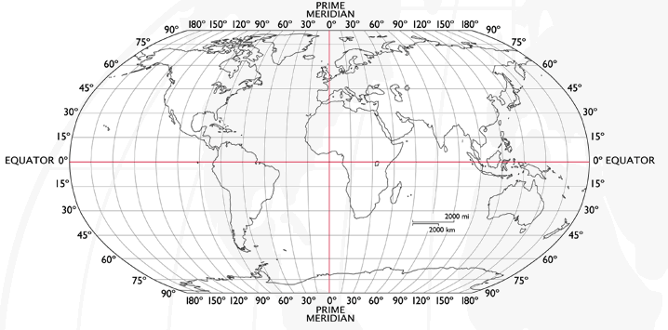
Coordinate Systems
Latitude and Longitude (WGS 1984) EPSG = 4326
  52°N 37’ 30.32’’ (52.6250) 1°E 14’ 2.05’’ (1.2339)
Notes:
-Coordinate Systems are derived from projections and are used to give coordinates (numbers) to locations on the Earth’s surface
-Best if your data is all in the same coordinate system (otherwise the coordinates might be slightly different for the same location), but ArcMap can convert between them
-Most common:
-Lat/Long (also WGS 1984) used by most GPS
-BNG (British National Grid) very common in UK data – Ordnance Survey format.
-Most important – are all your data in the same coordinate system?
-ArcMap can convert, but often if your data appears in the wrong place, it is because there is something wrong with the coordinate system.
http://www.worldatlas.com/webimage/testmaps/latslongs.htm
http://www.ordnancesurvey.co.uk/oswebsite/gps/information/coordinatesystemsinfo/guidetonationalgrid/page13.html
http://www.ordnancesurvey.co.uk/oswebsite/gps/information/coordinatesystemsinfo/guidetonationalgrid/page8.html

Slide 11
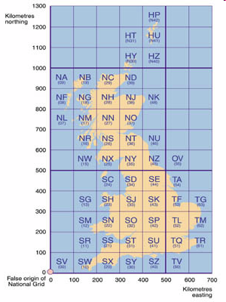
Coordinate Systems
Latitude and Longitude (WGS 1984) EPSG = 4326
  52°N 37’ 30.32’’ (52.6250) 1°E 14’ 2.05’’ (1.2339)
British National Grid (Eastings & Northings)
  Easting: 619301 Northing: 307416 EPSG = 27700
Notes:
-Coordinate Systems are derived from projections and are used to give coordinates (numbers) to locations on the Earth’s surface
-Best if your data is all in the same coordinate system (otherwise the coordinates might be slightly different for the same location), but ArcMap can convert between them
-Most common:
-Lat/Long (also WGS 1984) used by most GPS
-BNG (British National Grid) very common in UK data – Ordnance Survey format.
-Most important – are all your data in the same coordinate system?
-ArcMap can convert, but often if your data appears in the wrong place, it is because there is something wrong with the coordinate system.
http://www.worldatlas.com/webimage/testmaps/latslongs.htm
http://www.ordnancesurvey.co.uk/oswebsite/gps/information/coordinatesystemsinfo/guidetonationalgrid/page13.html
http://www.ordnancesurvey.co.uk/oswebsite/gps/information/coordinatesystemsinfo/guidetonationalgrid/page8.html

Slide 12
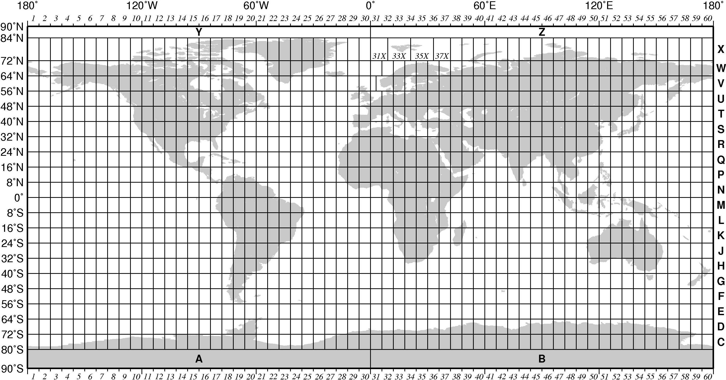
Coordinate Systems
UTM (Universal Transverse Mercator)
http://tabs2.gerg.tamu.edu/gmt/GMT_Docs/node108.html
Notes:
-Coordinate Systems are derived from projections and are used to give coordinates (numbers) to locations on the Earth’s surface
-Best if your data is all in the same coordinate system (otherwise the coordinates might be slightly different for the same location), but ArcMap can convert between them
-Most common:
-Lat/Long (also WGS 1984) used by most GPS
-BNG (British National Grid) very common in UK data – Ordnance Survey format.
-Most important – are all your data in the same coordinate system?
-ArcMap can convert, but often if your data appears in the wrong place, it is because there is something wrong with the coordinate system.
http://www.worldatlas.com/webimage/testmaps/latslongs.htm
http://www.ordnancesurvey.co.uk/oswebsite/gps/information/coordinatesystemsinfo/guidetonationalgrid/page13.html
http://www.ordnancesurvey.co.uk/oswebsite/gps/information/coordinatesystemsinfo/guidetonationalgrid/page8.html

Slide 13
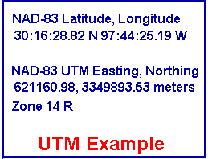
Coordinate Systems
UTM (Universal Transverse Mercator)
  621160.98, 3349893.53 meters, Zone 14 R
  Base unit of meters
http://tabs2.gerg.tamu.edu/gmt/GMT_Docs/node108.html
http://www.colorado.edu/geography/gcraft/notes/coordsys/coordsys.html
Notes:
-Coordinate Systems are derived from projections and are used to give coordinates (numbers) to locations on the Earth’s surface
-Best if your data is all in the same coordinate system (otherwise the coordinates might be slightly different for the same location), but ArcMap can convert between them
-Most common:
-Lat/Long (also WGS 1984) used by most GPS
-BNG (British National Grid) very common in UK data – Ordnance Survey format.
-Most important – are all your data in the same coordinate system?
-ArcMap can convert, but often if your data appears in the wrong place, it is because there is something wrong with the coordinate system.
http://www.worldatlas.com/webimage/testmaps/latslongs.htm
http://www.ordnancesurvey.co.uk/oswebsite/gps/information/coordinatesystemsinfo/guidetonationalgrid/page13.html
http://www.ordnancesurvey.co.uk/oswebsite/gps/information/coordinatesystemsinfo/guidetonationalgrid/page8.html

Slide 14
Coordinate Systems
Latitude and Longitude (WGS 1984) EPSG = 4326
  52°N 37’ 30.32’’ (52.6250) 1°E 14’ 2.05’’ (1.2339)
British National Grid (Eastings & Northings)
  Easting: 619301 Northing: 307416 EPSG = 27700
UTM (Universal Transverse Mercator)
  621160.98, 3349893.53 meters, Zone 14 R
  EPSG = depends on zone
Why is it important?
  Some data uses uses WGS84, some BNG, UTM
  Need to convert between then
  Some tools in QGIS do this automatically, but not all
  50% of GIS issues are due to coordinate systems!
Notes:
-Coordinate Systems are derived from projections and are used to give coordinates (numbers) to locations on the Earth’s surface
-Best if your data is all in the same coordinate system (otherwise the coordinates might be slightly different for the same location), but ArcMap can convert between them
-Most common:
-Lat/Long (also WGS 1984) used by most GPS
-BNG (British National Grid) very common in UK data – Ordnance Survey format.
-Most important – are all your data in the same coordinate system?
-ArcMap can convert, but often if your data appears in the wrong place, it is because there is something wrong with the coordinate system.
http://www.worldatlas.com/webimage/testmaps/latslongs.htm
http://www.ordnancesurvey.co.uk/oswebsite/gps/information/coordinatesystemsinfo/guidetonationalgrid/page13.html
http://www.ordnancesurvey.co.uk/oswebsite/gps/information/coordinatesystemsinfo/guidetonationalgrid/page8.html

Slide 15
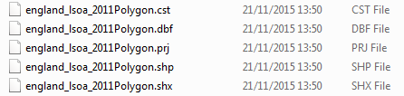
Shape Files
.shp the geometry (polygons) themselves
.shx extra geometry information
.dbf attribute information (dBase IV format)
.prj projection & coordinate system info
.cst text encoding
https://en.wikipedia.org/wiki/Shapefile
Notes:
Wikipedia can tell you more than you ever wanted to know about Shape file formats!

Slide 16
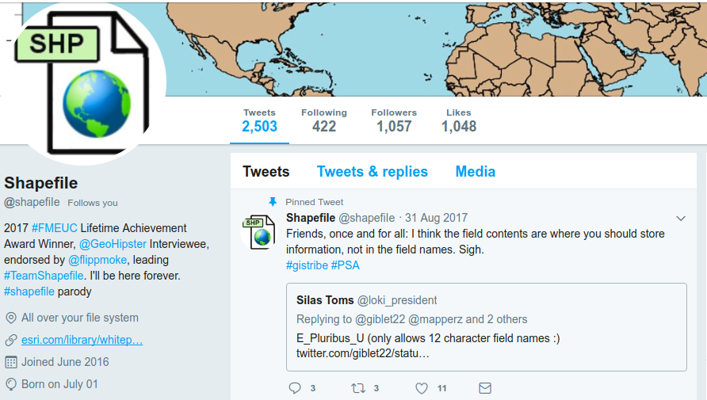
Shape Files
(One of) the most common spatial data file formats
ESRI 1990s, closed, → opened ~1997
Shape file twitter account
https://twitter.com/shapefiIe

Slide 17
File Formats
Mainly been using Shapefiles
They are just one of many formats
Will be using:
  GeoJSON
  GML
  And various other ones
Some are plain text - open in Notepad if you are interested
Notes:
Key aspect to remember is inputs and outputs

Slide 18
QGIS Recap
QGIS Recap
Loading & Joining Data
Creating a choropleth map
  What are appropriate classifications for the data?
Any questions, let me know
  Put up an orange post-it note if I am with someone else
If you are happy, you can carry on to Prac 2

Slide 20
Outline of the day
10:15am - 10:45am – Recap of GIS / spatial data
10:45am - 11:15am – P1: Recap of QGIS
11:15am - 11:45am – Using and evaluating data
11:45am - 12:30pm – P2: Crime, Houses Prices
12:30pm - 1:30pm – Lunch
1:30pm - 1:45pm – Recap and Analysis
1:45pm - 3:00pm – P3: Cardiff: LSOAs & IMD
3:00pm - 3:15pm – Tea/Coffee
3:15pm - 4pm/4:30pm – P4: Using your own data
Notes:
Practical 2 – Bring Your Own Data

Slide 21
Using and Evaluating Data
Data is crucial to GIS
~50% of time doing a GIS project is spent finding data or getting data into the right format!
Finding data can be a real pain
Previous work should reference where they get data from
  If not, it’s a reasonable question to ask the author
There is no one list of data, but some useful sources

Slide 22
Spatial Data
Ordnance Survey
  OS Open Data, Boundary Line, ...
EuroStat
Free GIS Data, Robert Wilson
  http://freegisdata.rtwilson.com/
Census & Census Boundary
  http://census.edina.ac.uk/
GADM - www.gadm.org
Google Search – shapefile / GIS

Slide 23
Spatial Data: Suitability
How complete is the data?
How up-to-date is the data?
Who is providing the data? How did they collect / collate / process / edit it?
Be critical of GIS data sources!
  Don’t just assume it is correct.

Slide 24
Spatial Data: Metadata
Metadata can help with providing some of this information
Can be very variable content, depending on who is providing the data

Slide 25
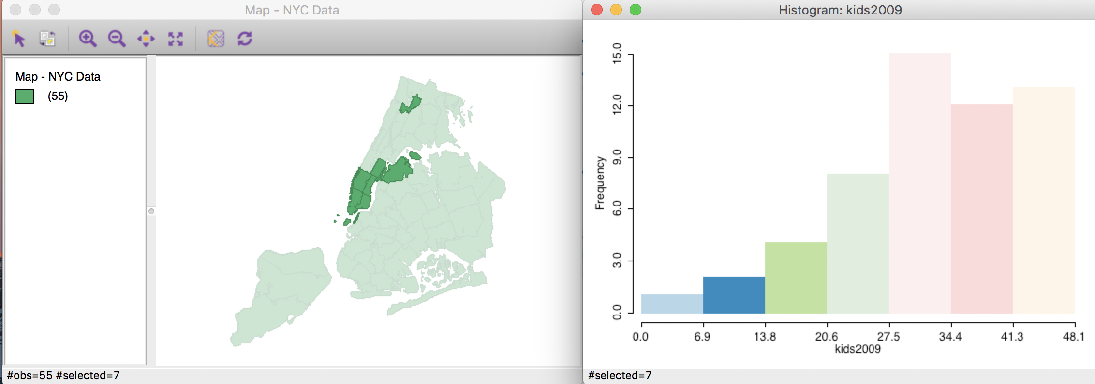
Practical 2: Swansea & Cardiff: Crime, Houses Prices and Flooding
Mostly be using QGIS
Also using GeoDa
  Linked Displays
http://geodacenter.github.io/workbook/2_eda/lab2.html

Slide 26
Practical 2: Swansea & Cardiff: Crime, Houses Prices and Flooding
We will be re-projecting data to 27700
Adding crime data
  X Y coordinates, latitude, longitude
Clip
Aggregating Data
  Count Points in Polygons (crime)
  Join Attributes by Location (house prices)

Slide 27
Practical 2: Swansea & Cardiff: Crime, Houses Prices and Flooding
Being critical of the GIS is important.
Are the results / outputs what you expect?
Don't just trust the computer!

Slide 28
Outline of the day
10:15am - 10:45am – Recap of GIS / spatial data
10:45am - 11:15am – P1: Recap of QGIS
11:15am - 11:45am – Using and evaluating data
11:45am - 12:30pm – P2: Crime, Houses Prices
12:30pm - 1:30pm – Lunch
1:30pm - 1:45pm – Recap and Analysis
1:45pm - 3:00pm – P3: Cardiff: LSOAs & IMD
3:00pm - 3:15pm – Tea/Coffee
3:15pm - 4pm/4:30pm – P4: Using your own data
Notes:
Practical 2 – Bring Your Own Data

Slide 29
Lunch

Slide 30
Outline of the day
10:15am - 10:45am – Recap of GIS / spatial data
10:45am - 11:15am – P1: Recap of QGIS
11:15am - 11:45am – Using and evaluating data
11:45am - 12:30pm – P2: Crime, Houses Prices
12:30pm - 1:30pm – Lunch
1:30pm - 1:45pm – Recap and Analysis
1:45pm - 3:00pm – P3: Cardiff: LSOAs & IMD
3:00pm - 3:15pm – Tea/Coffee
3:15pm - 4pm/4:30pm – P4: Using your own data
Notes:
Practical 2 – Bring Your Own Data

Slide 31
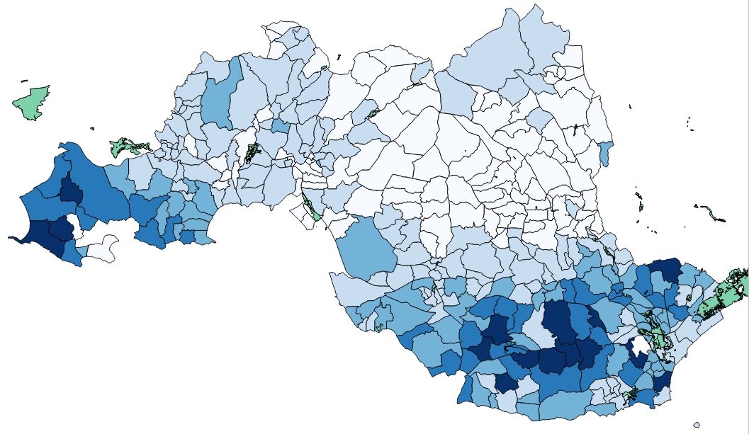
Practical 2: Swansea & Cardiff: Crime, Houses Prices and Flooding

Slide 32
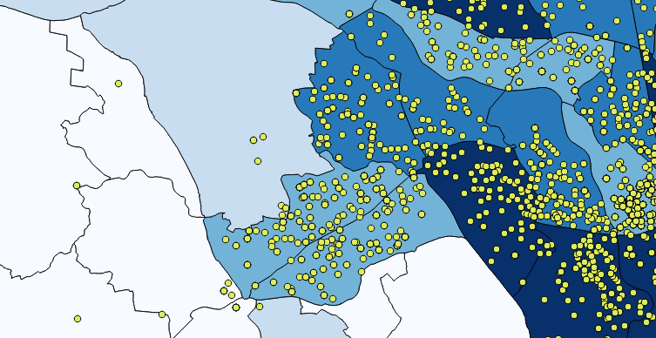
Practical 2: Swansea & Cardiff: Crime, Houses Prices and Flooding
Crime Data
How we aggregate the data is important

Slide 33
Modifiable Areal Unit Problem
“a problem arising from the imposition of artificial units of spatial reporting on continuous geographical phenomenon resulting in the generation of artificial spatial patterns” (Heywood, 1998)
Where (you) draw the boundaries is important
People don’t live in homogeneous units
Areas are created to count the population
MPs in row over new seats set to push the boundaries
  http://www.bbc.co.uk/news/uk-england-34701595
Gerrymandering (US) / How to Lie with Maps, Mark Monmonier

Slide 34
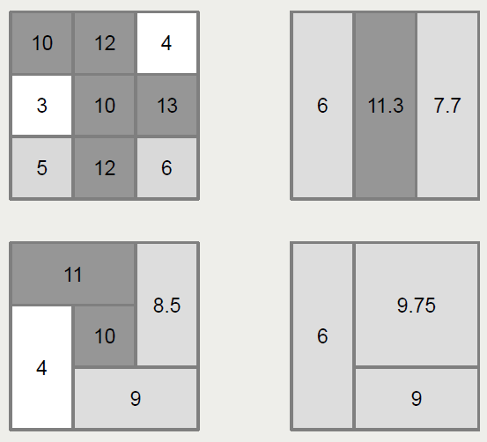
… an example …

Slide 35
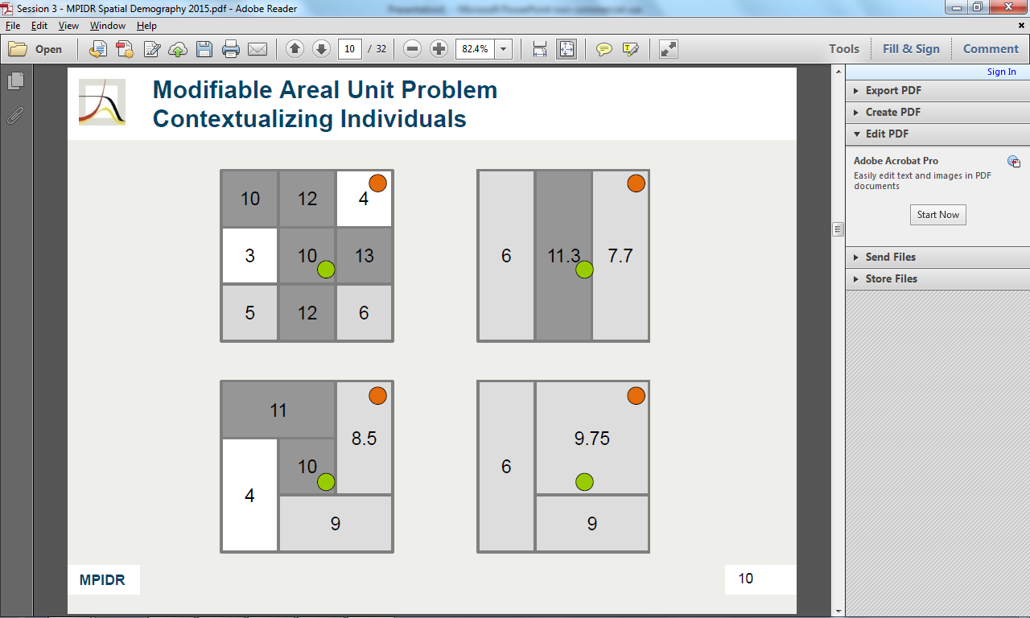
… and the potential for error

Slide 36
Modifiable Areal Unit Problem
What can we do about it?
  Not much
Just important to be aware that it can cause errors

Slide 37
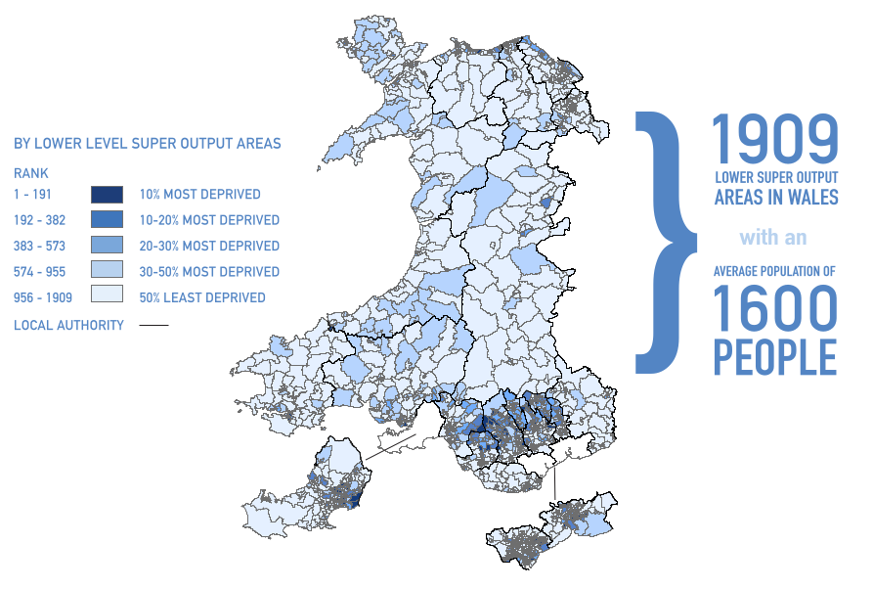
Welsh IMD – WIMD 2014

Slide 38

Welsh IMD – WIMD 2014
Welsh Index of Multiple Deprivation
Only have ranked data –
no score as in English IMD

Slide 39
Data Management
Data Management is key
Spatial data generates lots of files
Having a system is crucial
Particularly if you have multiple people working on the same project

Slide 40
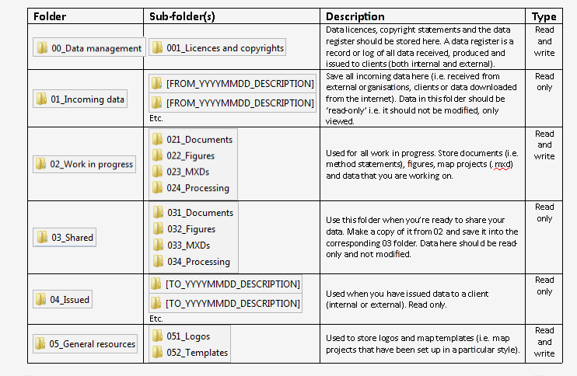
Data Management

Slide 41
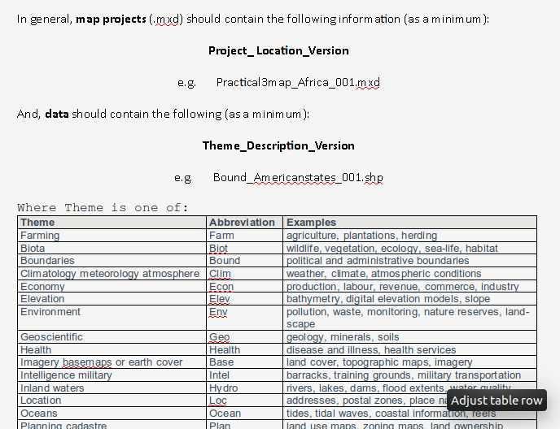
Data Management

Slide 42
Sharing Data
Emailing your colleague the shape files
  Easy.
  Easy to get confused
    Which is latest version?
Need naming convention
    Report.docx
    Final report.docx
    Approved Final report.docx
    USE THIS ONE Approved Final report.docx
    USE THIS ONE Approved Final report 2.docx
    USE THIS ONE Approved Final report 2b.docx

Slide 43
Sharing Data
Sharing shape files on a network drive
  Can’t edit at the same time
  Need naming convention
    Report.docx
    Final report.docx
    Approved Final report.docx
    USE THIS ONE Approved Final report.docx
    USE THIS ONE Approved Final report 2.docx
    USE THIS ONE Approved Final report 2b.docx

Slide 44
Sharing Data
Sharing shape files on a network drive
  Can’t edit at the same time
  Need naming convention
PostgreSQL / PostGIS
  Database
  Can edit multiple pieces at the same time
  More complex to setup

Slide 45
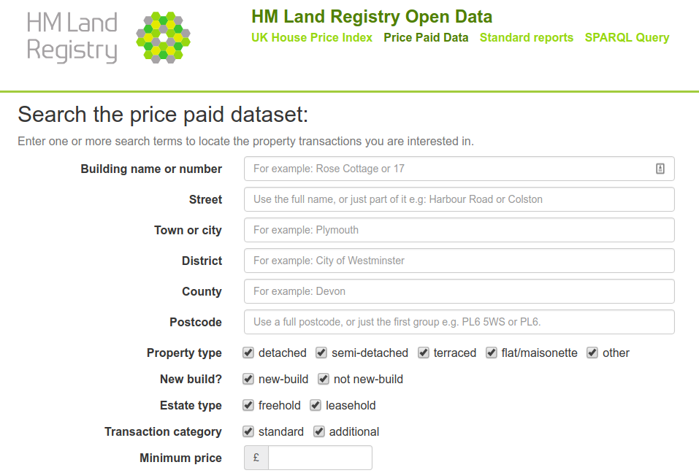
Land Registry: Price Paid Data

Slide 46
 | 21
TransactionID | {55BDCAE6-6668-521D-E053-6B04A8C0DD7A}
Price | 375000
Date | 2017-07-07
Postcode | KT9 1XE
Type | S
Old-New | N
Duration | F
PAON | 1
Street | HURST CLOSE
Town-City | CHESSINGTON
District | KINGSTON UPON THAMES
County | GREATER LONDON

Slide 47
 | 21
TransactionID | {55BDCAE6-6668-521D-E053-6B04A8C0DD7A}
Price | 375000
Date | 2017-07-07
Postcode | KT9 1XE
Type | S
Old-New | N
Duration | F
PAON | 1
Street | HURST CLOSE
Town-City | CHESSINGTON
District | KINGSTON UPON THAMES
County | GREATER LONDON

Slide 48
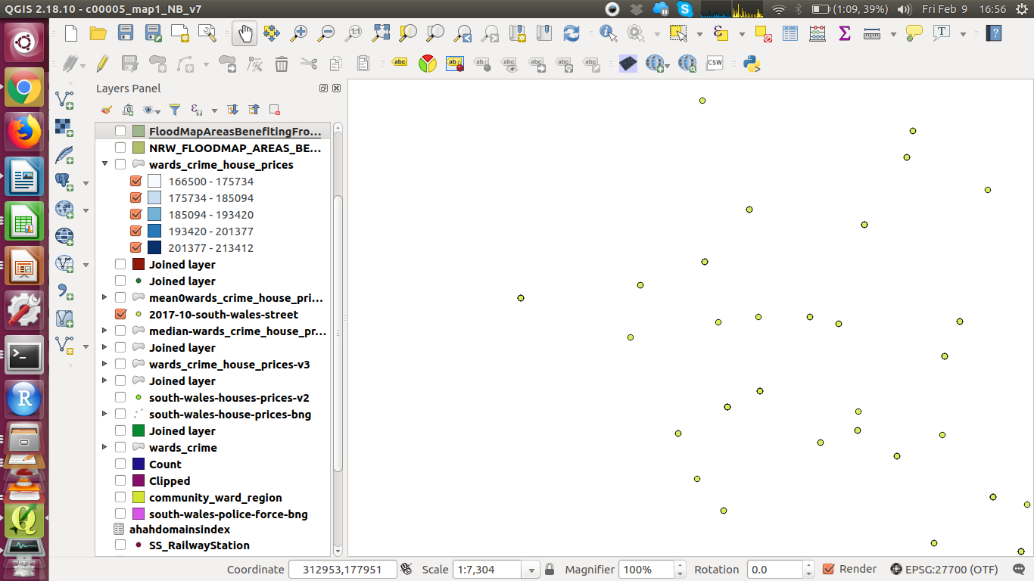
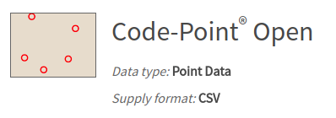
Attribute Join
TransactionID | Price | Postcode
{55BDCAE6-... | 375000 | TR1 1DE
{55BDCAE6-... | 225000 | PL6 7TH
{55BDCAE6-... | 150000 | L17 9QA
Postcode | Coordinate
TR1 1DE | 345000 450000
PL6 7TH | 645000 650000
L17 9QA | 845000 750000
https://www.ordnancesurvey.co.uk/opendatadownload/products.html

Slide 49
Geocoding Postcodes
Code Point or
doogal.co.uk/BatchGeocoding.php
I have done Price Paid Data for You
  (I used R, but can use QGIS)
Have a go at sample data if you want – see Postcodes handout

Slide 50
Practical 3: Cardiff: LSOAs,
IMD & Greenspace
We will be using GML data
Greenspace data
You can open it in Notepad if you like
  Or something else, as its 16mb

Slide 51
Outline of the day
10:15am - 10:45am – Recap of GIS / spatial data
10:45am - 11:15am – P1: Recap of QGIS
11:15am - 11:45am – Using and evaluating data
11:45am - 12:30pm – P2: Crime, Houses Prices
12:30pm - 1:30pm – Lunch
1:30pm - 1:45pm – Recap and Analysis
1:45pm - 3:00pm – P3: Cardiff: LSOAs & IMD
3:00pm - 3:15pm – Tea/Coffee
3:15pm - 4pm/4:30pm – P4: Using your own data
Notes:
Practical 2 – Bring Your Own Data

Slide 52
Tea / Coffee

Slide 53
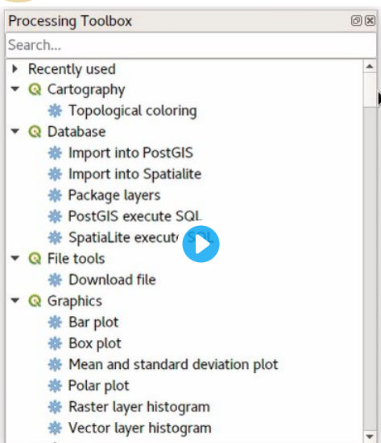
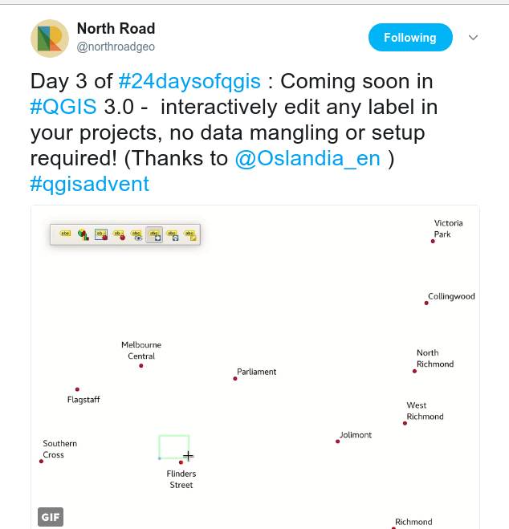
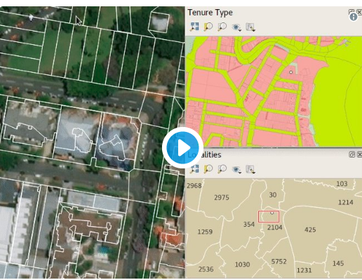
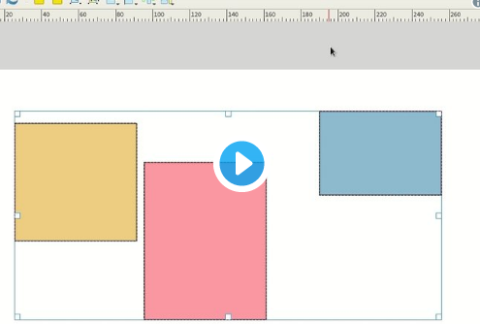
QGIS 3.0 – Soon!
https://north-road.com/2017/12/24/24-days-of-qgis-3-0-features/

Slide 54

FOSS4G UK 2018 - London
8th & 9th March
  10th for Codesprint
Geovation, Urban Innovation Centre
  1 Sekforde Street Clerkenwell Green London EC1R 0BE
Talks and Workshops
QGIS, Python, PostGIS, web, server, etc.
uk.osgeo.org/foss4guk2018/
Tickets will go – batches released on 12th & 21st Feb

Slide 55


Common Problems in Mapping
Data availability
  Google, other work
Losing work
  Saving, backups, testing backups
Specific feature not working
  Restart and try again, Google error message
How do I do x in y?
  Google, colleagues
Stack Exchange
  http://gis.stackexchange.com/

Slide 56
Next Steps
QGIS
  QGIS Plugins
  QGIS Courses
  Repeat material – 2/3 weeks, 2/3 months
    nick@clearmapping.co.uk
Feedback
Future Courses
  Intro to Using R/RStudio as a GIS
  Confident Spatial Analysis and Spatial Statistics in R & GeoDa

Slide 57
Using Your Own Data
Feel free to experiment
And/or try some of the techniques we’ve discussed on your own data
Feedback is really important for me

