Slide 1


Introduction to Spatial Data &
Using R as a GIS
Tue 21st Nov
10am – 4:00pm/4:30pm
Dr Nick Bearman
@nickbearmanuk

Slide 2
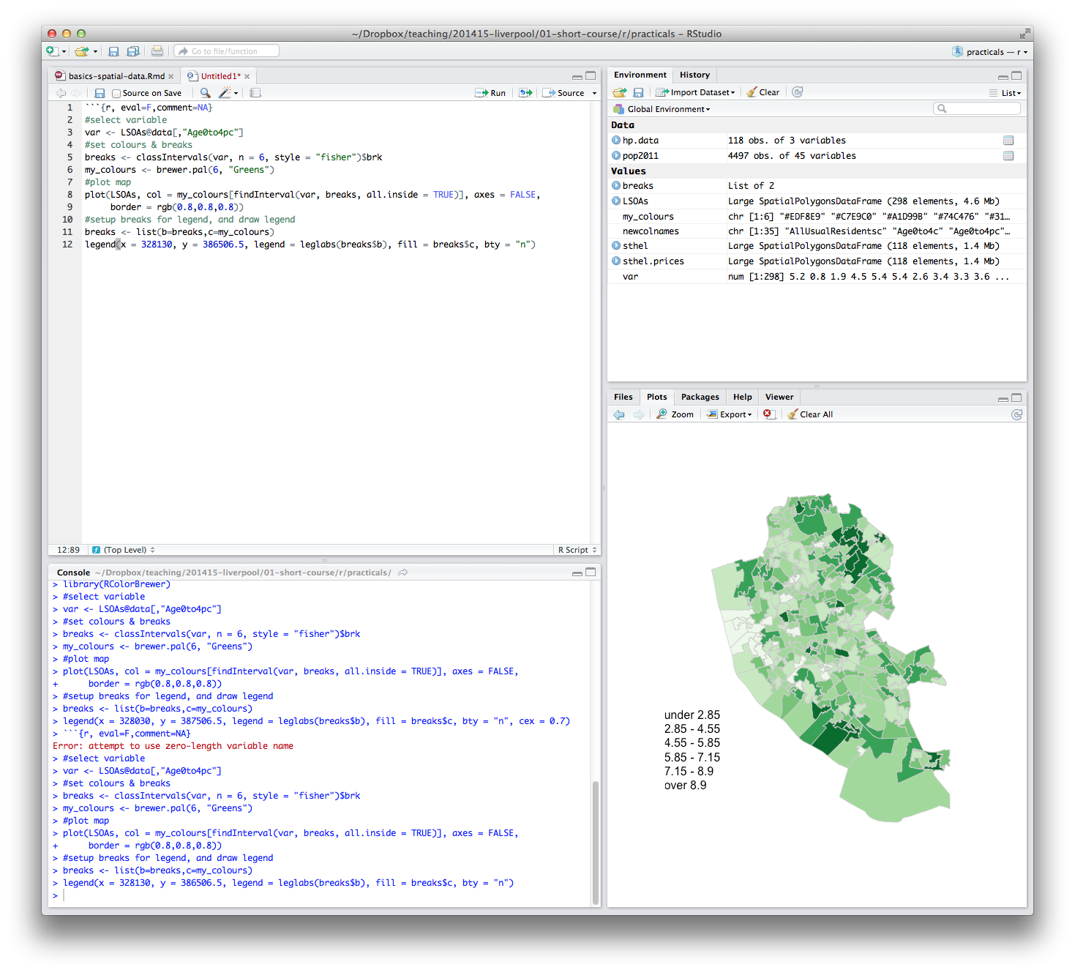
Welcome
Introductions
  Who are you?
  What GIS have you used before?
  What do you want to get from the course?

Slide 3
What will you get from the course?
Background on R and RStudio
Load spatial data
Create a map
Basic analysis
Using your own data

Slide 4
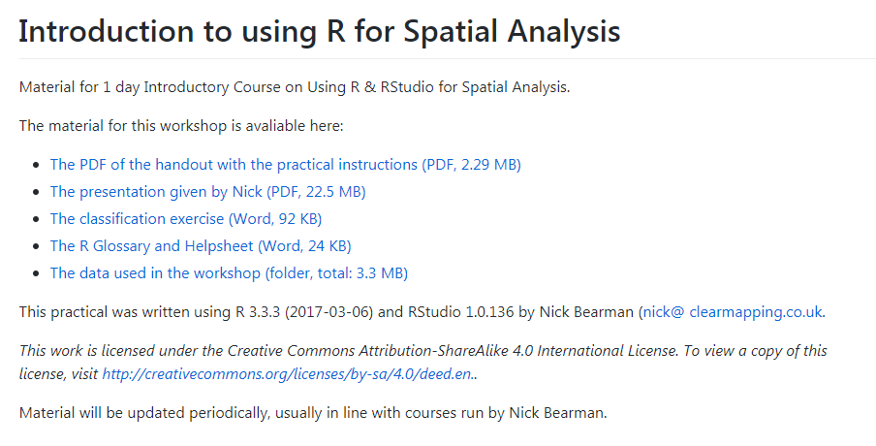
Housekeeping
Toilets
Fire Alarm
Breaks
Presentations, handouts and data online
  https://github.com/nickbearman/intro-r-spatial-analysis

Slide 5
Outline of the day
10:15am – 10:45am – What is GIS & R?
10:45am – 11:15am – Practical 1 Intro to GIS & R
11:15am – 11:45am – Classification
11:45am – 12:30pm – Practical 1 Intro to GIS & R
12:30pm – 1:30pm – Lunch
1:30pm – 1:45pm – Recap and Making Maps
1:45pm – 3:00pm – Practical 2 Analysis
3:00pm – 3:15pm – Tea/Coffee
3:15pm – 4pm/4:30pm – P.3 Bring your own data
Notes:
Practical 2 – Bring Your Own Data

Slide 6




CDRC
ESRC: Getting more Information from Retail Data
Outreach – Stakeholder Users
Engagement – PhD / MSc / Training
Data and Services
  Open, Safeguarded, Controlled

Slide 7
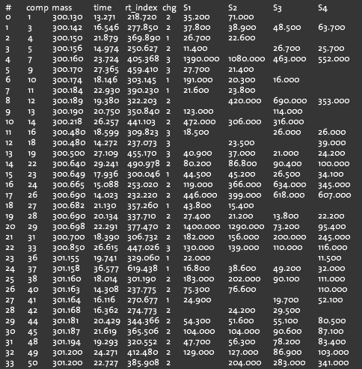
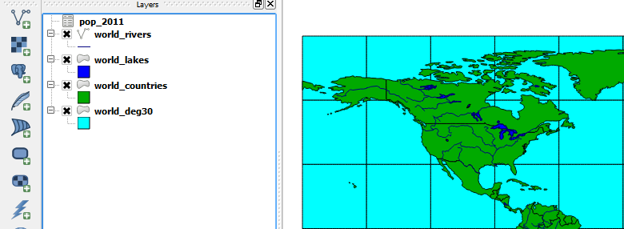
What is GIS?
Geographic Information Systems
Turning (spatial) data into information
Using this information to answer questions
  How have housing conditions changed in the past ten years?
http://www.flickr.com/photos/dsleeter_2000/3097476532 & ESRI Course “Teaching with GIS”

Slide 8
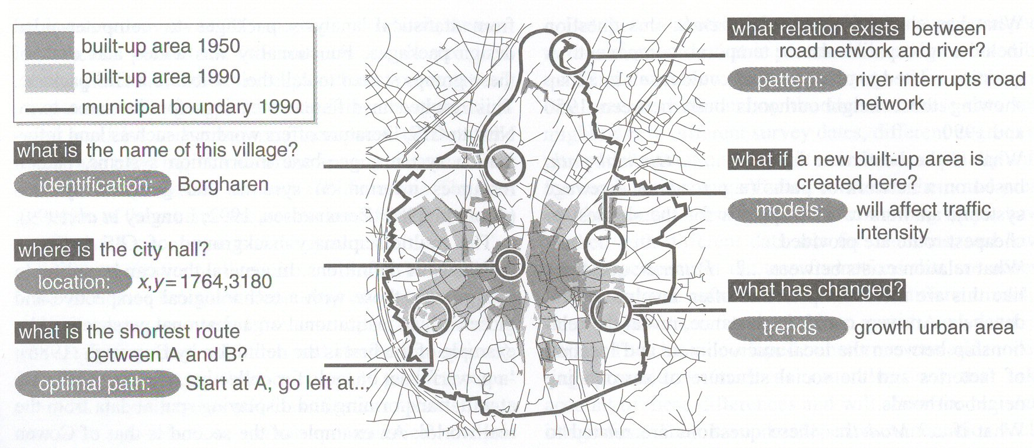
Types of questions a GIS can answer
Source: Kraak & Ormeling (2003) p.7.
Notes:
We can use a GIS for an almost infinite range of purposes, including…
-Location-based queries (e.g. where is the community centre?)
Relationship-based queries (e.g. where is the nearest Well or bore hole?)
Network analysis (e.g. what is the shortest route between A and B?)
Trend analysis (e.g. how has land use changed between time A and time B?)
3D visualisation (e.g. displaying 3d flood models)
This course will give you experience in using all three levels of using geographic information systems.

Slide 9

What is GIS?
http://www.flickr.com/photos/dsleeter_2000/3097476532 & ESRI Course “Teaching with GIS”

Slide 10
GIS – Geographic Information Systems
Almost all human activities and decisions involve an important geographic component
  the ‘where?’
Working with geographic information involves unique, complex and difficult choices
Why we need specialized software
  organize and store
  access and retrieve
  present and manage
  apply to the solution of problems

Slide 11
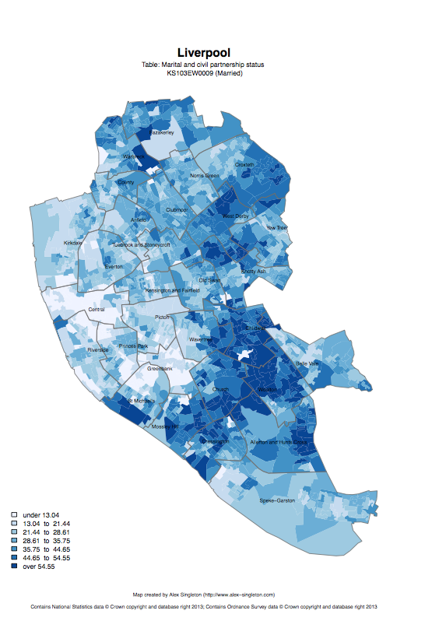
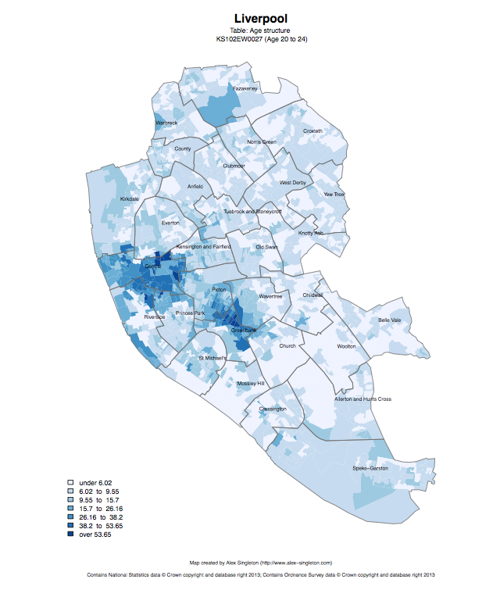
Census 2011
Married
Age structure – 20 to 24
http://www.alex-singleton.com/r/2014/02/05/2011-census-open-atlas-project-version-two/

Slide 12
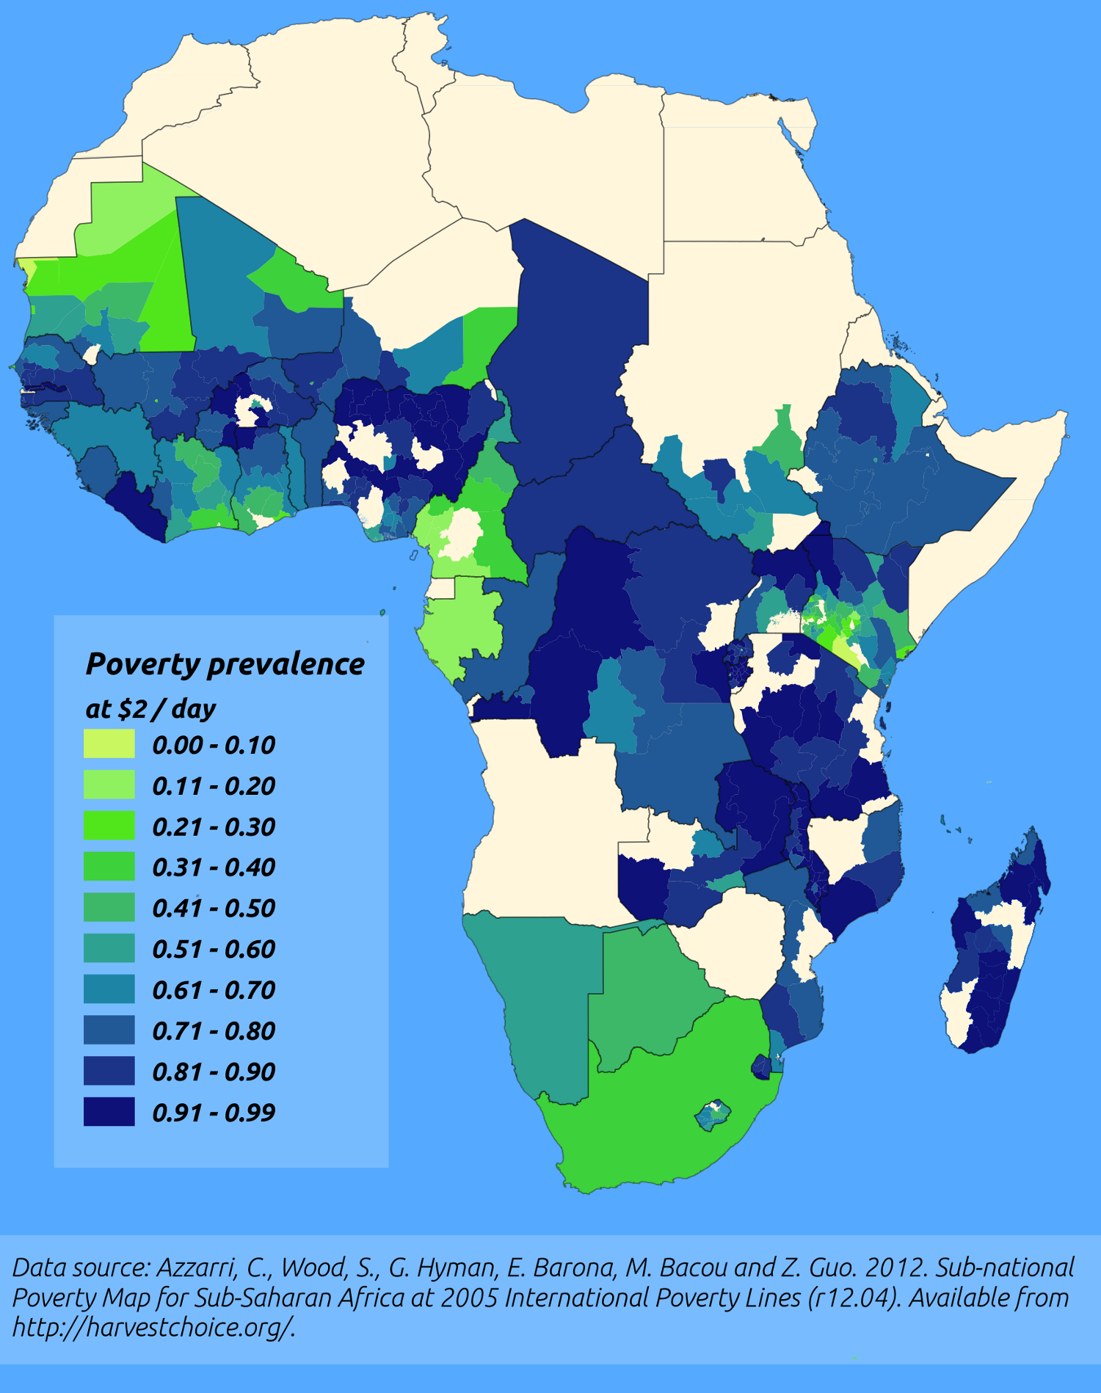
http://pvanb.wordpress.com/2012/05/09/poverty-maps-on-harvestchoice/

Slide 13

GIS: Systems and Science
Geographic Information Systems
  The methods, process and technology we use
Geographic Information Science
  The science behind the technology
  Including development of new
  technology, methods and processes
http://explore.tandfonline.com/pages/cfp/tgis-special-issue-call-for-papers

Slide 14
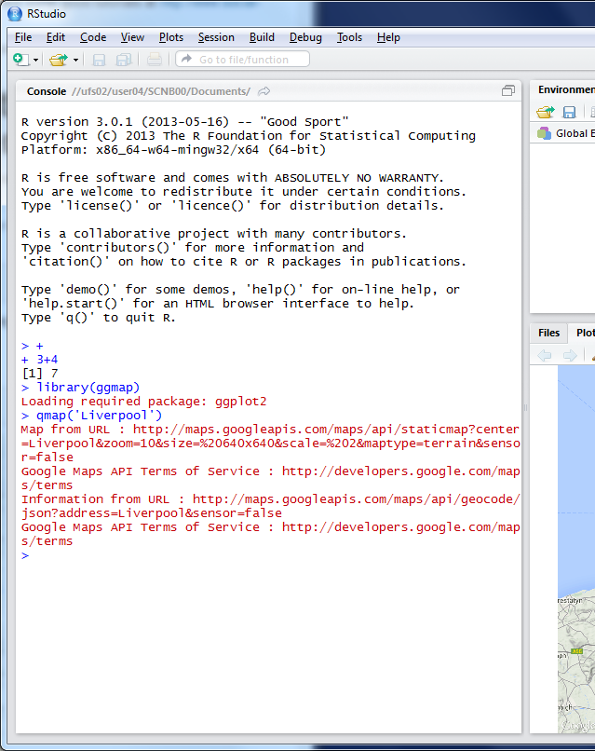
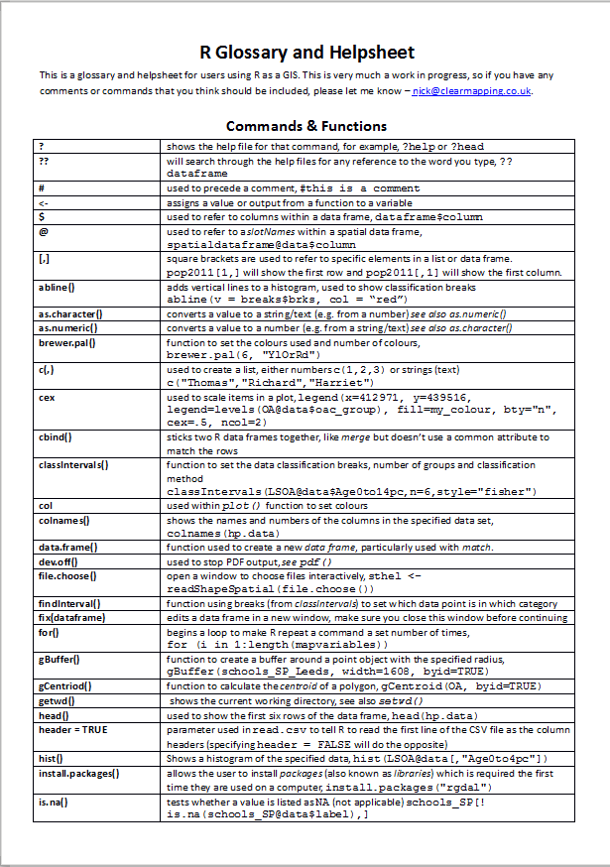

R as a GIS
Command line driven, rather than GUI
Disadvantages
  Remembering commands
    glossary
  Steeper
  learning
  curve

Slide 15
R as a GIS
Advantages
  Easy to record what you did and repeat specific pieces of work
  Lots of reproducible examples on the web
  Easily scriptable.
  134,567 maps? Easy! (354 areas X ~392 variables)
  2011 Census Open Atlas
  http://www.alex-singleton.com/r/2014/02/05/2011-census-open-atlas-project-version-two/

Slide 16
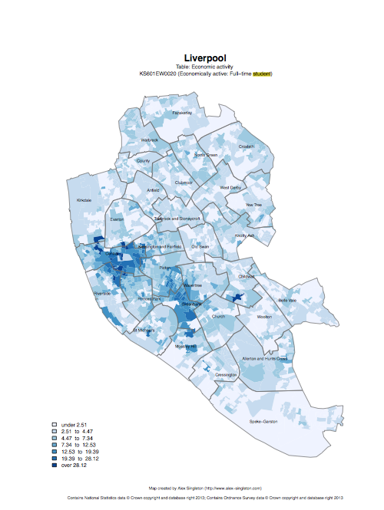

R in Action
Economically active – Full-time students

Slide 17
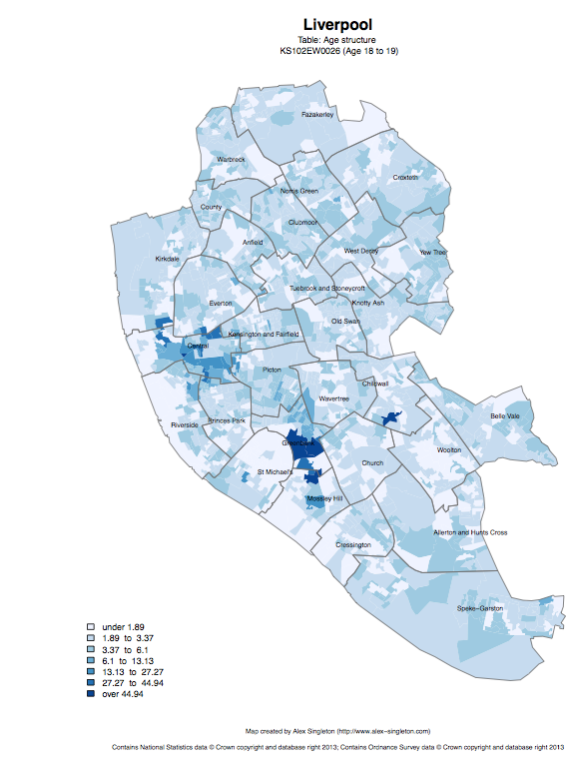
Age structure – 18 to 19
Age structure – 20 to 24

Slide 18
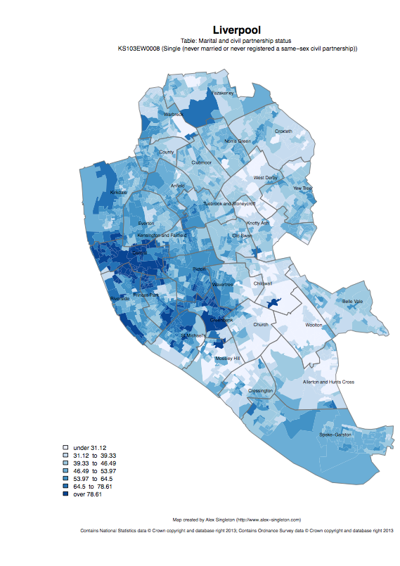
Single
Married

Slide 19
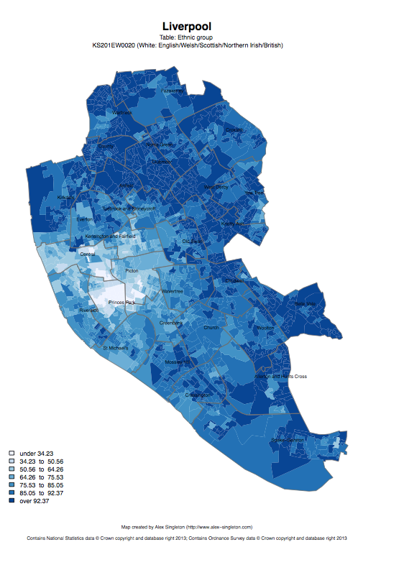
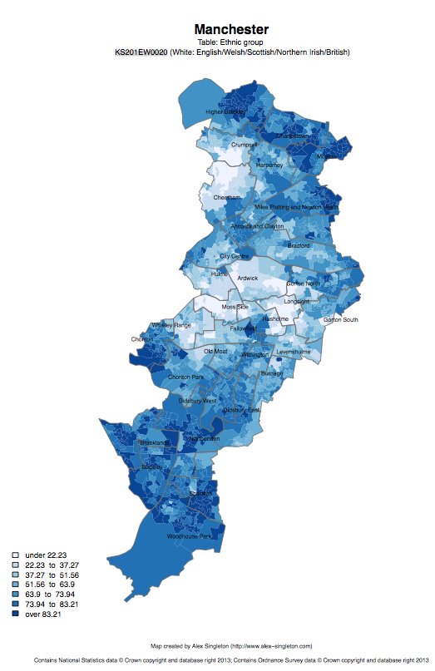
Ethnic group: white

Slide 20
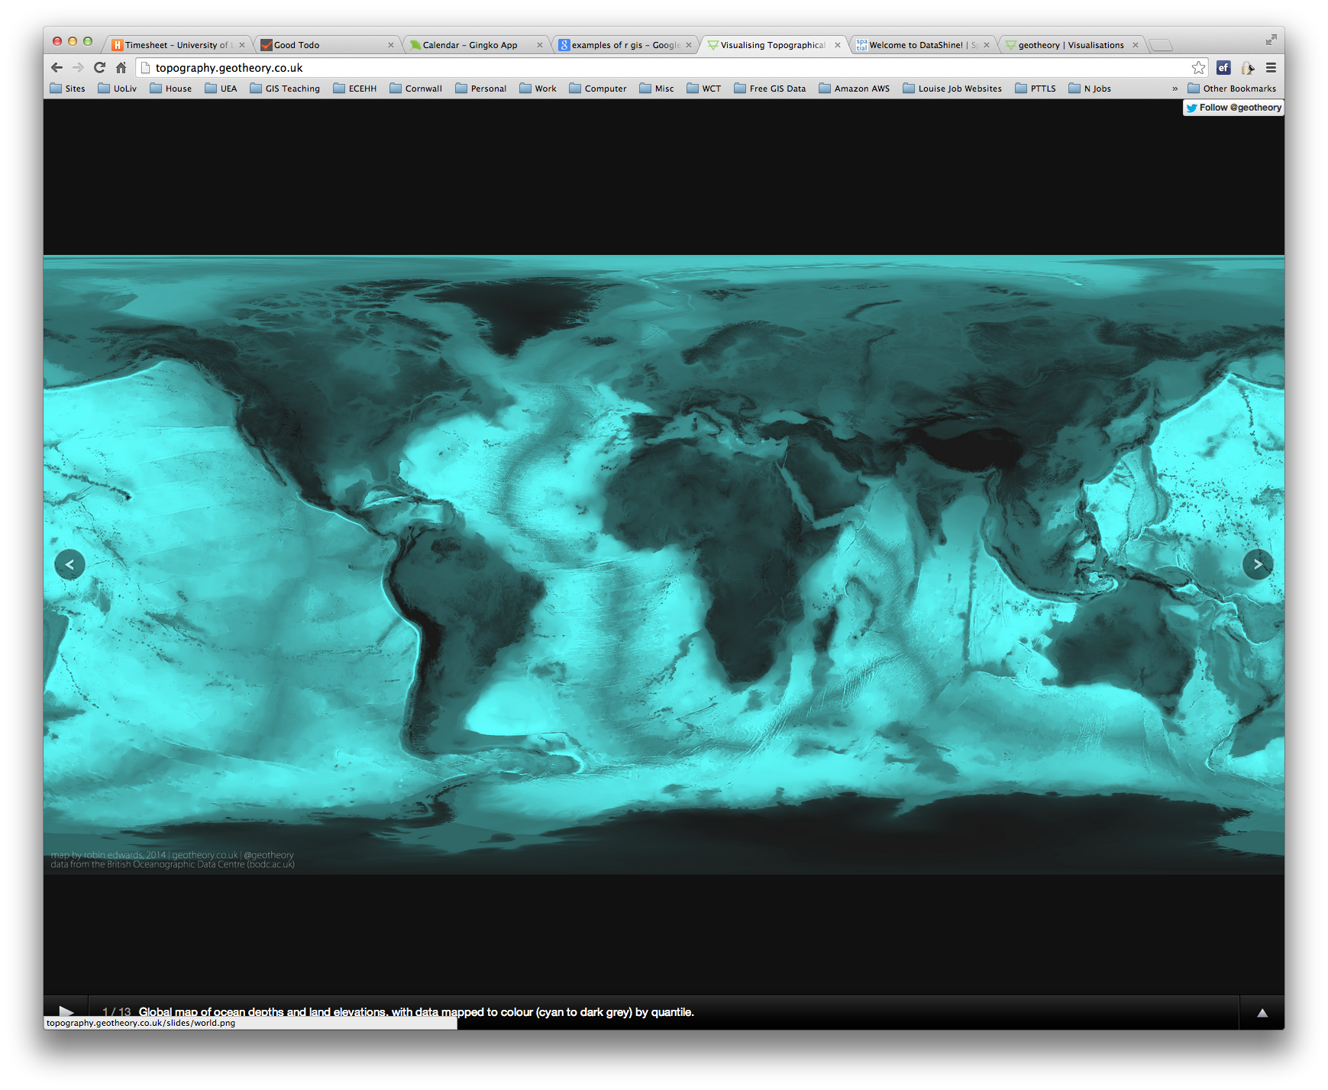

R as a GIS
Topography
http://topography.geotheory.co.uk/

Slide 21
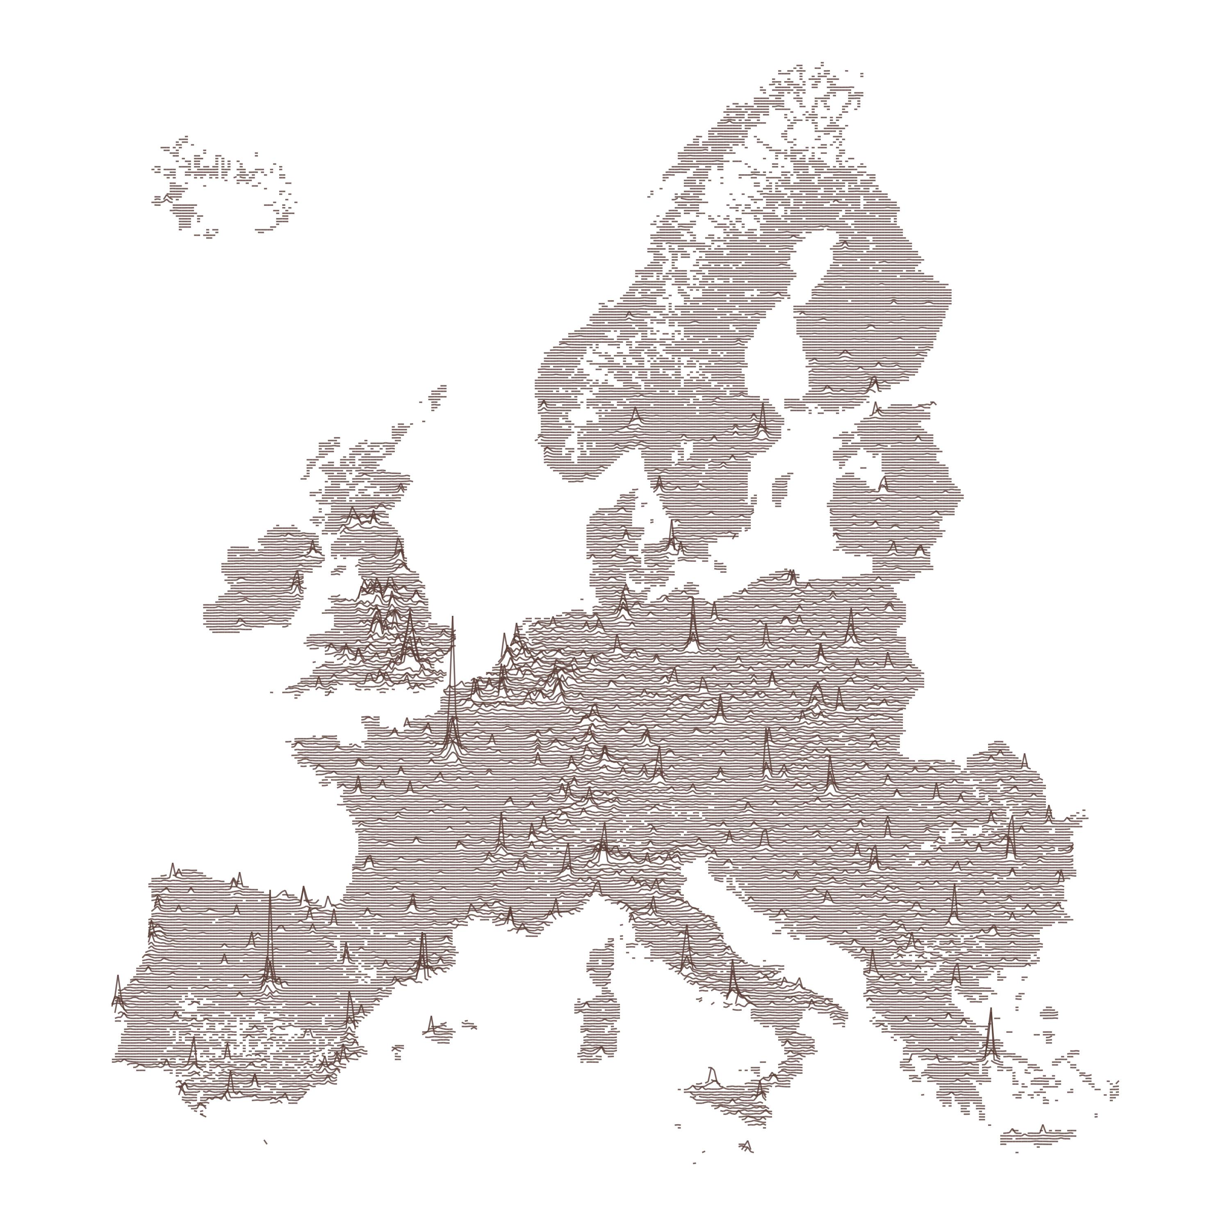
https://gist.github.com/halhen/659780120accd82e043986c8b57deae0

Slide 22
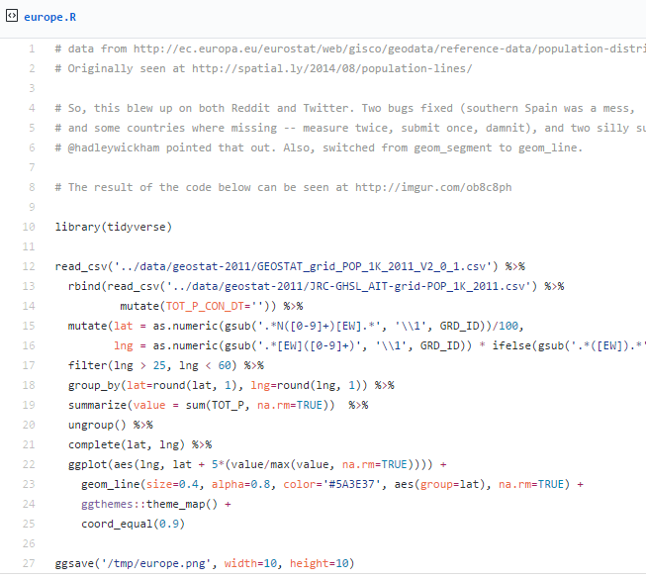
https://gist.github.com/halhen/659780120accd82e043986c8b57deae0

Slide 23




Other GIS software?
R is very different to ArcGIS, but can do many of the same operations
R is free (as is QGIS)
R is increasingly popular in academic sector
Try data in QGIS if you like
All can be useful

Slide 24
A quick reminder
Projections and Coordinate Systems
Joining

Slide 25
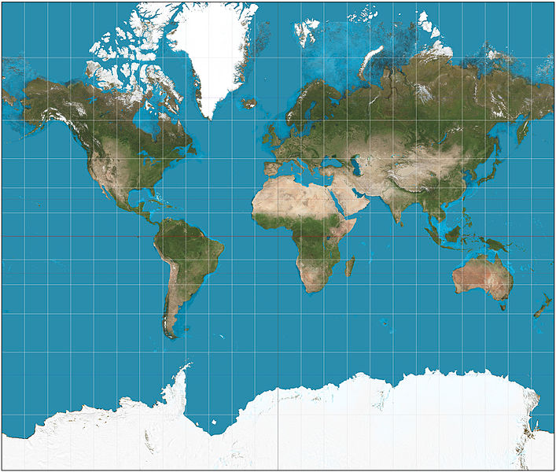
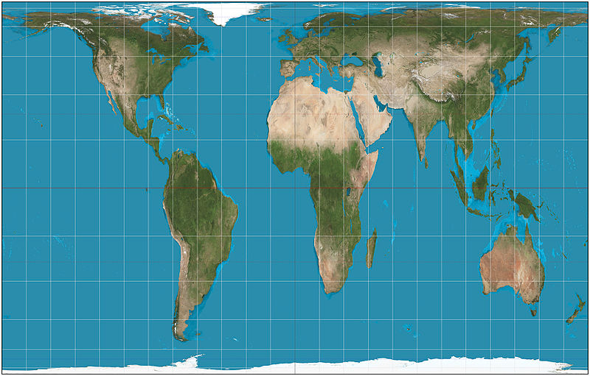
This file is licensed under the Creative Commons Attribution-Share Alike 3.0 Unported license. http://en.wikipedia.org/wiki/File:Mercator_projection_SW.jpg
Mercator projection
Gall-Peters projection
This file is licensed under the Creative Commons Attribution-Share Alike 3.0 Unported license. http://en.wikipedia.org/wiki/File:Gall%E2%80%93Peters_projection_SW.jpg

Slide 26
Projections etc.
Africa: 30 million sq km
Greenland: 2 million sq km

Slide 27
Projections etc.
Reprojection
Can’t maintain
area and angles
Peters: area
Mercator: angles

Slide 28
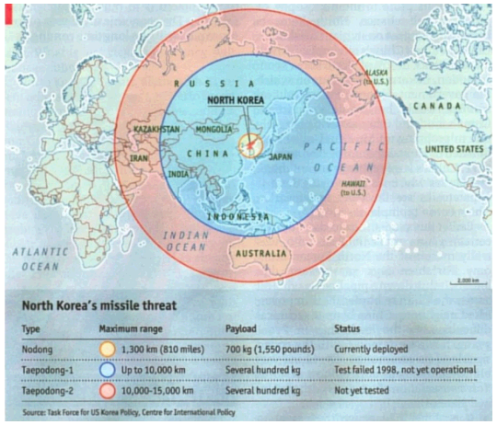
Economist magazine’s article on the threat of missiles from North Korea
http://spatial.ly/2011/01/geographical-mistakes-keeping-geographers-busy/

Slide 29
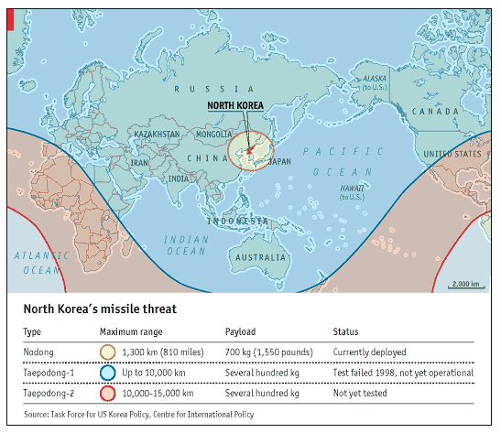
http://spatial.ly/2011/01/geographical-mistakes-keeping-geographers-busy/

Slide 30
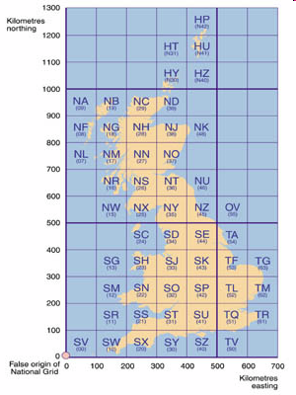
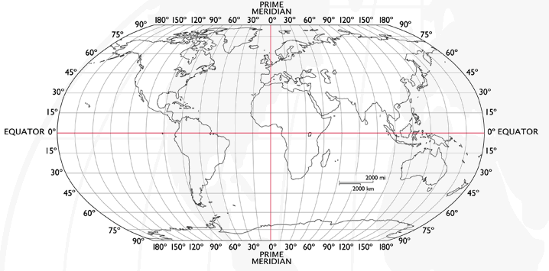
Coordinate Systems
Latitude and Longitude (WGS 1984) EPSG = 4326
  52°N 37’ 30.32’’ (52.6250) 1°E 14’ 2.05’’ (1.2339)
British National Grid (Eastings & Northings)
  Easting: 619301 Northing: 307416 EPSG = 27700
Notes:
-Coordinate Systems are derived from projections and are used to give coordinates (numbers) to locations on the Earth’s surface
-Best if your data is all in the same coordinate system (otherwise the coordinates might be slightly different for the same location), but ArcMap can convert between them
-Most common:
-Lat/Long (also WGS 1984) used by most GPS
-BNG (British National Grid) very common in UK data – Ordnance Survey format.
-Most important – are all your data in the same coordinate system?
-ArcMap can convert, but often if your data appears in the wrong place, it is because there is something wrong with the coordinate system.
http://www.worldatlas.com/webimage/testmaps/latslongs.htm
http://www.ordnancesurvey.co.uk/oswebsite/gps/information/coordinatesystemsinfo/guidetonationalgrid/page13.html
http://www.ordnancesurvey.co.uk/oswebsite/gps/information/coordinatesystemsinfo/guidetonationalgrid/page8.html

Slide 31
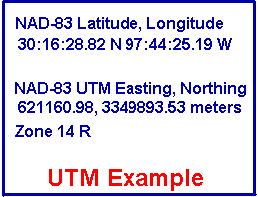
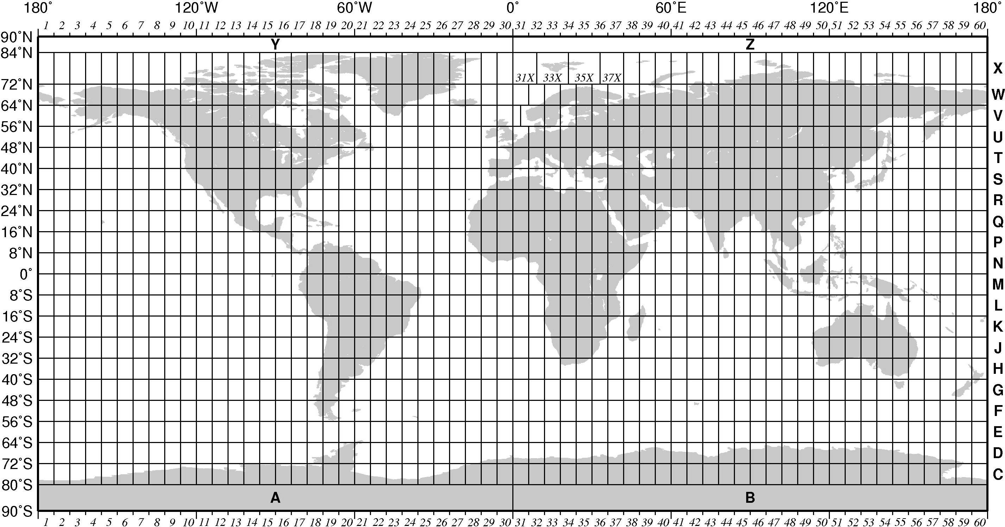
Coordinate Systems
UTM (Universal Transverse Mercator)
  621160.98, 3349893.53 meters, Zone 14 R
  Base unit of meters
http://tabs2.gerg.tamu.edu/gmt/GMT_Docs/node108.html
http://www.colorado.edu/geography/gcraft/notes/coordsys/coordsys.html
Notes:
-Coordinate Systems are derived from projections and are used to give coordinates (numbers) to locations on the Earth’s surface
-Best if your data is all in the same coordinate system (otherwise the coordinates might be slightly different for the same location), but ArcMap can convert between them
-Most common:
-Lat/Long (also WGS 1984) used by most GPS
-BNG (British National Grid) very common in UK data – Ordnance Survey format.
-Most important – are all your data in the same coordinate system?
-ArcMap can convert, but often if your data appears in the wrong place, it is because there is something wrong with the coordinate system.
http://www.worldatlas.com/webimage/testmaps/latslongs.htm
http://www.ordnancesurvey.co.uk/oswebsite/gps/information/coordinatesystemsinfo/guidetonationalgrid/page13.html
http://www.ordnancesurvey.co.uk/oswebsite/gps/information/coordinatesystemsinfo/guidetonationalgrid/page8.html

Slide 32
Coordinate Systems
Latitude and Longitude (WGS 1984) EPSG = 4326
  52°N 37’ 30.32’’ (52.6250) 1°E 14’ 2.05’’ (1.2339)
British National Grid (Eastings & Northings)
  Easting: 619301 Northing: 307416 EPSG = 27700
UTM (Universal Transverse Mercator)
  621160.98, 3349893.53 meters, Zone 14 R
  EPSG = depends on zone
Why is it important?
  Some data uses uses WGS84, some BNG, UTM
  LSOA use BNG (Eastings/Northings)
  Need to convert between the two
Notes:
-Coordinate Systems are derived from projections and are used to give coordinates (numbers) to locations on the Earth’s surface
-Best if your data is all in the same coordinate system (otherwise the coordinates might be slightly different for the same location), but ArcMap can convert between them
-Most common:
-Lat/Long (also WGS 1984) used by most GPS
-BNG (British National Grid) very common in UK data – Ordnance Survey format.
-Most important – are all your data in the same coordinate system?
-ArcMap can convert, but often if your data appears in the wrong place, it is because there is something wrong with the coordinate system.
http://www.worldatlas.com/webimage/testmaps/latslongs.htm
http://www.ordnancesurvey.co.uk/oswebsite/gps/information/coordinatesystemsinfo/guidetonationalgrid/page13.html
http://www.ordnancesurvey.co.uk/oswebsite/gps/information/coordinatesystemsinfo/guidetonationalgrid/page8.html

Slide 33
Joining
Area ID
1
2
3
4
5
14
7
8
11
Area ID | Deprivation
1 | High
2 | High
3 | High
4 | Average
5 | Average
6 | Average
7 | Low
8 | Low
9 | Low
10 | High
11 | Low
12 | High
13 | High
14 | Average
15 | Average
1
2
3
14
4
7
5
8
11
Data
Polygons
Lookup

Slide 34
1
Area ID | Deprivation
1 | High
2 | High
3 | High
4 | Average
5 | Average
14 | Average
7 | Low
8 | Low
11 | Low
2
3
14
4
7
5
8
11
High Deprivation
Average Deprivation
Low Deprivation

Slide 35
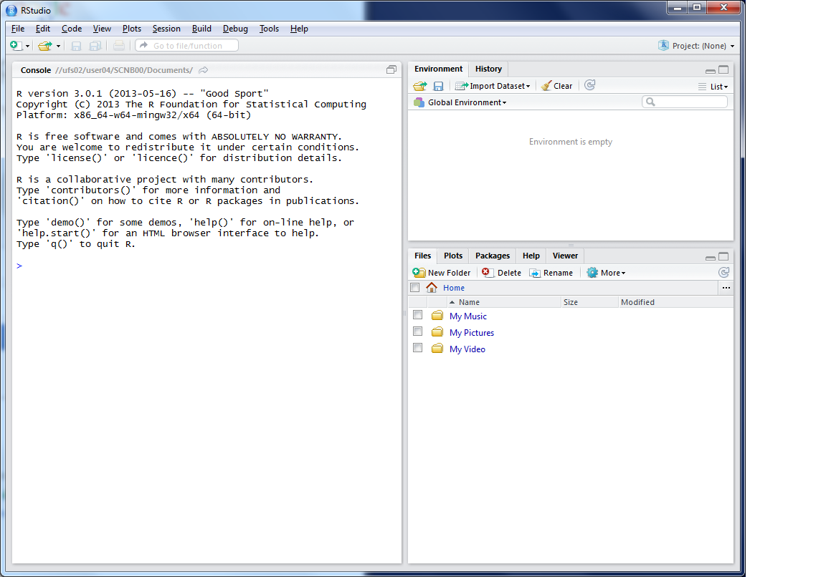
This lists the variables you have
This is the console where you can type in commands
Here will show either your files (the files tab) or your plots (the plots tab)

Slide 36
Working Directory
R uses a ‘working directory’ to store your files in
You might have a different one for each project / piece of work
e.g. M:\Documents\GIS
setwd(“M:/Documents/GIS”)

Slide 37
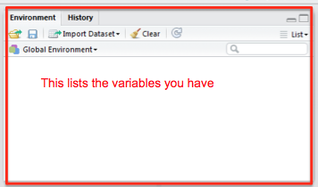
Variables
R uses variables to
store information –
listed in your ‘workspace’ (top-right)
house.prices <- c(120,150,212, 99,199,299,159)

Slide 38
Variables and Assignments
house.prices
<-
c(120,150,212,99,199,299,159)

Slide 39
Variables and Assignments
house.prices
<-
c(120,150,212,99,199,299,159)

Slide 40
Variables and Assignments
house.prices
<-
c(120,150,212,99,199,299,159)

Slide 41
Variables and Assignment
sthelens
<-
readOGR(".","sthelens")

Slide 42
Variables and Assignment
sthelens
<-
readOGR(".","sthelens")

Slide 43
Variables and Assignment
sthelens
<-
readOGR(".","sthelens")

Slide 44
Variables and Assignment
sthelens
<-
readOGR(".","sthelens")
See glossary for details
Case sensitive
StHelens ≠ sthelens ≠ STHELENS

Slide 45
Data Formats
Data frames are like a table or spreadsheet
dataframe[rows,cols]
dataframe[1,] first row
dataframe[,1] first col

Slide 46
Practical Approach
(Primarily) self-led practical
Good to explore the options
Ask questions as we go through
Try things
Use the help ?command

Slide 47
Typing out Code
Why do I make you type out code?
  Helps the learning process
  Make you think about what the code does
(but you can copy/paste long bits)
Optional exercises
Red post-its
Breaks

Slide 48
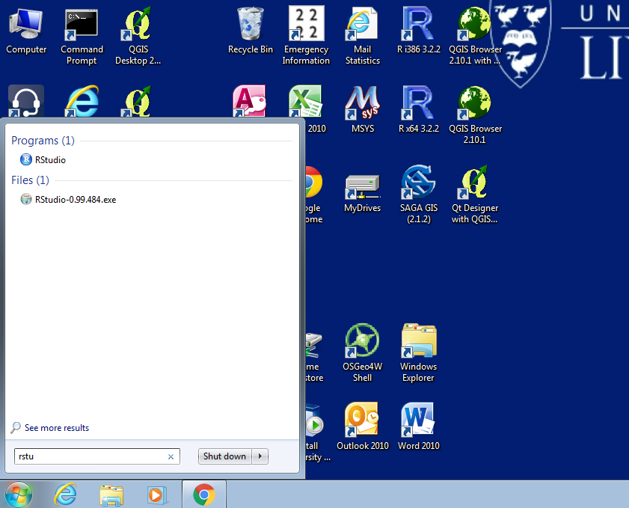
Load R

Slide 49
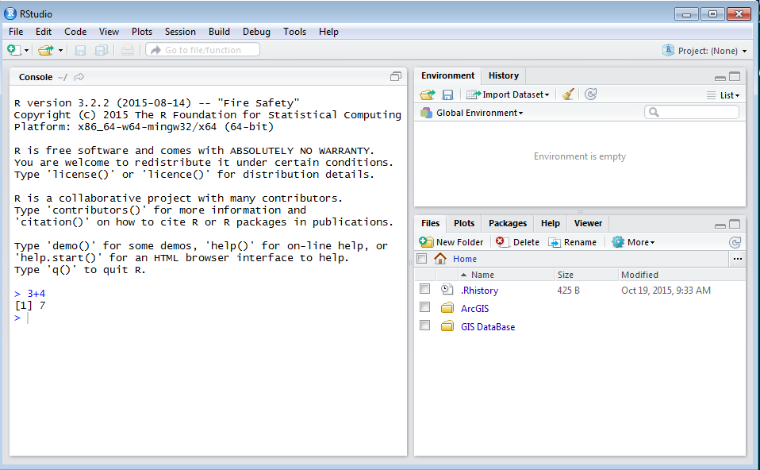
Load R

Slide 50
Notes:
Practical 2 – Bring Your Own Data

Slide 51
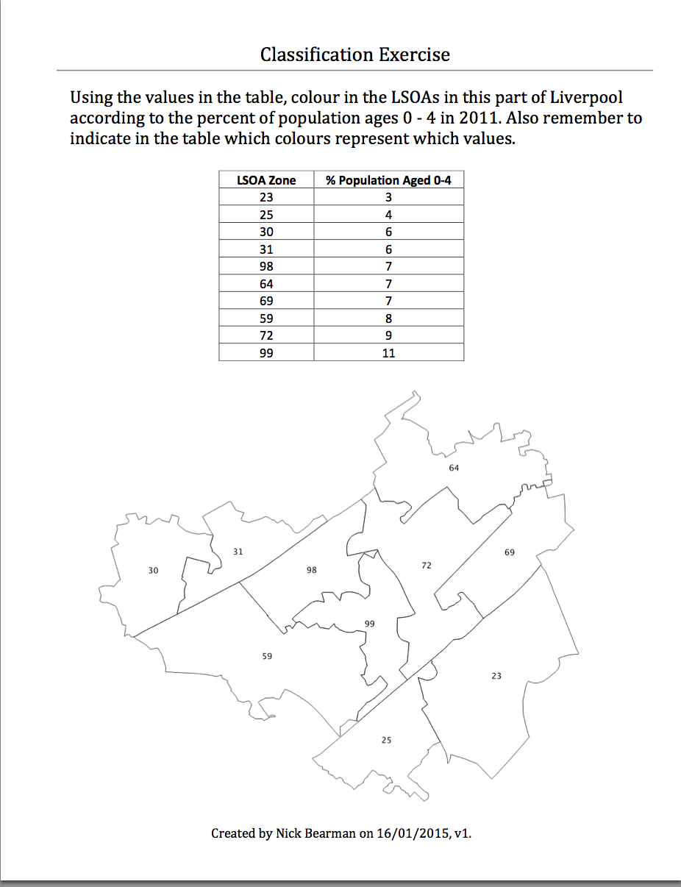
Classification
Colour in the values for Age (10 min)

Slide 52
Classification
Colour in the values for Age (10 min)
Discuss your choices

Slide 53
Classification
Colour in the values for Age (10 min)
Discuss your choices
  Colours
  Classes

Slide 54
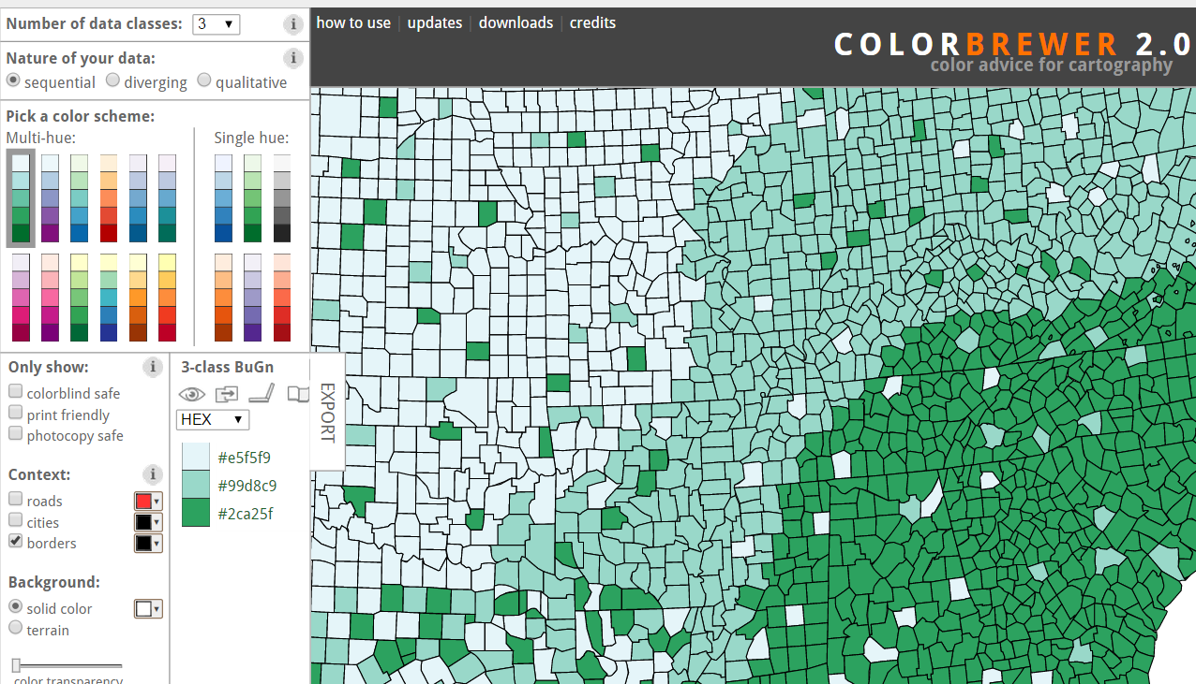
Map Design: Classification
Choropleth maps have colours
How do you choose the colours?
Why is this important?
Output
User
colorbrewer.org

Slide 55
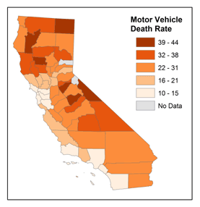
Map Design: Classification
Choropleth maps have classes
How do you choose the classes?
Why is this important?
© 2014 The Pennsylvania State University, https://www.e-education.psu.edu/geog486/l4_p7.html#classification_schemes

Slide 56
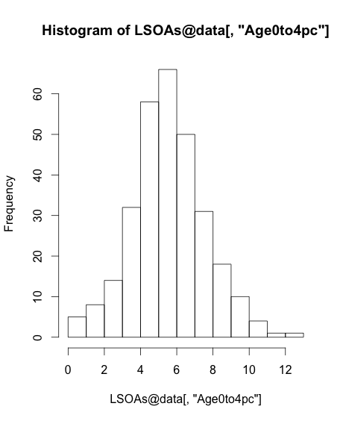
Map Design: Classification
[,"Age0to4pc"]

Slide 57
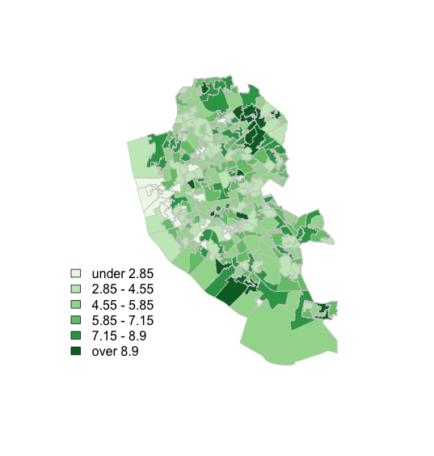
Map Design: Classification

Slide 58
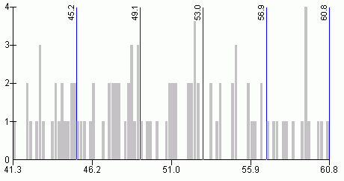
Map Design: Classification
s
http://www.directionsmag.com/entry/choropleth-mapping-with-exploratory-data-analysis/123579

Slide 59
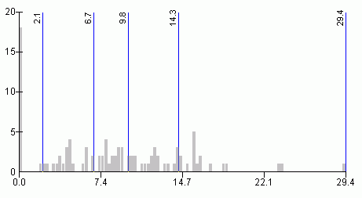
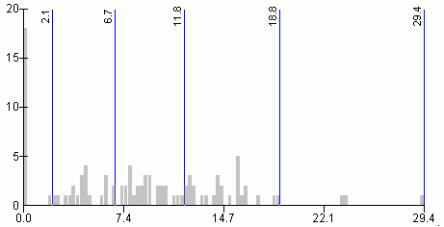
Quantiles
- “equal sized data subsets”
sN
Natural Breaks
reduce variance
within class
increase variance
between classes
http://www.directionsmag.com/entry/choropleth-mapping-with-exploratory-data-analysis/123579

Slide 60
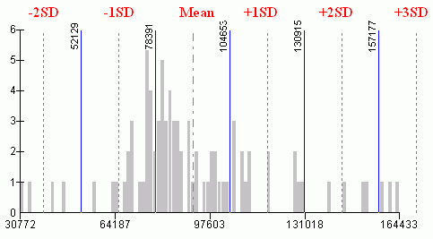
sN
Standard Deviation
R has:
fixed
sd
equal
pretty
quantile
fisher
jenks
….
(from ?classIntervals)
http://www.directionsmag.com/entry/choropleth-mapping-with-exploratory-data-analysis/123579

Slide 61
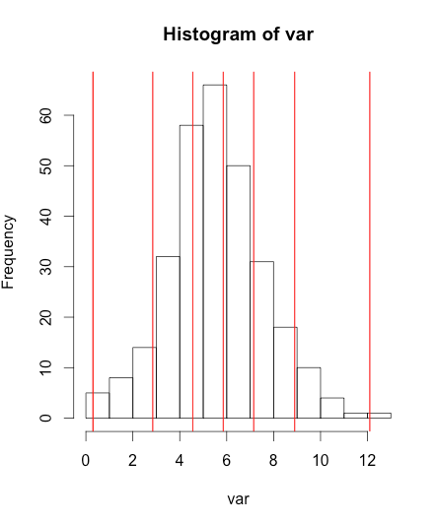
Can do this in R
var <- LSOA@data[,"Age0to4pc"]
breaks <- classIntervals(var, n = 6, style = "fisher")
hist(var)
abline(v = breaks$brks, col = "red")

Slide 62

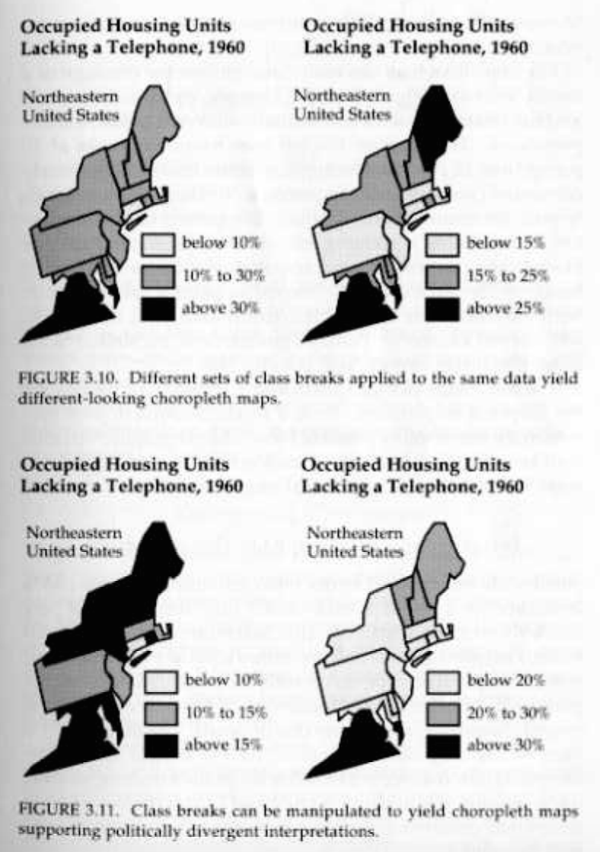
Why is it important?

Slide 63
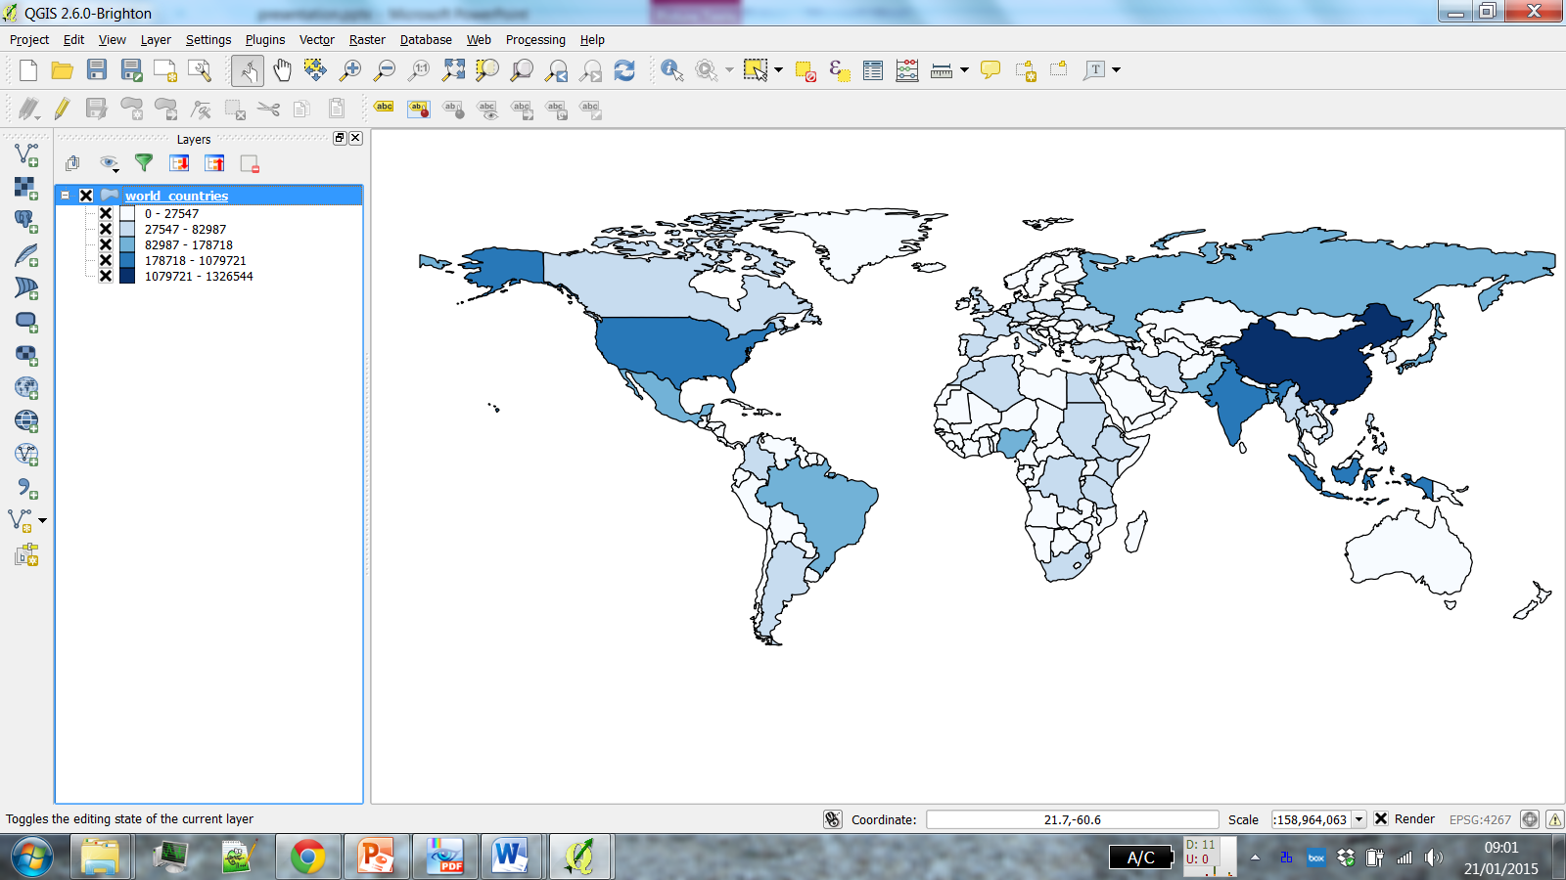
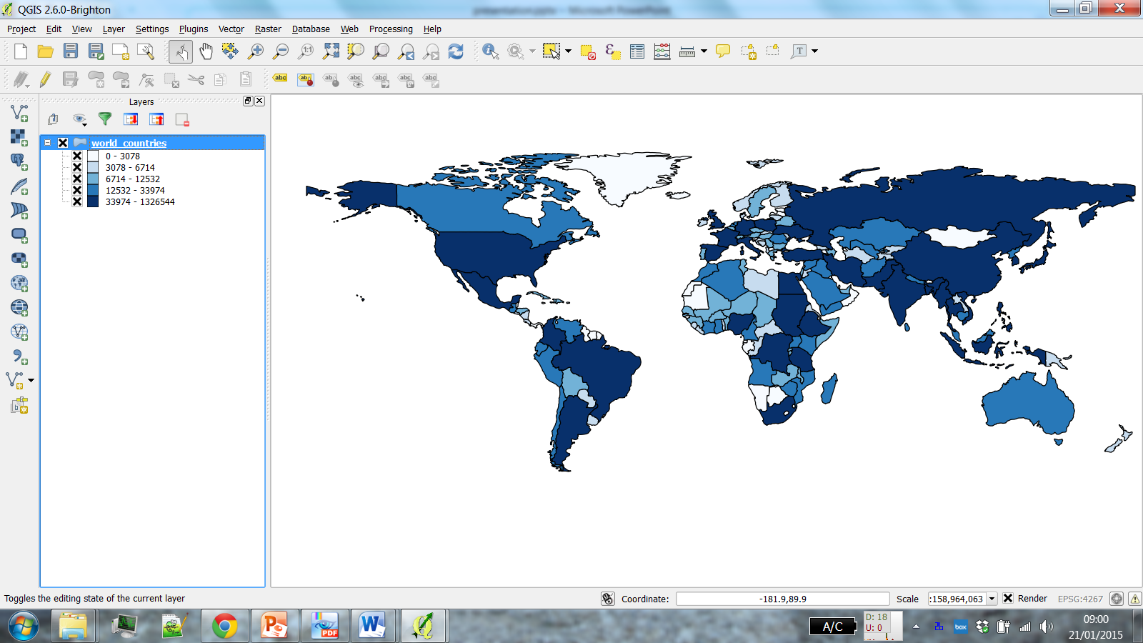
Why is it important?
POP2004
Natural Breaks
(Jenks)
Quantile
(Equal Count)

Slide 64
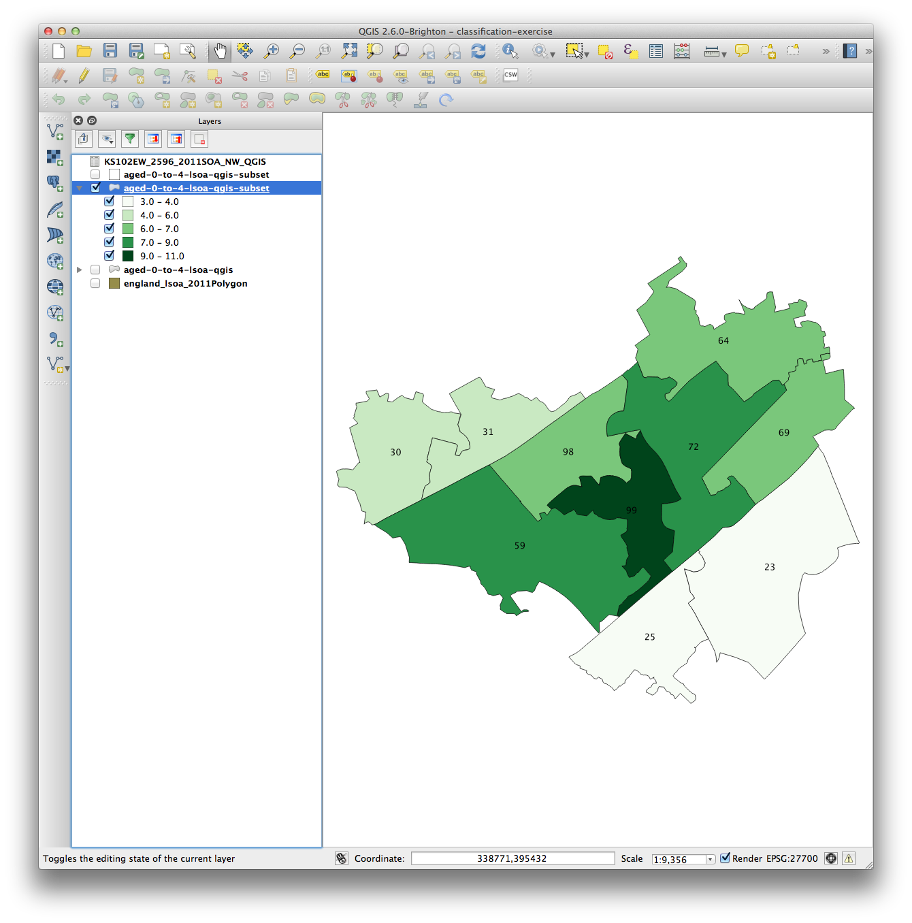
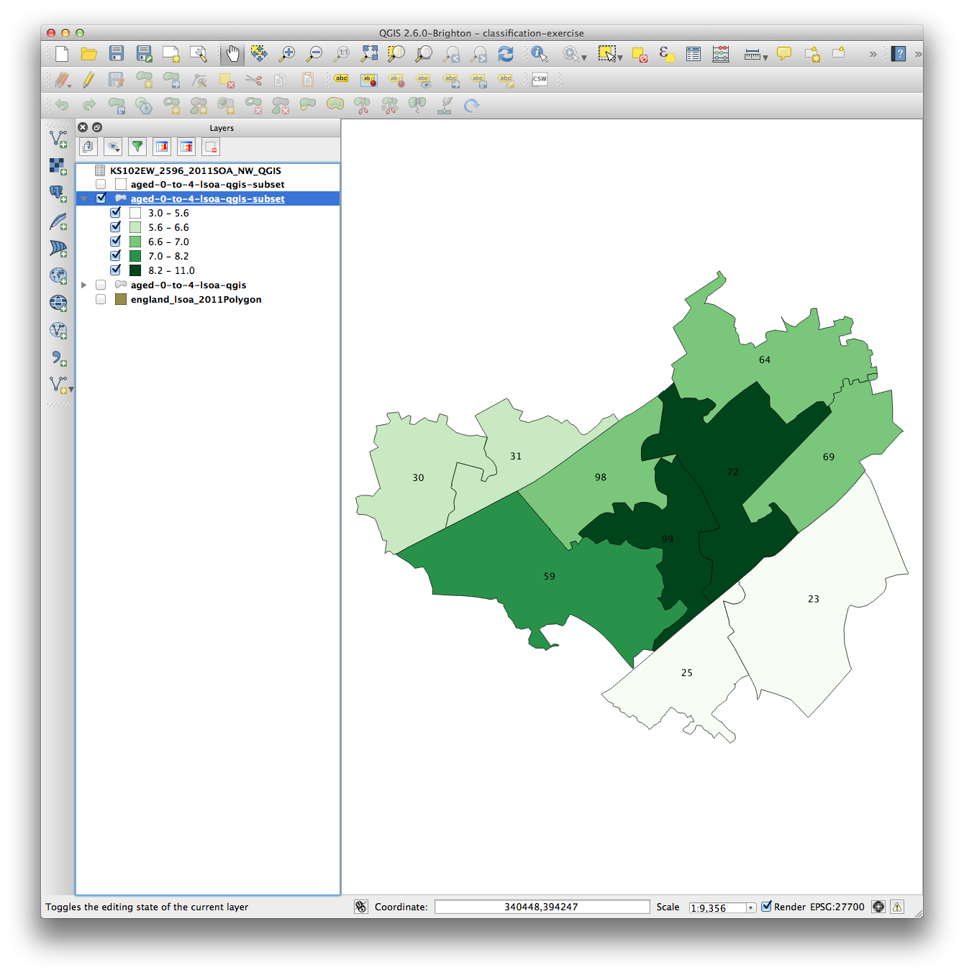
Why is it important?
Age 0-4
Natural Breaks
Quantile

Slide 65
Why is it important?
Age 0-4
Natural Breaks
Quantile

Slide 66
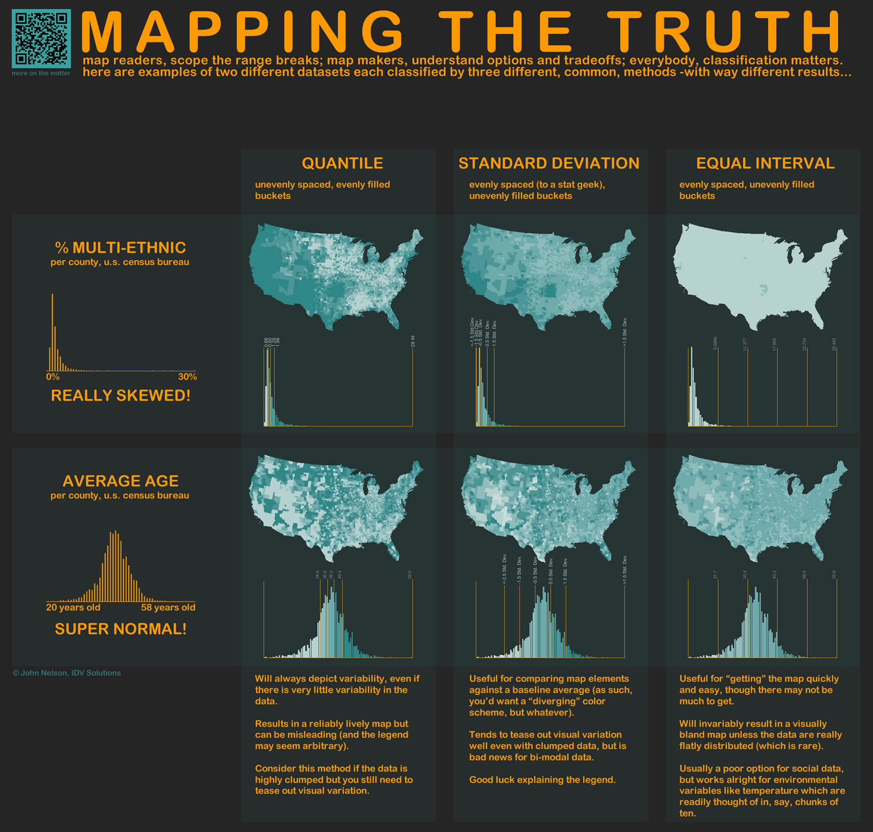
http://www.flickr.com/photos/idvsolutions/6691496421/in/photostream/
http://www.flickr.com/photos/idvsolutions/6691496421/in/photostream/
http://uxblog.idvsolutions.com/2011/10/telling-truth.html

Slide 68
Outline of the day
10:15am – 10:45am – What is GIS & R?
10:45am – 11:15am – Practical 1 Intro to GIS & R
11:15am – 11:45am – Classification
11:45am – 12:30pm – Practical 1 Intro to GIS & R
12:30pm – 1:30pm – Lunch
1:30pm – 1:45pm – Recap and Making Maps
1:45pm – 3:00pm – Practical 2 Analysis
3:00pm – 3:15pm – Tea/Coffee
3:15pm – 4pm/4:30pm – P.3 Bring your own data
Notes:
Practical 2 – Bring Your Own Data

Slide 69
Lunch

Slide 70
Outline of the day
10:15am – 10:45am – What is GIS & R?
10:45am – 11:15am – Practical 1 Intro to GIS & R
11:15am – 11:45am – Classification / Raster Data
11:45am – 12:30pm – Practical 1 Intro to GIS & R
12:30pm – 1:30pm – Lunch
1:30pm – 1:45pm – Recap and Making Maps
1:45pm – 3:00pm – Practical 2 Analysis
3:00pm – 3:15pm – Tea/Coffee
3:15pm – 4pm/4:30pm – P.3 Bring your own data
Notes:
Practical 2 – Bring Your Own Data

Slide 71
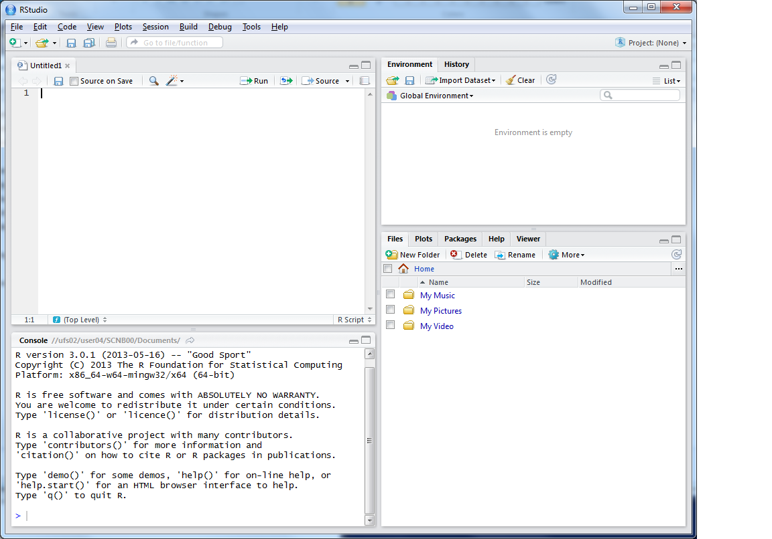
R Scripts
Why use scripts?
  Easier to correct code
  Can easily re run sections of code, or all code if you need to start again
  Good to enable you to reload data etc. if you move machines, or don’t
  have your workspace
  saved

Slide 72
This is where you can write scripts
This lists the variables you have
Link to survey:
Here will show either your files (the files tab) or your plots (the plots tab)
This is the console where you can type in commands

Slide 73
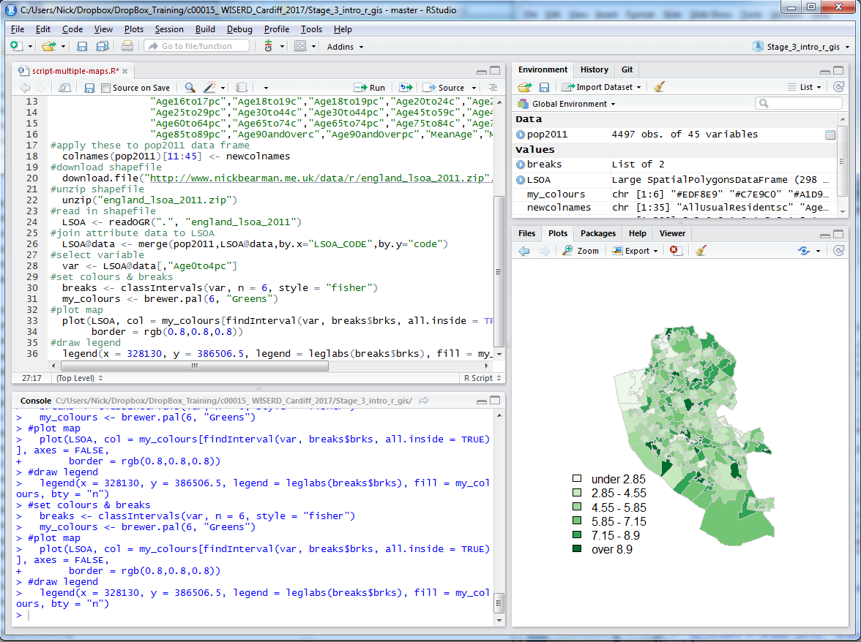

Slide 74
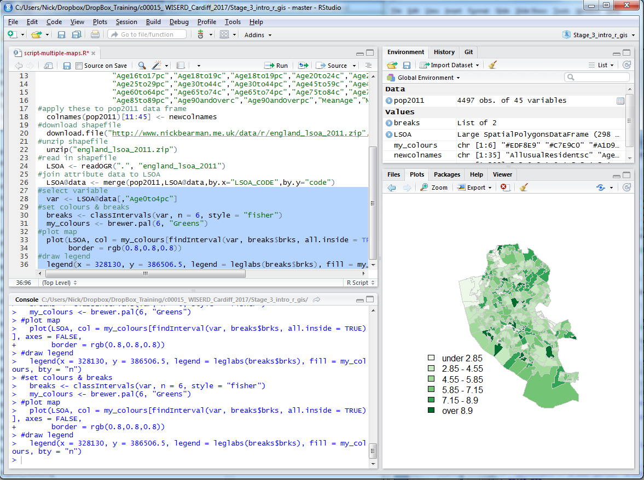
To run script, select lines

Slide 75
Click Run, or Ctrl-Enter

Slide 76
Working directory:

Slide 77
Untitled = you haven’t saved the file at all!
Red = changes have been made since you last saved
Ctrl-s

Slide 78
Code recap
Useful tips
  Up arrow in the console shows you the previous command
  History contains a history of all commands
  Plot window has a back arrow, and an export option
  Tab completion
  Reload libraries

Slide 79
Code debugging
R error messages can be cryptic
Remember
  case sensitive
  picky about , [ ] ( )
  typos
Error in getinfo.shape(fn) : Error opening SHP file can’t find shapefile
Error: could not find function ”readOGR” can’t find function
See glossary helpsheet – and let me know what to add!

Slide 80
Data Structure – Slot Names
Slot Names slotNames(LSOA)
  "data"
  "polygons"
  "bbox"
  "proj4string"

Slide 81
Data Structure – Slot Names
Slot Names slotNames(LSOA)
"data” ”polygons” "bbox" "proj4string”
LSOA@data
LSOA@data$LSOA_CODE
@ and $
Try running
LSOA@proj4string

Slide 82
Code recap
Plotting Maps
plot(LSOA,
col = my_colours[findInterval (var, breaks$brks, all.inside = TRUE)],
axes = FALSE,
border = rgb(0.8,0.8,0.8))

Slide 83
Code recap
Plotting Maps
plot(LSOA,
col = my_colours[findInterval (var, breaks$brks, all.inside = TRUE)],
axes = FALSE,
border = rgb(0.8,0.8,0.8))

Slide 84
Code recap
Plotting Maps
plot(LSOA,
col = my_colours[findInterval (var, breaks$brks, all.inside = TRUE)],
axes = FALSE,
border = rgb(0.8,0.8,0.8))

Slide 85
Code recap
Plotting Maps
plot(LSOA,
col = my_colours[findInterval (var, breaks$brks, all.inside = TRUE)],
axes = FALSE,
border = rgb(0.8,0.8,0.8))

Slide 86
Code recap
col = my_colours[findInterval (var, breaks$brks, all.inside = TRUE)],

Slide 87
Code recap
col = my_colours[findInterval (var, breaks$brks, all.inside = TRUE)],
> my_colours
[1] "#EDF8E9" "#C7E9C0" "#A1D99B" "#74C476" "#31A354" "#006D2C"

Slide 88
Code recap
col = my_colours[findInterval (var, breaks$brks, all.inside = TRUE)],
findInterval(var, breaks$brks, all.inside = TRUE)
[1] 3 1 1 2 3 3 1 2 2 2 1 3 3 3 3 4 3 1 2 2 2 2 2 4 2 2 5 3 3 3 4 5 5 4 5 2
[37] 1 1 6 1 2 5 1 4 3 5 4 3 2 4 2 3 2 2 3 5 4 4 3 3 3 4 4 3 3 3 2 3 3 3 3 2
[73] 4 2 4 2 3 2 4 2 3 4 6 3 2 2 2 3 3 4 4 3 5 3 3 4 5 2 3 2 3 2 2 2 2 4 2 2
[109] 3 2 2 4 4 3 6 5 5 4 6 4 5 4 3 2 4 2 5 4 4 4 4 5 5 2 2 4 4 6 5 5 5 4 3 4
[145] 5 3 3 6 5 6 2 6 6 3 6 2 2 3 2 4 2 2 4 3 3 4 5 5 2 5 3 4 6 6 4 4 3 5 2 5
[181] 3 4 4 3 4 4 5 5 5 3 3 4 5 5 2 2 1 4 3 4 5 6 3 4 6 5 4 3 3 5 5 3 3 4 5 5
[217] 4 2 1 1 3 3 5 4 5 6 6 6 3 2 3 3 4 4 3 6 6 2 3 4 4 2 3 3 3 2 3 4 4 3 4 4
[253] 5 4 3 2 5 5 3 2 3 3 3 3 4 3 2 2 2 3 3 3 4 5 4 3 5 2 1 2 1 1 1 1 1 1 1 1
[289] 5 1 1 1 1 3 4 2 4 2

Slide 89
Code recap
col = my_colours[findInterval (var, breaks$brks, all.inside = TRUE)],
> my_colours
[1] "#EDF8E9" "#C7E9C0" "#A1D99B" "#74C476" "#31A354" "#006D2C"
> findInterval(var, breaks$brks, all.inside = TRUE)
[1] 3 1 1 2 3 3 1 2 2 2 1 3 3 3 3 4 3 1 2 2 2 2 2 4 2 2 5 3 3 3 4 5 5 4 5 2
[37] 1 1 6 1 2 5 1 4 3 5 4 3 2 4 2 3 2 2 3 5 4 4 3 3 3 4 4 3 3 3 2 3 3 3 3 2
[73] 4 2 4 2 3 2 4 2 3 4 6 3 2 2 2 3 3 4 4 3 5 3 3 4 5 2 3 2 3 2 2 2 2 4 2 2
[109] 3 2 2 4 4 3 6 5 5 4 6 4 5 4 3 2 4 2 5 4 4 4 4 5 5 2 2 4 4 6 5 5 5 4 3 4
[145] 5 3 3 6 5 6 2 6 6 3 6 2 2 3 2 4 2 2 4 3 3 4 5 5 2 5 3 4 6 6 4 4 3 5 2 5
[181] 3 4 4 3 4 4 5 5 5 3 3 4 5 5 2 2 1 4 3 4 5 6 3 4 6 5 4 3 3 5 5 3 3 4 5 5
[217] 4 2 1 1 3 3 5 4 5 6 6 6 3 2 3 3 4 4 3 6 6 2 3 4 4 2 3 3 3 2 3 4 4 3 4 4
[253] 5 4 3 2 5 5 3 2 3 3 3 3 4 3 2 2 2 3 3 3 4 5 4 3 5 2 1 2 1 1 1 1 1 1 1 1
[289] 5 1 1 1 1 3 4 2 4 2

Slide 90
Code recap
col = my_colours[findInterval (var, breaks$brks, all.inside = TRUE)],

Slide 91
Code recap
col = my_colours[findInterval (var, breaks$brks, all.inside = TRUE)],

Slide 92
Code recap
col = my_colours[findInterval (var, breaks$brks, all.inside = TRUE)],
> breaks$brks
[1] 0.30 2.85 4.55 5.85 7.15 8.90 12.10

Slide 93
Code recap
col = my_colours[findInterval (var, breaks$brks, all.inside = TRUE)],
> breaks$brks
[1] 0.30 2.85 4.55 5.85 7.15 8.90 12.10
> breaks
style: fisher
one of 36,949,857 possible partitions of this variable into 6 classes
[0.3,2.85) [2.85,4.55) [4.55,5.85) [5.85,7.15) [7.15,8.9) [8.9,12.1]
25 64 81 65 44 19

Slide 94
Code recap
col = my_colours[findInterval (var, breaks$brks, all.inside = TRUE)],

Slide 95
Code recap
col = my_colours[findInterval (var, breaks$brks, all.inside = TRUE)],
“If true, the returned indices are coerced into 1,...,N-1, i.e., 0 is mapped to 1 and N to N-1.”

Slide 96
Code recap
col = my_colours[findInterval (var, breaks$brks, all.inside = TRUE)],
“If true, the returned indices are coerced into 1,...,N-1, i.e., 0 is mapped to 1 and N to N-1.”
the first (0) and last (N) values are moved inside the boundaries of the classification
0 moved to within “0 to 1” (0 > 1)

Slide 97
Code recap
Plotting Maps
plot(LSOA,
col = my_colours[findInterval (var, breaks$brks, all.inside = TRUE)],
axes = FALSE,
border = rgb(0.8,0.8,0.8))

Slide 98
Code recap
Plotting Maps
plot(LSOA,
col = my_colours[findInterval (var, breaks$brks, all.inside = TRUE)],
axes = FALSE,
border = rgb(0.8,0.8,0.8))

Slide 99
Code recap
Plotting Maps
plot(LSOA,
col = my_colours[findInterval (var, breaks$brks, all.inside = TRUE)],
axes = FALSE,
border = rgb(0.8,0.8,0.8))

Slide 100
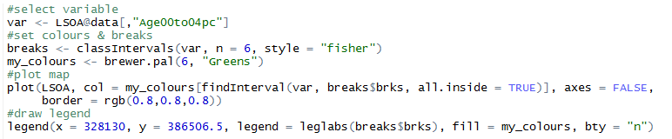
Making Maps from Census Data
Same as before

Slide 101

Making Maps from Census Data
Same as before, … but:
  Save as PDF

Slide 102

Making Maps from Census Data
Same as before, … but:
  Save as PDF & Loop

Slide 103
Making Maps from Census Data

Slide 104
Outline of the day
10:15am – 10:45am – What is GIS & R?
10:45am – 11:15am – Practical 1 Intro to GIS & R
11:15am – 11:45am – Classification
11:45am – 12:30pm – Practical 1 Intro to GIS & R
12:30pm – 1:30pm – Lunch
1:30pm – 1:45pm – Recap and Making Maps
1:45pm – 3:00pm – Practical 2 Analysis
3:00pm – 3:15pm – Tea/Coffee
3:15pm – 4pm/4:30pm – P.3 Bring your own data
Notes:
Practical 2 – Bring Your Own Data

Slide 105
Tea & Coffee

Slide 106
Outline of the day
10:15am – 10:45am – What is GIS & R?
10:45am – 11:15am – Practical 1 Intro to GIS & R
11:15am – 11:45am – Classification
11:45am – 12:30pm – Practical 1 Intro to GIS & R
12:30pm – 1:30pm – Lunch
1:30pm – 1:45pm – Recap and Making Maps
1:45pm – 3:00pm – Practical 2 Analysis
3:00pm – 3:15pm – Tea/Coffee
3:15pm – 4pm/4:30pm – P.3 Bring your own data
Notes:
Practical 2 – Bring Your Own Data

Slide 107


Slide 108


http://stackoverflow.com/questions/29190219/r-plot-multiple-maps-in-a-grid-from-a-single-shapefile

Slide 109

par(mfrow=c(1,2))
Plot additional rows,columns

Slide 110

Plotting Multiple Maps
plot(crime.pts, pch='.', col='darkred')
plot(LSOA, add = TRUE)

Slide 111
Point in Polygon
Points = Crimes
Polygons = LSOA

Slide 112
Overlays / Intersection
Many types, often depends on data type
gContains – wholly within (pts & polys)
gOverlaps – overlaps (not necessarily completely within) (poly & poly)

Slide 113
Using your own data
  Get it in to R
  Join it
  Look at the attribute data head(LSOA@data)
  Map it
Or download and map some data from http://data.cdrc.ac.uk
I will come around on a 1-to-1 basis

Slide 115
ArcGIS, QGIS & R
Which one to use?
All is possible in all software
But is easier in some than others!
Whichever you find easiest
  QGIS/ArcGIS quickly visualizing data
  R large data sets / reproducible & repetitive work
No silver bullet…

Slide 116
Next Steps
R/RStudio
  Lots of commands – remember the glossary
  R is very picky with typos
  Lots of libraries
    plot, ggplot, tmap, …
  Repeat material – 2/3 weeks, 2/3 months
    nick@clearmapping.co.uk
Future Courses
  Confident Spatial Analysis – (QGIS or R)

Slide 118
Unused Slides

Slide 119

An Introduction to R for Spatial Analysis and Mapping
Chris Brunsdon, Lex Comber

Slide 120
Data Formats
Spatial data
  Spatial*DataFrame
Using Shapefiles
  SpatiaLite
  Reading Personal & File Geodatabases is possible
  Writing is not (easily) possible
RStudio Server can be useful for very large datasets (> multiple tens GB RAM)

Slide 121

Common Problems in Mapping
Data availability
  Google, other work
Losing work
  Saving, backups, testing backups
Specific feature not working
  Restart and try again
  Google, Stack Exchange
  (http://www.stackexchange.com/)
How do I do x in y?
  Google, colleagues

Slide 122
Analysis Examples
Interpolation (points to surface)
Distance weighting
Spatial Autocorrelation
Clustering – Getis Ord
Geographically Weighted Regression
  Chris Brunsdon
Clustering – Geodemographics
Multi level modelling – space/distance/zone

Slide 123




Vector and Raster data
Points, Lines & Polygons
Road networks
Rivers and lakes
Street addresses
or postcodes
Administrative areas/boundaries
Notes:
-Raster data is constructed by surveying or sampling at regular intervals on a grid layout.
e.g. soil sample every 500m, or interpolated (estimated) from contours.
-Usually assigned a colour in GIS. Includes images, aerial photos.
-You can convert data between the different formats quite easily in the software for different applications

Slide 124


Vector and Raster data
Points, Lines & Polygons
Grid Based
Road networks
Rivers and lakes
Street addresses
or postcodes
Administrative areas/boundaries
Elevation
Temperature
Land cover
Population density
Light reflectance (in the form of satellite or aerial imagery)
Notes:
-Raster data is constructed by surveying or sampling at regular intervals on a grid layout.
e.g. soil sample every 500m, or interpolated (estimated) from contours.
-Usually assigned a colour in GIS. Includes images, aerial photos.
-You can convert data between the different formats quite easily in the software for different applications

Slide 125

Raster Data
Resolution
Type
Uses
http://docs.qgis.org/2.0/en/docs/gentle_gis_introduction/raster_data.html

Slide 126
Spatial Resolution
Grid Based
Ground area represented
by each pixel in an image
Size of the grid cells
E.g.
  10m
  100m
  1km
Notes:
-Raster data is constructed by surveying or sampling at regular intervals on a grid layout.
e.g. soil sample every 500m, or interpolated (estimated) from contours.
-Usually assigned a colour in GIS. Includes images, aerial photos.
-You can convert data between the different formats quite easily in the software for different applications

Slide 127
Types of raster data
Categorical
  Whole number (integer) represents a category

Slide 128

1
2
3
4
5
6
7
8
9
10
11
12
d
http://www.ncgia.ucsb.edu/cctp/units/unit42/algebra.html
http://www.ncgia.ucsb.edu/education/curricula/cctp/units/unit42/figs/u42c6.gif

Slide 129
Types of raster data
Categorical
  Whole number (integer) represents a category
Data / continuous
  The cell value represents a numerical value of data
  Elevation
  Temperature
  Population Density

Slide 130


Population Density, 10m resolution,
http://openpopgrid.geodata.soton.ac.uk/

Slide 131
Types of raster data
Categorical
  Whole number (integer) represents a category
Data / continuous
  The cell value represents a numerical value of data
  Population Density
  Height / Elevation (DEM, Digital Elevation Model)

Slide 132


Notes:
30 meter resolution, height in meters
Can derive a range of info, slope steepness, aspect, etc.

Slide 133
Types of raster data
Categorical
  Whole number (integer) represents a category
Data / continuous
  The cell value represents a numerical value of data
  Population Density / Elevation
Satellite Images

Slide 134
Satellite Images
Still using a grid
Values represent reflectance values
These are rendered as colours
% of Red, Green and Blue
  (as in web colours, RGB, etc.)
Often termed Remote Sensing

Slide 135

Computer treats raster data as images:

Slide 136

Computer treats raster data as images:
Pablo Tano, Grandfather and Granddaughter, Grenwich Park, London, England https://www.flickr.com/photos/pablotano/8523348326

Slide 137

Sensors detect different wavelengths and therefore different parts of the EM spectrum…
Band | Wavelength (micrometres) | Spectral response
1 | 0.45 – 0.52 | Blue-green
2 | 0.52 – 0.60 | Green
3 | 0.63 – 0.69 | Red
4 | 0.76 – 0.90 | Near IR
5 | 1.55 – 1.75 | Mid-IR
6 | 10.4 – 12.5 | Thermal IR
7 | 2.08 – 2.35 | Mid-IR
Notes:
Sensors (e.g. satellites) can detect a range of wavelengths depending upon their purpose e.g. a sensor collecting data to help identify wet vegetation would use a different combination of bands to that collecting data on land use. It would probably use a different spatial resolution too.

Slide 138

Satellite image of the cities of Fredericia and Middelfart, Denmark. Source: Google Earth
http://www.seos-project.eu/modules/classification/classification-c01-p03.html
Notes:
As we see it in reality.

Slide 139

A false colour composite image of the Middelfart - Fredericia area of Denmark, acquired by the TM satellite on 3rd June 2004. Image source: USGS
http://www.seos-project.eu/modules/classification/classification-c01-p03.html
Notes:
Using IR, Red & Green, represented as Red, Green, Blue. In this image, green vegetation appears as bright red, bare earth and urban or built up areas as cyan and water as very dark blue. There are different shades of red and blue and different structures can be detected.
You can now distinguish different kinds of landuse fairly easy

Slide 140

Red = Band 3, Green = Band 2, Blue = Band 1
Unhealthy vegetation
Red | 85
Green | 62
Blue | 75
Healthy vegetation
Red | 15
Green | 58
Blue | 75
Urban area
Red | 115
Green | 115
Blue | 130
Band | Wavelength | Spectral location | Features
1 | 0.45-0.52 | Blue | Good for water body mapping
2 | 0.52-0.60 | Green | Reflected by green vegetation
3 | 0.63-0.69 | Red | Absorbed by green vegetation
Notes:
Normal colour composite – colours appear similar to those that our eyes see (not all though!).
Healthy veg = darker green hues, unhealthy veg = browns hues
e.g. In the 321 combination, we know that when we display Red as Band 3 this is absorbed well by green (i.e. healthy) vegetation, therefore we will have lower reflectance values in the red band where we have healthy vegetation (‘Healthy’ table confirms this as we have a lower value for Red = more electromagnetic radiation is absorbed compared with ‘Unhealthy’).

Slide 141

Red = Band 4, Green = Band 3, Blue = Band 2
Grassland / sparsely vegetated area
Red | 80
Green | 48
Blue | 64
Broad-leaved woodland
Red | 125
Green | 17
Blue | 56
Urban area (concrete etc.)
Soil
Red | 92
Green | 171
Blue | 132
Red | 87
Green | 39
Blue | 53
Band | Wavelength | Spectral location | Features
2 | 0.52-0.60 | Green | Reflected by green vegetation
3 | 0.63-0.69 | Red | Absorbed by green vegetation
4 | 0.76-0.90 | Near IR | Strongly reflected by green vegetation
Notes:
False colour composite. Soils = darker brown hues, deep red hues = BLW, while lighter reds = grassland or sparsely vegetated areas.
e.g. In the 432 combination, we know that when we display Red as Band 4 this is strongly reflected by green/healthy vegetation/BLW therefore we will have higher reflectance values in the red band where we have green/healthy vegetation (‘BLW’ table confirms this where we have a higher reflectance value for Red = more electromagnetic radiation reflected compared with ‘Grassland’ table).
Likewise, we know that when we display Green as Band 3 this is absorbed by green vegetation. When we compare the ‘Urban’ and ‘BLW’ tables we can see the obvious disparity in the amount of absorbed electromagnetic radiation (i.e. much more EMR is reflected in the urban area where there is less green vegetation).

Slide 142
Types of raster data
Categorical
Data / continuous
Satellite Images
Many uses – mostly physical environment related
  Land cover
  Forest fires
  Temperature, …

Slide 143

Practical
Population Density
  Symbolizing
  Calculating change
  10:15 – 11:15 - Practical

